Slide 1


+
THE HUBSPOT
SALES PLATFORM

Slide 2

Take back your inbox with tools that make email better for everyone, including salespeople.
Say goodbye to manual tasks and confusing features. Say hello to HubSpot CRM.

Slide 3
Everything you need to sell better
and sell faster in one integrated suite.

Slide 4
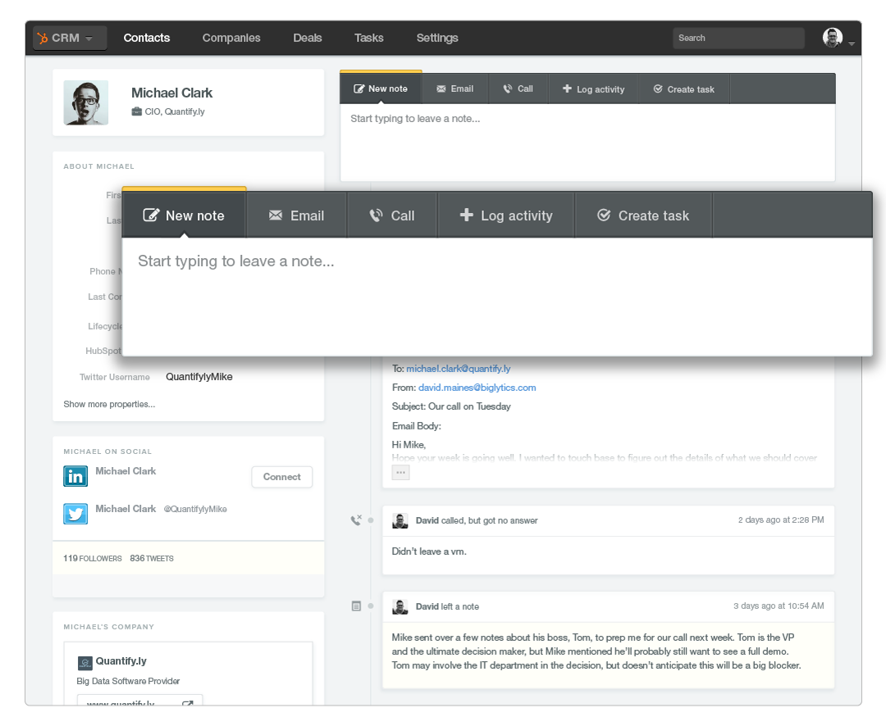
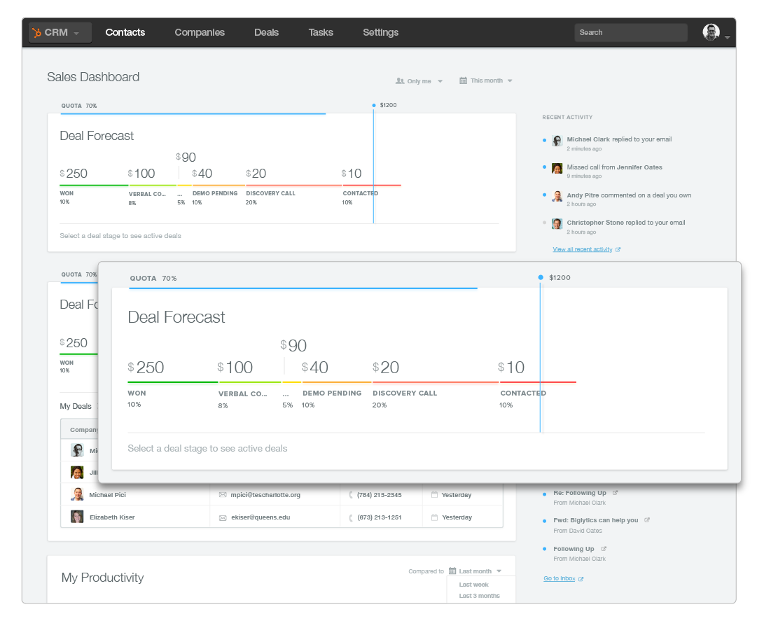

Slide 5
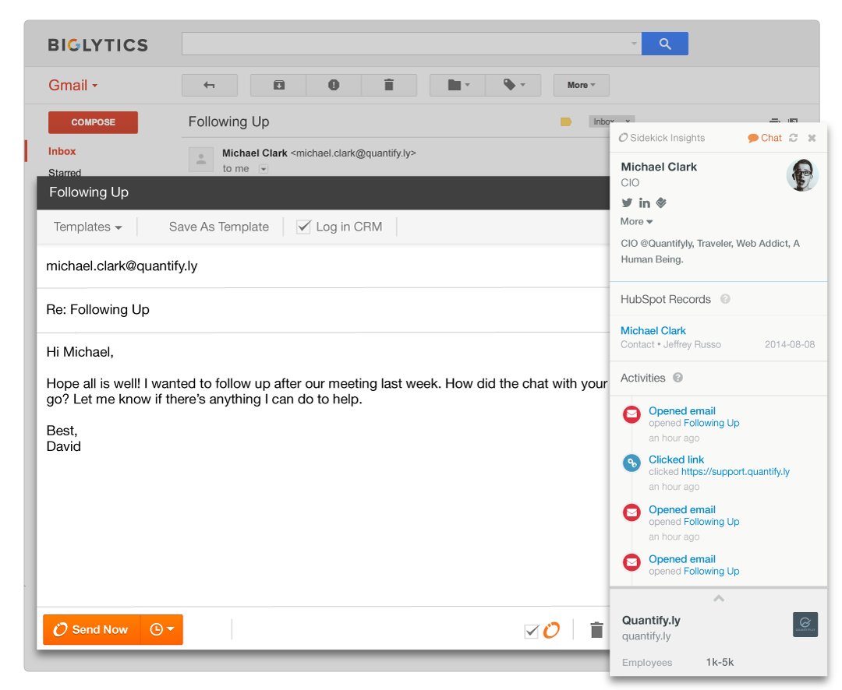
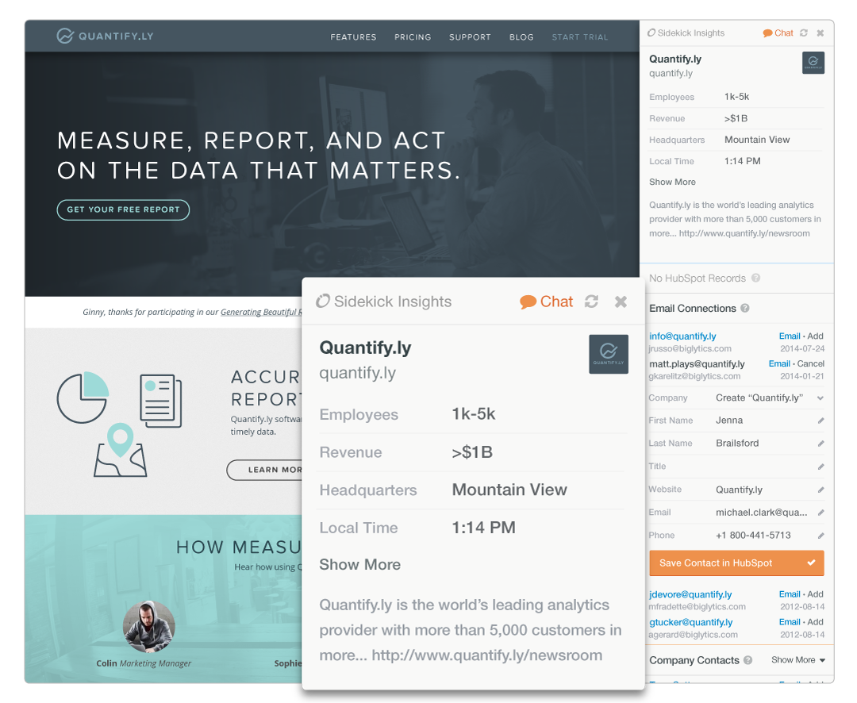

Slide 6
The story of a deal in HubSpot CRM

Slide 7
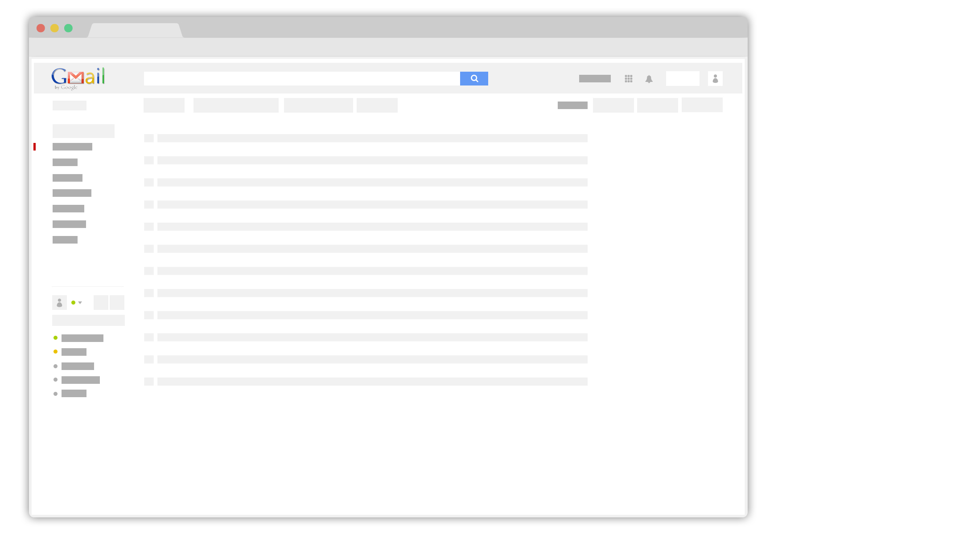
Notes:
It all starts in my inbox

Slide 8
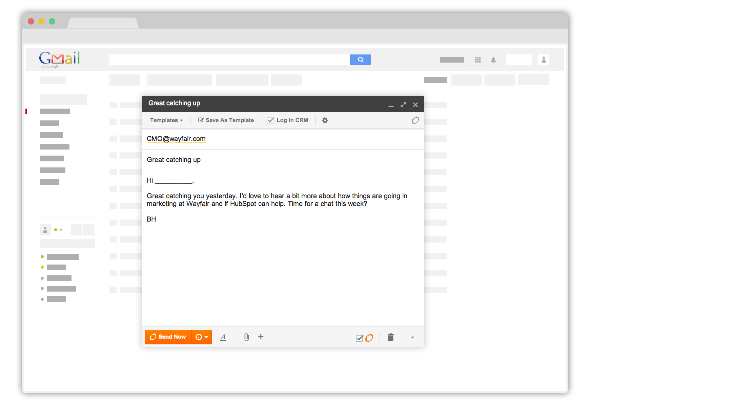
Notes:
Sending an email to Wayfair CMO

Slide 9
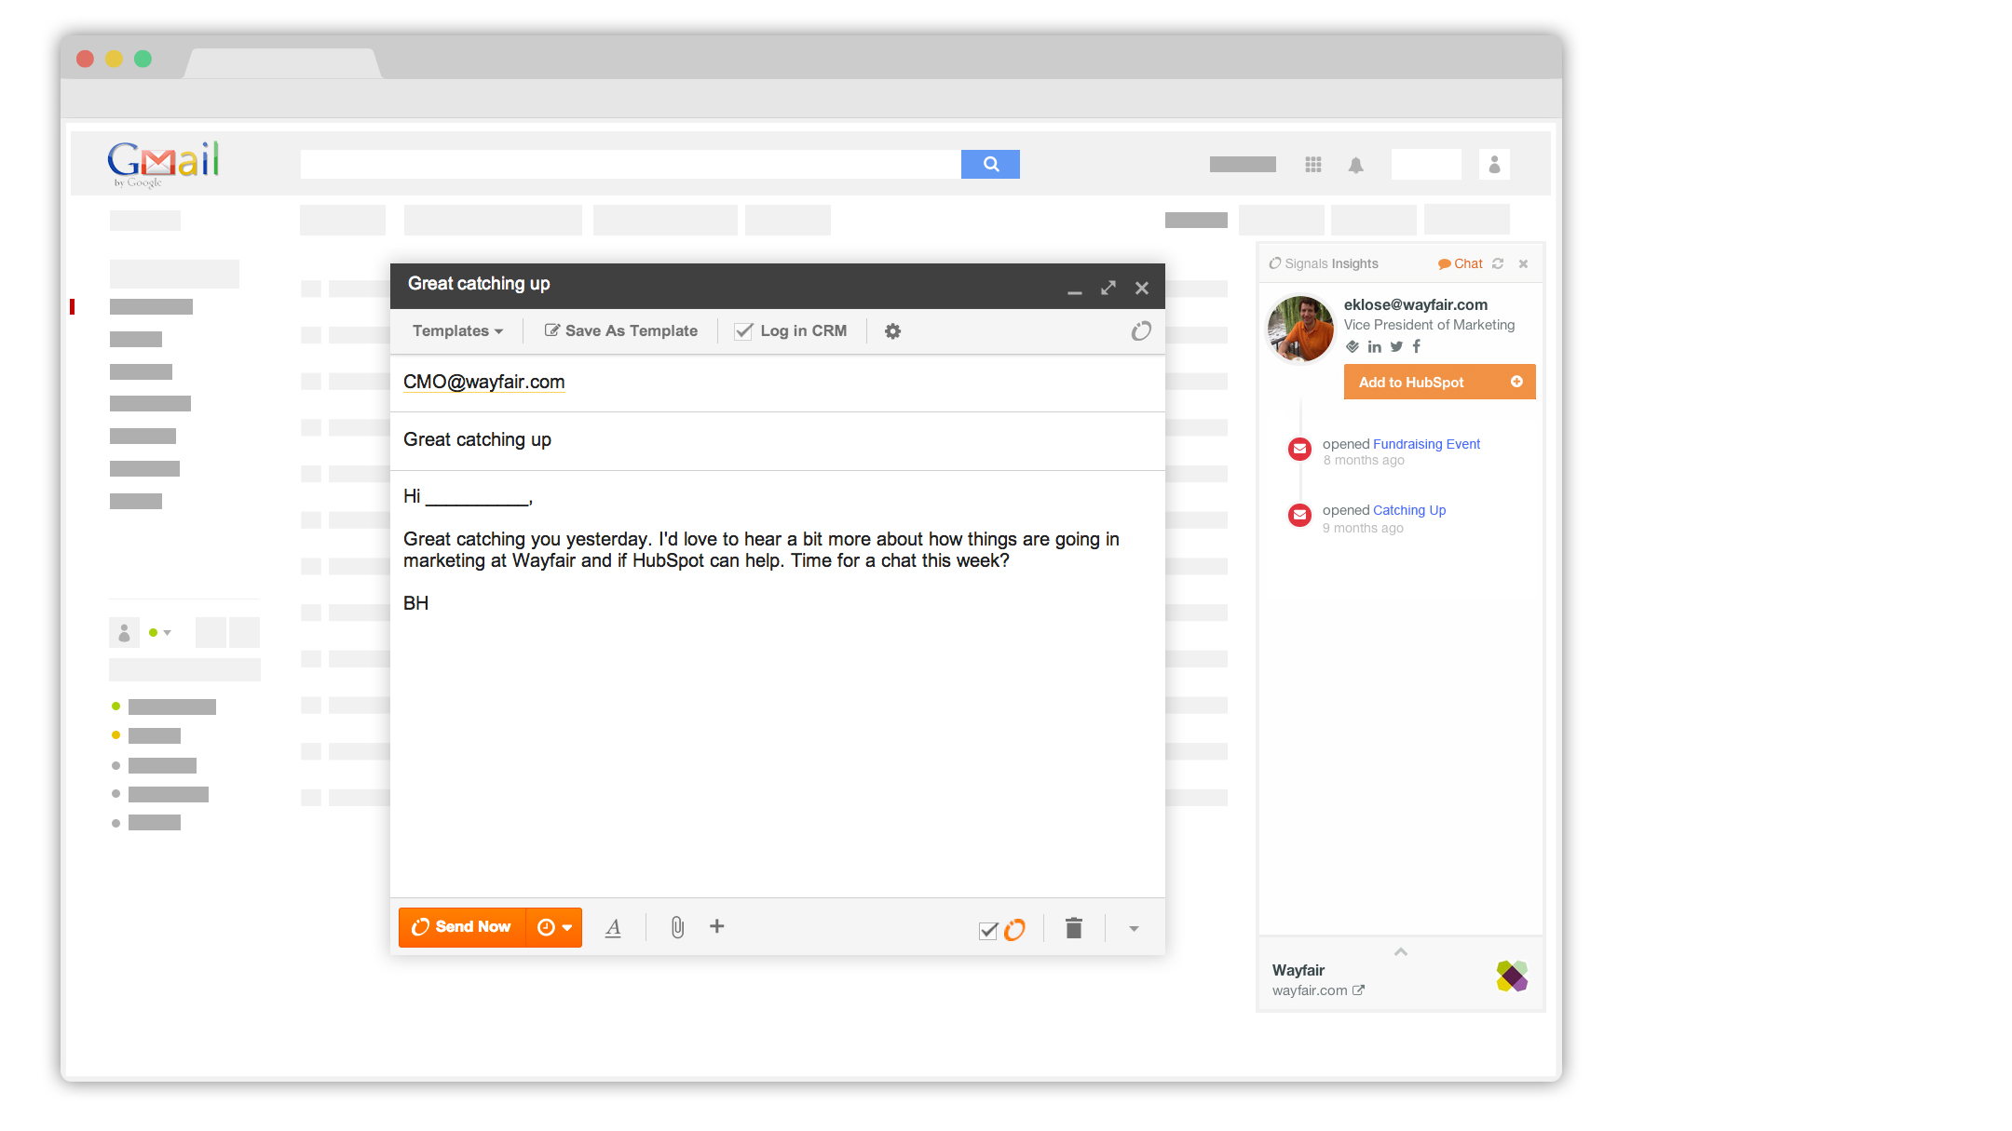
Notes:
Insights pops up. I can see some basic details about Eric, and the history of messages I’ve sent him... what he’s opened, what he’s clicked.

Slide 10
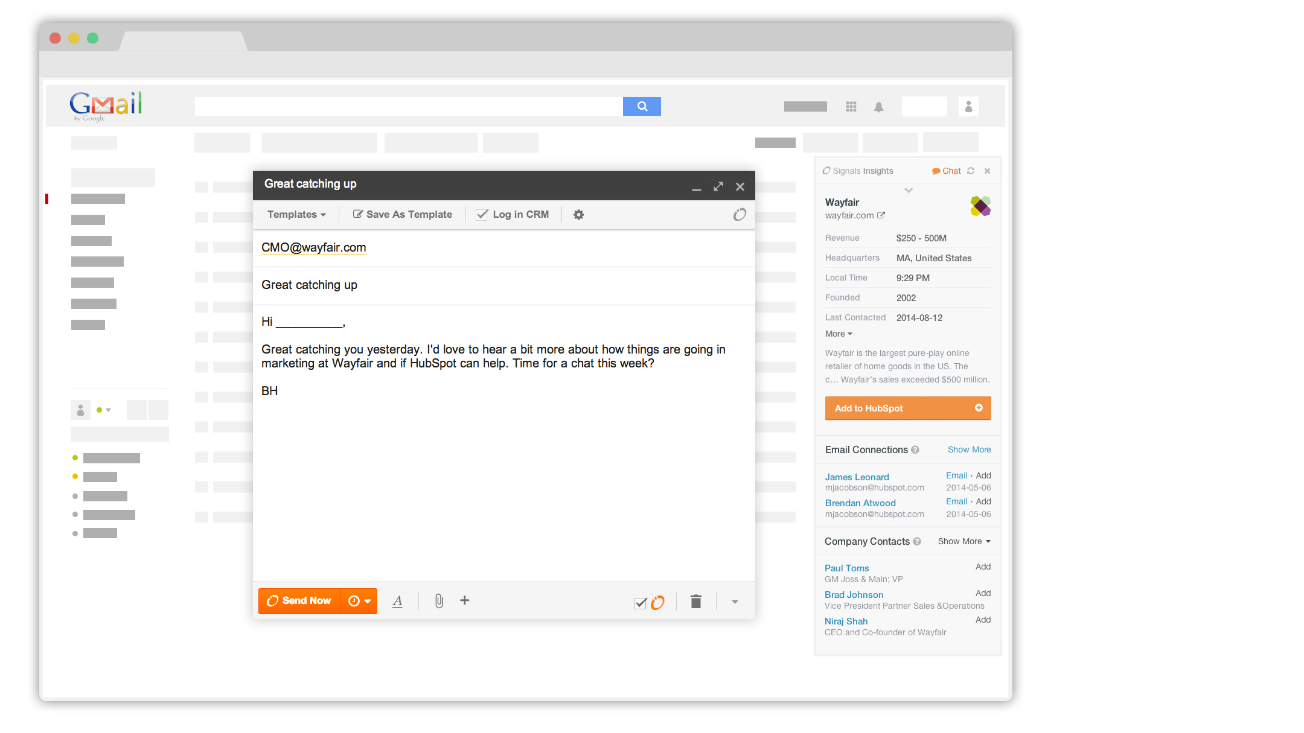
Notes:
I can click insights to see some useful details on the company. Looks like they aren’t in my CRM system yet, but a few folks here at HubSpot have corresponded with folks at Wayfair in the past (“email connections”.)

Slide 11
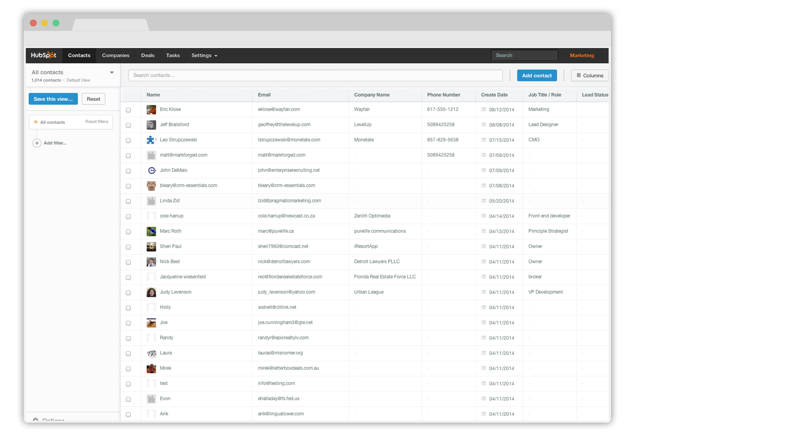
Notes:
Let’s jump over to CRM.

Slide 12
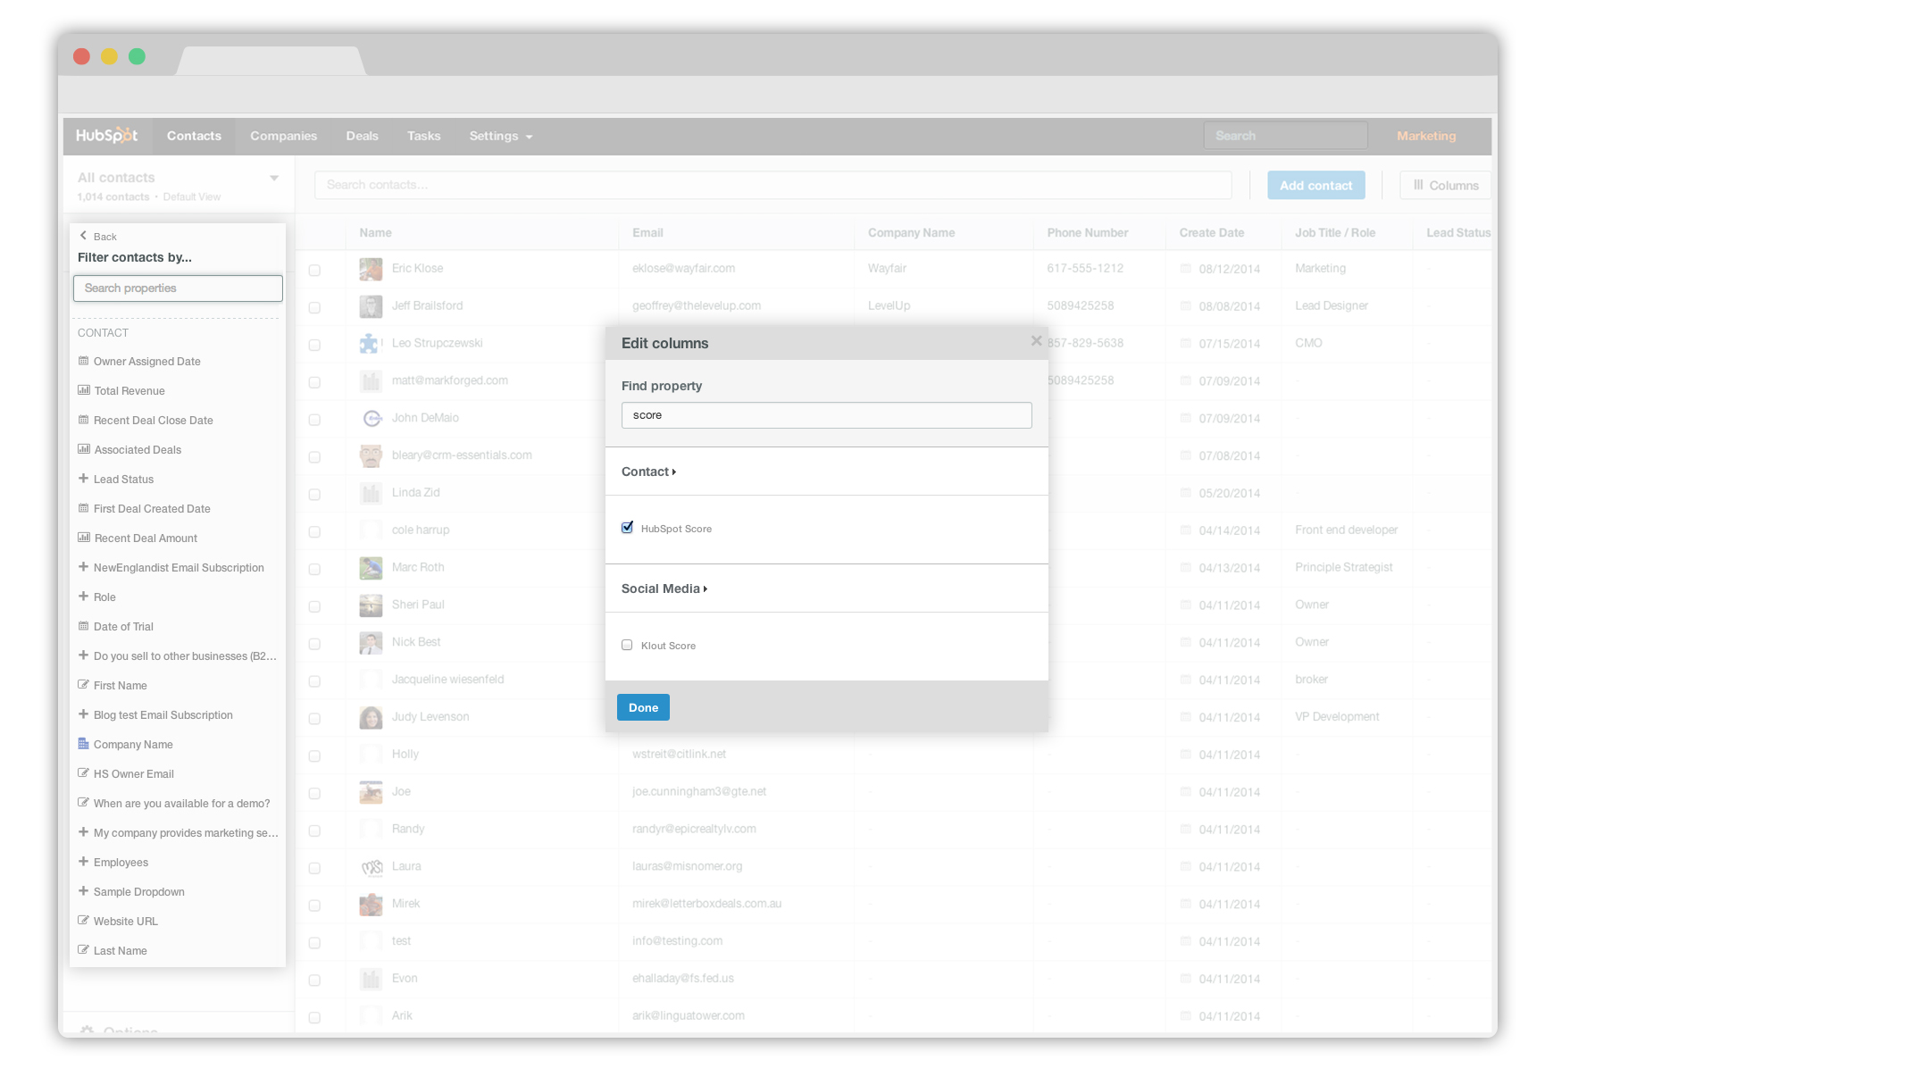
Notes:
We are looking at a table of contacts. Editing this view is easy. I can filter it based on any kind of criteria, add and rearrange any columns I want. Changing my view and sorting is instant.

Slide 13
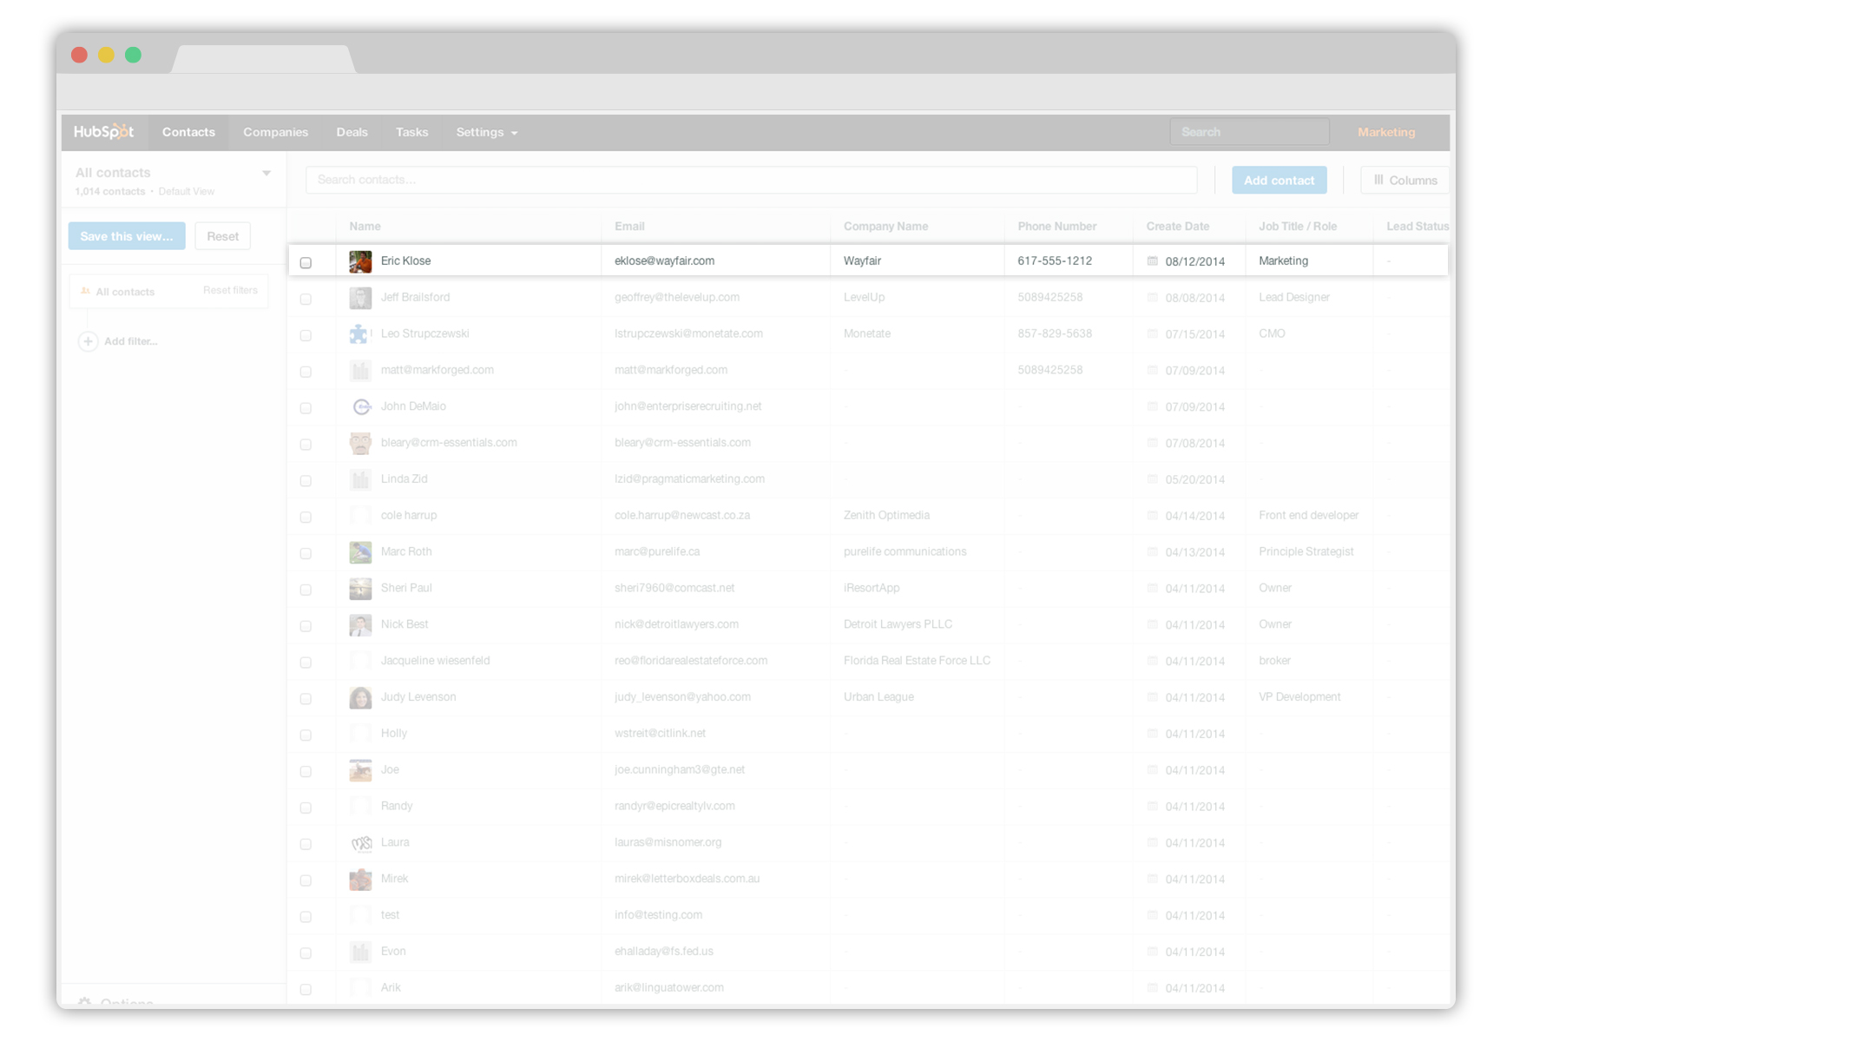
Notes:
There’s Eric. He wasn’t in my CRM, but HubSpot CRM detected the email I sent him and created a record for him automatically.

Slide 14
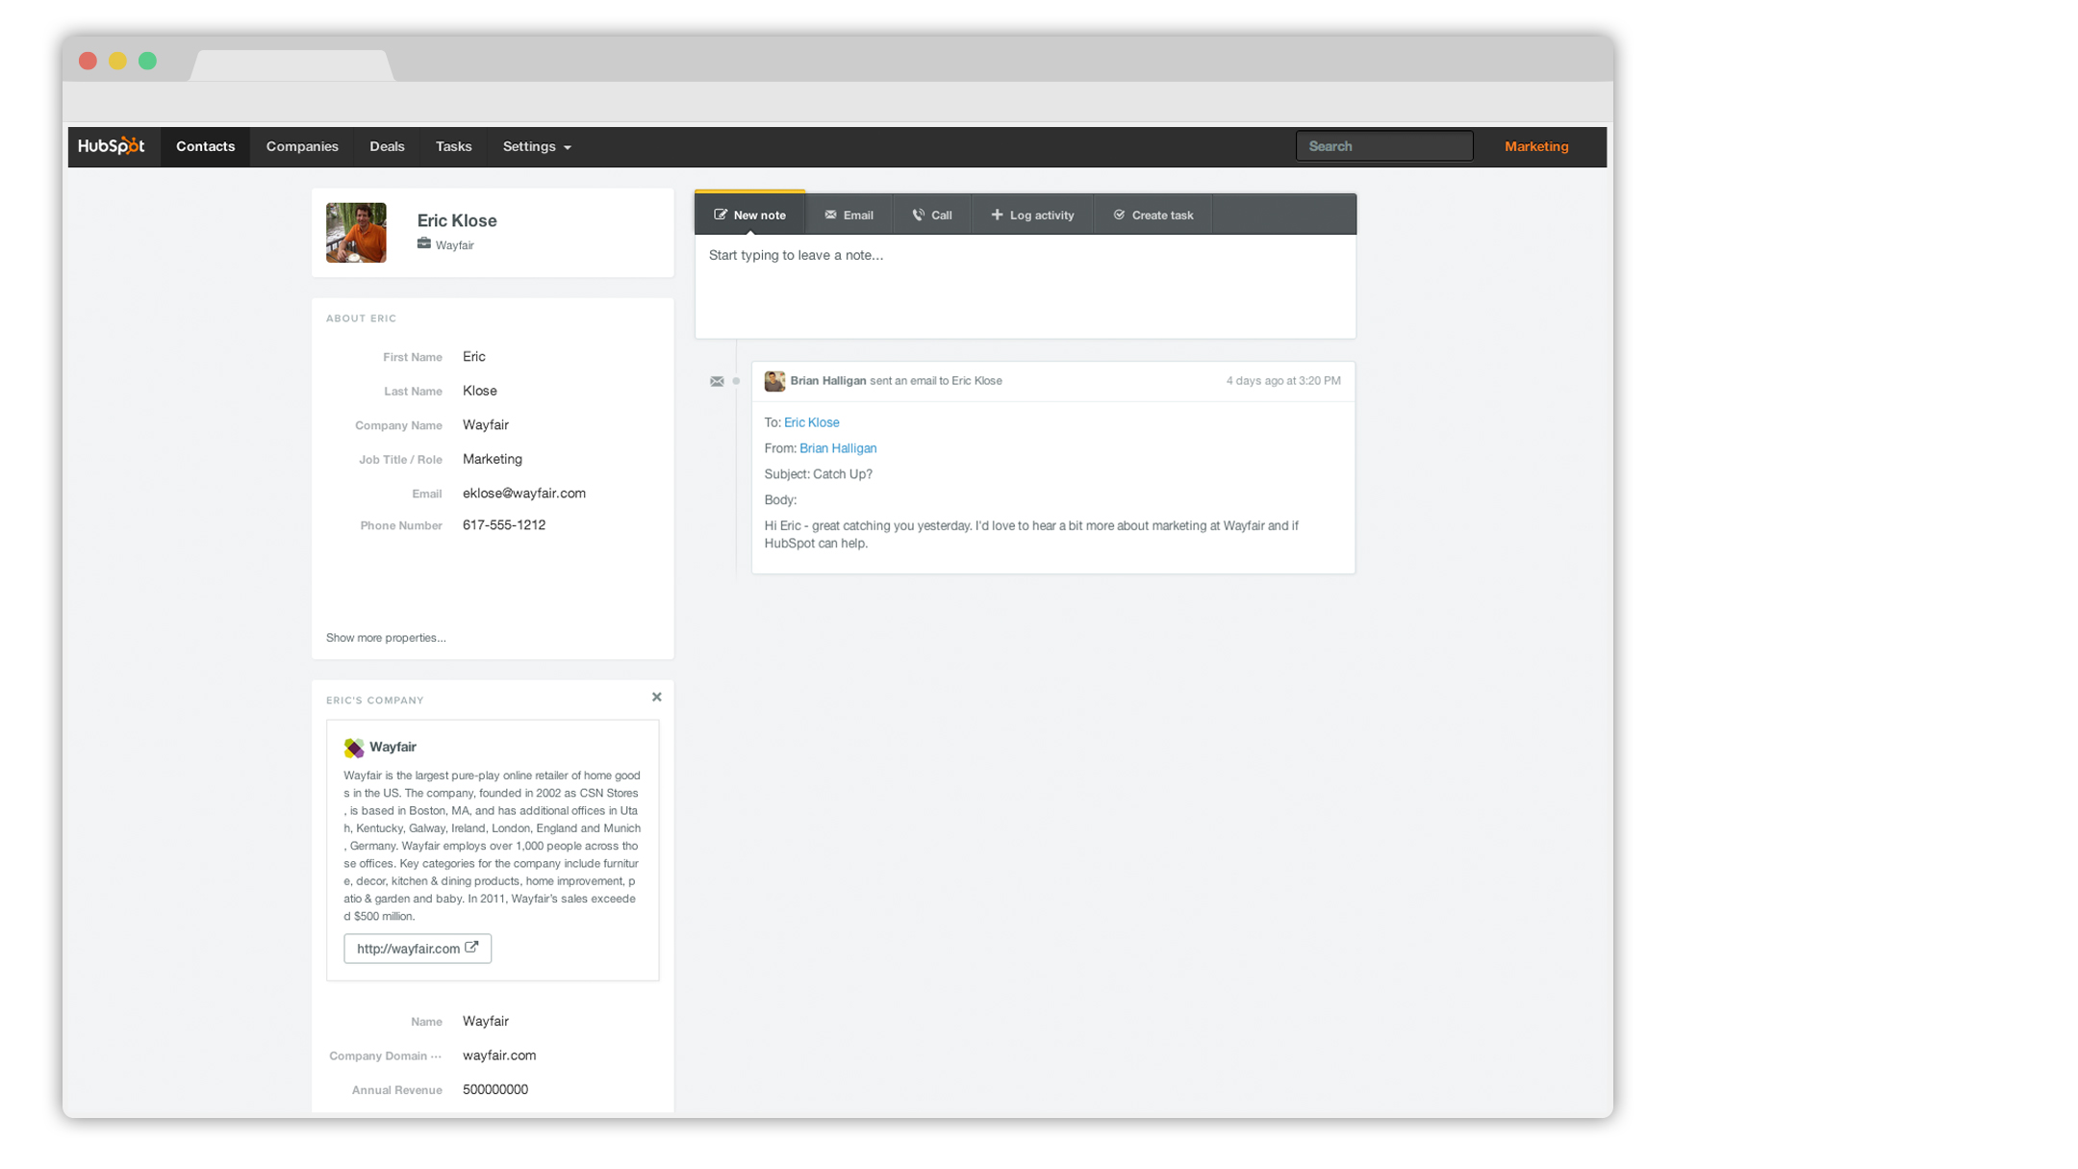
Notes:
Here’s his contact record. The email was logged in the timeline automatically.

Slide 15
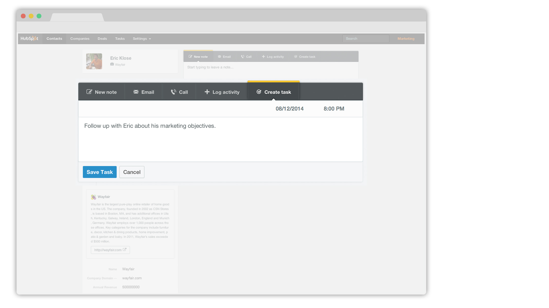
Notes:
I’m going to set a task for myself to follow up with Eric next week.

Slide 16
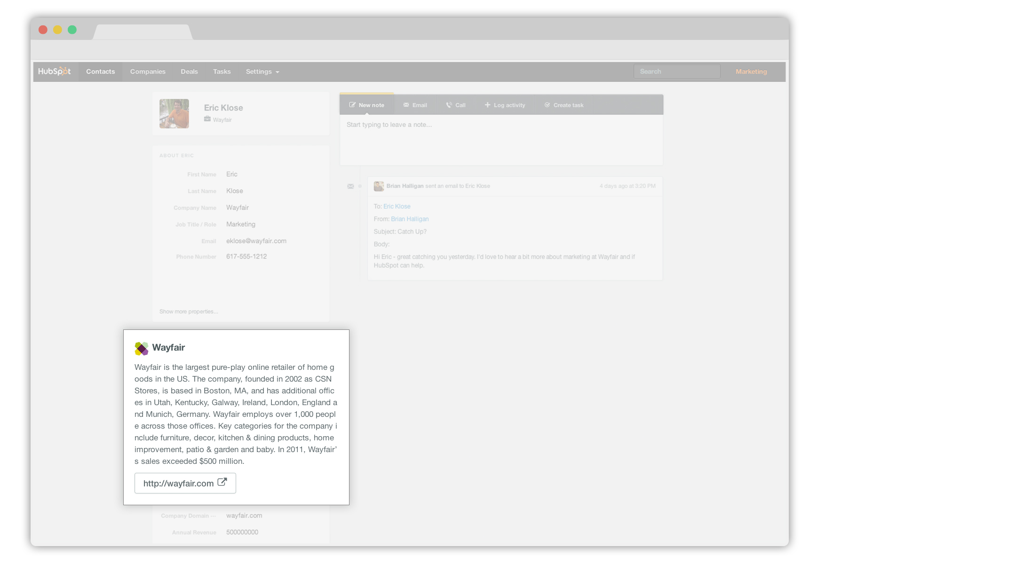
Notes:
HubSpot CRM even created a record for Eric’s company. Let’s click to his company profile and take a look.

Slide 17
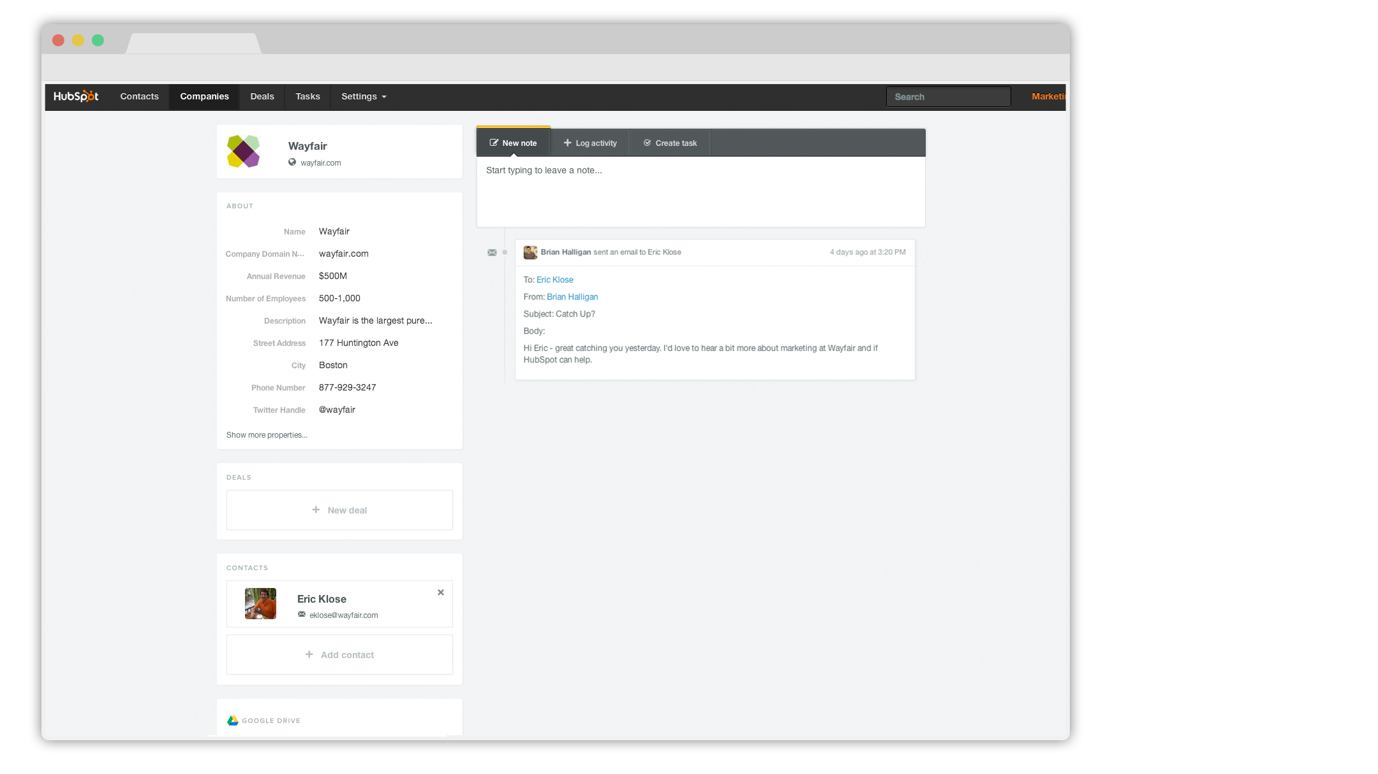
Notes:
Here’s our record for Eric’s company.

Slide 18
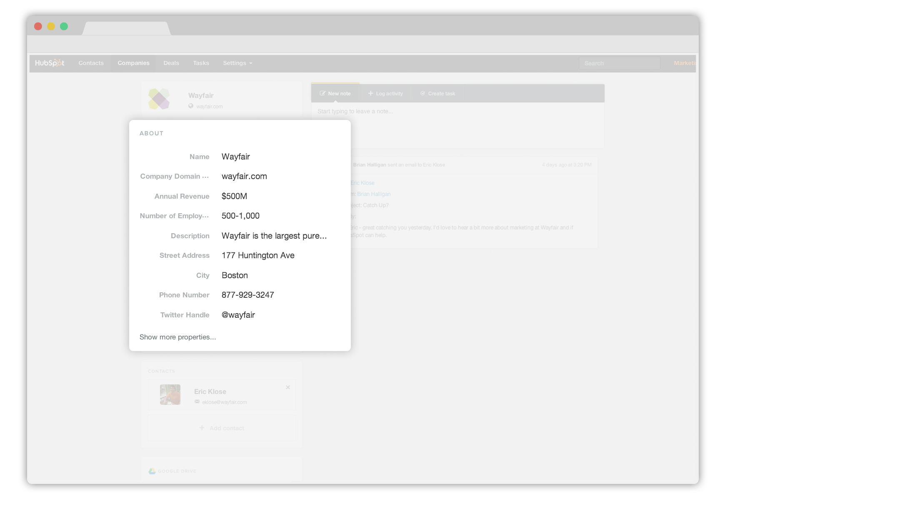
Notes:
HubSpot CRM automatically filled in some useful details about his company the second I emailed Eric. Social media information on his company, even their main phone line.

Slide 19
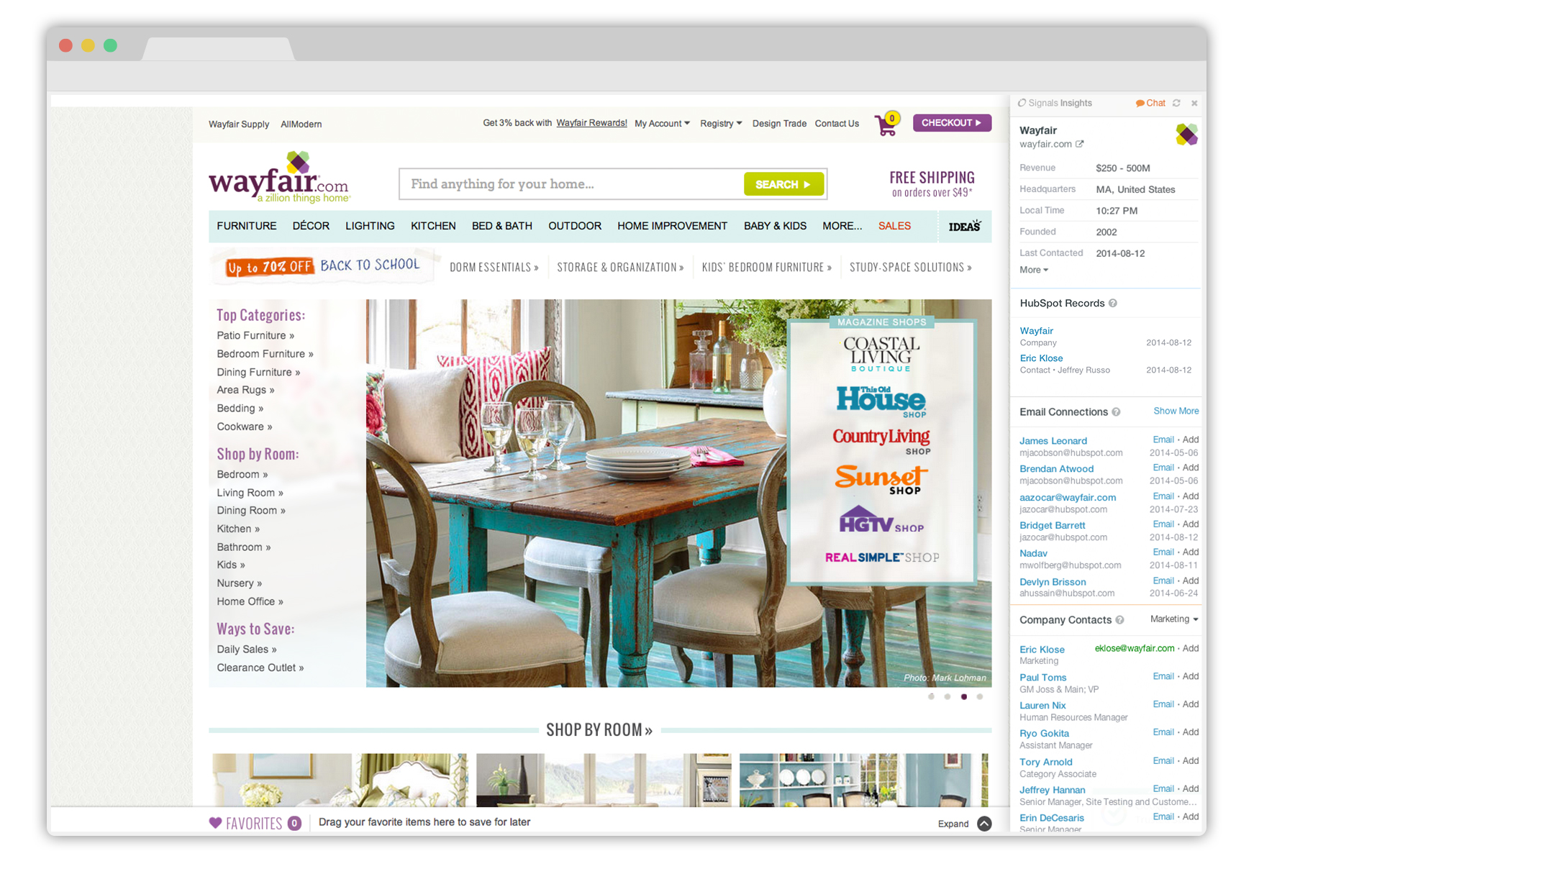
Notes:
I’ll click over to his company website. HubSpot CRM follows me everywhere I go through Sidekick.

Slide 20
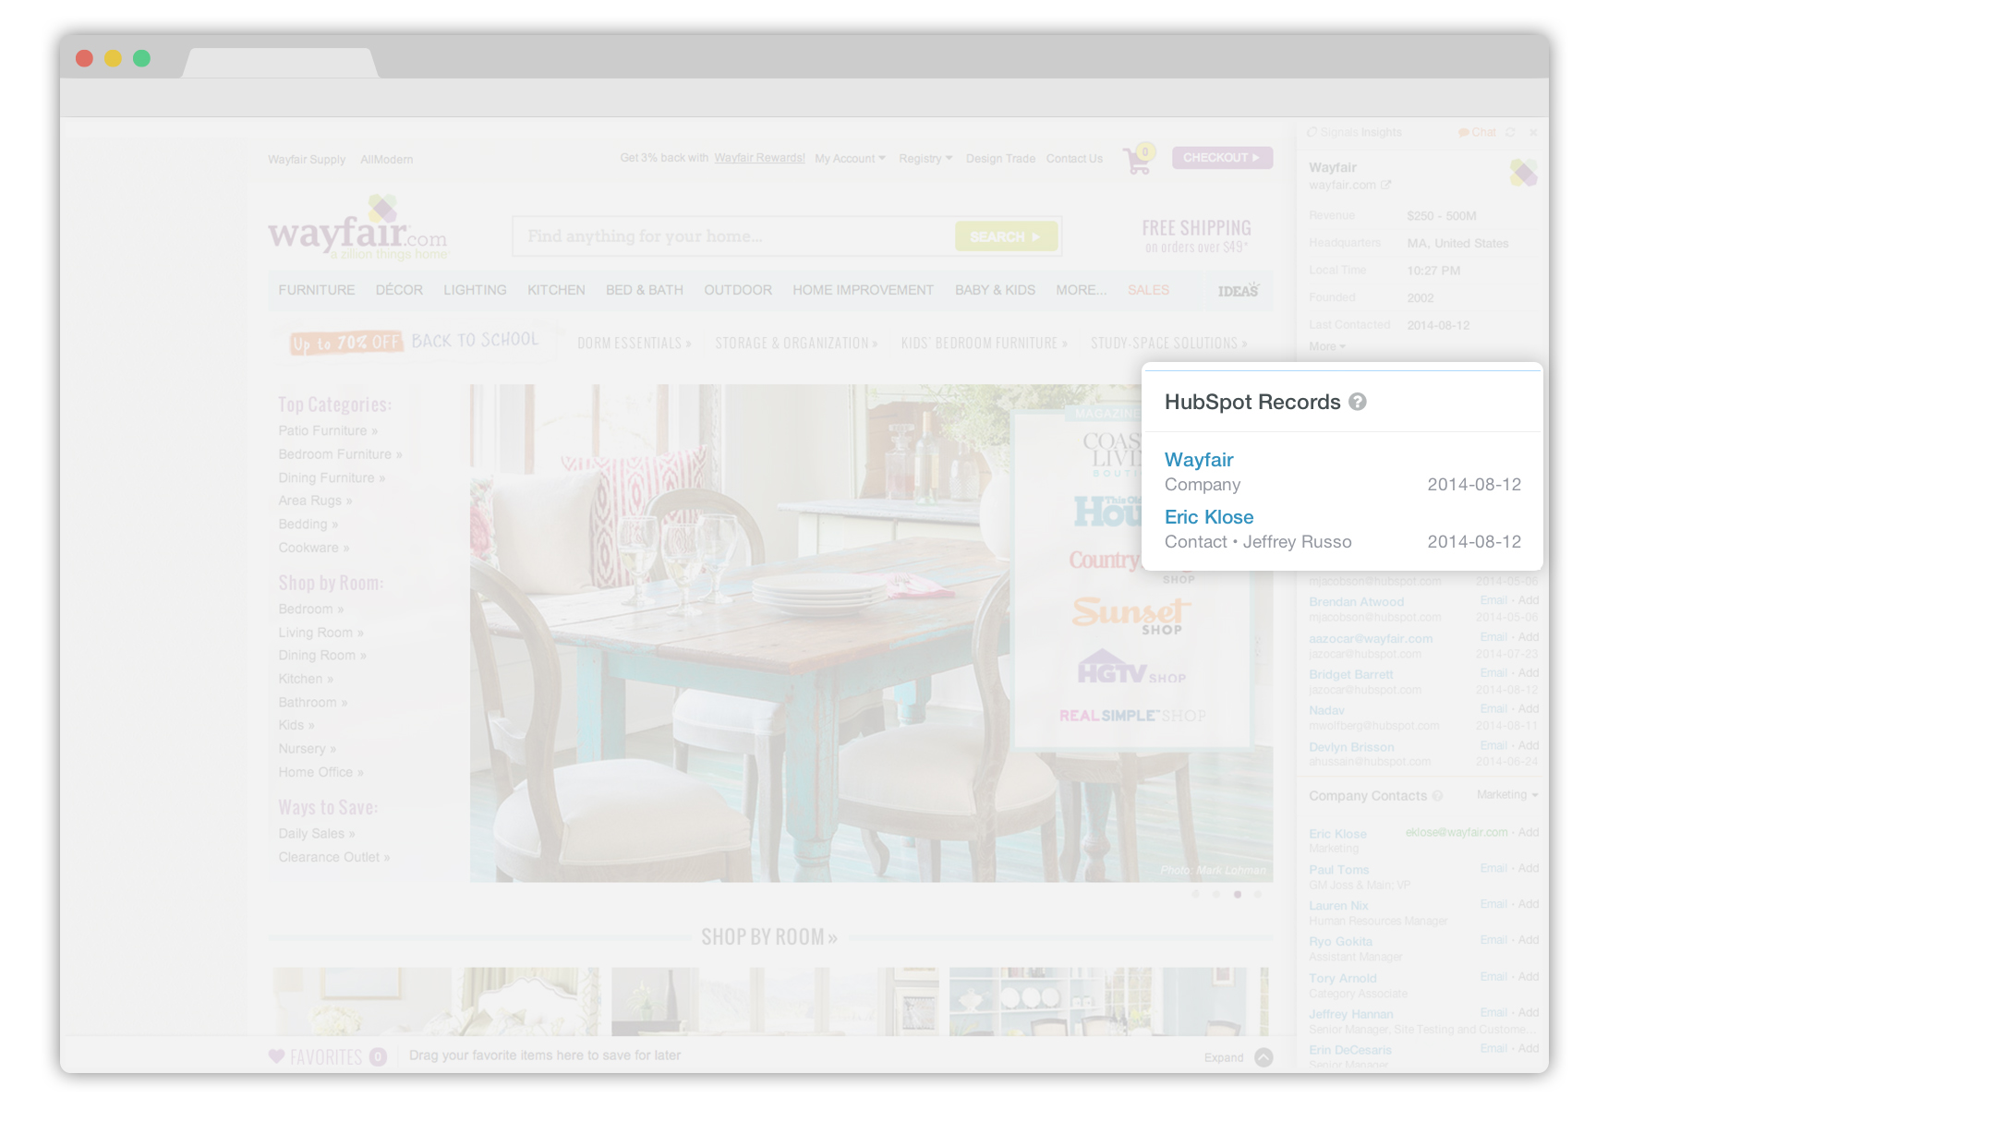
Notes:
I can see the new record for Wayfair and the new record for Eric in HubSpot CRM right here.

Slide 21
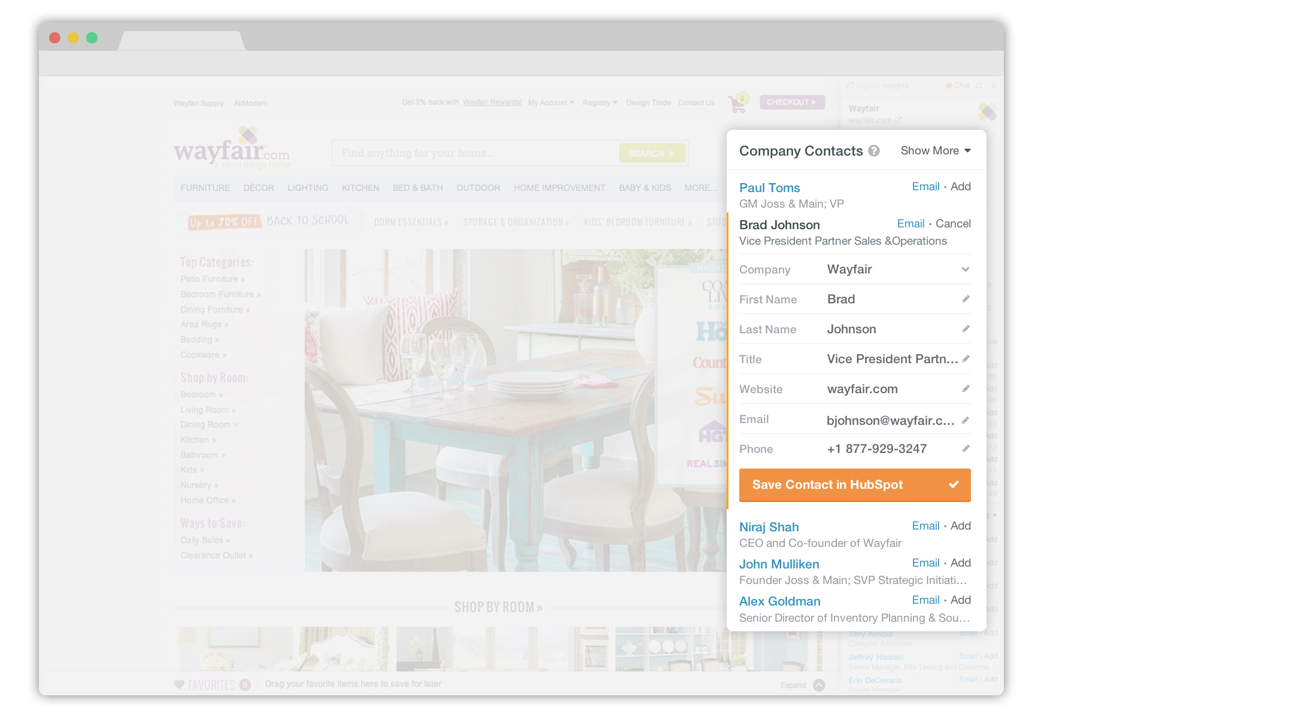
Notes:
Sidekick even found some other folks who work at Wayfair. With one click I can find their email addresses and add them to HubSpot CRM too.

Slide 22
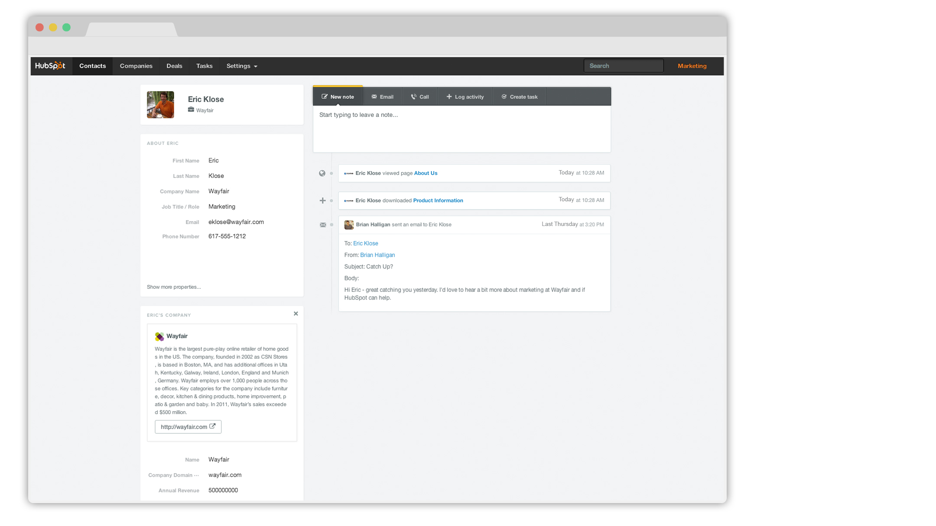
Notes:
A week has passed by... Eric has been on my website. I was alerted by Sidekick, and I see it here in the timeline.

Slide 23
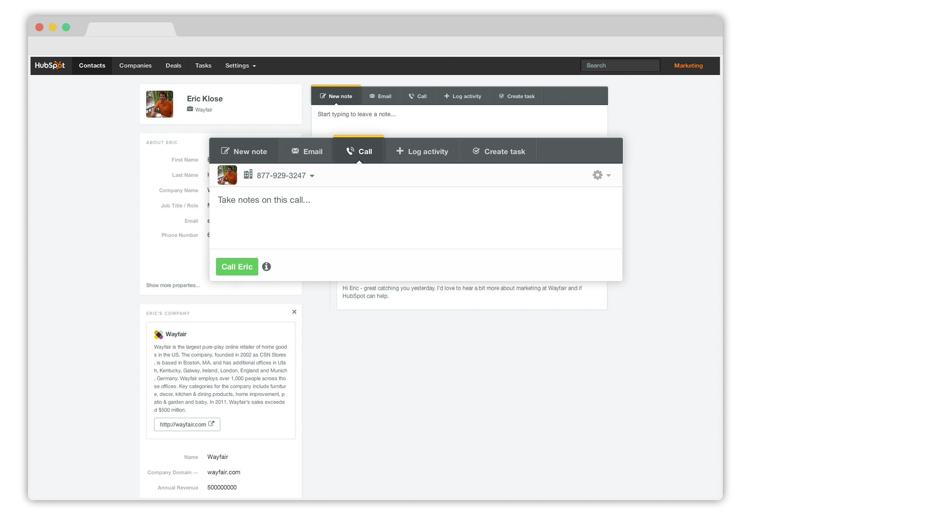
Notes:
It probably makes sense for me to give Eric a ring. I can do that right from my CRM! I don’t have his phone number, but with one click I can connect to the main line.

Slide 24
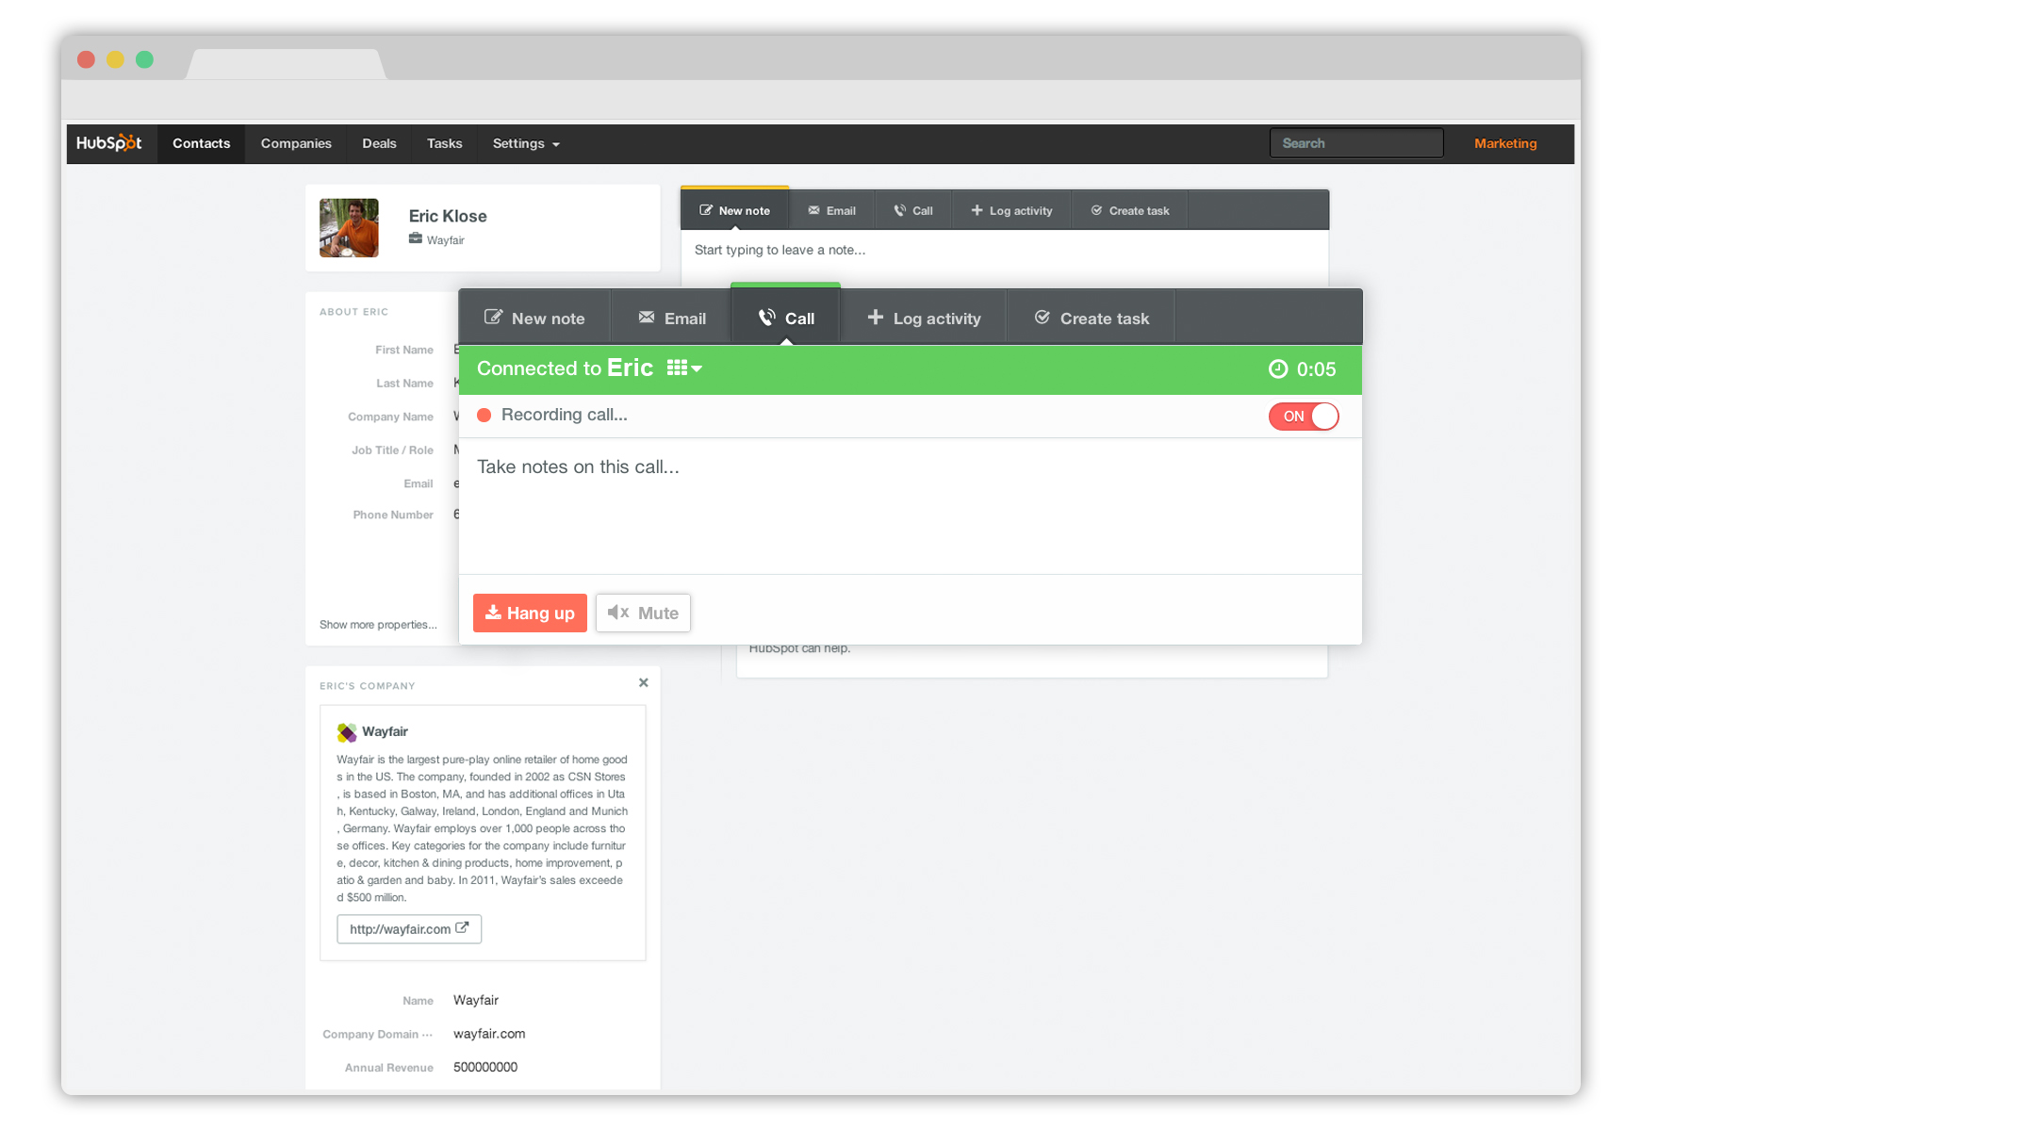
Notes:
The call is recorded while I’m talking to Eric. (Optional. It is your responsibility to be aware of local and state laws in your state, and the state you are calling to.)

Slide 25
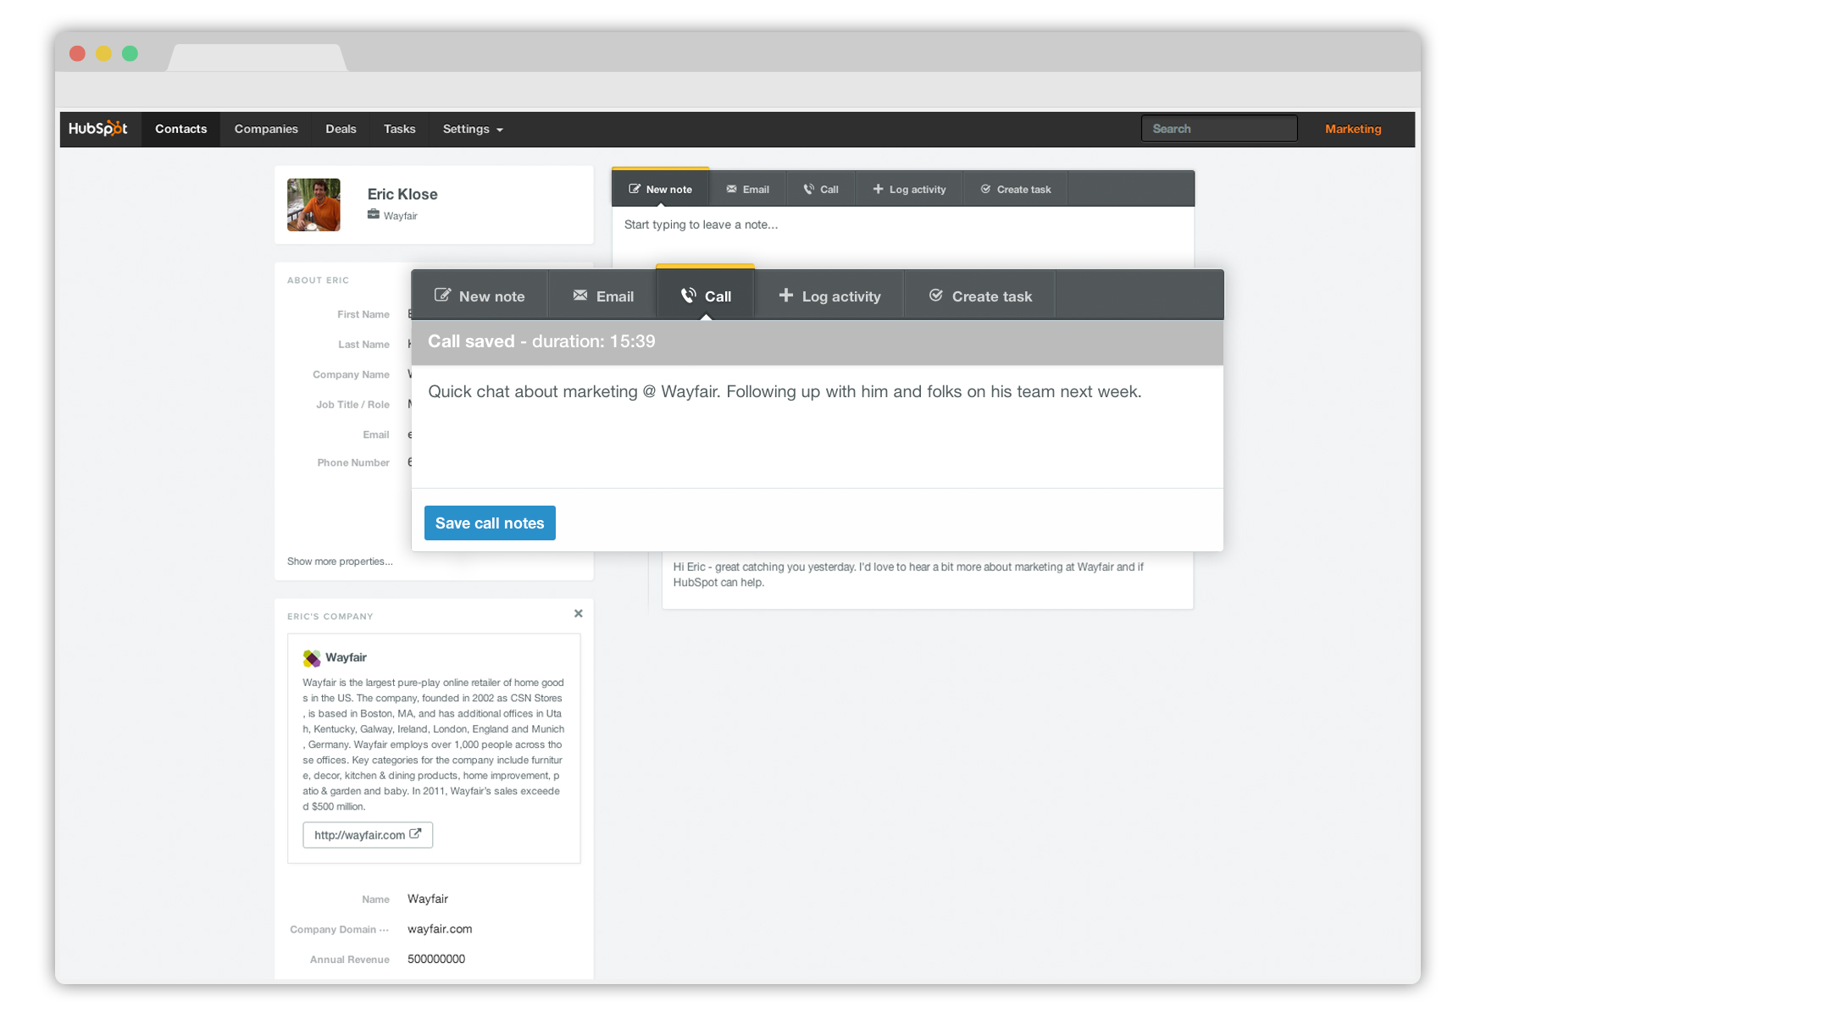
Notes:
Great call. I’ll take a few notes...

Slide 26
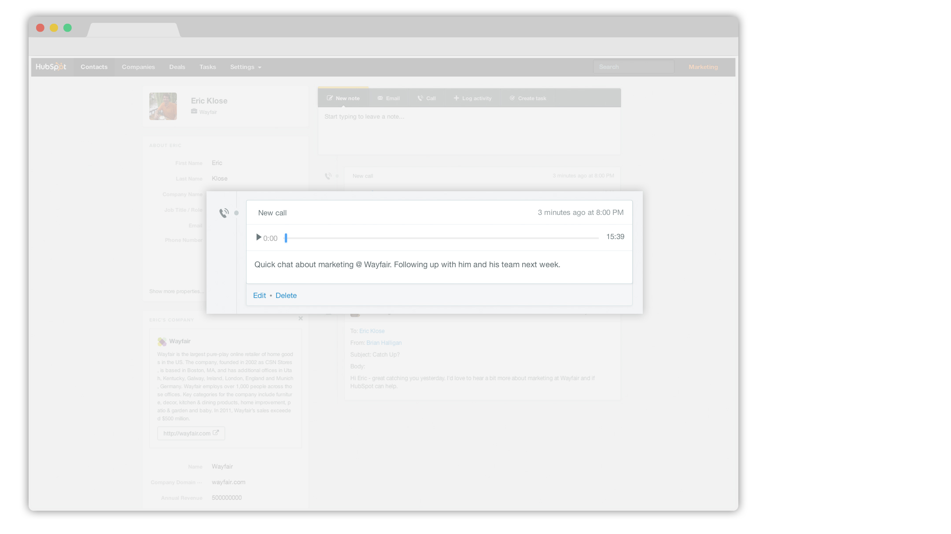
Notes:
And when I hang up, the call is logged, along with a full recording.

Slide 27
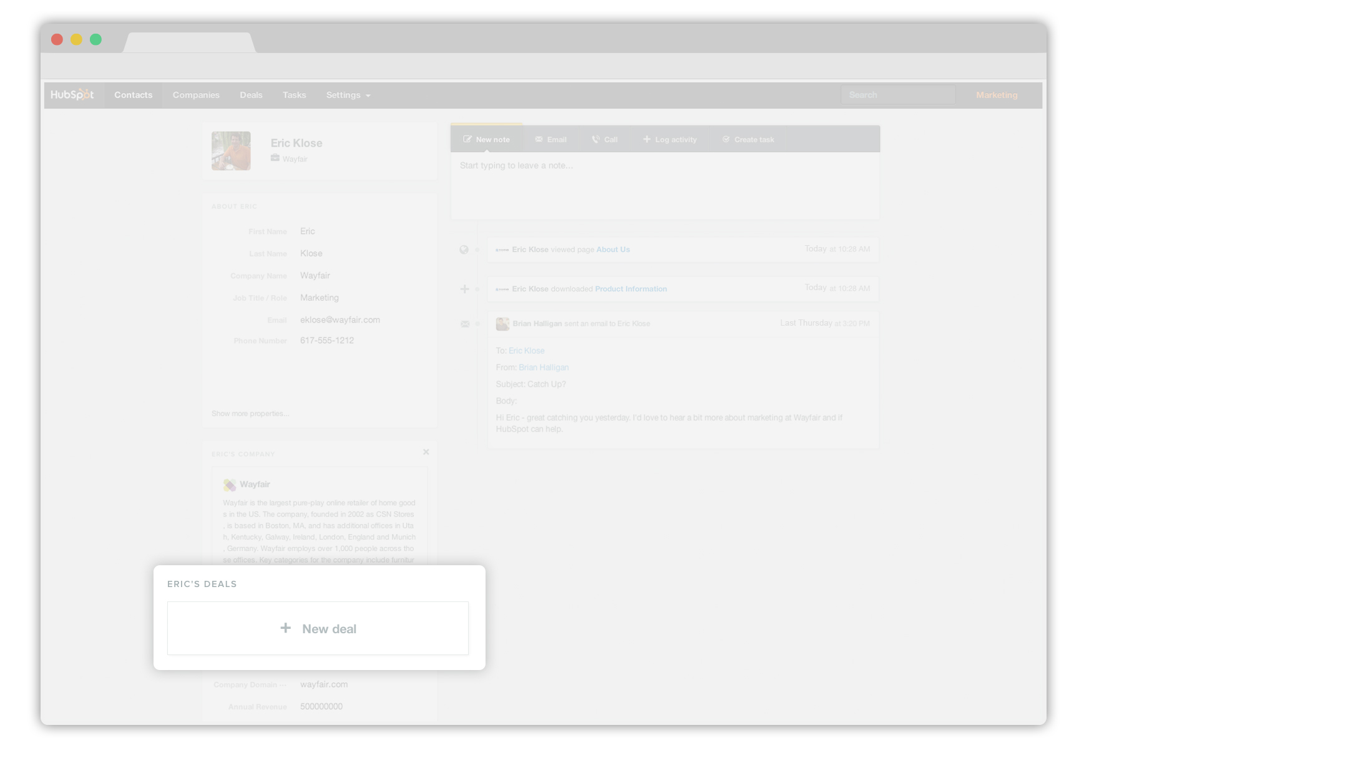
Notes:
The call went well, so I’m going to add a deal.

Slide 28
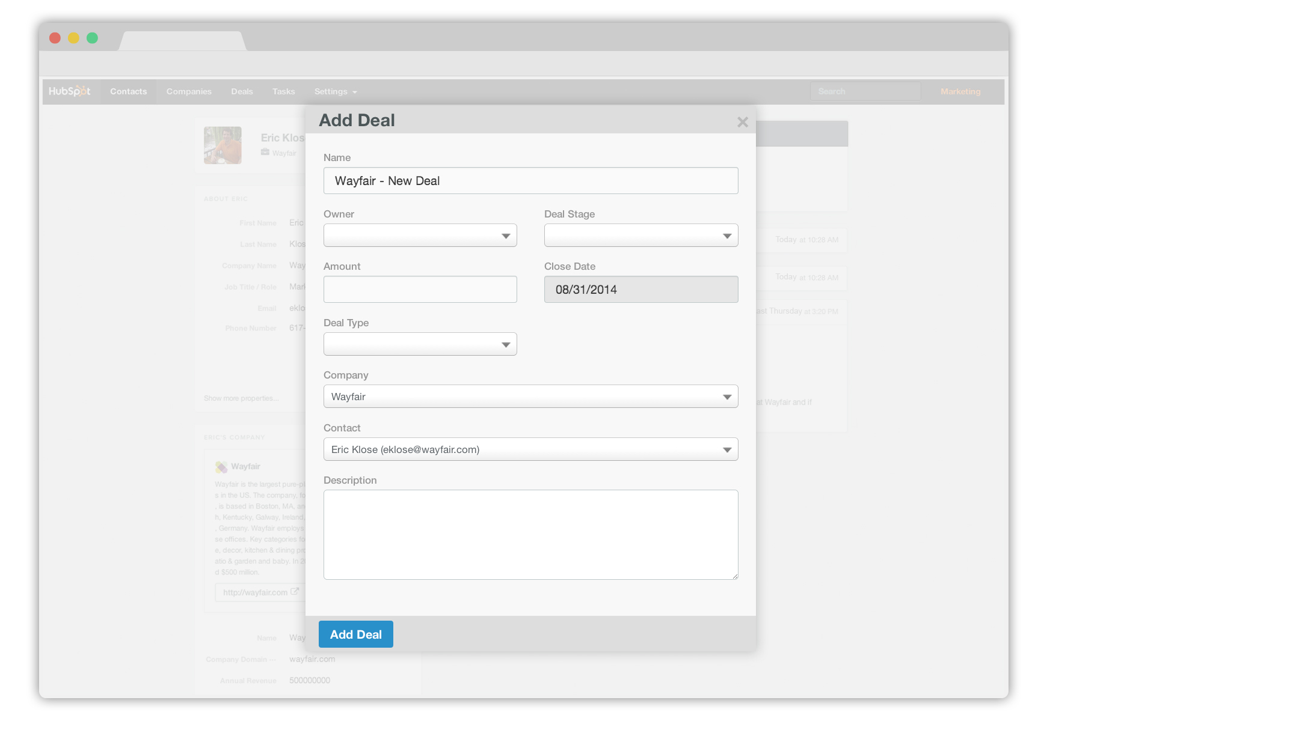
Notes:
Fill in some details about the deal...

Slide 29
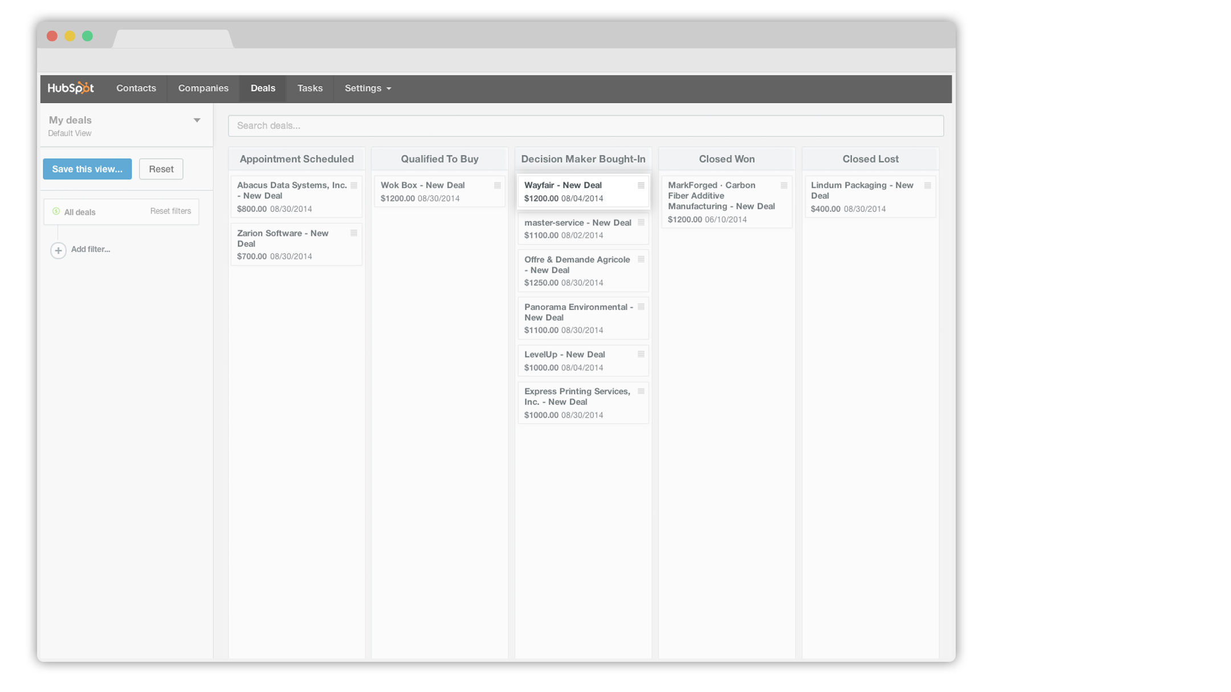
Notes:
And track the deal in this intuitive board view. As the deal progresses to closed won, all I need to do is drag it across my stages.

Slide 30
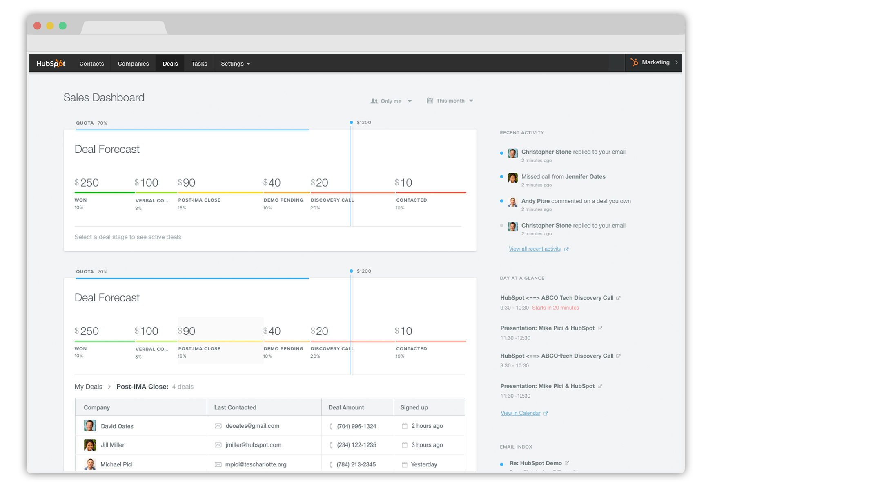
Notes:
Deal was won, and it’s reflected in my reporting.

