Slide 1
How to Create a High-Converting Landing Page

Slide 2
TABLE OF CONTENTS
Introduction About Landing Pages ………………………………………. 3
Best Practices for Designing a High Converting Landing Page … 4
Customizable Landing Page Elements ……………………............... 12
How to Save and Use These Elements .............…………………... 24
Conclusion & Additional Resources ……..……………………………… 28

Slide 3
INTRODUCTION
According to MarketingSherpa, the number one reason businesses don't use landing pages is because their marketing department doesn't know how to set them up or they are too overloaded. We want to make that easier.
Landing pages are a fundamental – and undeniable – part of your marketing. They are the hub of your lead generation efforts. Every campaign you run should be tied to a custom landing page, not your homepage. If you’re promoting a new event, why would you send people to your homepage? You should be directing them to a registration site with specific information about the event.
Of course, more campaigns means more landing pages. To help you build attractive, high-converting landing pages, we wanted to share tips and templates to customize and use! If you’re really crunched on time, you can always try building them in HubSpot for free.

Slide 4
7 Best Practices for Designing a High-Converting Landing Page

Slide 5
BEST PRACTICE
1
Get to the point.
We all know that people have short attention spans – so why aren’t we considering that in landing page creation? Your online audience won’t read your entire page, but will instead “forage” for information by visually scanning the screen until they find what they are looking for, according to Stuart Card and Peter Pirolli’s information foraging theory.
When designing your landing pages, get straight to the point. People came to the page for a reason, make sure your page immediately addresses that need.

Slide 6
BEST PRACTICE
2
Employ contrasting colors.
You want your main call-to-action on the page to POP off your landing page. Whether it’s filling out a form or clicking on a button, you want your reader to easily find that action. Using complementary and contrasting colors can call their attention exactly where you want it.

Slide 7
BEST PRACTICE
3
Consistent branding.
Make sure the viewer knows exactly where they are. All your landing pages should clearly convey your company branding, including a strategically placed logo. Don’t make it the central point of the page, but have it apparent enough that people register the page as one from your business.

Slide 8
BEST PRACTICE
4
Avoid visual clutter.
While having extravagant visuals sounds like a wondrous idea, A/B tests at HubSpot repeatedly shows that including such images doesn’t help conversion. In fact, often times it distracts the reader. And while graphics are certainly attractive they can increase the load times of your site. Visitors are willing to wait an average of 2 seconds for their website to load according to a study by Fiona Nah, “A study on tolerable waiting time: How long are Web users willing to wait?”
This same ideal can be applied to user attention. Just be simple.

Slide 9
BEST PRACTICE
5
Never underestimate formatting.
Formatting is probably the best tip you can follow for designing your landing page. Use your design to establish a clear visual hierarchy. Having clear headlines, titles, and so forth, tremendously helps drill down the proper message for your offer. Instead of explaining what you’re about to talk about, use a subtitle to make that point, and jump right into the main message in the copy. Kind of like this slide!

Slide 10
BEST PRACTICE
6
Add social sentiment.
Similar to adding case studies or recommendations, try adding social sentiment to your landing pages. Social sentiment is easier to discover – just search through Twitter or Facebook! Regardless of how present you are on these sites, or other social media sites, it’s likely that users have said something about your brand or your offer. Take screenshots and add them to your landing page to add social credibility and influence people to take action.

Slide 11
BEST PRACTICE
7
Be consistent.
A MarketingSherpa study that analyzed which elements of a landing page have the greatest impact on overall website performance, page layout came running in first. This is likely because page elements that alter the layout of the page for the visitor also change the order in which the visitor processes various aspects of the offer.
While it’s important to continuously test your landing page layout and try new forms of presentation, follow internet conventions rather than radically altering your layout every time. A sense of consistency helps the end user know how to navigate the page over time, rather than trying to figure it out each time – and therefore increasing drop off rates.

Slide 12
Customizable Landing Page Elements

Slide 13
2 QUICK TIPS FOR CUSTOMIZING ELEMENTS IN POWERPOINT
Double clicking on any image, textbox, or shape will open up various options for you to change the appearance of the respective object — this includes your shading, colors, fills, outline, or styles. Be open to playing around and seeing what you discover.
When inserting images for your graphic, you might find try to add images with white backgrounds. This can be a problem if your landing page does not. Either give the image a border to make it fit, or use the transparent tool in your toolbar. Simply click “Transparent color,” and then click the background of your image.

Slide 14
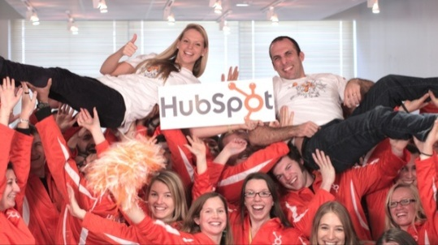
Adjust shape, text size, and colors as needed to fit your landing page.
Header 1
CTA 1
Replace “Header 1” with the title for this landing page.
Change “Footer 1” to include company name, address, or any other basic information you deem relevant.
Change CTA copy. Replace image to clearly show value to the prospect.
Register Now
Footer 1 (Company Name)

Slide 15
HEADER 2
SUBHEADER
Try including a secondary header to drive the main points home.
CTA 2
Try using interesting shapes to draw attention to your main CTA and drive conversions.
12
Million
12
Million
12
Million
12
Million
Laptops go missing at U.S. airports per week!
Laptops go missing at U.S. airports per week!
Laptops go missing at U.S. airports per week!
Laptops go missing at U.S. airports per week!

Slide 16
HEADER 3
Sometimes your headers can be as simple as just text on a page.
Same with the footer. Just customize the copy and right click “Save as Picture” to then move to paste as an image in your CMS.
Start Free Trial
Footer 3 (Company Twitter Handle)

Slide 17
More CTA Options
Change the direction of the speech bubble by clicking on the shape, and moving the yellow diamond with your mouse.
SIGN UP FOR A FREE HUBSPOT TRIAL
Grab Your Coupon

Slide 18
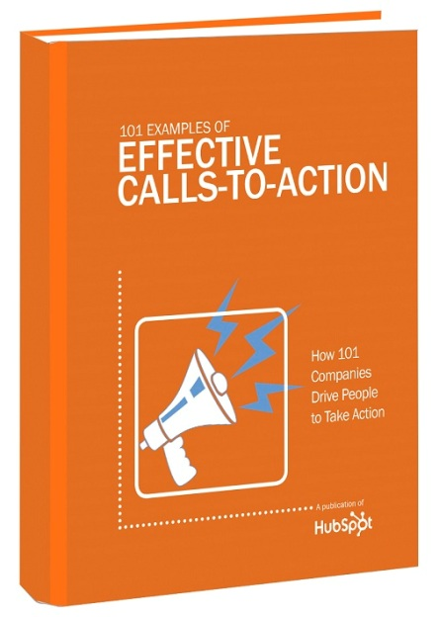
For this CTA, you might experiment with using an image of the offer in addition to the basic shapes and text.
101 Examples to Inspire Your CTA Creation
As you customize CTAs in this template, feel free to check out 101 examples of effective CTAs for further inspiration.
DOWNLOAD NOW >>

Slide 19
You can even drop in your company logo to add some nice branding to your CTAs – logos are visuals, too!
JOIN A
USER GROUP
WATCH A DEMO
Learn More >
All-in-one marketing software.

Slide 20
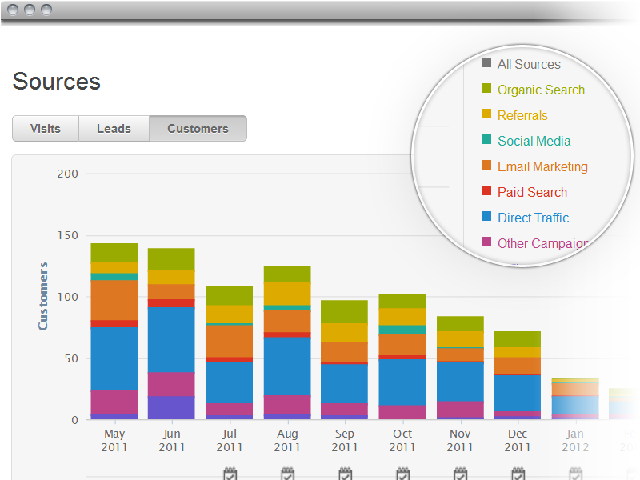
See HubSpot’s all-in-one marketing software in action.
In this CTA, we eliminated this image’s original hard borders using the “soft edges” tool under the Format tab to give the image border a softer look – this way, it appears more naturally within the CTA, rather than as a big image distracting from your text.
WATCH A DEMO

Slide 21
USE SHAPES TO ILLUSTRATE A STORY
41%
of B2B companies using Facebook have acquired a customer from it.
62%
of B2C companies using Facebook have acquired a customer from it.
You can change the shapes for this story-telling method depending on the data. For example, you could use Twitter birds if discussing Twitter.
51%
of Facebook fans are more likely to buy the brands they ‘like.’
Don’t be afraid to add written context to go along with any graphs or SmartArt you use on your landing page.

Slide 22
USE GRAPHS TO SUPPORT IDEAS WITH DATA
Call out a specific data point where relevant.

Slide 23
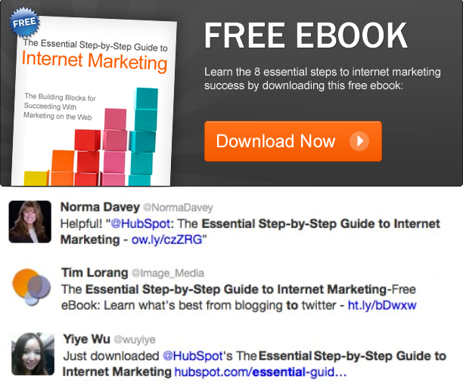
USE SOCIAL SENTIMENT TO INFLUENCE VISITORS
FREE EBOOK
Learn the 8 essential steps to internet marketing success by downloading this free ebook.
Download Now >
Find social sentiment that directly backs the value presented on the landing page. Save them as images, and add them on the page or attach them to the CTA.

Slide 24
How To Save & Use These Elements

Slide 25
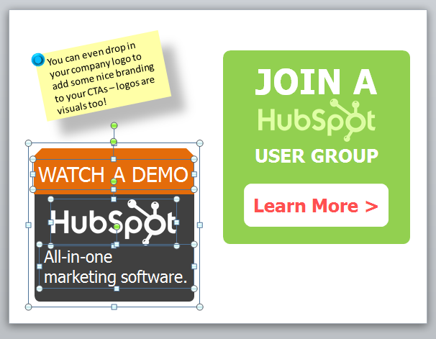
HOW TO SAVE & USE
Now that you’ve gone through the different customizable elements, it’s time to learn how to actually use the elements you end up customizing!
Step 1: For each element, click on every element associated with it, as shown in this screenshot:

Slide 26
HOW TO SAVE & USE
Step 2: With each component still selected, right click, and click “Save as Picture…”

Slide 27
HOW TO SAVE & USE
Step 3: Now, simply upload the images onto your website as you would any other image. If it’s a CTA, hyperlink the image to your CTA destination. And voila! You now have one of these custom elements on your website to build various landing pages.

Slide 28
Conclusion & Additional Resources

Slide 29
CONCLUSION
So what are you waiting for? Landing pages truly are the hub of your lead generation efforts. So stop reading, and start acting! Go build landing pages with these tips and elements to start generating results today.

Slide 30
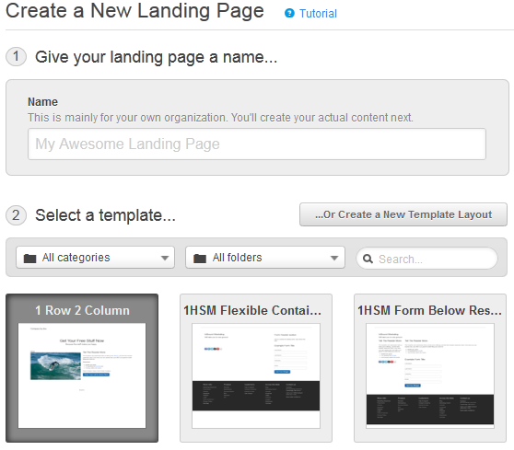
WANT TO EASILY DESIGN HIGH CONVERTING LANDING PAGES?
Try HubSpot’s marketing software for free to start using our simple landing pages tool.
http://bitly.com/79FreeLPHS

