Slide 1
Present a Winning Solution
Notes:
Jeetu:
Welcome to Session 6 of the Partner Program training webinar series for marketing agencies and independent marketing professionals.
My name is Jeetu Mahtani and I am joined by Corey Beale. We are both Partner Channel Managers at HubSpot.
Corey:
We partner with marketing agencies of all kinds to help agencies more cost-effectively and more efficiently provide a broader set of inbound marketing and demand generation services to our mutual customers.
Working with our partners, one of the biggest challenges that they have is adapting to a world where clients are asking for one agency that can do everything. The worlds of PR, advertising, marketing, seo, ppc, social media and web design and development are merging. And the feedback I’m getting from many types of agencies is that it’s really hard to do everything, deliver an ROI to clients and grow their agency at the same time.
That’s what HubSpot is helping partners with in many ways. Today, though, we’re going to talk about a framework for diagnosing the complete inbound marketing needs of a prospect or client. We’re going to provide you with a script and a playbook with how we’ve done this for about 10,000 companies.

Slide 2
Nice to Meet You
Jeetu Mahtani
HubSpot Sales Manager
http://www.linkedin.com/in/jeetumahtani
jmahtani@hubspot.com
Corey Beale
Hubspot Sales Manager
www.linkedin.com/in/coreybeale
cbeale@hubspot.com
Hash Tag: #AgencyTransform
Notes:
Corey:
We want to keep these sessions interactive both during and after the webinar. Feel free to reach out to either of us via email or LinkedIn and let’s get Twitter rocking today by using the hash tag #AgencyTransform

Slide 3
Notes:
Corey:
Ok ok this is the last time I promise. Before we dive right in to the agenda there are a few quick house keeping notes we should make about today’s session.

Slide 4
Bookmark this Page!!
http://www.hubspot.com/advanced-sales-training-home
Notes:
Corey:
Make sure to keep this handy, each week we’ll be uploading the recording and slides to this URL

Slide 5
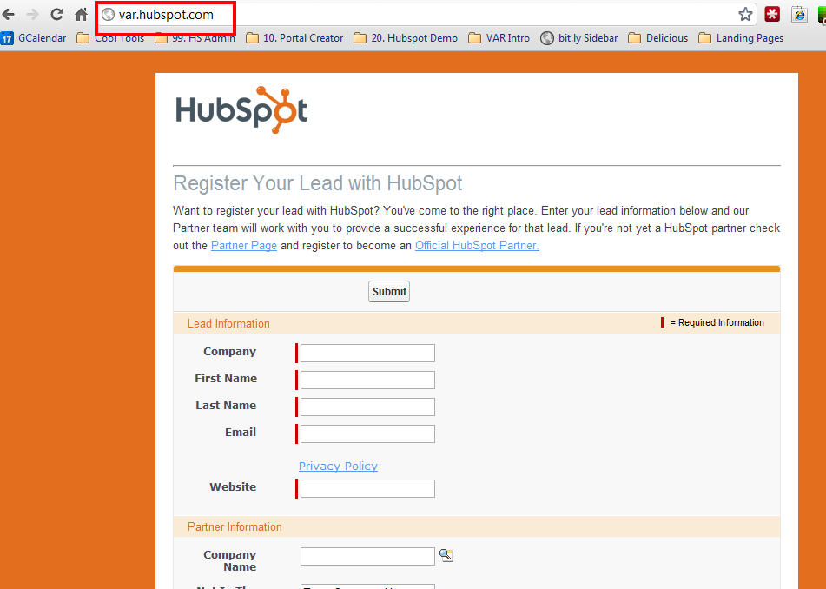
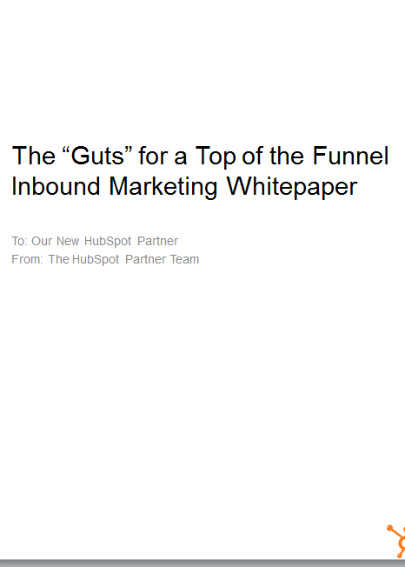
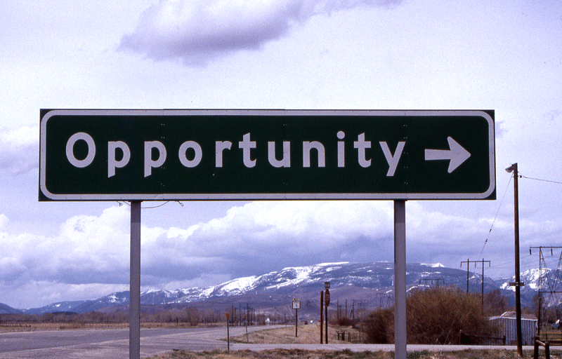
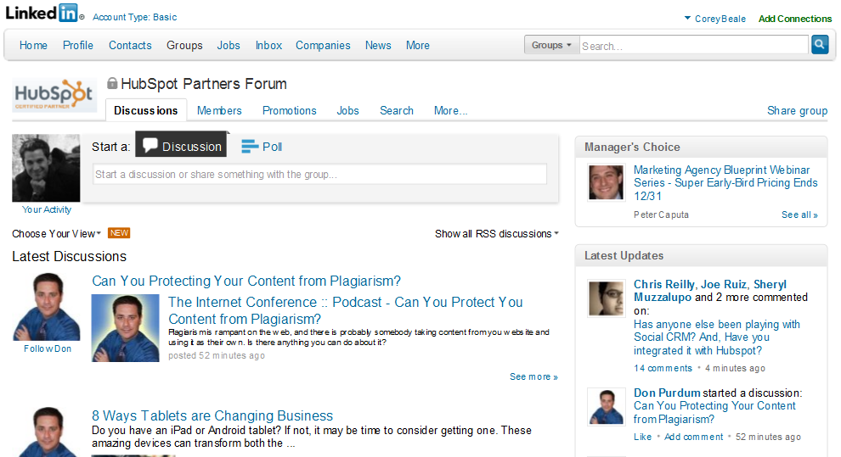
Notes:
Corey:
We’re recording
Register your leads, as often as possible and as many as possible.
Get your ebooks
Hang out with your CAM and discuss opportunities
Join the LinkedIn group!

Slide 6
AGENDA
1
Recap: The recommended sales process
2
Presenting your Solution – Bringing it Together
3
The typical flow and “how to” of a presentation
4
Suggested Demo Flow
5
Bonus: Trial Experimentation
6
Potholes, Key-Takeaways and homework
Notes:
Jeetu:
Here’s an overview of what we’re going to talk about today. The topic is around the presenting your solution. We are going to do a quick recap of the sales process and where we last left off, begin to touch on the purpose and background of the goal setting and diagnostic, move in to the actual flow of the call, quickly hit potholes that people typically hit then move right in to talking about the key take-aways homework for this wee.
We’ll share with you a how-to process to execute a Connect call successfully. As part of any Connect, there will be objections, pushbacks, and possibly the big No. We’ll talk about strategies to deal with these scenarios. We’ve also included a bonus section on dealing with influencers and gateways. Finally takeaways so you can get started with connecting with your prospects.

Slide 7
The Recommended Sales Process & Methodology
1
Notes:
Jeetu:
So let’s get down to it and start talking about the HubSpot sales process and methodology.

Slide 8
Generating Leads
Researching Leads and Prospecting
Connecting and Qualifying
Inbound Marketing Assessment (IMA)
Diagnostic and Goal Setting
Present Solution
Contract and Close

Slide 9
Inbound Marketing Sales Methodology
1. Generate Leads
Find Prospects to Call On
2. Research and Prospect
Get to a Connect
Lead
3. Connect
Schedule the Assessment
4. Qualify
Determine worthiness for next step
OPPORTUNITY
5. Diagnostic & Goal Setting
Align business goals with activities
6. Presentation & Experimentation Present Solution and/or Trial
7. Contract & Close
Agree to Proceed
Notes:
Corey:
We’re moving nicely down the funnel and today we are certainly at the meat of the sales process. Again my friendly weekly reminder is to print this out and hang it in your office to you don’t start skipping steps.

Slide 10
Presenting your Solution – Bringing it Together
2
Notes:
Corey:
So let’s begin to breakdown what exactly is the purpose behind a presentation and experimentation call and how you can begin to execute it properly.

Slide 11
Notes:
Corey:
If you have followed the sales process by executing an IMA and Diagnostic and Goal Setting call and ended each call with an inoffensive call, then you have successfully completed the tough parts and presenting your solution is more of a formality. It is the time when the prospect gets to see more of the HubSpot Product. It is the time when you lift the hood and show more of the workings behind your platform.
I want to emphasize that skipping steps in the sales process and showing them the product early on is not going to help you win. When you go through the IMA and Diagnostic and Goal Settings, the idea is to make sure they are BANT qualified, Budget, Authority, Need, and Timing, have a real compelling issue, and have urgency to fix them.

Slide 12
Bringing it Together
Opportunity to bring everything together for a Closing Sequence (Contract)
Summarize their Current Situation
Summarize their Goals
Share Challenges the Prospects is Facing
Continue Qualifying to make sure you haven’t missed anything
Continue with the Inoffensive Close that they want to fix their issues
Notes:
Corey:
When you are presenting your solution, it is your opportunity now to bring everything together for a closing sequence. It continues to close the gap between the prospects needs and your services with a solution to hit their goals. Presenting your solution also sets you up for a closing sequence in which you give them a contract. In bringing it together, you summarize their current situation, goals they would like to hit, and challenges they are facing towards their goals. You will always want to recap what you have learnt so you are able to relate their issues back to what you are going to share with them. Also, even though are presenting a solution, it doesn’t mean the sales qualification has stopped. You continue with the sales qualification and we’ll share with you questions you should be asking while you present. And finally, you still use your inoffensive close so when you do present a contract, there will be no questions about them moving forward.

Slide 13
Presenting your Solution is not…
A detailed feature by feature presentation of HubSpot – NO!
The prospect doesn’t care about every feature. They care about how you are going to fix their issues.
Avoid the temptation to show your technical expertise
Overwhelming your prospect – NO!
Stay away from overwhelming the prospect with technical details
You have trusted advisor status and they have agreed they need your help
End of the Sales Process – NO!
You continue your qualifying to make sure you haven’t missed anything
Continue with gaining their commitment
Notes:
Jeetu:
So even though it is your chance to present a solution, it is also a pothole I’ve seen with many Partners. It may be a pothole if you do a detailed feature by feature presentation or demo of HubSpot. The prospect doesn’t care about every feature. They care about how you are going to fix their issues. Don’t fall into the trap of showing them every feature in HubSpot with the hope of showing them how you smart you are…frankly they don’t care about the features, they care about how you are going to fix their issues.
Don’t overwhelm the prospect. You have done a great job of using the sales process. You have executed an IMA and Goal Setting and Diagnostic call. While other agencies jumped right into sharing a technical solution, you have approached the whole discussion from a business standpoint. You have asked great probing questions to uncover the prospects goals, pain, challenges, and their desire to fix them. You have clearly differentiated yourself by being a trusted advisor. They’ve accepted they need your help and they want to move forward. So don’t overwhelm them with way too many technical details
It is also not the end of the sales process. You still continue qualifying them to make sure you haven’t missed anything. You still continue gaining their commitment.

Slide 14
The Typical Flow and “How-To” of a Presentation Call
3
Notes:
Jeetu:
So lets look at the typical flow of a Presentation Call.

Slide 15
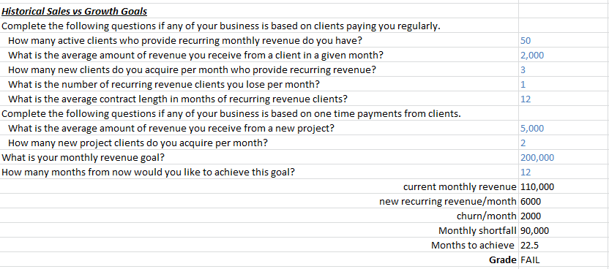
Review Their Situation
Historical Sales & Revenue Figures
Sales & Revenue Goals
Notes:
Jeetu:
If you completed your Diagnostic and Goal Setting call, you should have an understanding of their historic sales and revenue figures. You should also know their sales and revenue targets. Before your present a solution, you do want to bring this up again and summarize these figures and goals. Again, another reason not to skip steps.

Slide 16
Review Their Situation
“Based on our previous conversation, you shared with us that you’re generating $xyz/mo. You’d like that number to be $abc/mo. If you continued at your current rate of sales growth and with your current marketing and sales plan, you won’t achieve that within the x month target you’ve set. You agreed that you’d like to pursue inbound marketing as a strategy to help you achieve your goals within this timeline.”
Notes:
Jeetu:
Here is a soundbite to possibly use when reviewing their situation:
“Based on our previous conversation, you shared with us that you’re generating $xyz/mo. You’d like that number to be $abc/mo. If you continued at your current rate of sales growth and with your current marketing and sales plan, you won’t achieve that within the x month target you’ve set. You agreed that you’d like to pursue inbound marketing as a strategy to help you achieve your goals within this timeline.”

Slide 17
Review Their Goals
Notes:
Corey:
Along with their situation, lets review through their goals. Again, the goals are going to come directly from the calculator step in your Diagnostic and Goal Setting call. This is repetitive but it is part of the sales process to make sure what they shared with you is still accurate, nothing has changed in their situation, and they agree these are the goals they would like to hit.

Slide 18
Review Their Goals
“Based on your revenue target of $abc/mo, we discussed how to achieve that via inbound marketing. We discussed how there are 3 variables in inbound marketing: traffic, visit to lead conversion ratio and lead to customer conversion ratio. We discussed the techniques we can use to improve these over time. Today, we’ll talk about how we measure these metrics and we’ll demonstrate what activities need to be performed to improve them over time. We agreed on goal numbers for each of these metrics that will help you achieve your revenue goal.”
Notes:
Corey:
Here is a soundbite to use when reviewing through their goals:
“Based on your revenue target of $abc/mo, we discussed how to achieve that via inbound marketing. We discussed how there are 3 variables in inbound marketing: traffic, visit to lead conversion ratio and lead to customer conversion ratio. We discussed the techniques we can use to improve these over time. Today, we’ll talk about how we measure these metrics and we’ll demonstrate what activities need to be performed to improve them over time. We agreed on goal numbers for each of these metrics that will help you achieve your revenue goal.”

Slide 19
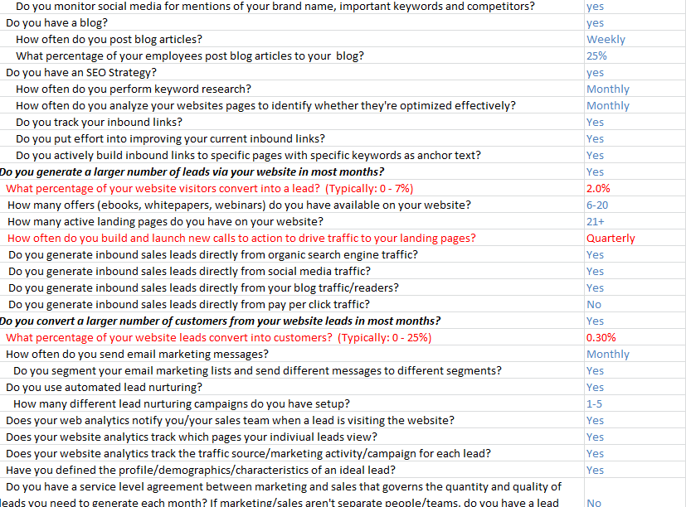
Review What They’re Not Doing Well
Inbound Marketing Evaluation
Notes:
Jeetu:
Bring up the evaluation worksheet from the Diagnostic and Goal Setting evaluation worksheet and share with them areas they are not doing well. I don’t recommend going through each and every row at this stage. I’d recommend highlighting specific areas in Red and discussing these areas during this call. Again, you have already gone through this in detail in the previous goal and you are really ensure you haven’t skipped anything and the prospects needs have not changed.

Slide 20
Use the IM Methodology to Paint the Picture
Qualified Traffic
SEO
Blog
Content
Creation
Landing
Pages
Social
Media
Marketing Analytics
Lead Nurturing &
Intelligence
CRM
(Salesforce.com or other)
Sales
Notes:
Jeetu:
Before diving into the platform and showing them tools within HubSpot, paint the Inbound Marketing methodology picture for them. You have already started painting the picture in the Evaluation worksheet during the Diagnostic and Goal Setting call. Go over the concept of the Inbound Marketing funnel and share the methodology around Getting Found, Convert, and Analyze. For example, when I go over the Inbound Marketing methodology, I bring up the funnel and share something like “Our goal is to help you get more traffic into your funnel with blogging, SEO, and social media. We then use lead conversion tactics to convert more of the traffic into leads. These leads are now nurturing campaigns that we setup to warm these leads for your salespeople and share with them a ton of lead intelligence. As we go through this process, the two of us have access to reports that tie marketing activities back to leads and eventually paying customers so we identify our best performing marketing activities and accordingly we would adjust or get rid of activities that do not drive the yield we are looking for”

Slide 21
Use the IM Methodology to Paint the Picture
“The key to using your web as a tool to grow your business is to think of your website as an inbound marketing system where you can do things that will predictably increase traffic, leads and sales. We’ll measure the impact of each of these individual activities on each of these metrics. Then, we’ll do more of what works, and tweak or stop doing what’s not.”
Notes:
Jeetu:
Here is another soundbite:
“The key to using your web as a tool to grow your business is to think of your website as an inbound marketing system where you can do things that will predictably increase traffic, leads and sales. We’ll measure the impact of each of these individual activities on each of these metrics. Then, we’ll do more of what works, and tweak or stop doing what’s not.”

Slide 22
Use the IM Product to Brush the Strokes
“We do all of this really efficiently by using software to help us. The software we use is integrated and SaaS based, so we can focus more on doing the work that will improve the metrics. It allows us to be more efficient and more effective, helping us deliver more services (and greater results) in less time and cost for you.”
Notes:
Jeetu:
“We do all of this really efficiently by using software to help us. The software we use is integrated and SaaS based, so we can focus more on doing the work that will improve the metrics. It allows us to be more efficient and more effective, helping us deliver more services (and greater results) in less time and cost for you.”

Slide 23
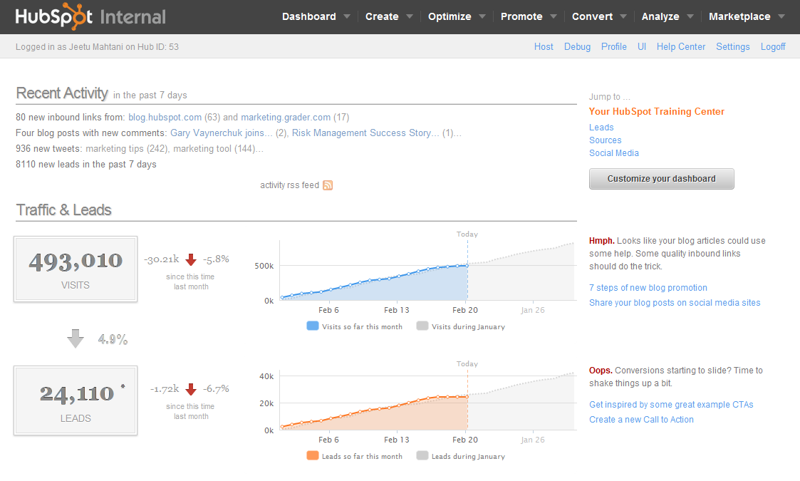
Use the Product to Brush the Strokes
Notes:
Corey:
Bring up the product and do a high level introduction to the platform. I usually like to start by related the IM methodology to the individual tabs. Many of our partners will steps through each of the tabs. For example, they will step through Create, Optimize, and Promote and share how that is related to Getting found. They will then do the same thing with Convert and Analyze.

Slide 24
SEO
1
1
All-In-One
Text goes here
Marketing
Automation
Text goes here
Social
Media
Marketing
Analytics
Content Creation
Landing
Pages
Text goes here
Email &
Lead Nurturing
Notes:
Corey:
Share how HubSpot is in all-in-one platform which enables you the agency to execute on the prospect’s goals through one single environment which in turn saves the prospect from investing in other platforms. It also enables the prospect and you to always be on the same page by having one environment to go over specially from an analytics standpoint.

Slide 25
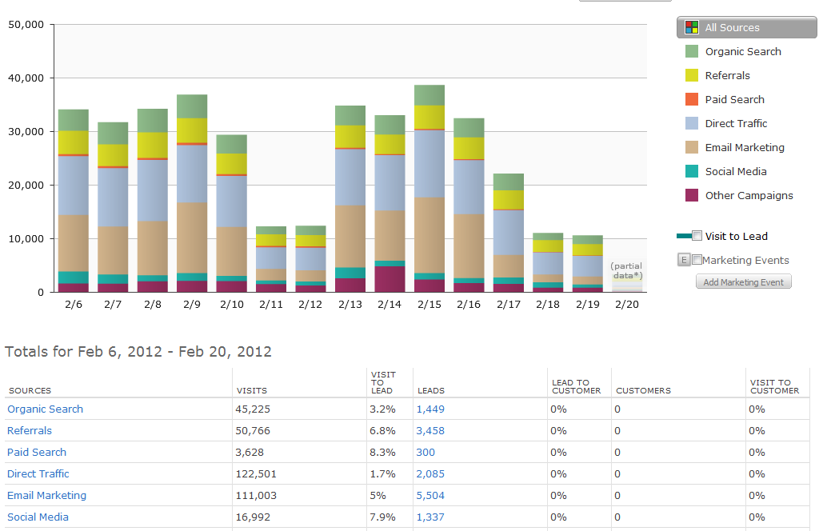
Use “Sources” to Connect Everything
Notes:
Corey:

Slide 26
Highlight Key Activity in order to Succeed
“The key thing for you to take away is the activities that must be performed on a regular basis, so that we can help you achieve your business goals.”
Notes:
Jeetu:
As you go through this process, always remember to highlight the key activity in order to succeed:
“The key thing for you to take away is the activities that must be performed on a regular basis, so that we can help you achieve your business goals.”

Slide 27
Suggested Demo Flow
4
Notes:
Jeetu:
Here is a suggested demo flow that you could follow

Slide 28
Traffic: Blogging, SEO + Social Media
Select Keywords
Write a Blog Post with a Keyword
Show Keyword propogation to Page Title (On Page SEO)
Show Social Media Publishing/Sharing
Notes:
Jeetu:
When demoinng, always relate the tool back to the objective. In the case of the objective being more traffic, you can demo the Keyword Grader. We usually recommend populating the keyword grader with relevant keywords prior to the demo. You can then move into the Blog and do a sample blog post in which you can show how you combine content generation with a keyword strategy. You can them into the social media publishing tool and show how the same keywords are now being monitoring on social media sites basically leveraging social media to identify relevant prospects.

Slide 29
Leads: Offers, Landing Pages, CTAs
Discuss Importance of Offers
Discuss Landing Page Best Practice
Show Landing Page Builder
Show Landing Page Dashboard
Notes:
Corey:
When discussing their objective around Leads, share the importance of creating compelling offers and integrating them into landing pages. Bring up and example of a compelling offer and landing pages possibly on your own site. Go back to Session 1 of this training series in which we shared landing pages that target prospects based on where they are in the sales funnel. For example, offers that target top of the funnel, middle of the funnel, and bottom of the funnel. In order to demo conversion, create a sample landing page by using the landing page builder. Also, bring up the landing page dashboard and share how you compare one landing page to the next and use data and analytics to help you make decision on going tweaks and adjustments to landing page to maximize conversion.

Slide 30
Customers: Nurturing, Scoring, CRM Integration
Discuss Email Marketing
Discuss Lead Nurturing
Discuss Lead Scoring
Discuss Sales Productivity from CRM Integration
Notes:
Corey:

Slide 31
Improvement Over Time: Analytics
Measure Traffic, Leads and Sales by Traffic Source
Discuss Importance of Social Media Reach
Discuss Analysis of Blog Content
Email & Lead Nurturing, Analytics
Notes:
Jeetu:

Slide 32
Check for Understanding Throughout
Do you understand why blogging is the centerpiece of helping you grow traffic? [TRAFFIC]
Can you think of strong top of the funnel offers that we can create to turn more visitors into lead? [CONVERT]
Do you understand how integrating your website with your CRM will help us improve sales productivity? [NURTURING AND CRM]
Do you understand why all of these activities are important to helping you achieve your business goals? [ANALYTICS]
Notes:
Jeetu:
As you go through the demo process, always make sure you are checking for understanding throughout the demo process. We call them tie downs and it is way for you to make sure the prospect understands the tool you showed them and how you are going to accomplish that specific objective.

Slide 33
Bonus: Trial Experiment
5
Notes:
Jeetu:
The trial is a great tool to quickly design experiments that prove ROI. We also call them a “Proof of ROI” concepts.

Slide 34
Inbound Marketing Sales Methodology
1. Generate Leads
Find Prospects to Call On
2. Research and Prospect
Get to a Connect
Lead
3. Connect
Schedule the Assessment
HubSpot Trial
4. Qualify
Determine worthiness for next step
OPPORTUNITY
5. Diagnostic & Goal Setting
Align business goals with activities
6. Presentation & Experimentation Present Solution and/or Trial
7. Contract & Close
Agree to Proceed
Notes:
Jeetu:

Slide 35
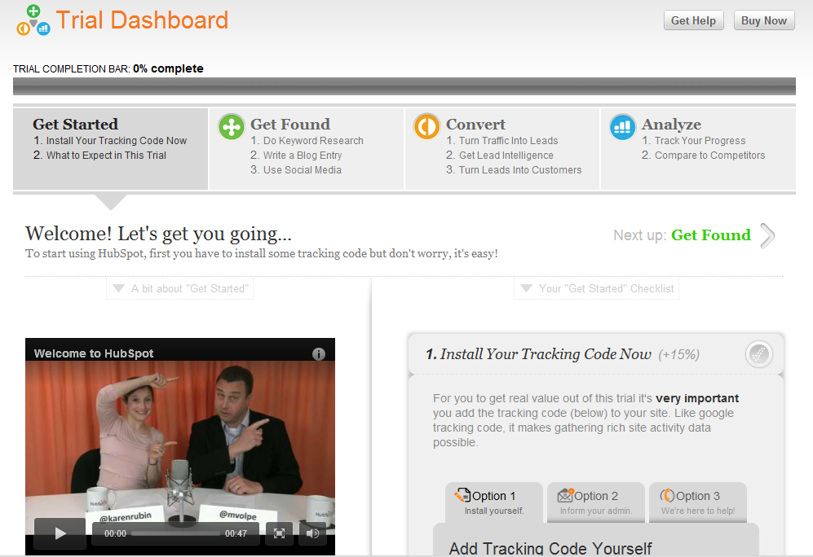
Navigating the Trial
Dashboard
Create
Optimize
Promote
Convert
Analyze
Marketplace
Notes:
Jeetu:
Let’s dive into the trial.
Along the top of your portal, you’ll see 7 tabs. The dashboard is where you should start. You should try and get as many green check marks as possible by setting up the features in the trial.
Once you get close to 100% complete, start exploring the tabs across the top.
You’ll see that this corresponds to the HubSpot Inbound Marketing Methodology where we encourage business to create content, optimize it for search engines. Promote it via social media and email marketing, then convert that traffic into leads and customers via landing pages, lead nurturing, lead segmentation. The last and most crtical part of the methodology is to analyze each step of the process in order to improve results month over month.
The software and the methodology go hand in hand. The methodology helps companies become all star inbound marketers and it’s impossible to implement the methodology fully without the software.

Slide 36
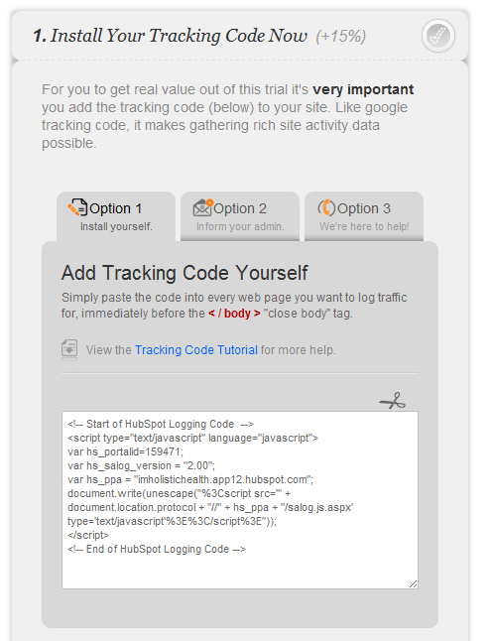
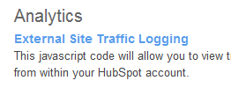
How Much Traffic from Each Traffic Source?
Notes:
Jeetu:
The first step is to set up HubSpot Analytics. It’s a simple process of cutting and pasting javascript code into the footer of your client’s site. It should take a technical webmaster only about 5 minutes, assuming their site is designed correctly using an include file for the footer.

Slide 37
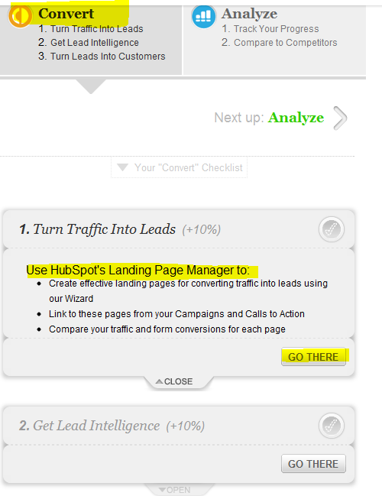
How Many Leads from Each Traffic Source?
3 Ways:
Hosted Landing Pages
Form Code
API
Notes:
Jeetu:
The next step is to set up lead tracking. There’s a few ways to do that. In the new navigation, you can access the instructions and a wizard which will help you determine which mehod(s) you should use for each client, based on their needs.
The easiest way is to set up HubSpot hosted landing pages on a subdomain of your client’s sites. You can also export form code and insert the form into any page on your client’s site OR use the API when you have clients that have sophisticated backend processing for leads, like an insurance company giving instant online quotes.

Slide 38
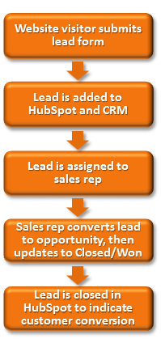
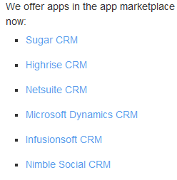
How Many Customers from Each Traffic Source?
Set up HubSpot Closed Loop Marketing (Salesforce, Manual, API with other CRMs)
http://help.hubspot.com/articles/Tutorial/integrate-your-crm
Notes:
Jeetu:
There’s two ways to set up Closed loop marketing. If your client uses, salesforce.com, it’s a few hour set up process. HubSpot Pintegrates with Salesforce.com through our application on the SFDC app exchange.

Slide 39
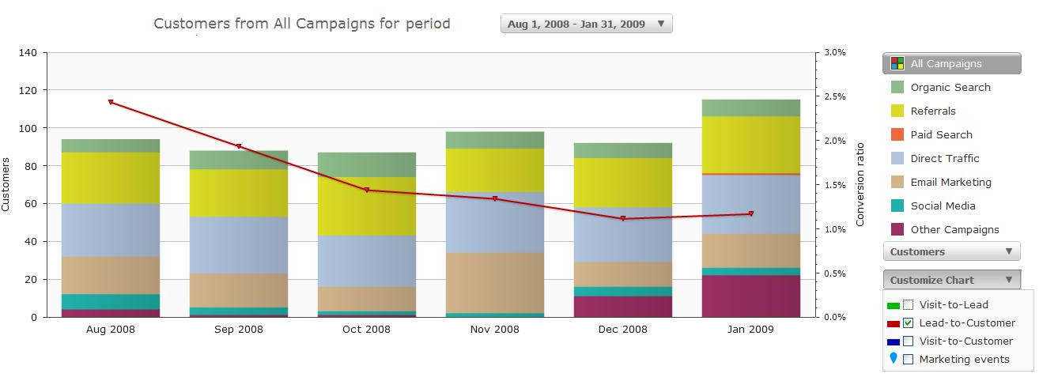
Which Channels Are Performing?
Get Visitor, Lead and Customer Quantities per Source from Analytics
Determine the action plan.
Adapt the action plan every month.
Notes:
Jeetu:
With HubSpot Sources Analytics, you can very quickly get all of the data you need per traffic source.
If social media shows an uptick, you can double down on that. If blogging is underperforming, you can diagnose why.
Using this data in your proposal allows you to give your clients a concrete action plan and specific steps to hitting their lead generation, customer acquisition and revenue targets. It helps you predict, then measure and improve their ROI over time.

Slide 40
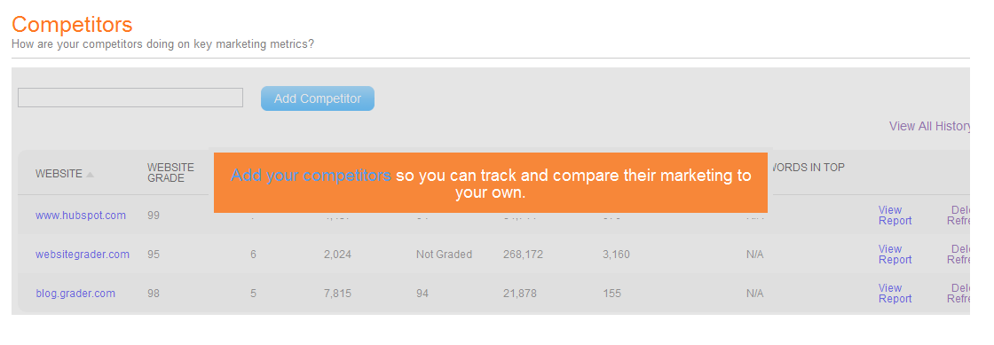
Use Competitors to Discuss SEO, Social Media
Enter 10 competitors and show/send this screenshot to them….
“I’m reviewing your site vs your competitors and I see that they have many more pages on their site. Do you know that helps them get more traffic to their site from search engines like Google?”
Notes:
Corey:
Another tool you can use in the Trial is the Competitor tool.

Slide 41
Use Benchmarks to Discuss Key Metrics
Enter their Goals from the Inbound Marketing Calculator
“The Benchmarks applications show your goals vs what about 6,000 other companies have achieved when they follow the process that we’re recommending.”
Notes:
Corey:
Other another tool to use in the Trial is the Benchmarks App. The Benchmarks applications show your goals vs what 6,000 other companies have achieved when they follow the process that we’re recommending.

Slide 42
Use Benchmarks to Discuss Key Activities
As always, discuss the Importance of Key Activities and Start to Set Some Activity Goals
“Each month, we’ll need to talk about what activities you’ll perform and which ones we’ll do for you. This is our way of setting goals for frequency of many activities. It also automatically measure how we’re doing against these goals.”

Slide 43
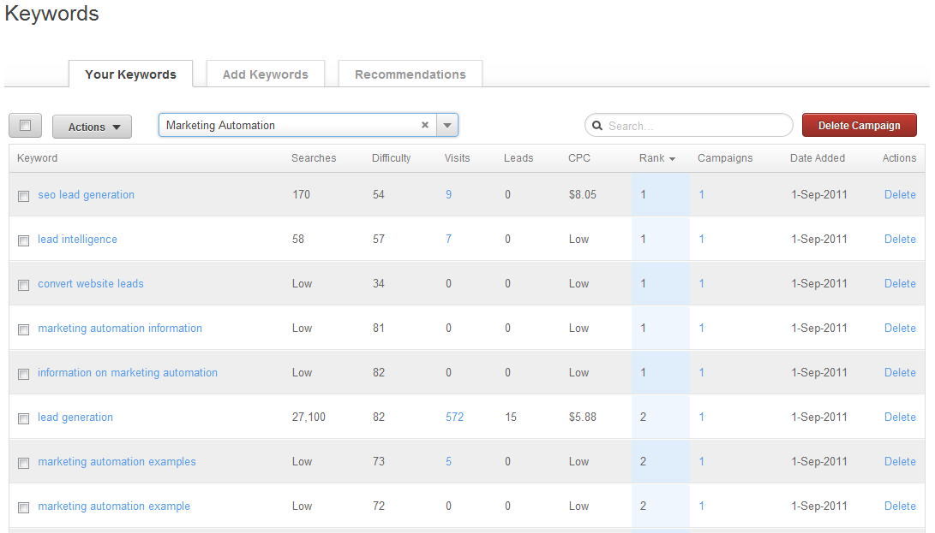
Establish Need for Long Term SEO/Content Plan
Enter 500 keywords into keyword grader. Use tool to find a few100 more. Work with them to identify favorites based on their knowledge and the data
“Now that we’ve identified the 30 best keywords that you can use to attract more highly targeted search traffic with the least amount of effort, we’ll develop a plan for ongoing content creation and link building using these keywords.
Notes:
Jeetu:
Another great thing to do during your trial is keyword research.

Slide 44
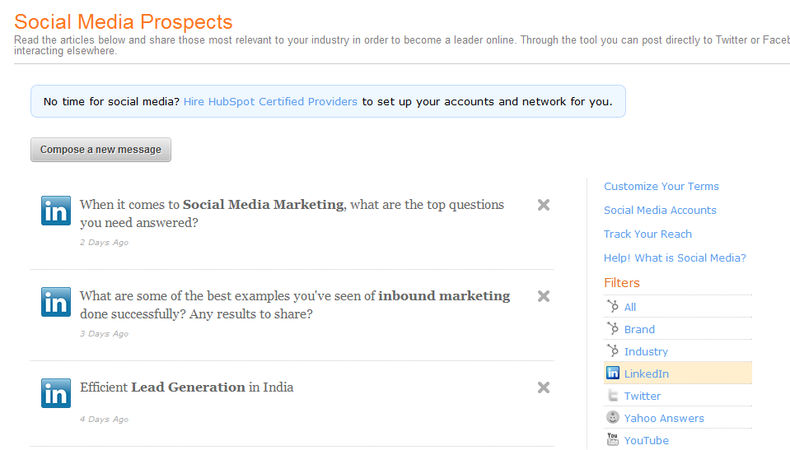
Find Prospects on Social Media
Enter 10 longer tail keywords and send them links to prospects talking about their company, solutions like theirs, competitors…
“After we examine the relevant conversations on social media sites, we can see that there’s a bunch of people talking about your company and your important keywords. If you’re not interacting with prospects and thought leaders via social media, you’re not going to benefit from the traffic, buzz and leads that social media can help generate.”
Notes:
Jeetu:
Another great tool to explore during the trial is social media monitoring.
We recommend you enter 10 keywords that are mid or long tail, so that you can identify some linkedin questions or tweets that talk about their company or their important keywords.
If you can find a few prospects for them via social media, it usually piques their interest in learning more and starts to show them that social media can help them improve their sales and marketing.

Slide 45
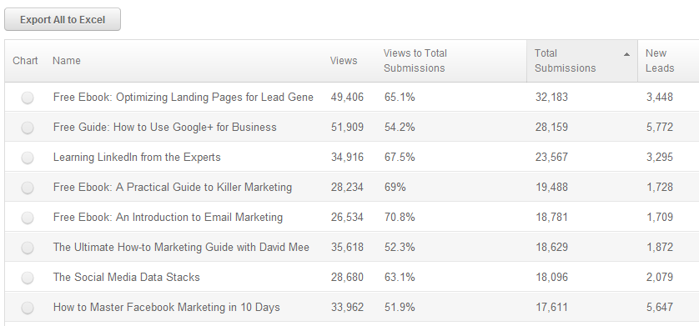
Which Offers & Landing Pages Are Performing?
Notes:
Jeetu:
Here’s an example of how you can measure conversion rates for different offers and forms.

Slide 46
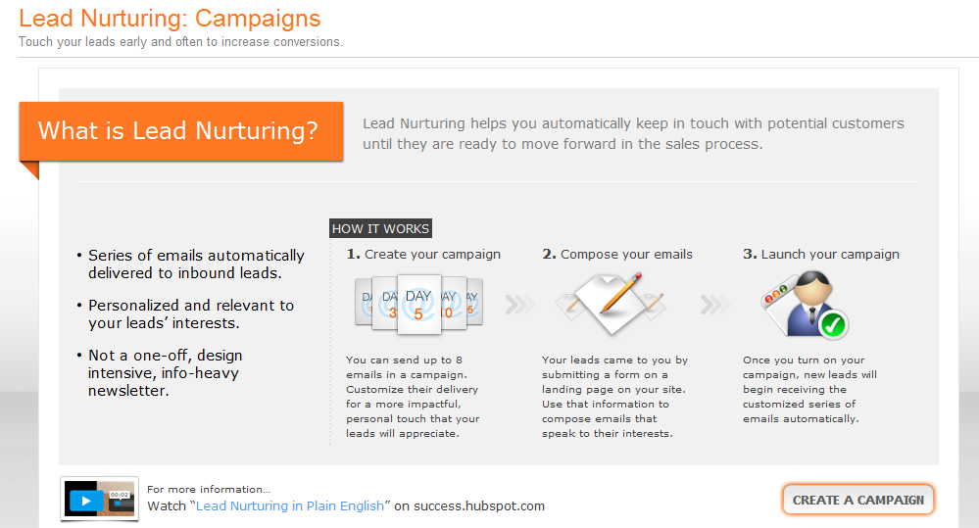
Discuss Importance of Nurturing Leads
Notes:
Jeetu:
Once you’ve set up a landing page, you can set up a series of auto-responder emails. This is new functionality in our software that we’re continuing to enhance. But, what we’ve built is far beyond what most companies do now.
In HubSpot Small you can set up one lead nurturing campaign. In Medium, you can set up more.
Let’s go through and create a campaign and associate it with a landing page.

Slide 47
Get Commitment, Next Step
What are your thoughts at this point?
What other things do we need to discuss before you’d be ready to hire me/my company to help you implement inbound marketing?
Typically, our next step is to put together a contract together that discusses all of the details of our engagement. Then, we sign it and move forward. I’ll need you to think about what you’d like to include in that contract. But, if you want to move forward, we should schedule another meeting to finalize things and execute our agreement.
Notes:
Jeetu:

Slide 48
If You Want us to Do a Presentation for You
If you’re reselling HubSpot with your retainer, we can help present the HubSpot solution and support the need for your services during our presentation.
Email your Channel Account Manager (CAM)
Your CAM can only assist with the presentation if you have followed the sales process i.e. IMA and Diagnostic and Goal Setting Calls need to be completed
Your CAM will email you a pre-Demo checklist that you will need to complete

Slide 49
Potholes
6
Notes:
Corey:
Now any sales process is going to have objections and pushbacks. If sales did not have any objections and pushbacks, then everyone would be in sales and every call would result in a deal.

Slide 50
Potholes
Showing every tool
Forgetting that you know way more than they do
Not relating the information to their GPCTC
Not relating the demo or trial path to their needs
Going TOFU in a trial
Not rolling with the punches
Notes:
Corey:

Slide 51
Key Take-Aways and Homework
6
Notes:
Corey:
It’s that time again, so let’s talk about this weeks key take-aways and the homework to help you be successful.

Slide 52
Prepare for your presentations; nothing is more important than this. Nothing.
Stick to a path the best you can, avoid the rabbit holes
Prepare your tie-downs and business value statements
Practice
Notes:
Corey:

Slide 53
Your success in sales is driven by
Activity
Process
Skills
Notes:
Corey:
No changes here this week folks, nothing can replace activity at this stage either. Keep hitting the phones hard, calling your well researched leads and start booking appointments.

Slide 54
Homework
Setup 2 trial experiments
Practice running 3 demo’s
Run 1 of either live for a current client or prospective client!
Practice, practice, practice and prepare, prepare, prepare
Notes:
Corey:
Tons of great homework this week. Since everyone has been doing such a great job generating and researching leads let’s get on the phones and run some diagnostic calls!

Slide 55
Tuesday, February 28
11 AM US EST
Next Topic – Contract and Close
Notes:
Corey:
Talk to slide

Slide 56
Questions?

