Slide 1
Contract and Close
Notes:
Jeetu:
Welcome to Session 7 of the Partner Program training webinar series for marketing agencies and independent marketing professionals.
My name is Jeetu Mahtani and I am joined by Corey Beale. We are both Partner Channel Managers at HubSpot.
Corey:
We partner with marketing agencies of all kinds to help agencies more cost-effectively and more efficiently provide a broader set of inbound marketing and demand generation services to our mutual customers.
Working with our partners, one of the biggest challenges that they have is adapting to a world where clients are asking for one agency that can do everything. The worlds of PR, advertising, marketing, seo, ppc, social media and web design and development are merging. And the feedback I’m getting from many types of agencies is that it’s really hard to do everything, deliver an ROI to clients and grow their agency at the same time.
That’s what HubSpot is helping partners with in many ways. Today, though, we’re going to talk about a framework for diagnosing the complete inbound marketing needs of a prospect or client. We’re going to provide you with a script and a playbook with how we’ve done this for about 10,000 companies.

Slide 2
Nice to Meet You
Jeetu Mahtani
HubSpot Sales Manager
http://www.linkedin.com/in/jeetumahtani
jmahtani@hubspot.com
Corey Beale
Hubspot Sales Manager
www.linkedin.com/in/coreybeale
cbeale@hubspot.com
Hash Tag: #AgencyTransform
Notes:
Corey:
We want to keep these sessions interactive both during and after the webinar. Feel free to reach out to either of us via email or LinkedIn and let’s get Twitter rocking today by using the hash tag #AgencyTransform

Slide 3
Notes:
Corey:
Ok ok this is the last time I promise. Before we dive right in to the agenda there are a few quick house keeping notes we should make about today’s session.

Slide 4
Bookmark this Page!!
http://www.hubspot.com/advanced-sales-training-home
Notes:
Corey:
Make sure to keep this handy, each week we’ll be uploading the recording and slides to this URL

Slide 5
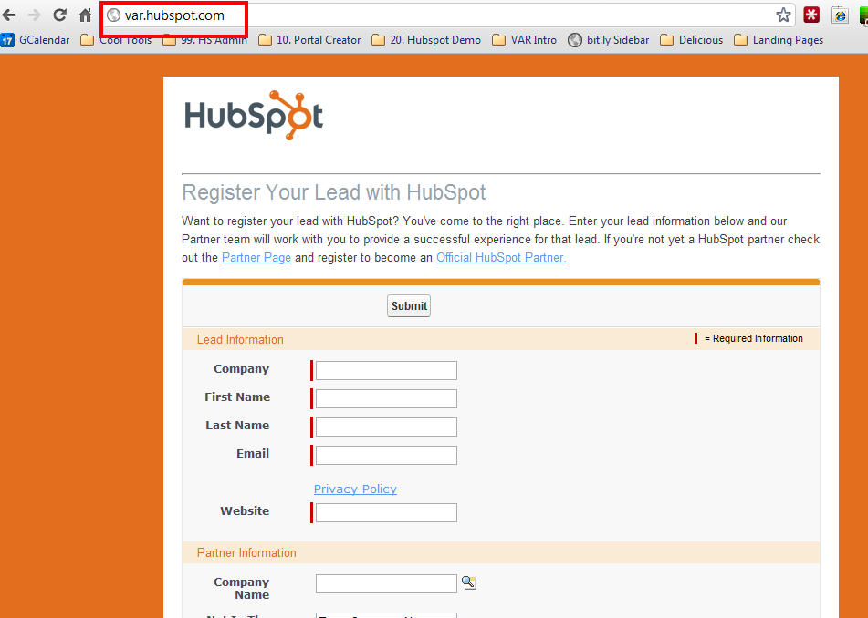
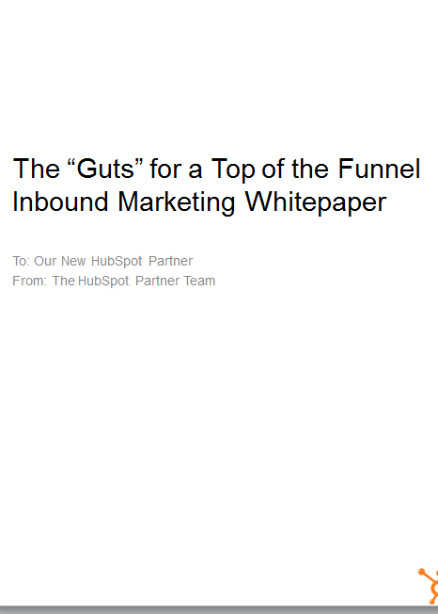
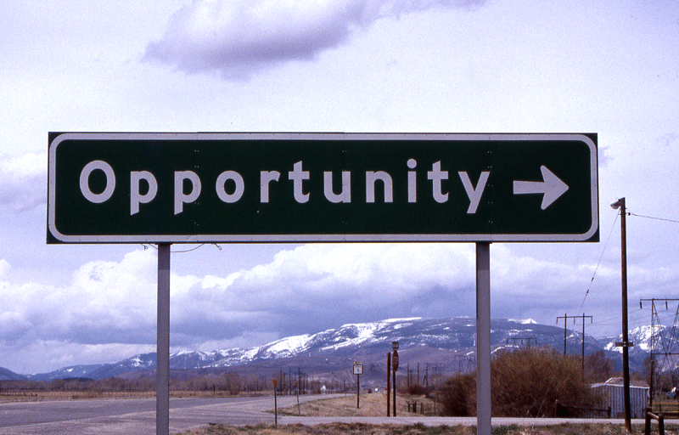
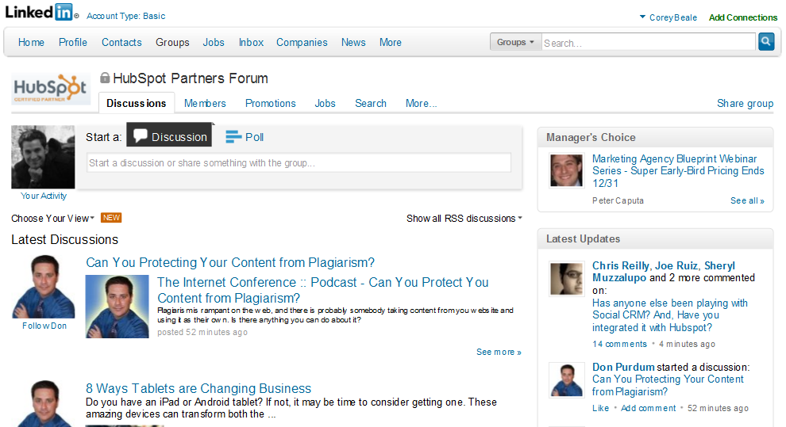
Notes:
Corey:
We’re recording
Register your leads, as often as possible and as many as possible.
Get your ebooks
Hang out with your CAM and discuss opportunities
Join the LinkedIn group!

Slide 6
AGENDA
1
Are we ready to Close?
2
Proposals vs. Contracts
3
The typical flow and “how to” of a close
4
Closing
5
Structure of a Contract
6
Potholes, Key-Takeaways and homework
Notes:
Jeetu:
Here’s an overview of what we’re going to talk about today. The topic is around your Contract and Closing business. We are going to do a quick recap of the sales process and where we last left off, begin to touch on the flow of a contract and closing sequence, share with you a recommended structure of a contract document, quickly move into potholes that people typically hit and then move right into talking about the key take-aways and homework for this week.

Slide 7
Are we Ready to Close?
1
Notes:
Jeetu:
So are we ready to close and win new business? Yes, we are if we have followed the sales process. It is critical not to skip steps. We all know prospects lie to us and when you skip steps, you unfortunately assume what the prospect is thinking and it does not give you a chance to uncover their lies and identify the real issue. You don’t get a chance to dig deep enough to figure out if there is real pain and urgency and if the prospect is committed to fixing their problems. So yes, we are ready to close and win new business when we follow the sales process since when you do follow it, you positioning yourself for success.

Slide 8
Generating Leads
Researching Leads and Prospecting
Connecting and Qualifying
Inbound Marketing Assessment (IMA)
Diagnostic and Goal Setting
Present Solution
Contract and Close
Notes:
Jeetu:
Lets do a quick final recap of the sales process. Once you have leads, you will research them, pick up the phone and make that call. If you don’t reach and connect with them, you are going to leave a voicemail and send an email immediately. We talked about the Basho sequence of voicemail and email in our last session. When you do connect with them, you are going to engage them with a positioning statement and start your initial qualification. Following the connect, you are going to have a scheduled call during which you are going to continue your qualification by executing on an Inbound Marketing Assessment also known as an IMA. At the end of the IMA, you should have “trusted advisor” status and do an inoffensive close during which your prospect agrees they need your help and would like to define their marketing goals with you. Following the diagnostic and goal setting call, you are going to share the solution to hit their goals. Wrap that meeting up with an inoffensive close again, they agree they want your help and want to see a contract. You finally present a contract which includes their goals they shared with you and close out the deal.
So we are at step #7 in which we are ready to present a contract which includes their goals and you are ready to get their commitment with a signature.

Slide 9
Inbound Marketing Sales Methodology
1. Generate Leads
Find Prospects to Call On
2. Research and Prospect
Get to a Connect
Lead
3. Connect
Schedule the Assessment
4. Qualify
Determine worthiness for next step
OPPORTUNITY
5. Diagnostic & Goal Setting
Align business goals with activities
6. Presentation & Experimentation
Present Solution and/or Trial
7. Contract & Close Agree to Proceed
Notes:
Corey:
We’re moving nicely down the funnel and today we are certainly at the meat of the sales process. Again my friendly weekly reminder is to print this out and hang it in your office to you don’t start skipping steps.

Slide 10
Proposals vs Contracts
2
Notes:
Jeetu:
So lets talk about Prosposals vs. Contracts. I suspect many of us love writing proposals. I suspect many of us when asked to write a proposal, assume the prospect is ready to work with us, drop every other key activity and spend hours writing a proposal. Well, that is going to have to stop. Why? Because proposals don’t work when you are in a closing sequence. No more proposals.

Slide 11
Proposals vs Contracts
Proposals
Notes:
Jeetu:
No more proposals. Lets think about a scenario. You are working with a prospect who has gone through your sales process and they ask you for a proposal. You spend hours writing a proposal, send it to them and follow up a few days later. You don’t get a hold of them and you try again the next day. You get desperate and you keep trying but no word back from the prospect. The prospect has gone dark on you. Two things could have happened. One could be you’ve lost urgency. Your prospect has agreed they need your help and they want to move forward. You go back, work on a proposal that took you two full days to put together and the proposal is a 20 page document. You basically repeated everything from your sales process into the proposal. In the mean time while you are working on the proposal, your prospect may have started questioning his decision and by the time he or she receives your proposal, they are not sure they want to do business with you. Basically, you’ve lose urgency. The second thing that could have happened is you sent them this great looking 20 page document with way too much detail and now the prospect needs days and days to read through it. You’ve basically introduced a distraction in your sales process, lengthened your sales process, and possibly also blown it since while the prospect reads through 20 pages of your proposal, anything could have happened – the prospect decided to change his or her mind, the prospect decided to shop your proposal around, and overall just decided what they felt a week ago as urgency is no longer a priority.

Slide 12
Purpose of a Contract
Purpose of a Contract
Make it easy to Commit
Signature is your destination
1 to 3 pages
Not overwhelm them with granular detail causing them to overthink their commitment
Signature in the closing meeting
No Selling in your Contract
The Selling is Done!
Verbal commitment is in place
No distraction in the closing sequence
Notes:
Jeetu:
No more proposal and only Contract. The purpose of a contract is to –
Purpose of a Contract
Make it easy to Commit
Signature is your destination
1 to 3 pages
Not overwhelm them with granular detail causing them to overthink their commitment
Lets make it easy
Signature in the closing meeting
No Selling in your Contract
The Selling is Done!
Verbal commitment is in place
Distraction in the closing sequence

Slide 13
Roleplay
Notes:
Jeetu:
So lets roleplay when a prospect asks me for a proposal. Corey is the prospect and I am the awesome HubSpot Certified Partner Agency.
Now that you are considering getting out of the proposal writing business you’re probably imagining what those get me a proposal conversations sound like.
“Alright, I am ready to move forward. Get me a proposal.”
“Thats great. We are excited to be working with you. I propose to grow your business by hitting your goals (fill in the blank)”
“Perfect. Send me a written proposal”
"I’d be happy to write up a contract for your signature if you’re telling me that we have an agreement. Do we?”
“No, we don’t. I need something to read in detail and also share with my team and maybe also share with my manager.”
“I don’t mean to be sarcastic but I want you to understand that we’re not in the proposal writing business. Here’s what I’m willing to do. I’ll agree to invest in the presentation of a proposal to you and your boss. In exchange all I ask is that at the end of the meeting we agree on whether or not to move forward on my proposal.”
Winning agencies write contracts that get signed, order-taker agencies write proposals that sit on shelves. Forget proposal. Wirte contacts. Let your competition write the proposals.

Slide 14
The Typical Flow and “How-To” of a Contract Call
3
Notes:
Jeetu:
So lets look at the typical flow of a Contract call and closing sequence.

Slide 15
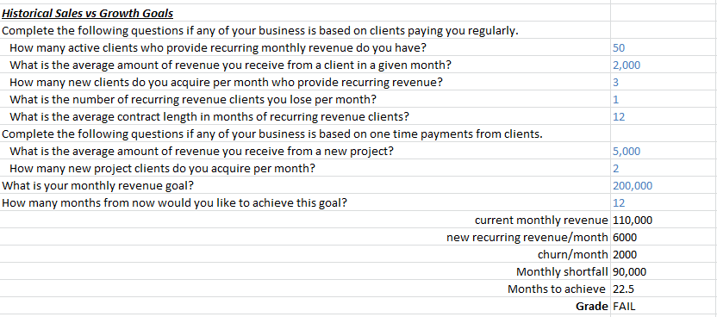
Recap Their Situation
Historical Sales & Revenue Figures
Sales & Revenue Goals
Notes:
Jeetu:
If you completed your Diagnostic and Goal Setting call, you should have an understanding of their historic sales and revenue figures. You should also know their sales and revenue targets. Before you present a contract, you do want to bring this up again and summarize these figures and goals. Again, another reason not to skip steps.
Here is a soundbite to possibly use when reviewing their situation:
“Based on our previous conversation, you shared with us that you’re generating $xyz/mo. You’d like that number to be $abc/mo. If you continued at your current rate of sales growth and with your current marketing and sales plan, you won’t achieve that within the x month target you’ve set. You agreed that you’d like to pursue inbound marketing as a strategy to help you achieve your goals within this timeline.”

Slide 16
Recap Their Goals
Notes:
Corey:
Along with their situation, lets review through their goals. Again, the goals are going to come directly from the calculator step in your Diagnostic and Goal Setting call. This is repetitive but it is part of the sales process to make sure what they shared with you is still accurate, nothing has changed in their situation, and they agree these are the goals they would like to hit.
Here is a soundbite to use when reviewing through their goals:
“Based on your revenue target of $abc/mo, we discussed how to achieve that via inbound marketing. We discussed how there are 3 variables in inbound marketing: traffic, visit to lead conversion ratio and lead to customer conversion ratio. We discussed the techniques we can use to improve these over time. Today, we’ll talk about how we measure these metrics and we’ll demonstrate what activities need to be performed to improve them over time. We agreed on goal numbers for each of these metrics that will help you achieve your revenue goal.”

Slide 17
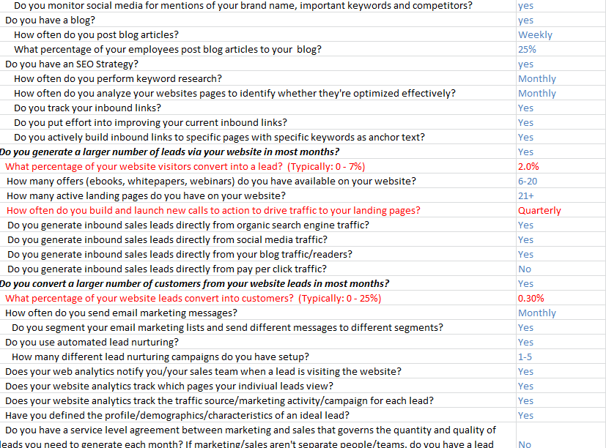
Recap What They’re Not Doing Well
Inbound Marketing Evaluation
Notes:
Jeetu:
Bring up the evaluation worksheet from the Diagnostic and Goal Setting evaluation worksheet and share with them areas they are not doing well. This is repetitive and you would have done this when presenting your solution. It is ok that it is repetitive and the the idea is to quickly recap what they not doing well. Again, I don’t recommend going through each and every row at this stage. I’d recommend highlighting specific areas in Red and discussing these areas during this call. Again, you have already gone through this in detail in the previous goal and you are really ensure you haven’t skipped anything and the prospects needs have not changed.

Slide 18
Highlight Key Activity in order to Succeed
“The key thing for you to take away is the activities that must be performed on a regular basis, so that we can help you achieve your business goals.”
Notes:
Corey:
As you go through this process, always remember to highlight the key activity in order to succeed:
“The key thing for you to take away is the activities that must be performed on a regular basis, so that we can help you achieve your business goals.”

Slide 19
Show the Gap Between Their Current Metrics & Goals
Notes:
Corey:
Now we are moving into sharing with them the retainer price and moving into a closing sequence. We are going to share with you a retainer quoting spreadsheet. It is basically a continuum of the evaluation and goals worksheet that are part of the Diagnostic and Goal Setting spreadsheet. There is a third worksheet called Plan. If you have completed the Diagnostic and Goal Setting call completely and correctly, we are going to generate a section in the Plan worksheet that shows them the current metric vs. their goals. It shows them the monthly, first month, and total improvement needed in order to hit targeted goals. This quickly summarizes from a metrics and goal standpoint what needs to be accomplished in order to succeed. Business owners love to see how you are thinking through their situation and outlining clear gaps that need to be fulfilled.

Slide 20
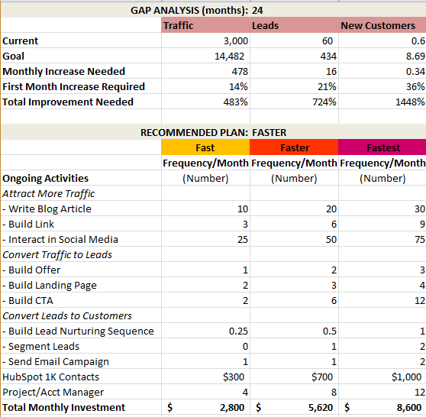
Review the Activities Required
Notes:
Corey:
You have set the stage in terms of where they are and where they would like to be and the gap that needs to be covered in order to hit their goals. They realize that the improvement needed is significant and they need your help in order to hit their goal. At this point, you are going through the set of ongoing activities that are required in order to hit their goal. The set of activities should not be a surprise to them since you have consistently shared with them the Inbound Marketing methodology and the activities behind the methodology. Right below the Gap Analysis, is the recommend plan along with the list of activities that will be completed.

Slide 21
Emphasize the Activities Required
“In order to be successful, there are a handful of activities we’ll need to do regularly including blogging, link building and social media interaction for traffic acquisition; offer, landing page and CTA creation for lead generation; email marketing, lead segmentation and nurturing to improve lead to customer conversion rate. We’ll need your buy-in and assistance to do all of this.”
Notes:
Jeetu:
Emphasize the activities that are required to succeed. Use a sound bite like –
“In order to be successful, there are a handful of activities we’ll need to do regularly including blogging, link building and social media interaction for traffic acquisition; offer, landing page and CTA creation for lead generation; email marketing, lead segmentation and nurturing to improve lead to customer conversion rate. We’ll need your buy-in and assistance to do all of this.”

Slide 22
Emphasize the Importance of Collaboration
“As we’ve discussed, however, the key thing for you to understand is that the activities we perform together must be performed on a regular basis, so that you can achieve your business goals. This isn’t a one time thing and we will require your assistance with a variety of activities.”
Notes:
Corey:
It is also important for them to realize that they are going to play a key role in the process. It isn’t like you are going to solve 100% of their lead generation issues without their participation. Emphasize the importance of collaboration with a soundbite similar to –
“As we’ve discussed, however, the key thing for you to understand is that the activities we perform together must be performed on a regular basis, so that you can achieve your business goals. This isn’t a one time thing and we will require your assistance with a variety of activities.”

Slide 23
Determine How They’ll Be Involved
Who on their team will be involved in each of these activities and how much time can they devote?
Setup: CMS (subdomain for blog, domain), CRM integration, analytics.
Content creation: blog posts, offers for lead generation, lead nurturing/email messages, website pages.
Social media interaction
Lead follow up & sales productivity training
Monthly reviews of analytics and results
Planning of each month’s activities
Notes:
Corey:
In order to succeed, it is key you set expectations that they need to get individuals from their team involved in the process.
Who on their team will be involved in each of these activities and how much time can they devote?
Setup: CMS (subdomain for blog, domain), CRM integration, analytics.
Content creation: blog posts, offers for lead generation, lead nurturing/email messages, website pages.
Social media interaction
Lead follow up & sales productivity training
Monthly reviews of analytics and results
Planning of each month’s activities

Slide 24
Give Your Recommendation
Notes:
Jeetu:
Lets give them our recommendation in terms of the services package they should go with based on the gap analysis.

Slide 25
Setting Expectations about Results
“Now, unfortunately, I do not have a crystal ball. And while internet marketing is pretty predictable and extremely measurable, at this point, we are unable to say with certainty exactly how quickly we can improve your key metrics. This is an estimation. And we’ll work towards it. And we’ll do our best. But, you’ll need to realize this is a partnership and just like hiring an employee, we’ll need to adapt our plan once we start getting going. In several months, we’ll be able to predict much more accurately how fast we can achieve your long term goal. But, in the beginning, it’s going to be hard to predict perfectly.”
Notes:
Corey:
“Now, unfortunately, I do not have a crystal ball. And while internet marketing is pretty predictable and extremely measurable, at this point, we are unable to say with certainty exactly how quickly we can improve your key metrics. This is an estimation. And we’ll work towards it. And we’ll do our best. But, you’ll need to realize this is a partnership and just like hiring an employee, we’ll need to adapt our plan once we start getting going. In several months, we’ll be able to predict much more accurately how fast we can achieve your long term goal. But, in the beginning, it’s going to be hard to predict perfectly.”

Slide 26
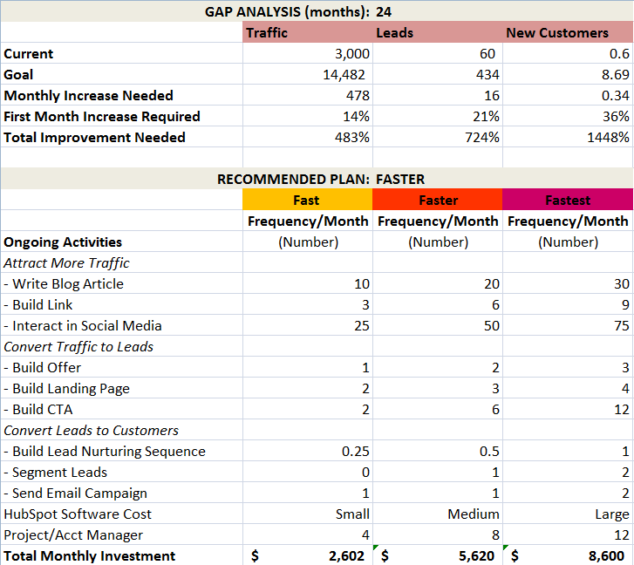
Configuring the Retainer Quoting Tool
Notes:
Jeetu:
Bring up spreadsheet and show un-hiding of columns

Slide 27
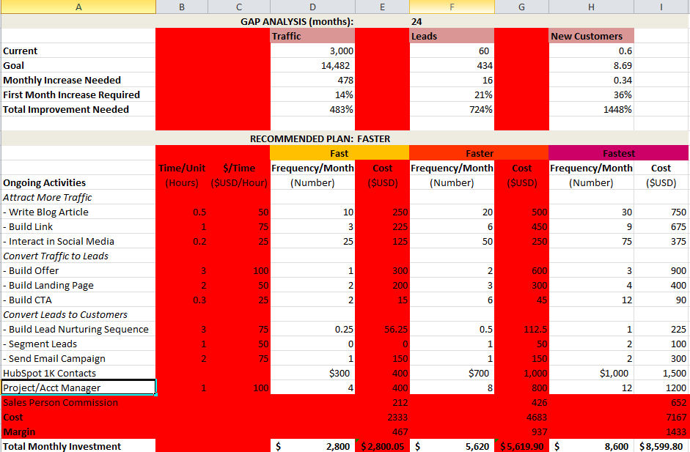

Slide 28
Closing
4
Notes:
Corey

Slide 29
The Inoffensive Close
Do you believe I understand all of your challenges? Goals? Constraints? Concerns? Timeline? (Restate them.)
Do you believe that the solution that I’ve presented to you will effectively help you overcome your challenges and achieve your goals? (Restate them.)
Do you want our help?
Notes:
Corey:
So we are getting ready to give them a contract and get them to sign off. Continue to use the inoffensive close.
Do you believe I understand all of your challenges? Goals? Constraints? Concerns? Timeline? (Restate them.)
Do you believe that the solution that I’ve presented to you will effectively help you overcome your challenges and achieve your goals? (Restate them.)
Do you want our help?

Slide 30
The 1-10 Close
On a scale of 1-10, where 1 is “Go away, I’ll never do business with you” and 10 is “sign me up yesterday. We really need to do this. We’re totally committed to making this work and we want your help”, what # are you?
Why is it not 1? (Listen. Restate why they want to move forward.)
Then, why is it 10? (Listen. Handle objections)
Notes:
Corey:
The 1-10 close. On a scale of 1-10, where 1 is “Go away, I’ll never do business with you” and 10 is “sign me up yesterday. We really need to do this. We’re totally committed to making this work and we want your help”, what # are you?
Why is it not 1? (Listen. Restate why they want to move forward.)
Then, why is it 10? (Listen. Handle objections.)

Slide 31
Bonus: Structure of a Contract
5
Notes:
Jeetu:

Slide 32
Winning Contracts
Are less than 5 pages in length.
The goal is to get them to sign in a closing meeting
Contracts do not sell
Do not repeat and pitch you or the sales process. The pitching is done by following the sales process
Always set clear expectations in terms of activities, roles, and metrics for success
Create standardized blocks of content that you can use in every contract
Notes:
Jeetu

Slide 33
Structure of a Contract
Executive Summary
No Technical Jargon
Weave a story of their current situation and challenges and how you are going to help them meet their goals
Discovery (what we’ve learnt about the prospect’s Goal, Challenges, Plan, Timeline, and Consequences)
Another reason not to skip the sales process. Leverage everything you have learnt in the IMA and Diagnostic and Goal Setting.
Scope of Services
Services/Activities and Time per Activity (Retainer Quoting)
ROI and Metrics for Success (Analytics)
Role (expected role and activities for both Agency and Client)
Timeline and Retainer Length
Costs
Place to Sign
Terms and Conditions
Appendix
Notes:
Jeetu

Slide 34
Potholes
6
Notes:
Corey:
Now any sales process is going to have objections and pushbacks. If sales did not have any objections and pushbacks, then everyone would be in sales and every call would result in a deal.

Slide 35
Potholes
Doing proposals vs. contracts
Contracts win. Proposals don’t.
Not using an inoffensive Close
It isn’t a deal until we have a signature
Setting incorrect expectations about results
Use the “Plan” worksheet when recommending a plan
Set expectations
Notes:
Corey:

Slide 36
Key Take-Aways and Homework
6
Notes:
Corey:
It’s that time again, so let’s talk about this weeks key take-aways and the homework to help you be successful.

Slide 37
Prepare for your presentations; nothing is more important than this. Nothing.
Stick to a path the best you can, avoid the rabbit holes
Prepare your tie-downs and business value statements
Practice
Notes:
Corey:

Slide 38
Your success in sales is driven by
Activity
Process
Skills
Notes:
Corey:
No changes here this week folks, nothing can replace activity at this stage either. Keep hitting the phones hard, calling your well researched leads and start booking appointments.

Slide 39
Homework
Follow the sales process and invite your Channel Account Manager to one of your calls (e.g. presenting the HubSpot solution).
Revisit your Agency Grader Goals and see how you are doing. Invite your CAM to a call and review together.
Tinker with the spreadsheet to learn your numbers
Practice/prepare
Notes:
Corey:
Tons of great homework this week. Since everyone has been doing such a great job generating and researching leads let’s get on the phones and run some diagnostic calls!

Slide 40
Reminder - If You Want us to Do a Presentation for You
If you’re reselling HubSpot with your retainer, we can help present the HubSpot solution and support the need for your services during our presentation.
Email your Channel Account Manager (CAM)
Your CAM can only assist with the presentation if you have followed the sales process i.e. IMA and Diagnostic and Goal Setting Calls need to be completed
Your CAM will email you a pre-Demo checklist that you will need to complete

Slide 41
Tuesday, March 6
11 AM US EST
Next Topic – Final Session - Objections Role Play
Notes:
Corey:
Talk to slide

Slide 42
We need your input for Questions and Scenarios to review for next week’s session
http://www.hubspot.com/advanced-sales-training-home
Notes:
Corey:
Make sure to keep this handy, each week we’ll be uploading the recording and slides to this URL

Slide 43
Questions?

