Slide 1
Connecting and Qualifying
Notes:
Jeetu:
Welcome to the Partner Program training webinar series for marketing agencies and independent marketing professionals.
My name is Jeetu Mahtani and I am joined by Corey Beale. We are both Partner Channel Managers at HubSpot.
Corey:
We partner with marketing agencies of all kinds to help agencies more cost-effectively and more efficiently provide a broader set of inbound marketing and demand generation services to our mutual customers.
Working with our partners, one of the biggest challenges that they have is adapting to a world where clients are asking for one agency that can do everything. The worlds of PR, advertising, marketing, seo, ppc, social media and web design and development are merging. And the feedback I’m getting from many types of agencies is that it’s really hard to do everything, deliver an ROI to clients and grow their agency at the same time.
That’s what HubSpot is helping partners with in many ways. Today, though, we’re going to talk about a framework for diagnosing the complete inbound marketing needs of a prospect or client. We’re going to provide you with a script and a playbook with how we’ve done this for about 10,000 companies.

Slide 2
Nice to Meet You
Jeetu Mahtani
HubSpot Sales Manager
http://www.linkedin.com/in/jeetumahtani
jmahtani@hubspot.com
Corey Beale
Hubspot Sales Manager
www.linkedin.com/in/coreybeale
cbeale@hubspot.com
Hash Tag: #AgencyTransform
Notes:
Corey:
We want to keep these sessions interactive both during and after the webinar. Feel free to reach out to either of us via email or LinkedIn and let’s get Twitter rocking today by using the hash tag #AgencyTransform

Slide 3
Notes:
Corey:
Ok ok this is the last time I promise. Before we dive right in to the agenda there are a few quick house keeping notes we should make about today’s session.

Slide 4
Bookmark this Page!!
http://www.hubspot.com/advanced-sales-training-home
Notes:
Corey:
Make sure to keep this handy, each week we’ll be uploading the recording and slides to this URL

Slide 5
Notes:
Corey:
This session is being recorded and we’ll be putting it up by the end of the day. All of the recordings can be found on the page from weeks prior. If you don’t have that link please email your Channel Account Manager to receive it.
If you have colleagues or partners who were unable to attend today, definitely have them watch the recording prior to the session next week. Please post any questions into the chat pane and we’ll answer any questions towards the end.

Slide 6
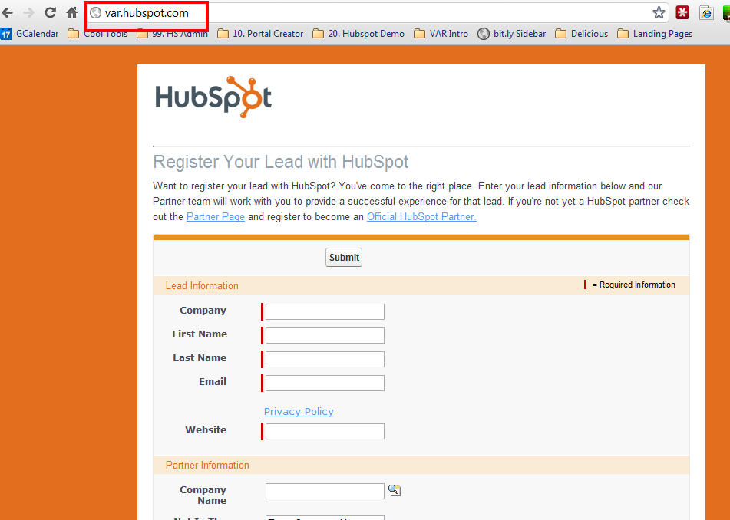
Notes:
Corey:
Register your leads, as often as possible and as many as possible. This will help your channel account manager focus the time you spend together and help coach you through to achieve some big wins on these accounts.

Slide 7
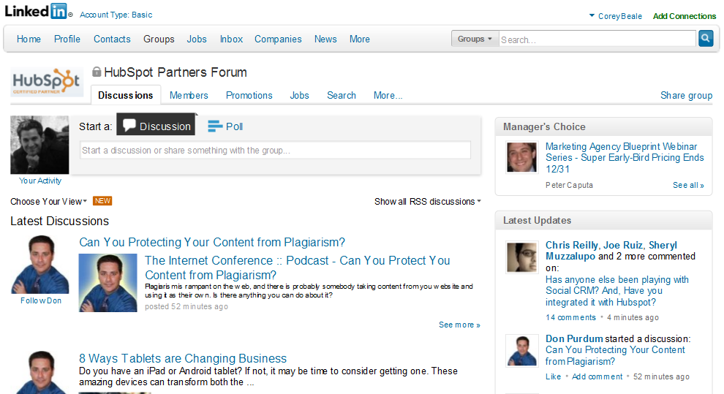
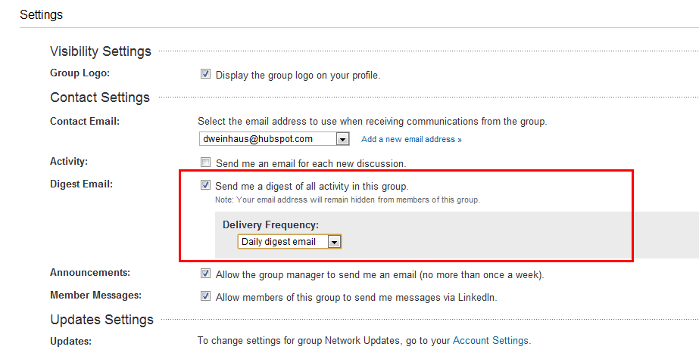
Notes:
Corey:
If you haven’t already make sure you have joined the LinkedIn Group “HubSpot Partners Forum” and make sure to setup the email settings for a daily digest of all activity in the group so you don’t miss anything to help you sell better, move quicker and network easier.
There’s been some great threads on here lately from you guys about the sessions and we totally appreciate the feedback both good and bad so keep it coming!

Slide 8
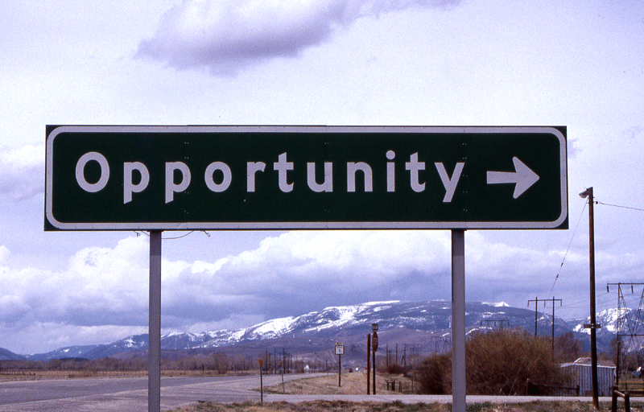
Notes:
Corey:
If you have an opportunity in play right now, maybe you jumped the gun and started calling those 25 leads you generated last week, if so then be sure to schedule time with your Channel Account Manager asap. He/she will help you determine the best ways to approach next steps and what items you’ll need to be successful.

Slide 9
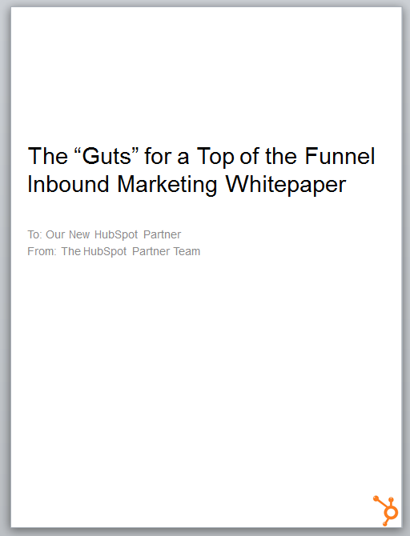
Notes:
Corey:
Since we’re talking about actually talking to your leads don’t forget to get materials to help you generate leads! Here is today’s friendly to get your eBooks start using them on your website TODAY to start generating inbound leads ☺

Slide 10
AGENDA
1
Recap: The recommended sales process
2
The purpose of the connect call
3
The typical flow and “how to” of a connect call
4
Objections, pushback and the big NO
5
Bonus Section – influencers and gatekeepers
6
Key-Takeaways
Notes:
Jeetu:
Here’s an overview of what we’re going to talk about today. The topic is around connecting with the leads that you have generated and completed your research around. We are going to do a quick recap of the sales process. We’ll discuss the purpose of the connect call and a typical flow of a connect call. We’ll share with you a how-to process to execute a Connect call successfully. As part of any Connect, there will be objections, pushbacks, and possibly the big No. We’ll talk about strategies to deal with these scenarios. We’ve also included a bonus section on dealing with influencers and gateways. Finally takeaways so you can get started with connecting with your prospects.

Slide 11
The Recommended Sales Process & Methodology
1
Notes:
Jeetu:
So let’s get down to it and start talking about the HubSpot sales process and methodology.

Slide 12
Generating Leads
Researching Leads and Prospecting
Connecting and Qualifying
Inbound Marketing Assessment (IMA)
Diagnostic and Goal Setting
Present Solution
Contract and Close
Notes:
Jeetu:
So here is the sales process we shared with you in our last session. We focused on Researching Leads in the last session. You completed your research on leads you generated from tactics discussed in the first sesion. Todays session is focused on Connecting on the phone and initiating your qualification process.
To recap the sales process, once you have leads, you will research them, pick up the phone and make that call. If you don’t reach and connect with them, you are going to leave a voicemail and send an email immediately. We talked about the Basho sequence of voicemail and email in our last session. When you do connect with them, you are going to engage them with a positioning statement and start your initial qualification. Following the connect, you are going to have a scheduled call during which you are going to continue your qualification by executing on an Inbound Marketing Assessment also known as an IMA. At the end of the IMA, you should have “trusted advisor” status and do an inoffensive close during which your prospect agrees they need your help and would like to define their marketing goals with you. Following the diagnostic and goal setting call, you are going to share the solution to hit their goals. Wrap that meeting up with an inoffensive close again, they agree they want your help and want to see a contract. You finally present a contract which includes their goals they shared with you and close out the deal.

Slide 13
Inbound Marketing Sales Methodology
1. Generate Leads
Find Prospects to Call On
2. Research and Prospect
Get to a Connect
Lead
3. Connect
Schedule the Assessment
4. QUALIFY
Determine worthiness for next step
OPPORTUNITY
5. Diagnostic & Goal Setting
Align business goals with activities
6. Presentation & Experimentation
Present Solution and/or Trial
7. Contract & Close
Agree to Proceed
Notes:
Corey:
We’re moving nicely down the funnel and beginning to get in to the meat of the sales process. Again my friendly weekly reminder is to print this out and hang it in your office to you don’t start skipping steps.

Slide 14
The Purpose of a Connect Call
2
Notes:
Jeetu:
So before diving into the details of a Connect call, Corey can you share with us the purpose of a Connect call.

Slide 15
Notes:
Corey:
Sure can Jeetu, there’s a pretty structured sequence that occurs in a connect call and we’ll address each one of those stages today. From what I’ve seen a connect call should be used to:
Establish an initial relationship with the prospect
Build some initial credibility and trust
Begin the qualifying process
Decide if the prospect is a good initial fit for an IMA
Set The Initial Appointment – The IMA

Slide 16
Notes:
Corey:
One note on the connect call, I actually learned this from one of our senior sales reps a few years ago and it never left my mind and always enabled me to be successful.
If you begin your connect calls with the end in mind and an ultimate goal you’ll see much more success. Ultimately your goal will be to book a next step of some kind. Ideally that’s an exploratory call or at least getting a NO. It has to end somewhere and those are your choices of outcomes.

Slide 17
The Typical Flow and “How To” of a Connect Call
3
Notes:
Jeetu:

Slide 18
Open/Transition/Purpose
Positioning
Get Them Talking
Go for the IMA
Pushback
Preliminary Exploration
Wrap It Up
Notes:
Jeetu:
So lets discuss typical flow of a Connect Call. So you have generated leads, you have researched them and you attempt to Connect with them. At some point along the Basho sequence we discussed in the last session, they decide to reply to you or answer the phone. So what now? Your first step is to introduce yourself and get them to drop what they are doing and start paying attention to you. This happens through a transition.

Slide 19
Inbound Lead Approach
[Intro] Hello, Prospect. It’s ____ (your name) from _(your company name)______. (Pause)
[Transition] Sounds like I caught you at a bad time? (Pause)
[Purpose] I am calling because I was notified that you came to the website and downloaded our __(offer)_______ on _(date)_.
[Get Them Talking] Does that ring a bell?
What were you looking for help with?
Notes:
Jeetu:
So for example, it starts with the Intro – “Hello Corey, it’s Jeetu Mahtani from HubSpot”. Remember to Pause at this point since you need them to drop what they are doing, try to identify your company and start paying attention to you. You are then going to get their permission to continue by transitioning and making sure you caught them at an ok time by saying “Sounds like I caught you at a bad time?”. Remember to Pause again. Your next step is to share the purpose of your call and this is going to be easy since they are an inbound lead. You will something like “I am calling because I was notified that you came to the website and downloaded our ___ on ___. Does that ring a bell?”. Wait for their response and get them talking by saying something like “What were you looking for help with?”
Remember, the the first big battle of a connect is to break them out of what they are doing and get them talking. This is much easier with inbound. Don’t be too much of a hard ass yet, we’ll get into that later.

Slide 20
Cold Call Approach
[Intro] Hello, Prospect. It’s ___ (your name) from _(your company name)______. (Pause)
[Transition] Sounds like I caught you at a bad time? (Pause)
[Purpose] Prospect, I’m calling because I notice you sell business intelligence software. Pause)
I also notice that you are trying to drive leads from your site…(Pause)
[Positioning] My company helps business owners who have a website and are trying to drive more leads but are frustrated because they have spent a lot of effort, maybe on a new site, or SEO, or adwords, but they still aren’t getting the leads and return they had hoped for?
[Get them talking] I was calling to see if…
this might strike a chord with you [or]
You might want to chat for a few moments about this and then see if there is anything worth talking about.
Notes:
Jeetu:
Now it is much more easier with getting the conversation going with an inbound lead. They came to your website and they took an action. We know they were looking for something. With a cold call approach, it is tougher but if you follow the framework, it isn’t too different. The start of the call may be a bit awkward so remember to breathe and don’t rush. So a flow would be something like “Hello, Corey. It’s Jeetu Mahtani from HubSpot”. Pause. Break them out of what they are current doing and get them to pay attention. Get permission to continue by asking “Sounds like I caught you a bad time?”. Pause. Continue with the purpose “Corey, I’m calling because I notice you sell business intelligence software.” Pause again. “I also notice that you are trying to drive leads from your site”. Pause and move to your Position statement, which is the next step of your Connect. We’ll talk about Positioning in just a moment.

Slide 21
Calling Referral Leads
[Intro] Hello, Prospect. It’s ___ (your name) from _(your company name)______. (Pause)
[Transition] Sounds like I caught you at a bad time? (Pause)
[Purpose] Prospect, I’m calling because (Person’s Name) introduced us over email. (Person’s Name) felt that we should talk. (Pause)
[Positioning] My company helps business owners who have a website and are trying to drive more leads but are frustrated because they have spent a lot of effort, maybe on a new site, or SEO, or adwords, but they still aren’t getting the leads and return they had hoped for?
[Get them talking] I was calling to see if…
this might strike a chord with you [or]
You might want to chat for a few moments about this and then see if there is anything worth talking about.
Notes:
Jeetu:
Here is a framework when calling a referral leads.

Slide 22
Inbound Opportunities
Prospect calls in
[Intro] “Hello, Prospect. (Pause)
Your client, ___(common connection) referred me to you. He said you did a great job helping him ____ . I’m interested in redesigning my site again. Is this something you could help with?”
[Transition] Hey Barry. Nice to meet you. Thanks for calling. John was a pleasure to work with. Since you said “again”, I’m guessing you recently did this and it didn’t have the desired result? Tell me a bit more about why you want to redesign your site again?
With John, his goal was to not just do a redesign, but to figure out how to attract more traffic, capture more leads and convert more leads to customers. Is this something you’re looking to do too?
[Get Them Talking]Tell me a bit more about what you did in the past with your website and online marketing, and what you plan to do going forward?
Notes:
Jeetu:
Now of courses in cases when someone calls in asking for help. It may not happen always but it will happen when you do great work, your clients will remember you and will be excited to refer prospects to you. The Connect approach is actually faster and you transition directly into asking questions and getting them to talk.

Slide 23
Intro/Transition/Purpose
Positioning
Get Them Talking
Go for the IMA
Pushback
Preliminary Exploration
Wrap It Up
Notes:
Jeetu:
The next step after you have completed the Introduction, got them to drop what they are doing and introduced the purpose for calling, you move into positioning yourself.

Slide 24
Notes:
Jeetu:
Importance of positioning yourself correctly and having a few of these kind of statements to choose from

Slide 25
Inbound Lead Approach
[Intro] Hello, Prospect. It’s ____ (your name) from _(your company name)______. (Pause)
[Transition] Sounds like I caught you at a bad time? (Pause)
[Purpose] I am calling because I was notified that you came to the website and downloaded our __(offer)_______ on _(date)_.
[Get Them Talking] Does that ring a bell?
What were you looking for help with?
Notes:
Jeetu:
So remember you asked them “what were you looking for help with?”. Following their response, you are now going to share your Positioning Statement.

Slide 26
We help <companies like yours>…
Who are struggling with (OR frustrated because OR unhappy that…an emotional word)
<insert up to 3 probable problems based on the persona and industry you’re calling>
They’re not growing as fast as they want.
Losing market share to competitors.
They spent a lot of $ on their website, but aren’t generating an ROI.
Do you face any of these challenges?
Notes:
Jeetu:
The framework of a Positioning Statement is something like “We help companies like yours who are frustrated with spending a lot of money on their website, not generating high quality leads, and are overall not generating an ROI. Do you face any of these challenges?”
Notice I used a couple of words in my positioning statement to relate to the prospect. For example, I said companies like yours. I used the word frustrated. I shared three challenges around spending money on their website, not generating high quality leads, and not seeing an ROI. In most cases, your prospect is probably dealing with these challenges. You move into asking the them if they are facing similar challenges”
We have a few more positioning statement examples which we have included at the end of this deck. Along with a recording of this presentation, we’ll include a link to this PowerPoint deck.
SEE APPENDIX A FOR MORE EXAMPLES

Slide 27
Open/Transition
Positioning
Get Them Talking
Go for the IMA
Pushback
Preliminary Exploration
Wrap It Up
Notes:
Corey:
So you have completed your introduction, transitioned to get them to pay attention, delivered your Positioning Statement to share your expertise and relate to them. You are now ready to get them talking.

Slide 28
Notes:
Corey:
Get them to talk: It’s amazing what a well positioned positioning statement can do, the same goes for simple open ended questions like “what were you looking for help with”. This can often elicit a response that has several points of interest that will perk your ears up and make you want to dig deeper on them.
Corey: Active listening
Listen for cues and pain points. It’s incredibly important to stay in the moment and not let your mind wander OR make assumptions based on their statements. If you hear something you know you can solve what will happen is your mind will wander to the solution rather than listening and thinking about how to dig deeper on that item.
Give example of how we teach it internally here at HubSpot

Slide 29
Some Good Initial Questions
What were the biggest challenges you faced in 2011?
Oh tell me more about that?
Is that a big challenge?
Tell me how your company is fixing that this year?
How do you generate business today?
Who is your ideal customer?
What kind of competition do you face?
What makes you different than your competitors?
Why is your website Important for your business?
Are you trying to generate more qualified traffic and leads to your site?
Notes:
Corey:
So after your Positioning Statement, you asked them “Do you face any of these challenges?” Based on their response, you can continue getting them to talk, continue probing and digging deeper by asking some of the questions listed on this slide. For example, you could say “is that a big challenge” or “tell me more about that”. Based on their response, you would ask another follow up question.
Very open ended questions here until the end.

Slide 30
Some Good Tactical Questions
Do you feel like you have control over how much traffic you get?
Are you happy with the rate that your web site convert visitors into leads?
Do you generate a lot of leads? Enough?
Are the leads that you are generating turning into customers for you?
Notes:
Corey:
This set of questions is a bit more tactical in nature and focus around traffic, leads and sales, but at some point in the conversation once you’re digging on a specific topic they can become incredibly valuable to help you discern the metrics associated with the problem.

Slide 31
Some More Business Questions
Are you satisfied with the growth rate of your company? Why? Why not?
How do you plan to grow your company over the next few years?
Do you think you’ll do things differently than what you’ve done in the past?
If you made $xyz dollars in 2012, would you be happy?
Notes:
Corey:
These are a bit more business focused so they will provide you with higher level answers all of which are designed to open the door for you to dig a bit deeper on more topics.
Ideally in a connect call 1 or 2 challenges are typically more than enough to schedule an IMA with that person. These will open up challenges, it’s your job to then determine how big of a challenge that then is.

Slide 32
Open/Transition
Positioning
Get Them Talking
Go for the IMA
Pushback
Preliminary Exploration
Wrap It Up
Notes:
Jeetu:
So you’ve followed the script, opened confidently, delivered your positioning statement, asked tough and probing questions and have overall uncovered pain and challenges the prospect faces. If you have done this correctly so far, you would have automatically differentiated yourself from other salespeople. I am sure everyone on this call has noticed that we haven’t sold a single thing, there has been no product, no services, not selling that has happened. We’ve focused on asking probing questions to show that we are interested in their business, we are interested in their challenges, and overall establishing our credibility. We’re now ready to ask for the Inbound Marketing Assessment…IMA.

Slide 33
“We provide a complimentary inbound marketing assessment. We share some tips to help you drive more traffic and leads right away. We’ll also share a competitive assessment to let you know how you stack up versus others and what type of opportunity exists. Would you like to schedule such an assessment? “
Notes:
Corey:
This is a blanket statement to help you go for the IMA. Alternatively if you offer a specific kind of assessment by a different name just fill in the name and value proposition of that assessment to this slide.

Slide 34
Objections, Pushback and the Big NO
4
Notes:
Corey:
Now any sales process is going to have objections and pushbacks. If sales did not have any objections and pushbacks, then everyone would be in sales and every call would result in a deal.

Slide 35
Open/Transition
Positioning
Get Them Talking
Go for the IMA
Pushback
Preliminary Exploration
Wrap It Up
Notes:
Corey:
So lets talk about objections and pushback. When you get a pushback on the IMA, it usually means that you haven’t established enough credibility and are not being seen by the prospect as a trusted advisor. At this point you want to go into giving mode. You have been in get mode by asking questions and now you are getting pushback and objections. What is the natural thing to do? Lets go in to the giving model. It is basically a give and get relationship. When you are struggling, go into give model by sharing advice and insight.

Slide 36
Example Tips and Questions
“I noticed you have a contact us form on your site. Do you know what your visitor to lead conversion rate is?”
“Companies who generate more leads from their site typically have multiple offers and landing pages. Some companies achieve 8% conversion rates.”
“Do you think you could benefit if you understood how they do this?”
Notes:
Jeetu:
Here is a good give example around offers and conversions and a follow up question to engage in a discussion.

Slide 37
Tips You Could Provide
SEO: keyword tips, on page optimization, 301 redirects.
Blog: frequency, engagement, on their own domain.
Social media: promoting content, setup: facebook fan page, activities: LI questions.
Lead Generation: calls to action, offers, landing pages.
Notes:
Jeetu:
A few more tips you can provide around SEO, blogging, social media, and lead generation. One that I really like using and one that is fairly basic to use is the Page Title. So something like “I noticed your home Page Title is your company name. Do you know what the Page Title is? Do you see the blue area ll the way to the top left? Well that is the place Google looks at first to determine what your homepage is about and what keywords to rank you. By repeating your company name it doesn’t help you since you will always rank #1 for your company name. I’d recommend replacing it with a key phrase that prospects are using on search engines.”

Slide 38
Notes:
Corey:
So what happens if you still can’t break through? No is actually ok. You’re going to have to get comfortable both hearing it and dealing with it. Rejection is going to be a part of life when it comes to sales, but that’s ok. There are plenty of good things to leverage in the connect call which will help you get past the no.

Slide 39
Open/Transition
Positioning
Get Them Talking
Go for the IMA
If Pushback - Give/Get
Preliminary Exploration
Wrap It Up
Notes:
Corey:

Slide 40
Preliminary Exploration – High Gain Questions
Goals
What are you hoping your website will accomplish?
What metrics do you look at determine how well you are doing?
Why are these goals important for the business?
Challenges
What’s holding you back?
Why is it important to fix these?
If you fix these, would it really make much of an impact on the business?
Timing
It sounds like you are pretty serious about this, why now and not 6 months ago.
What timing is driving your initiatives?
Maybe you should hold off doing something new for now?
Plan
How are you currently generating new business?
What’s the current plan?
Why not just do more of what you are doing?
Notes:
Corey:
After the give/get you might have a chance to do some preliminary exploration, here are some good questions you can use placed around this concept of GPCT which we’ll discuss more in our next session.
The RED questions are a bit more negative in approach.

Slide 41
Open/Transition
Positioning
Get Them Talking
Go for the IMA
If Pushback - Give/Get
Preliminary Exploration
Wrap It Up
Notes:
Corey:
Ok let’s talk about the finale of the connect and how to carry out the next steps effectively.

Slide 42
Book Exploratory Call
Of all of the challenges we’ve discussed today, are any of them important enough to you that you’d want to start fixing them?
Would you like to schedule an exploratory call to determine whether I can help you?
During this call, we’ll review data about your site and online marketing success to date, as compared to your competitors. Can you provide me with some information, so I can do some homework?
Notes:
Corey:
I’m a big of fan knowing your limits on a connect and knowing when to move it to the next step and stop asking questions. It’s hard to explain, but after you do this several times you’ll get a feel for when it’s time to begin to wrap up.
Looking at this slide these are all great ways to begin the wrap up sequence and move towards the actual tie down of time/date on the calendar.

Slide 43
Tee Up the Appointment
Can you provide me with some information, so I can do some homework?
Get up to 10 competitors sites
A handful of keywords
Set date and time – 45 minutes is a good time allotment
Are there any other relevant goals, plans, challenges or timeline constraints that I should know about before we speak again?
Notes:
Corey:
Confirm email address
Send the calendar out right away
Ask who else should join the meeting?

Slide 44
Working Influencers and Gate Keepers – Bonus Rapport Tips
5
Notes:
Jeetu:

Slide 45
Notes:
Corey:
So one thing you may encounter during your connect calls this week is a gatekeeper. I’m not talking about gatekeepers in the Ghostbusters sense (for any of you 80s movie fans), more so something as simple as a secretary, their husband/wife, assistant, or what could potentially be the main influencer/champion in your sale. A gatekeeper comes in many forms, the good news is all are conquerable.

Slide 46
Working the Front Desk
Be polite
Remember their name
Make them laugh
Be polite (don’t underestimate this)
Leverage and build rapport
Remember their name and info about them the next time you call
You’re calling more than once right?
Notes:
Corey:
Personally, I love gatekeepers. Which is odd for a sales person to say, but hear me out here.
Tell story from call last week with Sean.

Slide 47
Notes:
Corey: Rapport matters here, it matters in every stage of the sales process so this will be the first of several times you hear me talk about it. In a connect call you have a few options, it can be used with a gatekeeper or at the end of a connect call or even the beginning.
Bonding, Rapport, Commonality
Sports, City, Family, Events
Share your personal goals and plan
ANYTHING BUT THE WEATHER
Rapport by location – talk about this

Slide 48
Key Take-Aways and Homework
6
Notes:
Corey:
It’s that time again, so let’s talk about this weeks key take-aways and the homework to help you be successful.

Slide 49
Your success in sales is driven by
Activity
Process
Skills
Notes:
Corey:
No changes here this week folks, nothing can replace activity at this stage either. Keep hitting the phones hard, calling your well researched leads and start booking appointments. Next week we’ll show you how to run that first qualification call.

Slide 50
Homework
Schedule time in your Calendar for Prospecting (you did generate 25 new leads and research them properly right?)
Connect with 10 decision makers
Schedule 3 next step appointments
HIT THE PHONES!!!
Notes:
Corey:
Tons of great homework this week. Since everyone has been doing such a great job generating and researching leads let’s get on the phones and book some qualification calls!

Slide 51
Tuesday, February 7
11 AM US EST
Next Topic – “The Inbound Marketing Assessment (IMA)
Notes:
Corey:
Talk to slide
http://www.crossland1969.com/

Slide 52
Questions?

Slide 53
Appendix a

Slide 54
Lead generation Positioning Statement
I help small business owners like you who are frustrated that they have spent a lot of money in making improvements to their website and they are still not seeing leads come in as they expected. Typically they have either hired a SEO consultant or put some money into Google Adwords to increase their rankings in search engines. Now they either still fail to show up in the results or they are ranking for some keywords but not seeing any increase in leads. Are you experiencing similar challenges?
I help marketers like you who are frustrated that they’ve spent a lot of time and money working to please the sales team with high quality leads that close faster, but they have yet to see the quality leads they expected from their website and online marketing efforts. Typically they’ve hired an outside agency to do the work, purchased lists or gone to tradeshows in order to achieve their goals and they aren’t seeing the results so upper management and the sales team are concerned. Are you experiencing similar challenges?
When I talk to marketers like you I typically hear that the two biggest aggravations they face on a day to day basis are bringing in enough leads to satisfy their bosses and the challenge of showcasing the ROI their lead generation efforts produce. Does that ring true for you as well?

Slide 55
Inbound marketing Positioning Statement
Every day I speak with small business owners who are frustrated with the current return on investment they’re seeing from traditional marketing approaches like direct mail and yellow pages, and they would like to get more leads and sales from online marketing but are a little unsure about how or where to even begin. Does that resonate with you?
Every day I speak with marketing professionals who are spending a lot of time and effort doing various online marketing activities like spending money on things like Google AdWords or working with an SEO consultant or doing sporadic email blasts, etc…--but are frustrated because they can’t tie it all together and understand what’s actually working and what’s not. Does that ring a bell with you?
Every day I speak with folks who are unsure of exactly how to use blogging and social media strategies to strengthen their marketing efforts. They know they want to start getting more visitors to their website and generating leads online but aren’t exactly sure how to get the ball rolling. Does that resonate with you?

Slide 56
Appendix B

Slide 57
My 4 Favorite Gives
Page Titles Stink
Service Pages Aren’t Optimized
No Good Tofu Calls to Action
No Good Calls to Action on Their Blog
Notes:
Have these in mind before you call!

Slide 58
Give/Get - Convert
Convert
Convert to Traffic to Leads through Calls to Action
You should have two to three calls to action on every page. These should be targeted to prospects in different stages in the buying cycle. For instance, I notice your main call to action is ‘contact us’. My guess is your conversion rate is very low. You would increase it dramatically if you add a second call to action such as ‘Free Whitepaper – The Top 3 Potholes to be Aware of When Buying X’ or ‘Free Buying Guide – What Every Buyer of X Should Know’
A Contact Us or Request a Quote aren’t enough. You need to give visitors a reason to tell you who they are. What you are doing is creating an opportunity for a visitor to your site to trade their valuable contact information for a piece of information you can provide that helps them solve something, learn something or make a better decision.
A key thing to remember is that your calls to action don’t need to be unique for every page; you can use the same one across multiple pages.
Notes:
See Appendix A for more give/get

Slide 59
Give/Get Blogging & Social Media
Blogging
It is critical to have your blog set up on your own website and not on a different domain. When you set up your blog like “yourcompany.blogspot.com” all of your SEO credit goes to blogspot and not you. Your blog should be set up like “blog.yourcompany.com.
Take a look and see if they have any CTA’s on their blog, if not call that out and offer a piece of advice around it
When you blog with the right strategy it will make your site sticky and decrease your bounce rate.
Social Media
Search engines are now consider social media markers in determining how you’re content will rank for your most important keywords. You should not be ignoring social media.

Slide 60
Give/Get - SEO
Them: “NO!”
You: “That’s okay. I totally understand. By the way, I notice you are doing something wrong with your [page titles]. If you fix it – it can help you start driving more qualified traffic almost right away. Do you have 30 seconds?
THEN GIVE SOMETHING LIKE THIS…:
I notice your page titles do not include what I would think would be your most important keywords. Your page title is your most important piece of real estate. It is essential to use keywords in your page titles that your potential customers use to search for what you sell rather than just your company name or a tag line. OR
I notice you don’t have pages broken out by your services. Every page on your site is an opportunity to rank for a new keyword, so you are depriving yourself of an opportunity to rank when searchers search by the services you offer. OR
I notice you are not blogging. Sites that blog have on average 55% more visitors and 126% more leads. Have you thought about blogging?

