Slide 1

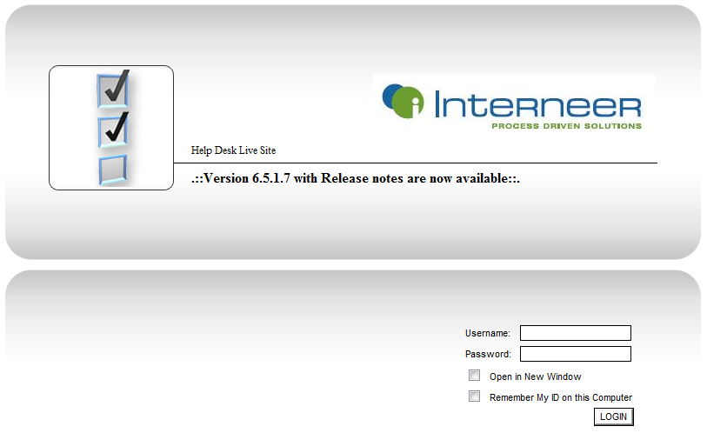
How to best leverage support & minimize issues
By Lenin Martinez
Interneer Customer Support

Slide 2
What we will cover…
Support ticket submission
Urgent vs. Non-Urgent issues
Leveraging the helpdesk
Intellect tools
Performance tips
Stable production environments
Server platforms

Slide 3
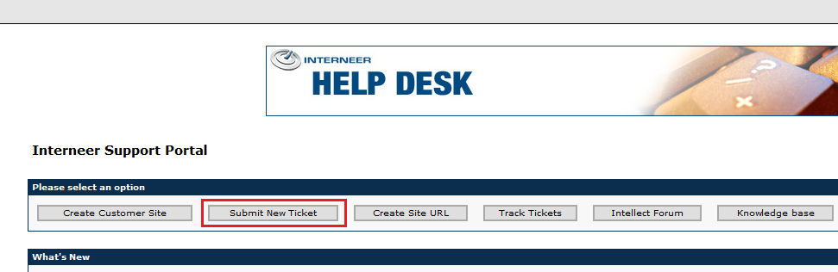
How to submit a support ticket
Navigate to http://helpdesk.interneer.com/intellect
Login with your credentials. (All customers and partners should have access to the Helpdesk)

Slide 4
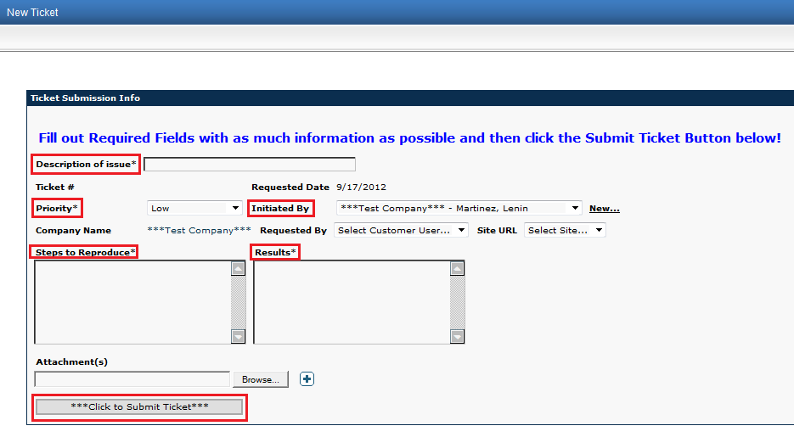
Description of issue
Priority
Initiated by
Steps to reproduce – Provide login info, URL, Location in the system, element info
Results – What issue are you experiencing
Click the Submit Ticket button

Slide 5
Support Ticket Submission (cont.)
Email confirmation
Emergency Issues
  Call
  Submit Ticket
  Email
Non-Urgent support issues will be prioritized and comments updated weekly
Support will also assist with quick configuration questions

Slide 6

Urgent versus Non-Urgent issues
Internally we will determine the severity of issues.
Urgent issues include:
Live site/production issues
Critical project roll-out delays
Non-Urgent issues include:
Issues on a testing, demo or design site
Non mission critical locations within a live production environment

Slide 7
How to leverage the helpdesk

Slide 8
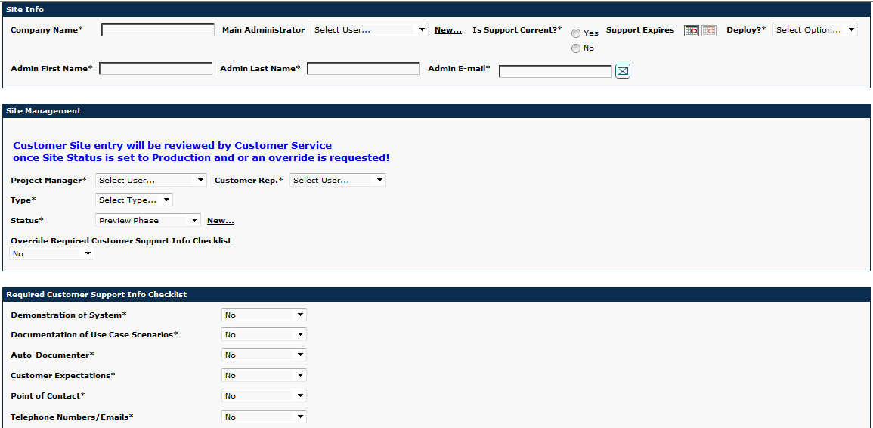
How to leverage the helpdesk (cont.)
Create a Customer site

Slide 9
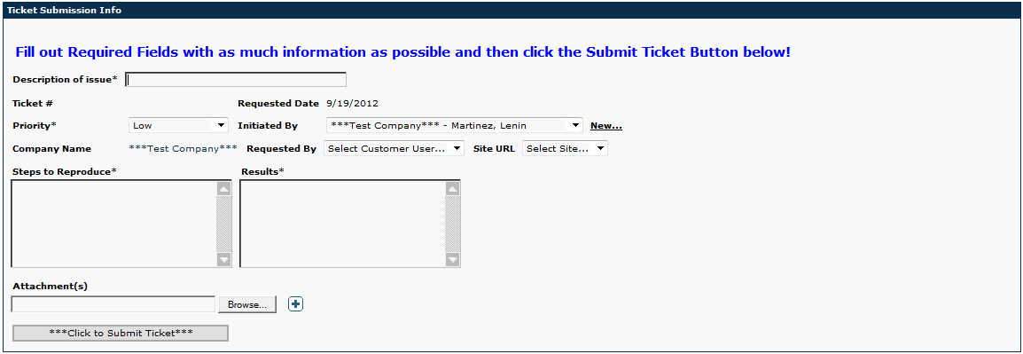
How to leverage the helpdesk (cont.)
Submit support tickets

Slide 10
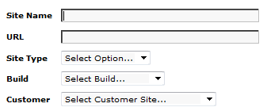
How to leverage the helpdesk (cont.)
Create a site URL

Slide 11
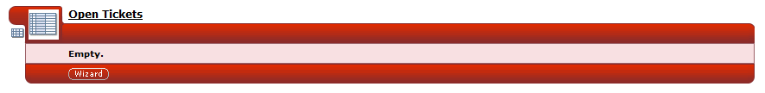
How to leverage the helpdesk (cont.)
Track support tickets

Slide 12
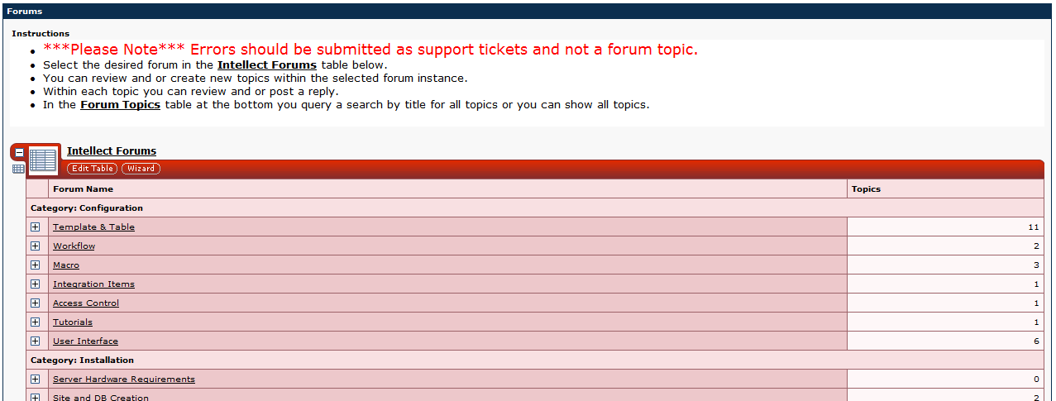
How to leverage the helpdesk (cont.)
Visit the Intellect Support Forum

Slide 13
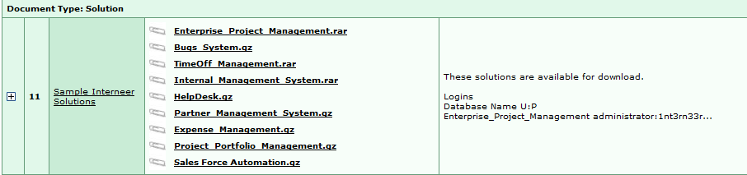
How to leverage the helpdesk (cont.)
Applications, Documentation, Troubleshooting

Slide 14
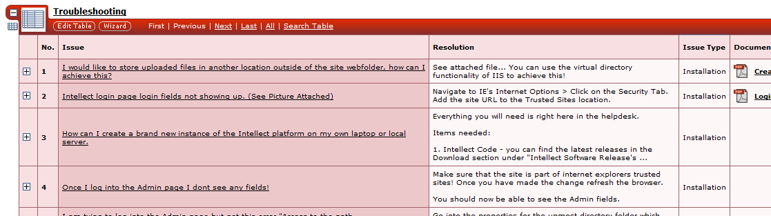
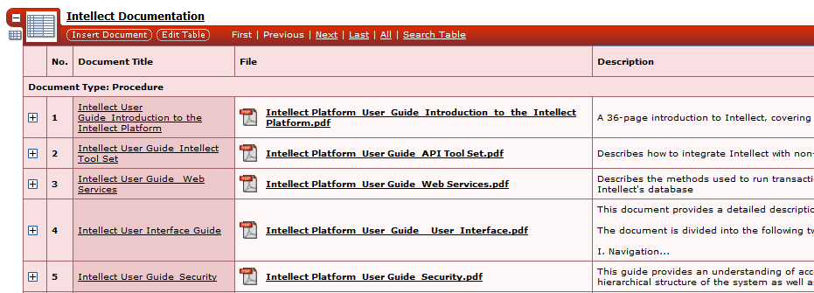
How to leverage the helpdesk (cont.)
Applications, Documentation, Troubleshooting

Slide 15
How to leverage the helpdesk (cont.)
Applications, Documentation, Troubleshooting

Slide 16
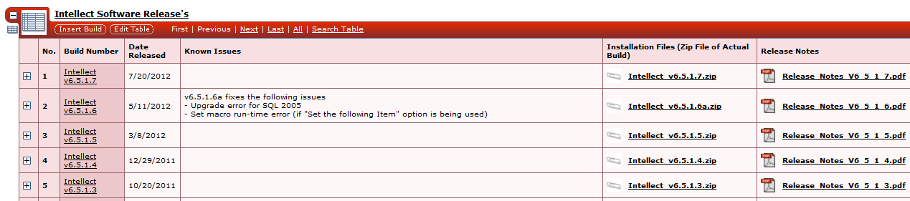
How to leverage the helpdesk (cont.)
Intellect Software releases and release notes

Slide 17
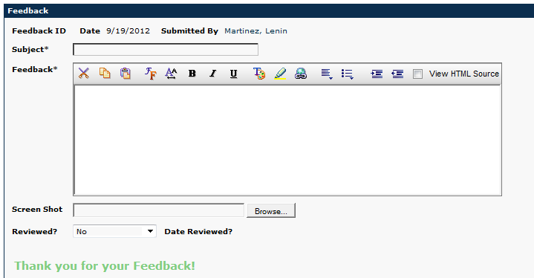
How to leverage the helpdesk (cont.)
Support portal feedback

Slide 18
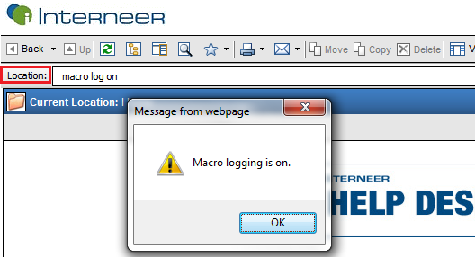

Tools within Intellect which can help with configuration or troubleshooting
Macro Log

Slide 19
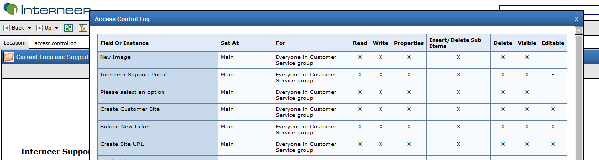
Access Control Log

Slide 20
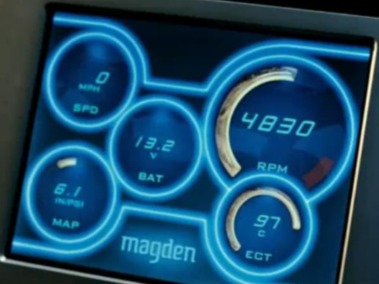
Intellect Performance Tips
IE web browsing (script checking, smart screen filter anti virus)
Manual activities which have user groups as owners
Amount of Elements on a single page
Multiple inner tabs with many elements

Slide 21
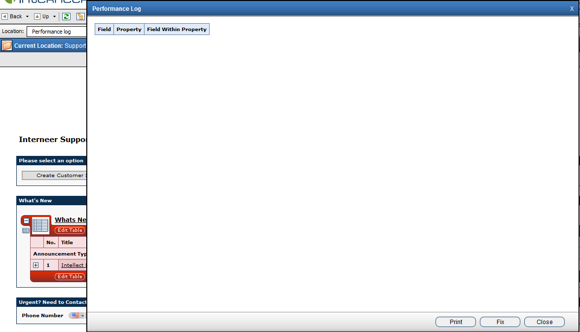
Intellect Performance Tips(cont.)
Performance log

Slide 22
Maintaining a stable production environment as you upgrade your configuration and platform.
Configuration Change/Software Upgrade
Setup a sandbox environment which is 1 to 1 with the live site
Create and test the new configuration/Upgrade the site
Perform test session and validate script
Setup a maintenance window for the live site, lock the site and backup the database.
Apply the configuration to the live site/Upgrade the site
Do some brief testing and unlock the site

Slide 23


Supported Window Servers and SQL versions
Window Servers
2003
2008
2008R2
2012*
SQL Servers
2005
2008
2008R2
2012*

