Slide 1
March 18, 2014
Partner with Professional Services for Success and Configuration Best Practices
Erika Fahey, Director of Professional Services, Interneer

Slide 2
Why partner with Professional Services
Another set of eyes to review your processes
Get up to speed fast on your new module or system while getting trained
Create a solid foundation for future modules
Guidance towards the right direction in the configuration
Managed Services Package

Slide 3
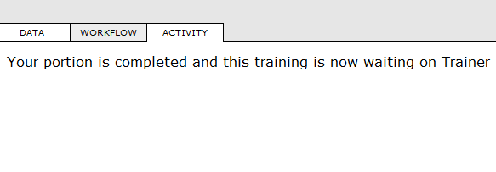
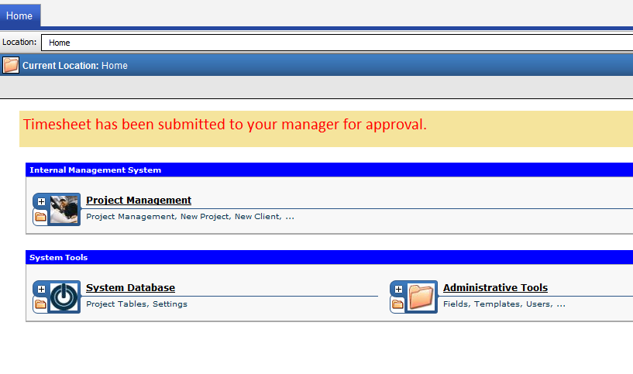
Did you know…
You can create customized messages upon a workflow activity completion
Also the user can be redirected to another page

Slide 4
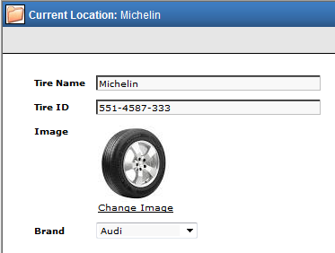
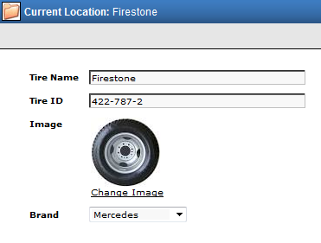
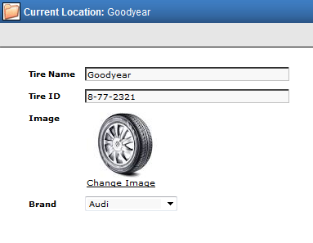
Did you know…
The image object can display different images on template instances
You can add help tooltips to the input fields

Slide 5
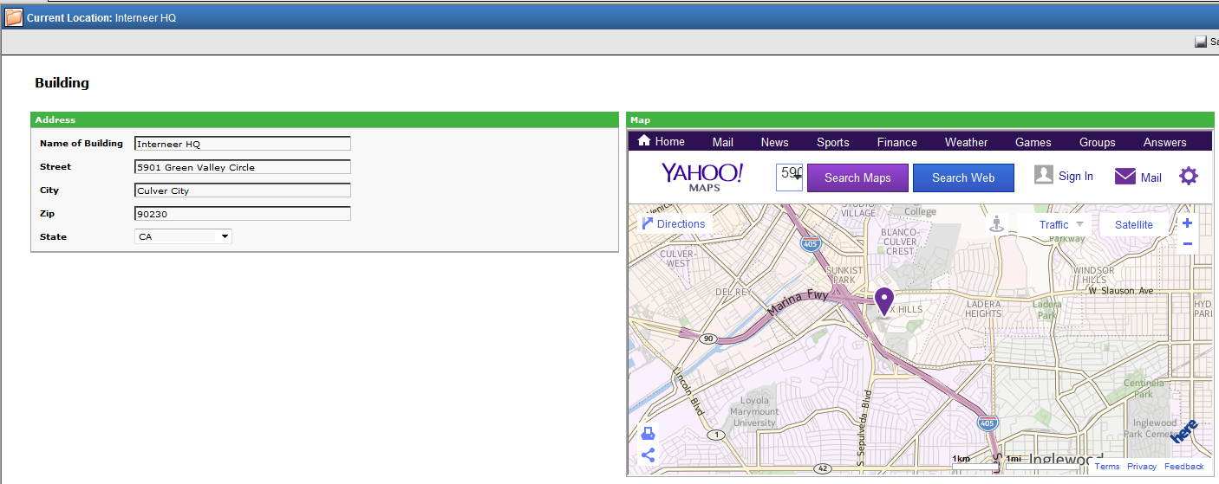
Did you know…
You can display Yahoo Maps, or YouTube videos etc. in Intellect

Slide 6
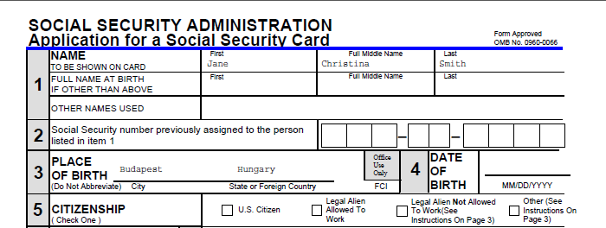
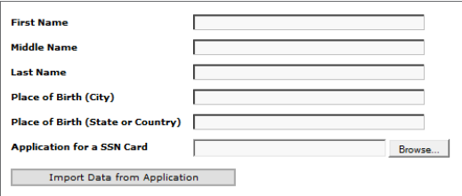
Did you know…
You can read data from a pdf file and use it in Intellect
You can write data into a pdf file as well
You can merge word documents and/or pdf files into one file
OR

Slide 7
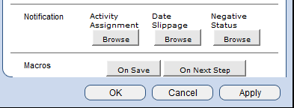
Did you know…
You can hide the Next Step, Activity Status, and Save buttons
You can add macros to manual activities to be executed On Save or On Next Step

Slide 8
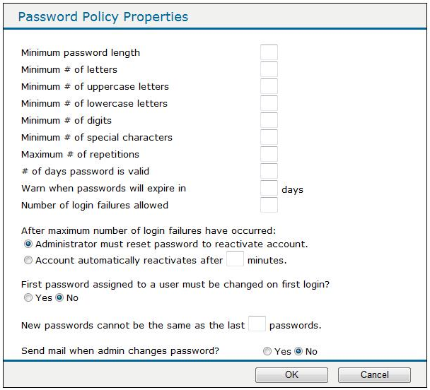
Did you know…
You can use a virtual breadcrumb for the location trail
You can activate the Password Policy
vs.

Slide 9
Did you know…
You can create custom login pages

Slide 10
Did you know…
You can scramble the data in the database before sending to Interneer Support
The Intellect platform can authenticate the user with Active Directory

Slide 11
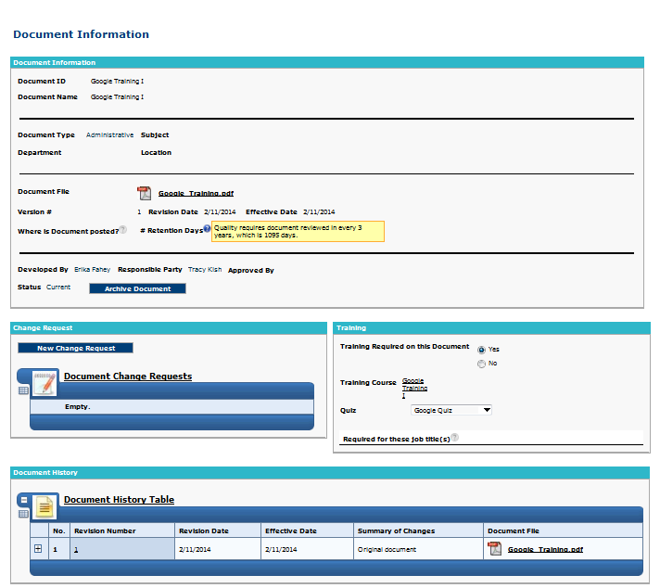
Best Practices – Make the system user friendly
Add colors, images, icons, onscreen instructions and tooltips

Slide 12
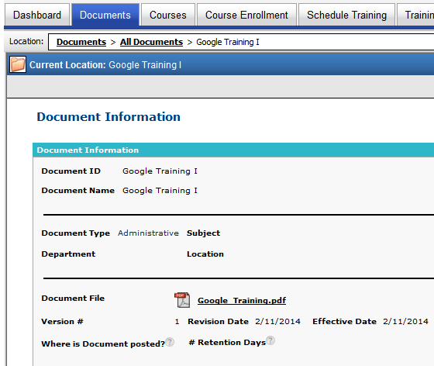
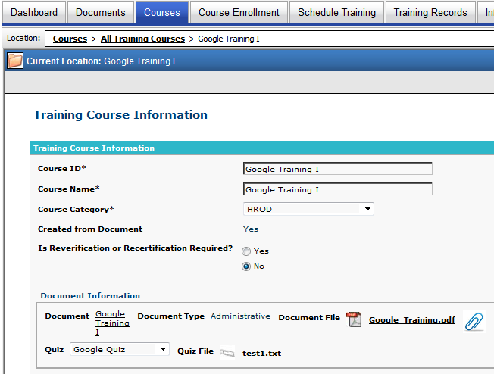
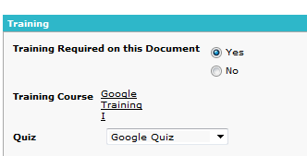
Best Practices – Make the system user friendly
Use a browse box for easy navigation
Document
Training Course

Slide 13
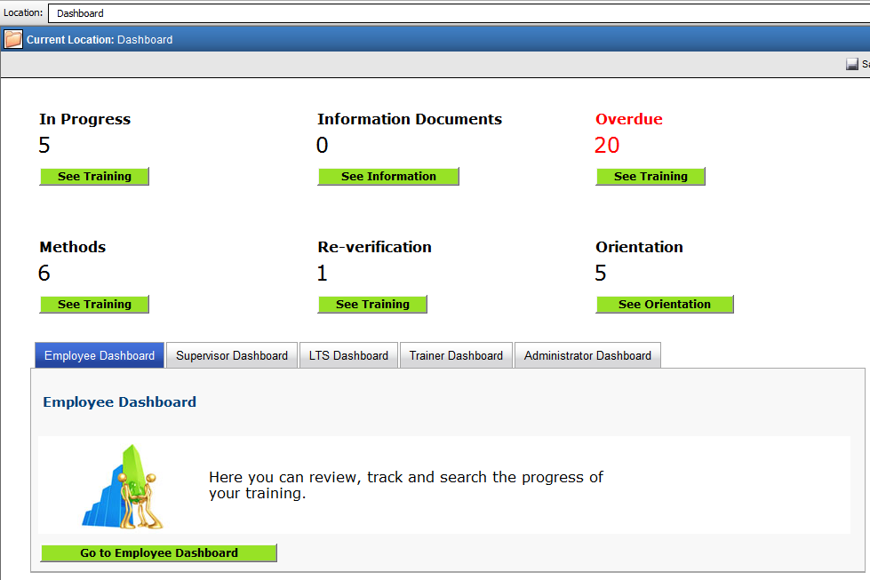
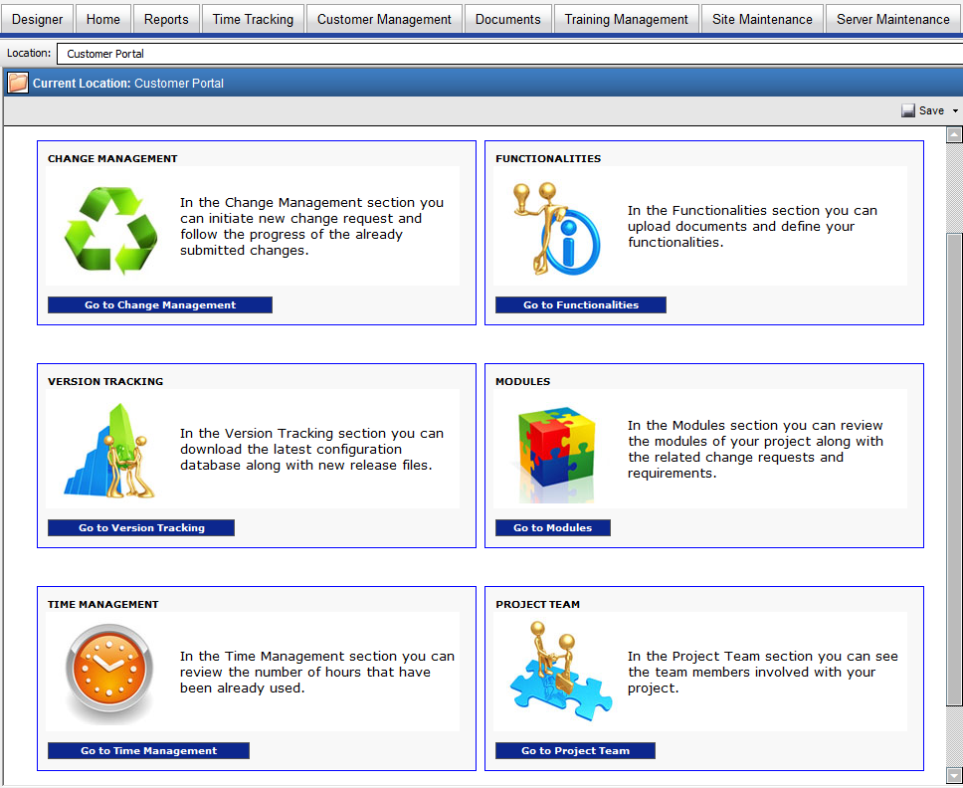
Best Practices – Make the system user friendly
Dashboards

Slide 14
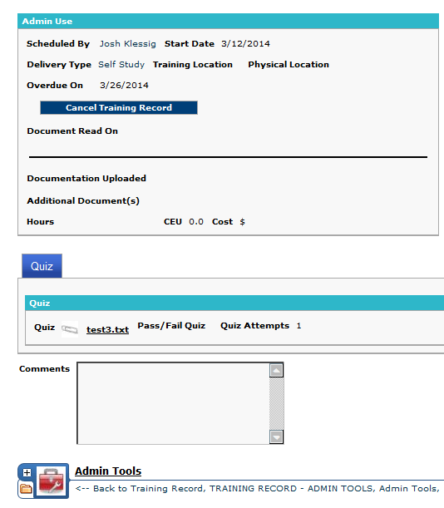
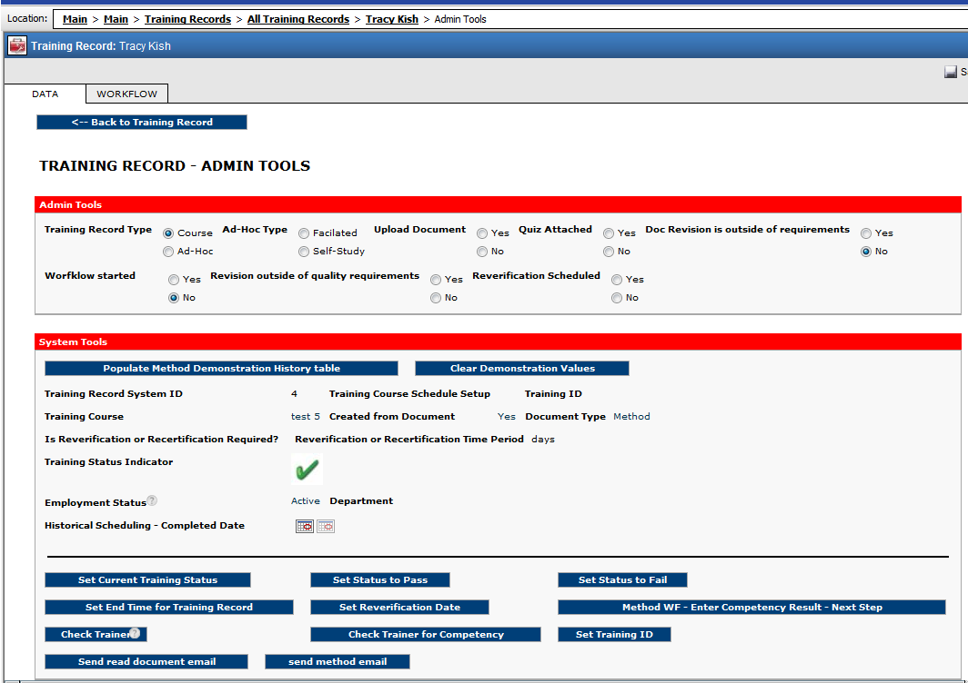
Best Practices – Behind the scene
Admin tools category
Usage of “flags”
Usage of macro buttons

Slide 15
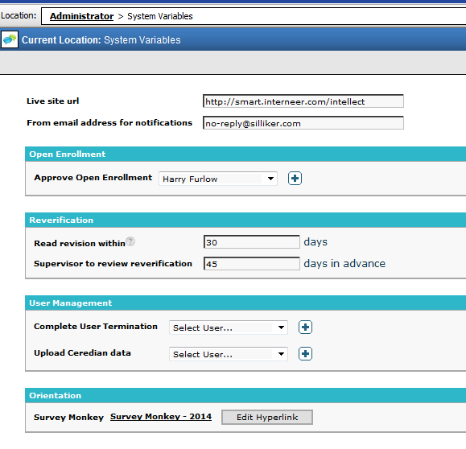
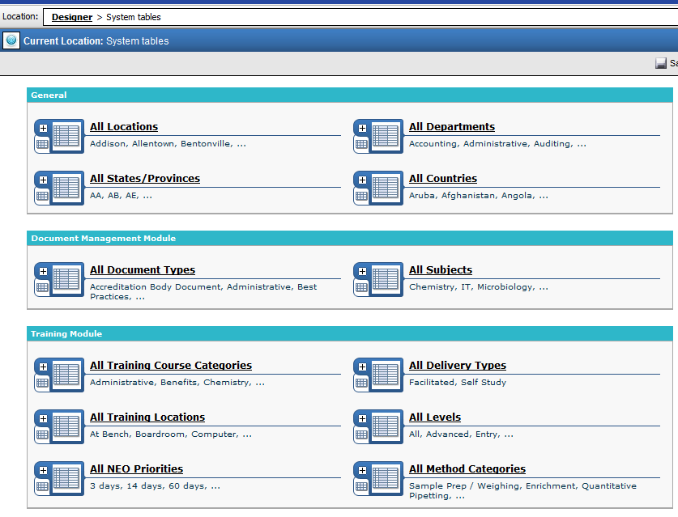
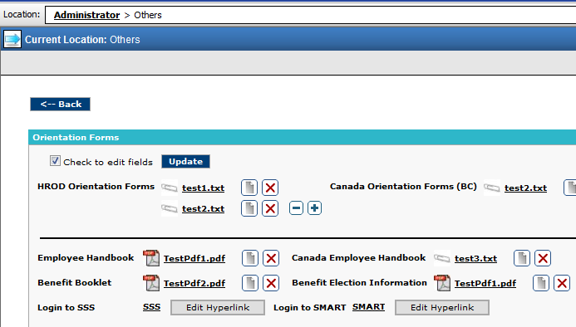
Best Practices – Behind the scene
System tables and variables

Slide 16
Online Classes and other available resources
Every 3 months - NO charge
Register at:
http://training.interneer.com
Coming soon
B201 - Macros
A101 – Tables and Templates
A102 – Basic Workflow
A103 – Parent-Child Relationship
A104 – Putting it altogether
S101 – Visual Enhancements
S103 – Mobile Apps
S104 – Admin Functions
B200 – Access Control
B202 – Intermediate Workflow
C301 – External Data Integration

Slide 17
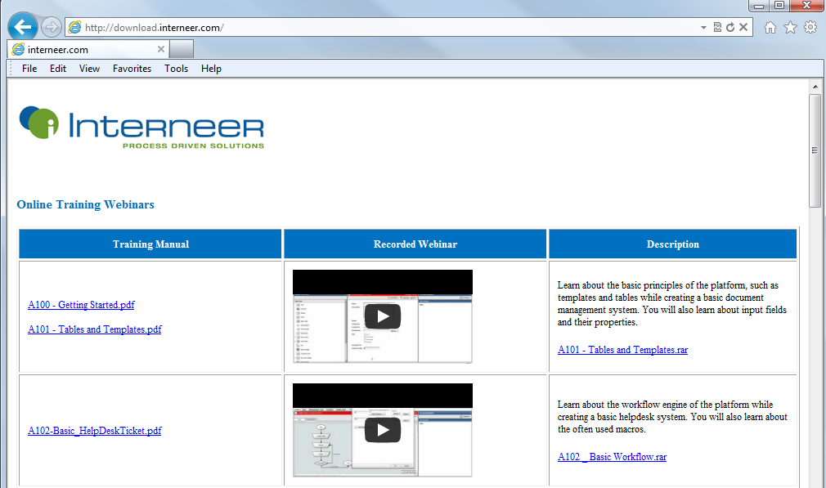
Documentation
http://download.interneer.com

Slide 18
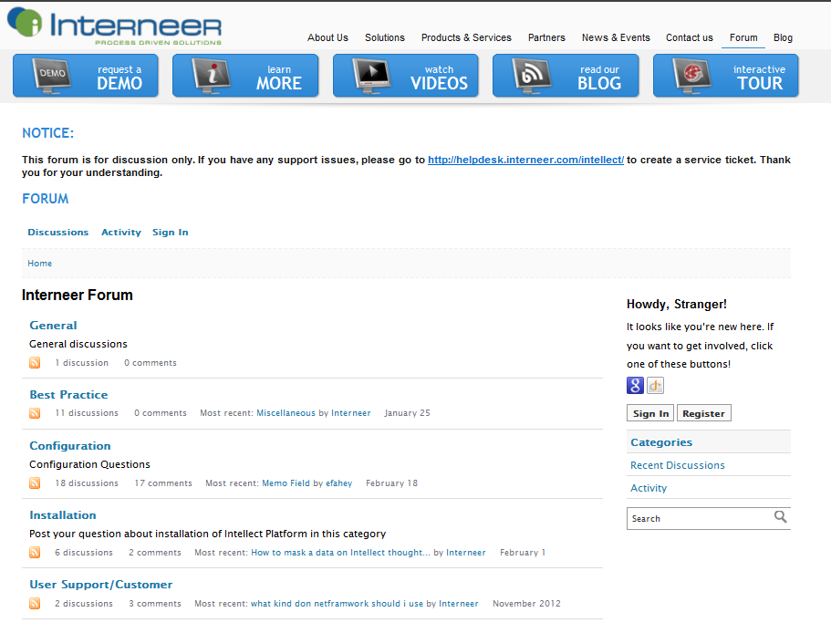
Interneer Forum
http://www.interneer.com/forum

Slide 19
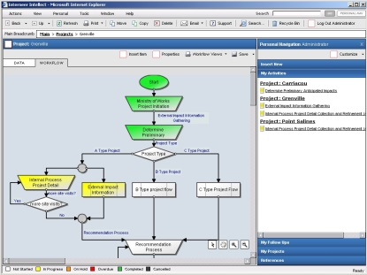
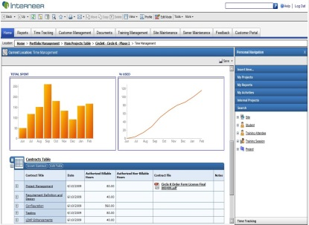
Interneer Intellect
Certification
Part I – Several multiple choice questions
Part II – Proof of Concept hands-on exercise

Slide 20
THANK YOU!

