Slide 1


Interneer Product Roadmap: What’s New and What’s Coming
Selim Ozyel, Director of Engineering, Interneer

Slide 2
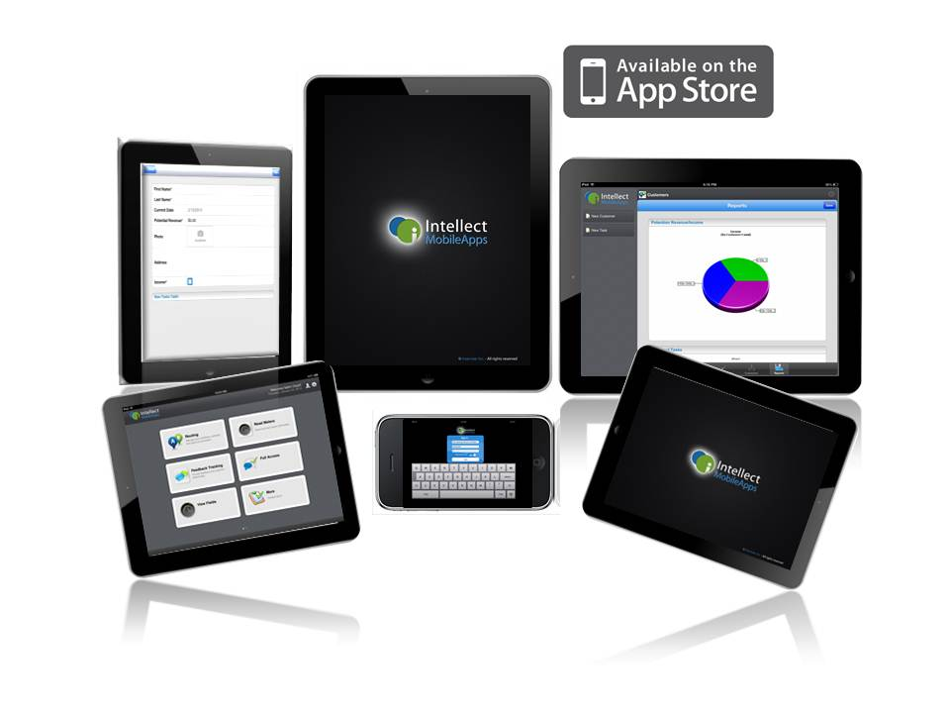
Since Last Conference - Mobile
Access Data anywhere
  iPad
  iPad Mini
  iPhone
  iPod Touch
iOS 7 support
Notes:
Main focus is Mobile; you can access data anytime anywhere; today’s economy you need to access data from anywhere
Last year supporting more devices, iphone, itouch, ipad mini
Main focus for the upcoming years continue to be Mobile devices; to support this vision

Slide 3
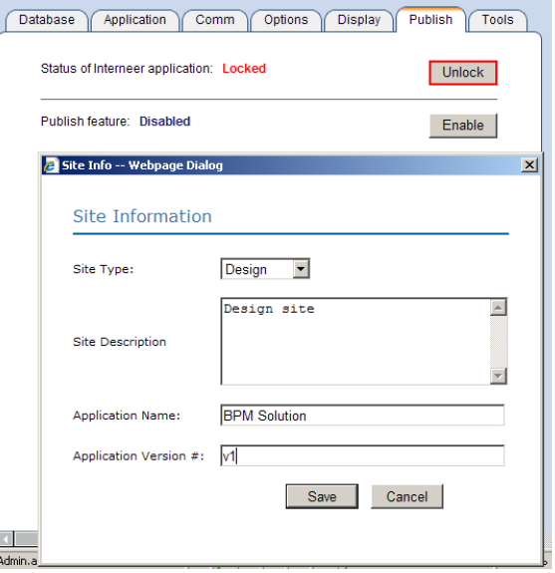
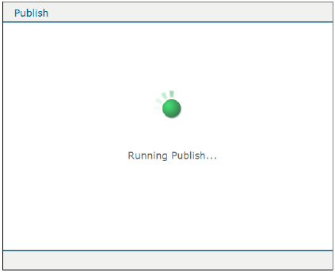
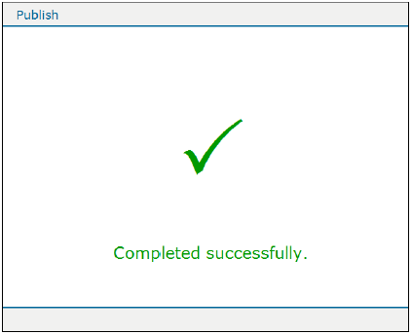
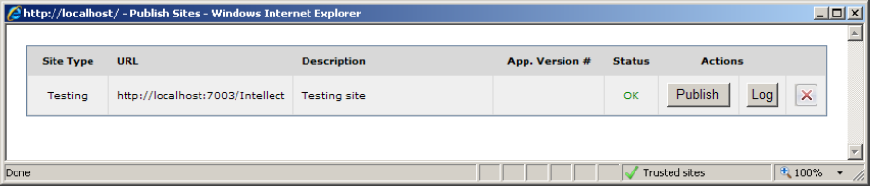
Since Last Conference - Publish
Notes:
Hear complains from our customers, sit as a team and redesign whole backend code;
We are getting good feedbacks with this new version; some customers are using and I know some are planning to use
Now it is more robust and stable;

Slide 4
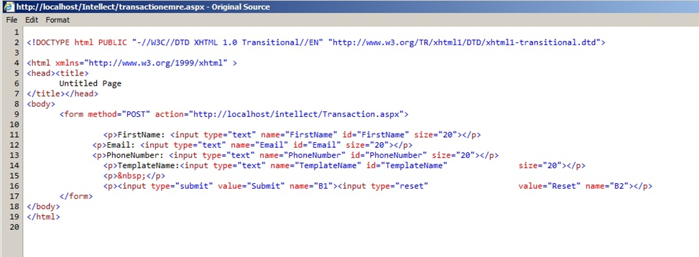
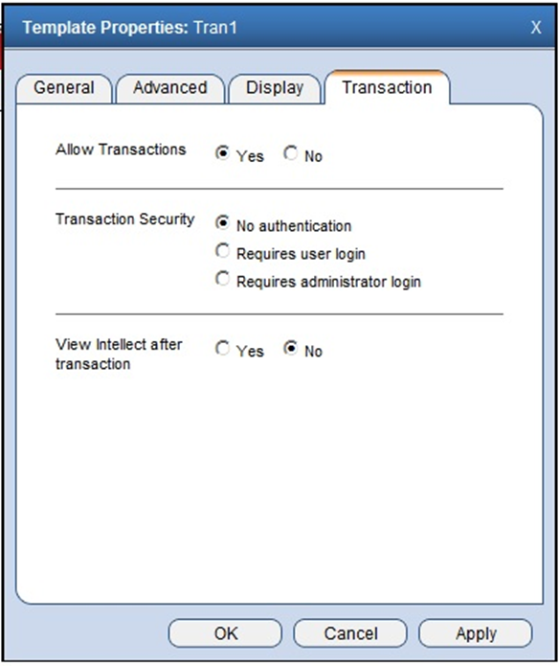
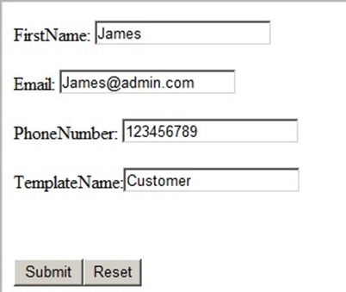
Since Last Conference – Web Transaction
[URL]/intellect/Transaction.aspx?TemplateName=Customer&FirstName=James&Email=jjames@admin.com
Notes:
Web transaction;
We have different ways on connecting data and gathering data from other systems (linked server, web services, server transactions…)
enhancing the transaction that we have(web service & server transaction); now you can submit a form though URL or post forms to Intellect –easy no coding required
Lead tracking; capture info in intellect; have reports

Slide 5
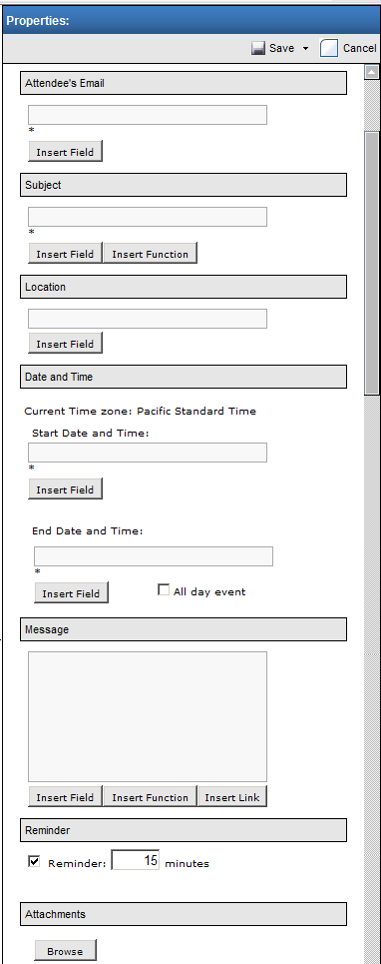

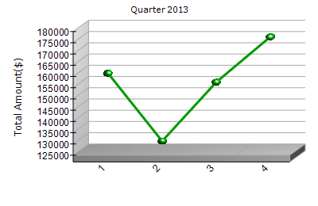
Since Last Conference - Various
Browser support
Calendar Invite macro
Quarter/Week support for date/time field
Notes:
Continue to support major browser; ie10/11; latest version of chrome, safari…
Automated way of managing calendar activities
Quarter; enhance date reporting capabilities and will help for calculations… - a lot of customer requested this feature before and we had a chance to implement this last year
Sales based on quarter
Leads per week

Slide 6
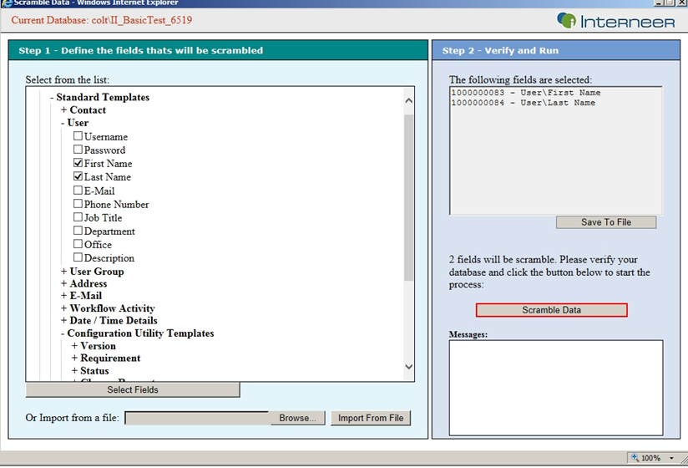
Since Last Conference – Admin Tools
Upgrade email notification
Scramble database
Notes:
Upgrade notification email; customer likes this and requested similar functionality for other long running processes such as restore database, publish…
Scramble database; on premises clients; secure data like social security

Slide 7
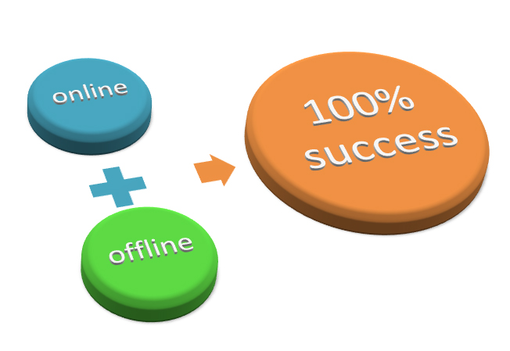



What’s New - Upcoming Release
Offline support for iOS devices
Conditional(Visibility, Required)
support for iOS
Support for Windows 2012 & SQL 2012
OracleCRM Web Service
Notes:
We are very exciting with the upcoming release to introduce the offline capabilities
Access data anywhere; empowering users; offline or online
Ex: inspection in hotel or construction area, do the inspection, collect data… where no reception. You can collect the information about the environment, take pictures of the current stage; and sync it when you back on office. – David will give more information about this and do a demo.
This open a huge usage in other areas of your processes
Give you the power and control – on the down side you do not have any excuse not to complete a work
So you can create some dynamic pages in your iOS devices even though you are offline
To add more benefit to offline; we add more control; add conditional support; where you can create dynamic forms, on the fly changes even in offline mode – this will give you a lot of flexibility
OracleCRM – Access Account & Contact info though web services

Slide 8
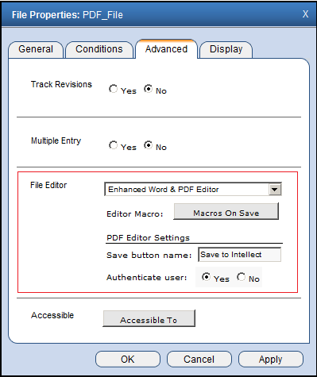
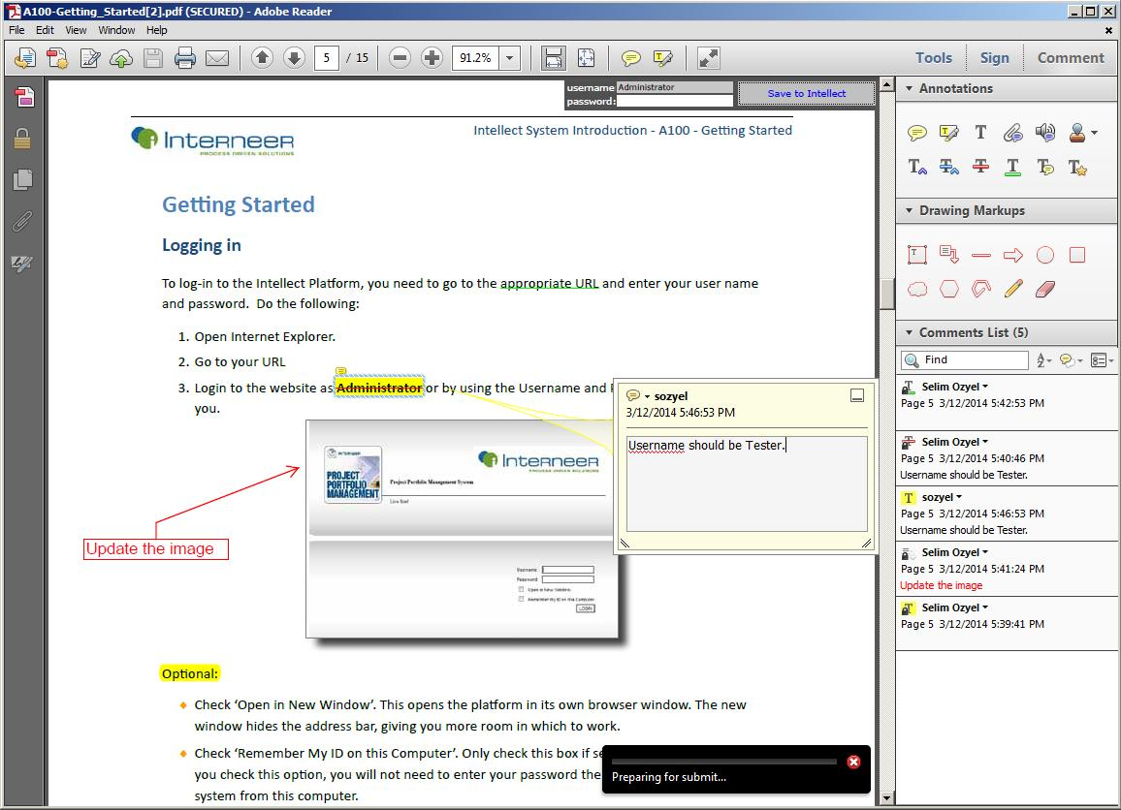
What’s New - Upcoming Release
PDF Markup Editor
Notes:
Addition to the Word editor;
You can do markup, review, sign the documents.

Slide 9



What’s Coming (Q2/Q3 2014)
License Management(Q2)
Multi-Language support in forms(Q2)
Android support(Q3)
Notes:
License management – keep track of the usage
Multi-Language – world is more connected and companies serve all other countries; we already support entering data in any language; another layer to support different languages
this will give more power to define forms in different languages.
Android; as I mentioned the focus is mobile; we want to make sure you can reach the data from anywhere;

Slide 10
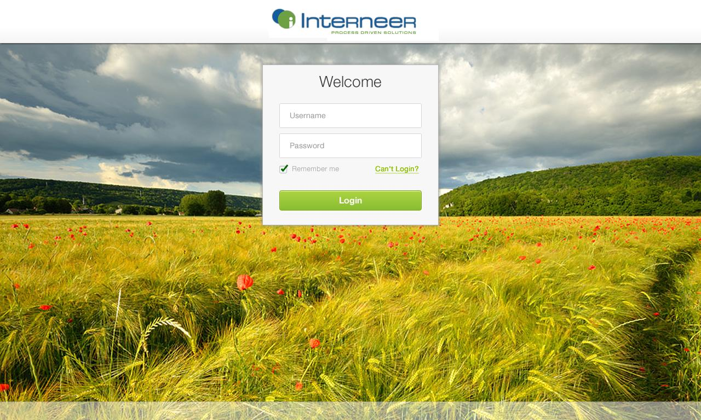
What’s Coming (Q4)
New, Stylish and Modern User Interface
Notes:
And new UI, I know a lot of people are waiting for this.
Get several feedbacks from our customers; and a lot of people currently sitting here provide a lot of feedbacks and would like to thanks for your time and valuable feedbacks. That will help us to shape the final design
We are spending a lot of time in this; it is not only a UI design change; it is more than that. That’s why we are putting a lot of effort, try different things to make it right.
Beside the beautiful and simple design, we are doing some logical design changes; Regrouping and organizing some parts for simpler access, and define clear separation in others.
The goal is to minimize the learning time, provide more flexibility and make the system consistent in all devices.
UI is still in design phase and we haven’t finalize it.

Slide 11

What’s Coming (Q4)
Customizable Login Page
Notes:
Keep in mind in during the design - customizability

Slide 12
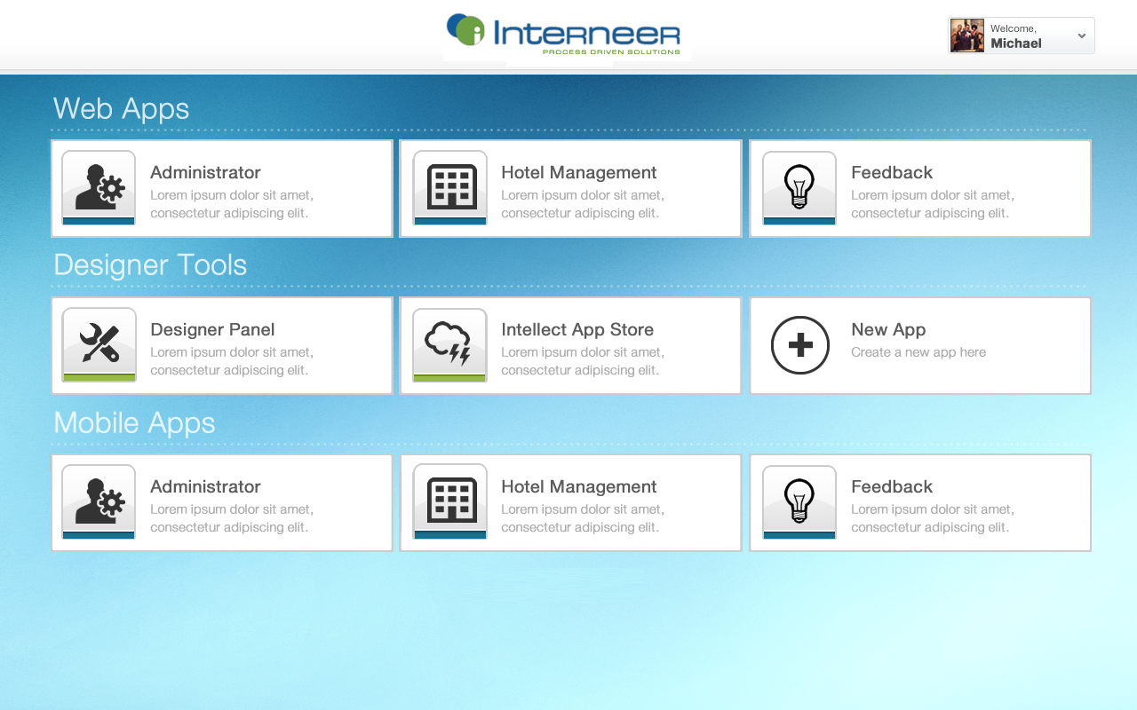
What’s Coming (Q4)
Application Centric Design - Consistent structure though all devices
Notes:
Concept of creating application -> easier to manage, easier to assign groups, clear separation of different actions and departments(sales, marketing, management…)
Much easier; everyone working on different boundaries; define their our rule, manage
Each department can create and manage their own application
Easier to customize navigation controls and functionalities within apps
This new concept will simplify things a lot. Will give you better control and flexibility.
Implement Hr application; simple,fast, cheap implementation
Separation of design(templates, workflows, integrations…) and applications
Consistently though all devices
This is a big change and we think that it will simplify a lot of things
Download a pre-configure up though Intellect app store

Slide 13
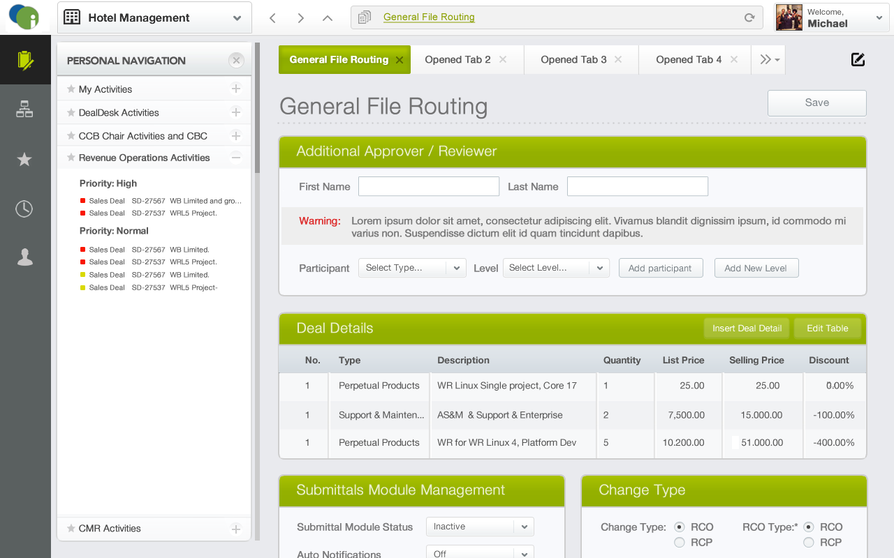
What’s Coming (Q4)
Simple, organized and touch-enabled navigation
Notes:
Define each working area
Each application can have different settings/access control

Slide 14
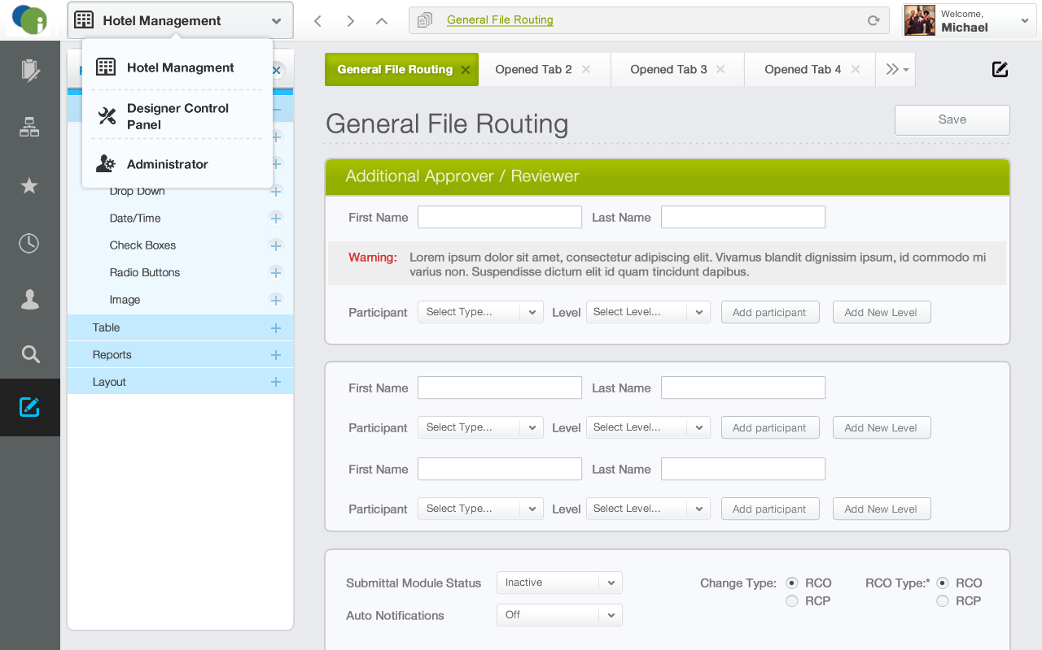
What’s Coming (Q4)
Easily navigate though applications
Notes:
Different color schema on personal nav
Switching between applications

Slide 15

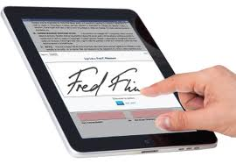
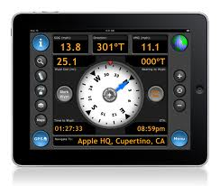
What’s Coming (TBD)
Intellect App Store
E-Signature support
Mobile App branding
Integrate with device capabilities such as GPS, Maps
Notes:
Download pre-configured application from Intellect store

Slide 16


Questions?

