Slide 1


March 17, 2014
Enabling the Mobile Enterprise Revolution
Peter Hargittay, CMO & VP of Business Development, Interneer

Slide 2

Chris – May 9
Christine – Mar 13
Fulberto – Apr 10
Julie – May 22
Justino – June 16
Katie – Nov 25
Richard – April 3
Romeo – Feb 7

Slide 3
Internet Access Paradigm Shift – A New Era
Desktop Era
Mobile Era
WW Internet Users (M)
Source: Morgan Stanley 2012

Slide 4


Why Do Mobile Apps Matter?
Apple App Store contains more than 1.25 million apps
60 Billion iOS apps have been downloaded
Developers have made $13B through the App Store - $5B in the last year
Over 1 million Android apps available – catching up to iOS
2.5 Billion android apps downloaded every month

Slide 5

Mobile technology has
revolutionized the way
we live, work and play.
But for much of its history, mobility has been led by consumer
preferences, forcing enterprises to adapt… until now.
Smart mobile apps extend business processes and data,
revolutionizing productivity, efficiency and collaboration

Slide 6

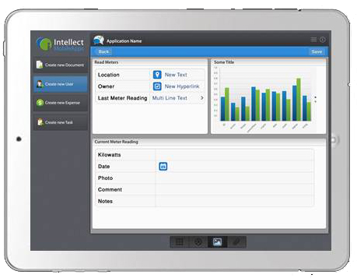

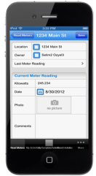



Mobility is Transforming All Business Processes
Forms
Critical Process Functions
Process
Database
Going Mobile
Display
Collaborate

Slide 7
MOBILE IS THE NO. 1
DISRUPTIVE FORCE
FACING COMPANIES
TODAY.
- Clay Richardson, Principle Analyst at Forrester Research, 2013

Slide 8





Enterprise Mobile Apps Are the Future
MOBILITY IN THE ENTERPRISE
75%
Of respondents believe mobile apps
will improve employee productivity
(2012)
Every
Enterprise
Will Have
25
Mobile Apps
B2E
In 2
Years
(2012)
Yet a majority of
organizations have
made no progress
with enterprise
mobile apps
75%
(2012)
Source: AIIM – April 2012, McKinsey & Co - 2012
Notes:
Mobile is changing the way business is done... but many companies have yet to realize/implement the benefits of mobile technology to improve their processes

Slide 9

Enterprise Mobility is All About Productivity
TechInsights Report:
Enterprise Mobility –
It’s All About the Apps
Surveyed 1,300 senior IT decision-makers
Published November 2013
61% of mobile projects are employee-focused
83% expect an increase in employee productivity (up from 75% in 2012)
Major concerns
  “lack of in-house mobile development talent and skills”
  “Integrating mobile apps with existing systems and processes”

Slide 10
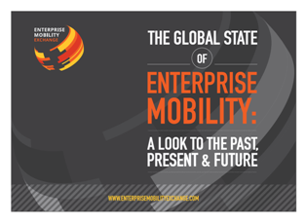
Enterprise Mobility Dominates IT Agenda in 2014
Enterprise Mobility Exchange
Surveyed 150 IT Professionals
Published January 2, 2014
44% of organizations have implemented an enterprise mobility project (up from 25% in 2012)
45% of organizations will spend at least $500,000 on mobility projects over the next 12 to 18 months
One of the biggest perceived barriers to future mobile initiatives is failure to integrate with legacy systems

Slide 11

Realities to Be Aware Of
Must-Watch Trends for Your
Enterprise Mobility Plan
Richard Absalom, an Analyst with Ovum’s Enterprise Mobility and Productivity Practice
Published January 14, 2014
57% of employees access corporate data from a personally owned smartphone
70% of employees who are tablet owners use their tablet for work
Mobility is not the death of the PC

Slide 12
Mobile Apps Will Transform All Business Processes – Is Your Company Ready?
January 29, 2014

Slide 13

Mobile BPM

Slide 14
8 Predictions
Enterprise software will become app-centric
Enterprises will offer an App Store or library of mobile apps for employees, customers and others
Every department will demand their own unique app
Specialized apps will extend business processes and data in a more targeted way
Enterprise apps will be native, rather than HTML5
Non-IT people will be able to build and deploy mobile apps, but corporate IT will own security, integration
Apps will create new ways to work, further improving productivity, efficiency and collaboration
BPM will undergo a renaissance due to mobile BPM

Slide 15

Our Next Speaker
Richard Frere
Director of IT at Enviva
Passionate about building world-class IT departments
Mobility enthusiast and evangelist

