Slide 1



INTERNEER INNOVATE 2014

Slide 2

WHY ARE WE ALL HERE?

Slide 3

we are all INNOVATORS
Notes:
We all want to solve problems at work
We want to improve operations, save time, save $
We all have ideas on how to do that

Slide 4



seeking EMPOWERMENT
Notes:
We can solve these problems
We can do it ourselves
We are not hostage to others

Slide 5
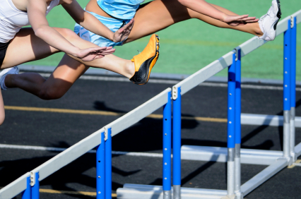



with EXPECTATIONS
Notes:
We expect Intuitive solutions
We expect Agility
We expect Fast
We expect Highly Flexible
We expect Mobile

Slide 6
we are all
INTELLECTUALS
Notes:
Ingrained into Interneer DNA from inception 14 years ago
EMPOWER EVERYONE TO INNOVATE
Market took time to catch up with our vision

Slide 7
our passion
EMPOWER
EVERYONE
TO
INNOVATE
Notes:
Ingrained into Interneer DNA from inception 14 years ago
EMPOWER EVERYONE TO INNOVATE
Market took time to catch up with our vision

Slide 8

by SIMPLIFYING
Automation
Drag and Drop
Smart Choices

Slide 9
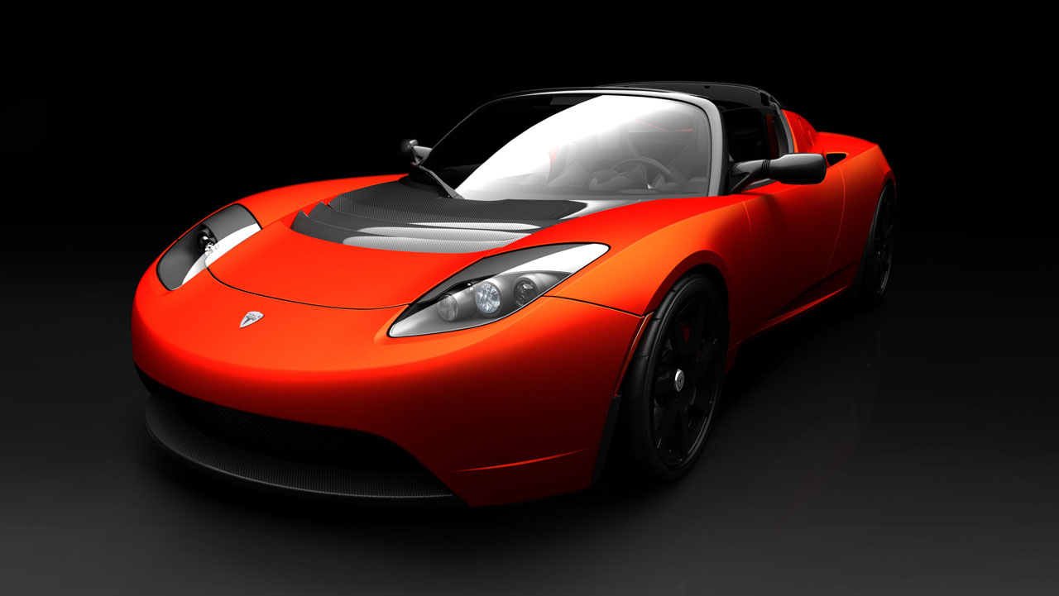
by delivering SPEED
Technology
Scalability
Mobility
Notes:
Focus – midmarket, SMB, Depts, Business user
Business model – start small, show value, expand, prove
Software – automate, make assumptions for users, speed of change,
UI – simplify, improve, apps
Support – help, empower, train

Slide 10

by delivering VALUE
Service
Knowledge
Efficiency
Notes:
Focus – midmarket, SMB, Depts, Business user
Business model – start small, show value, expand, prove
Software – automate, make assumptions for users, speed of change,
UI – simplify, improve, apps
Support – help, empower, train

Slide 11



















the MARKET agrees
Marketscope for BPM Platform-as-a-Service
The 17 Hottest Enterprise
Mobile Startups Right Now

Slide 12
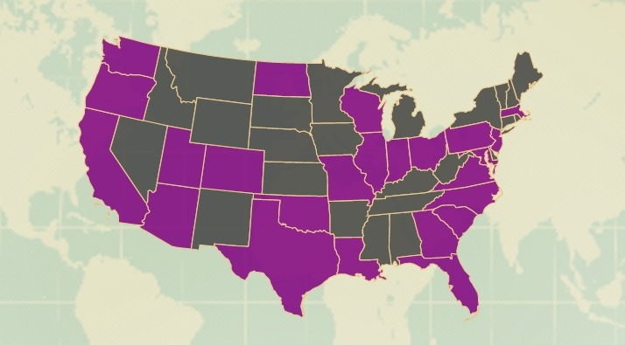
































40% growth

Slide 13
global ECOSYSTEM

Slide 14

LEARN, NETWORK, VALUE
PANELS & INTELLECTUALS
EMPOWER TO INNOVATE
INNOVATION AWARDS
Notes:
Packed event – knowledge, network, value
Learn from you Panel
Learn from us Panel
Empower to innovate tomorrow by painting
Awards
Introduce our keynote

Slide 15





Interneer Innovation Awards 2014
Notes:
Focus – midmarket, SMB, Depts, Business user
Business model – start small, show value, expand, prove
Software – automate, make assumptions for users, speed of change,
UI – simplify, improve, apps
Support – help, empower, train

Slide 16
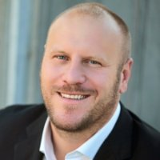

Keynote Speakers
Patrick Vlaskovits
New York Times bestselling author of “The Lean Entrepreneur”
Entrepreneur, advisor, and mentor
CEO of Superpowered
Bennett Blank
Innovation Leader at Intuit
A leading “lean startup in the enterprise” practitioner, mentor, and thought leader.
Notes:
Focus – midmarket, SMB, Depts, Business user
Business model – start small, show value, expand, prove
Software – automate, make assumptions for users, speed of change,
UI – simplify, improve, apps
Support – help, empower, train

