Slide 1


InvestBulgaria Agency
Empower your Investment

Slide 2

Content
2
Who are we
What is InvestBulgaria Agency and what is its purpose
What can you get
What are your benefits from investing in Bulgaria and how can you receive them
Conclusion
Pros of investing in Bulgaria

Slide 3




Did you know?
3
Best outsourcing
destination
Automotive producer
Largest Lavender
Producer
Fast Internet Speed
In Europe for 2015 according to
Cushman and Wakefield’s rating
More than 100 companies. 80% of the cars in Europe have parts, produced in Bulgaria
For the past years Bulgaria have successfully surpassed France
Bulgaria is in Top 10 countries in the world with fastest internet connection

Slide 4

What Bulgaria offers
4
Points of success
InvestBulgaria Agency promotes the great investment conditions in Bulgaria and how these conditions help the potential investors.
Government Incentives
Social security and tax benefits
Educated and Skilled Workforce
High staff qualification and improvement in the production capacity
Easy Market Access
Easy access to EU markets as well as Russia, Turkey and
Middle East
Reduced Cost and Risk
Political and economic stability along with competitive cost labor and low tax rate

Slide 5
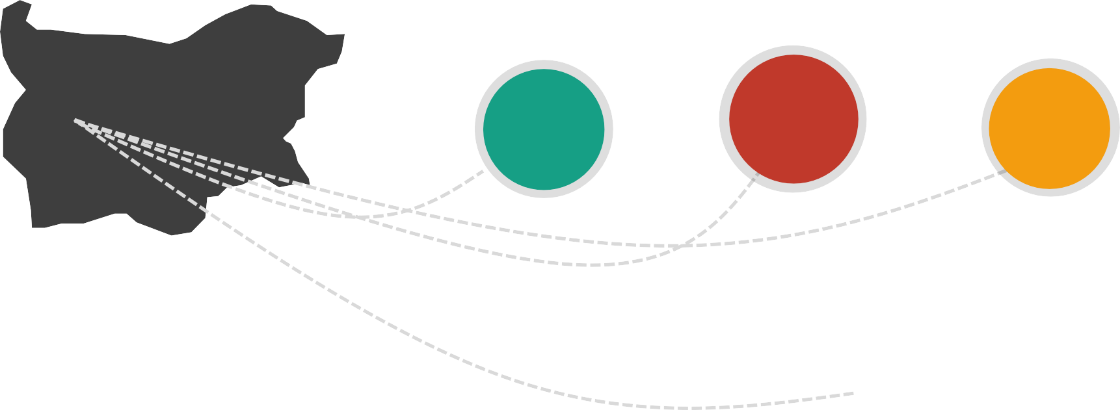


Competitive cost of business
5
Rents
Labor Cost
Electricity
2,5€
(m2/month)
261€
Minimum
0,078€
(€/kWh)
Gas
Water
0,032€
(€/kWh)
1.09
(€/m)

Slide 6
Investment map
6
FDI by host country
Millions of Euro
2017
Netherlands – 885
Germany– 131
Switzerland – 130
Turkey – 81
Greece – 75

Slide 7







GDP Growth Rate
7
1,6% | 0,2% | 1,3% | 1,5% | 3% | 3,4% | 3,6%
2011 | 2012 | 2013 | 2014 | 2015 | 2016 | 2017
GDP growth has been accelerating for the last five years. The other major macroeconomic indicators such as unemployment and inflation rate have also shown a positive trend, making Bulgaria a sweet spot for investors.

Slide 8
Taxation Rates
8
21 %
20 %
19 %
19 %
19 %
16 %
15 %
10 %
Bulgaria
Serbia
Romania
Czech
Poland
UK
Turkey
Slovakia
Bulgaria has attractive taxation system.

Slide 9

IT & BPO
9
Education
01
IT & BPO
IT & BPO sectors are currently the fastest growing sectors in Bulgaria. Aiming towards the high tech workforce, the sectors have reached average salary of 1350 euro, which is way above the average for the country.
According to the branch, the workplaces in the sectors are growing by nearly 5% each year, making the sector reachable for qualified workers.
Within the last 10 years, 70 000 people are currently engaged in these particular sectors.
Inspiration
02
Development
03
Notes:
Това е един от най-бързоразвиващите се сектори в страната, като генерира над 3% от БВП за 2016 г. , а средните работни заплати достигат 2700лв. (1350 Евро). От развитието от последните години може да се очаква, че секторът ще нараства и в бъдеще.

Slide 10
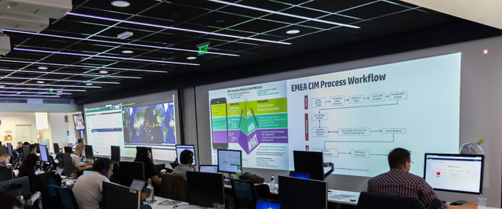






10
SUCCESSFUL COMPANIES

Slide 11

Machine Building
11
Large workforce
01
Machine Building
Being one of the largest sectors in Bulgaria, machine building offers great variety of different labor subsectors such as construction, robots etc.
This sector creates work for more than 600 000 people in Bulgaria, offering wages larger than the average for the country between 5 and 10 thousand euro per year.
The sector is expected to grow in the following years due to the constantly developing and smart-seeking technologies.
Becoming smart
02
New technologies
development
03
Notes:
Един от най-големите сектори в страната с повече от 600 хил души заети в областта, като заплатите достигат почти 10 хил. евро на годишна база. Едни от основните предимства на сектора са това, че той започва да става „умен“ и да използва нови технологии и преимуществото пред другите сектори с размера на работната ръка.

Slide 12
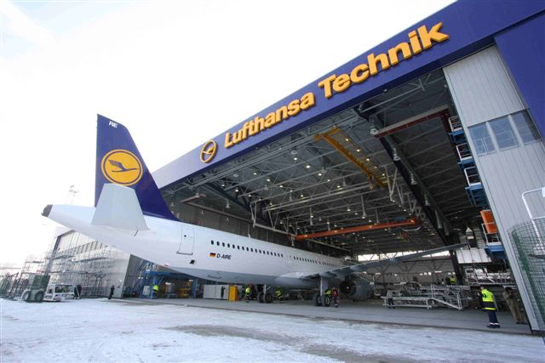



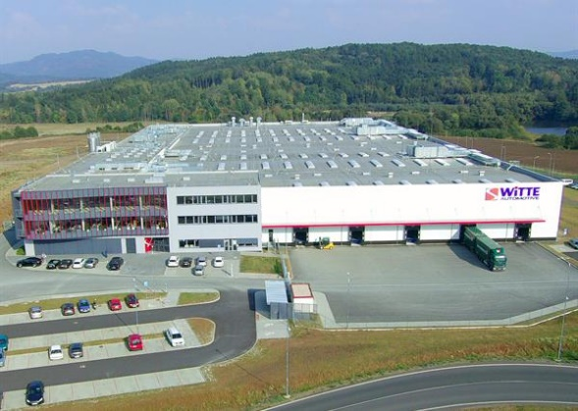

12
SUCCESSFUL COMPANIES

Slide 13

Electronics
13
Large workforce
01
Electronics
The electronics sector is one of the most traditional in Bulgaria, due to the qualified workforce at an affordable price.
More than 45 000 people are working within this sector with 6 000 euro annual wages.
75% of the created goods are being exported outside Bulgaria, whereas only 25% is held in Bulgaria.
The sector is interesting because of the cooperation between universities and companies to create qualified workforce.
Experienced
Workforce
02
75% Export
03

Slide 14
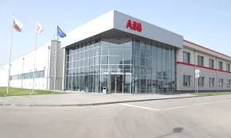




14
SUCCESSFUL COMPANIES

Slide 15
Food Industry
15
Large workforce
01
Food Industry
The sector is another traditional for the country.
Existence of a number of public and private research and analytical centers, more than 10,000 researchers.
Workforce available throughout the country at some of the most competitive prices in Europe.
Very high quality of organic products (GMO ban).
50% of the territory of the country is farming land.
Unique
Agricultural
Conditions
02
50% of the territory is farming lands
03

Slide 16





16
SUCCESSFUL COMPANIES

Slide 17
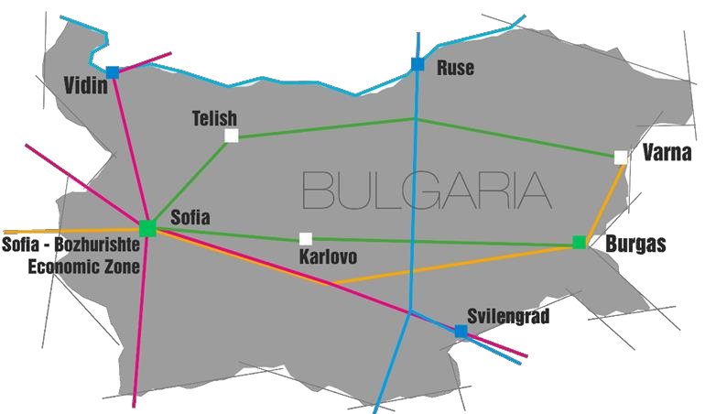
INDUSTRIAL ZONES
17
Four operating zones
Free Zone Ruse
Free Zone Vidin
Free Zone Svilengrad
Transit Trade Zone – Varna
Two newly constructed zones
Sofia – Bozhurishte Economic Zone
Industrial & Logistics Park – Burgas
Three zones under development
Industrial Zone Karlovo
Industrial Zone Telish /Pleven/
Industrial Zone Varna West
A total of 9 projects
6 804 095 m² total area
76 409 m² built-up area
240 500 m² open-air warehouses

Slide 18
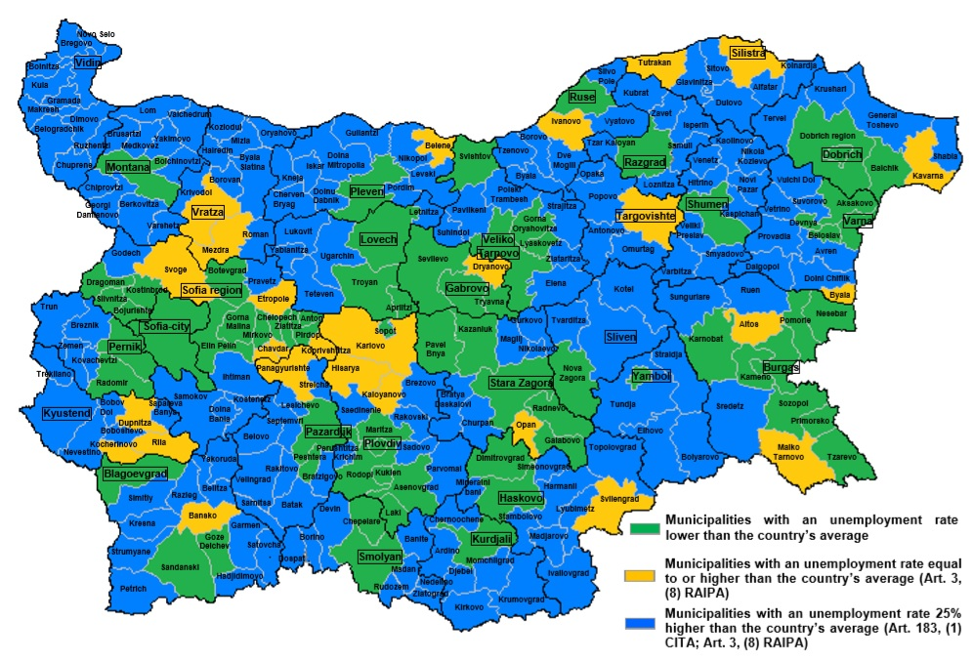
Unemployment map
18
0% corporate tax rate in zones with unemployment 25% or higher than the average
Municipal unemployment
Bulgarian legislation allows potential investors to receive 0% corporate taxation rate should they decide to invest in as what is considered to be a high unemployment region (blue zones).
Notes:
Една от най-интересните възможности за потенциални инвеститори в страната е и възможността за 0% корпоративен данък. Както виждате картата на нашата страна е разделена в 3 основни цвята, като в синьо са зоните, маркирани като такива с безработицата достигаща нива от над 25% над средната за страната. Условието е спестените данъци да бъдат реинвестирани.

Slide 19


Certification Criteria
19
Employment Establishment
Employment establishment. Creating new working places is within the requirements for receiving certificate by the investor.
Economic activity. The targeted sectors are defined by The State and high-tech ones are with preference and therefore with lowered financial requirements for the investment.
Location. Establishment of the project in a region with
high unemployment will reflect in doubling the period
of reimbursement of social security payments. Additionally it will result in 0% corporate taxation rate.
Economic activity
Location of the
project

Slide 20
Certificates
20
 | Priority Class | Class A | Class B
THRESHOLD INCENTIVES | € 50.00 M 50 – 150 Jobs | € 1.00 M – 5.00 M 25 – 150 Jobs | € 500 K – 2.50 M 10 – 100 Jobs
SHORT CUT ON ADMINISTRATIVE TERMS | ✔ | ✔ | ✔
NO TENDER – NO COMPETITION | ✔ | ✔ | ✔
FINANCING VOCATIONAL TRAINING | ✔ | ✔ | ✔
SOCIAL SECURITY CASH BACK | ✔ | ✔ | ✔
INDIVIDUAL SERVICES | ✔ | ✔
FINANCING TECHNICAL INFRASTRUCTURE | ✔ | ✔
PUBLIC-PRIVATE PARTNERSHIP | ✔
NO TAX ON CHANGING LAND STATUS | ✔
BUYING PUBLIC LAND ON FAVOURABLE PRICES | ✔
GRANTS FOR R&D | ✔

Slide 21


What Bulgaria offers
21
Reduced Cost and Risk Political and economic stability along with competitive cost labor and low tax rate
Easy Market Access
Easy access to EU markets as well as Russia, Turkey and Middle East
Government Incentives Social security and tax benefits
Educated and Skilled
Workforce High staff qualification and improvement in the production capacity
InvestBulgaria Agency has the main purpose of not only attracting investors but also retaining them. Post investment services that we offer are just as important as pre- investment ones.

Slide 22

Office
22
Where are we
Head Office
InvestBulgaria Agency
23 Vrabcha Street
Sofia 1000, Bulgaria
Tel.: ( +359 2 ) 985-5500
Fax: ( +359 2 ) 980-1320
E-mail: iba@investbg.government.bg

