Slide 1
Creating a Collaborative Learning Environment in Teams Class Notebook

Slide 2
Your Presenters
Krista Walker
Program Manager for Professional Development
Boxlight – EOS Education
Phoenix, Arizona
krista.walker@boxlight.com
Taylor-Ann Charles
Digital Learning Specialist
Boxlight-EOS Education
Phoenix, Arizona
taylor-ann.charles@boxlight.com

Slide 3
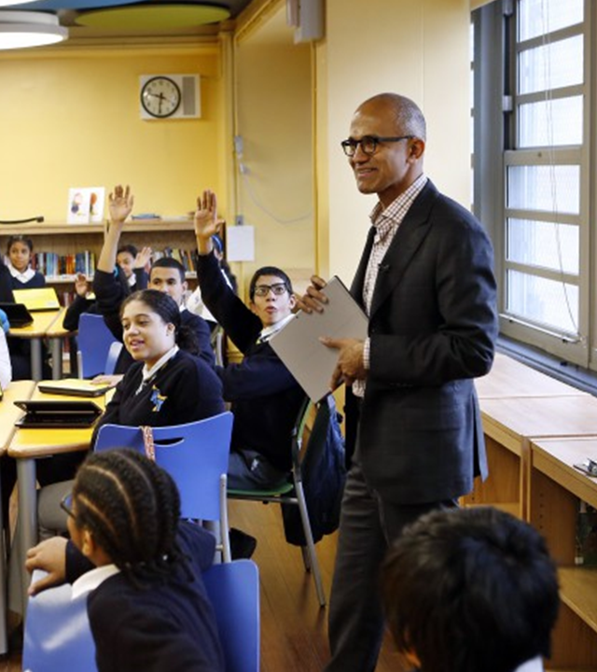
Empower students in a Remote Classroom

Slide 4
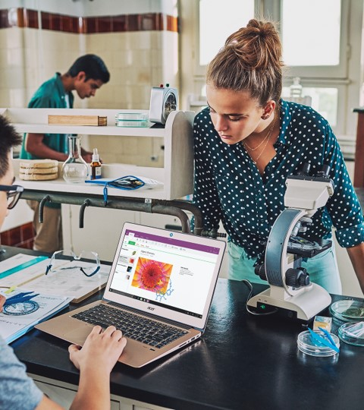
Overview
Access Class Notebook in Teams
Anatomy of a Class Notebook
Manage Notebooks
Things to Do
Organizing and Adding Content
Distribute Content to Students
Student Collaboration
Review Work and Give Feedback

Slide 5
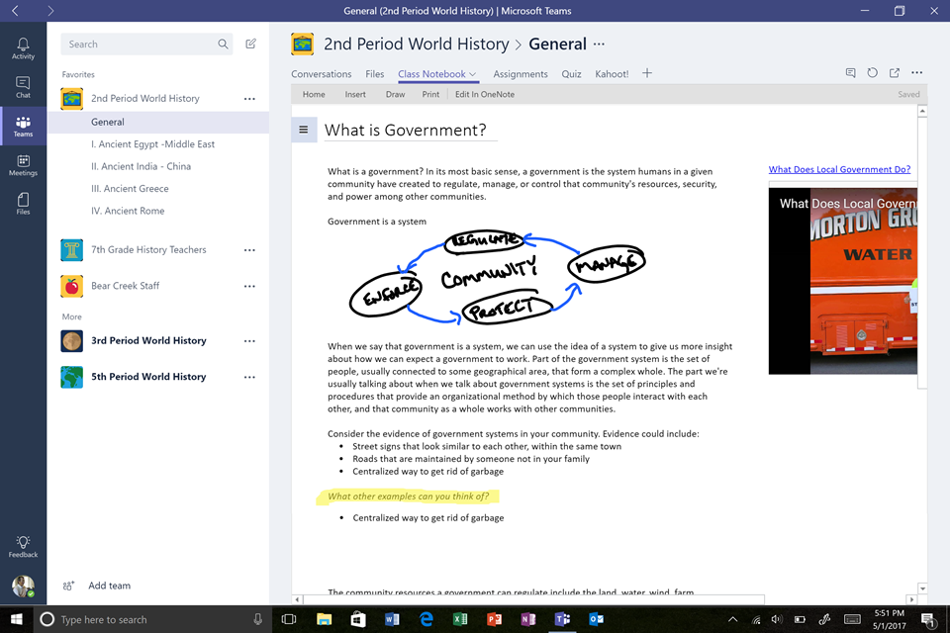
Microsoft Teams: A Digital Hub
Create more collaborative learning experiences with Microsoft Teams

Slide 6
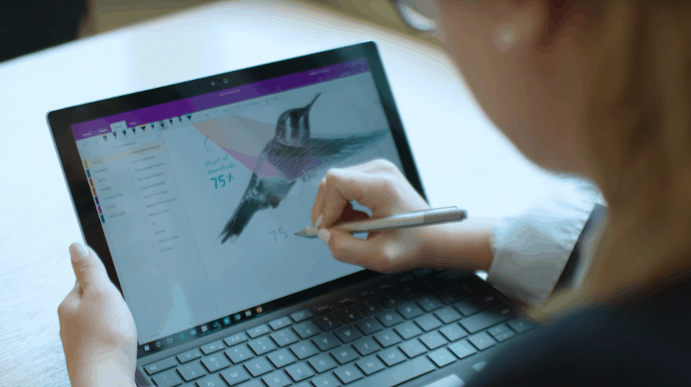
Class Notebook in Teams
Acts like a digital binder to help organize content
Provides students a venue to explore, discuss, practice, and explain
Digitized environment for engagement
Opportunities for communication and feedback
Collaborate in Channel Notes and Notebook
Easily Review student contributions and work

Slide 7
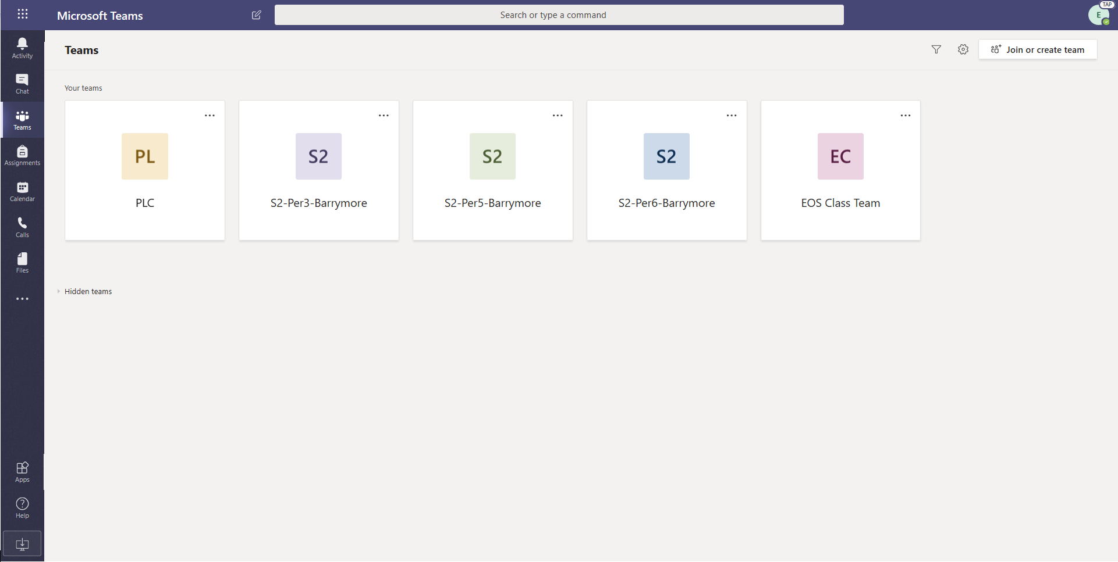
Log Into office.com
Web UI with highlight

Slide 8
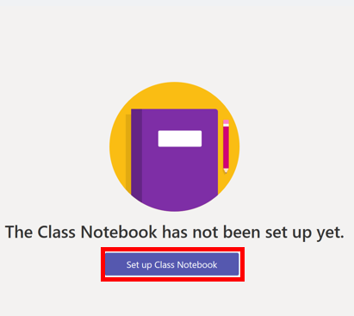
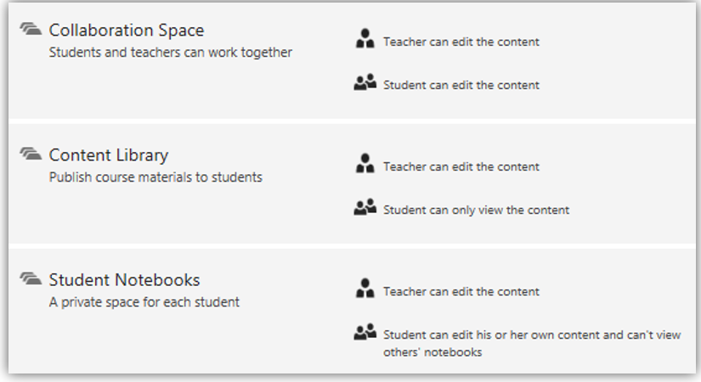
Unpack a Notebook
Web UI with highlight
Select Class Notebook
Set Up Class Notebook
Organize Student Sections

Slide 9
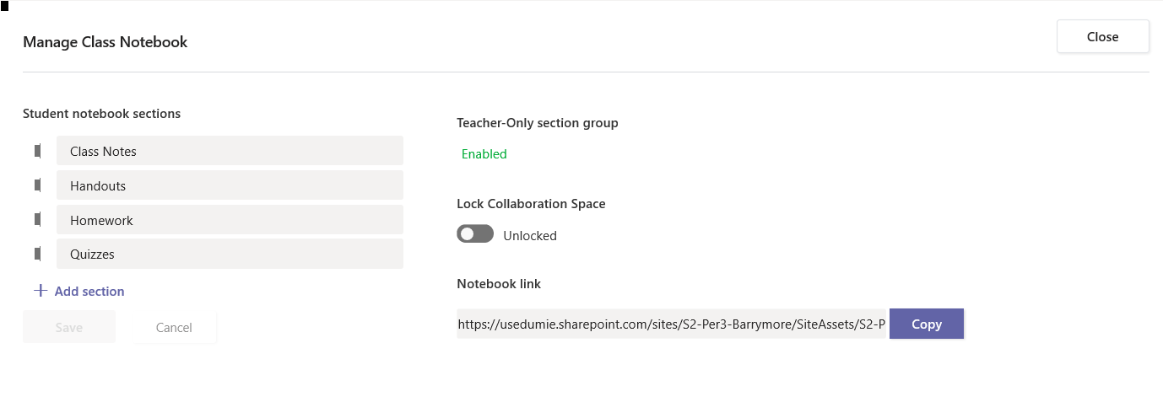
Manage Class Notebook
Web UI with highlight

Slide 10
Anatomy of Class Notebook
Web UI with highlight
Welcome – Share general course information and announcements
Content Library – Publish course materials for students to VIEW only
Collaboration Space - Teacher and all students can work collaboratively
Student Notebooks – Private space for each student to take notes, brainstorm, and work. Only the teacher and the student have access.

Slide 11
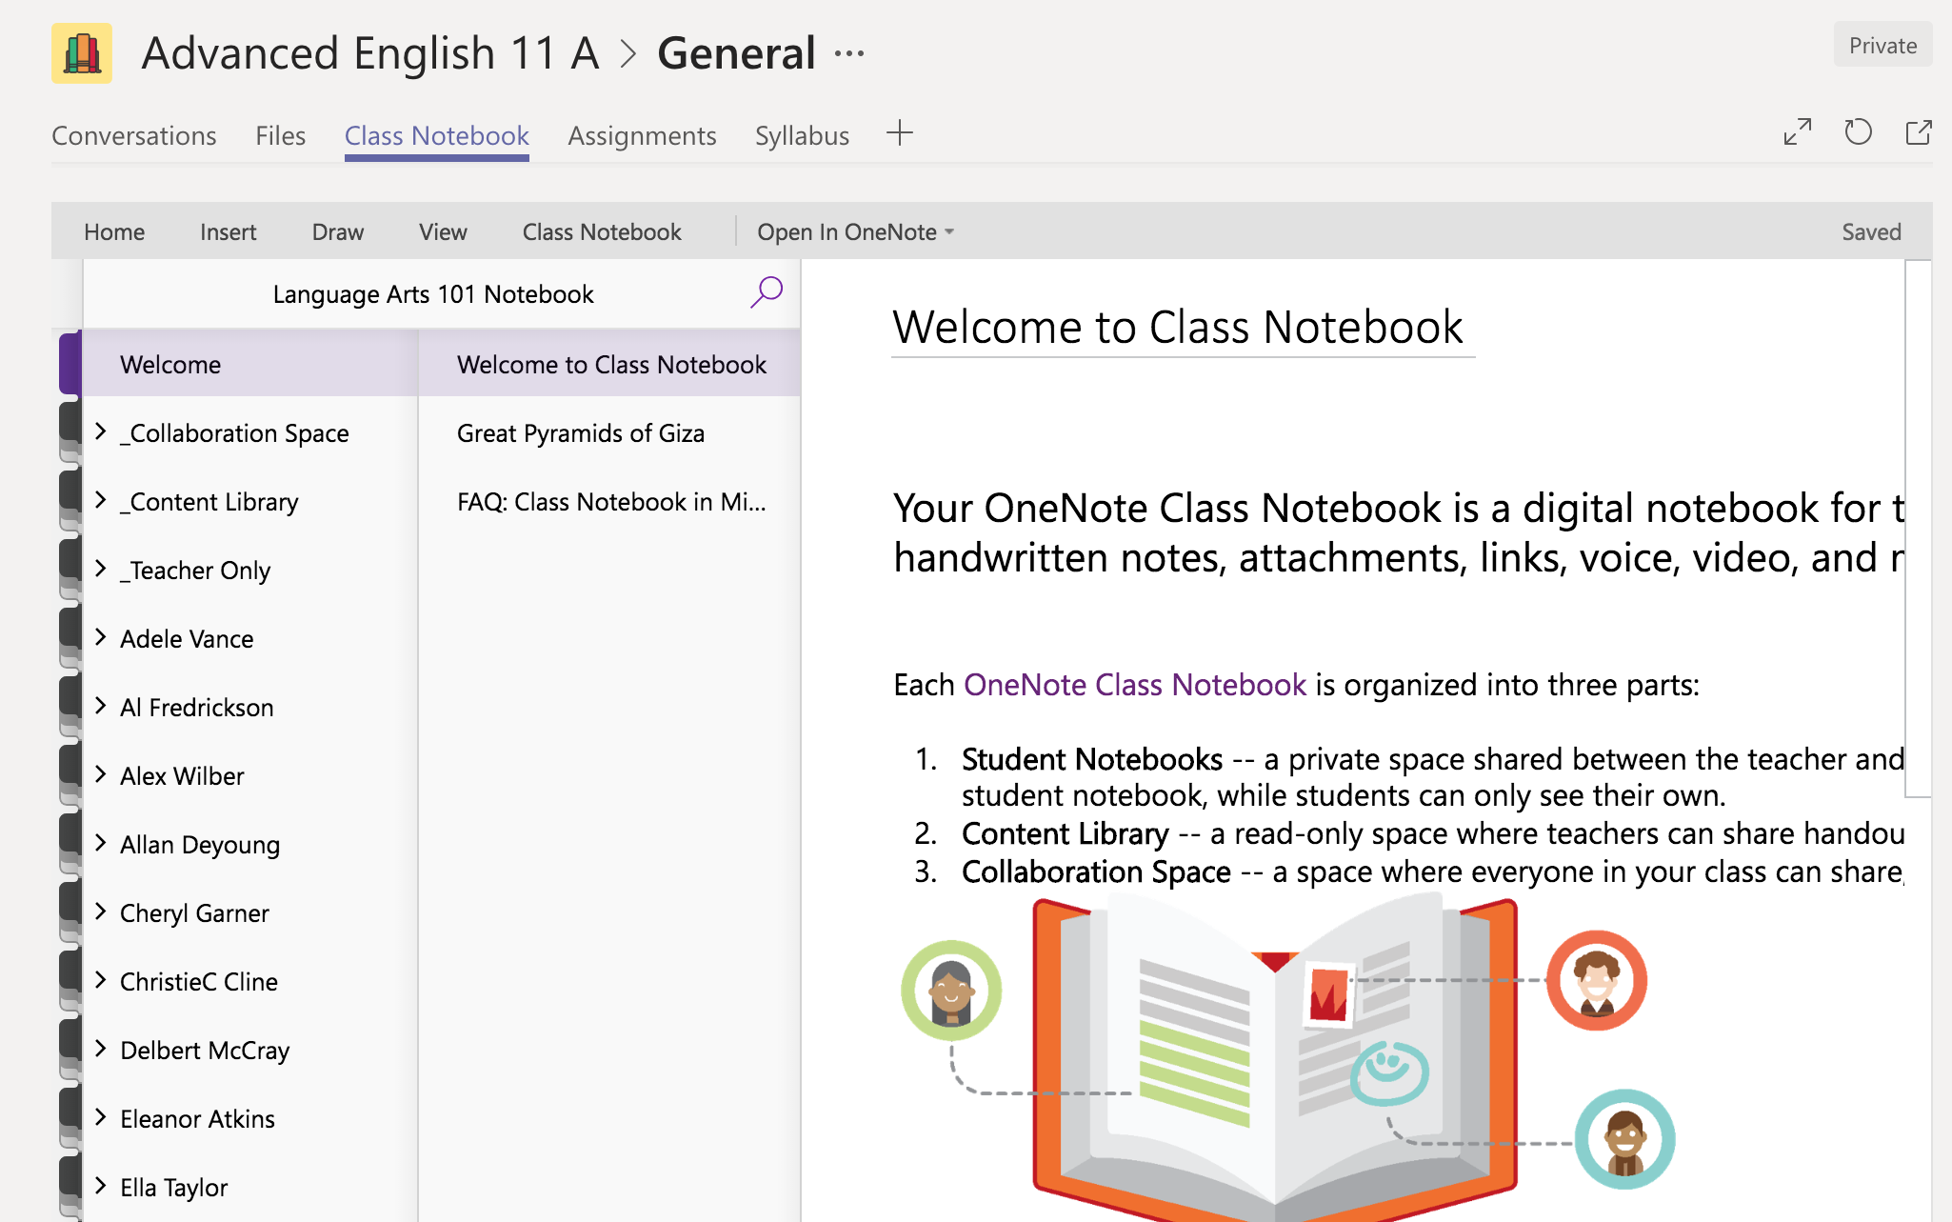
View of Class Notebook
Web UI with highlight

Slide 12
Things to Do
Web UI with highlight
Explore
Wake up a Class Notebook.
Create a Teacher Only section.
Explore the canvas and its features.
Possibilities include: tables, videos, links, and photos; record audio; add stickers, etc.
Apply
Consider an upcoming lesson or content planned.
Collect materials, do research, compile helpful resources.
Create an assignment or an experience for your students.

Slide 13
What You Can Do with Class Notebook
Web UI with highlight
Explain
Easily distribute content to whole classes or individual students
Track student work
Leave feedback and offer support
Send work back for revision
Reuse content

Slide 14
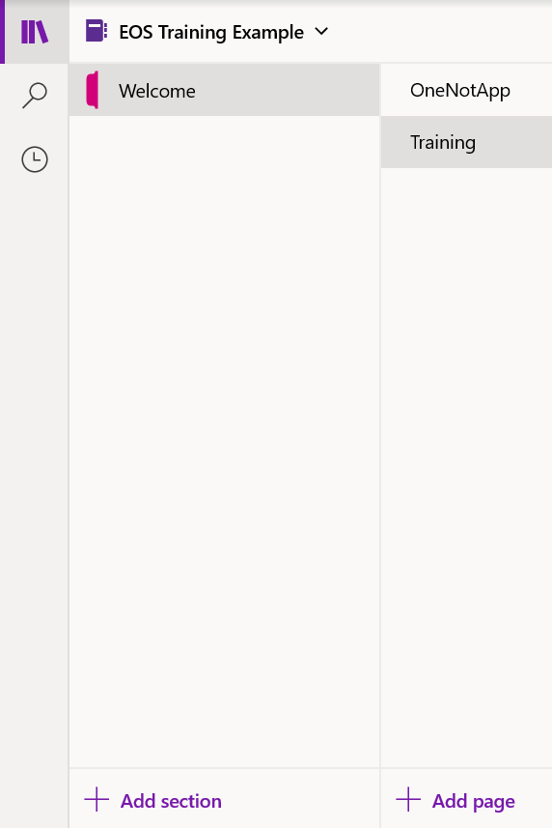
Adding Content to Notebook
Bookshelf
Search
Recent Notes
Add Sections
Add Pages

Slide 15
Getting Started: The Ribbon
HOME
Formatting
Headings
Dictate
Share
Tags
DRAW
Tools
Highlight
Shapes
Ruler
Math
INSERT
Tables
Files
Links
Audio/Video
Specialized content

Slide 16
Getting Started: The Ribbon
VIEW
Immersive Reader
Page Color
Rule Lines
Translate
Replay
CLASS NOTEBOOK
Add-In
Distribute Content
Assign/Review Work
Manage
HELP
Topics
Feedback
Training
What’s New

Slide 17
Getting Started: The Ribbon
VIEW
Immersive Reader
Page Color
Rule Lines
Translate
Replay
CLASS NOTEBOOK
Add-In
Distribute Content
Assign/Review Work
Manage
HELP
Topics
Feedback
Training
What’s New

Slide 18
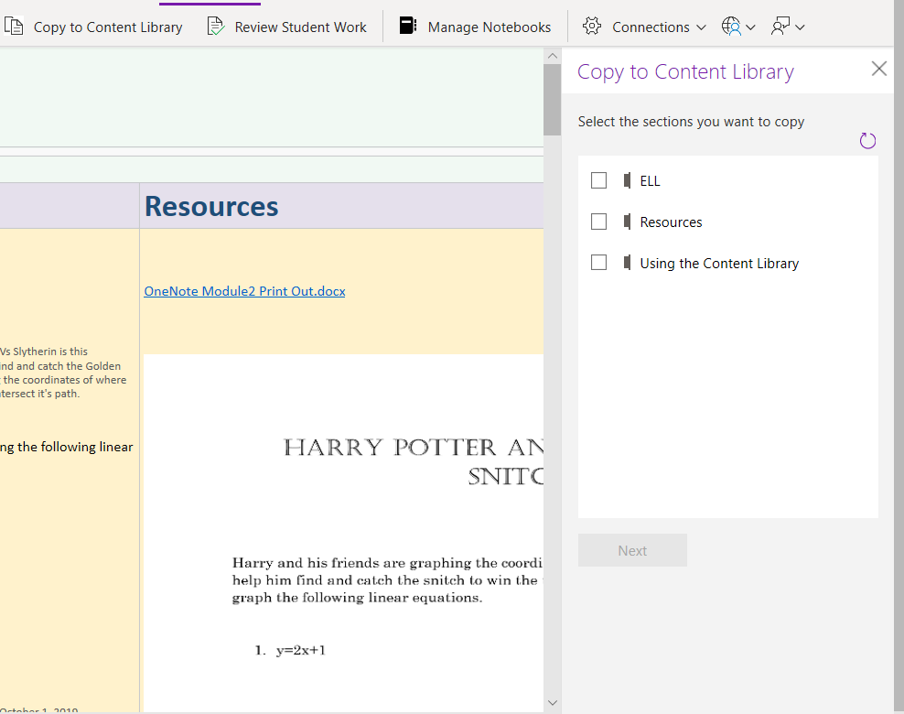
Distribute Content to Students

Slide 19
Student Collaboration
The Collaboration Space is open to everyone in a class, and all class members can read or write on anything in this part of the notebook. Teachers and students can also create new sections and pages in ways that work best for them.
For example, if a class splits up into group projects, each group could create a section where students can work together and share project-related materials. Educators can also create private sections in the
Better than a document on a file share or shared drive
With a Collaboration Space:
Multiple people can edit a document at the same time.
Changes are merged automatically.
The Collaboration Space section group is available offline for everyone.
Keep your class "on the same page."
The Collaboration Space is great for storing:
Class project vision and brainstorming ideas
Supporting materials collected by group members
To-do lists for students to mark off

Slide 20
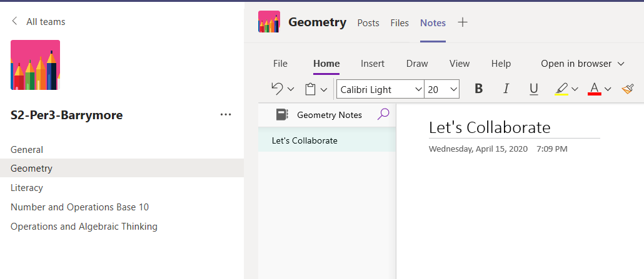
Channel Notes

Slide 21
Student collaboration examples
Notes:
This slide matches with the Student collaboration in Class Notebook in Teams: Situation and demonstration section of the Presentation plan.
Say:
“Now that you know where all the student work spaces are, let's see some examples of how real students use these spaces to complete the geometry assignment.”
“In this screenshot, we see that our example student, Adele, has gone into the Class Notes section of her private space and brainstormed shapes in nature ideas for the assignment.” (Click mouse to show)
“She’s taken notes by hand via a Stylus, and has even drawn a lovely little starfish.”
“Remember, only she and her teacher can see this.”
Do this:
Point to the examples of student collaboration in Class Notebook in Teams. Highlight features you’ve covered in the course so far.
Time frame: 30 seconds

Slide 22
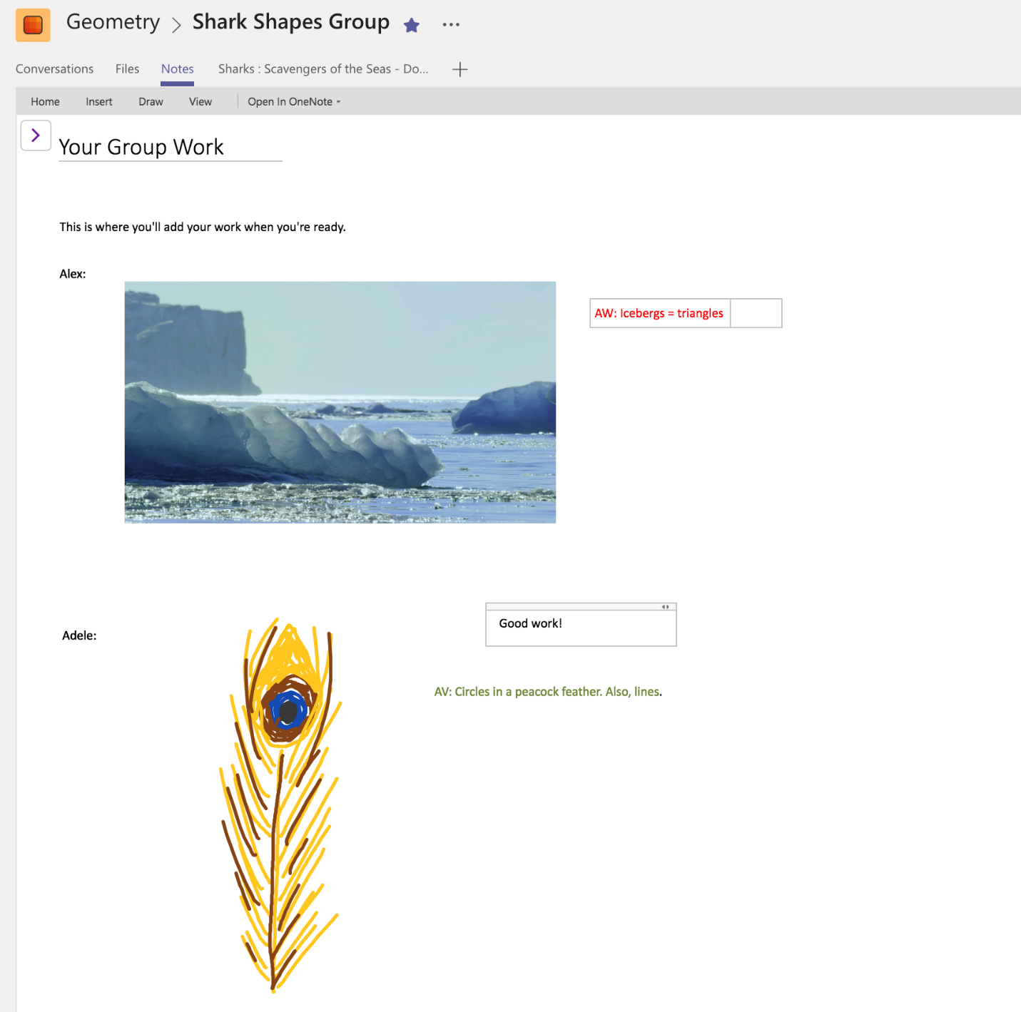
Student collaboration examples
Notes:
This slide matches with the Student collaboration in Class Notebook in Teams: Situation and demonstration section of the Presentation plan.
Say:
“When the students are ready to compile their work into a group setting, they’ll go into the Collaboration Space within their Class Notebook and find the section that has been designated for group notes.”
“Here you can see that Adele has added a sketch she made of a peacock feather.”
“Her group member, Alex, has also added a picture of an iceberg to represent triangles in nature.”
“They’ve both added comments in different colors to expand on their thoughts.”
Do this:
Point to the examples of student collaboration in Class Notebook in Teams. Highlight features you’ve covered in the course so far.
Time frame: 30 seconds

Slide 23
Student collaboration examples
Notes:
This slide matches with the Student collaboration in Class Notebook in Teams: Situation and demonstration section of the Presentation plan.
Say:
“Throughout the project, the group members need to communicate with each other and their teacher.”
“They’ve used the conversations feature of Teams to decide what topics they will focus on and to let each other know when they’ve added work to the Collaboration Space.” (Click mouse to show)
“They’ve also asked a clarifying question of their teacher, and one student explains where her work is in the flow.” (Click mouse once, then one more time to show both examples)
Do this:
Point to the examples of student collaboration in Class Notebook in Teams. Highlight features you’ve covered in the course so far.
Time frame: 30 seconds

Slide 24
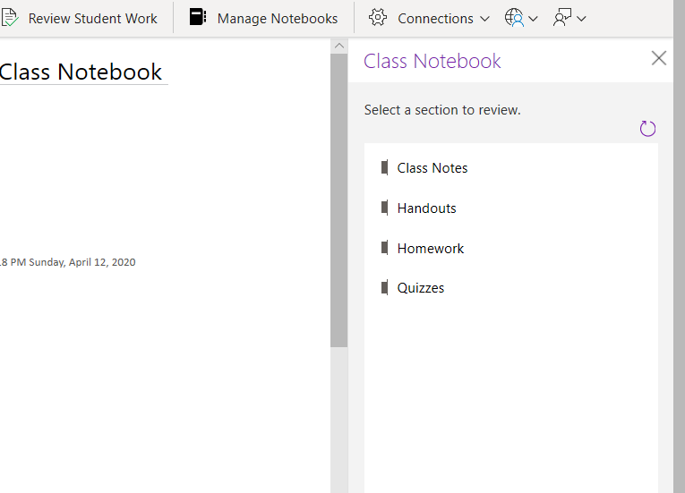
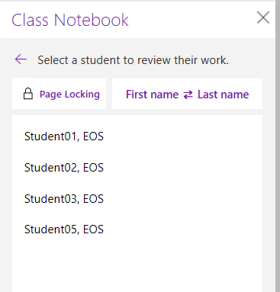
Review Student Work

Slide 25
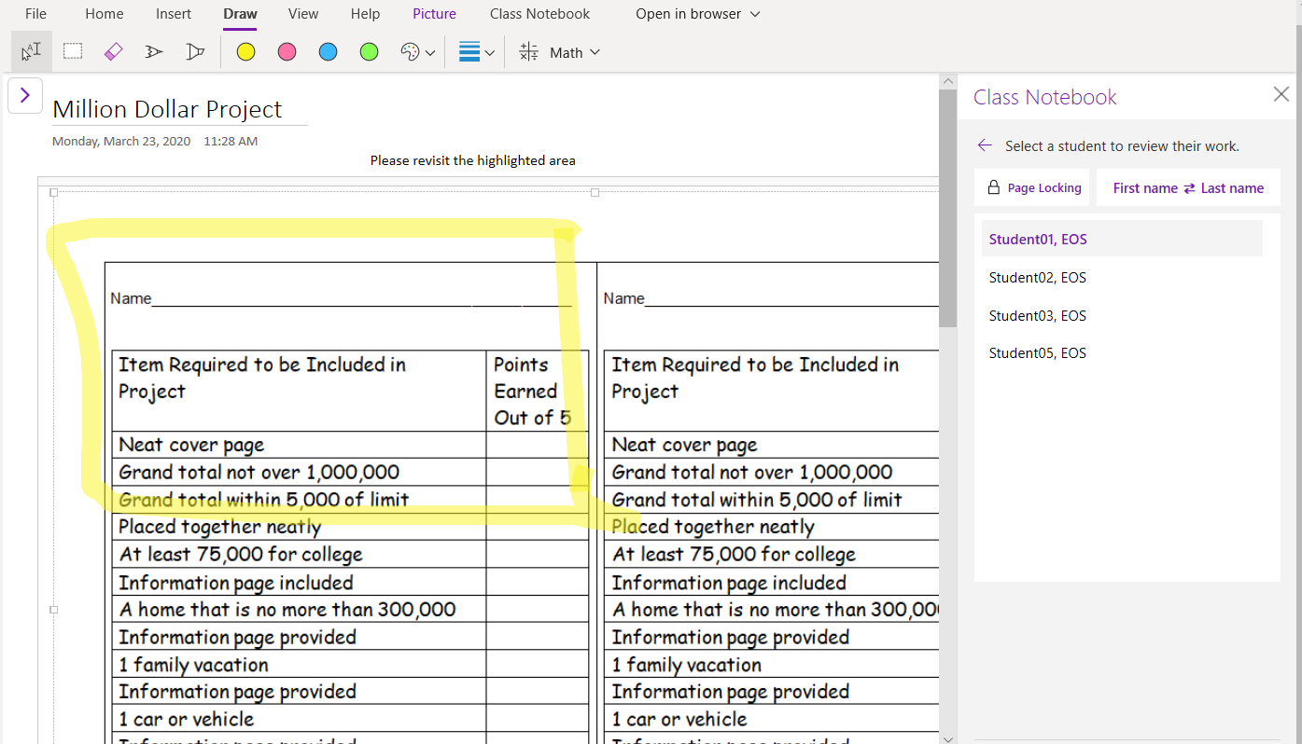
Provide Feedback

Slide 26
Reflection How might a digital binder with both private and collaborative spaces enhance student learning?

Slide 27
How can we support?

Slide 28
Thank You
Next Webinar: Friday, April 17, 2020 Supporting Learning Initiatives with Staff Teams 2:00pm EST
To learn more about additional resources and training available to support the transition to Distance Learning please visit: mimio.boxlight.com/together/
Krista Walker
krista.walker@boxlight.com

