Slide 1
The Most Important IT Person in the Room:
Why Data Experts Own the Future
Kevin Kline, SentryOne
  Principal Program Manager, kkline@sentryone.com
  Microsoft SQL Server MVP since 2003
  Twitter , Facebook, LinkedIn @ KEKline
  Author of SQL in a Nutshell, and 10 other books
  http://blogs.sqlsentry.com/author/kevinkline/

Slide 2
Agenda
What’s the context?
Others in IT
Power in the Narrative
An Epiphany in the Haystack
Secret Ingredients in the Sauce

Slide 3
Context
40% attrition expected in the next 10 years, according to Unisphere Research, meaning supply.
How are enterprises responding?
More consultants
More outsourcing
More H1B visas
More unskilled/accidental DBAs
Sometimes more pay
Older workers retiring
Middle-aged workers moving up and out
Top 10 professions according to Bureau of Labor Statistics.
Businesses are now better understanding the value of data.
15% growth year-over-year, meaning demand.
#5 best IT jobs
#12 best overall jobs
FaceBook and LinkedIn
Google
Notes:
What happens when demand goes up and supply goes down?
“Shortage of skilled staff will persist. In the U.S. alone there will be 181,000 deep analytics roles in 2018 and five times that many positions requiring related skills in data management and interpretation,” IDC predicted.

Slide 4
Others in it
Is it all IT people or is it just me?

Slide 5
System Admins?
It’s just servers.
Network Admins?
It’s all TCP/IP packets to me.
Email Admins?
An email is an email.
Developers?
Sometimes yes. Sometimes no.
Database Admins? BI/BA? Data Scientists?
Yes, always, every time.

Slide 6
Power in the narrative
Data tells a story. And that empowers us.
Notes:
Data tells a story. If I’m a developer or a DBA for an oncology practice, our data tells the story of a group of people struggling to overcome cancer. What therapies have the used? What was their health outside of the diagnosis of cancer? Were they young with their whole life in front of them or advanced in years and approaching their sunset years anyway? Our data could tell that story, … if we wanted it to.
As data professionals, we’re the MOST empowered people in IT to tell our story. Yet, we seldom do. Why is that?

Slide 7

Notes:
First, let’s talk about stories. Stories are important because they are meaningful.
They resonate within our psyche and help us to determine our baseline for decision-making. That is, our values.

Slide 8

MEMORABLE
IMPACTFUL
PERSONAL
Notes:
Memorable: data and statistics are processed solely by the parts of the brain that process language. There is no emotional component to that brain process. Stories, on the other hand, can engage the entire brain, including emotions and even sensory regions of the brain.
Impact is measured in terms of impact on a single human. Statistics do not persuade. Use the anecdote of college fundraisers.
Personal stories connect to an emotionally significant component of the person’s psyche. Why do teenagers love horror movies? Because being scared resonates with them emotionally as they go through monumental hurdles of meeting new people, going to new schools, worry about bullies or fitting in. Meaning can be extract from a story only where there’s a personal connection. And when a story is well told, they connect not just with the characters in the story, but also with the storyteller. Use the anecdote about “rockstar” preachers.

Slide 9
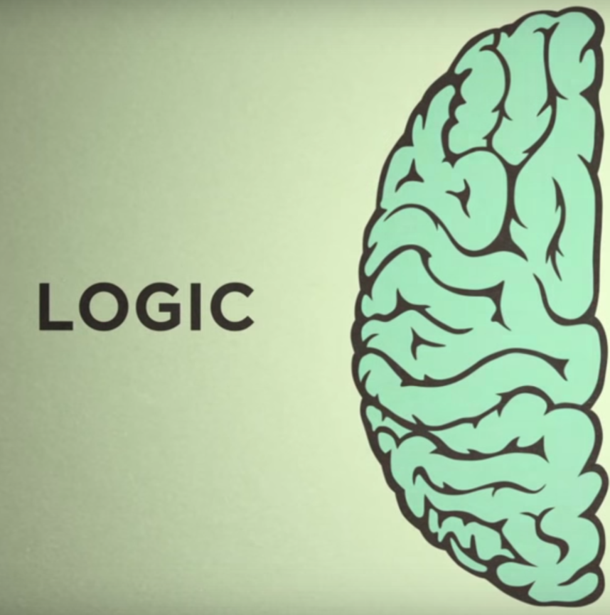
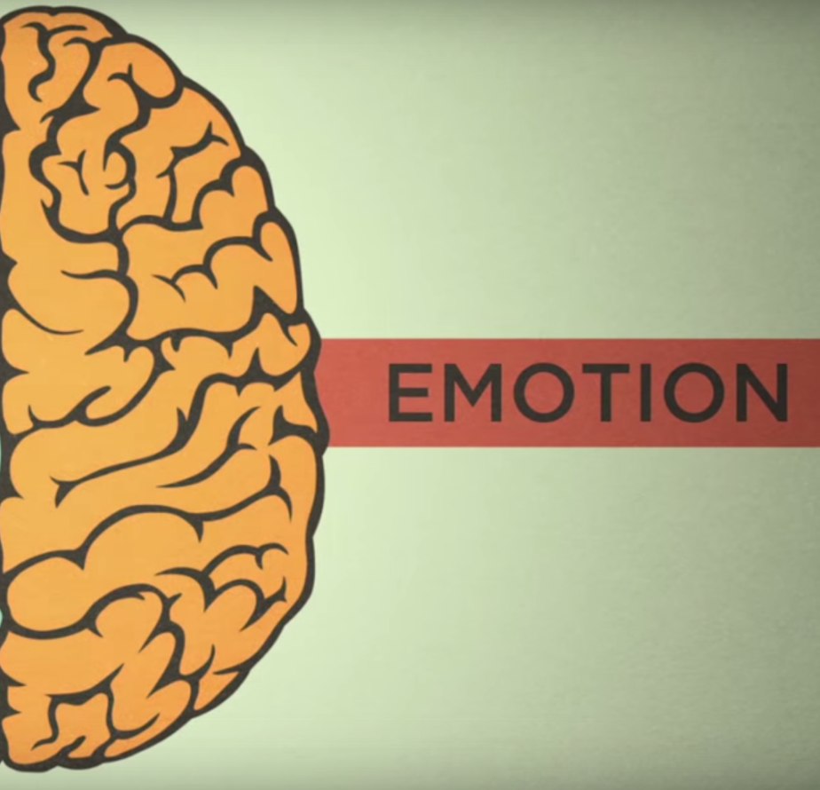
Notes:
Conventional wisdom used to say that ppl make decisions from a rational place.
What science now shows is that we make decisions based on our emotions … and then later use logic, facts, and data to back up those decisions.

Slide 10
DATA
+
STORY

Slide 11
=
Intellectual Connection
Emotional Connection
If history were taught in the form of stories, it would never be forgotten.
-Rudyard Kipling
Notes:
For lasting effect, you must connect with the emotional brain, but also resonate with the intellectual brain.
Data is one form of curations. So are stories.

Slide 12
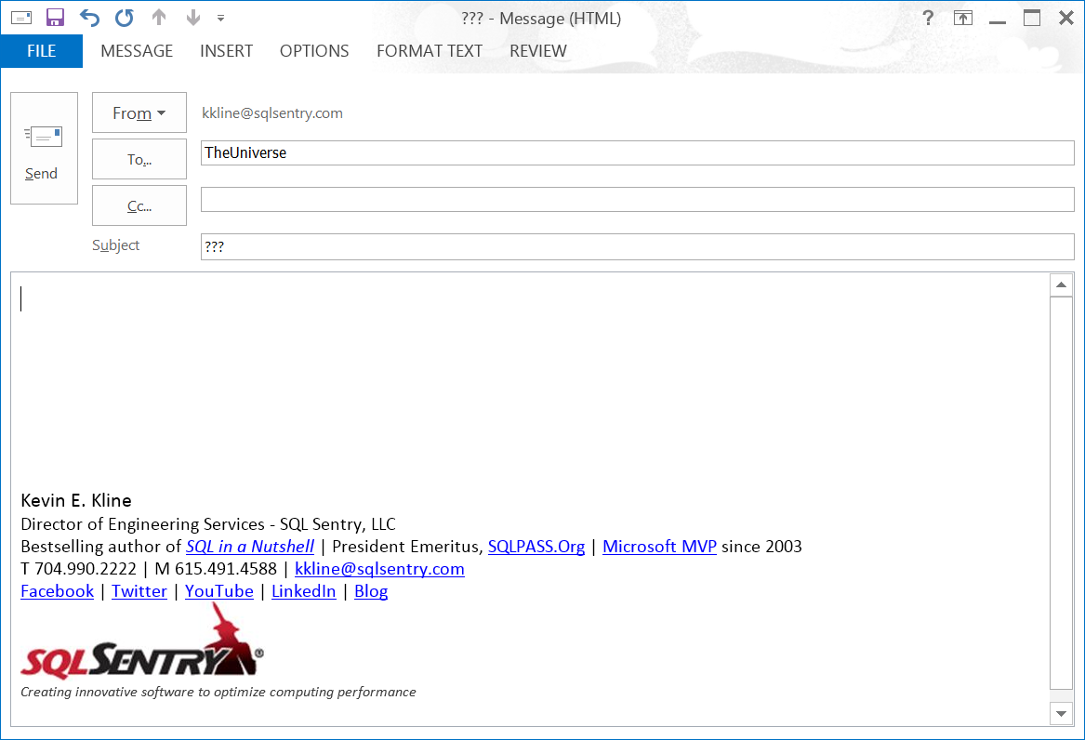
What’s the story?
Why are we making this decision?
Notes:
For most of us, we work with data every day, and yet make no effort to understand the story of our data. Why is that?
https://hbr.org/2013/04/how-to-tell-a-story-with-data/
https://www.thinkwithgoogle.com/articles/tell-meaningful-stories-with-data.html

Slide 13
An Epiphany in the haystack
Three stories: the Ghost Map, the Turing Test, & the FiveThirtyEight

Slide 14
The ghost map

Slide 15
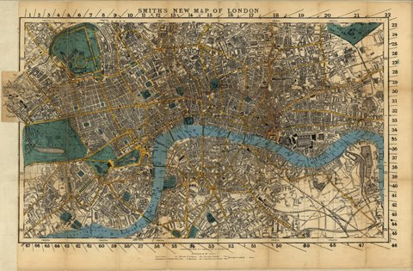
Notes:
Describe London, 1854, the year of the Big Stink. (Henry Mayhew, http://datavizblog.com/tag/mayhew/ ). Refuse, animals, pets, human waste. It was in this time that the Soho cholera outbreak would claim more than 10k lives.
John Snow, researcher lecturer and doctor/anesthetist to Queen Victoria. Henry Whitehead, vicar of St Lukes and genuine missionary to the poor of Soho.
The theory of miasma and “malaria”.

Slide 16
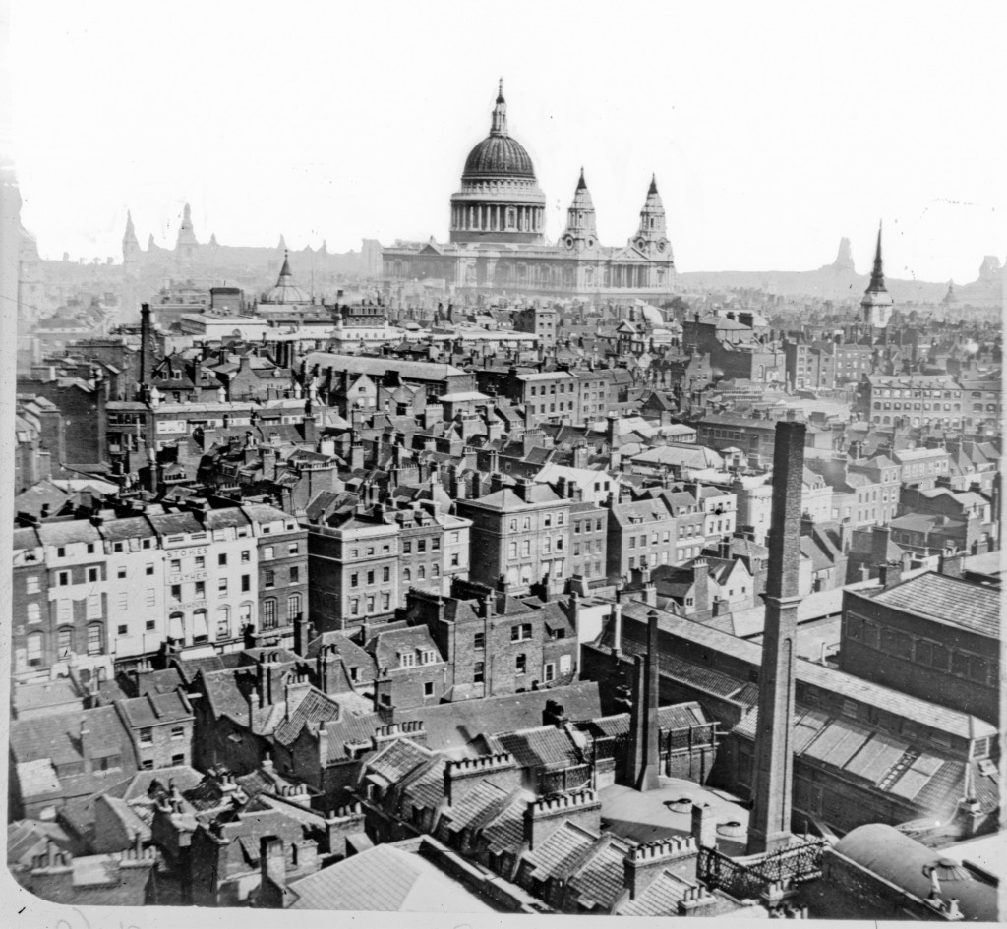
Notes:
The greatest city of the western world! The best industry, rail, energy sources, universities, research institutions, navy, army, and commerce.
In 100 years, the city grew from less than 1m to 3m! The industrial revolution, privatized common land, fast rail transport, and a new leisure lifestyle beckoned.

Slide 17
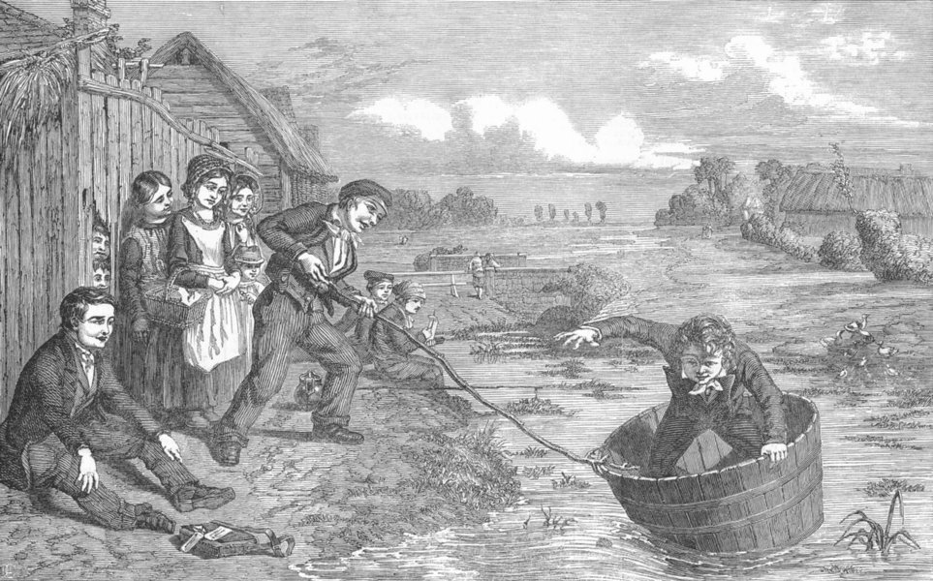

Slide 18
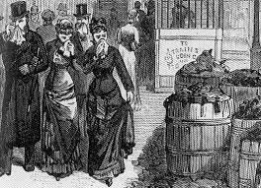
Notes:
Nightsoil men, cosymongerers, and toffers.
Cesspoils and the huge build-up of waste
Elizabethan sewers, with direct-to-the-Thames upgrades n 1840.

Slide 19
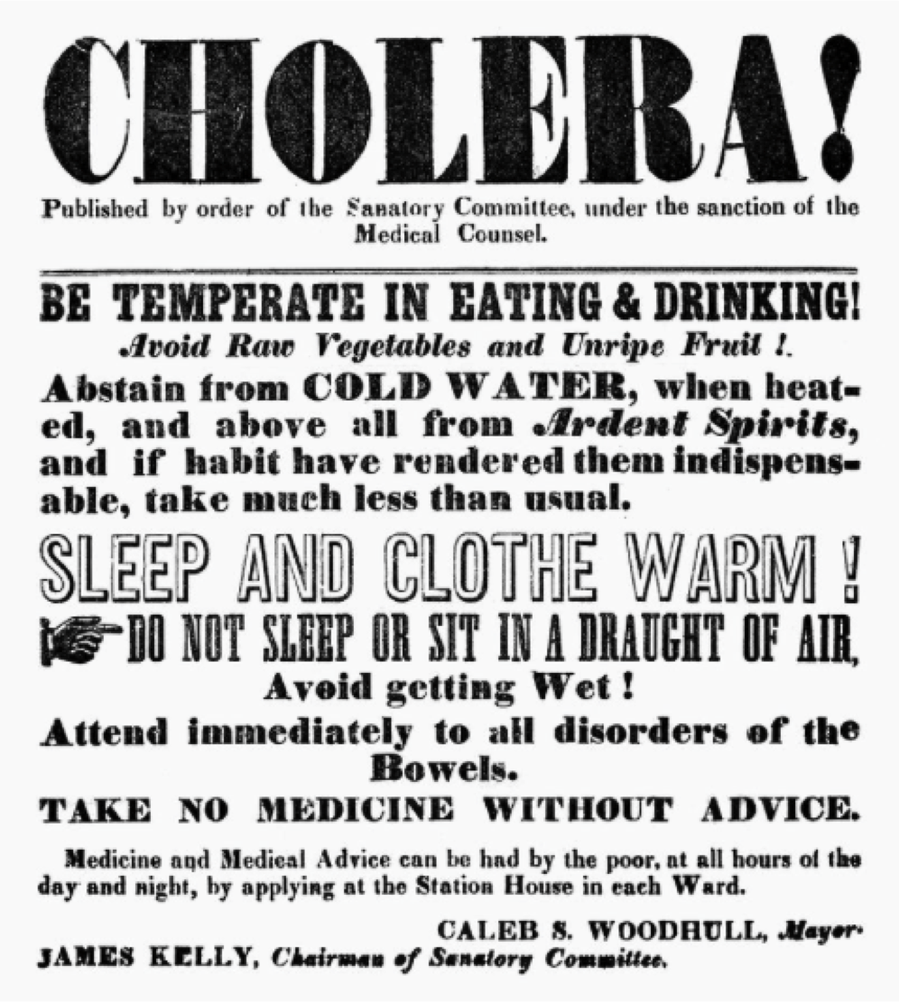
Notes:
10s of thousands of deaths and all, or almost all, were located around the pumps at Rupert Street, Little Marlborough, and Broad Street – whose water was so good that emigres such as Susannah Eley of Hampstead would have brought to her regularly. On the other hand, neighborhood holdouts like Lion Brewery, whose workers had their own water and could drink beer instead of water.
Miasma! Malaria!

Slide 20
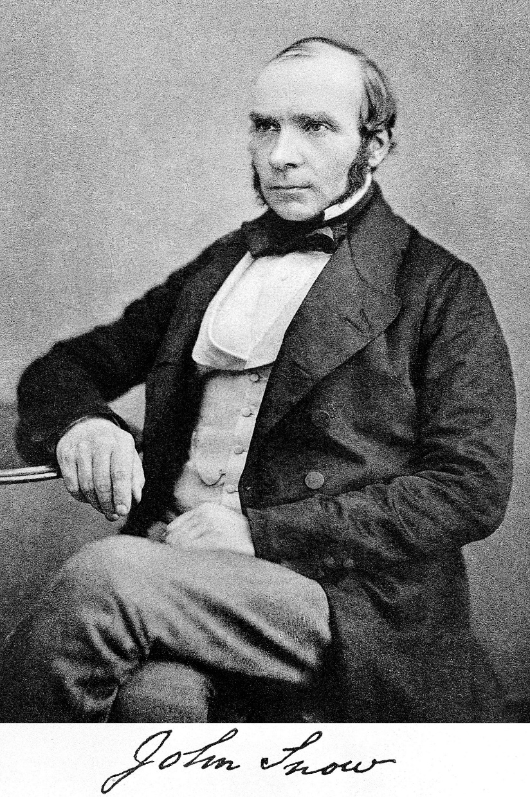
Notes:
Introduce Henry Whitehead + John Snow.
John Snow on a delivery of chloroform to a dentist…Maybe it’s waterborne? But how to prove it?
William Farr and the “Bills of Mortality”, with his statistical calculations. The Royal Society of Epidemiology was only 4 yrs old and statistics was only two decades old. Scientists didn’t believe the scientific method applied to illness and treatments for illness.
Private water from two companies – one rife with sewage from S&V water co and the other relatively clean from Lambeth co. Data was now available! 1 in 100 died on S&V while none from Lambeth. But now I must PROVE where these deaths happen to show now just correlation, but causation!

Slide 21
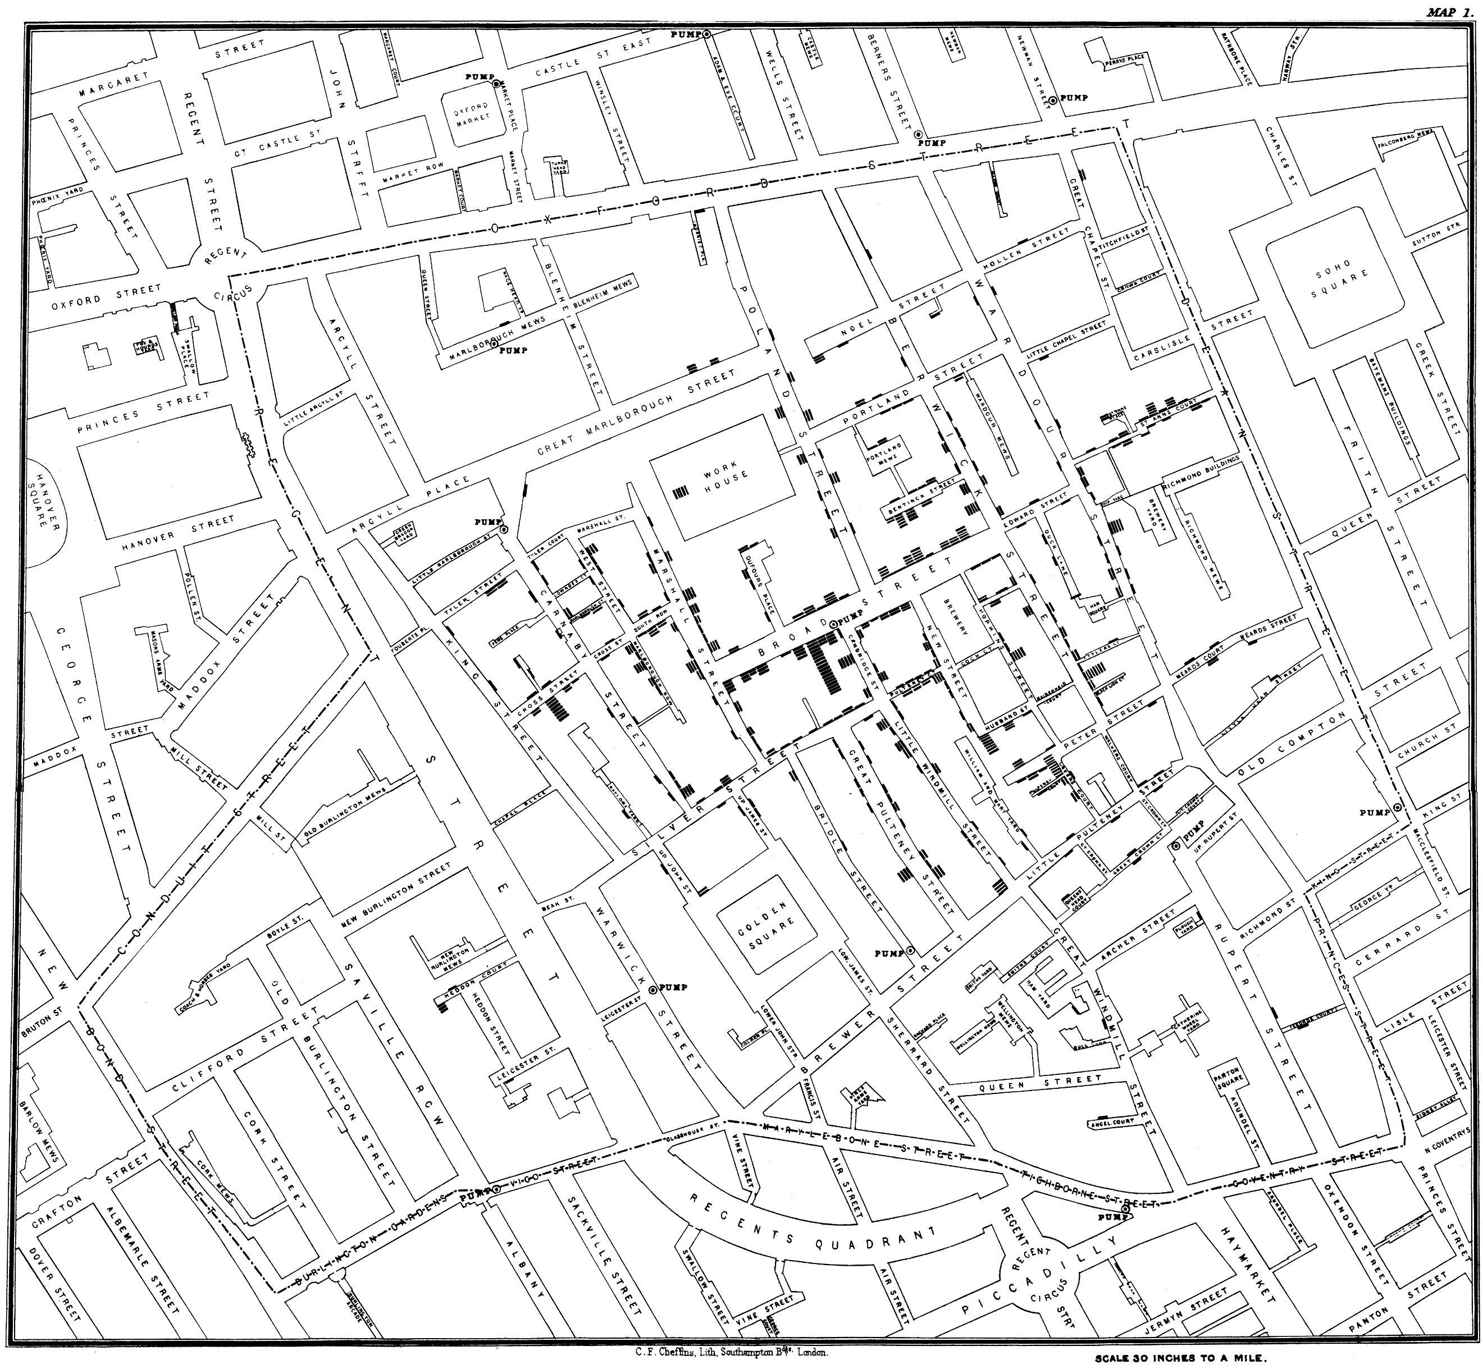
Notes:
Introduce Henry Whitehead + John Snow.
John Snow on a delivery of chloroform to a dentist…Maybe it’s waterborne? But how to prove it?
William Farr and the “Bills of Mortality”, with his statistical calculations. The Royal Society of Epidemiology was only 4 yrs old and statistics was only two decades old. Scientists didn’t believe the scientific method applied to illness and treatments for illness.
Private water from two companies – one rife with sewage from S&V water co and the other relatively clean from Lambeth co. Data was now available! 1 in 100 died on S&V while none from Lambeth. But now I must PROVE where these deaths happen to show now just correlation, but causation!

Slide 22
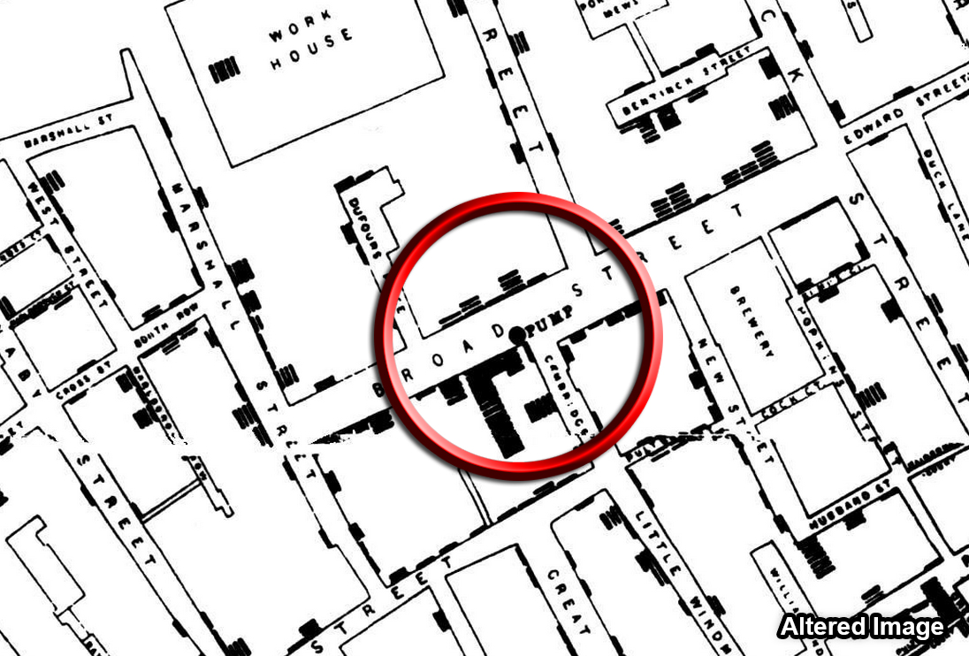
Notes:
Introduce Henry Whitehead + John Snow.
John Snow on a delivery of chloroform to a dentist…Maybe it’s waterborne? But how to prove it?
William Farr and the “Bills of Mortality”, with his statistical calculations. The Royal Society of Epidemiology was only 4 yrs old and statistics was only two decades old. Scientists didn’t believe the scientific method applied to illness and treatments for illness.
The Voronoi diagram showed walking distance to each pump.
The ghost map is now iconic. Edward Tufte, the father of modern data visualization, wrote about it. But what makes the ghost map truly innovative is the data behind it and the idea that the data is a reflection of real life facts collected by two Soho residents talking regularly to their neighbors.
Private water from two companies – one rife with sewage from S&V water co and the other relatively clean from Lambeth co. Data was now available! 1 in 100 died on S&V while none from Lambeth. But now I must PROVE where these deaths happen to show now just correlation, but causation!

Slide 23

Notes:
They persuaded local officials to remove the pump handle until, contrary to conventional wisdom, the cholera abated.
In one neighborhood alone, 21 instances of husband and wife dying within 24hrs of each other. Children died with there parents. Sometimes lingering the longest knowing everyone else in their family was dead. The daily hersts couldn’t carry all of the coffins away. In on stretch of four houses, 33 people had died.
Yet, the miasmists in science and government fought Snow and Whitehead tooth and nail for many years after. John Snow died before seeing his theories win the day.
But Henry Whitehead continued the battle, leading to an ecclesiastic support for the ghost map in the Vestry Committee which, while seeming small, was the first official blessing of the theory. It proved to be the snowball that started an avalanche.
The board of health would later build new sewers leading far south of the city center and its water suppy, finishing in 1887. It was an even bigger public works that then Eiffel Tower.
By 1866, the wider medical community accepted germ theory and, in shocking but somewhat predictable form, claimed to have worked shoulder-to-shoulder with Snow & Whitehead to conquer cholera.
Now, Google and Facebook can use similar algorithms in real-time to foresee an epidemic and trace the outbreak

Slide 24
The turing test

Slide 25
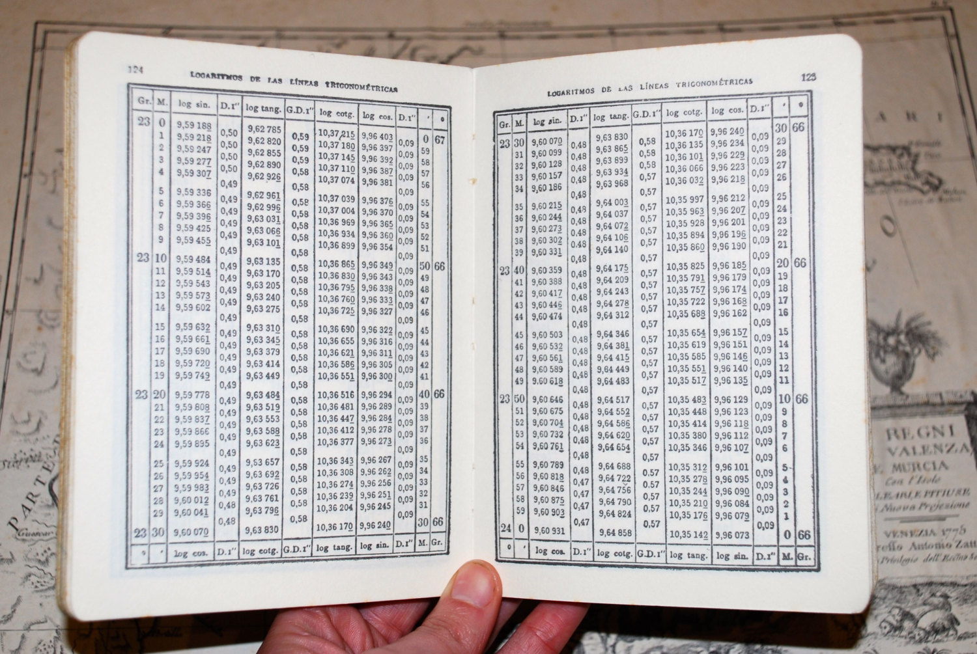
Notes:
For centuries, the term “computer” referred to a profession. A professional mathematician who derived answers to mathematical problems, often as a junior clerk.
Excluding the Bible, the best selling books after the invention of the printing press were, believe it or not, were books of math tables: multiplication, division, logarithms, and such. Interestingly, some of the very earliest books were often just copied in later versions, resulting in the occasional math error persisting for many generations, since no one ever checked the math.

Slide 26

Notes:
Alan Turning, considered the father of computer science and artificial intelligence, developed the Turing Maching (and the Turing Test) an early model of a general purpose computer. The Turing Test incidentally, has a common inverse, the CAPTCHA test to determine whether the user is a human and not a computer.

Slide 27

Notes:
The Bomb lead to increasingly innovative computers, such as the ENIAC, which employed punch card technology inherited from Flemish Jacquard Loom technology as a form of stored memory.
For nearly the next 40 years, computing machines incrementally improved, especially after the introduction of transistors and, later, microprocessors. But their work was still known as “Data Processing” well into the 1980s.

Slide 28
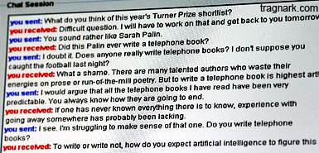

Notes:
Two subjects are separated from an interrogator who may ask questions using a teleprompt. The interrogator attempts to determine if the test subjects are human or computer.
If more than 30% of the judges mistook the program for human, the machine passes. The best computer contestants have required almost an hour to crack

Slide 29
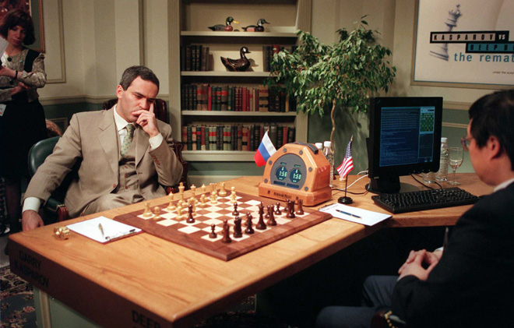
Notes:
Chest master Gary Kasparov versus Deep Blue. It wasn’t programmed to play chess. It was programmed to play Kasparov.

Slide 30
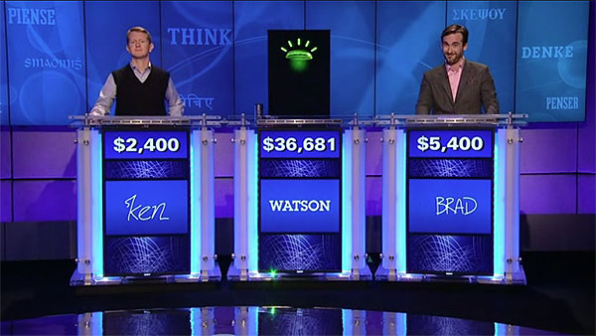
Notes:
Similarly, IBM’s Watson is programmed to understand the intersection of natural language and the most common questions (via wolfram alpha).

Slide 31
The FiveThirtyEight
Notes:
The data they used: https://github.com/fivethirtyeight/data/tree/master/pollster-ratings

Slide 32
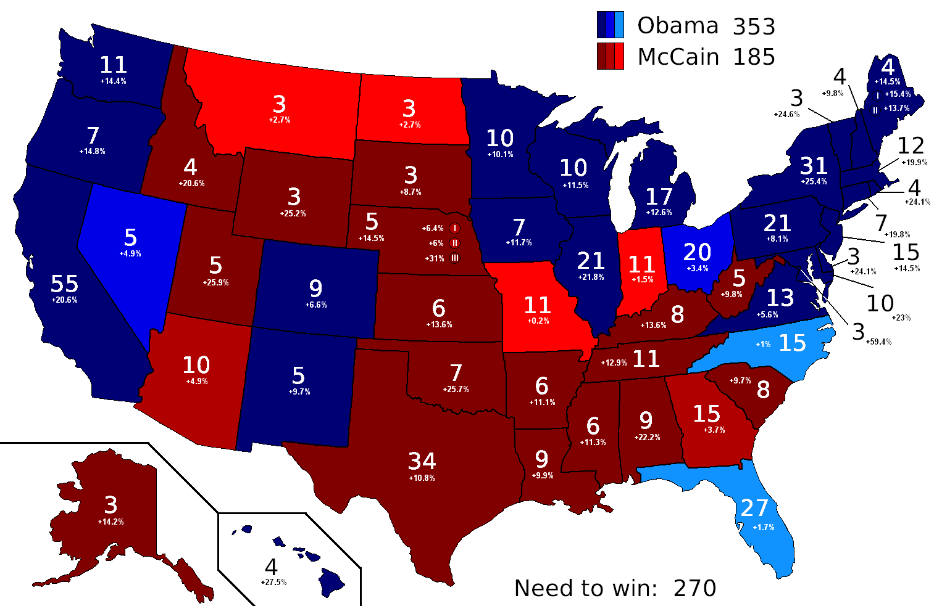
Notes:
The popular blog and website called FiveThirtyEight, taking its name from the number of electors in the US electoral college, is a harbinger of the new age of big data, data science, and societally-applicable statistical analysis. It also started a new field known as “data journalism”, because data tells a story!
Its founder, Nate Silver, started out as a baseball statistics fanatic. So much so that he started out as a baseball stats number cruncher and made a small fortune selling his first system, PECOTA, to Baseball Prospectus.
PECOTA & Baseball Prospectus have an interesting connection with the other Hollywood favorite marking the coming of bigdata, Moneyball.
While stranded in New Orleans airport, Silver got the idea of quantitatively analyzing the political game because he was sick of political analysts, pollsters, and demographic forecasters making many of the same mistakes as baseball scouts.
FiveThirtyEight went on to correctly call the outcome of 49 of the 50 states in 2008 presidential election, the Democratic loss of seats in the 2010 senate elections, and all 50 state in the 2012 presidential elections.
By comparison, entrenched big money pollsters are a swag. For example, Rasmussen Reports "missed on six of its nine swing-state polls“.

Slide 33
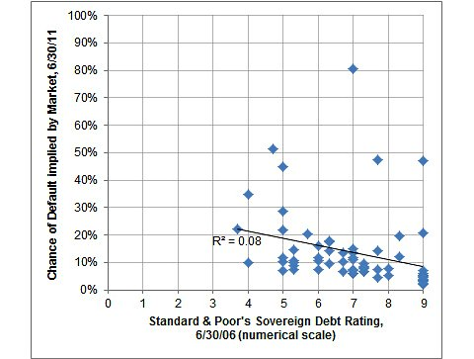
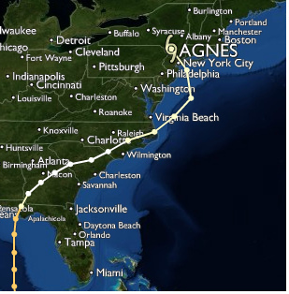
Notes:
FiveThirtyEight builds on the concepts developed during the era of the Ghost Map.
By apply deep subject matter expertise on a particular topic along with analysis of available date, 538 correctly identified that Standard & Poor’s analysis of sovereign debt (along with most other financial instruments they sold), were in their words “Substandard & Porous”.
Similarly, 538 began to implement predictive analytics, assessing the amount of financial impact a hurricane making landfall in the NYC area could cause. 538 expected between ~$58b to $83b in damages. A year after the event, the Economics & Statistics Administration estimated a $75b price tag.
Critics now argue against something that was rarely, if ever argued about in previous generations, the data itself.

Slide 34
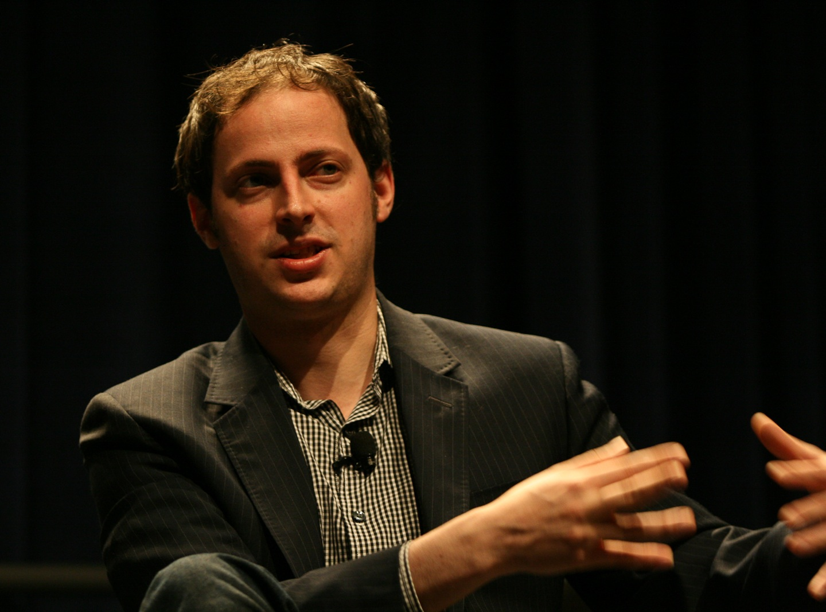
Gartner
Data is the “oil” of the 21st century.
Proprietary algorithms are the “refined” fuel.
Together, they are a means of acting on data to solve specific problems via direct action.
Notes:
Critics now argue against something that was rarely, if ever argued about in previous generations, the data itself. Whereas previous generations, would argue about the decisions made based upon available data, new lines of criticism are springing up that data and/or the algorithms used to assess the underlying data are intentionally constructed with bias to support a given line of thought.
http://www.theguardian.com/data
http://www.gartner.com/smarterwithgartner/wake-up-to-the-algorithm-economy/

Slide 35
Secret ingredients in the recipe
Four things MIPs do frequently

Slide 36
Become the MIP
Data as story.
Story within a narrative.
Memorable, Impactful, Personal.
Deep domain knowledge.
Tech skills +
team values.
Notes:
What’s the difference between a narrative and a story? A narrative is a coherent set of many stories all leading towards the same fundamental conclusions, values, or points.
They figure out the story explaining their data.
They build a narrative about their data so that it is a memorable, impactful, and personal.
They parse out the emotional power, as well as the intellectual power, of their story in order to persuade.
They seek to understand the impact of their data and, once done, ask new questions of it.

Slide 37
The Enterprise Architecture Question
If we can choose from a vast number of data platforms, which should we use?
Purpose & Payoff vs Ego
Team Skills vs Learning Curve
Team Values?
Recognize “Overchoice”
Key Features vs Frameworks
Notes:
PURPOSE vs EGO:
Many data platforms are become so specialized that they excel in specific industry verticles.
OVERCHOICE:
The number of active automobile manufacturers dropped from 253 in 1908 to only 44 in 1929, with about 80 percent of the industry’s output accounted for by the big three.
The Paradox of Choice by Barry Schwartz, also known as “overchoice”.
Overchoice leads to an over-reliance on anecdotal evidence (sales persuasion) and less on empirical analysis and research.
The more choice, the more the likelihood of buyers remorse.
FEATURES vs FRAMEWORKS:
When assessing NoSQL or non-MSSQL choices, remember that most open-source platforms are only frameworks. It’s like they’ve supplied you a lumber yard, and you now

Slide 38

Recap
There are NO IT problems. There are human problems solved using IT.
  The core asset in IT is its data.
Humans naturally think in terms of story and narrative.
  Data is the part of IT that tells a story.
Learn how to tell a data-driven story with emotional heft:
  Memorable
  Impactful
  Personal
Be curious about your data and write new stories with it.

