Slide 1
Pitch Perfect
Presenting Ideas That Win Executive Support
Kevin Kline, Principal Program Manager

Slide 5
Kevin Kline
Founder & Past President of PASS
Kevin was one of the original nine independent founders of PASS and served two terms as president from 2004-2008.
Industry Expert
Kevin authored his first technology book out of 11 (on Oracle, gasp!) in 1995. His best known book is SQL in a Nutshell, a best-seller. He has been a Microsoft Data Platform MVP since 2003.
Principal Program Manager, SentryOne
The Horde
Kevin has a big blended family of one son, now 26, and six daughters, ranging in age from 24 to 14. The Horde has taught him patience at the cost of his hair, literally.
/KEKline
@KEKline
KEKline

Slide 6
Agenda
Set the Context
Obstacles and Workarounds
Pitching Ideas, A Methodology:
Credibility
Align with the Biz
Build the proposal
Get Explicit Buy-In
Follow-up Explicitly
Summary

Slide 7
Groundwork: Political Capital
Build political capital, so that you’re more likely to sway decisions when you make requests or express opinions.
Don’t give reasons to reject your ideas out of hand
Aim for basic competency in:
Technical credibility
Communication skills
Listening skills
Team building
Professionalism
Train to overcome your weaknesses or get an ally.
One weakness generally isn’t an obstacle.
Two or more weakness can be a big obstacle.

Slide 8
Obstacles and Workarounds
Rational pitches work only when the audience is _________.
Relationships.
FUD.
Confirmation bias.
The trump card for persuasion is always __________.
Notes:
=rational=
=values=

Slide 9
Notes:
Conventional wisdom used to say that ppl make decisions from a rational place.
What science now shows is that we make decisions based on our emotions … and then later use logic, facts, and data to back up those decisions.

Slide 10
Methodology for Pitching: A Persuasive Argument
0. Credibility
1.
Align with the Biz
2.
Build the proposal
3.
Get Explicit Buy-In
4.
Follow-up Explicitly
Notes:
Some people think that making proposals or asking for things builds credibility. It doesn’t. You must have at least some credibility first to achieve your ends. So think of credibility as a pre-requisite.

Slide 11
Align with the Business
Demonstrate that you understand the business and what the business needs
What do the managers need to be considered successful?
Consider when asking for something, …
How will it further the goals of the organization?
How will it further the goals of other teams or potential allies?
What are the immediate questions that arise from the proposal? Anticipate them and have answers prepared.

Slide 12
Build the Proposal
Have several formats:
Super-short, 2-minute “elevator pitch”
Executive Summary, for “IT-ish” people
Full proposal, often a full business case, with details as appendixes
Describe the situation and its opportunities or consequences:
A challenge or problem that needs help
An idea that needs support, approval or input
What’s the risk? Or, what’s the ROI?
SWOT or another form of analysis?
Notes:
Leaders who are skillful at gaining support and resources for their staff and who can remove obstacles when appropriate are often seen as powerful and positive role models in their organization.
You need this skill to 1) remove a challenge w/ higher-level help or 2) your team has generated an idea that needs support, approval, or input

Slide 13
Example Pitches
Pitches in Useful Formats

Slide 14
Due Diligence
Appropriate documentation to be well prepared:
Business case
Technical assessment
Often just a spreadsheet
Definitely include non-technical aspects like Support, Release Cycles, Training available, etc
ROI study
Risk assessment, where appropriate
Community Ratings? Try https://trustradius.com
Notes:
Describe benefits:
–Process efficiencies –System usage efficiencies –Organizational efficiencies –Cycle time reductions –Per unit/transactional efficiencies –Revenue improvement
Categorize:
–Cost Savings –Cost Avoidance –Revenue Uplift
Payback scenarios:
–Cost Savings Only –Cost Savings + Cost Avoidance –Cost Savings + Cost Avoidance + Revenue

Slide 15
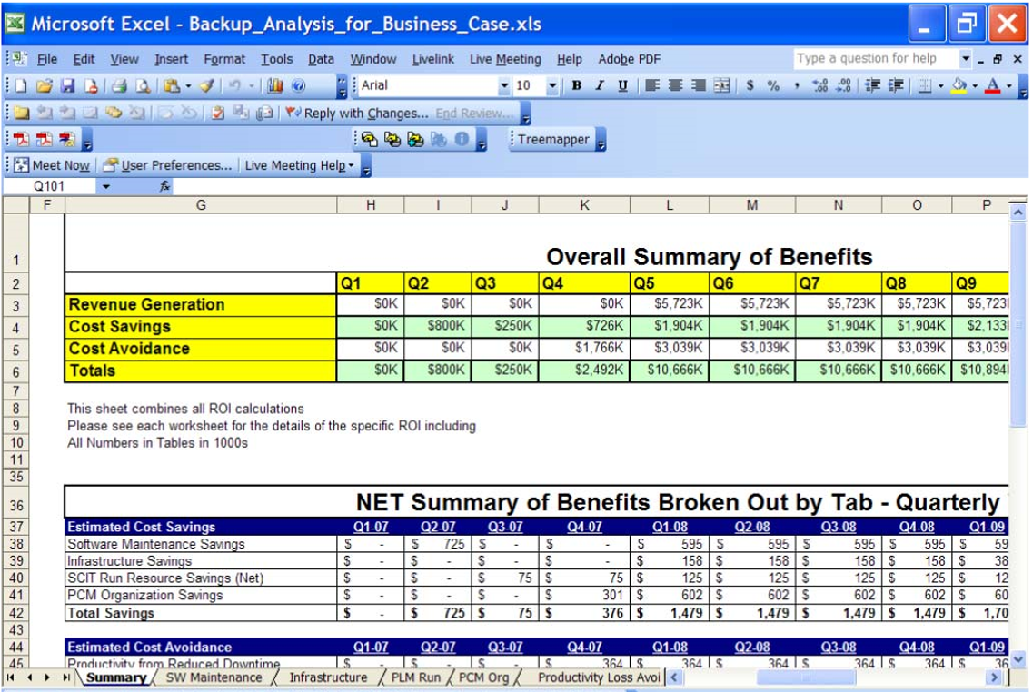

Slide 16
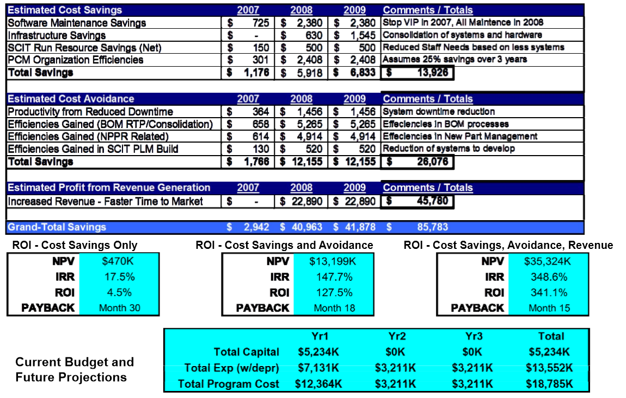

Slide 17
Test Before Launch
You wouldn’t roll out a new software release without QA or a trial, would you?
Solicit input from trusted friends, mentors, allies who will provide real constructive criticism.
Ask you most trusted friends to play devil’s advocate and shoot holes in your proposal.

Slide 18
Get a Commitment
One of the most common mistakes is not making an explicit call to action. With that in mind …
Depending on manager’s style:
“May I make a suggestion…?”
Ask for manager’s ideas & suggestions, offer yours
Propose solution, its benefits, then probe for reaction
Trial run – make it easy to say ‘yes’.
Come to agreement on solution and action plan.
Send summary email afterwards.
Define the explicit follow-up date and express appreciation
Notes:
The oreo compliment…
Make it seem like their idea…
The puppy proposal…

Slide 19
Don’t Know Much About Negotiations
For products:
Don’t forget price is separate from annual product maintenance (APM) .
Quantity discounts are the norm.
You can negotiate on many fronts: price discounts, APM discounts, deep discounts on secondary products, included training, included services, and more.
For services:
Discounts by volume, for retainer, or alternately by project
You can also negotiate by giving back, such as becoming a reference customer, offering public testimonials, and acting as case-study participants.
Some companies are very driven by quarter-end and year-end metrics.

Slide 20
Follow-Up
A very common mistake is failing to explicitly follow-up at a specific time and date.
For greatest impact, express gratitude for the trust and the opportunity.
Report on progress at regular milestones, whether it’s required or not.
After completion, provide a follow-up report touting the success of the initiative, lessons learned, ROI achieved, brag on the team, etc.
Remember that political capital has the physics-like properties of momentum and inertia.

Slide 21
Text ‘KEVIN’ to 797979 for slides and scripts.
Summary: Pitch Perfect
The groundwork builds political capital.
Common obstacles: rationality vs emotions, FUD, confirmation bias.
Values-based appeals are the ace card.
Follow the 5-step methodology:
Credibility
Align with the Biz
Build the proposal
Get Explicit Buy-In
Follow-up Explicitly

Slide 22
Learn more from Kevin Kline
@KEKline
kkline@sentryone.com

