Slide 1
Secrets of the Query Optimizer Revealed
Presenting Ideas That Win Executive Support
Kevin Kline, Principal Program Manager

Slide 5

Kevin Kline
Founder & Past President of PASS
Kevin was one of the original nine independent founders of PASS and served two terms as president from 2004-2008.
Industry Expert
Kevin authored his first technology book out of 11 (on Oracle, gasp!) in 1995. His best known book is SQL in a Nutshell, a best-seller. He has been a Microsoft Data Platform MVP since 2003.
Principal Program Manager, SentryOne
The Horde
Kevin has a big blended family of one son, now 26, and SIX daughters, ranging in age from 24 to 14. The Horde has taught him patience at the cost of his hair, literally.
/KEKline
@KEKline
KEKline

Slide 6
About the session
What this session is not:
  An end-to-end optimizer session
  A performance tuning session
Goals of this session
  Additional and deeper understanding of SQL Server optimizer internals
  Understanding query processing queries
  Provide an additional skill for performance tuning
Special thanks to Brian Hansen:
Twitter: https://twitter.com/tf3604
Blog: http://www.tf3604.com/
Also, thanks to Rob Volk, Paul White, and Benjamin Nevarez.

Slide 7
Agenda
Background:
  Physical processing considerations
Executing a query:
  Parse, bind, transform, optimize, execute
Revealing the secrets:
  Heuristics, transformation rules, parse trees, memos with trace flags 860x
  Extended events and DMVs
Limitations & DMVs

Slide 8
I Want Hidden Secrets!
Combine T3604 with DBCC {RULEOFF | RULEON}
  DBCC RULEOFF ('GetToScan')
  DBCC RULEON ('GetToScan')
  DBCC RULEON ('JNtoHS')
  DBCC RULEON ('JNtoSM')
Use DBCC {SHOWONRULES | SHOWOFFRULES} to see the access methods chosen by the optimizer.
Use OPTION ( {QUERYRULEON | QUERYRULEOFF} ) for query-level hints.
Notes:
Script 13

Slide 9


Example Query: People vs SQL Server
FROM CorpDB.dbo.OrderHeader oh
INNER JOIN CorpDB.dbo.OrderDetail od
INNER JOIN CorpDB.dbo.Customer cust
ON oh.OrderId = od.OrderId
ON oh.CustomerId = cust.CustomerID
WHERE cust.State = 'NE'
GROUP BY od.ProductId
HAVING SUM(od.Quantity) >= 20
SELECT od.ProductId, SUM(od.Quantity) - 20 ExcessOrders
ORDER BY od.ProductId
TOP 5;

Slide 10
Example Query: SQL Server vs People

Slide 11
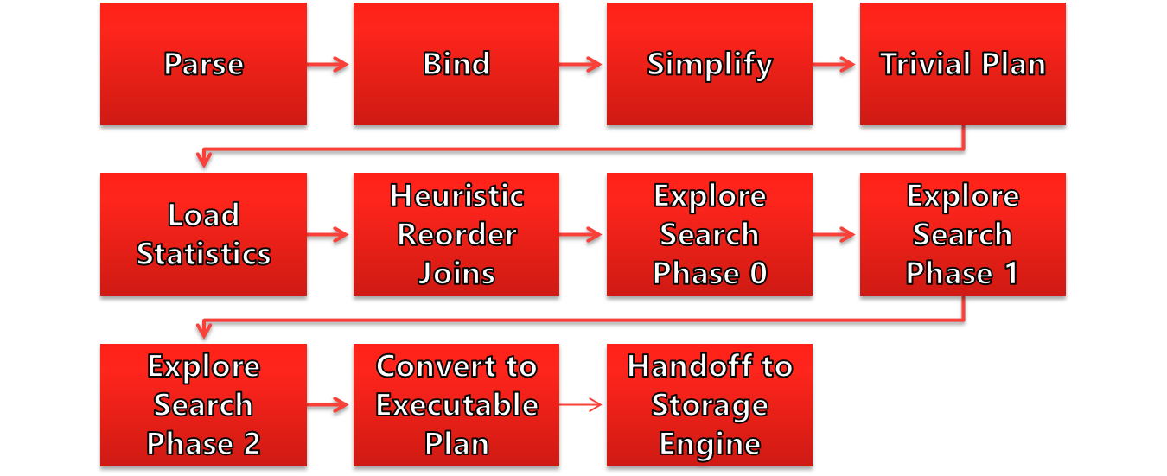
Deep Dive on the Query Processing
Notes:
Parsing and binding are the first operations performed when a query is submitted to a SQL Server instance. They produce a tree representation of the query, which is then sent to the query optimizer to perform the optimization process. At the beginning of this optimization process, this logical tree will be simplified, and the query optimizer will check whether the query qualifies for a trivial plan. If it does, a trivial execution plan is returned and the optimization process immediately ends. The parsing, binding, simplification, and trivial plan processes do not depend on the contents of the database (such as the data itself), but only on the database schema and query definition. Because of this, these processes also don’t use statistics, cost estimation, or cost-based decisions, all of which are only employed during the full optimization process.

Slide 12
Parsing and Binding
Sometimes called the ‘algebrizer’ or ‘normalizer’
Validates correct syntax
Identifies constants
Expands views
Builds initial logical parse tree*
Metadata discovery & name resolution; Beware deferred name resolution
Checks user permissions
Data type resolution (e.g. UNIONs)
Aggregate binding; Associates table/column names to system catalog
Generates a hash based on query text
Checks plan cache to see if it exists
Notes:
Parsing and binding are the first operations performed when a query is submitted to a SQL Server instance. They produce a tree representation of the query, which is then sent to the query optimizer to perform the optimization process.
At the beginning of this optimization process, this logical tree will be simplified, and the query optimizer will check whether the query qualifies for a trivial plan. If it does, a trivial execution plan is returned and the optimization process immediately ends. The parsing, binding, simplification, and trivial plan processes do not depend on the contents of the database (such as the data itself), but only on the database schema and query definition. Because of this, these processes also don’t use statistics, cost estimation, or cost-based decisions, all of which are only employed during the full optimization process.
Generates a hash based on query text
Important: Case sensitive, white space sensitive
Checks plan cache to see if it exists
May be first time, may have been aged out
If a match is found, move to query executor
If a match is not found, then optimization must occur before going further

Slide 13
Parse trees
Notes:
a.k.a. query trees, or relational trees
Script 11

Slide 14
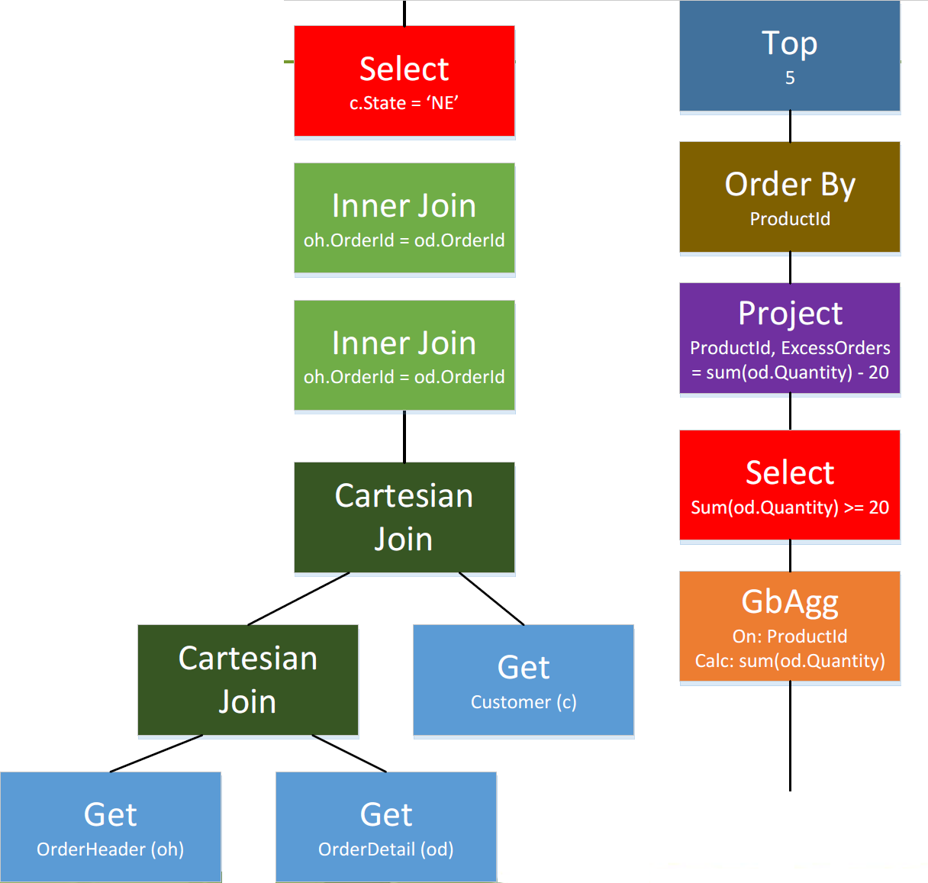
Parse trees
More like a WHERE clause
Internal representation of logical query operators
Nodes may be logical or physical operators; logical at first
    0 to infinity inputs, 1 output
SQL Server will output parse trees at various phases of optimization
    Special trace flags will trigger output
    Used to initialize the Memo structure
More like a SELECT clause
Notes:
a.k.a. query trees, or relational trees
Script 11

Slide 15
Early Stage Metadata
Early stages of QP do NOT depend on contents from the database:
  The data itself
  Statistics
  Cost estimates
  Cost-based decisions
Only need database schema and query definition.

Slide 16
Simplification
  Make this query easier to process! Do things like standardize queries, remove redundancies.
  For example:
    Convert subqueries to joins; Convert inner join to outer join
    Remove redundant joins, such as foreign key join elimination
    Predicate pushdown
    Contradiction detection
    Aggregates on unique keys
Notes:
Graphic windows property, by pressing F4 on the plan operator, in SSMS execution plan will show TRIVIAL.
Showplan XML will show a StatementOptmLevel attribute as TRIVIAL.

Slide 17
Trivial Plans
  The last step before true query optimization takes place.
  Only one way to solve the query, or one obviously best way, use a trivial plan.
  Trace flags:
    T8757 disables trivial plans entirely.
    T2861 enables forced caching of trivial plans.
Notes:
Redundant inner and outer joins may be removed. A typical example is the Foreign Key Join elimination, which occurs when SQL Server can detect that some joins may not be needed, as foreign key constraints are available and only columns of the referencing table are requested. An example of Foreign Key Join elimination is shown later.
Filters in WHERE clauses are pushed down in the query tree in order to enable early data filtering as well as potentially better matching of indexes and computed columns later in the optimization process (this simplification is known as predicate pushdown).
Contradictions are detected and removed. Because these parts of the query are not executed at all, SQL Server saves resources such as I/O, locks, memory, and CPU, thus making the query execute faster. For example, the query optimizer may know that no records can satisfy a predicate even before touching any page of data. A contradiction may be related to a check constraint, or may be related to the way the query is written. Both scenarios will be shown in the next section.

Slide 18
sys.dm_exec_query_optimizer_info
Documented. Sort of.
Three columns:
    counter: Name of the optimizer event
    occurrence: Number of times the event was recorded since last restart
    value: Average value per event to date
Collect before and after images of this view on a quiet system.
  Don’t forget system-generated queries.
Notes:
Script 7: Demo
Thirty-nine counters exist for SQL Server 2014, and include things like merge stmt and trivial plan.

Slide 19
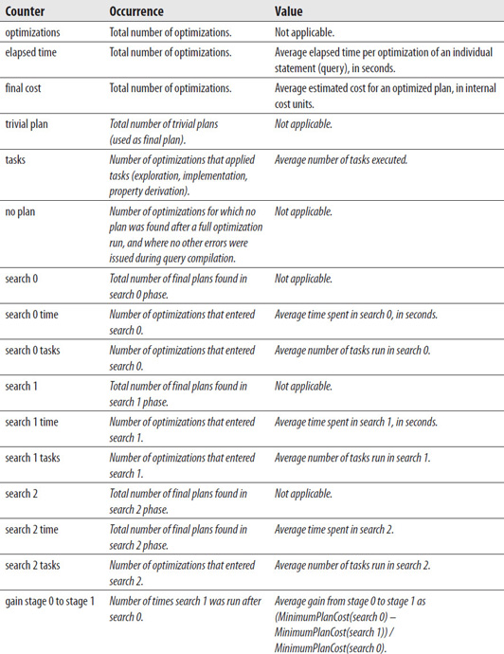
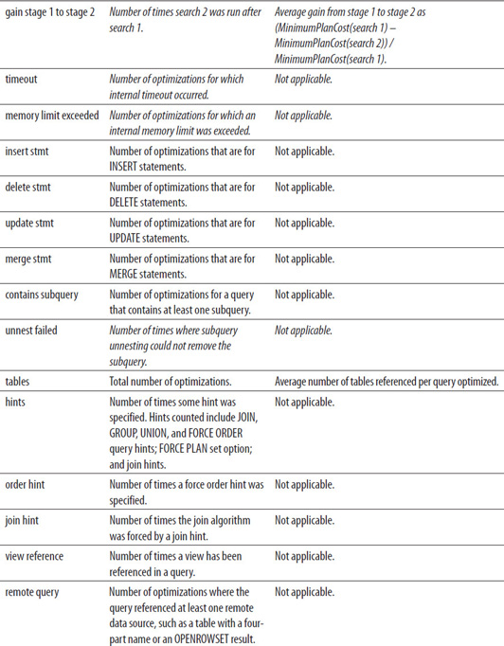
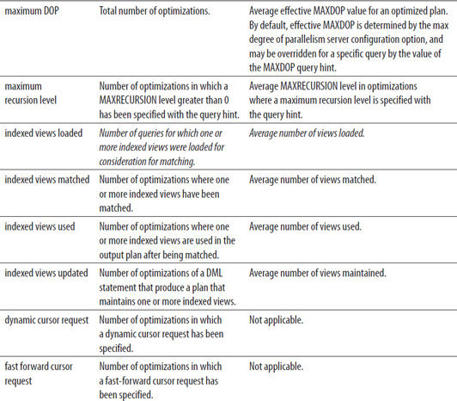
SYS.DM_EXEC_QUERY_OPTIMIZER_INFO Counter Descriptions
From the book Microsoft SQL Server 2014 Query Tuning & Optimization
By Benjamin Nevarez, McGraw-Hill Osborne Media, 2014
Notes:
Items shown in italics are undocumented in SQL Server 2014 Books Online.
You can use before and after snapshots of this DMV to see what short of query optimizations have occurred during a query tuning session.

Slide 20
Query Optimization
Notes:
Parsing and binding are the first operations performed when a query is submitted to a SQL Server instance. They produce a tree representation of the query, which is then sent to the query optimizer to perform the optimization process. At the beginning of this optimization process, this logical tree will be simplified, and the query optimizer will check whether the query qualifies for a trivial plan. If it does, a trivial execution plan is returned and the optimization process immediately ends. The parsing, binding, simplification, and trivial plan processes do not depend on the contents of the database (such as the data itself), but only on the database schema and query definition. Because of this, these processes also don’t use statistics, cost estimation, or cost-based decisions, all of which are only employed during the full optimization process.

Slide 21
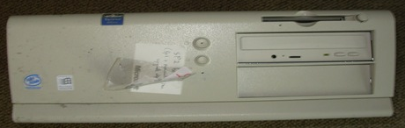
Query Optimization Description
Optimization is cost-based:
  Optimized for worst case scenario: “everything comes from disk”
  Require comparisons of candidate plans’ costs in order to guide decisions
Load statistics and cardinality estimation
  Checks for manually and auto-created statistics
  SQL Server 7 vs 2014 cardinality estimator
  Considers other physical properties, such as amount of memory or number of CPUs
Notes:
Script #4
Want to dig deeper? Plenty of resources online, e.g. http://blogs.technet.com/b/josebda/archive/2009/03/30/sql-server-2008-sqlos.aspx
The cost numbers are abstract, “query pennies”
Estimated costs may have no basis in current reality
Where did these numbers come from? Well back in the SQL7 days, they needed a way to compare different operators plan among themselves, and to choose the cheapest plan via a mechanism to assess the value of each operator. The developer responsible for this (sources say that his name was Nick) took the basis of an operation on his 486 Intel PC. Thus, the cost of the plan of 1 means that the optimizer evaluated the query time by Nick’s at 1 second. Thence, he added some went to some constants and operations, e.g. random access 320 operations per second spawned constant 1/320 = 0.003125, which to this day is sewn inside the server and is used to estimate the cost of random access operations. (Source: Lubor Kollar - http://blogs.microsoft.co.il/dannyr/2008/10/09/what-estimated-subtree-cost-1-means-or-a-great-sql-server-history-story/)
The ones we care about for this workshop:
Query Processor
Parsing, binding, optimization, compilation
Query Optimizer & Executor
You get three guesses
Storage Engine
Buffer management, retrieve results

Slide 22
Query Optimization Search Phases
Multiple phases or “searches”. Probes the search space to find transformations it might apply:
  Phase 0: Transactional plans
    Simple, basic tests and a low internal cost threshold. Looks for simple rule matches.
    For example, nested loops without parallelism.
  Phase 1: Quick plans
    Plans that can be simplified. Applies more transformation rules, some join reordering, limited parallel exploration and a medium internal cost threshold. Looks for intermediate rule matches.
    For example, comparing the cost of the best serial plan versus best parallel plan.
  Phase 2: Full plans:
    Complex queries, parallelism, spills & spools to tempdb.
    Applies the full set of transformation rules, invokes heuristics to exclude entire branches of the full search space; Pruning vs Matching.
    Normally exits on timeout.
Notes:
Script 4
The ones we care about for this workshop:
Query Processor: Parsing, binding, optimization, compilation
Query Optimizer & Executor: You get three guesses
Storage Engine: Buffer management, retrieve results
Search 0: Ideal for small queries with two or three table. Join smallest tables first or tables with the greatest filtering. Only those join orders are considered. At the end of this phase, the query optimizer compares the cost of the best plan generated to the internal threshold and if is still to expensive, it goes to the next phase.
Search 1:
Search 2: Full optimization is used for more complicated queries or queries using more complex features, which will require comparisons of candidate plans’ costs in order to guide decisions; this will be explained in the next section. In this particular example, because the predicate ProductID = 870 can return zero, one, or more records, different plans may be created depending on cardinality estimations and the available navigation structures.
Want to dig deeper? Plenty of resources online, e.g. http://blogs.technet.com/b/josebda/archive/2009/03/30/sql-server-2008-sqlos.aspx.

Slide 23
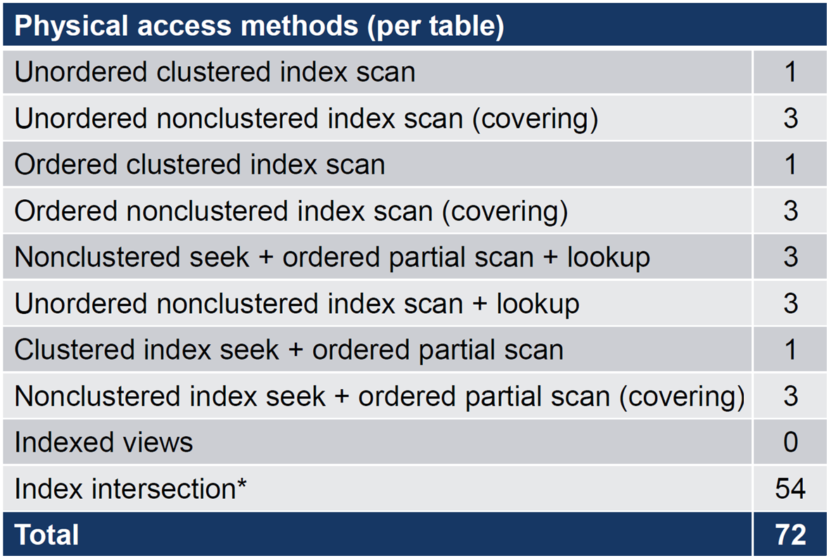
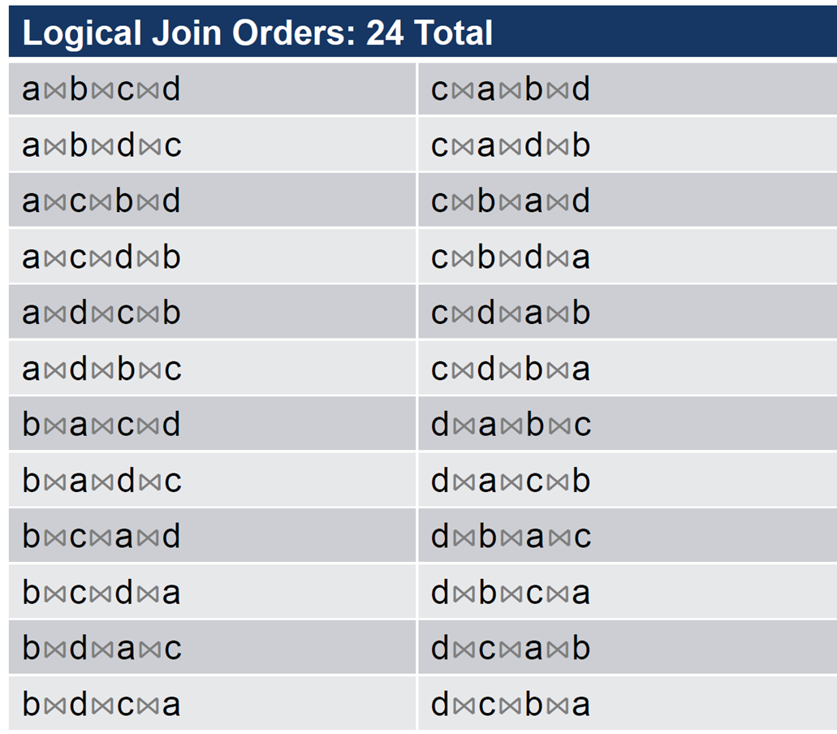
Optimal Plan vs Best Plan
The query optimizer seeks an optimal plan, not the best plan.
To find the best plan, the optimizer might have to assess every possible execution plan that achieves the directive of a given query.
Assume a, b, c, d are tables with a clustered index and 3 non-clustered indexes each.
How many physical access methods per table are available for this query?
Consider:
  SELECT...
  FROM a
  JOIN b ON ...
  JOIN c ON ...
  JOIN d ON ...
72 Possible physical data access
methods
120 Possible logical join orders
Physical joins possible per
logical join
+ May require intermediate sort operation
--- --------------------------------
= 25,920 possible plans
Notes:
Script 10
6 combinations of 2 indexes; 1 join per pair = 6 joins; 3 join methods each = 18
6 combinations of 3 indexes; 2 joins per triplet = 12 joins; 3 join methods each = 36; total = 54
For really advanced users:
The sys.dm_exec_query_optimizer_info DMV includes a counter named “gain stage 0 to stage 1,” which shows the number of times search 1 was executed after search 0, and includes the average decrease in cost from one stage to the other, as defined by the following formula:
(MinimumPlanCost(search 0) – MinimumPlanCost(search 1)) / MinimumPlanCost(search 0)
Indicates improvement from phase to phase
Search 0 to 1 gain
Search 1 to 2 gain
Value that is >= 0 and < 1
0 indicates no improvement
Approaching 1 indicates significant improvement
Definition:
𝐺𝑎𝑖𝑛𝑆0𝑡𝑜𝑆1=𝑀𝑖𝑛𝐶𝑜𝑠𝑡(𝑆0)−𝑀𝑖𝑛𝐶𝑜𝑠𝑡(𝑆1)𝑀𝑖𝑛𝐶𝑜𝑠𝑡(𝑆0)

Slide 24
How Does the Optimizer Go So Fast?
Heuristic application of transformation algorithms speeds up SQL Server query optimization.
Based on relational algebra.
Alternatives are stored in memory structures called “Memos”.
Four transformation types:
  Simplification
  Exploration
  Implementation
  Physical Property Enforcement
Notes:
I like to say about SQL Server’s query plan selection “It might not be good, but it’s good enough”.
Another way to say this is “The goal of cost-based optimization is not to find the best possible physical execution plan by exploring every possible alternative; rather, the goal is to find a good plan quickly. This approach gives us an optimizer that works pretty well for most workloads, most of the time.”
We’ve already seen simplification. Let’s look at the other three.

Slide 25
Exploration Transformation
Start from a logical operation (may be a sub-branch of the full query)
Find equivalent logical operations, i.e. a substitute operation
Examples:
    Join commutativity: A⋈B ➔ B⋈A
    Join associativity: (A⋈B)⋈C ➔ A⋈(B⋈C)
    Aggregate before join
Notes:
It’s important to remember that applying rules does not necessarily reduce the cost of the generated alternatives, and the costing component still needs to estimate their costs. Although both logical and physical alternatives are kept in the Memo structure, only the physical alternatives have their costs determined. It’s important, then, to bear in mind that although these alternatives may be equivalent and return the same results, their physical implementations may have very different costs.

Slide 26
Implementation Transformation
Start from a logical operation
Find equivalent physical operation
Examples:
    A⋈B ➔ A (nested loops join) B
    A⋈B ➔ A (merge join) B
    A⋈B ➔ A (hash join) B
Obtain costing on physical operations
Can prune expensive branches from tree

Slide 27
Physical Property Enforcement Transformation
Properties associated with parse tree nodes
    Uniqueness, type, nullability, sort order
    Constraints on column values
Transformation rules may cause certain properties to be enforced
    Example: sort order for a merge join

Slide 28
sys.dm_exec_query_transformation_stats
  One row per transformation rule:
    “Promise_Total” –Estimate of how useful might the rule be for this query
    “Built_Substitute” –Number of times the rule generated an alternate tree
    “Succeeded” –Number of times the rule was incorporated into search space
  Collect before and after images of this view on a quiet system.
Notes:
Script 6

Slide 29
Prefer Xevents?
Use sqlserver.query_optimizer_ estimate_cardinality to return the statistics being used for a given query.
Now, look at the XE session:
    Calculator is the algorithm used to estimate cardinality
      Subcalculator shows predicate cardinality
    Input_relation - shows input tree
    StatsCollection will show the loaded statistics.
      StatsCollectionID appears as a property of the operator in the plan as well.
      The StatsCollectionID is in the Calculator which tells you what stats is used for what predicate.
Notes:
Script 14

Slide 30
The Memo Structure
Used to explore different alternatives to a portion of the query tree. Can be visually huge.
Can think of it as a matrix:
    Rows (groups) represent substitutes – each entry is logically equivalent optimizer choice and is hashed to prevent duplication
    Columns represent application of a transformation rule
Both logical and physical alternatives go into the Memo. But only physical alternatives are costed.
Notes:
Script 12
Originally defined in “The Volcano Optimizer Generator” by Goetz Graefe and William McKenna in 1993 and implemented in SQL Server using the Cascades Framework, a descendent of Volcano. I met Goetz back in 1996 with Mark Souza after he first came to work at Microsoft!

Slide 31
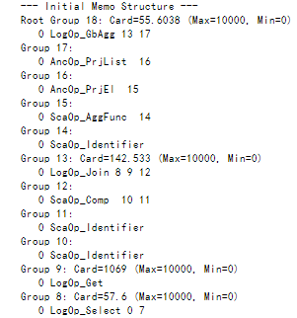
Deciphering the Initial Memo Structure
Entry number, all zero since there’s only one logical entry per group.
Logical operation.
Group number of child groups, referencing its two inputs, group 8 and 9, and the logical comparison defined by sub-tree of group 12.
Cardinality estimate
Notes:
Script 12

Slide 32
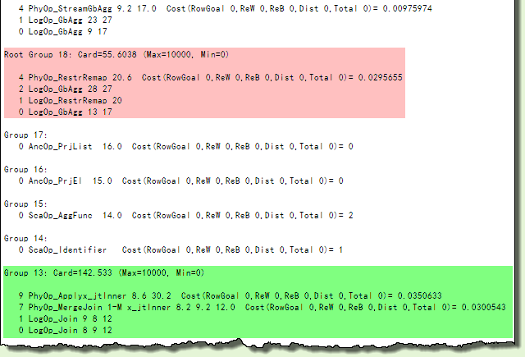
Deciphering the Final Memo Structure
Costing evaluation
Original operation
Notes:
Script 12
Remember, there’s a final memo after each phase. Compare the Initial Memo to the Final Memo, going from 18 to 38 groups, many now containing several alternatives. It requires a single run through Search 1 (where most queries terminate) and terminates early after 509 moves (tasks) with a ‘Good Enough Plan Found’.
Note that the Memo allows the optimizer to consider very many alternatives at once in a compact and quick-to-search structure; the optimizer does not just work on one overall plan, performing incremental improvements (this is a common misconception).
Group 19 and 13 relate directly to the join implementation of the query:
Group 13
Item 0 is the original (joining groups 8 and 9 and applying the condition described by the sub-tree starting with group 12).
Item 1 applies the Join Commutative rule, reversing the input groups
Item 7 applies a one-to-many Merge Join, with group 8 option 2 as the first input and group 9 option 2 as the second option
Item9 applies a physical Inner Apply driven by group 8 option 6, on group 30 option 2
Costing calculations are based on a complex mathematical model. This model generally provides a good basis on which to compare alternatives internally, regardless of the workload or particular hardware configuration. The costing numbers do not mean very much by themselves, so it is generally unwise to compare them between statements or across different queries. The numbers are perhaps best thought of as a unit-less quantity, useful only when comparing alternative plans for the same statement.

Slide 33
Give the optimizer more time
Use trace flag -T8780.
Doesn’t literally give the optimizer more time. It raises the number of transformations allowed, but roughly works out to the same thing.
DOES NOT GUARANTEE:
  …an alternative plan.
  …that an alternative plan will be better.
Notes:
SQL Server must eventually return a plan, even if that plan is not as efficient as it would like. To that end, the optimization process also includes the concept of an “optimization cost budget” in terms of the number of optimizations it is budgeted. When this budget is exceeded, the search for the optimal plan is terminated, and the query optimizer will show an optimization timeout. When the optimizer encounters the timeout (i.e. exceeds its budget), it stops the optimization process and returns the least expensive plan it has found so far and the query optimizer will show an optimization timeout in the execution plan.
Is this an alternative to writing better queries? HELL NO! Quick tips:
Use relational design
Use constraints – omitting constraints may mean that the optimizer is denied opportunities for simplification and exploration transformations
Statistics, indexes, and issues with statistics on computed columns
Avoid implicit conversions
Avoid user-defined functions (other than the in-line variety)
Deep trees can cause problems, so it’s often wise to break big, complex queries into smaller, simpler ones

Slide 34
Appendix: Trace Flags Reference
T2312 and T9481 enables or disables the SQL2014 cardinality estimator, respectively.
T2372 Memory before and after properties and rules, with Search Phases
T2373 Memory before and after deriving properties and rules (verbose).
T2861 enables caching trivial plans.
T4199 enables all fixes that were previously made for the query processor under many trace flags/hot fixes based on “special” policy.
T7357 Unique hash optimization used.
T8605 shows query initial tree representation created by SQL Server.
T8606 shows simplified logical trees used during the optimization process.
T8607 shows the optimization output tree.
T8608 shows the input tree for cost-based optimization when first copied into the Memo structure.
T8609 Task and operation type counts.
T8615 shows the final memo structure.
T8675 shows information on the stages of optimization phases and search times.
T8757 disables trivial plans entirely.
T8739 shows group optimizer info and results.
TF9130 will show the pushed predicate in the query plan.
T9292 shows the statistics objects the optimizer is considering for the optimization process.
T9204 shows the statistics objects used to produce a cardinality estimated loaded during the optimization process.
Notes:
Some others are obsolete and work only for SQL2005 to SQL2012:
7352 : Final query tree
8605 : Converted tree
8606 : Input, simplified, join-collapsed, and normalized trees
8607 : Output tree
8608 : Initial memo
8615 : Final memo
8675 : Optimization stages and times

Slide 35
Appendix: Command Reference
DBCC {TRACEON | TRACEOFF}
DBCC {RULEON | RULEOFF}
DBCC {SHOWONRULES | SHOWOFFRULES}
OPTION (RECOMPILE, QUERYTRACEON n, QUERYRULEOFF ‘xxx’)
sys.dm_exec_query_optimizer_info
sys.dm_exec_query_transformation_stats
Notes:
Some others are obsolete and work only for SQL2005 to SQL2012:
7352 : Final query tree
8605 : Converted tree
8606 : Input, simplified, join-collapsed, and normalized trees
8607 : Output tree
8608 : Initial memo
8615 : Final memo
8675 : Optimization stages and times

Slide 36

Summary
SQL Server doesn’t see SQL statements the way humans see them.
Steps in optimization search phases?
Common transformations?
Trace flag lessons: 3604, 86xx, 8780
Memo structures tells you the alternatives considered
Notes:
Four phases:
Trivial plan
Transactional plan
Quick plan
Full plan
Four transformation types:
Simplification
Exploration
Implementation
Physical Property Enforcement

Slide 37
Learn more from Kevin Kline
@KEKline
kkline@sentryone.com

Slide 38
Demo Title
Demo

