Slide 1
Notes:
Welcome to Specifying Code-Compliant Toilet Partitions presented by Bobrick Washroom Equipment, Inc.
This presentation has been prepared by Alan Gettelman, Bobrick Vice President of External Affairs.
CLICK

Slide 2
AIA Best Practices
Bobrick is a registered provider with the American Institute of Architects (AIA) Continuing Education Systems (CES).
Program registered for continuing professional education. Product content not considered an endorsement by AIA.
Credits earned on completion of this program will be reported to CES Records for AIA members.
Certificates of Completion are available for recordkeeping and self-reporting purposes.
Questions related to specific products and application should be directed to Bobrick after completing this learning unit.
Notes:
Bobrick Washroom Equipment is a registered provider with the American Institute of Architects (AIA) Continuing Education Systems (CES).
This program is registered for continuing professional education. The product content is not considered an approval or endorsement by the AIA.
Credits earned on completion of this program will be reported to CES Records for AIA members.
Certificates of Completion are available for recordkeeping and self-reporting purposes.
We have available a completed Provider’s Form for California Architects Board Licensing Renewal.
Questions related to specific products and their application should be directed to Bobrick Washroom Equipment, Inc. after you complete this learning unit.
CLICK

Slide 3
IDCEC Education Credits
This CEU is registered with the Interior Design Continuing Education Council (IDCEC) for continuing education credits. This credit will be accepted by the American Society of Interior Designers (ASID), International Interior Designers Association (IIDA) and Interior Designers of Canada (IDC).
The content included is not deemed or construed to be an approval or endorsement by IDCEC of any material or construction or any method or manner of handling, using, distributing or dealing in any material or product.
Questions related to specific materials, methods and services should be directed to the instructor or provider of this CEU.
Notes:
This CEU is registered with the Interior Design Continuing Education Council (IDCEC) for continuing education credits. This credit will be accepted by the American Society of Interior Designers (ASID), International Interior Designers Association (IIDA) and Interior Designers of Canada (IDC).
The content included is not deemed or construed to be an approval or endorsement by IDCEC of any material or construction or any method or manner of handling, using, distributing or dealing in any material or product.
Questions related to specific materials, methods and services should be directed to the instructor or provider of this CEU.
CLICK

Slide 4
IDCEC Education Credits
This program is registered for one (1) CEU value. IDCEC class-code is: 103747.
This CEU will be reported on your behalf to IDCEC and you will receive an email notification. Please log in and complete the electronic survey for this CEU.
Certificates of completion will be automatically issued once you have submitted the online survey for this CEU.
Attendees who do not belong to ASID, IIDA or IDC and do not have a unique IDCEC number will be provided with a Certificate of Completion after this CEU.
Notes:
This program is registered for one (1) CEU value. IDCEC class-code is: 103747.
This CEU will be reported on your behalf to IDCEC and you will receive an email notification. Please log in and complete the electronic survey for this CEU.
Certificates of completion will be automatically issued once you have submitted the online survey for this CEU.
Attendees who do not belong to ASID, IIDA or IDC and do not have a unique IDCEC number will be provided with a Certificate of Completion after this CEU.
CLICK

Slide 5
This presentation is protected by US and international copyright laws. Reproduction, distribution, display and use of the presentation without written permission of the speaker is strictly prohibited.
© Bobrick Washroom Equipment, Inc., 2013-2018
Notes:
This presentation is protected by US and international copyright laws. Reproduction, distribution, display and use of the presentation without written permission of the speaker is strictly prohibited.
CLICK

Slide 6
Course Description
This course will provide up-to-date information on:
Selecting and specifying code-compliant toilet partitions for commercial restrooms.
Fire codes and accessibility standards.
Guidelines for writing toilet compartment specifications.
Notes:
This course will provide up-to-date information relating to the selection and specification of code-compliant toilet partitions for commercial restrooms. Fire codes and accessibility standards will be discussed, as will guidelines for writing toilet compartment specifications.
CLICK

Slide 7
Learning Objectives
Understand current toilet partition material fire code compliance.
Learn how to select the most appropriate toilet partition material, hardware, mounting configuration and privacy options based on building type.
Describe three ADA accessible toilet compartment layouts.
Identify guidelines for writing toilet compartment specifications.
Notes:
At the end of this course you will be able to:
CLICK Understand current toilet partition material fire code compliance.
CLICK Select the most appropriate toilet partition material, hardware, mounting configuration and privacy options based on building type.
CLICK Describe three ADA accessible toilet compartment layouts.
CLICK And, identify guidelines for writing toilet compartment specifications.
CLICK

Slide 8
Notes:
In learning objective one, we will discuss current standards and protocols for toilet partition material fire code compliance.
CLICK

Slide 9
Introduction to Model Fire Codes & Standards
Model codes and standards related to fire safety and building construction have been developed by:
ICC
NFPA
Codes and standards mandatory when adopted by a jurisdiction.
48 states have adopted various ICC (IBC, IFC) and NFPA codes from 2009 or later
Many major corporations require compliance.
Notes:
In the United States today, there are two key organizations when it comes to model codes and standards relating to fire safety and building construction. These organizations are the International Code Council (ICC) and the National Fire Protection Association (NFPA).
CLICK The codes and standards they develop are mandatory when adopted by a jurisdiction such as a city, county, state or the federal government.
CLICK Currently 48 states, (all but Hawaii and Texas), Washington DC and the Federal Government have adopted the 2009 or later versions of the various ICC (IBC, IFC) and NFPA codes. To locate current ICC codes effective in each state, visit the ICC’s website at http://iccsafe.org and search for “International Building Code.” The top result will direct you to an IBC Overview page. Under “Adoptions of the IBC,” open the link to a PDF chart labeled “State Adoptions.” This up-to-date document summarizes the status of each ICC code’s adoption by State.
CLICK Also, many major corporations require compliance regardless of government policy.
CLICK

Slide 10
Introduction to Model Fire Codes & Standards
Toilet room privacy partition codes:
International Building Code (IBC)
International Fire Code (IFC)
NFPA Life Safety Code® (NFPA 101®)
NFPA Fire Code (NFPA 1)
Notes:
There are numerous model codes written by both the ICC and NFPA. The codes of most interest pertaining to the subject of Interior Finishes, which include toilet room privacy partitions, are the:
CLICK International Building Code (IBC),
CLICK International Fire Code (IFC),
CLICK NFPA Life Safety Code® (NFPA 101®)
CLICK and the NFPA Fire Code (NFPA 1), which is virtually identical to NFPA 101 with regard to the requirement being discussed.
CLICK

Slide 11
Revised Toilet Partition Requirements
ICC and NFPA codes have been revised:
Toilet room privacy partitions are now regulated as interior finish, and as such, shall comply with interior finishes compliance standards.
Notes:
The model codes written by both ICC and NFPA clearly regulate toilet room privacy partitions as “interior finish.”
This is an important clarification, as some jurisdictions have interpreted that fire and building code requirements for interior finish do not apply to various types of partitions including toilet room privacy partitions.
These revisions started with the 2006 editions of these documents. The 2009, 2012, 2015 editions of the IBC and IFC and the 2012 editions of the NFPA 101 and NFPA 1 reaffirm earlier editions that toilet room privacy partitions shall be regulated as interior finish, and as such, shall comply with any compliance standards pertaining to interior finish.
CLICK

Slide 12
Non-PP and Non-HDPE Interior Finishes Compliance
Non-PP and Non-HDPE toilet partition materials:
Stainless steel
Painted metal
High pressure laminate (HPL)
Compact laminate (CL)
Color-through-solid phenolic core
Solid color reinforced composite (SCRC)
Must be tested in accordance with:
ASTM E 84
UL 723
Or alternatively,
NFPA 286 Room-Corner Test
Notes:
Non-polypropylene (PP) and non-high-density polyethylene (HDPE) toilet partition materials include: stainless steel; painted metal; high pressure laminate (HPL); compact laminate (CL), also known as solid phenolic core (with brown or black edge); color-through-solid phenolic and solid color reinforced composite (SCRC).
CLICK These materials, used as toilet room privacy partitions, are regulated as an interior finish and require testing in accordance and compliance with ASTM E 84 or UL 723 testing.
CLICK They are also allowed testing in accordance and compliance with NFPA 286 Room-Corner Test instead of ASTM E 84 or UL 723.
CLICK

Slide 13
PP and HDPE Interior Finishes Compliance
Requirements for polypropylene and high-density polyethylene have been revised:
ASTM E 84 is not best method for testing certain plastics.
NFPA 286 Room-Corner Test is proper way to regulate them.
All 4 codes require interior finishes using PP or HDPE be tested in accordance with NFPA 286 Room-Corner Test.
Notes:
Starting with the 2012 through 2015 editions of the IBC and IFC, and with the 2012 editions of the NFPA 101 and NFPA 1, the requirements for polypropylene (PP) and high-density polyethylene (HDPE), have been revised.
CLICK It has been recognized for some time that ASTM E 84 (the tunnel test) is not the best test method to use in most cases when testing certain plastics.
CLICK Both the ICC and NFPA membership concluded that the test performance of PP and HDPE was such that testing per ASTM E 84 was inappropriate and that NFPA 286 (the Room-Corner Test) was the proper way to regulate them.
CLICK As a result, all four codes now require that interior finishes using PP or HDPE be tested in accordance with the NFPA 286 Room-Corner Test. This full-scale test is far better at determining the hazards of an interior finish, especially with certain plastics, than is the traditional “tunnel test,” ASTM E 84. It should be noted that both the IFC and NFPA 101 apply this new requirement to existing interior finishes.
CLICK

Slide 14
Request Test Documentation Confirming Compliance
Material | Test
HPL, CL, Color-Through- Phenolic, SCRC | ASTM E 84, UL 723 or NFPA 286
PP, HDPE | NFPA 286
Notes:
It is recommended that architects, interior designers, specifiers and contractors request complete ASTM E 84, UL 723 or NFPA 286 Room-Corner Test compliance documents from high pressure laminate, compact laminate, color-through-solid phenolic and solid core reinforced composite (SCRC) toilet partition manufacturers and insist on unmodified NFPA 286 Room-Corner Test compliance documentation from polypropylene (PP) and high density polyethylene (HDPE) toilet partition manufacturers prior to specifying or purchasing either untreated or treated HDPE toilet partitions.
CLICK

Slide 15
Code-Compliant Specifications
For Solid Plastic Toilet Compartments:
“Solid plastic, HDPE toilet compartments shall be tested and comply with the NFPA 286 Room-Corner Test.”
For Non-Plastic Toilet Compartments:
“Compact laminate, high pressure laminate or stainless steel toilet compartments shall be tested and comply with ASTM E84, UL 723 or alternatively, NFPA 286
Notes:
Whether you’re specifying a roofing system or toilet compartments, every client expects compliance expertise from an architect. They do not want the risks and liabilities of building code violations. In any specification for solid plastic, solid polymer, PP or HDPE toilet compartments, we recommend adding specific language to ensure that the toilet compartment specifications you produce are code-compliant.
CLICK If you’re specifying HDPE solid plastic toilet compartments, which includes solid polymer, polypropylene or high-density polyethylene (HDPE), we suggest you include the phrase “Solid plastic, HDPE toilet compartments shall be tested and comply with the NFPA 286 Room-Corner Test” in your solid plastic HDPE toilet compartment specifications.
CLICK If you’re specifying non-plastic toilet compartments, such as compact laminate, high-pressure laminate or stainless steel, we suggest you use the language “Compact laminate, high pressure laminate or stainless steel toilet compartments shall be tested and comply with ASTM E84, UL 723 or alternatively, NFPA 286.”
By adding the language, appropriate for the material you’re specifying, you ensure that your toilet compartment specifications are code-compliant and it’s now up to the contractor to fulfill what you specify.
CLICK

Slide 16
Notes:
Here, you will learn how to select the most appropriate toilet partition material, hardware, mounting configuration and privacy options based on building type.
CLICK

Slide 17
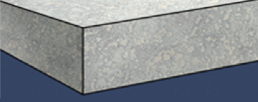
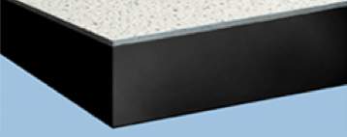
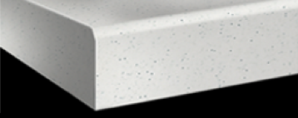
Materials and Construction Methods
Honeycomb Construction
Painted metal
Stainless steel
Bonded Construction
High pressure laminate
Layered Construction
Compact laminate
Homogeneous Construction
HDPE
SCRC
Notes:
This course will focus on six common materials used for toilet partitions, which are painted metal, stainless steel, high pressure laminate, compact laminate, high density polyethylene (HDPE) and solid color reinforced composite (SCRC). Other materials are available, such as solid surface, special laminates and marble.
In a bit, we will review the pros and cons of each of these six toilet partition materials.
Let’s position the six common materials by their construction methods.
CLICK Honeycomb construction includes painted metal and stainless steel.
CLICK Bonded construction includes high pressure laminate
CLICK and layered construction includes compact laminate.
CLICK Finally, homogenous construction includes HDPE and SCRC.
CLICK

Slide 18
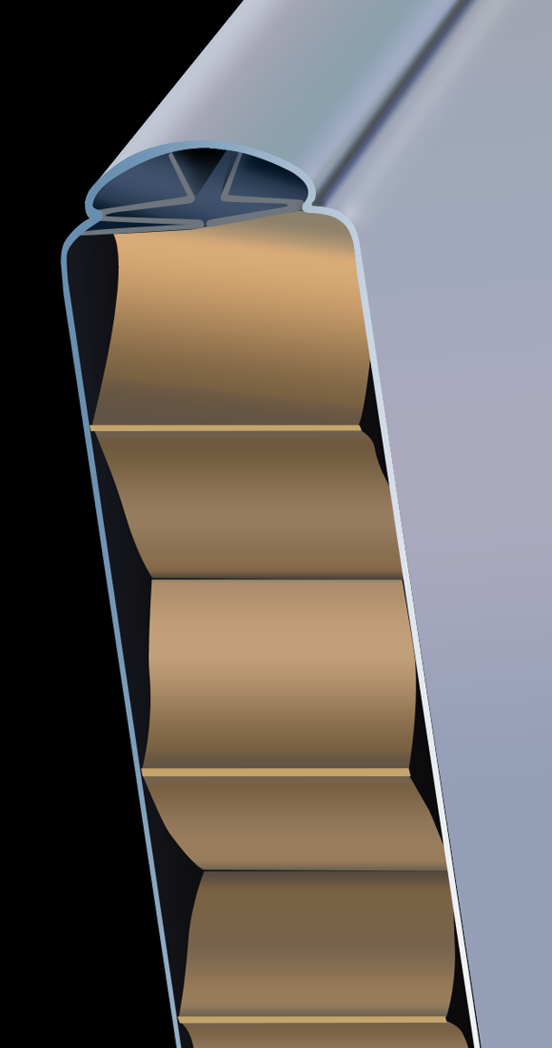
Honeycomb Construction – Painted Metal
Pros | Cons
Availability | Rusts
Inexpensive | Dents
Can be painted | Scratches
Class “A” Interior Wall Finish Classification | Graffiti
 | Odors
 | Limited warranty
Notes:
First, we’ll discuss metal partitions with a honeycomb construction. Painted metal, with either a baked enamel or powder coated surface, and stainless steel, both have a honeycomb cardboard core.
CLICK The pros of painted metal toilet partitions are their wide availability and low cost. Another benefit is that they can qualify as a Class “A” Interior Wall Finish Classification.
The cons of painted metal partitions are that they rust, dent, scratch and their exposed cardboard cores can absorb odors. Also, graffiti is difficult to remove from painted metal partitions and they have a limited warranty.
CLICK

Slide 19
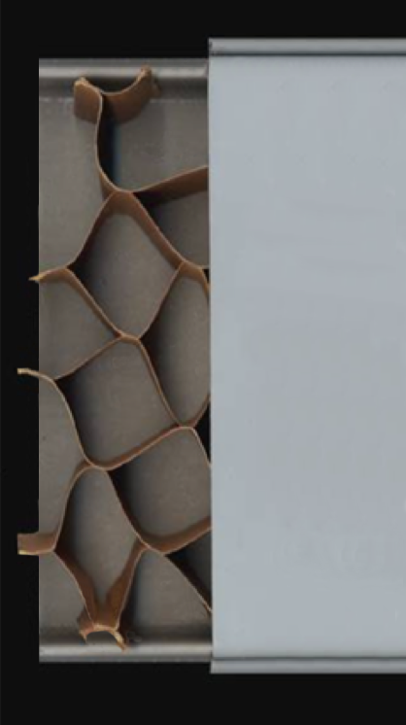
Honeycomb Construction – Stainless Steel
Pros | Cons
Corrosion resistant | Dents
Cleanliness | Scratches
High design appeal | Odors
Class “A” Interior Wall Finish Classification | Expensive
 | Limited warranty
Notes:
The pros of stainless steel toilet partitions are that they are corrosion resistant, improve cleanliness, have high design appeal, and can also receive a Class “A” Interior Wall Finish Classification. The cons, like painted metal, are that they dent and scratch, their exposed cardboard cores absorb odors and they have a limited warranty. In addition, stainless steel is more expensive than painted metal.
CLICK

Slide 20
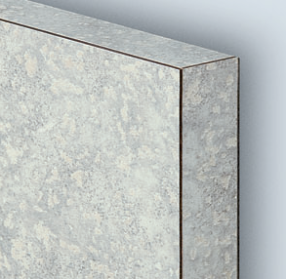
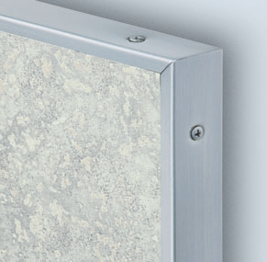
Bonded Construction - High Pressure Laminate
Pros | Cons
Wide color selection | Visible brown or black edges
Graffiti resistant | Deep scratches may expose dark Kraft paper
Scratch resistant | Core material may swell when exposed to excessive moisture
Inexpensive | Odors
Class “B” Interior Wall Finish Classification | Special laminates may increase cost and lead time
 | Limited warranty
Notes:
The bonded construction method for high pressure laminate uses high-pressure plastic laminate on the outer surfaces bonded with glue to industrial-grade wood particle board. The particle board may vary in density; three-ply, 45-pound density is best for durability and sub-surface support.
CLICK The pros of high pressure laminate toilet partitions are that they are available in many colors and patterns and are graffiti- and scratch-resistant. High pressure laminate toilet partitions are inexpensive and can obtain a Class “B” Interior Wall Finish Classification.
The cons are that they have visible brown or black edges, deep scratches may expose dark Kraft paper, the core material may swell when exposed to excessive moisture, and they absorb odors. Also, special laminates may increase costs and lead time and have a limited warranty.
CLICK

Slide 21
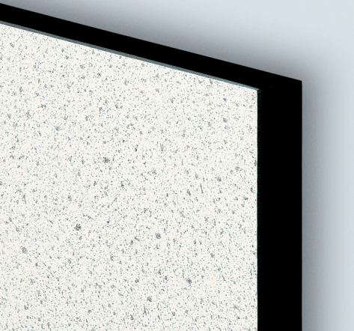
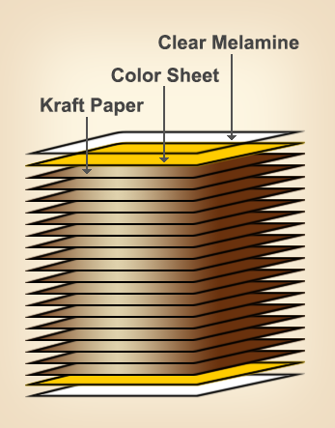
Bonded Construction - Compact Laminate
Pros | Cons
Water resistant, can “hose” down for cleaning | Layered construction – black core can be exposed by deep scratches
Hard material | Black or brown edges
Dent resistant
Scratch resistant
Graffiti resistant
Wide color selection
Class “A” or “B” Interior Wall Finish Classification
25-year warranty
Notes:
Partition materials with layered construction are known as compact laminate, also known as “solid phenolic” or “thick stock.” Compact laminate is constructed of layers of resin-impregnated Kraft paper, a color or decorative sheet on the top and bottom, and over that, a clear melamine protective sheet. All of this is fused together using pressure and heat.
CLICK The pros of compact laminate toilet partitions are that they are water resistant so they can be “hosed-down” for cleaning and they are a hard material that is dent-resistant, scratch-resistant and graffiti-resistant. Compact laminate partitions are available in a wide color selection and have Class “A or B” Interior Wall Finish Classification with a 25-year warranty.
The cons are that because it is a layered construction, the black core can be exposed by deep scratches and black or brown edges are visible.
CLICK

Slide 22
Homogeneous Construction - HDPE
Pros | Cons
Homogeneous solid color throughout | Graffiti containing xylene solvents “ghosts” into material
Repairable, can sand out gouges/scratches | Moderate color selection
Water resistant, can “hose down” for cleaning | Softest material surface; easily scratches
High recycled content | Untreated HDPE does not meet requirements for NFPA 286 Room-Corner Test
Extended warranty
Notes:
Homogeneous construction has the same material properties throughout the thickness of the material. A popular material with this type of construction is HDPE, which has the same material and color throughout the thickness of the partition and is made by extruding HDPE pellets into sheets.
CLICK The pros of HDPE toilet partitions are that they have a homogeneous solid color throughout and are therefore repairable so gouges and scratches can be sanded out. The material is water resistant so it can be “hosed-down” for cleaning and it has high recycled content and an extended warranty.
The cons of HDPE are that graffiti “ghosts” into the material and cannot be fully removed. It is the softest of the materials discussed so it can be easily scratched and dented due to its low impact-resistance. To comply with 2009, 2012 and 2015 IBC, and 2012 NFPA 101, HDPE partitions must comply with the NFPA 286 Room-Corner Test. It is critical to request NFPA 286 Room-Corner Test documentation when specifying HDPE partitions.
CLICK

Slide 23
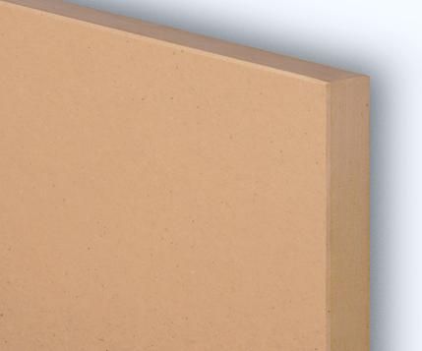
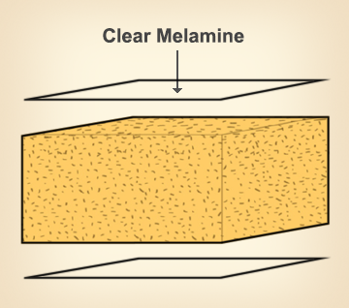
Homogeneous Construction - SCRC
Pros | Cons
Homogeneous solid color throughout | Limited colors
Repairable, can sand out gouges/scratches | Price is similar to stainless steel partitions
Graffiti resistant surface (no ghosting)
Hard material
High resistance to scratches/dents
Water resistant, can “hose down” for cleaning
Class “B” Interior Wall Finish Classification
25-year warranty
Notes:
Another homogeneous material is SCRC, which consists of a clear melamine sheet on the top and the bottom, fused under pressure to dry-formed wood chips impregnated with phenolic resin.
CLICK The pros of SCRC are that the material is a homogeneous solid color throughout and like HDPE is repairable so gouges and scratches can be sanded out. It has a graffiti-resistant surface (no ghosting) and is a hard material with high resistance to scratches and dents. The material is also water-resistant so it can be “hosed-down” for cleaning, has Class “B” Interior Wall Finish Classification and a 25-year warranty.
Disadvantages of SCRC toilet partitions include they are only available in limited colors and the price of SCRC partitions is similar to stainless steel partitions.
CLICK

Slide 24
Graffiti-Resistance Test: Protocol ASTM D 6578
Graffiti-Resistance Test:
Material samples prepared with marks from 9 different staining agents.
Marks cleaned after 24 hours using different cleaning methods.
Removability or non-removability of marking agents recorded
Notes:
Now let’s see how performance testing compares these materials. The American Society for Testing and Materials (ASTM) protocol was selected because it provides an objective, repeatable and comparable procedure to analyze the relative differences between toilet partition materials.
CLICK The graffiti resistance test consists of preparing samples of material with marks from 9 different staining agents.
CLICK After 24 hours, the marks are cleaned using different cleaning methods until they are removed.
CLICK The removability or non-removability of the 9 different marking agents is then recorded.
CLICK

Slide 25
Graffiti-Resistance Test: Protocol ASTM D 6578
Number of Graffiti Markers Cleaned Out of 9 Marks Applied
Higher readings perform better
High Pressure Laminate (HPL), Compact Laminate (CL) and SCRC are the most graffiti resistant and easiest to clean
Notes:
Let’s review the chart on this slide. Along the horizontal (X-axis) are the five different partition materials tested. Along the vertical (Y-axis) are the number of graffiti marks cleaned.
All 9 marks were removed from high pressure laminate and SCRC.
8 marks were cleaned from compact laminate, leaving one.
5 were cleaned from painted metal, leaving 4, and
3 were cleaned from untreated HDPE, leaving 6.
The test concluded that high pressure laminate and SCRC are the easiest to clean. These materials are well suited where graffiti is a problem. This test revealed that HDPE is most difficult to clean.
Note that stainless steel was not tested.
CLICK

Slide 26
Scratch-Resistance Test: Protocol ASTM D 2197
Scratch-Resistance Test:
Tests scrape resistance of coatings such as paints.
Weight added to a scraper and material sample is dragged underneath.
When scratch occurs weight is recorded
Notes:
ASTM also standardizes a procedure to test the scrape- or scratch-resistance of coatings, such as paints.
CLICK In this procedure, weight is added to a scraper and a material sample is dragged underneath the loaded scraper.
CLICK When a scratch occurs, the weight is recorded. The amount of weight is varied up to a maximum of 10 kilograms (approximately 22 pounds).
CLICK

Slide 27
Scratch-Resistance Test: Protocol ASTM D 2197
Weight Needed to Scratch Material (kilograms)
Higher readings perform better
High Pressure Laminate (HPL), Compact Laminate (CL) and SCRC are the most scratch resistant
Notes:
Again, the chart shows the materials that are tested along the horizontal axis and the amount of weight in kilograms it took to scratch the material along the vertical axis.
High pressure laminate, compact laminate, and SCRC did not scratch with 10 kilograms of weight.
Untreated HDPE scratched with less than 4.5 kilograms (approximately 10 pounds) and painted metal with 3 kilograms (approximately 6.5 pounds).
High pressure laminate, compact laminate, and SCRC were the most scratch-resistant of the materials tested.
CLICK

Slide 28
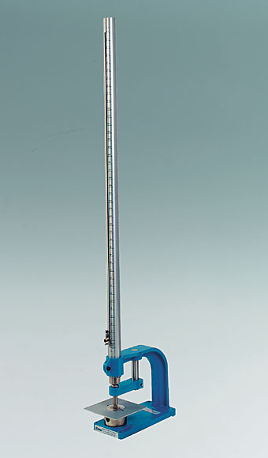
Impact Resistance Test: Protocol ASTM D 2794
Impact-Resistance Test:
Developed to evaluate the effect of denting by dropping a 2-lb steel ball on a coating film and its substrate from increasing heights.
When dent occurs drop height is recorded.
Notes:
The ASTM D 2794 Impact Resistance test was developed to evaluate the effect of denting by dropping a 2-pound steel ball on a coating film and its substrate from increasing heights.
CLICK In this protocol, when a dent occurs, the drop height is recorded.
CLICK

Slide 29
Impact-Resistance Test – Protocol ASTM D 2794
Drop Height in Inches of 2 lb Hemispherical Indenter
Higher readings perform better
Compact Laminate (CL) is the hardest to dent
Notes:
In this chart, the left vertical axis shows the drop height in inches.
Untreated HDPE, metal and high pressure laminate are relatively easy to dent.
Compact laminate and SCRC are the most dent-resistant. Compact laminate materials can withstand an impact from a 2-pound steel ball from approximately 48 inches before a dent occurs.
CLICK

Slide 30
Surface Burning Characteristics: Protocol ASTM E 84
Test used by ICC and NFPA to evaluate burning characteristics of materials classified as Interior Wall and Ceiling Finishes.
Material placed in tunnel and flame introduced to surface of material.
Rate of flame spread and degree of smoke development, measured by visibility in tunnel, are recorded throughout a 10-minute test
For Non-Plastic Toilet Compartments:
Stainless steel
Painted metal
High pressure laminate
Compact laminate
Color-through phenolic
Solid color reinforced composite
Notes:
Protocol ASTM E 84 test results are used by the ICC and NFPA to evaluate the burning characteristics of materials classified as Interior Wall and Ceiling Finishes.
CLICK In this test procedure, material is placed in a tunnel and flame is introduced to surface of material.
CLICK The rate of flame spread and the degree of smoke development, measured by the visibility in the tunnel, are recorded throughout a 10-minute test.
CLICK As we discussed earlier, the ASTM E 84 test is relevant for all toilet partition materials except HDPE and PP, such as stainless steel, painted metal, high pressure laminate, compact laminate (brown or black edge), color-through phenolic, and solid color reinforced composite (SCRC). These materials all require testing in accordance and compliance with ASTM E 84 or UL 723. Alternatively, they can be tested in accordance and compliance with the NFPA 286 Room-Corner Test. HDPE and PP both require NFPA 286 Room-Corner Test compliance.
CLICK

Slide 31
Surface Burning Characteristics: Protocol ASTM E 84
Material | Flame Spread Index | Smoke Developed Index | Interior Wall & Ceiling Finish Classification
Painted Metal | 5 | 0 | Class A
High Pressure Laminate | 60 | 195-300 | Class B
Compact Laminate | 15/30 | 20/55 | Class A/B
SCRC | 45 | 95-120 | Class B
ASTM E 84 provides comparative classifications used to measure and describe the response of materials, products, or assemblies to heat and flame under controlled conditions, but does not by itself incorporate all factors required for fire-hazard or fire-risk assessment of the materials, products, or assemblies under actual fire conditions.
HDPE must be tested and comply with the NFPA 286 Room-Corner test, not the ASTM E 84 Tunnel Test.
Stainless steel was not tested
Notes:
Let’s review the chart on this slide. The partition materials are in the first column. The top row has two indexes; the Flame Spread (distance/time) Index and the Smoke Development (volume) Index.
The scores on these indexes determine the Interior Wall and Ceiling Finish Classification. To receive an Interior Wall and Ceiling Finish Classification, the Flame Spread Index must be 200 or less and the Smoke Development Index must be 450 or less. All materials are under the 200 index for Flame Spread. One material, HDPE, must be tested and comply with the NFPA 286 Room Corner-Test, not the ASTM E 84 Tunnel Test.
Note that stainless steel was not tested.
CLICK

Slide 32
Surface Burning Characteristics: Protocol ASTM E 84
Flame Spread Index requirements are as follows:
Class A, 25 or less
Class B, between 26 and 75, and
Class C, between 76 and 200
The test concluded the following :
Painted metal tested as a Class A, and
High pressure laminate as Class B.
Compact laminate is Class B, and can be ordered as a Class A.
SCRC is Class B.
Notes:
Flame Spread Index requirements are as follows:
for Class A, 25 or less
for Class B, between 26 and 75, and
for Class C, between 76 and 200.
CLICK The test concluded the following:
Painted metal tested as a Class A, and
High pressure laminate as Class B.
Compact laminate is Class B, and can be ordered as a Class A.
SCRC is Class B.
CLICK

Slide 33
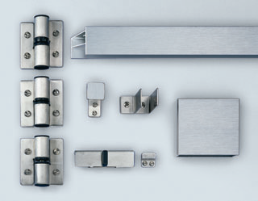
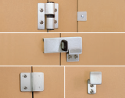
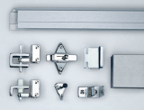
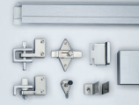
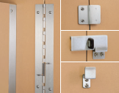
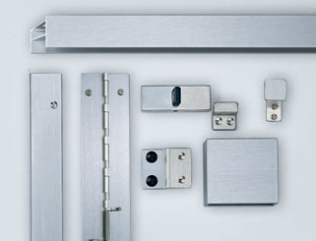
Hardware Selection
Notes:
Toilet partition hardware consists of components such as hinges, latches and keepers, coat hooks, as well as mounting brackets. Hardware and mounting configuration are two considerations for toilet partition durability. If inappropriate hardware is selected for the intended use and it does not perform well, then the toilet partition system will be less durable; this is also true for the mounting configuration.
First, let’s talk about hardware.
CLICK

Slide 34
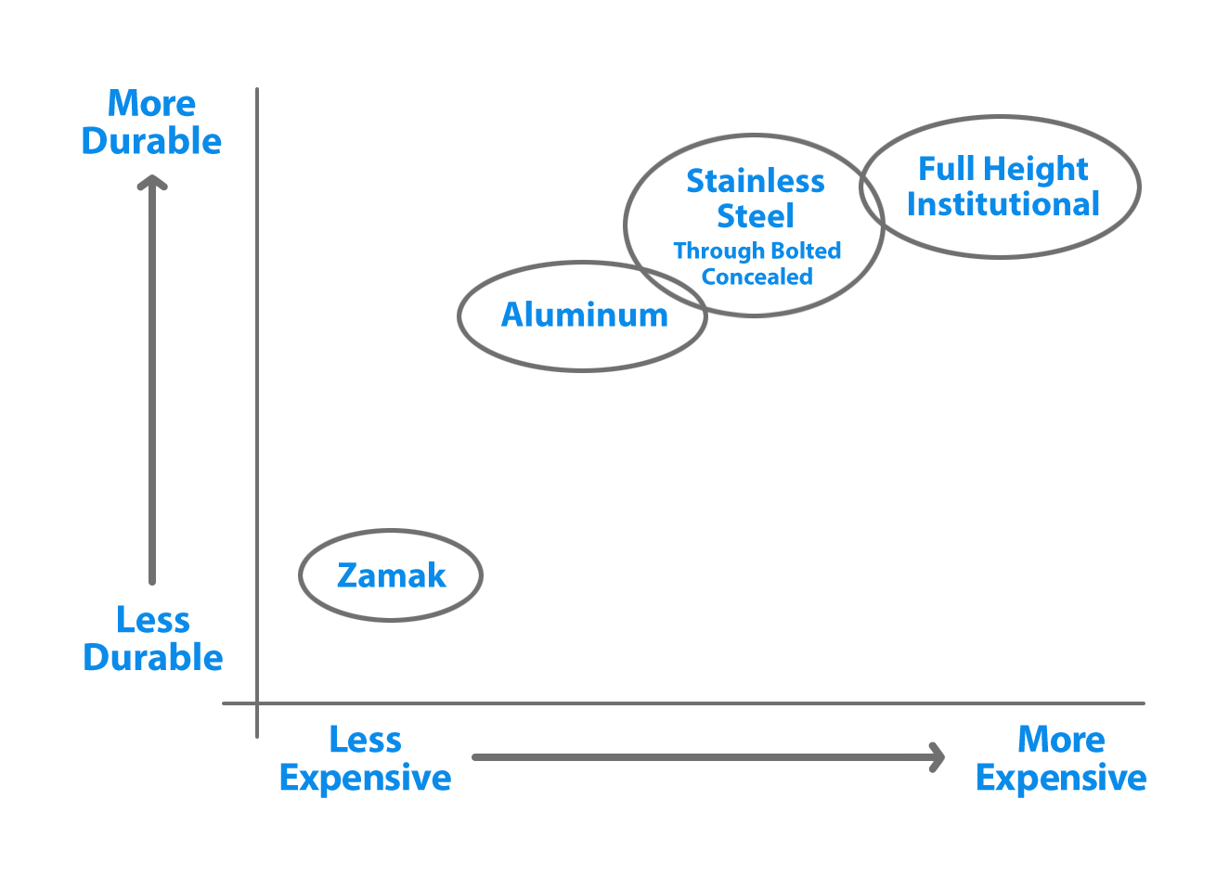
Hardware Selection
Notes:
Selection of hardware affects the durability and design of toilet partitions. This chart compares price vs. durability of different hardware types. The horizontal axis shows the relative price of hardware. To the left is less expensive and to the right is more expensive. The vertical axis shows durability, from less durable on the bottom to more durable on the top. Zamak is an alloy made up of zinc, aluminum, magnesium and copper and is common on metal and high pressure laminate partitions.
Aluminum and stainless steel hardware are more durable. These materials cost more but in life-cycle cost evaluations, if less-durable, less-expensive hardware fails, life-cycle costs increase. Full-height institutional hardware is the most durable. Also, because of the full-height hinge and attachment brackets, sight gaps are reduced, adding privacy. Specify concealed hardware when a clean flush front is desirable. Most importantly, do not specify less durable hardware to reduce cost in heavy traffic, vandal prone bathrooms. When hardware fails, the whole partition fails.
CLICK

Slide 35
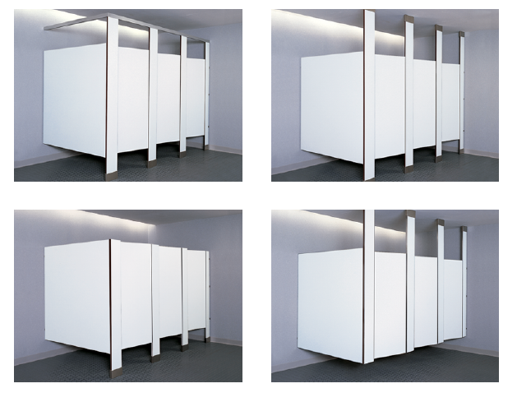
Mounting Configurations
Overhead-Braced
Floor-to-Ceiling
Floor-Anchored
Ceiling-Hung
Notes:
Now, we will move onto the four mounting configurations as shown in the images on this slide. The photos move from the most durable in the upper left to the least durable in the bottom right.
Overhead-Braced offers the sturdiest mounting configuration at a budget price level. The stiles have two attachment points.
Floor-to-Ceiling Anchored is also the most durable. It has two attachment points, and is similar to Overhead-Braced in durability with improved aesthetics, but it is more expensive.
Floor Anchored is great for aesthetics, but with its single attachment point, it must be anchored into a solid base substrate. Specify this configuration only in low-traffic, non-vandal prone bathrooms.
A favorite for custodians is Ceiling-Hung, as it reduces cleaning time because there is no attachment to the floor. Structural support must be detailed and provided in-ceiling for stable installation of stiles. It is not recommended for high traffic or vandal-prone bathrooms. The single attachment point is high in the ceiling, so if a vandal applies pressure to the bottom, partitions may wobble, doors may open, and in an extreme cases, the partition or hardware may break.
CLICK

Slide 36
Client Needs
Toilet Partition Material Price Comparisons
 | Painted Metal | High Pressure Laminate | HDPE (Untreated) | Compact Laminate | SCRC | Stainless Steel
Price Index | 1 | 1.1 | 1.9 | 2.4 | 2.7 | 2.7
Note: Painted metal prices have increased, closing the price difference with high pressure laminate, which offers more design freedom.
Stainless steel is the most expensive, at about 2.7 times the price of painted metal or high pressure laminate.
Notes:
The primary challenge in specifying toilet partitions is to match the client’s needs with partition materials. The budget will always be an important factor for a client. In assessing their needs, consider whether they need low cost today or if they are looking for low life-cycle cost over the long term. This chart is a price comparison of toilet partition materials. It shows the relative difference among materials with standard installation.
Note: Painted metal toilet partition prices have increased, closing the price difference with high pressure laminate, which offers more design freedom. As you can see, stainless steel and SCRC are the most expensive, at about 2.7 times the price of painted metal or high pressure laminate.
CLICK

Slide 37
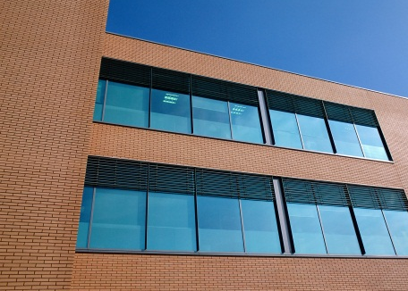
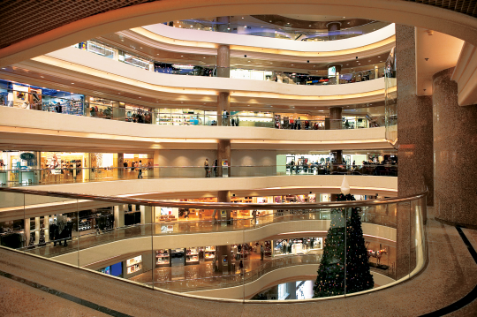
Building Type
Building type forms a baseline for the design.
Three building types:
Prestige
Standard Use
Heavy Traffic
Notes:
Now, we will examine how the building type forms a baseline for the design.
CLICK The three building types we will discuss are prestige, standard use and heavy traffic.
When you understand these three basic categories, it is much easier to match a toilet partition material to the client needs.
CLICK

Slide 38
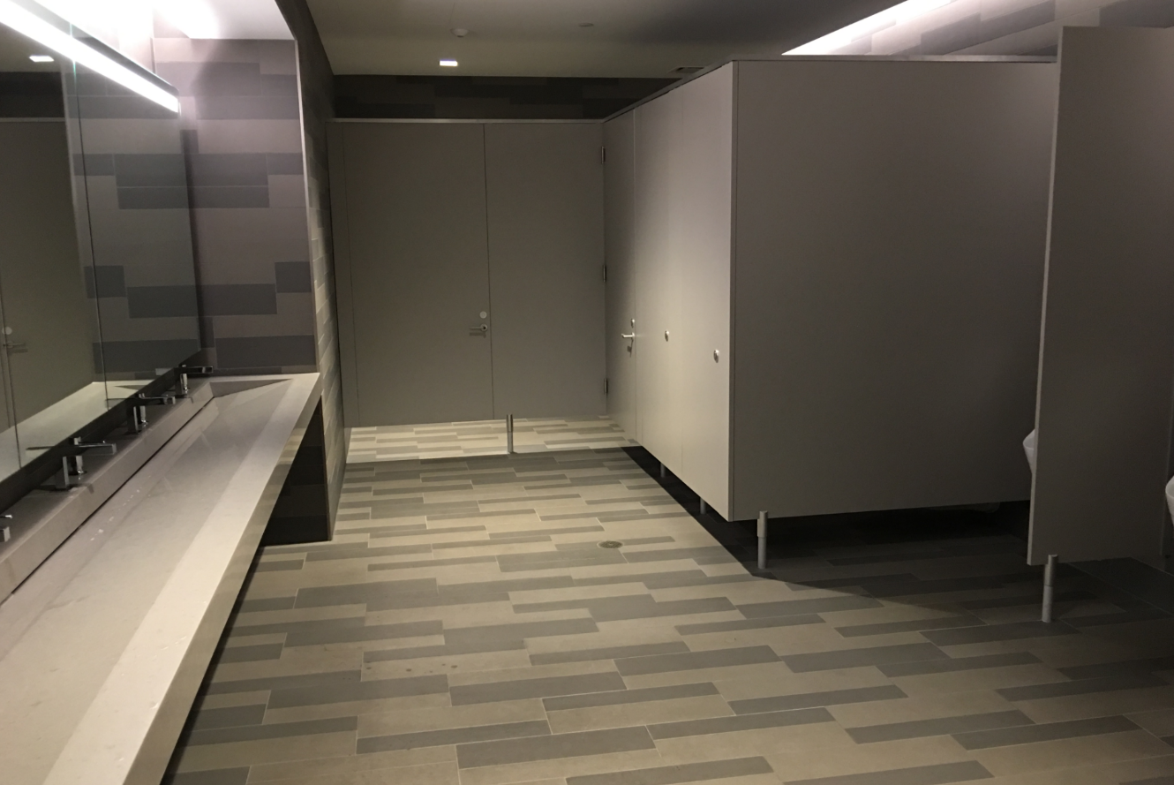
Prestige Buildings
Signature facilities with low traffic.
Buildings Include:
Corporate headquarters
Class A office projects
Civic center icons
Major universities
Focus on architectural design excellence and quality materials and equipment
Notes:
Prestige buildings are signature facilities with moderate to low traffic flow with minimal use and abuse.
CLICK These types of buildings include corporate headquarters, Class A office projects, civic center icons and major universities.
CLICK The focus is on architectural design excellence and quality materials and equipment.
CLICK

Slide 39
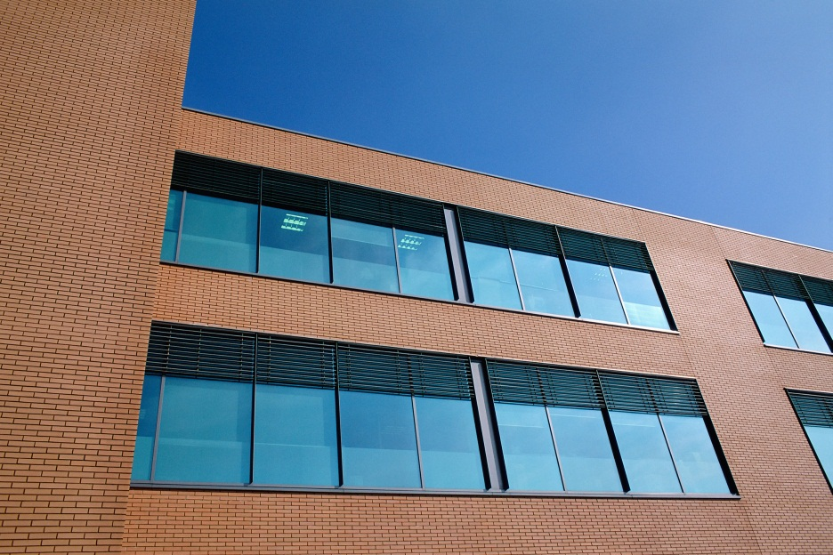
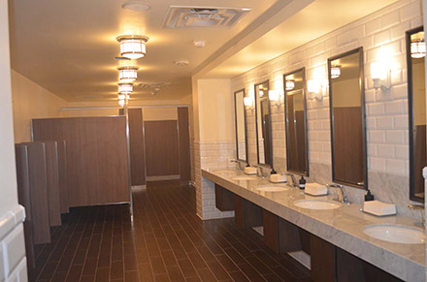
Standard Use Buildings
Moderate to heavy traffic and incidence of vandalism
Buildings include:
Commercial office facilities
Healthcare centers
Hospitality projects
Manufacturing plants
Equipment durability and budget are important
Notes:
Standard Use buildings have moderate to heavy traffic and moderate to heavy incidence of vandalism. This choice is price-driven.
CLICK Standard Use buildings include commercial office facilities, healthcare centers, hospitality projects and manufacturing plants.
CLICK The restroom usage and accessory requirements are moderate to heavy traffic with some heavy use and abuse. Equipment durability is important, as are budget-sensitive specifications.
CLICK

Slide 40
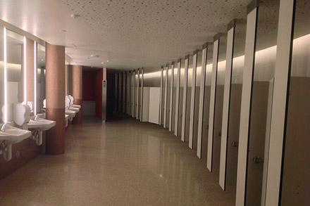
Heavy Traffic Buildings
Heavy traffic flow with possible high incidence of vandalism
Buildings include:
K-12 schools
Retail malls
Amusement / recreation facilities
Transportation centers
Equipment durability and extra-large capacities are important
Notes:
Finally, Heavy Traffic buildings have heavy traffic flow with a possible high incidence of vandalism. Where there is heavy traffic and vandal problems, heavy traffic occupancy must be considered first in the design, overriding the prestigious and standard use models.
CLICK Heavy Traffic buildings include K-12 schools, retail malls, amusement and recreation facilities, as well as transportation centers.
CLICK Restroom usage and accessory requirements include periods of extreme traffic flows, vandal-prone use and abuse, equipment durability over design, and extra-large dispensing and disposal capacities.
CLICK

Slide 41
Building Type Summary
Matching Partition Materials to Building Needs
Building Type | Painted Metal | Stainless Steel | HPL | HDPE | Compact Laminate | SCRC
Heavy Traffic
Standard Use
Prestige
Best Choice Good Poor
Notes:
To summarize, let’s review the Matching Partition Materials to Building Needs chart on this slide. It shows the building types in the left column with the 6 material types across the top row. Colored circles range from poor selection choice (RED), good choice (YELLOW), to the best choice for that building type (GREEN CIRCLE WITH STAR).
For Heavy Traffic applications, SCRC partitions are usually the best choice due to their superior scratch- and graffiti-resistant characteristics in addition to their ability to have graffiti removed completely. Compact laminate can also be a good choice for Heavy Traffic buildings. Painted metal and stainless steel are not well-suited for these applications.
For Standard Use buildings, HPL partitions are the best choice due to their price and good resistance to scratches and impact.
For Prestige applications, Stainless Steel and HPL are the best choices. While these materials are among the most expensive, they can produce the high-end aesthetic and design appeal that these projects often require.
CLICK

Slide 42
Privacy Options
Integrated no-sightline privacy doors and stiles
Notes:
Finally, it’s important to note that privacy is quickly becoming a key consideration in toilet partition design.
Integrated no-sightline privacy doors and stiles have routed edges that result in an interlocking design with no sight lines. They come with standard or optional full-height hardware. These configurations typically produce flush styling across a series of doors and stiles to produce a high-end, clean aesthetic.
CLICK

Slide 43
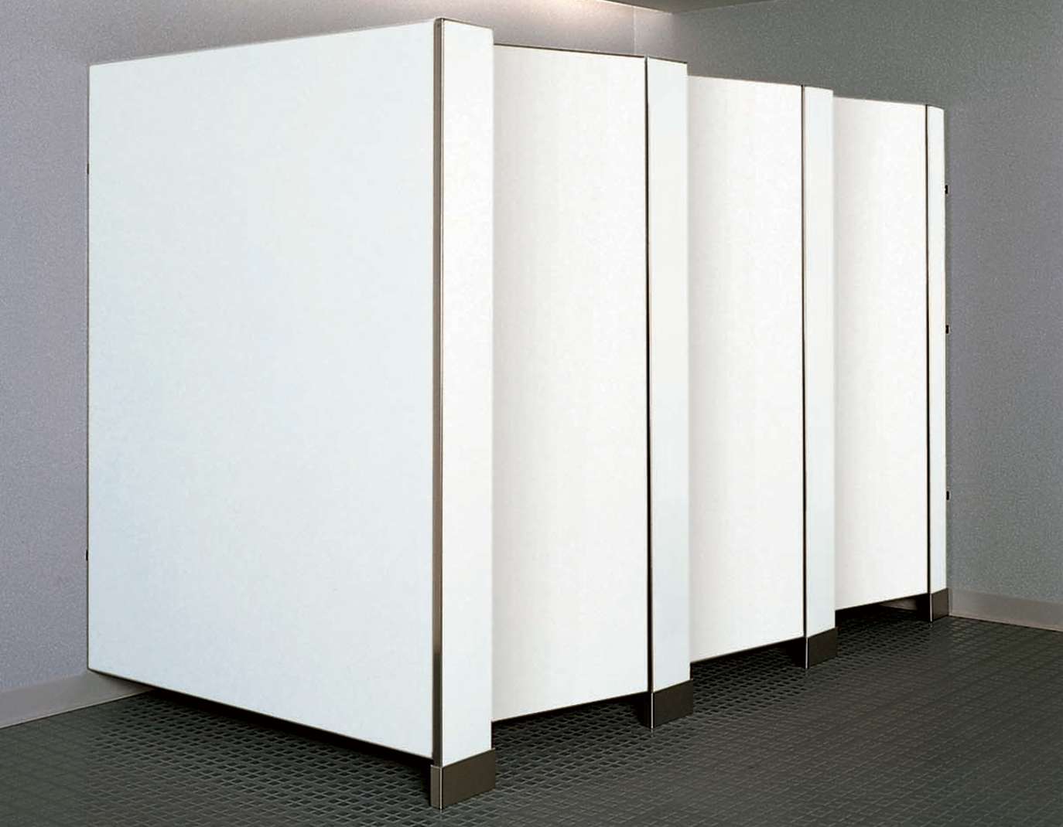
Privacy Options
Extended height privacy compartments
(72" doors and panels, compared to standard heights of 55" or 58".)
Notes:
Extended height privacy compartments consist of 72-inch high doors and panels with nominal 4-inch floor clearance and come with standard or full-height hardware. A combination of integrated no-sightline privacy doors and stiles with extended height privacy compartments provides the most privacy, as it combines both an interlocking design with no sight lines and 72-inch high compartments.
Compare this to the standard sizes of toilet compartment doors and panels. Metal, stainless steel, high pressure laminate, compact laminate and SCRC partitions are typically 58 inches high. HDPE partition doors and panels are typically 55 inches high. Therefore, maximum height compartments can add as much as an additional 17 inches to the standard door height, depending on the material used.
Both integrated no-sightline privacy doors and stiles and extended height privacy panels are typically available in all four standard mounting configurations.
CLICK

Slide 44
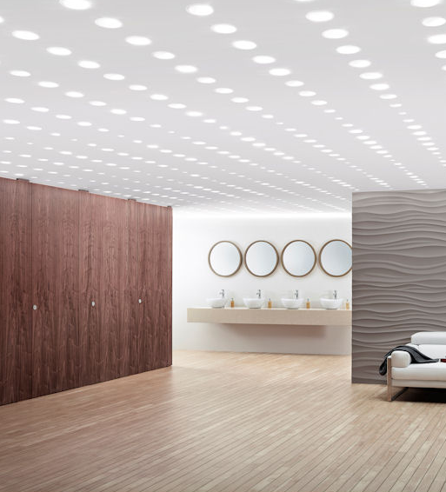
The Privacy Trend
Influenced by evolving needs and preferences:
Health issues
Personal preference
Transgender population
Popular in educational and office buildings
U.S. catching up to international privacy options
Notes:
An increasing proportion of today’s restroom users see privacy as a key amenity for reasons ranging from personal preference to health needs. For example, a diabetic individual may prefer increased privacy while they self-administer insulin injections in a toilet compartment. Due to evolving societal attitudes and other factors, the needs of the transgender population have driven significant demand for privacy options across a number of building types, especially educational facilities. Consequently, privacy partitions and gender-inclusive restroom design often go hand-in-hand.
CLICK In addition to educational facilities such as universities, owners of office buildings that cater to a younger workforce have also been primary adopters of privacy partitions in recent years.
CLICK It’s important to note that historically, the United States has caught up to other nations only recently in terms of the privacy options offered. Asia and Europe have had privacy options for years. This is because American manufacturers of metal partitions in the 1920s utilized sheet sizes that produced doors that were 12 inches off the floor—eventually, that size became the standard.
CLICK

Slide 45
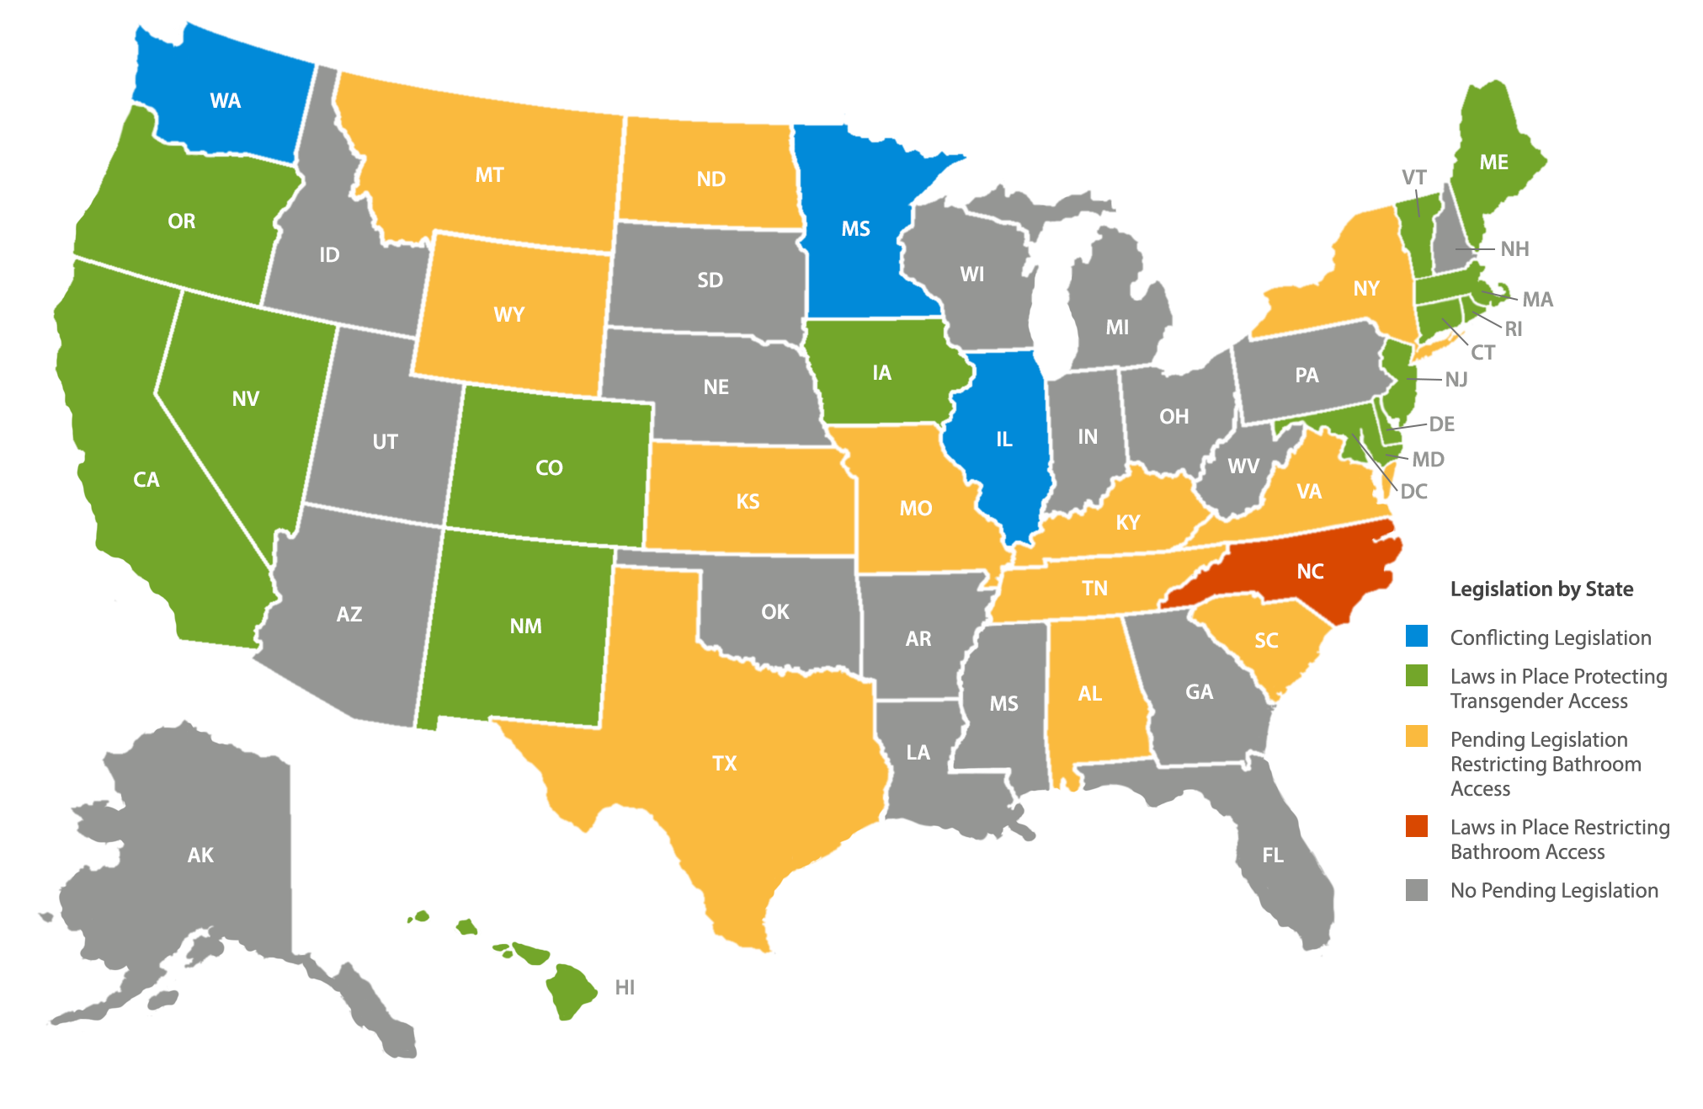
Gender-Inclusive Bathroom Legislation
Notes:
A number of states have passed laws requiring public facilities to have gender-inclusive (or gender-neutral) restrooms.
The states in green have conflicting legislation—that is, city, state and/or federal codes are at odds with one-another regarding this issue. The states in orange have passed laws requiring public facilities to have gender-inclusive bathrooms. The states in yellow have pending legislation. The one state in purple, North Carolina, restricts access to some public bathrooms by some individuals, by law.
Finally, the states in white have no pending legislation on the issue.
CLICK

Slide 46
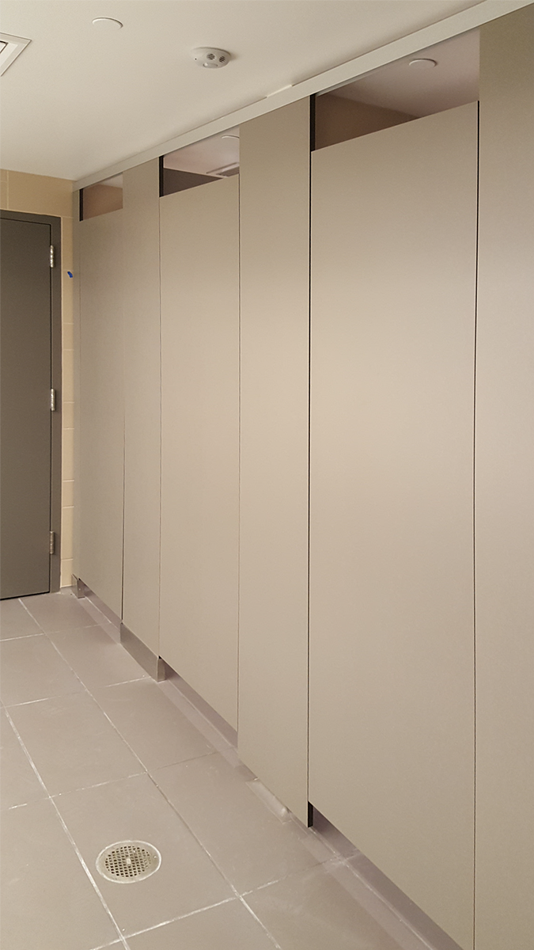
Privacy Partition University Installations
University of California, Berkeley Moffitt Library
San Jose State University
Notes:
California is one of the states that have passed laws regarding gender-inclusive bathrooms and many California facilities have adopted them, regardless of whether or not they are required to by law. The Moffitt Library at the University of California, Berkeley, shown here, was originally designed in the late 1960s. In 2016, a renovation was completed that included gender-inclusive bathrooms.
Prior to construction, the University president declared that the renovated library must feature gender-inclusive toilet rooms that were individual and “room-like,” so that no individual could reach under or over a door or panel with their cell phone or a “selfie stick.” The new restrooms feature high-privacy, integrated no-sightline privacy doors and stiles with floor-to-ceiling doors and extended height panels to enhance user privacy, support gender-inclusive design and promote peace of mind. Note that these features can be equally valuable to gender-inclusive restrooms as they would be to traditional men’s or women’s rooms.
CLICK San Jose State University has also employed privacy partitions to satisfy evolving preferences, installing 90"-tall panels and 80"-tall gapless doors.
CLICK

Slide 47
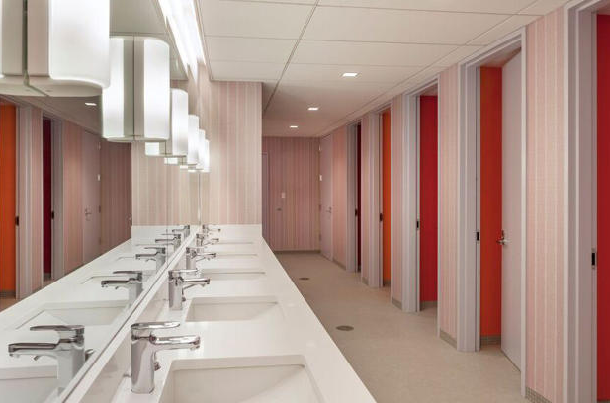
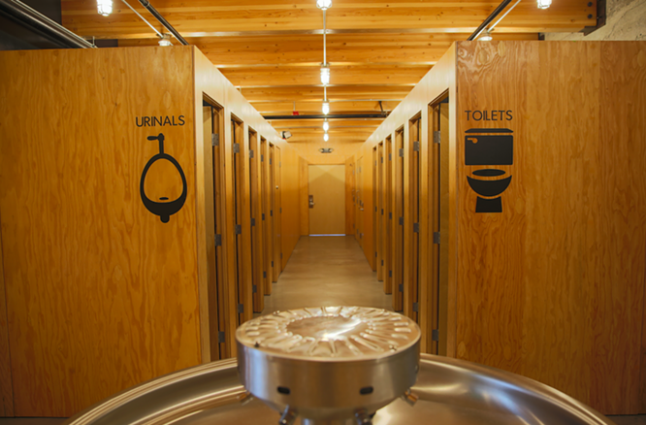
Full Room/Single-User Restroom Considerations
Toilet inside a room built with fully finished, stud walls, with an entry door
High financial and spatial costs relative to privacy toilet partitions with integrated privacy options
Considerable construction needs and indirect costs
Notes:
One popular privacy solution is full toilet rooms or single-user restrooms, often found in fine dining restaurants and high-end hotels. These typically consist of a toilet inside a room built with fully finished, stud walls, with an entry door.
CLICK While this construction configuration can support privacy and gender-inclusive design, it comes at a high financial and spatial cost relative to privacy toilet partitions with integrated privacy options. For example, in full room construction, each room must meet local codes individually and have its own lighting, ventilation and fire suppression sprinkler. Each of these mechanical services adds to the cost. In addition, when constructing full toilet rooms, the material must be code-compliant, just like a traditional toilet partition system.
CLICK Full rooms also have considerable construction needs, including studs, drywall, painting and tiling, as well as indirect costs, such as the extra space they can take up and the utilization of contractors from several trades.
CLICK

Slide 48
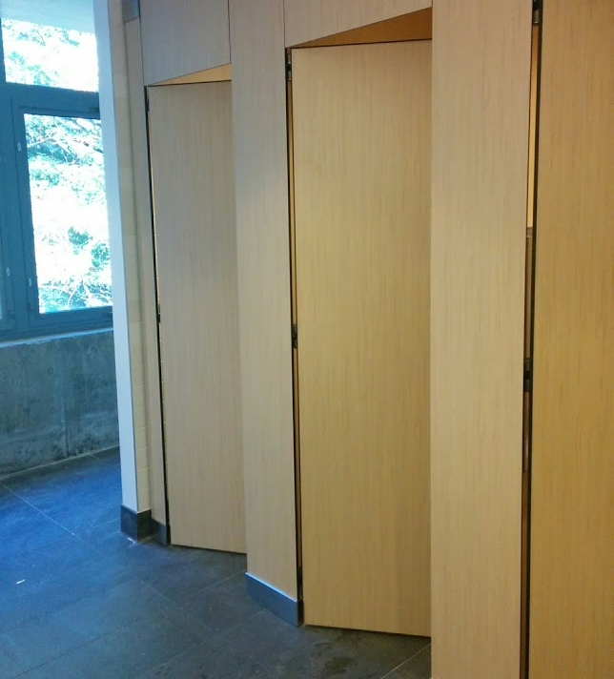
Privacy Partition Considerations
Balance of compliance, cost, aesthetics and privacy
Compartments can share HVAC, ventilation, lighting and fire suppression systems
Notes:
When budget and space are important, privacy toilet partitions typically provide the best balance of compliance, cost, aesthetics and privacy.
CLICK Privacy partitions allow each compartment to share HVAC and ventilation systems across the tops and bottoms of stalls, can utilize recessed lighting systems to share light across the entire row of partitions and can share a single fire suppression system at a rate of one nozzle for multiple toilet compartments if partition panels are at least 22 inches beneath the ceiling, otherwise the rate is one nozzle per toilet compartment.
CLICK

Slide 49
Relative Costs of Privacy Partitions vs. Alternatives
 | Standard Toilet Partitions | Increased Privacy Toilet Partitions | Extended Fully Enclosed Toilet Partitions | Fully Enclosed with Drywall
Solutions | 58" doors and panels with 85" stiles | 72" doors and panels with 85" stiles | Doors, stiles and panels made to fit room height | Drywall to fit room height
Cost of Materials/ Installation* | $3,750 - $7,500 ($650 -$1,500/stall) 5 stalls | $7,500 - $11,000 ($1,500 - $2,200/stall) 5 stalls | $11,000 - $18,000 ($2,200 - $3,600/stall) 5 stalls | $13,500 - $20,000+ ($2,700 - $4,000/stall) 5 stalls
Infrastructure Implications & Cost | None** | None** | $900+/stall (For separate ventilation, fire sprinkler, alarms & lighting) | $900+/stall (For separate ventilation, fire sprinkler, alarms & lighting)
Minimum Number of Trades to Coordinate | 2 (P,T) | 2 (P,T) | 4 (P, T, E, M) | 6 (P, F&D, Pa, T, E, M)
* Only the cost of materials and installation for partitions or full walls are shown here
** Assumes 22" or greater distance from top of headrail to ceiling
P = Plumbing, F&D = Framing & Drywall, T = Tile, E = Electrical, M = Mechanical, Pa = Paint
Notes:
This chart shows the relative cost differences for different degrees of privacy while taking into consideration the efforts required to ensure compliance. Standard toilet partitions with 58-inch-tall doors and panels with 85-inch-tall stiles will cost from $650 to $1,500 per stall, for a total of $3,750 to $7,500 for a five-stall layout. There are typically no infrastructure implications. Only plumbing and tiling services are required.
Increased privacy toilet partitions with 72-inch-tall doors and panels with 85-inch-tall stiles will cost between $1,500 and $2,200 per stall, for a total for $7,500 to $11,000. There are no infrastructure implications. Only plumbing and tiling are required.
Extended, fully enclosed toilet partitions feature doors, stiles and panels to fit the room’s height. They cost between $2,200 and $2,600 per stall for a total cost of $11,000 to $18,000, plus about $900 per stall for separate ventilation, fire sprinklers, alarms and lighting. Plumbing, tiling, electrical and mechanical services are required.
A fully enclosed room with drywall to fit the room’s height will cost from $2,700 to $4,000 per room, totaling $13,500 to $20,000 or more. The client will also pay around $900 for infrastructure and must coordinate six trades: plumbing, framing and drywall, painting, tiling, electrical and mechanical.
CLICK

Slide 50
Notes:
Now, we will describe three ADA accessible toilet compartment layouts.
CLICK

Slide 51
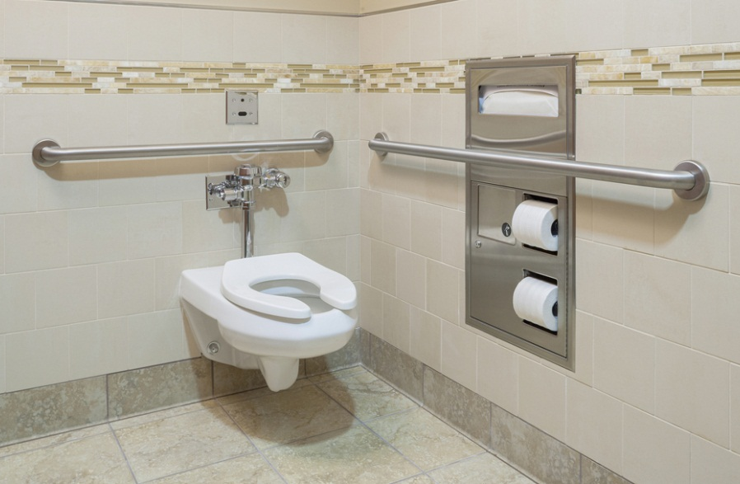
Accessible Toilet Compartments
Required in all public restrooms
Two basic toilet compartment designs:
Wheelchair Accessible Toilet Compartment
Accommodates people who use wheelchairs
Ambulatory Accessible Toilet Compartment
Accommodates people who use canes, crutches or walkers
Notes:
Accessible toilet compartments are required in all public restrooms.
CLICK There are two basic toilet compartment designs that are shown in the standards: the Wheelchair Accessible Toilet Compartment and the Ambulatory Accessible Toilet Compartment.
CLICK The wheelchair accessible toilet compartment accommodates people who use wheelchairs and who transfer onto and off of a toilet using a variety of approaches.
CLICK The ambulatory accessible toilet compartment accommodates people who use canes, crutches or walkers to assist their mobility.
CLICK

Slide 52
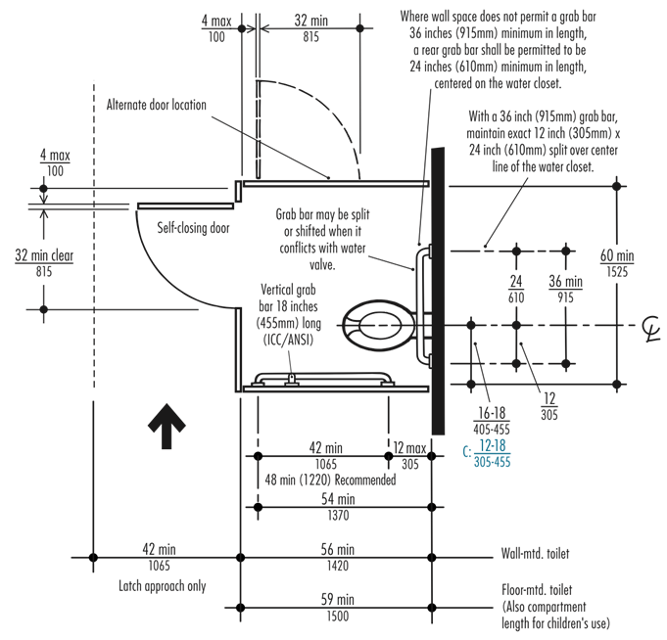
Wheelchair Accessible Toilet Compartment
Depth 56" min. for wall-hung toilets and 59" min. for floor-mounted toilets.
Width is 60" min.
Toilet offset on back wall with toilet centerline 16" min. to 18" max. from side wall or partition.
Grab bars mounted on rear wall and on closest side wall or partition to toilet.
Notes:
There are two styles of Wheelchair Accessible Toilet Compartments: standard front access and large wheelchair accessible with side door access.
CLICK In the standard front access wheelchair accessible toilet compartment, the depth must be 56 inches minimum for wall-hung toilets and 59 inches minimum for floor-mounted toilets.
CLICK The minimum width is 60 inches. Note that some jurisdictions have different requirements for accessible toilet compartment size and configuration. It is recommended that you check local codes.
As an example, the 2016 California Building Code (Section CBC 11B-604.3.1 Size) requires, “A minimum 60" wide and 48" deep maneuvering space in front of the toilet.” This requirement eliminates use of the nominal 60" by 60" square Wheelchair Accessible Toilet Compartment in the state of California. The Large Wheelchair Accessible Toilet Compartment, 8' long, 5' wide, frequently used at the end of the restroom, complies with the California requirement.
CLICK In addition to compartment dimension requirements, the toilet must be offset on the back wall with the toilet centerline 16 inches minimum to 18 inches maximum from the side wall or partition.
CLICK Grab bars must be mounted on the rear wall and on the closest side wall or partition to the toilet. The 2009, 2017 ICC A117.1 Standards require a vertical grab bar 18 inches long minimum above the horizontal side grab bar.
CLICK

Slide 53
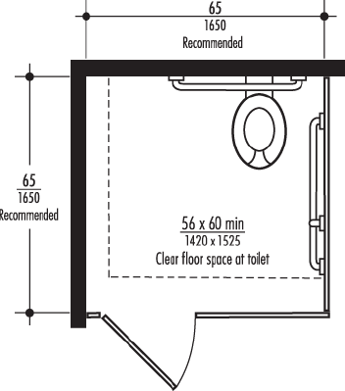
Large Wheelchair Accessible Toilet Compartment
66" x 65" toilet compartment interior
56" x 60" clear floor space at toilet
New ICC A.117.1 (2017) Alternate Wheelchair Accessible Toilet Compartment is 60" x 84"
Notes:
The recommendation for a large wheelchair accessible toilet compartment is a 66 inch by 65 inch toilet compartment interior with 56 inch by 60 inch clear floor space at the toilet.
CLICK The 2017 edition of ICC has added a new Alternate Wheelchair Accessible Toilet Compartment 60 inches minimum in width by 84 inches minimum in depth.
CLICK

Slide 54
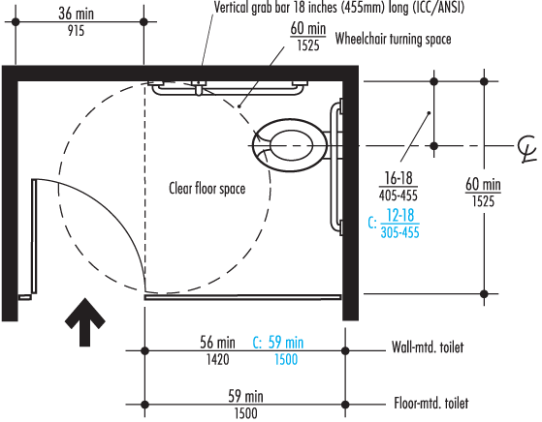
Large Wheelchair Accessible, Side Door Access
Alcove layout toilet compartment:
5' deep and 8' long with an internal 60" diameter wheelchair turning space.
In-swing doors must not overlap required toilet clearance.
Notes:
The Large Wheelchair Accessible Toilet Compartment with side door access shown is a common end-of-the-restroom alcove layout. In-swing doors must not overlap the required 56 inch-by-60-inch clear floor space at the toilet. This layout complies with the California Building Code Section CBC 11B-604.3.1 because there is a maneuvering space minimum 48 inches deep by 60 inches wide in front of the toilet.
CLICK

Slide 55
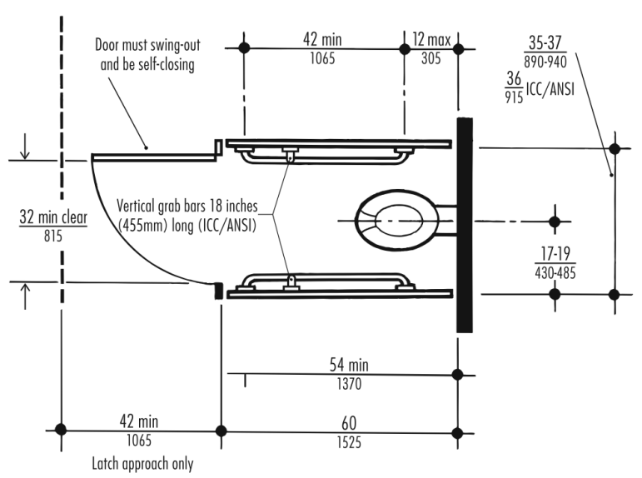
Ambulatory Accessible Toilet Compartment
Used where 6 or more fixtures are provided.
Depth is 60" min. with 2009 ICC/ANSI Standards retaining the 36" absolute width dimension.
Notes:
An ambulatory accessible toilet compartment is used where six or more fixtures, including toilets and urinals, are provided.
CLICK The Ambulatory Accessible Toilet Compartment has a depth of 60 inches minimum. The 2009 ICC A117.1 Standard retains the 36 inches absolute width dimension. The 2010 ADA Standards allow a range of 35 inches to 37 inches maximum width.
CLICK

Slide 56
Ambulatory Accessible Toilet Compartment (cont.)
35" to 37" wide, per ICC A117.1 (2017) and 2010 ADA Standards
Self-closing doors must swing out, not into the compartment.
Toilet must be located on back wall with toilet centerline 17" min. and 19" max. from side wall or partition.
Grab bars must be provided on both sides per side wall requirements.
Notes:
In the 2017 edition of ICC A117.1, the width dimension is 35 inches minimum to 37 inches maximum—the same dimensions as the 2010 ADA standards.
CLICK Self-closing doors must not swing into the minimum required compartment area. Door pull hardware must be installed on both sides of the door near the latch.
CLICK The toilet must be located on the back wall with the toilet centerline 17 inches minimum and 19 inches maximum from the side wall or partition.
CLICK Horizontal Grab bars must be provided on both sides of the toilet compartment. Additionally, the 2009 ICC/ANSI standards require that a vertical grab bar 18" long minimum, be installed above the horizontal side grab bar on both sides of the toilet compartment.
CLICK

Slide 57
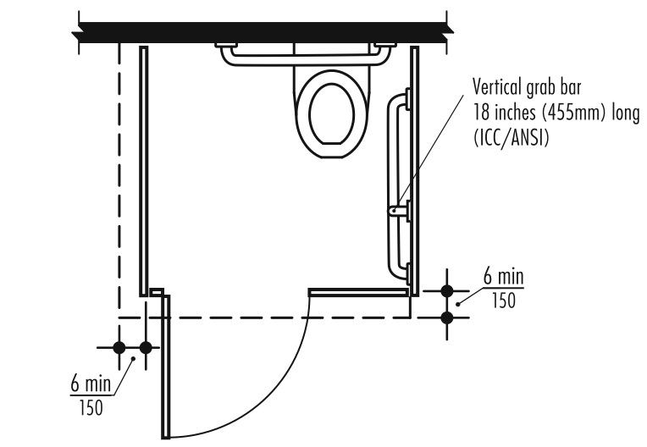
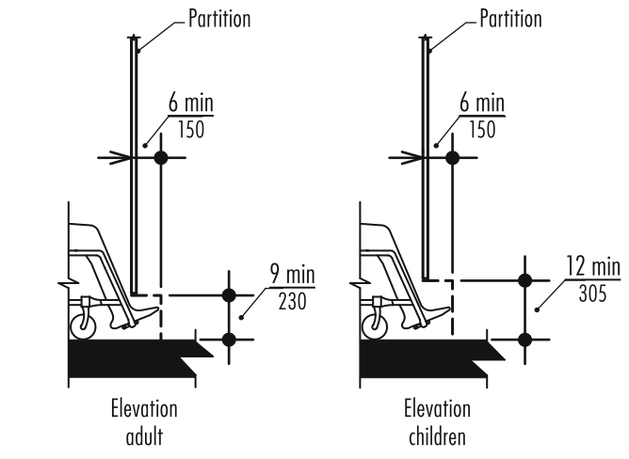
Toe Clearance: 2010 ADA & 2009 ICC A117.1
Horizontal Toe Clearance
Vertical Toe Clearance
Notes:
Per the 2010 ADA and the 2009 ICC A.117.1 Standards, a toe clearance above the finish floor of 9 inches minimum for adults and 12 inches minimum for children is required under the front partition and one side partition of all accessible toilet compartments.
The toe clearance must extend 6 inches deep minimum beyond the compartment-side face of the partition.
Toe clearance at the front partition is not required if the depth of the compartment is greater than 62 inches deep with a wall-hung toilet or 65 inches deep with a floor-mounted toilet. Toe clearance at the side partition is not required in a compartment greater than 66 inches wide.
CLICK

Slide 58
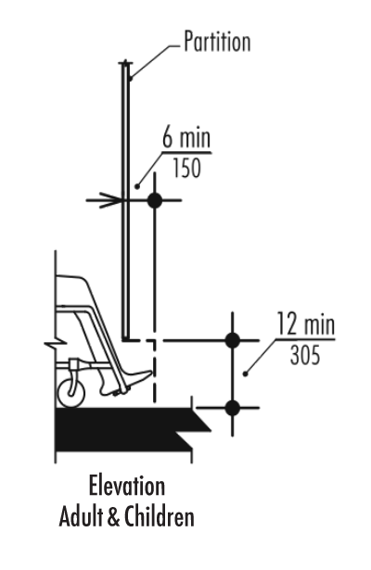
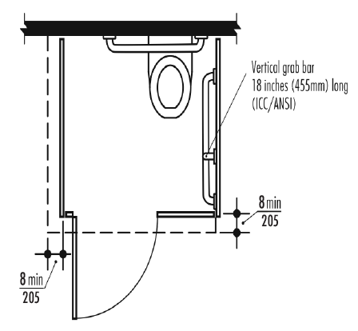
Toe Clearance Update in ICC A117.1 – 2017 Edition
Toe clearance must extend 8" minimum (compared to previous requirement of 6") beyond compartment front and side (not including partition stiles)
Not required on compartments greater than 67" deep and 68" wide (compared to previous limit of 65" deep and 66" wide)
Notes:
In the 2017 edition of ICC A117.1, toe clearance remains at 12 inches high minimum for adults and children, but now must extend 8 inches minimum, compared to the previous six inch minimum, beyond the compartment front and one side, not including partition stiles.
CLICK Toe clearance at the front and side is not required on compartments greater than 67 inches in depth and 68 inches in width, compared to the previous limit of 65 inches in depth and 66 inches in width.
CLICK

Slide 59
Notes:
Finally, we will identify guidelines for writing toilet compartment specifications.
CLICK

Slide 60
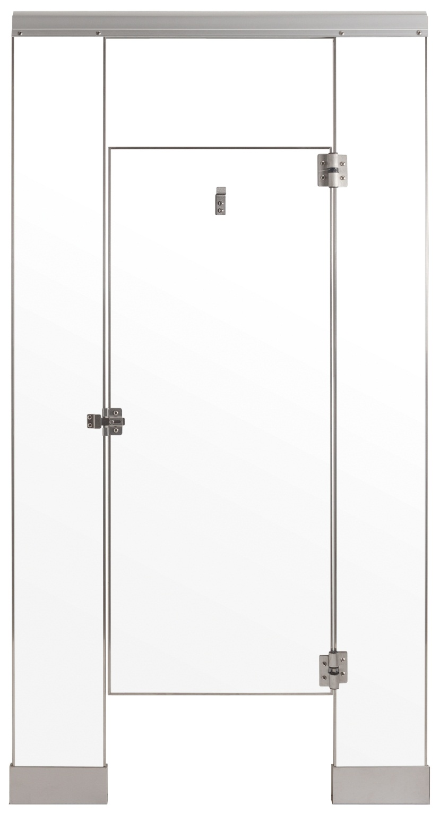
Writing an Enforceable Toilet Compartment Specification
The Importance of Clarity & Specificity
Always write a clear description.
Ambiguity can result in the contractor making the specification for you.
All materials, hardware and compliance standards should be referenced and described completely.
Notes:
When you write a specification for toilet compartments, it’s critical that the specifier, architect or interior designer understands that this document represents their standard of quality and the exact work they expect the contractor to fulfill.
CLICK It’s important that you always write the specification with a clear description of what you want.
CLICK Any ambiguity can result in confusion when the contractor reviews the specification and begins to assemble the bid. For example, if your toilet compartment specification simply delineates “metal partitions” with no further description, the contractor may be inclined to choose any metal partition at his or her own discretion. Always focus on absolute requirements and ensure that they are clearly stated.
CLICK All materials, hardware and standards of compliance should be described and referenced completely.
CLICK

Slide 61
Writing an Enforceable Toilet Compartment Specification
Example: Airport Restroom
Specifying Compact Laminate.
Mounting configuration is floor-anchored, overhead-braced.
Door hinges and mounting bracket hardware are full-height, heavy-duty, stainless steel.
Notes:
As we have discussed, there are many specification variables for toilet partition systems based on material, hardware selection and mounting configuration. It is recommended that each new specification reflect the requirements for the given project and not be cut and paste from a previous project which frequently results in a system that is not code-compliant, is not manufactured and cannot be bid.
CLICK For the purposes of this example, we’ll assume that the project is an airport that sees heavy traffic with some heavy use and abuse by a diverse population of users. As such, equipment durability and privacy are the most significant considerations.
With this information in mind, we are specifying Compact Laminate with privacy options. This material selection will provide scratch and impact resistance with the ability to remove graffiti.
CLICK The mounting configuration is floor-anchored, overhead-braced, which will provide the sturdiest mounting configuration.
CLICK Door hinges and mounting bracket hardware are full-height, heavy-duty, stainless steel.
CLICK

Slide 62
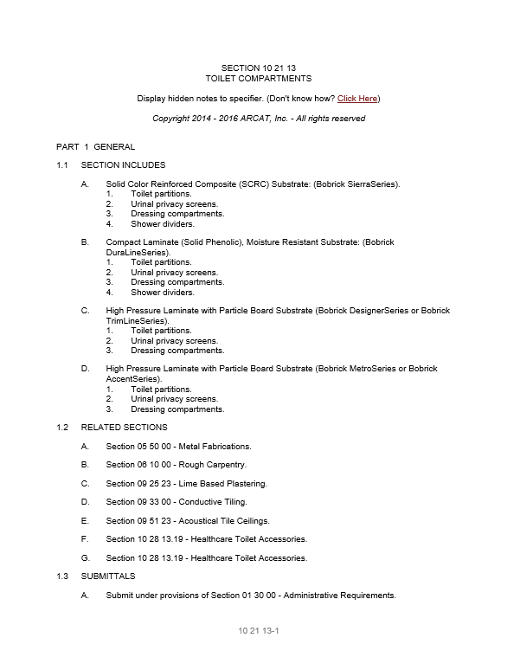
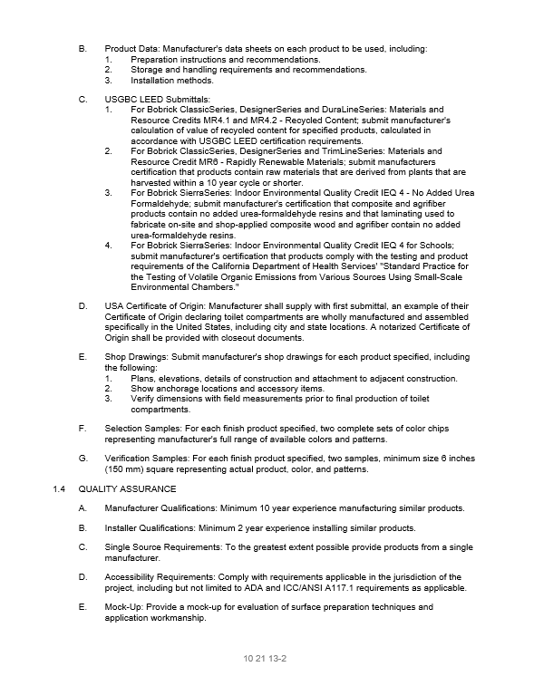
Writing an Enforceable Toilet Compartment Specification
Writing a Truly Complete Specification
Ask the following:
What is the material?
How is it mounted?
Which privacy options will be employed?
What are the hardware features?
Which codes and standards do I intend to comply with?
Language should specify what you want—and what you don’t want
Notes:
Before you begin assembling your specification, it is recommended that you ask yourself, what are the toilet compartment needs for the project on which you are working?
CLICK What is the material? How is it mounted? Which privacy options will be employed? What are the hardware features? Which fire codes and accessibility standards do I need to comply with?
In all sections of the specification, you should think not only about the material itself—for example, High-Pressure Laminate or Compact Laminate—but also its construction, the partition system’s mounting configuration, the thickness of the panels, stiles and doors, stile reinforcement and the door and mounting hardware appropriate for the occupancy needs of the project. Additionally, the fire-resistance standards with which you intend to comply should be included in the “Referenced Standards” section of the specification.
CLICK Always describe every facet you expect to be fulfilled by the contractor, within the specification. Your language should say what you want—and what you don’t want.
CLICK

Slide 63
Example Toilet Compartment Specification
Material Description
Stiles, panels, doors and screens: Solid Phenolic material. High Pressure Laminate with matte-finish Melamine surfaces and integrally colored face sheets solidly fused with black Phenolic-resin core. Phenolic edges are black; brown edges are not acceptable.
Finished Thickness: Stiles and doors ¾ -inch thick. Uniform thickness of stiles and doors to ensure flush front. Panels and screens ½ -inch thick.
Privacy: Stiles and doors shall have integrated stile and door no-sightline privacy closing. Doors and panels shall be 72 inches extended height.
Fire-Resistance: NFPA/IBC Class B Interior Wall and Ceiling Finish Classification.
Notes:
In the “Materials” section, it’s critical that the exact material and the qualities and construction of each facet are listed to ensure that the contractor fulfills the specification in accordance with your vision, standard of quality and most importantly, local, state and national codes. For this example, the Material Description would read as follows:
MATERIAL DESCRIPTION
Stiles, panels, doors and screens: Solid Phenolic material. High Pressure Laminate with matte-finish Melamine surfaces and integrally colored face sheets solidly fused with black Phenolic-resin core. Phenolic edges are black; brown edges are not acceptable.
Finished Thickness: Stiles and doors ¾ -inch thick. Uniform thickness of stiles and doors to ensure flush front. Panels and screens ½ -inch thick.
Privacy: Stiles and doors shall have integrated stile and door no-sightline privacy closing. Doors and panels shall be 72 inches extended height.
Fire-Resistance: NFPA/IBC Class B Interior Wall and Ceiling Finish Classification.
CLICK

Slide 64
Example Toilet Compartment Specification
Hardware Features
Materials: 18-8, Type 304 stainless steel with satin finish. Chrome-plated “Zamak”, aluminum, plastic hardware not acceptable.
Fastening: Stainless steel machine screws into factory-installed inserts. Fastening directly into material not acceptable.
Mounting: Door hardware and mounting brackets concealed inside compartment. Exposed hardware and fasteners on exterior of compartment not acceptable except on accessible compartment.
Latching: Slide latch into keeper, track prevents door from swinging beyond stile. Twist-style door latch not acceptable.
Notes:
Similarly, all elements are described completely in the “Hardware Features” section. Features deemed “not acceptable,” such as twist-style door latches, which would not be ADA-compliant, are explicitly identified.
HARDWARE FEATURES
Materials: 18-8, Type 304 stainless steel with satin finish. Chrome-plated “Zamak”, aluminum, plastic hardware not acceptable.
Fastening: Stainless steel machine screws into factory-installed inserts. Fastening directly into material not acceptable.
Mounting: Door hardware and mounting brackets concealed inside compartment. Exposed hardware and fasteners on exterior of compartment not acceptable except on accessible compartment.
Latching: Slide latch into keeper, track prevents door from swinging beyond stile. Twist-style door latch not acceptable.
CLICK

Slide 65
Example Toilet Compartment Specification
Hardware Features (continued)
Hinges and Mounting Brackets: One-piece, extend full height of door and panel. Hinge shall be self-closing.
Compliance: Operable with one hand, without tight grasping, pinching or twisting of the wrist; force to operate does not exceed five pounds.
Emergency Access: Hinges, latch allow door to be lifted over keeper from outside of compartment
Notes:
Hinges and Mounting Brackets: One-piece, extend full height of door and panel. Hinge shall be self-closing.
Compliance: Operable with one hand, without tight grasping, pinching or twisting of the wrist; force to operate does not exceed five pounds.
Emergency Access: Hinges, latch allow door to be lifted over keeper from outside of compartment.
CLICK

Slide 66
Summary
You should now understand:
Importance of specifying appropriate material, hardware, mounting configuration and privacy options for toilet partitions.
Building type and budget are important considerations in specifying the most appropriate toilet partitions for the needs of a project.
Toilet Partition compliance with accessibility standards and fire codes is mandatory.
Notes:
You should now understand:
CLICK The importance of specifying the appropriate material, hardware, mounting configuration and privacy options for toilet partitions.
CLICK That building type, and budget are also important considerations to ensure that the appropriate toilet partitions are specified.
CLICK And finally, that toilet partition compliance with accessibility standards and fire codes is mandatory.
CLICK

Slide 67
Thank You
Thank you for your interest in specifying code-compliant toilet partitions.
Please contact Bobrick with any questions.
Notes:
Thank you for your interest in specifying code-compliant toilet partitions. Please contact Bobrick with any questions.
CLICK

