Slide 1
NCR RETAIL ONLINE
Ecommerce Made Simple

Slide 2
AGENDA
Product Overview
Review Components
NCR Counterpoint
Admin Panel
Demo Store
Sign up and pricing

Slide 3
WHY ECOMMERCE?
$1,000,000,000,000
Online sales increased 13.9% in North America
(source: eMarketer report 2013)
Notes:
You are here either because you are looking to grow and start selling online or because you are looking to make ecommerce easier with integration
So why does ecommerce matter?
Global e-commerce sales exceeded 1 trillion dollars in 2012. This growth was driven by growth in the North America and Asia.
According to a survey by market research firm eMarketer, North America sales increased 13.9 percent year-over-year
Notes (not part of script):
Ecommerce is a cost effective sales channel and the integration to CP ties all your data together.
reaching USD 365 billion and Asia-Pacific sales have risen by 33 percent to about USD 332 billion.
The same source shows that while North America currently leads the way in e-commerce sales, this will change in 2013. eMarketer predicts that North America sales will grow at a slightly lower rate of 12.2 percent in 2013 to USD 409 billion. Asia-Pacific sales, on the other hand, will grow by 30 percent to USD 433 billion.
Results point out that the US will continue to have the highest e-commerce sales of any country at least through 2016. eMarketer estimates that the US e-commerce sales will grow from USD 343 billion in 2012 to USD 385 billion in 2013, more than double the sales of China, which is expected to grow to USD 182 billion in 2013 from USD 110 billion in 2012.
Online holiday shopping is up 14.4%
(source: comScore Inc
looking at online sales Nov 3 – Dec 4, 2012)

Slide 4
WHAT IS IMPORTANT?
Integration
Features
Notes:
There are two important pieces when researching ecommerce solutions:
Integration: your brick and mortar store should function seamlessly with your online store
Features: in a nutshell, you need your site to do what it needs to do. Your customers have expectations of how a site should work – you want to meet those expectations.

Slide 5
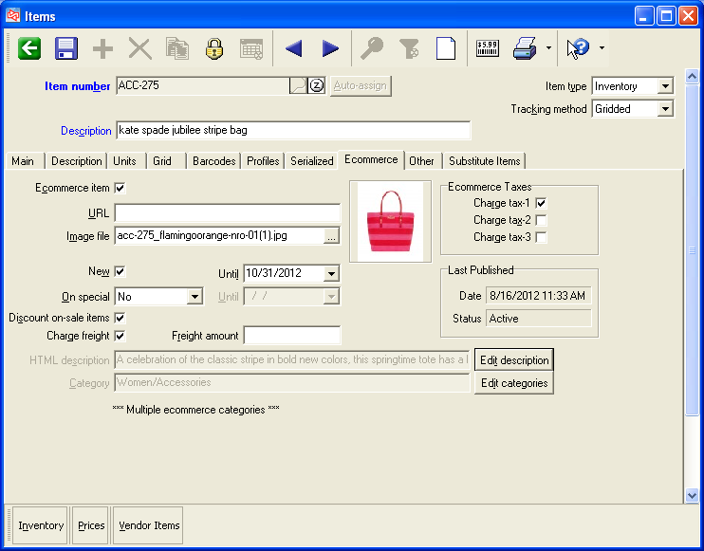
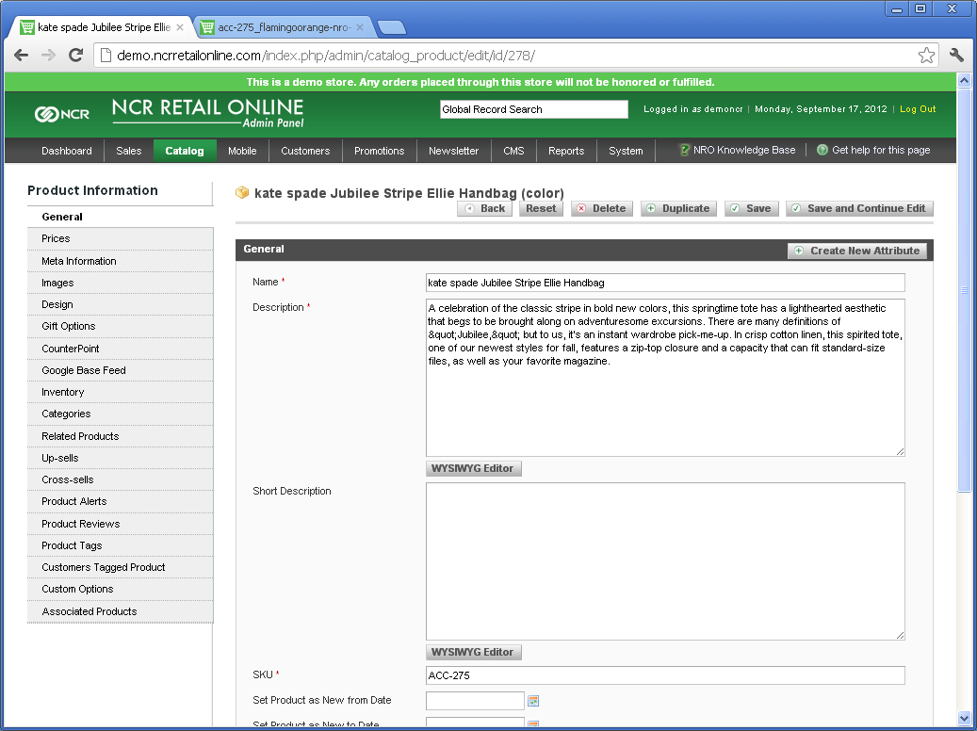
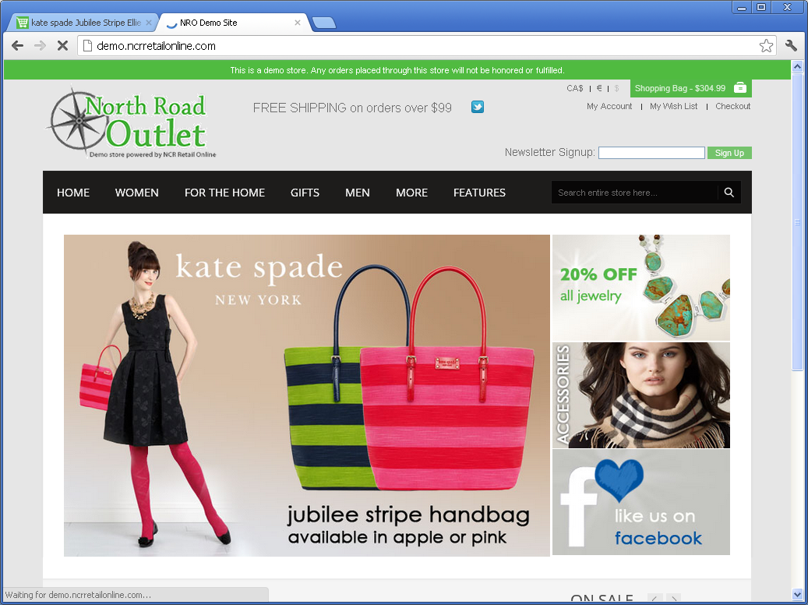
INTEGRATION
Integration Agent
Notes:
NCR Retail Online has 4 components:
Counterpoint – with all your item information
The Admin Panel – where you choose how your site looks, behaves and functions
Your Online Store – where your customers come to shop and when they place an order, that order is automatically imported into Counterpoint
The 4th component is the integration agent. This is a piece of software that sits on your Counterpoint server. It sends information back and forth from your Counterpoint system and your online store.
There are many benefits to having an integrated system. I am going to talk about 3 of them.

Slide 6
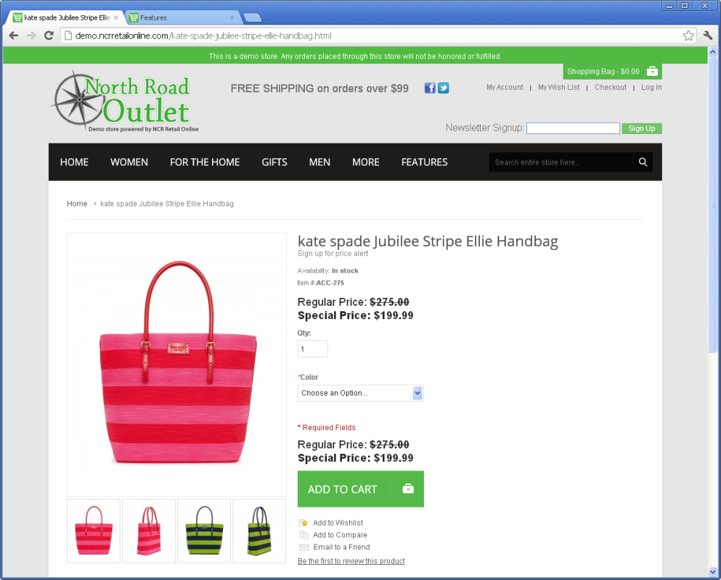
MAKE CHANGES ONCE
Notes:
#1 - Having an integrated system means that you are only working with one set of inventory data.
Add items once
Price changes
Description updates
The integration agent looks for updates every 15 minutes

Slide 7
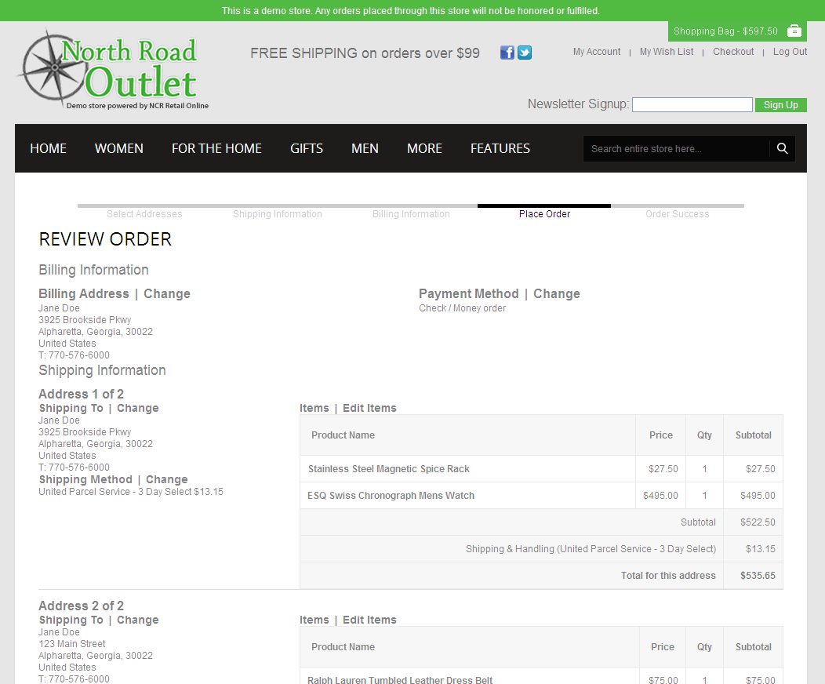
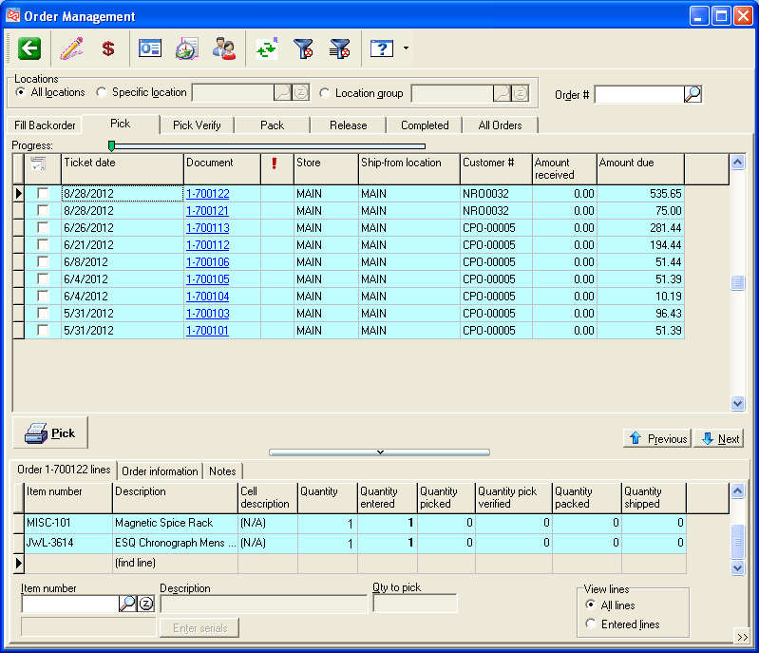
AUTOMATICALY IMPORT ORDERS
Notes:
The second benefit of having an integrated ecommerce system is that orders placed online are automatically imported into Counterpoint. Again, this is the integration agent looking for new orders every 15 minutes.
Once the order is imported, you will process it as you process other orders in your system.

Slide 8
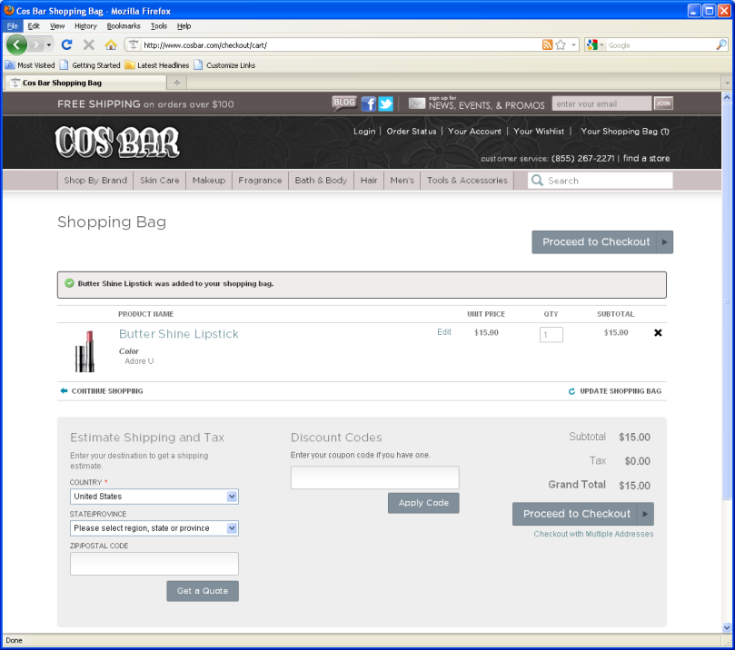
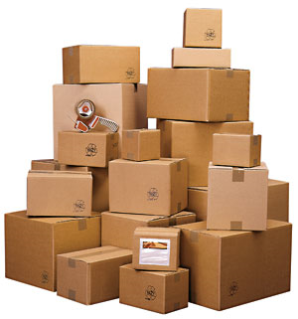
CENTRALIZED INVENTORY
Sales made in-store
Sales made online
Notes:
The second benefit of having an integrated ecommerce system is that you only maintain inventory in 1 location. Sales made online affect your quantities inside Counterpoint and vice versa.
There are other benefits as well including a shared customer database.

Slide 9
BENEFITS OF INTEGRATION
Items and Customers
Inventory
New Orders
Notes:
Integration is the key piece that will save you time and $$
All of your catalog data (items and customer) is held in your CP database
This data feeds your online store – when you update in CP, the item updates online
New orders are downloaded directly into CP
Information is passed automatically between CP and your NRO website every 15 minutes
This covers the main points around integration. Let’s talk next about FEATURES.

Slide 10
POWERED BY MAGENTO
Built-in Features
Layered navigation with product filtering
Multiple images for each item, including zoom
Unlimited item attributes
Cross-sells / Up-sells
Product ratings & reviews
Product comparisons
Recently viewed items
Ability to group together similar products
Display multiple SKUs with dropdown, like gridded items
Quantity checking/display with threshold display (e.g., “Only 3 left”)
Support for required purchase quantity increments
Category Landing Pages
Thumbnail pages with “view all”, sort options, and items-per-page options
List / Grid view for thumbnails
Product Tags
Add all Wish List items to the shopping cart
Share wish lists by email
Item- and Category-specific promotional codes
Promotional discounts such as free shipping over specific order amount, brand-specific discounts, etc.
Shopper email alerts when items return to stock and/or when item price changes
Full-text search with auto-complete and search term reporting
SEO tools, including SEO-friendly URLs, sitemaps, URL rewrites, and meta information
Address book that allows each shopper to store multiple addresses
Ship to multiple addresses
FedEx / UPS / USPS shipping rate lookups
Configurable zone-based tax rules based on state/ZIP
HTML transactional emails
Terms & Conditions
RSS Feeds
Google Analytics integration
Google Site Map
CMS (Content Management System) editor that supports unlimited pages and content blocks
WYSIWYG editor with formatting controls similar to Microsoft Word
And more…
Notes:
NCR Retail Online is built on a Magento platform.
Magento is a very powerful open-source platform in use by over 100,000 merchants
It has a LOT of built-in features. I am not going to read you this list, my point is that this is a very feature-rich platform.
Pairing with Magento allows us to take advantage of new ecommerce functionality while giving us the ability to focus on the integration.
Notes (not part of script):
Powerful ecommerce software owned by eBay
In use by 110,000+ merchants worldwide
Community Edition is open source
Large user community
Large development community
Magento also offers Enterprise Edition, which carries licensing fees that we will save you by adding advanced features ourselves to NRO
$14,420 per year for Enterprise (single production server)
$49,990 per year for Enterprise Premium (multi-server package)

Slide 11
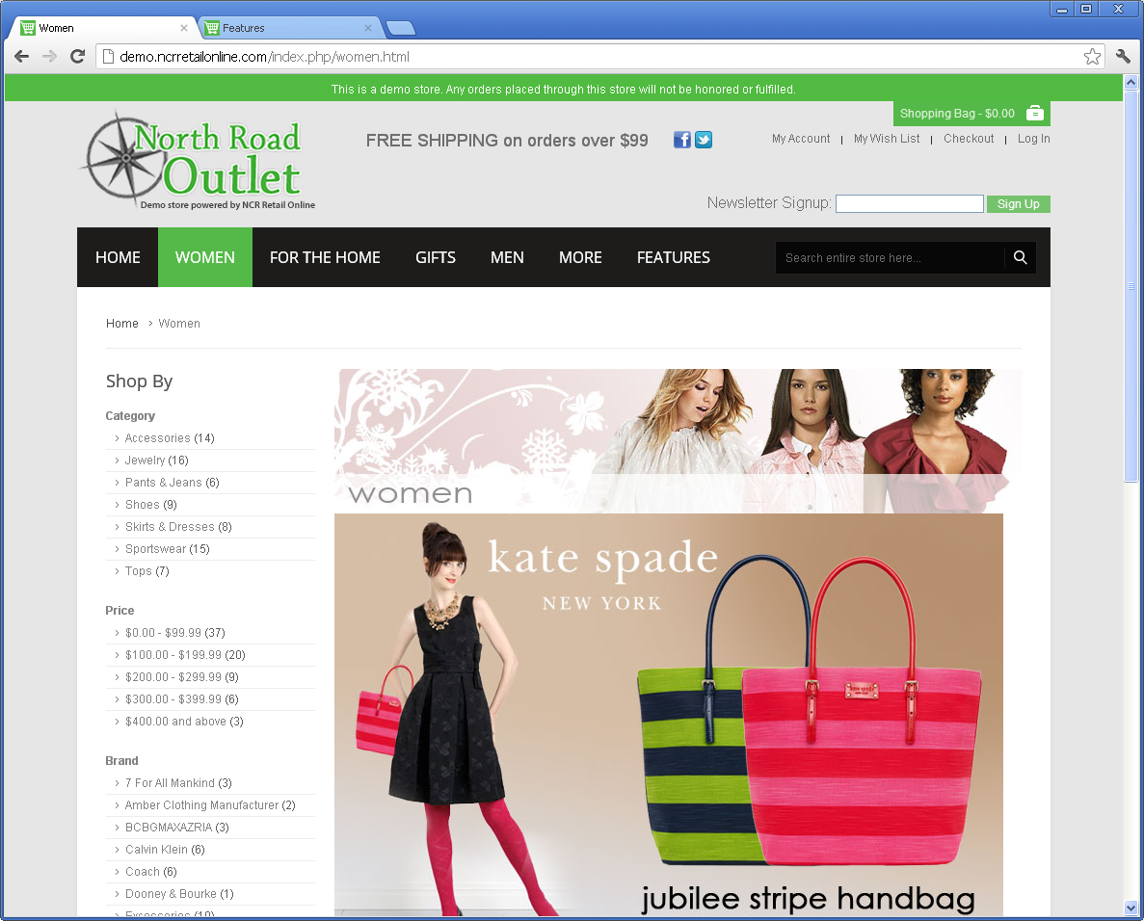
DIVE IN
Notes:
Demo store: Start at the end to see the “finished product” and then we will walk through the steps to get here
Overview of homepage
- Customizable theme optimized for ecommerce best practice
Other example sites: Margaritaville, etc. (end back on the demo store)
- Homepage slide show
- Sale and new items sliders
- Cart widget dropdown
- Navigation – mega menu
“For the Home” category – see items immediately
- View by grid/list, view quantities
- Layered navigation
Schaefers example – see how they used layered navigation
“Women’s” category landing page
-Shop by Brand: “Coach,” choose purse, show item page
- Information from CP
- Change color, changes image
- Related items
- Search engine friendly URLs
Wish List
- Recently viewed items
- Compare products
Bulova Watch
- Out of stock
- Image zoom
- Reviews
- Related items
Counterpoint: That was the final product, let’s take a look at where this information originates
Item information comes from Counterpoint
View purse – marked as ecommerce, look at tabs
Admin Panel: This is where you configure how your site looks, behaves and functions
Quickly mention Dashboard
CMS - Design components
- Pages show the “About Us” page
- Use static blocks to create content that will appear on multiple pages (banners, header and footer, etc.)
- Create a homepage slide show
System / Configuration (give overview of setup – Sections/Tabs)
Design components
Homepage Slideshow – choose rotation effect and timing
Configuration of business decisions
Shipping methods
Payment options
Dashboard
Admin panel recap: this is an area to control how your site looks, behaves and functions. Many of the settings available are quite granular. They come set by default but it is nice to know you have the option to alter them.
PowerPoint:
Recap of next steps

Slide 12
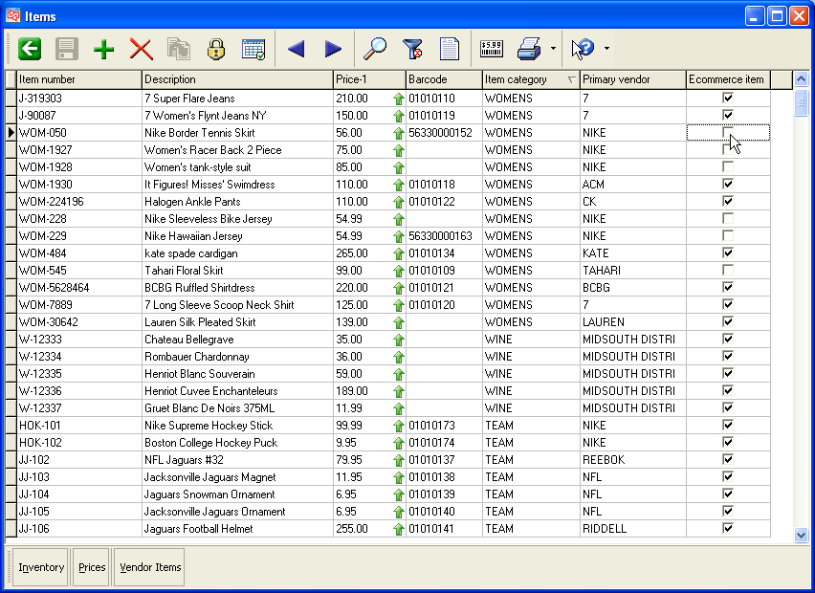
STEP 1: Choose Inventory
Notes:
Let’s talk about the steps involved in bringing your site live. There are 3 main steps and each of these steps has multiple pieces involved.
Step 1:
This is when you choose which items to include in your online store.
- update description
- add long description
- add weight
- web-ready images
These pieces are done inside CP

Slide 13
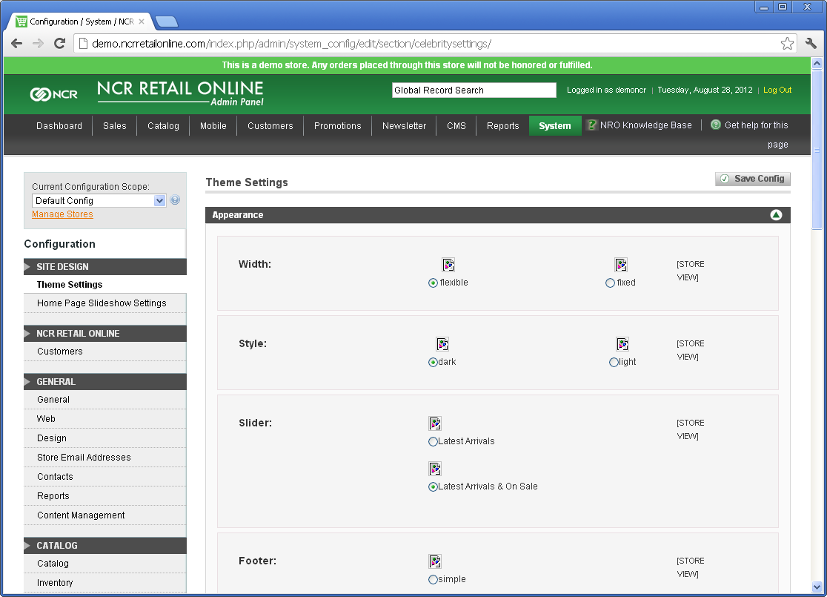
STEP 2: Design Website
Notes:
Step 2 is to look at your website design
- Change the Colors
- Choose a font
- Upload storefront images
- Change the Header and Footer
- Add Home Page Content

Slide 14
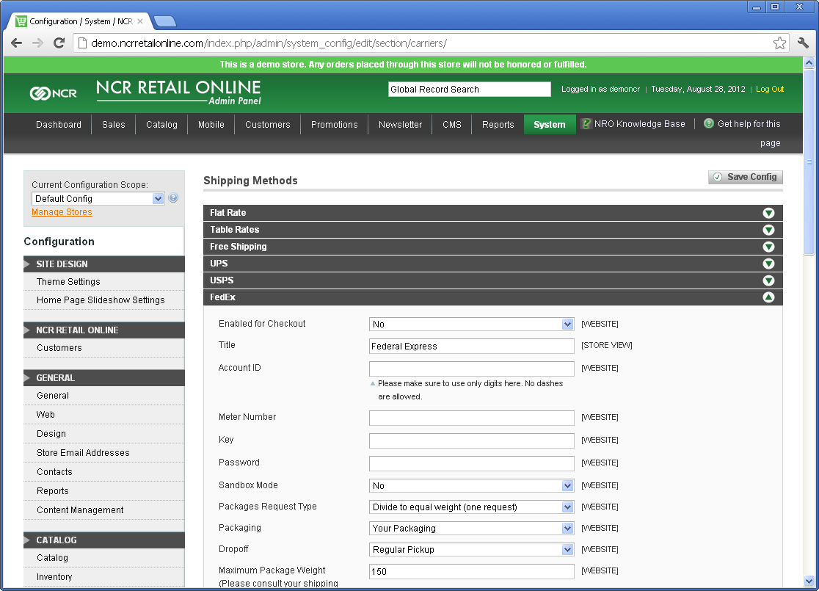
STEP 3: Configure Settings
Notes:
Step 3: Set up your site configuration
- Shipping options
- Payment methods
- Define tax information

Slide 15
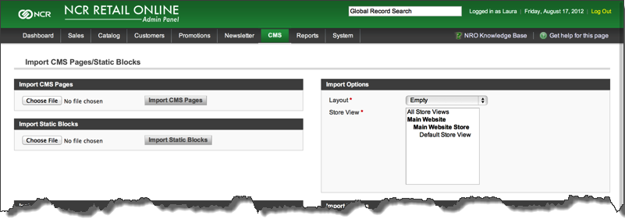
MIGRATION UTILITIES
Notes:
There are migration utilities to help you move from an existing site. For example, there is a tool to help you with 301 redirects. If you have a site today, that site is building trust with Google and you want to transfer that trust to your new site when you move. 301 redirects are like sending google an address change notification and this migration tool will make that easier.

Slide 16
WHO BENEFITS?
Customer
Web Manager
Owner
Notes:
With NCR Retail Online…
Your customers get an enhanced shopping experience on a customer friendly site
Your Web Manager only has to
Add items once
Making changes once
Maintain inventory in 1 location – don’t have to manually track which items have sold in your store and remove them from your website.
AND…No rekeying orders
We know you are busy. We want to help save you time.
As the Owner:
- integration will reduce overhead
- enhanced customer experience will increase sales

Slide 17
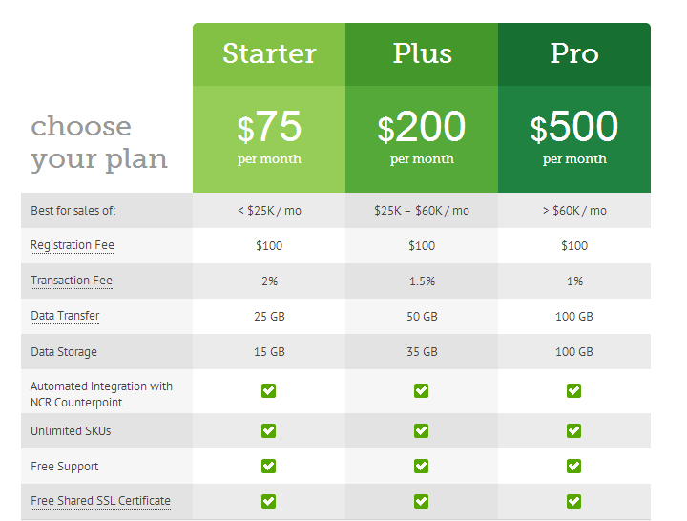
HOSTING PLANS
Notes:
We have 3 hosting plans available

Slide 18
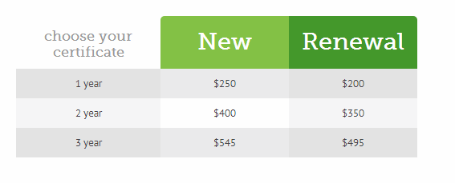
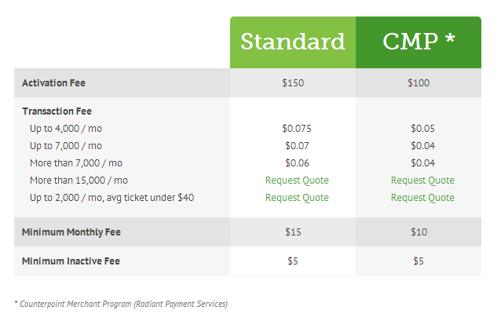
PRICING
SSL Certificates (optional)
NCR Secure Pay (credit card gateway)

Slide 19
Example Pricing
One Time Fees
$100 Registration
$250 1 Year SSL Certificate
+ $150 NCR Secure Pay Activation
$500 Total
$6,995 Standard Implementation (optional)
Monthly Fee
$ 75 Hosting
$400 Transaction Fee
+ $ 30 NCR Secure Pay Transaction Fee
$505 Total Per Month
Store Profile:
$20,000 Monthly Sales
$50 Average Ticket
400 Tickets Per Month
Non-NCR Merchant Services Customer

Slide 20
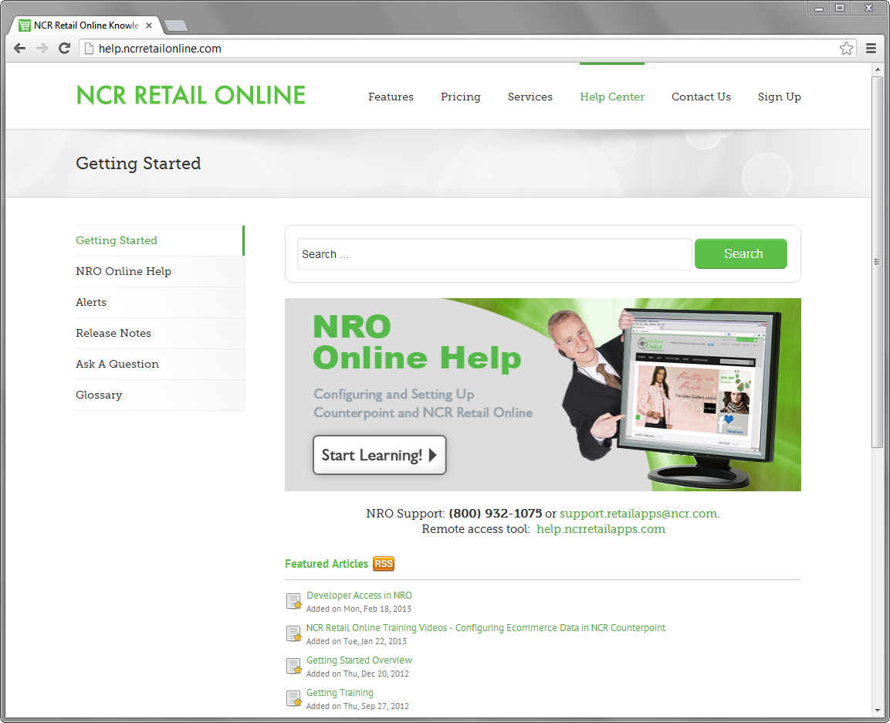
RESOURCES
Help Documentation
Knowledge Base
Training Videos
We have paid options for guided training and implementation services available
Our support team is available if you run into problems. General response time is within 24 hours.
Notes:
We have a large library of help documentation and videos.
NCR Retail Online is built to be a do-it-yourself ecommerce platform allowing you to control your website changes.
We realize some of you may want help during the implementation process and we have paid implementation services available.

Slide 21
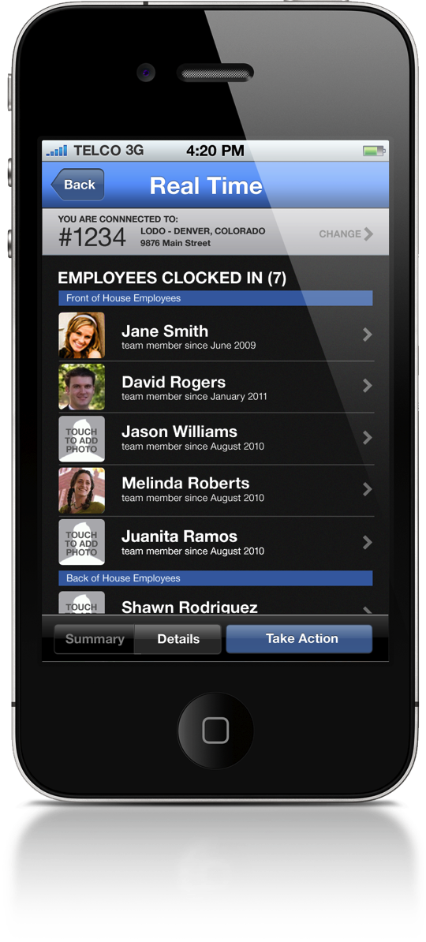
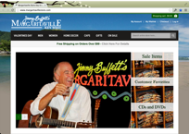
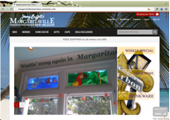
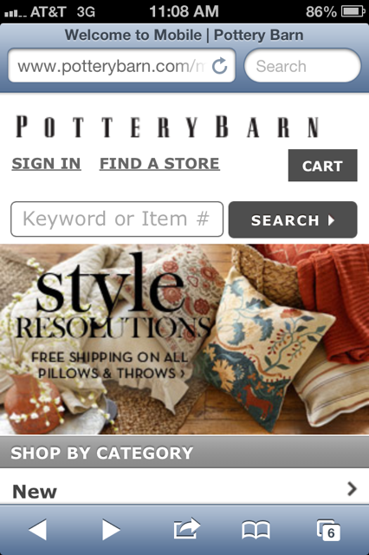
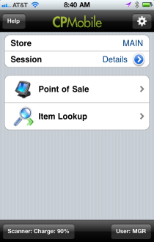
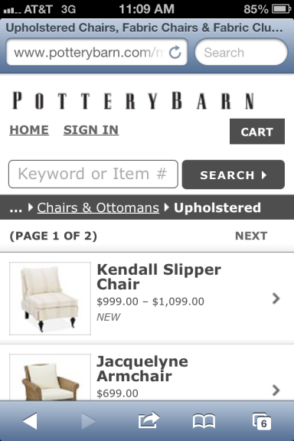
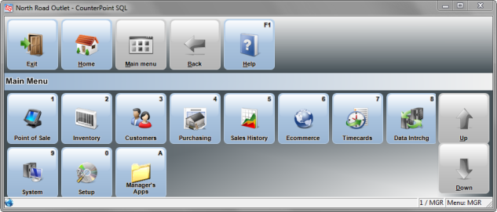
ROADMAP
Just the beginning…
Mobile Theme
Payment by A/R Charge
Payment by SVC
Order Processing Improvements
Boutique Storefronts
Member Pricing
Extension Store

Slide 22
ADDITIONAL SERVICES
NCR Professional Services (optional)
Site Design
Custom Modules / Extensions
Research, development, installation, configuration, conflict resolution
Full Site Implementation
Consultation, project management, feature configuration, best practices, design, add-ons, customizations, training
Search Engine Marketing
Social Media Marketing

Slide 23
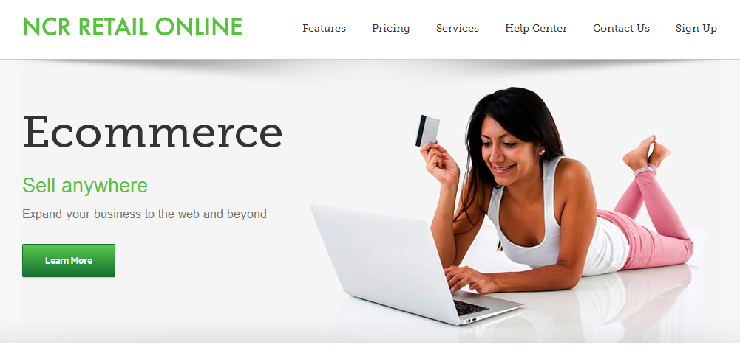
Next Steps
800.852.5852
RetailSales@ncr.com
More info: www.ncrretailonline.com
Demo store: demo.nrostores.com

Slide 24
Why Ecommerce?
The number of US consumers researching or shopping online is steadily growing and will surpass
200 million by 2015
(source: eMarketer)
Notes:
You are here either because you are looking to grow or looking to make ecommerce easier.
Ecommerce is a cost effective sales channel and the integration to CP ties all your data together.

Slide 25
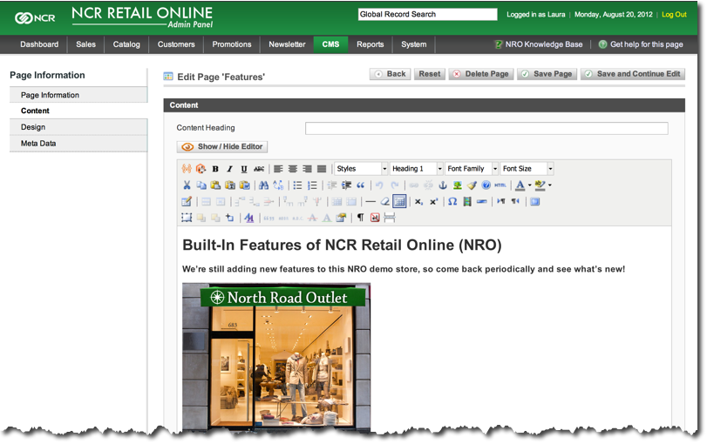
Creating Page Content
Create Page Content
WYSIWYG Editor
Home Page Slide Show (optional)

