Slide 1
2016 Walmart Program
DirectHealth Agent Portal
Notes:
The Direct Health Agent Portal was created to be a comprehensive and robust tool that will allow you to do many of your day to day tasks. Tasks such as reviewing your store assignments, completing your Direct Health training modules, selecting your carriers for the products you will sell, viewing certification status from those selected carriers, scheduling your sales events, and reporting daily sales activities.
As an agent you will hear about a lot of Agent Portal. Ever carrier has one.
There is also a Direct Health Agent Portal User Guide that is available that also presents the detailed specific instructions on how to use the Agent Portal.

Slide 2
Agent Portal Functions
Home
Training
Carrier Certification
Name Tag Ordering
Scheduling your Store Staffing Events
Reporting Store Activity
Help
Notes:
Our Objective today is to review all of the current functionality of the Direct Health Agent Portal.
We will be updating and adding additional functionality all the time to the Agent Portal. One of the major functionality features to come is the “Reporting” functionality. We will cover that when it is released.
IN this training deck we are going to specify review the:
Getting Started with the Portal,
Home Page,
Training Tab,
Carrier Certifications,
Ordering Name Tags,
Event Scheduling and Properly Using the Calendar Functionality,
Activity Reporting,
and finally using
Help

Slide 3
Getting Started
Notes:
Follow the included instructions to log into the Agent Portal. The instructions will include a very specific URL, user name, and password to use. Please use the provided information.

Slide 4
Getting Started
Notes:
After you successfully enter your user name and initial password, the portal will prompt you to change your password. Choose A password that you will remember but is also secure! You will be using this tool daily. Choose a mix of upper and lower case alpha-numeric characters.

Slide 5
Getting Started
Notes:
Once you change your password, you will be prompted to log in again. Simply enter in your user name aka your email address and your new password. If you ever forget your password, click on the “Forgot your password”. Enter your email address when prompted. A new temporary password will be emailed to you.

Slide 6
Getting Started
Notes:
The very first time you enter into the Agent Portal, you will be asked to verify your National Producer Number also called your NPN. You will be asked for some basic information to include your First Name and Last Name. It is very important that you enter your first name and last name as it appears on your insurance license. You will also need to provide the last 4 of your SSN and you need to select the licensed state that you reside in. If you are also licensed in another state, select that as well. If not, simply leave your Licensed Non-Resident State as “Select.”
When you have entered all of your information, click on the “Verify and Obtain NPN” to verify and obtain your NPN.

Slide 7
Getting Started
Notes:
After clicking on the “Verify and Obtain NPN” you will be brought to this screen, which lists your contact information, NPN, and store assignments. If your store assignment seems incorrect, contact your FMO immediately. If everything looks correct, click “Continue” to enter the main portal. That’s all of the first time Agent Portal access items. Let’s now a look at all the normal Agent Portal functionality.

Slide 8
Home
Notes:
On the Agent Portal homepage, you will see your store assignment or assignments if you are working more than one store. If your FMO has not yet assigned you to a store, this will appear blank. If you are assigned to the wrong store or if the store information is not present, contact your FMO to get this corrected.

Slide 9
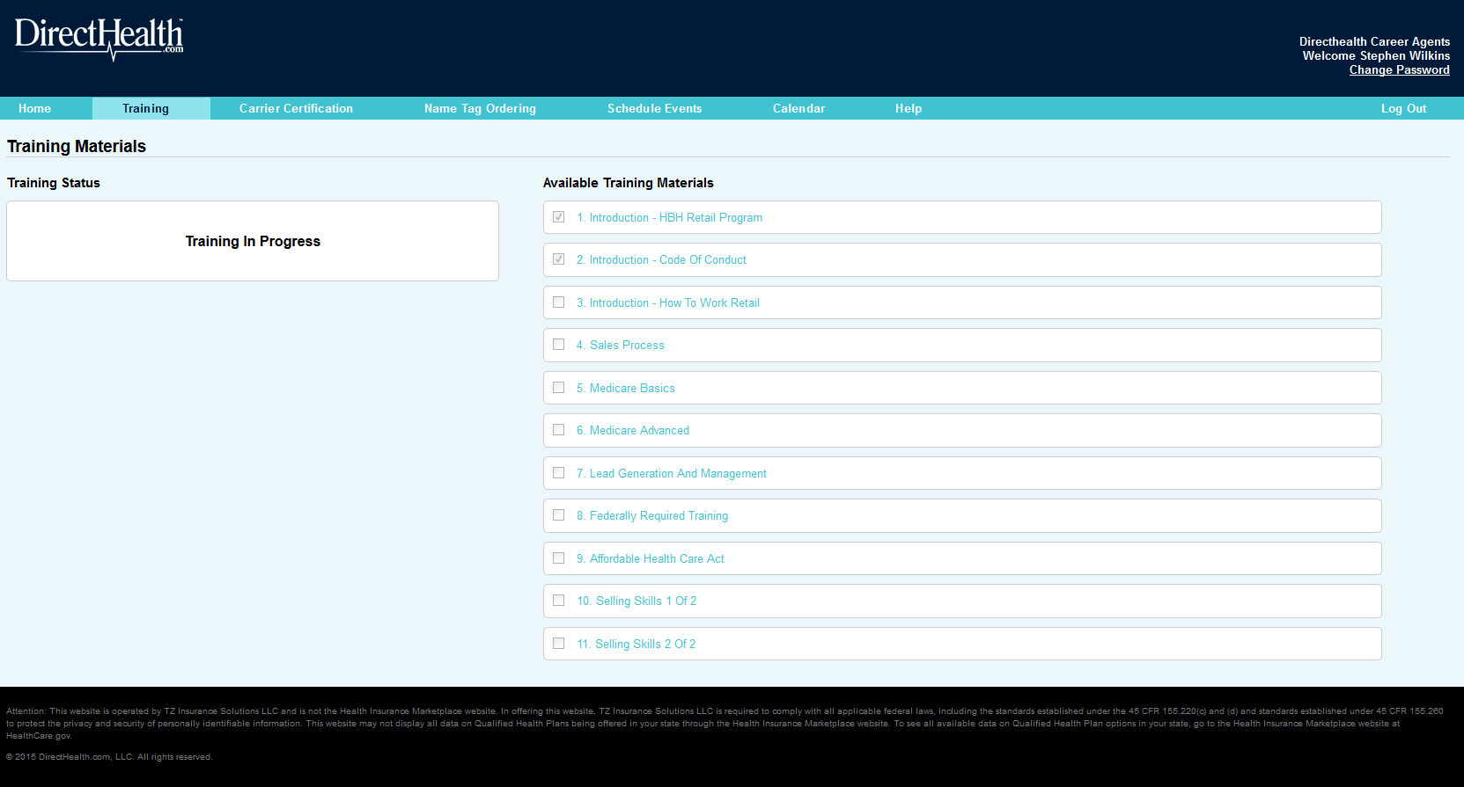
Training
Notes:
The Training Tab provides links to the Direct Health Online Training Modules. It also indicates the competition of those Required Training Modules. There are a total of 3 Training Modules for the 2015 Direct Health Walmart Retail Initiative. The Agent Portal will link out to the BrainShark Website where you will complete the actual learning modules. BrainShark is the Service Provider that hosts our Direct Health Walmart Retail Initiative training modules.
Make sure you have popups enabled in your web browser, or else you will not be able to click on the training links.
You are required to complete all 3 online DirectHealth Walmart Retail Initiative training modules. In order to successfully complete a module you must view ALL of the slides and score 80% or better on the examination portion of each module. The 3 Required Modules are displayed below. Note how the first two modules are “checked” indicating that they have been successfully completing.

Slide 10
Carrier Certification
Notes:
The Carrier Certification Tab allows you to select the Carriers that you will be certified sell in the Walmart Retail Kiosk. Within the Carrier Certification tab you will find the Top 5 over 65 carriers, as well under 65 carrier found in your market. For the Over 65 You will need to select a minimum of three of the top five carriers in your Market that offer MA/MAPD product(s).
To select your carriers, click the ‘Select Carrier’ button. Not sure which carriers to select, talk to your FMO.

Slide 11
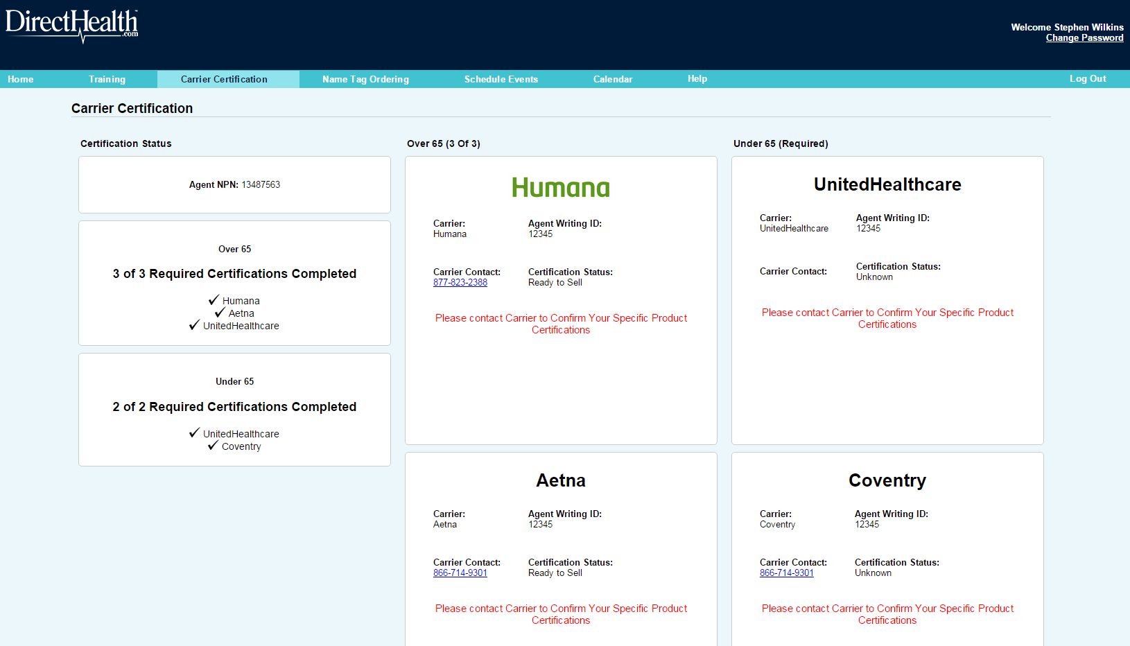
Carrier Certification
Notes:
As you move forward with the Appointment and Certification process you will notice the carriers status will change to ‘Ready To Sell’ Status. You will not be able to schedule your sales events until you received ready-to-sell status from at least 2 of your carriers.

Slide 12
Name Tag Ordering
Notes:
Walmart is requiring all agents to wear DirectHealth name badges. These items will be provided to you at no cost. You order your official DirectHealth name badge, lanyard, and marketing buttons under the Name Tag Ordering tab. The intent of those items is to enhance your visibility with potential consumers.
In this tab, provide your name as you would like it to read on your name badge, First and Last name. Also provide the address where you would like those items shipped.

Slide 13
Scheduling Sales Events
Notes:
Let’s take a look at Scheduling your Sales Events.

Slide 14
Scheduling Events Basics
What is a Sales Event
Why do I need to Schedule Work Hours
5 Time Slots Available
9 AM to 1 PM
10 AM to 4 PM
11 AM to 3 PM
1 PM to 5 PM
3 PM to 7 PM
Hours must be Schedule for all events in the Walmart Store from 10/5/2015 to 1/31/2016.
Notes:
When it comes to your attendance at your assigned store, there are strict rules and guidelines required by the program. These rules and guidelines come from a combination of CMS, Walmart, and Direct Health.
CMS has defined the time that an agent staffs a kiosk at Walmart as an informal sales event. Furthermore, CMS requires that all Carriers notify them when an agent will be presenting their products to a potential consumer. So what does this mean to you?
It means that you must notify the carriers whenever you will be presenting their products at your Kiosk. However, Direct Health has created the Portal to take care of all of those very complex rules for you so that you do not have to worry about filing all of those events to all of those different carriers. In order for us to make sure we are always in compliance with CMS and Carrier requirements there are several things we need you to do.
First, you must determine the hours that you are going to staff your Walmart kiosk. When determining what times you will be staffing the kiosk, try to be as consistent as possible week to week. The Walmart customers will get accustomed to seeing you there at a standard time. Once you determine when you will be there, you need to enter those times in the Agent Portal. There are 5 daily time slots available:
9 AM to 1 PM
10 AM to 4 PM
11 AM to 3 PM
1 PM to 5 PM
3 PM to 7 PM
You are required to schedule all events/times you will be in the Walmart from 10/5/2015 to 1/31/2016 and all of those must be scheduled in the Direct Health Agent Portal.

Slide 15
Scheduling Events Timeline
Number of Permissible Changes/Cancels | Required Days Prior to Creating New Event | Required Days to Change Event | Required Days to Cancel Event
5 | 15 Days | 7 Days | 7 Days
Dates that are not outside of 15 calendar days will not be available for scheduling new events.
You have the option to modify or change your events.
Once you meet your limit of 5 permissible changes or cancels, you will require escalated intervention to cancel events.
Notes:
There are some very specific requirements and limitations around scheduling your hours/events. First, as an agent you must file your events no later than 15 calendar days before the event takes place. The only exception to that rule can be made by Senior Management at Direct Health. It will be very rare if at all that Senior Management would approve an event to be staff at Walmart with less than a 15 calendar day advanced scheduling.
You will have the option to modify or change your events as well as to cancel your events. However, the maximum number of permissible changes or cancels as an agent you can submit is 5. Any changes or cancellations beyond 5 requires escalation. Escalation requires that you notify the Direct Health Agent Support Desk.
You have greater freedom to modify events than to cancel them. An event may only be rescheduled for another date within the SAME month and must be at the same store.
As we said you will have the option to cancel events. However, cancelation of events is to be avoided at all costs if possible. If an event must be cancelled or modified 7 calendar days or less, it can only be cancelled or modified by notifying the Direct Health Agent Support Desk. Depending on the number of days remaining before the scheduled event, any request for cancellation will need to be escalated to the appropriate management level.
Once you meet your limit, you will require escalated intervention to cancel events, i.e. you must notifying the Direct Health Agent Support Desk.
If you cancel an event, you will need to provide a reason why. This is required by the carriers and CMS. Once you’ve cancelled an event, you will no longer see that event and you can’t get it back to “uncancel”. Proceed with caution in cancelling events. Don’t cancel unless you really can’t make it.

Slide 16
Schedule Events
Notes:
Let’s take a look at how you actually schedule your events in the Agent Portal. When you look at the schedule events tab, you will see a calendar, which will provide a summary of your currently scheduled events.
Initially, you will not see any of the colors on the calendar, since you have not scheduled any events. The Calendar uses color to indicate the current status of your scheduled events.
Colors reflect the following:
Blue – Pending: We have not received an approval from any carrier
Orange – Partially Approved: At least one carrier has approved the event. You MUST attend the event.
Green – All carriers have approved the event. You may represent ALL carriers for which we have filed events.
Red – All carriers have REJECTED this event. You cannot conduct this event.
If a date does not have a hyperlink, it may not be scheduled. This will happen on blackout dates, such as Thanksgiving and Black Friday.
The Schedule Events view defaults to the first month in which you can schedule an event. The first day for events is October 5th. Dates that are within the 15 calendar days will not be available for scheduling new events.
The dates in the scheduling dropdown will correspond to the days in the selected month. You may navigate forward and backwards to other months by clicking on the arrows near the month on the calendar. If you click on any date in a future month, you will be able to schedule events for any open days in that month. This is to make the date list more manageable and individual dates easier to find.
To create a new event, select a date from the drop-down, advancing to a future month, if necessary. If you are assigned to more than one store, select your store. The Agent Portal will default to one store. If a store is selected, the portal will show the address so it is clear which store you are scheduling an event for.
Select a time-slot. If you select a time slot and another agent has already scheduled an event during the same time slot, you will see a notification that another agent has already scheduled an event. You may still schedule. This is just a notification. A time slot will not be available if TWO agents are already staffing the event.
Click Submit. You will receive a notification that the event has been requested. Statuses for these events will be “Pending” until at least one carrier has approved the event or all have rejected it.
Some notes on available time slots.
If you schedule two events on the same day, you will receive an information message alerting you that you already have an event scheduled at another time. This is to ensure you don’t unintentionally request two events in the same day. You MAY scheduled two back-to-back events at the same store. You may NOT schedule two back-to-back events at DIFFERENT stores. This is due to the requirement that you would need commute time, therefore it is assumed that you would be unable to fulfill your obligation to attend both events.

Slide 17
Viewing, Changing, and Cancelling Scheduled Events
Notes:
Now that you have scheduled a few days at your store, how do you view, change, or cancel those events?

Slide 18
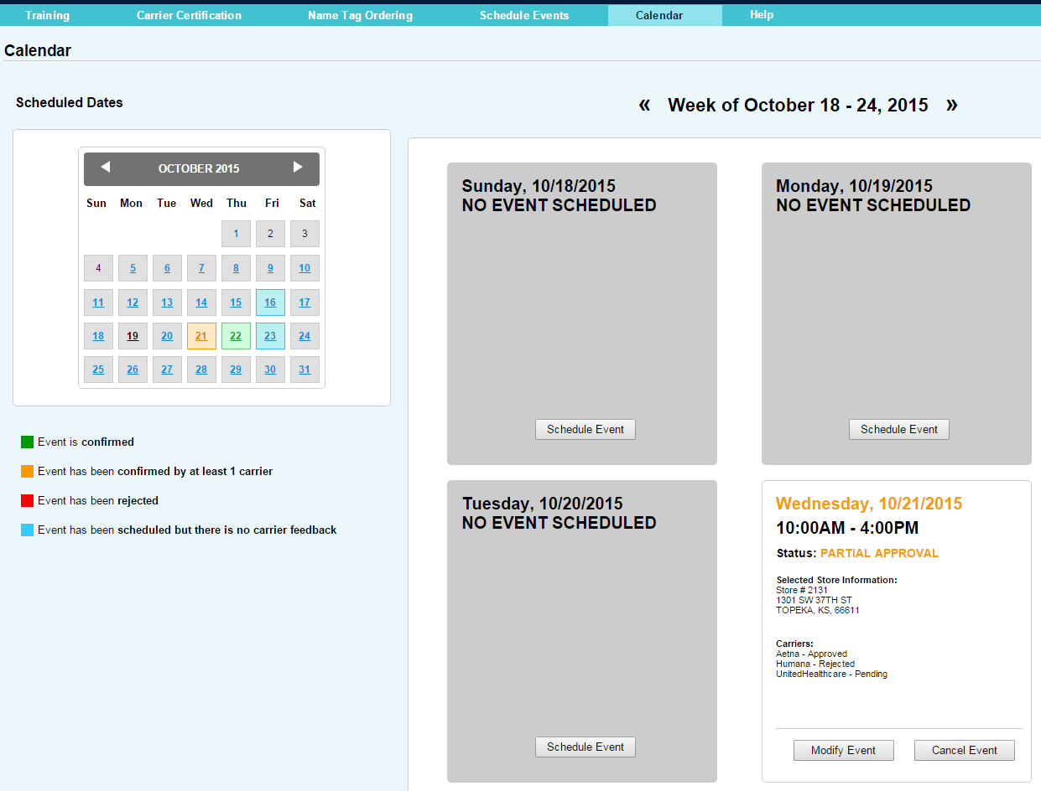
Calendar
Notes:
The Calendar Tab will give you your “Week at a Glance”. When you click on the Calendar tab you will be taken to the current week. The Calendar in the Calendar Tab will look just like the Calendar on the Schedule Events Tab. If you have two events on one day, the calendar will apply the same logic as for a single event.
You will need to check the detail of ALL events if your status is Partially Approved. There will be a box or “module” for EACH event you have scheduled. If NO event has been scheduled on a day, you will see a gray box and a notification that you have no events scheduled that day. If you want to schedule an event, you may click the button to “Schedule Event” and you will be taken to the Schedule Event Tab.
The event modules will provide detailed information on your requested events. You will see a breakdown for each carrier letting you know your status for THAT carrier.
If an event has been REQUESTED, and at least one carrier has approved it, but not all, you will see the date in ORANGE and an overall status of PARTIALLY APPROVED. You will see a breakdown for each carrier letting you know your status for THAT carrier. In this scenario, the other carriers may either still be pending or one or more may have rejected the event.

Slide 19
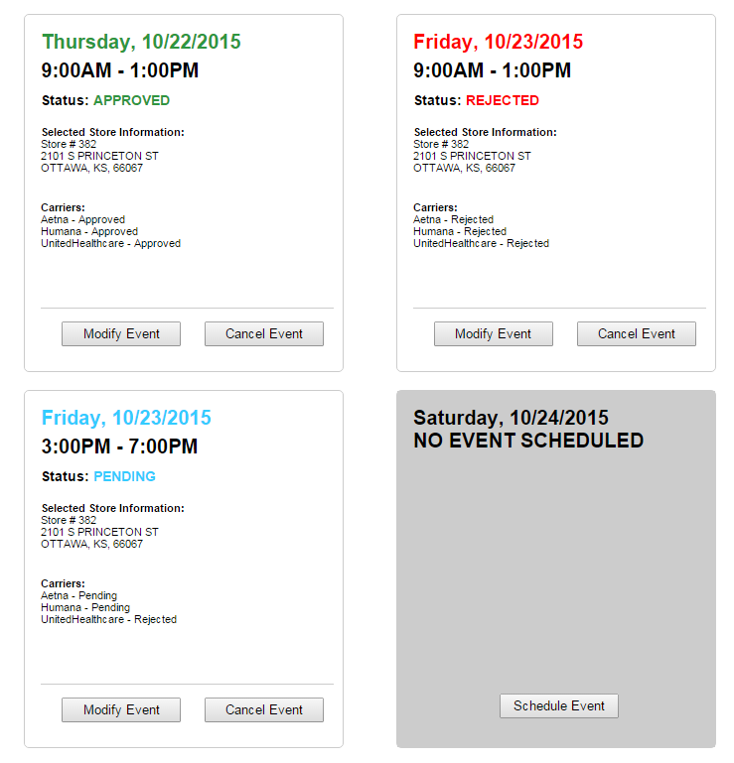
Calendar
Notes:
If an event has been REQUESTED, and ALL carriers have approved it, you will see the date in GREEN and an overall all status of APPROVED. You must attend this event
RED means all carriers have rejected the requested event.
If an event has been REQUESTED, but we have not received any feedback from any carrier, you will see the date in BLUE and an overall status of PENDING.

Slide 20
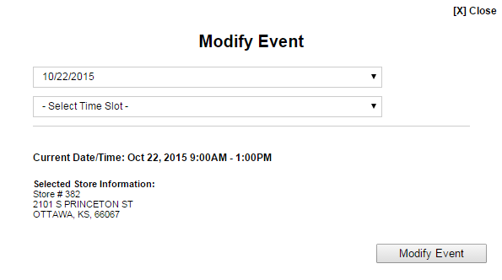
Modify Event
Notes:
As previously mentioned, you will have the option to modify or change your events. To do so, just click on the “Modify Event” button. It will bring up this dialog box. Enter the requested information. Remember, an event may only be rescheduled for another date within the SAME month and must be at the same store.

Slide 21
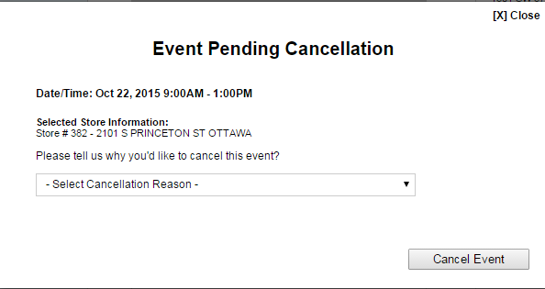
Cancelling Event
Notes:
You can also cancel an event by clicking on the “Cancel Event” button. When cancelling an event you must provide a cancellation reason. Remember, we want you to avoid cancelling an event if at all possible.

Slide 22
Reporting
Activity in the
Store
Notes:
Now that you have scheduled your time in store, how do you report your activity at those events?

Slide 23
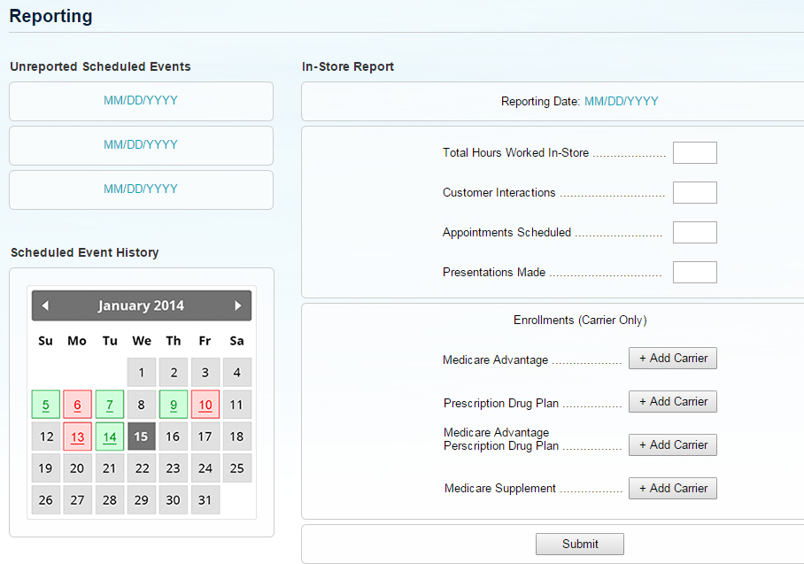
Reporting Your Store Activity
Notes:
The Reporting Tab contains the same Calendar functionality that you have seen in the Scheduling and Calendar Tabs with one minor change. As with the other calendars, the Reporting Calendar uses color to indicate status. However, only 2 colors are used. Green indicates that Reporting has been submitted for that day. Red indicates that Reporting has not been submitted for that day.
You are required to report your activity each day that you work whether you worked at the store or away from the store doing scheduled appointments that day. You will report on the “Total Hours Worked In-Store”, number of “Customer Interactions” you had, number of “Appointments Scheduled”, number of “Presentations Made”, and finally, the number of enrollments by carrier by product.
Carriers are added by clicking on the “Add Carrier” button.

Slide 24
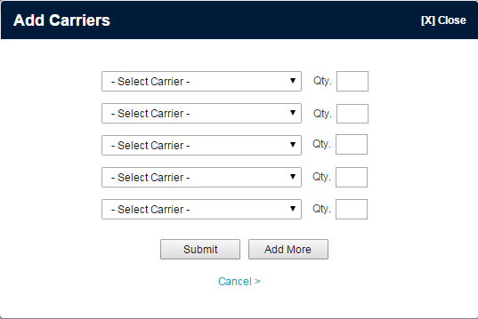
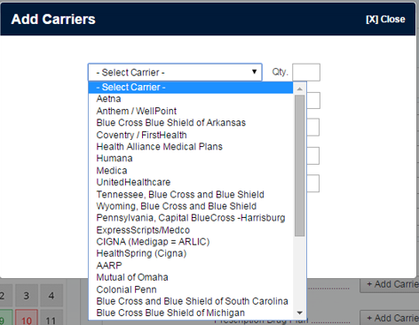
Reporting Your Store Activity
Notes:
Once you click the “Add Carrier” button, a drop down with all of the participating carriers is presented. Choose the desired carrier and then enter the number of enrollments for that carrier with that product.

Slide 25
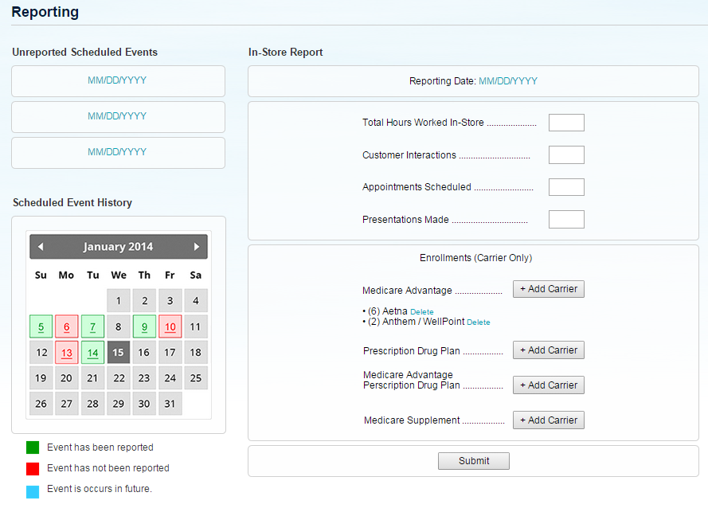
Reporting Your Store Activity
Notes:
Here is an example of how the Reporting page will display your enrollments after you have entered the requested information.

Slide 26
How do I get Help?
Notes:
Where do you go when you need Help? Your FMO is your go to source for most of your Program Questions. The Agent Portal has a help function that should be used for all of your IT and Technology related questions.
What kind of items should be reported using the Help function? Issues with the Agent Portal or any of technology tools should be reported using the Help function.
Let’s take a look at how to get help using any of the Program Technology or Special Requests.

Slide 27
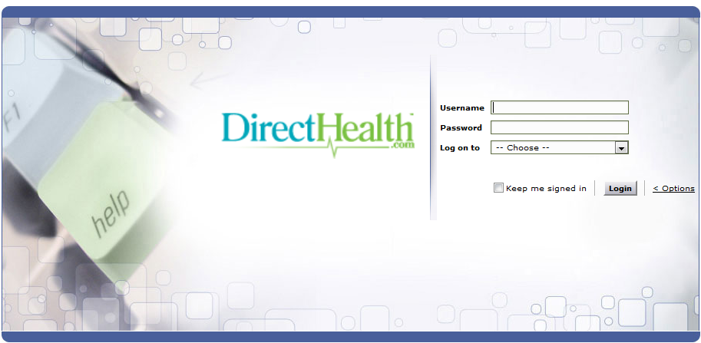
Help
Notes:
When you click on Help for the first time in the Agent Portal you will be prompted to enter in your Agent Portal username and password again. You will also need to select a domain to log on to, please select “Local Authentication”.

Slide 28
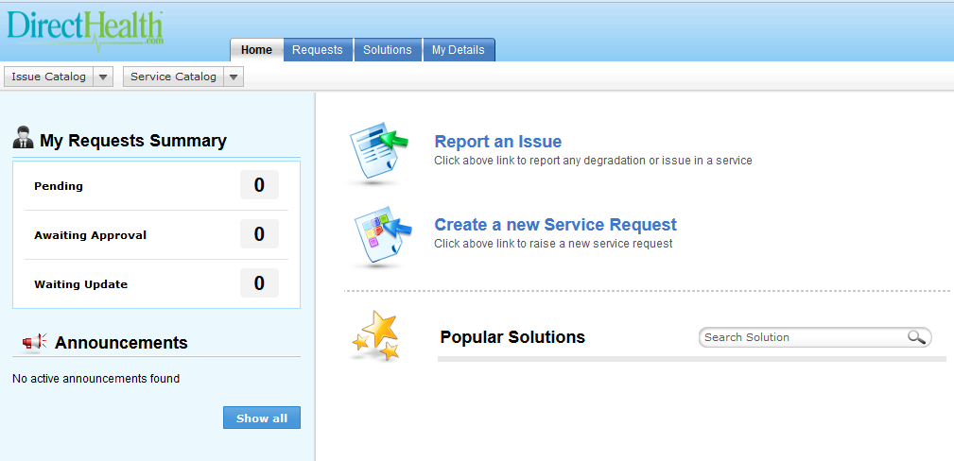
Help
Notes:
After you log into the Help Tool, you have two ways in which to submit a help requests. You can choose “Report an Issue” or “Create a new Service Request”. It does not matter which one you choose. Both items will take you to the same submission form. Both with present 7 different categories to enter your request.

Slide 29
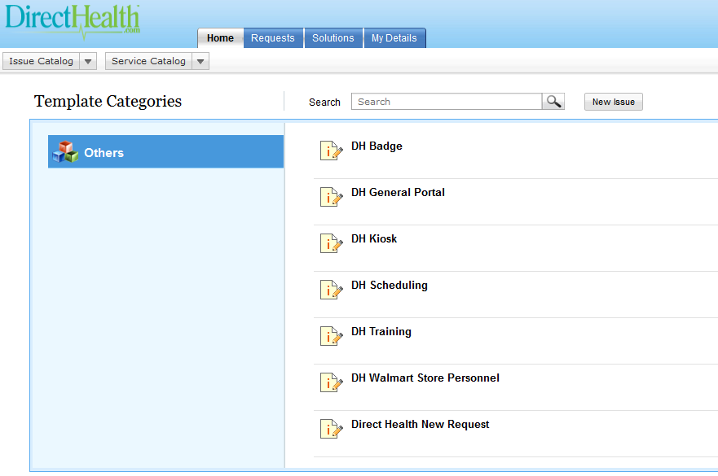
Help
Notes:
Those Categories include:
Direct Health Badge
Direct Health General Portal
Direct Health Kiosk
Direct Health Scheduling
Direct Health Training
Direct Health Walmart Store Personnel, and
Direct Health New Request
You should pick the Category that best fits the issue or request you have.

Slide 30
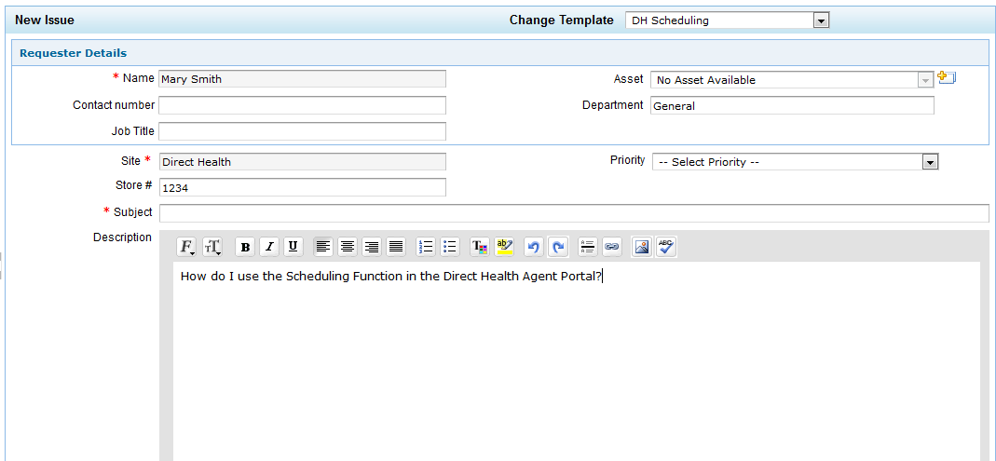
Help
Notes:
After you pick the Category, the Issue/Request submission form is presented.
The Subject, Agent Name, and Site Name are required fields. While the system will save a request without you providing a Store number it is essential that you provide the store number that you are working in. It helps to confirm your account in the Agent Portal.
When submitting IT related issues it really helps the Resolver is you can provide a screen shot of any error messages or dialog boxes you get. Screen shots are very easy to take. Simply use the Print Screen function on your computer. Normally that is a combination of the Function [Fn] key + the Prt Sc key. After you press those two keys at the same time, open up Word and paste the screen capture in Word. You can then attach the Word file using the “Attach File” button on the submission form.

Slide 31
Help
Notes:
The Request tab on the Help page is your one stop location for reviewing and checking the status of all of your requests and submissions. You should also get automated emails to keep you informed of any reported problems or service requests.

Slide 32
Thank you

