Slide 1
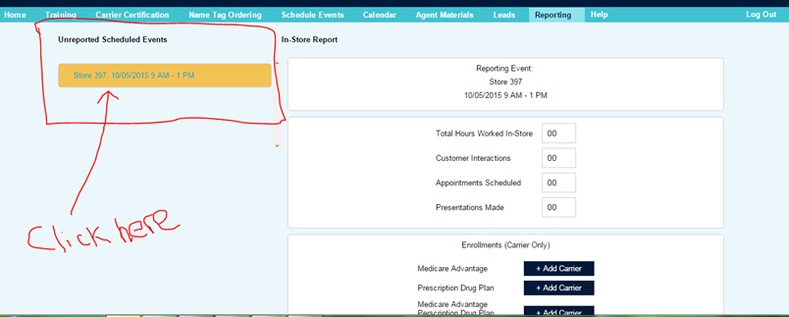
Step 1: Log into Portal and click on the “Reporting” tab.
Step 2: Under “Unreported Scheduled Events” on the left hand side, click on the store, date and time for the specific event that needs to be reported.

Slide 2
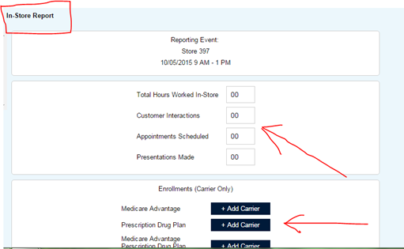
Step 3: Under “In-Store Report” on the right hand side, enter in the information as necessary to complete the form

