Slide 1
GlobalSearch® C2
Simplified Cloud Content Management

Slide 2
What’s Most Important To You?
Every organization is looking for new ways to work more efficiently while making their lives less complicated.
You need a solution to help increase office productivity while streamlining the management of business information.
Ideally if would be built on a platform that eliminates any unwanted technology infrastructure and unreliable back up processes.
Most importantly it needs to be a product that’s easy to use but still powerful and flexible enough to grow with your business.
Notes:
GlobalSearch C2 helps organizations to work with information more efficiently while eliminating the need for paper based filing. All through a cloud based delivery model that requires no IT infrastructure to manage.

Slide 3
Introducing
GlobalSearch C2
A cloud hosted Enterprise Content Management solution that simplifies document centric tasks by capturing information and creating highly efficient workflows, through desktop scanners and multi-functional printers.
Notes:
GlobalSearch C2 not only works to capture information being scanned from your MFP, it also works with desktop scanners and with the most popular office productivity tools like Word, Excel and Outlook.

Slide 4
Effectively Managing Cost, Compliance & Collaboration
Every organization is looking to lower the cost of managing their business content, and GlobalSearch C2 provides the solution for working with that information more efficiently.
Secure archives for protecting information that adheres to regulatory standards for HIPAA, GDPR, FERPA, IS0 9001 and more.
Powerful database driven search capabilities for finding information immediately and without wasted effort.
A collaborative cloud repository for users to securely find and share critical business information.
Integrated tools for easy document capture including drag & drop capture, KeyFree Indexing and the option to add GlobalCapture Convey.
Notes:
GlobalSearch C2 allows you to organize and collaborate on information in a way the makes it easy to find in an interface that’s scalable, secure and compliant.

Slide 5
Protecting, Securing and Ensuring Information Availability
We understand the sensitivity of business documents and make every effort to protect them as if they were our own.
HTTPS Transmission Protocols
In transit encryption with Secure Socket Layer (SSL)
At Rest Encryption (AES-256 Standard)
Information has to be available when you need it. The GlobalSearch C2 platform enjoys some of the highest performance rates in the industry.
Designed for 99.99% Availability
Designed for 99.99999 Document Durability
Real Time Document Versioning
Notes:
There’s simply no better place to securely protect your information. With end to end encryption, GlobalSearch C2 ensures your documents are protected whether they’re traveling across the internet or to fulfill a users request or residing in our cloud repository. And with 99.99 availability and 99.99999 document durability we make sure your information is always available for critical decision making.

Slide 6
Easily Scaling Your C2 Solution
It’s easy to expand from a core content management system to an Enterprise Content Management solution for Business Process Automation.
Document centric workflow for controlling the flow of information.
Web forms management to eliminate the reliance
on inefficient paper based forms processes.
Advanced document capture for transforming scanned documents in to high value data.
Unlimited extensibility with highly affordable options for increasing hosted document storage as required.
Notes:
Many companies begin with GlobalSearch C2 as a simple means for replacing their paper filing systems but this is a solution that is easily scalable. With the addition of workflow, web based forms processing and advanced data capture and transformation options, GlobalSearch can meet the most demanding needs of any organization.

Slide 7
What Makes GlobalSearch C2 Unique?

Slide 8
Affordable and Fully Expandable
GlobalSearch C2 Office Essentials
With a value based pricing model for the small business customer, C2 Essentials delivers a cloud ECM solution for getting control of your business content and reducing the cost of managing information.
$42 per user per month (3 user minimum)
GlobalSearch C2 for Workgroups Edition
For organizations looking to automate the flow of information with a department or small business environment, look towards our Workgroups solutions for a true business process management experience.
Starting at $72 per user per month (5 user minimum)
GlobalSearch C2 Enterprise Edition
If your organization is prepared to take information management to the next level than the GlobalSearch C2 Enterprise is fully prepared to deliver. With unlimited workflow capabilities and enterprise accessibility tools all included, this is the platform for untethered growth.
Starting at $108 per user per month (5 user minimum)
Notes:
GlobalSearch scales out with three different tiers of functionality:
Office Essentials provides a powerful but value driven solution for managing your information that’s designed for increasing efficiency as you lower costs.
The GlobalSearch C2 Workgroups Edition continues to offer great value while it introduces workflow capabilities to automate the flow of information for the small office or for departmental applications.
Finally, the Enterprise Edition is for designed for larger organizations looking to automate multiple business processes while they benefit from enterprise accessibility tools.
Each of these tiers offer tremendous value while giving you the option to scale up as needed should your requirements evolve over time.

Slide 9
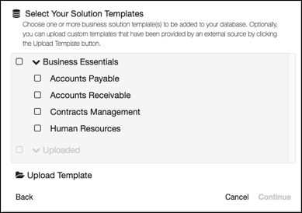
Pre Loaded With Common Business Applications
GlobalSearch C2 offers a collection of pre-designed solution templates that offer proven performance for common business applications including Human Resources compliance and Account Payable Management.
Business Solution Templates are maintained in a hosted environment that is regularly refreshed with new projects as Square 9 adds vertical or horizontal applications.
As new Business Solution Templates are released, they are made available for immediate consumption so you can easily add new use cases to your installation.
Notes:
A unique feature of GlobalSearch C2 is its ability to share solutions designs within your user community through the use of solution templates. Templates are pre-designed solutions that address a specific horizontal application like Human Resources or a vertical application like Municipal Government.
This approach allows users to benefit from the proven practices of others through shared solution templates while reducing the overall costs of implementation.

Slide 10
Capture to the Cloud Options for GlobalSearch C2
Notes:
With multiple options for capture to the cloud, Square 9 Softworks offers solutions ranging from very simple scanning to powerful document transformation services.

Slide 11
Simplified Scanning to the Cloud with DirectConnect
Easy to install utility that acts as the bridge between your local scanning devices and the Cloud.
Automatically syncs your GlobalSearch Archives with your local network directories allowing you to scan from any device using “scan to folder technology.”
Works easily with copiers, desktop scanners, fax machines and even through the drag and drop of files.

Slide 12
Extending Capture Possibilities with GlobalCapture Convey
Add extended levels of capture automation through the local pre-processing of documents for delivery to the cloud.
Leverage the power of automated separation, data capture and classification or the conversion of documents to text searchable PDF format.
Notify users via email when a document needs their attention.

Slide 13
Capture & Transform with GlobalCapture Enterprise
Powerful multi-threaded capture workflow engine that transforms images into business critical information that can be shared with other lines of business applications.
Easily trained to recognize, classify and validate high volumes of data regardless of the format or structure of your documents.
Fully extensible platform that can handle any volume, or type of documents, including the transformation of email and their attachments.

Slide 14
Need More Information on
GlobalSearch C2?

Slide 15
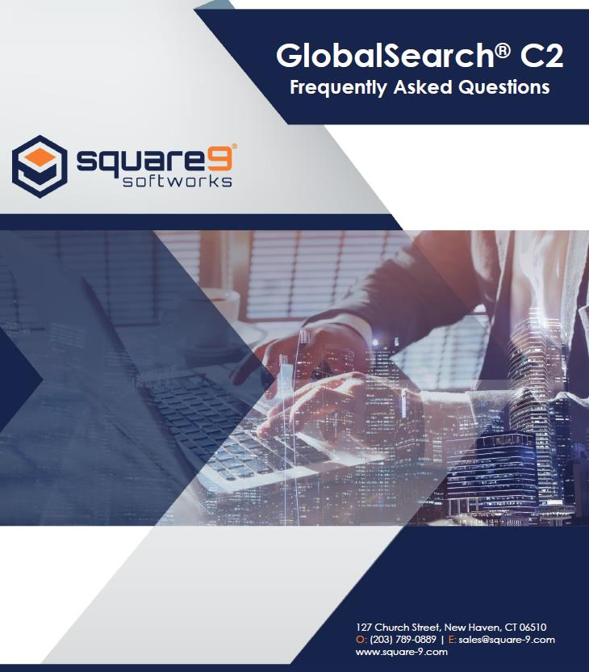
GlobalSearch C2:
Frequently Asked Questions
Within this document you will find a list of frequently asked questions about the GlobalSearch C2 service and how it works to deliver value to our customers.
Information addressed includes:
Where information is stored.
How documents are protected.
How we ensure system reliability.
How to renew or cancel your service.
View the FAQ!
Notes:
If you’d like to learn more about how GlobalSearch C2 works, there is plenty of information available. I would recommend starting with the GlobalSearch C2 FAQ that describes how exactly the service works.

Slide 16
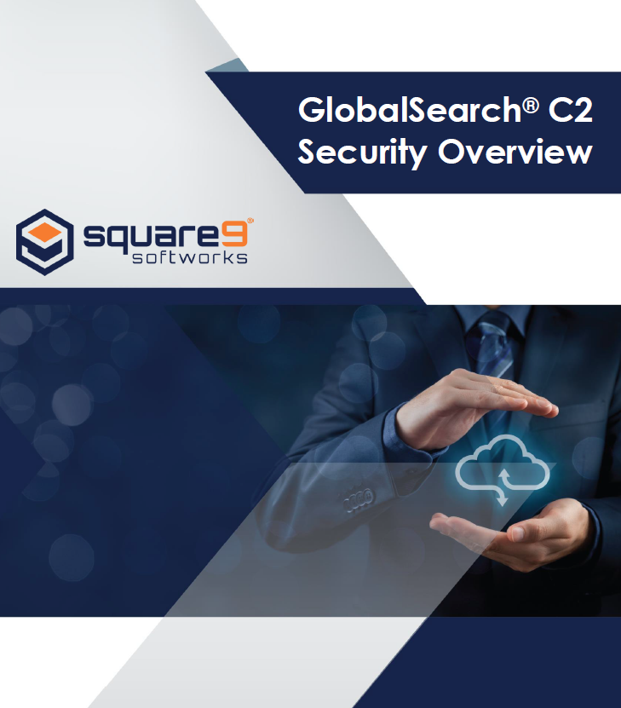
GlobalSearch C2:
Security White Paper
The security of your information is critical. Learn more about the steps we take to protect your most precious asset.
Security within the GlobalSearch C2 Infrastructure including physical security, fire suppression and power systems protection.
Firewall , threat protection and security of your data including In Transit and At Rest encryption levels .
Application Security and the highly granular levels of access permissions that can be applied to GlobalSearch C2
Download the White Paper!
Notes:
Information security is always a concern but Square 9 has documented how they go about protecting your business critical documents in a white paper on system security. Please feel free to check this out as well.

Slide 17
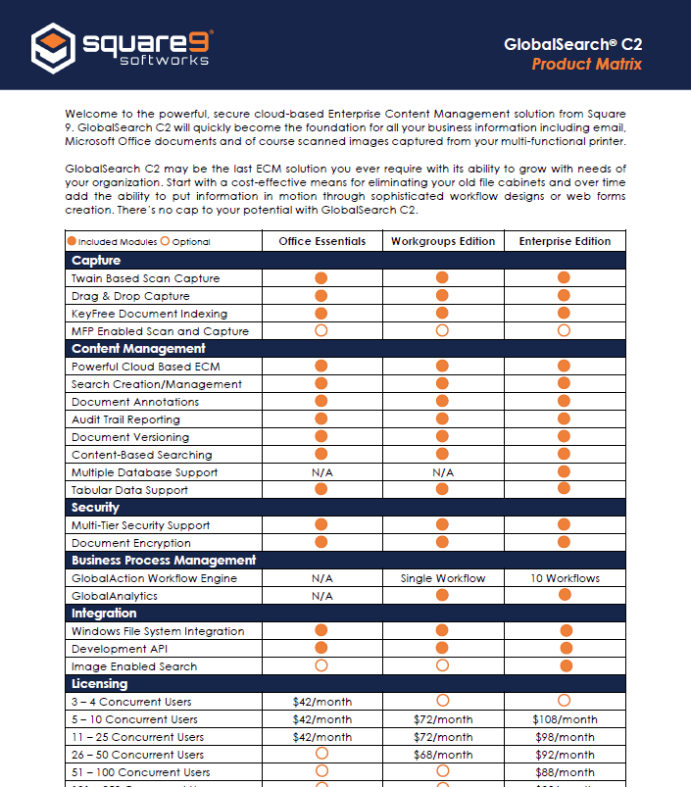
GlobalSearch C2:
Product Matrix
The GlobalSearch C2 Product Matrix breaks out all features and functionalities by edition for easy reference allowing you to select the correct product for your organization.
This easy to use tool clearly shows all optional and standard features that for Content Management, Security, Business Process manager, and more.
View the Product Matrix!
Notes:
Finally, if you’re not sure which GlobalSearch C2 version best fits the needs of your organization, please check out the GlobalSearch Feature Matrix which outlines which options are available in each.

Slide 18
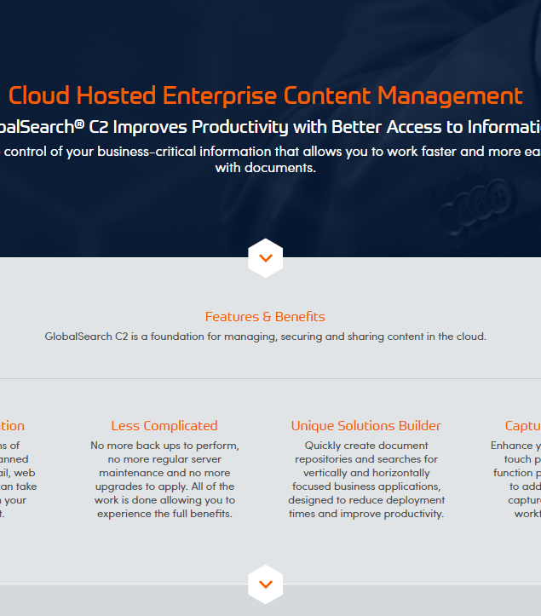
GlobalSearch C2:
Informational Webpage & Brochure
Found on the Square 9 website and designed to educate the customer specifically about C2.
This page gives you a full understanding about ECM in the cloud and how GlobalSearch C2 can meet your organizational needs.
View the Webpage!
Notes:
More information for the customer to research the product on their own and evaluate all features and benefits, as well as share with others.

Slide 19
Thank You!
www.square-9.com
sales@square-9.com
203-789-0889
Square9Softworks
S9Softworks
Square 9 Softworks
Square9Softworks
Notes:
We hope you enjoyed this brief presentation and would be happy to show you a live demonstration of the product if your schedule permits.

