Slide 1
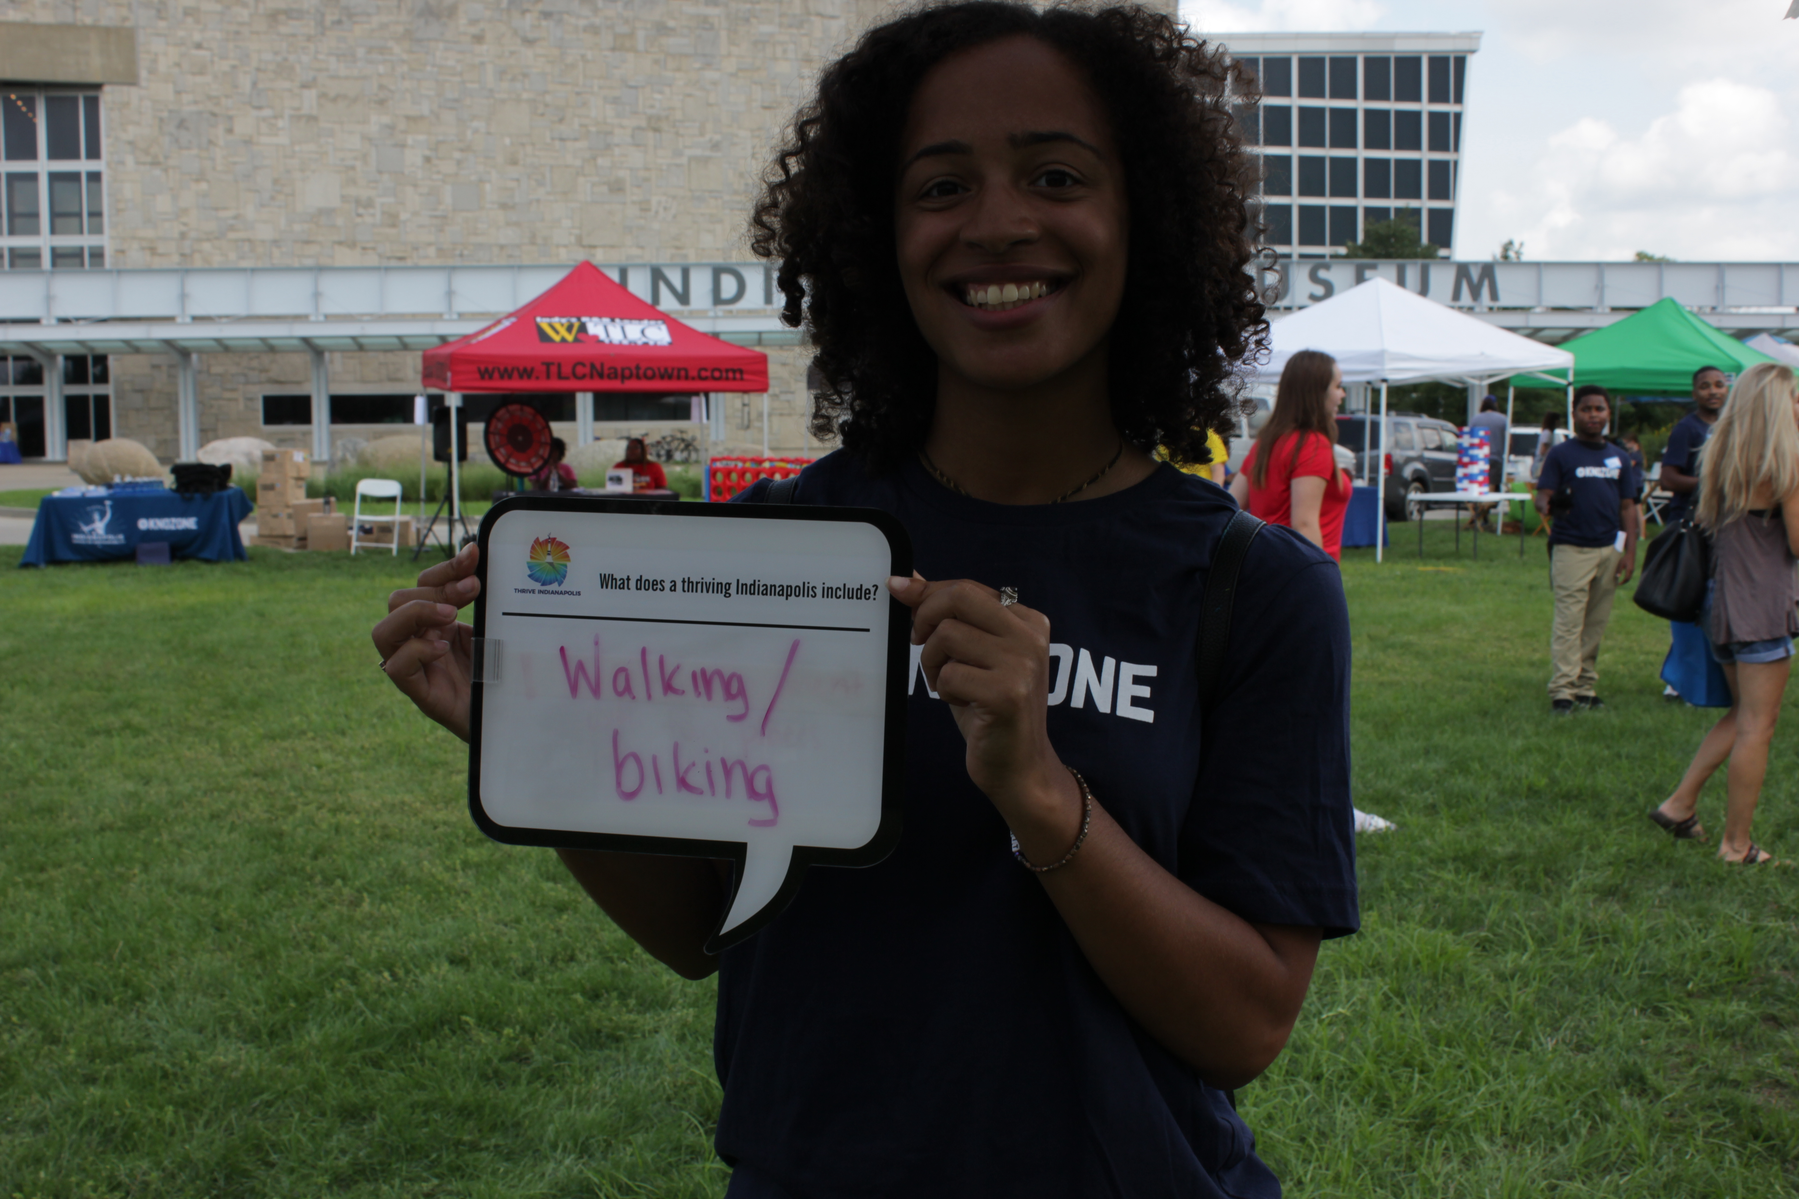
Key Steps for Effective Equitable Engagement
Identify & Understand Priorities for Target Audiences
You need to do this separately for each audience and potentially each project.
Which audience(s) have you not heard from?
What does your audience value?
Recognize that individuals can be part of multiple audiences.
Meet Them Where They Are
Take into account their physical location as well as their general knowledge/interest in your topic.
What places or events in the community does your audience frequent?
Focus on the “why”- but connect it to one of their “why’s”. Try not to assign your values to them.
Use a Street Team. Hire youth or engage volunteers in the community to be the ambassadors for the work.
How long do you need to engage them? What amenities will they need in that time? You must account for these additional costs.
Childcare, food, transportation, translation, accessibility services, incentives
Incentives that work
Audience | Incentive
Low Income | Food, gift cards (grocery stores), child care
Youth | Food, tech (tablets, echo dots), T-shirts
People Experiencing Homelessness | Food, socks

Slide 2
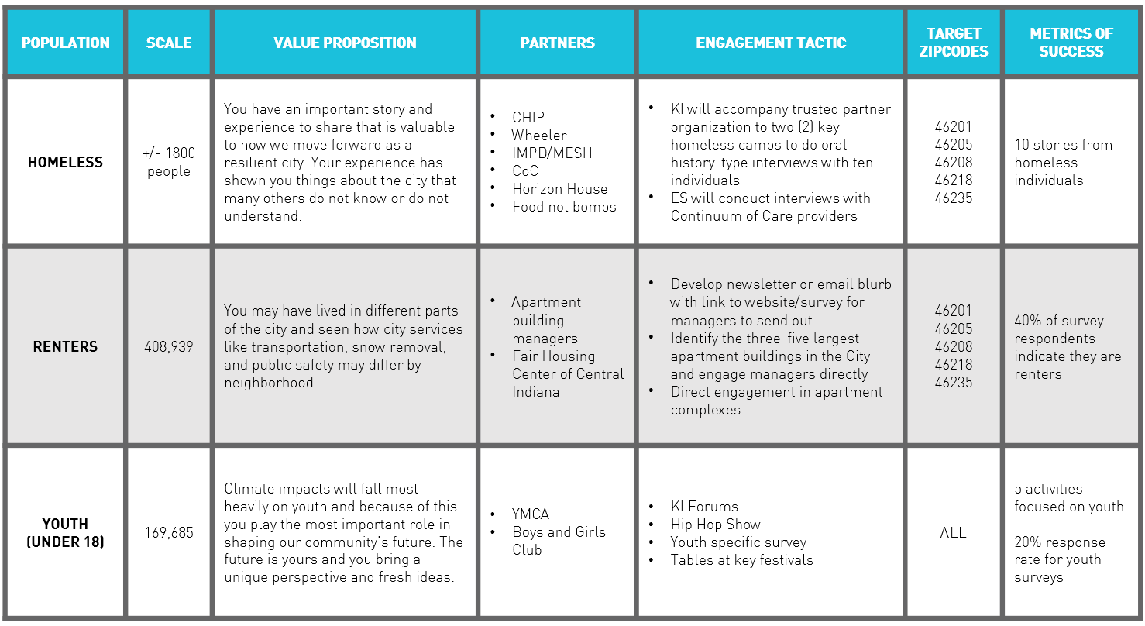
Build Capacity of Local Organizations
Which existing organizations already work with your target audience?
Align with their mission. Help them see how supporting your work actually promotes and delivers their mission.
Provide training and workshops about your project and the topic- i.e. climate change communication training.
Provide ongoing support- technical, financial, communication, etc.
Content for social media, newsletters and blogs
Paid street team or internship opportunities for their members/staff
Set Targets & Evaluate
What does success look like?
Establish your targets early and assess your progress regularly so you can adjust your tactics if you are falling short.
Recognize that some information is not easily gained (i.e. income), so you need to develop metrics accordingly.
Keep the conversation going with your community in a meaningful, equitable way with KLA’s Dashboard, public engagement and communications support.

