Slide 1
Adapt it report – financial results announcement project
4 SEPTEMBER 2017

Slide 2
Overview of interviews on the announcement day
13 interviews secured:
• Kyle Venktess, Fin 24
• Sandile Mchunu, Business Report
• Paula Gilbert, Itweb
• Marc Husenfuss, Business Day
• Schalk Burger, Engineering News
• Justin Brown, City Press
• Keith McLachlan, smallcaps.co.za
• Duncan McLeod, Tech Central
• Nqobile Dludla, Thomson Reuters
• Natassia Arendse, SA FM
• Andile Khumalo, Power FM
• Mashudu Masutha/David Williams, CNBC Africa
• Gugulethu Cele, Kaya FM

Slide 3
Online coverage
Sharenet-Adapt IT holdings limited- preliminary summarized consolidated audited results for the year ended 2017
Tech Central- Adapt IT hikes dividend per share by 23%
Tshwi-Fi- Adapt IT hike dividend per share by 23%
Money Web- Adapt IT hikes dividend share by 23%
Tech Central- Adapt IT predicts rise in organic growth
Business Tech- Adapt IT turnover surges 25%
IT Web- Adapt IT reports strong turn over
Biznis Africa- Adapt IT gross profit rises to ZAR 573.3 million
Tshwi-Fi- Adapt IT predicts rise in the organic growth
Engineering News- Adapt IT pursues Pan- African expansion
IT Web- Adapt IT on track to reach its 2020 growth target
Fin24- Financials and retailers drag the JSE down
Fin24- Watch: We're on track to 3bn turnover- Adapt IT CEO
CNBC Africa- Adapt IT HEPS 10%
Money Web- Adapt IT tracks its 2020 growth target
SAfrica- We’re on track to R3bn turnover - Adapt IT CEO
Business Live- Adapt IT raises dividend 23%
The Gauteng Guardian- Adapt IT on course to attain 2020 targets
Metro News- Adapt IT on course to attain 2020 targets
Fin News Africa- Adapt IT Course to attain 2020 targets
IT Web- Adapt IT sees East Africa Future
CAJ News Africa- Adapt IT on course to attain 2020 targets

Slide 4
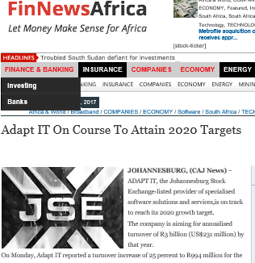
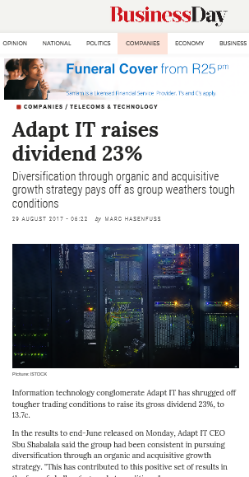
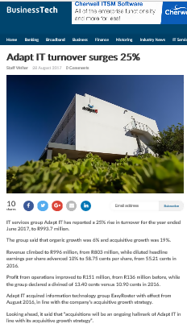
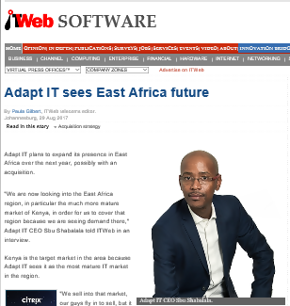
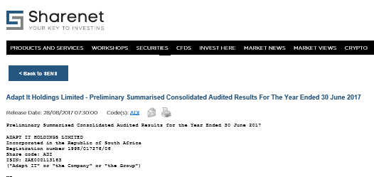
Snapshot of Online coverage

Slide 5
print coverage
Business Day, late Final- Adapt IT raises dividend 23%
Business Day, late final ( companies and markets)- Adapt IT raises dividend by 23%
Business Day, Final- Adapt IT dividends by 23%
Business Day, Final- Adapt IT raises dividend to 23%
Fin Week- Market Place: Simon Says

Slide 6
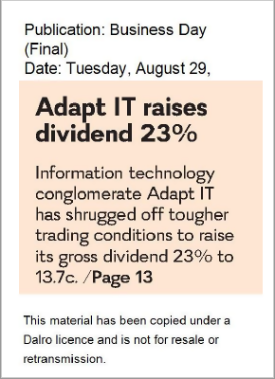
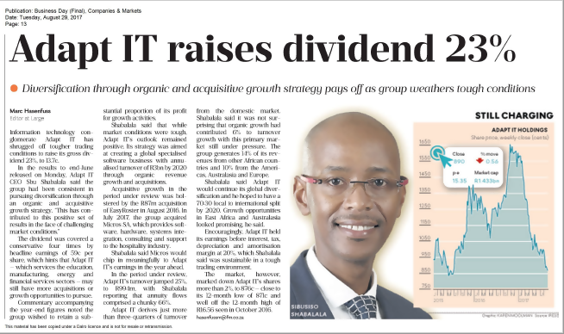
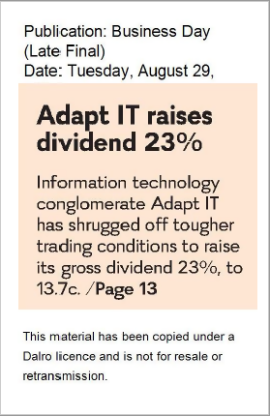
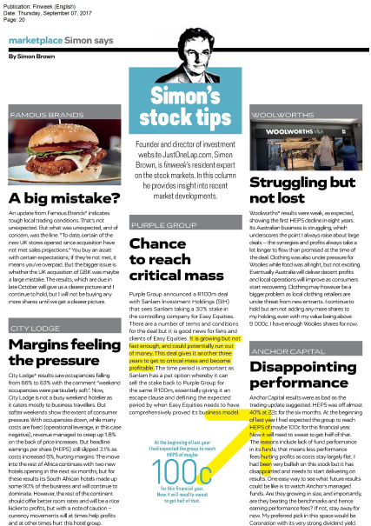
Snapshot of print coverage

Slide 7
broadcast coverage
702 FM, Repeat – Market update
CNBC Africa, Adapt IT hikes dividend per share by
Kaya FM, Show line up – Kaya Bizz,
Kaya FM, Company Results – Adapt IT
CNBC Africa, Adapt IT’s turnover for the past financial year increased by 25%
CNBC Africa, Local markets with Joseph Busha
Mix FM, Market commentary with Simon Brown
Business Day TV, Adapt IT FY earnings up 2%, hikes
SA FM, Interview with Adapt IT CEO
Business Day TV, A look at equity space with Kyle Burgess from Nedbank Private Wealth
SA FM- Show line up
CNBC Africa, Repeat --- Adapt IT's turnover for the past financial year increased by 25%,
Power FM, An interview with Adapt IT CEO,
Business Day TV, Repeat --- Adapt IT FY earnings up 2%, hikes dividend 23%,
Business Day TV, Repeat – Adapt IT FY earnings up 2%, hikes dividend 23%
Business Day TV, Repeat - A look at equity space with Kyle Burgess from Nedbank Private Wealth
Business Day TV, Repeat - A look at equity space with Kyle Burgess from Nedbank Private Wealth
Business Day TV, Company Wrap

Slide 8
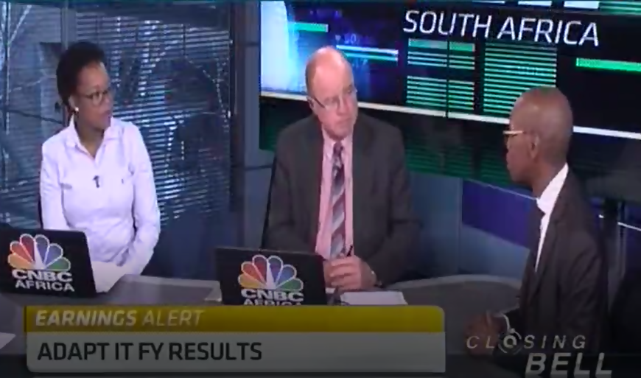
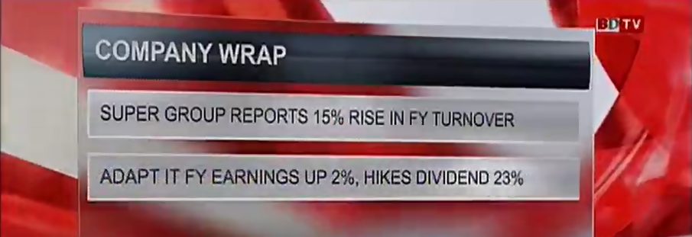
Snapshot of broadcast coverage

Slide 9
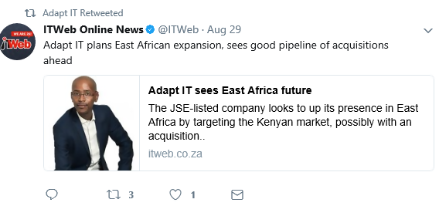
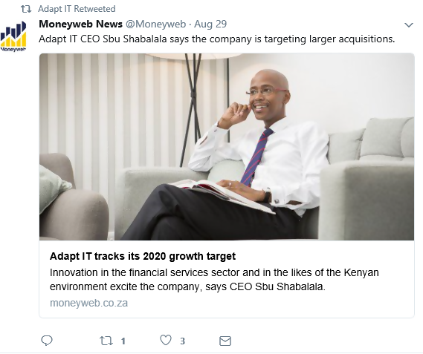
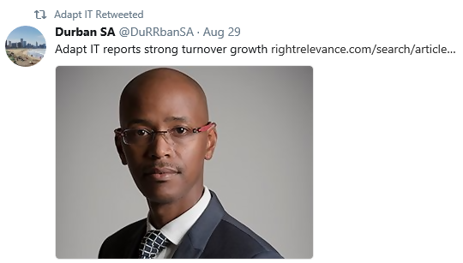
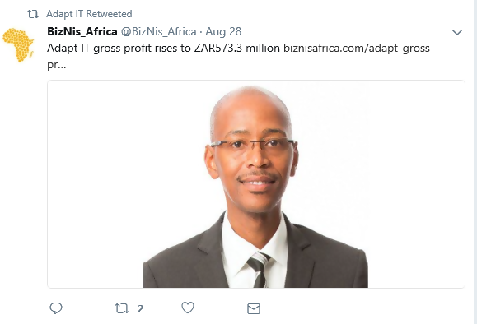
Snapshot of social media coverage

