Slide 1
Physician Certifications: What You Don’t Know Can Hurt You
December 4, 2018
Presented by: Celeste Rininger RN, RAC-CT

Slide 2
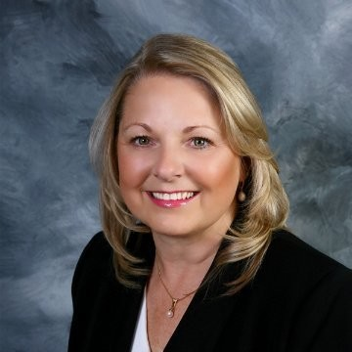
Today’s Presenter
Celeste Rininger, RN, RAC-CT Clinical Consultant

Slide 3
Objectives
Participants will be able to:
Name the key components of the certification/recertification (cert/recert)
Identify what is an acceptable cert/recert statement
Identify reasons for claim/audit denials based on cert/recert

Slide 4
Question
TRUE OR FALSE? There is no appeal available if the cert/recert is not completed correctly.
ANSWER: TRUE
Notes:
This is the one area in LTC where there is no appeal process for an incorrect/incomplete cert/recert = it is your Golden Ticket to payment
Thus everyone should understand and receive training regarding cert/recert and documentation requirements of SNF

Slide 5
Question
TRUE OR FALSE? Your process may mean the difference between payment and a denial.
ANSWER: TRUE Show me the money

Slide 6
Skilled Nursing Services Requirements
Clinical Eligibility Requirements
The beneficiary must have a need for, and receive medically necessary skilled care on a daily basis which is provided by or under the direct supervision of skilled nursing or rehabilitation professionals.

Slide 7
Skilled Nursing Services Requirements (cont.)
These skilled services can only be provided in an SNF setting.
Skilled services must be ordered and certified by the Attending Physician.
The services provided must be for a condition for which the client was treated for during the qualifying hospital stay or that arose while in the SNF for treatment of a condition for which the client was previously treated in the hospital.
Notes:
Attending Physician can include a PA/NP or a physician who has knowledge of the case and is willing

Slide 8
How and When to Document Cert and Recert Statements
There is no specific format or procedure for documentation of the cert or recert statement(s), but to be considered an acceptable cert and/or recert statement, they must include specific items.
Notes:
“Can we create a UDA for our cert/recert” not recommended as each one would have to be signed individually, hard to track and very easy to identify dates if not completed per guidelines
Remember to include nursing services – what are you doing for the person via nursing? Can’t just be therapy services or they could be at home!

Slide 9
Cert/Recert Statements
A physician must certify or recertify on a regular scheduled basis supporting medical necessity that a resident requires particular treatments or care.
Question: Can another physician such as the Medical Director sign the certification/recertification?
Answer: Yes, if the physician has knowledge of the case and is willing to sign. However, generally this should be completed by the physician of record.
Notes:
“Can we create a UDA for our cert/recert” not recommended as each one would have to be signed individually, hard to track and very easy to identify dates if not completed per guidelines
Remember to include Nursing services – what are you doing for the person via nursing? Can’t just be therapy services or they could be at home!

Slide 10
How and When to Document the Cert/Recert Statements
All of the required information is included in the individual’s medical record; and
Continued post-hospital extended care services are medically necessary.
Notes:
*** Why is the person in your facility? What are the Skilled needs- there must be a necessary nursing need or they could be at home- do not forget to include the nursing reasons for skilled care!!! What is the length of stay the person is expected to remain in your facility requiring skilled services? Generally set for 30 days as that follows with the 2 and 3rd recert. What are the discharge plans? And is this stay for a reason that occurred during the hospitalization or related to?

Slide 11
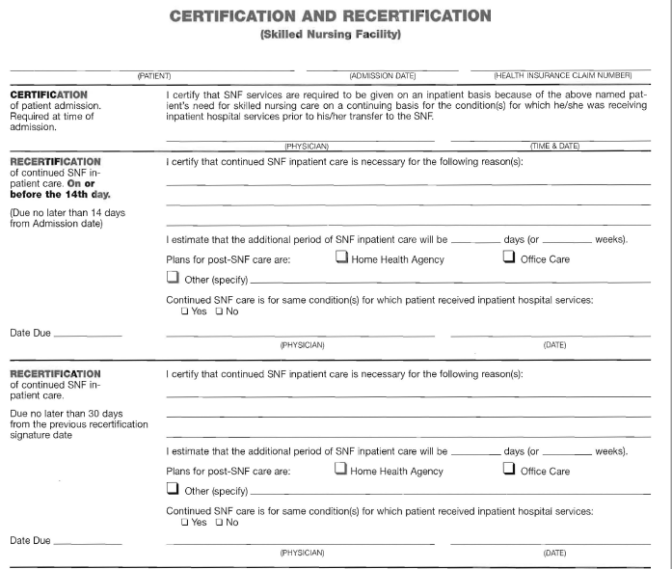
Typical Cert/Recert

Slide 12
Required Time Frames for Cert/Recert Statements
The certification must be obtained at the time of admission or as soon thereafter as is reasonable and practicable.
The first recertification is required no later than the 14th day of post-hospital SNF care. (e.g., admission date to the SNF).
Subsequent recertifications are required at least every 30 days after the first recertification.
Notes:
Generally 3 day’s for initial cert is acceptable
The initial and first recertification may be signed at the same time. Note the date for the next recertification is based on the date signed with the first recertification.

Slide 13
Who Should have Cert or Recert
Any person entering your facility with a skilled service provider should have a cert/recert.
Medicare A
Medicare Advantage
Insurance
Payers change and/or they could have been communicated incorrectly. If you don’t have the required/completed cert/recert, you will forfeit payment.

Slide 14
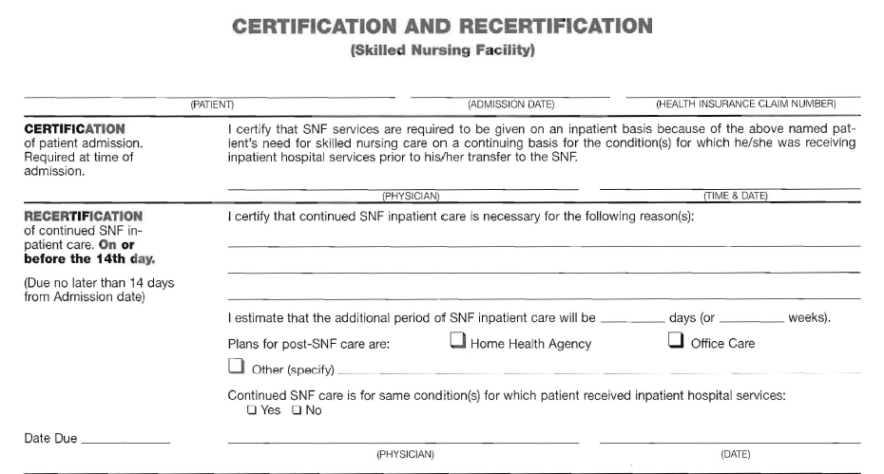
Cert/Recert
Notes:
Generally 3 day’s for initial cert is acceptable
The initial and first recertification may be signed at the same time. Note the date for the next recertification is based on the date signed with the first recertification.

Slide 15
Required Time Frames for Cert/Recert Statements
Delayed Certs
SNFs are expected to obtain timely cert and recert statements. However, delayed certs and recerts will be honored where there has been an isolated oversight or lapse. Delayed certs and recerts must include an explanation for delay and any medical or other evidence the SNF considers relevant to explain the delay.
Notes:
NOT the norm and must include the documented explanation for the delay.

Slide 16
What is Included in an Acceptable Cert Statement?
An acceptable cert statement must contain the following information:
The individual needs skilled nursing care (furnished directly by or requiring the supervision of skilled nursing personnel) or other skilled rehabilitation services;
Such services are required on a daily basis;
Notes:
What is nursing doing for them? Care Plan, observation, injections, BS monitoring, wound care, ATB, respiratory care, etc.

Slide 17
What is Included in an Acceptable Cert Statement? (cont.)
Such services can only practically be provided in a SNF or swing-bed hospital on an inpatient basis;
Such services are for an ongoing condition for which the individual received inpatient care in a hospital; and
A dated signature of the Certifying Physician or NPP is required.
The dates contained/obtained on the cert/recert must be in the handwriting of the Certifying Physician or NPP; must be legible; and must reflect the date you begin to count from for your next recert.
Notes:
Signature and dates must be legible

Slide 18
Cert/Recert
Notes:
Generally 3 day’s for initial cert is acceptable
The initial and first recertification may be signed at the same time. Note the date for the next recertification is based on the date signed with the first recertification.

Slide 19
What is Included in an Acceptable Recert Statement?
A recert statement must contain the following:
The reasons for the continued need for post-hospital SNF care;
The estimated time the individual will need to remain in the SNF;
Plans for home care, if any;

Slide 20
What is Included in an Acceptable Recert Statement? (cont.)
A recert statement must contain the following:
Indication if the reason for continued need for services is a condition that arose after admission to the SNF (and while being treated for an ongoing condition for which the individual received inpatient care in a hospital) this must be indicated; and
A dated signature of the Recertifying Physician or NPP.

Slide 21
Common Cert/Recert Challenges
Cert: Doctor does not sign timely and/or date.
Note the signature AND date must be in the physician’s handwriting and must be legible.
Notes:
Generally 3 day’s for initial cert is acceptable
The initial and first recertification may be signed at the same time.

Slide 22
Common Cert/Recert Challenges (cont.)
Understanding what needs to be included in the recert (skilling needs should include nursing and each therapy with detail, estimated skilled stay, plans for post-SNF, care continued for condition treated in hospital or that arose while being treated for such).
Notes:
Generally 3 day’s for initial cert is acceptable
The initial and first recertification may be signed at the same time. Note the date for the next recertification is based on the date the first recertification is signed.

Slide 23
Common Cert/Recert Challenges (cont.)
One more time:
Timing of the certs/recerts.
Signature and date by the physician, NP or CNS—in their own handwriting.

Slide 24
Supporting Documentation
Supporting documentation of skilled services provided is an absolute for all disciplines, including Nursing Skilled Services.
Physician progress notes should also reflect the skilled services.
Orders for skilled services must be obtained/signed.
Notes:
Physician PN- not just “PT” when all three disciplines are in & don’t forget Nursing!
COP requires daily documentation which clearly identifies the skilled service(s) being provided for that resident

Slide 25
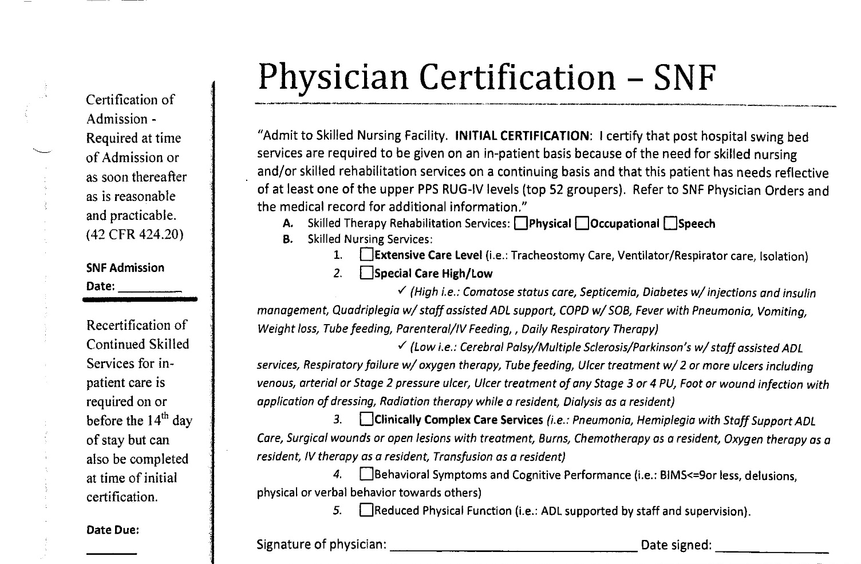
Examples of Certs/Recerts
Notes:
This is not resident specific

Slide 26
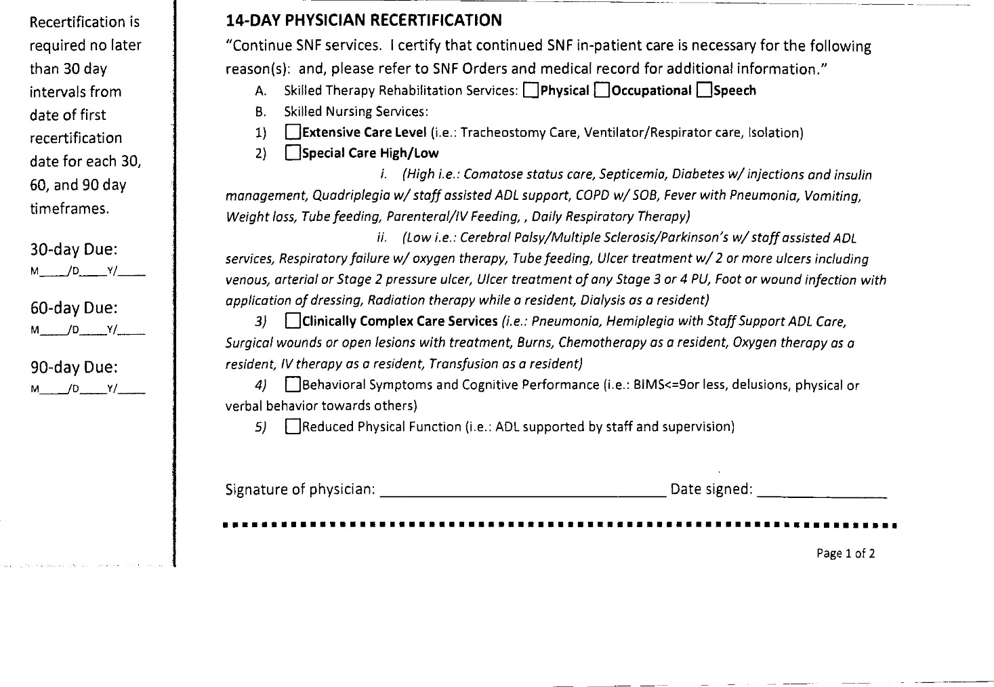
Examples of Certs/Recerts (cont.)
Notes:
Not resident specific, where are the other requirements such as discharge plan length of skilled stay???

Slide 27
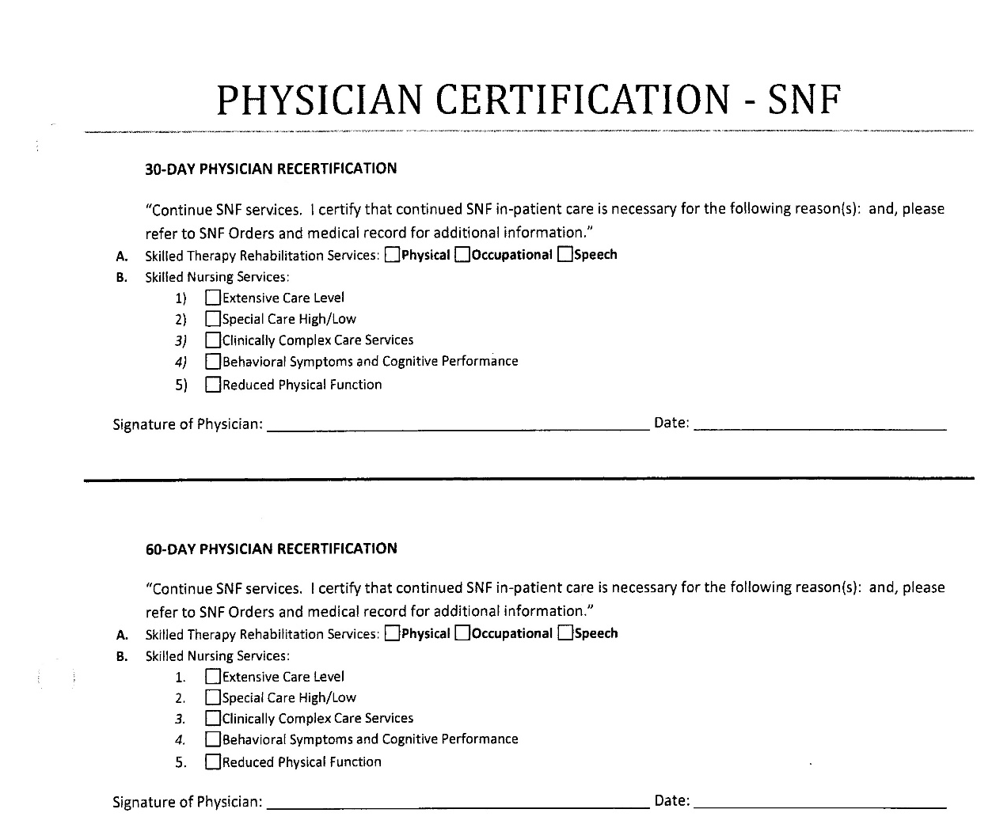
Examples of Certs/Recerts (cont.)
Notes:
Not resident specific, where are the other requirements such as discharge plan length of skilled stay???

Slide 28
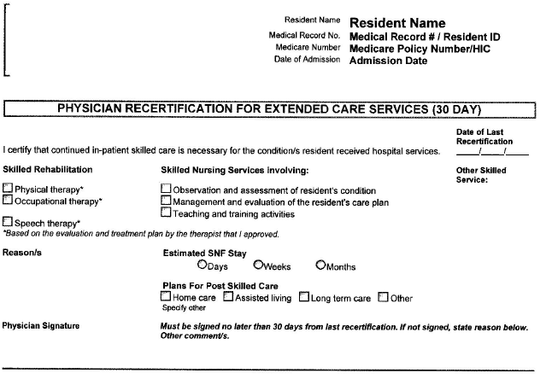
Examples of Certs/Recerts (cont.)
Notes:
Another option- DATE MISSING from physician signature.

Slide 29
Permission to Bill
One of the Requirements of Participation (RoP) for coverage and billing of skilled services in an SNF is that a physician, NP or CNS has certified the need for services in the SNF. Failure to obtain such certification would preclude the SNF from billing the services to Medicare (or Medicare Advantage/Insurance following Medicare guidelines) for reimbursement.
CMS expects SNFs to certify the presence and completeness of such before submitting a claim for reimbursement.
Notes:
You should be validating the Cert/Recertification’s are being completed during UR and at Triple Check

Slide 30
Permission to Bill (cont.)
Although SNFs are not required to transmit the physician cert and recert information to validate coverage, these documents will be requested upon any type of medical review to validate that the requirements have been met.
If a claim is submitted before there is a signed cert or recert, it is a technical denial with no appeal rights.
Notes:
At Richter, don’t be surprised if you are requested to submit your Cert/Recertification prior to submitting claims for any given period.

Slide 31
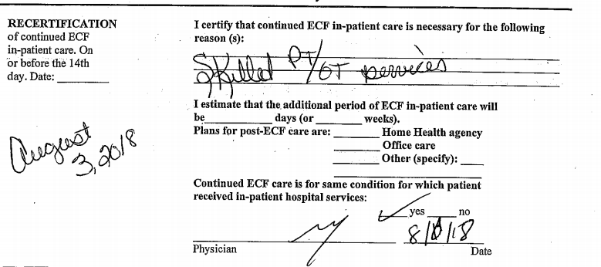
Example of Incomplete Cert/Recert
Notes:
Can you identify at least 4 items that are incorrect with this cert?

Slide 32
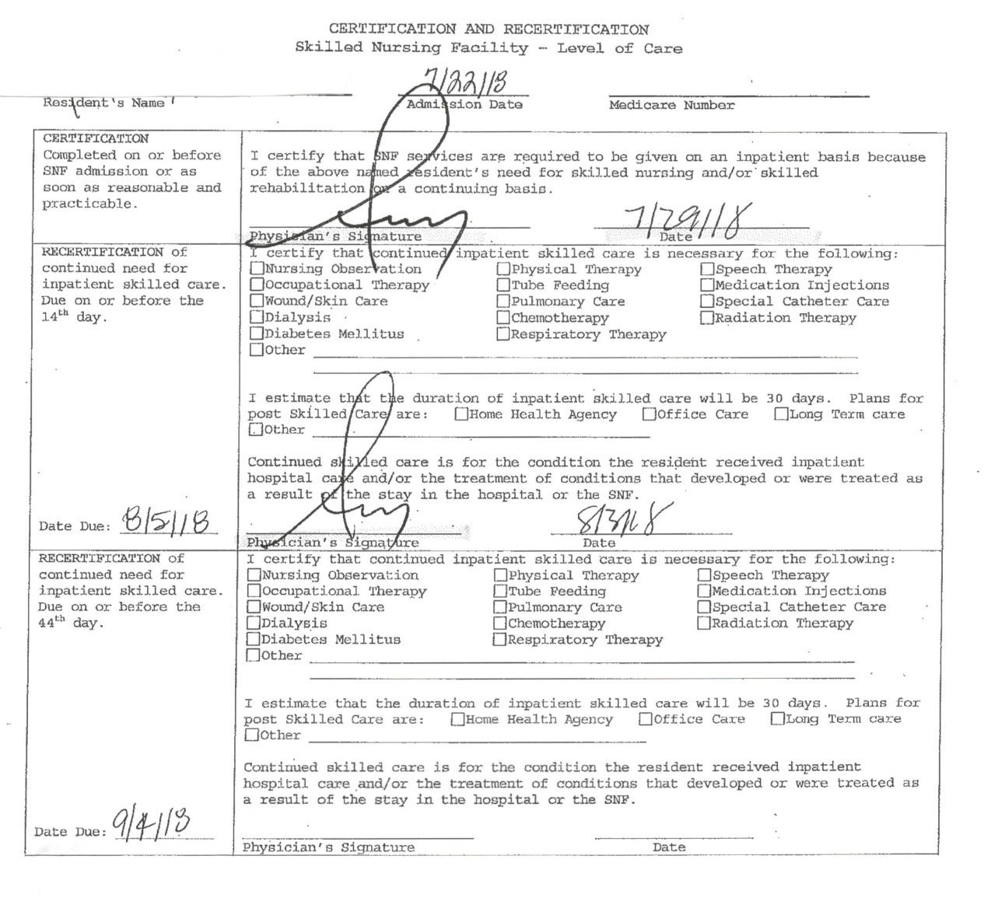
Example of Incomplete Cert/Recert (cont.)
Notes:
There are at least 6 items wrong with this cert, can you identify them? (MCR/MGD #blank, date physician signed original cert >3 days, skilled services blank, post discharge blank, recert dated 8/3/18 which means next recert would be required by 9/1/18 not 9/4 which would have invalidated the next recert).

Slide 33
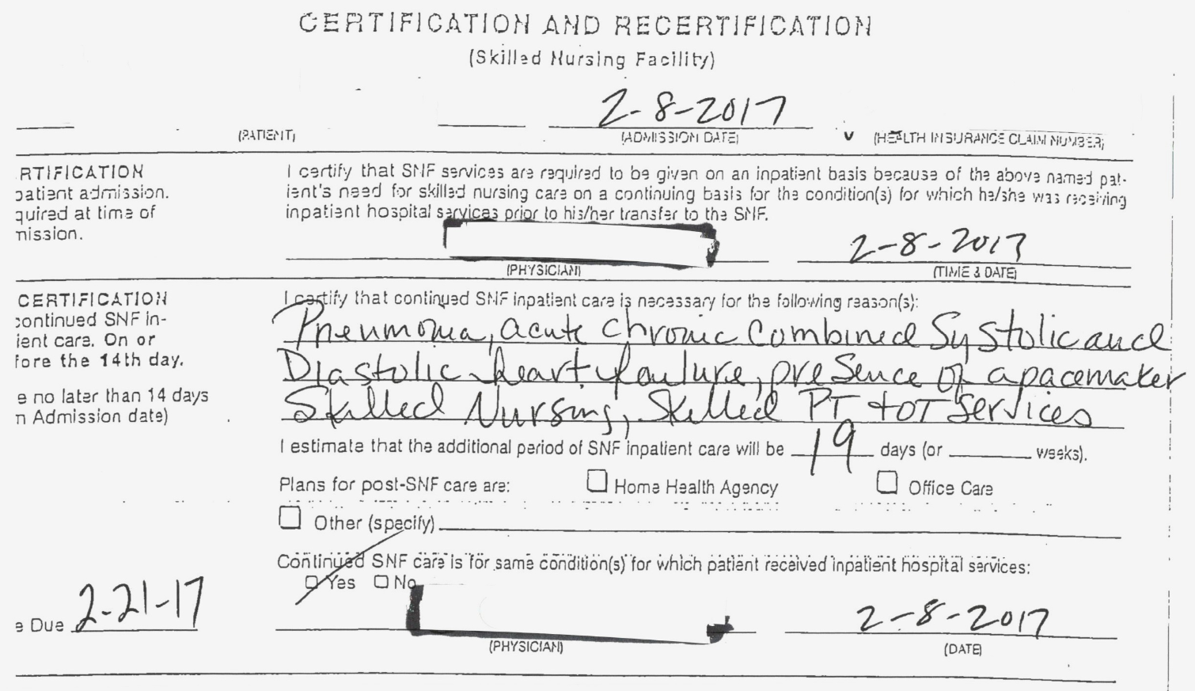
Example of Incomplete Cert/Recert (cont.)
Notes:
What’s wrong with this cert? minimum 3 items incorrect

Slide 34
Storing of the Cert/Recert
How and where will you store your Golden Ticket?
Notes:
Suggest copy scanned to documents folder if using PointClickCare®, original to BO folder

Slide 35
Recap
Physician cert/recert cannot be appealed.
Must be completed fully/timely with signatures and dates of the physician or NPP.
Richter Triple-Check process.

Slide 36
Recap
A review of the cert/recert with Triple Check/claim submission and at time of discharge is highly recommended.
Review of the cert/recert should be completed by a person not responsible for the certs/recerts but who understand the requirements.

Slide 37
Additional Resources
The Physician Certification and Recertification for Extended Care Services in the “Medicare Benefit Policy Manual,” Chapter 8, Section 40: https://www.cms.gov/Regulations-and-Guidance/Guidance/Manuals/downloads/bp102c08.pdf on the CMS website
MLN Matters Number SE1428 Revised

Slide 38
Questions?

Slide 39
Thank You!
Celeste Rininger, RN, RAC-CT Clinical Consultant
(216) 593-7140
celeste.rininger@richterhc.com
www.richterhc.com

