Slide 1

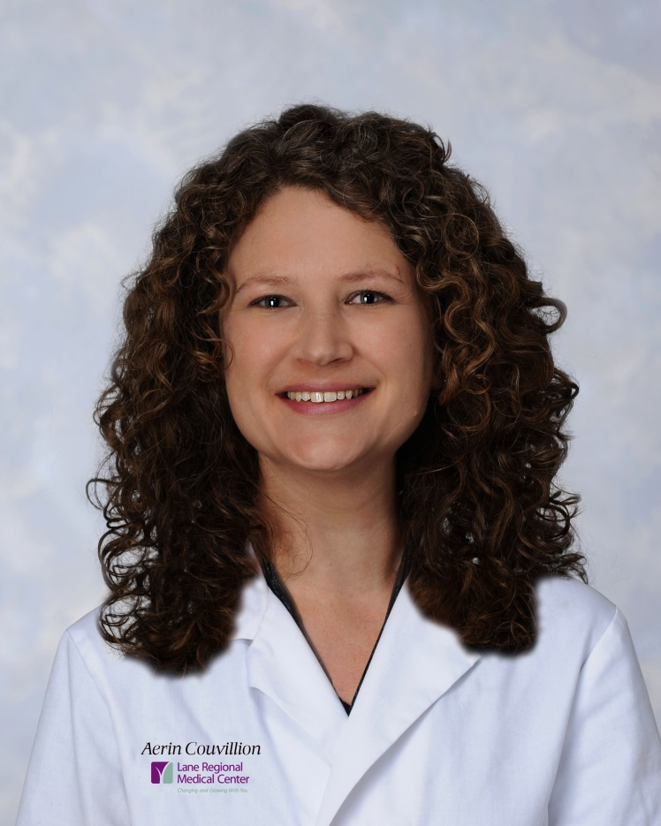
Aerin Couvillion, Licensed Acupuncturist
Fleur de Lis Acupuncture
4710 McHugh Road
Zachary, LA 70791
(225)658-6624

Slide 2
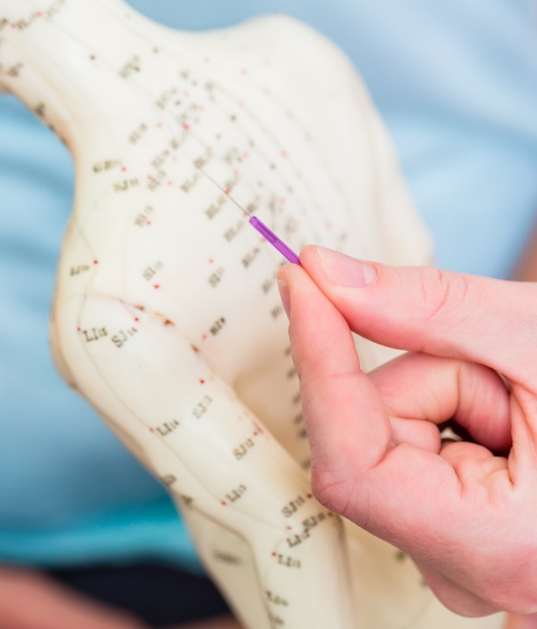
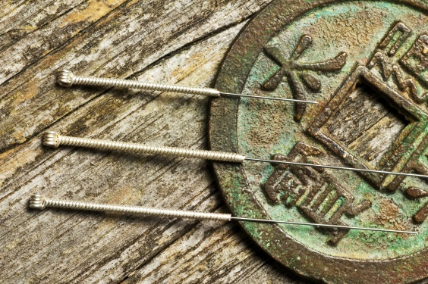
What is Acupuncture?
Acupuncture is a form of Chinese medicine that has been practiced for centuries. It's based on the theory that energy, called chi, flows through and around your body along pathways called meridians.
Acupuncturists believe that illness occurs when something blocks or unbalances your chi, and acupuncture is a way to unblock or influence chi and help it flow back into balance.
Acupuncture is done by putting very thin needles into your skin at certain points on your body. This is done to influence the energy flow. Each of the points relates to certain health problems or body functions.
Most people find that it doesn't hurt. The area may tingle, feel numb, itch, or be a little sore. Providers believe that this is a sign that the energy flow, or chi, has been accessed.

Slide 3
What Does it Take to Become a Licensed Acupuncturist?
1. Mandatory Education and Training:
  Masters of Sciences in Traditional Oriental Medicine from an accredited institute
  900 hours of clinical internships
  4200 hours of coursework including biomedical courses: Anatomy, Physiology, Pathophysiology, Clinical Science, Pharmacology, Neuroanatomy and Biochemistry
  Eastern Medicine coursework: Meridian theory, acupuncture point location, herbology and herbal formulas, needle technique, and ancillary manual therapies
2. National board exams regulated by the National Certification Commission for Acupuncture and Oriental Medicine (NCCAOM).
3. Application for license unique to each individual state.

Slide 4
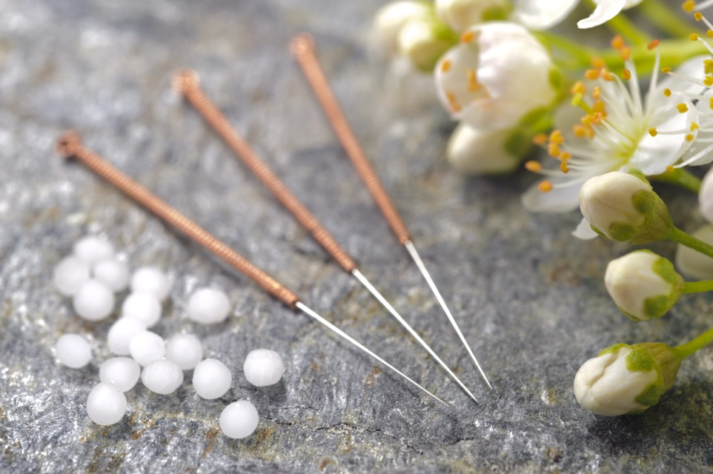
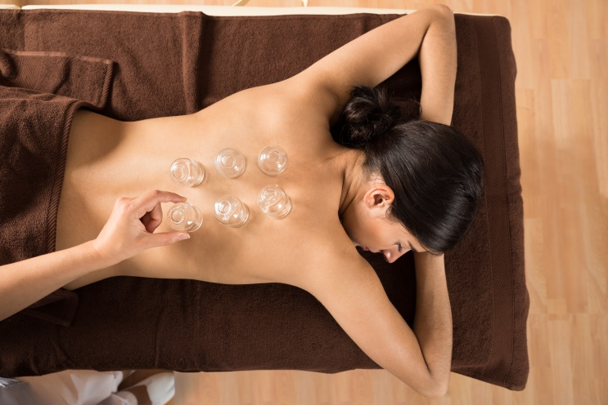
Oriental Medicine Consists of Many Components:
Acupuncture
Herbal Medicine
Nutrition
Meditation/ Tai Chi
Manual Therapies:
Tui Na
Cupping
Gua Sha

Slide 5
What Makes “Dry Needling” Different from Acupuncture?
1. It is a certification course, therefore minimal training is involved; Illegal in most states because of this
2. Used by practitioners of Western Medicine: physicians, chiropractors, physical therapists
3. More aggressive, therefore more painful
4. “Trigger Point Therapy” - Goal is to address musculoskeletal complaints, therefore no recognition or use of acupuncture points nor holistic therapy

Slide 6

Recognized by the World Health Organization, Acupuncture is a Safe and Effective Means of Treating a Wide Range of Medical Conditions, including:
Musculoskeletal: neck, shoulder & back pain, carpal tunnel, sciatica, chronic pain, swelling, localized traumatic injury, sports injury, sprains, strains, tendonitis
Neurological: headache, migraine, insomnia, stress, high blood pressure, tremors
Gynecological: fertility, menstrual pain, PMS, menopause
Respiratory: asthma, cough, sore throat, hay fever, seasonal allergies
Gastrointestinal: constipation, acid reflux, nausea, poor digestion, weight loss
Other: smoking cessation, chronic fatigue, anxiety, depression, autoimmune, addiction, post-traumatic stress disorder, Meniere’s disease

Slide 7
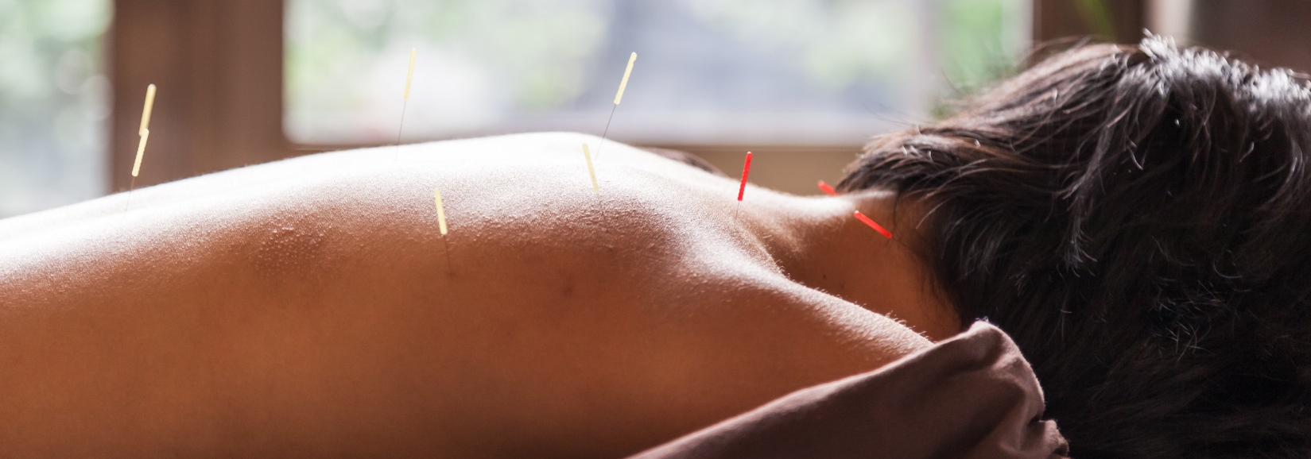
How can Acupuncture be Effective for such a Wide Range of Problems?
In Oriental Medicine, the focus for treatment is on the person as an individual, not the symptom.
This is why the term “Holistic” is associated with Oriental Medicine.
The lens by which we view dysfunction or disease incorporates the whole being and it’s relation to the environment as well as the relationships between the systems of the body.

Slide 8
Questions?
Aerin Couvillion, Licensed Acupuncturist
Fleur de Lis Acupuncture
4710 McHugh Road
Zachary, LA 70791
(225)658-6624

