Slide 1
Returning Student Housing Guide
Saint Leo University
2017-2018 Housing Selection Process for Returning Students

Slide 2
Table of Contents
Introduction
Important Dates
Eligibility for Housing Selection
Logging On to Your RESIDENCE Account
Completing Your Application
Selecting and Building Roommate Groups
Room Selection Lottery
Additional Important Information

Slide 3
Welcome to the Returning Student Housing Selection Guide
This guide is meant to assist returning upper-class students with information related to the housing selection process including how to complete a housing application, how to form a roommate group, and how the room assignment/confirmation portion of the process works.
All housing selection processes will be completed online through your RESIDENCE account.
The Table of Contents provided covers the necessary information on housing selection. Each heading will act as a link to each section allowing you to search for content faster. Each slide also contains a link back to the table of contents as seen below.
(All links in this guide will only work in the open slide show view)
Table of Contents

Slide 4
Important Dates (1 of 2)
February 13th @ 8:00AM Housing Applications Available Online
February 22nd @ 2:00PM Cookies and Conversation (SAB Lobby)
Housing selection information will be available
Residence Life staff will be present to help students review and understand accounts, holds & eligibility
Living Learning Community information will be available
March 1st @ 2:00 PM Cookies and Conversation (SAB Lobby)
Information on forming roommate groups will be available
Staff will be on hand to answer questions about how room selection works
General housing selection information will be available
March 6rd & 9th @ 5:30 PM Roommate Meet & Greet Events (Apartment Building 6, MMR)
An opportunity for students to match with other students they would be happy to live with in the upcoming academic year
(“Important Dates” continued on the next slide)
Table of Contents

Slide 5
Important Dates (2 of 2)
March 10, 2017 @ 5:00 PM Housing Application Deadline
All housing applications are due at this time to be considered for room selection
All housing applications received after March 10, 2017 will not take part in housing selection
Students who submit a housing application after the March 10th deadline will be placed in available space after room selection has completed
March 20 - 27, 2017 Room Selection Lottery
The room selection details can be found at Room Selection Lottery
(“Important Dates” continued from the previous slide)
Table of Contents

Slide 6
Eligibility for Housing Selection (1 of 2)
Who is Eligible for the Housing Process?
Students who will be eligible and will automatically receive an application on February 13, 2017:
Student's with a $0 to $499.00 balance
Student's with a balance of $500 or more IF
They are current with a payment plan by February 13, 2017
They are current with a payment agreement from past semester balances by February 13, 2017
(“Eligibility” continued on the next slide)
Table of Contents

Slide 7
Eligibility for Housing Selection (2 of 2)
Students who are not currently eligible are those with a balance of $500 or more or who do not have/are not current with a Payment Plan and/or Payment Agreement. These students will need to complete the following to become eligible for the Housing Selection Process:
An Eligibility Financial Waiver
Signed off by Trane Stop/Student Financial Services (SFS) that shows this individual has created and is current and up-to-date with all payments on the Plan and/or Agreement
Additionally, the compliance with the payment arrangement must result in a zero account balance once complete
This waiver, is available at the Office of Residence Life and/or at the Financial Aid Office
must be signed off by a SFS staff member
submitted by the March 10, 2017 Noon deadline
(“Eligibility” continued from the previous slide)
Table of Contents

Slide 8
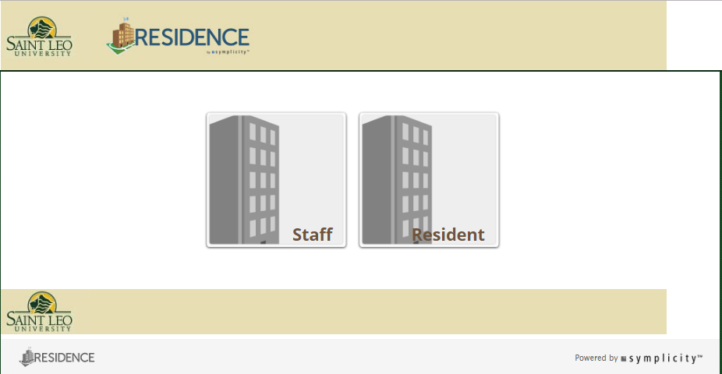
Logging Into Your RESIDENCE Account
Its Easy! Log into your RESIDENCE online account at www.saintleo.edu/residence
Make sure you select the “Resident” login
User name and password
Username is your entire Saint Leo email address
(example: firstname.lastname@email.saintleo.edu)
Password is the same as your Saint Leo email password
Is your login not working?
Try resetting your student portal password at my.saintleo.edu
Make sure your password is at least eight characters and includes numbers
If you still need help then please contact Residence Life for assistance
Email: residence.life@saintleo.edu
Phone: 352-588-8268
Table of Contents

Slide 9
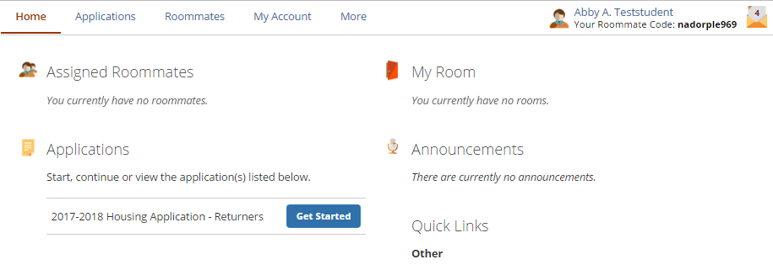
Completing Your Application
Once you have completed your housing application be sure you have clicked the “Submit” button!
You should receive a confirmation that your housing application was approved with in 48 hours
After you log into your RESIDENCE account click the “Get Started” button and begin your 2017-2018 Housing Application
Table of Contents

Slide 10
Selecting and Building Roommate Groups (1 of 2)
Step 2- Click on the “Roommates” tab and select the Fall 2017 term
Step 1- You must have an approved Housing Applications before you can select or be selected for a roommate group
(“Selecting and Building Roommate Groups” continued on the next slide)
Table of Contents

Slide 11
Selecting and Building Roommate Groups (2 of 2)
You can search and invite specific people by using their roommate code
Group members will receive an invitation from the Group Leader. You can accept or reject this invitation. If you accept the invitation, you will then be added to the “group”
Only Group Leaders can invite or remove group members from a group.
The Group Leader
Is the first person to send an invitation
Will be the person who invites the other group members
Is responsible for selecting the rooms during room selection at their appointed time
Can select another group member to be the group leader
Has the ability to release other members from the group
Step 3- Search by profiles for roommates or find someone your know using their roommate code
Step 4- Whomever sends the first invitation is considered the Group Leader and will be responsible all aspects of building the group and selecting rooms
Group Leaders will be identified here by a Star
(“Selecting and Building Roommate Groups” continued from the previous slide)
Table of Contents

Slide 12
Room Selection Lottery
THIS YEAR in response to student feedback about roommate satisfaction and process; priority will be given to roommate groups from largest to smallest. Roommate group selection times will continue to be based on average credit hours completed per group.
Day 1: Roommate Groups of 4 select their room
Day 2: No selection taking place
Day 3: Roommate Groups of 3 select their room
Day 4: No selection taking place
Day 5: Roommate Groups of 2 select their room
Day 6: No selection taking place
Day 7: Individuals students (groups of 1) select their room
Assistance with selection and choosing rooms will be available on days when selection is not taking place. This will be a good time for students struggling with selection to come to the Office of Residence Life for help.
For more details on Room Selection and the Housing Selection Process check out the Housing Selection Bulletin Board at http://www.saintleo.edu/resources/residence-life/housing-selection.aspx
Table of Contents

Slide 13
Additional Important Information
Resources that can help with the process
The Office of Residence Life
Hours of Operation: Monday through Friday 8AM – 5PM; located in Apartment Building 6 on the first floor
Contact by phone: 352-588-8268 or email: residence.life@saintleo.edu
Student Financial Services
For assistance with all financial questions and processes
Hours of operation: Monday-Friday, 8AM – 5PM, located in Saint Edwards on the first floor
Contact by phone: (800) 240-7658
Accessibility Services
Provides information and supportive services to students with disabilities
Hours of operation: Monday-Friday, 8AM-5PM, located in Kirk Hall on the first floor
Email: adaoffice@saintleo.edu or webpage: Accessibility Services
For more detailed information on First Year Housing Options including pictures and floor plans click on the link provided below:
Upperclass Housing Options
Room and Meal Plan Rates
Table of Contents

