Slide 1
First Year Housing Guide
Saint Leo University
2018-2019 Housing Selection Process for Incoming First Year Students

Slide 2
Table of Contents
Introduction
Important Dates
Logging Into Your RESIDENCE Account
Completing Your Application
Selecting and Creating Roommate Groups
Room and Building Preferences
Additional Important Information

Slide 3
Welcome to the First Year Housing Selection Guide
This guide is meant to assist new incoming first year students with information related to the housing selection process including how to complete a housing application, how to form a roommate group, and how the room assignment/confirmation portion of the process works.
All housing selection processes will be completed online through your RESIDENCE account.
The Table of Contents page lists the categories of information related to the first year housing selection process. Each category heading will act as a link to a specific section, allowing you to search for content faster. Each slide also contains a link back to the Table of Contents as seen below.
(Please note: links will only work when the presentation is open in “Slide Show View”; it is also possible to read through the presentation clicking from slide to slide)
Table of Contents

Slide 4
Important Dates
April 1st @ 8:00AM Housing Applications Become Available Online for Incoming First Time in College Students
  Roommate matching can begin as soon as your application is approved
    Approvals will be made on an on-going basis, usually within 48 hours
  Students who are under the age of 18 must print and have their parent or legal guardian sign a 2018-2019 Housing Agreement. You can download this agreement from your housing application.
    Housing Agreements for minors can be uploaded to your RESIDENCE account or emailed to the Office of Residence Life at residence.life@saintleo.edu
July 1st – 7th the Office of Residence Life processes First Year housing assignments
July 7th – 14th Residents will be notified of 2018-2019 room assignment
Table of Contents

Slide 5
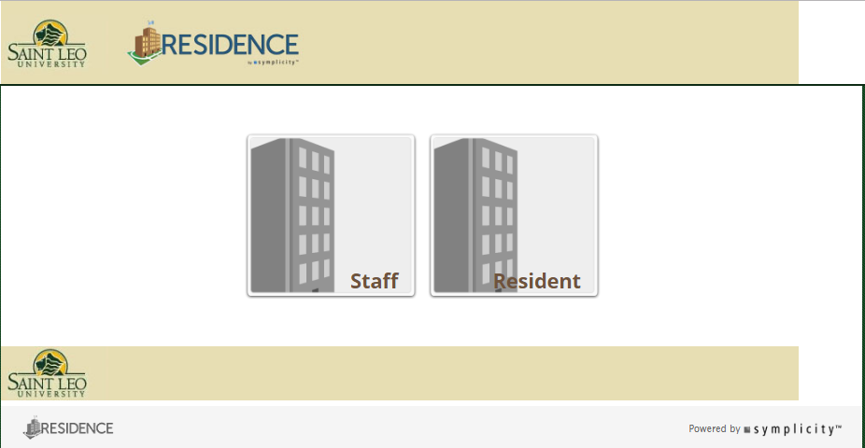
Logging Into Your RESIDENCE Account
Its Easy! Log into your RESIDENCE online account at www.saintleo.edu/residence
Make sure you select the “Resident” login
User name and password
  Username is your entire Saint Leo email address
    (example: firstname.lastname@email.saintleo.edu)
  Password is the same as your Saint Leo email password
Is your login not working?
  Logging into your RESIDENCE account will not be possible until at least 48 hours after depositing with the university
  Try resetting your student portal password at my.saintleo.edu
    Make sure your password is at least eight characters and includes numbers
  If you still need help then please contact the Office of Residence Life for assistance
    Email: residence.life@saintleo.edu
    Phone: 352-588-8268
Table of Contents

Slide 6
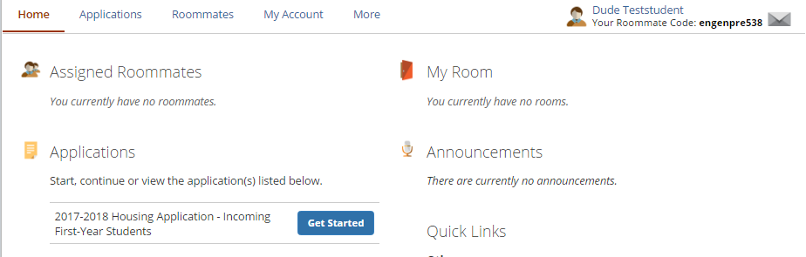
Completing Your Application
2018-2019
Once you have completed your housing application be sure you have clicked the “Submit” button!
You should receive a confirmation that your housing application was approved with in 48 hours
After you log into your RESIDENCE account click the “Get Started” button and begin your 2018-2019 Housing Application
Table of Contents

Slide 7
Selecting and Creating Roommate Groups (1 of 3)
Things to keep in mind when creating roommate groups
  Do not feel pressured into accepting another student’s invitation … you have the right to reject an invitation at any time!
  Make sure you and your chosen roommate have selected the same building and room preferences in your housing application or you will not be placed together.
    You can contact the Office of Residence Life to assist you with changes to a housing application at any time.
    If you are not sure about what building and room preferences you chose, simply log back into your RESIDENCE account at www.saintleo.edu/residence and you can review your submitted application.
  You do not have to choose a roommate. If you decide not to chose a roommate a roommate assignment will be made for you according to the preferences you entered in your application
(“Selecting and Creating Roommate Groups” continued on the next slide)

Slide 8
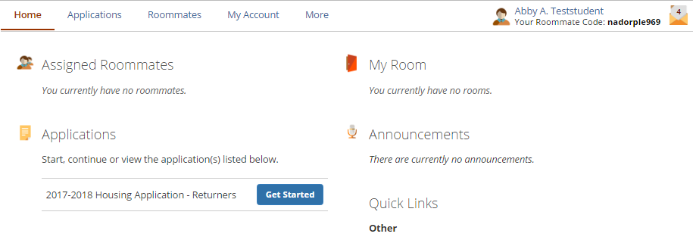
Selecting and Creating Roommate Groups (2 of 3)
Step 2- Click on the “Roommates” tab and select the Fall 2017 term
Step 1- You must have an approved Housing Application before you can select or be selected for a roommate group
(“Selecting and Creating Roommate Groups” continued on the next slide)
Table of Contents

Slide 9
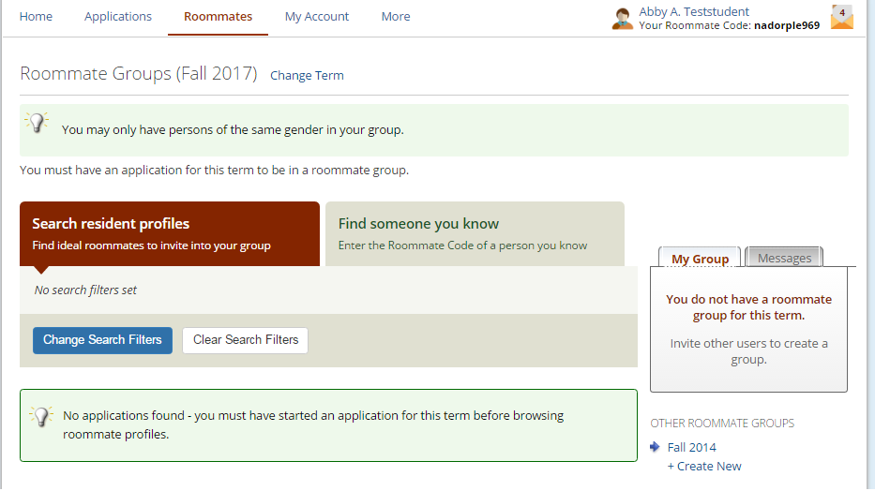
Selecting and Creating Roommate Groups (3 of 3)
You can search and invite specific people by using their roommate code
Group members will receive an invitation from the Group Leader. You can accept or reject this invitation. If you accept the invitation, you will then be added to the “group”
Only Group Leaders can invite or release group members from a group
2018
The Group Leader
Is the first person to send an invitation
Will be the person who invites any/all other group members
Can select another group member to be the group leader
Has the ability to release other members from the group
Step 3- Search by profiles for roommates or find someone your know using their roommate code
Step 4- Whomever sends the first invitation is considered the Group Leader and will be responsible for all aspects of building the group
Group Leaders will be identified by a Star
(continued from previous slide “Selecting and Creating Roommate Groups”)
Table of Contents

Slide 10
Room and Building Preferences
For more detailed information on First Year Housing Options including pictures and floor plans click on the link provided below:
First Year Housing Options
Room and Meal Plan Rates
The majority of first year residents live in double rooms in hallways with community bathrooms. Room types vary depending on the building selected.
Marmion (male only) and Snyder (female only)
  Predominantly double rooms (2 people to a room)
  Limited triple rooms on the Garden Level of Snyder (3 people to a room)
Benoit (male only) and Henderson (female only)
  Predominantly double rooms (2 people to a room)
  Limited number of triple rooms (3 people to a room)
  Limited number of quad rooms (4 people to a room)
Alumni Hall hosts our “Academic Excellence Living Learning Community” (same gender room; co-ed floors)
  All double rooms; each room has a private bathroom
  By special application only
  Must be accepted to Honors Program before an application can be made available
Table of Contents

Slide 11
Additional Important Information
Resources that can help with the process
  The Office of Residence Life
    Hours of Operation: Monday through Friday 8AM – 5PM; located in Apartment Building 6 on the first floor
    Contact by phone: 352-588-8268 or email: residence.life@saintleo.edu
  Student Financial Services
    For assistance with all financial questions and processes
    Hours of operation: Monday-Friday, 8AM – 5PM, located in Saint Edwards on the first floor
    Contact by phone: (800) 240-7658
  Accessibility Services
    Provides information and supportive services to students with disabilities
      Hours of operation: Monday-Friday, 8AM-5PM, located in Kirk Hall on the first floor
      Email: adaoffice@saintleo.edu or webpage: Accessibility Services
Table of Contents

