Slide 1
Transfer Housing Guide
Saint Leo University
2018-2019 Housing Selection Process for Incoming Transfer Students

Slide 2
Table of Contents
Introduction
Important Dates
Logging Into Your RESIDENCE Account
Completing Your Application
Room and Roommate Preferences
Additional Important Information

Slide 3
Introduction to the Transfer Housing Selection Guide
This guide is meant to assist transfer students with information related to the housing selection process including how to complete a housing application and how the room assignment/confirmation portion of the process works.
All housing assignment processes will be completed online through your RESIDENCE account.
The Table of Contents page lists the categories of information related to the transfer housing selection process. Each category heading will act as a link to a specific section, allowing you to search for content faster. Each slide also contains a link back to the Table of Contents as seen below.
(Please note: links will only work when the presentation is open in “Slide Show View”; it is also possible to read through the presentation clicking from slide to slide)
Table of Contents

Slide 4
Important Dates
April 1st @ 8:00AM Housing Applications Become Available Online for Incoming Transfer Students
Housing assignments are made on a rolling basis, after your application is approved
Students who are under the age of 18 must print and have their parent or legal guardian sign a 2018-2019 Housing Agreement. You can download this agreement from your housing application.
Housing Agreements for minors can be uploaded to your RESIDENCE account or emailed to the Office of Residence Life at residence.life@saintleo.edu
April 1st – July 1st Transfer students are assigned into an available space in our upper-class housing areas
You will be notified of new room assignment and roommate(s) once assigned
Table of Contents

Slide 5
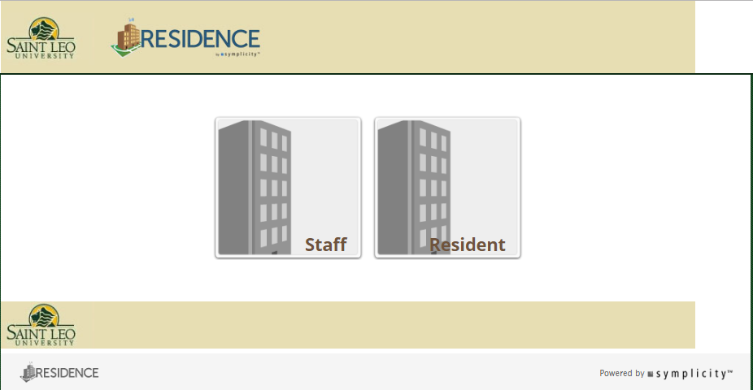
Logging On to Your RESIDENCE Account
Its Easy! Log onto your RESIDENCE online account at www.saintleo.edu/residence
Make sure you select the “Resident” login
User name and password
Username is your entire Saint Leo email address
(example: firstname.lastname@email.saintleo.edu)
Password is the same as your Saint Leo email password
Is your login not working?
Logging into your RESIDENCE account will not be possible until at least 48 hours after depositing with the university
Try resetting your student portal password at my.saintleo.edu
Make sure your password is at least eight characters and includes numbers
If you still need help then please contact the Office of Residence Life for assistance
Email: residence.life@saintleo.edu
Phone: 352-588-8268
Table of Contents

Slide 6
Completing Your Application
2018-2019
Once you have completed your housing application be sure you have clicked the “Submit” button!
You should receive a confirmation that your housing application was approved with in 48 hours
After you log into your RESIDENCE account click the “Get Started” button and begin your 2018-2019 Housing Application
Table of Contents

Slide 7
Room and Roommate Preferences
Transfer students are placed in available upper-class housing spaces. These spaces consist mostly of single and double rooms.
Spaces for transfer students will be assigned on an ongoing basis
You can request building and room style preferences in your housing application
The Office of Residence Life will take your preferences into consideration, but does not guarantee any preference or requests
You can also request specific roommate(s) if you already know someone you would like to live with in one of our upper-class residence halls
Please know that we cannot guarantee roommate requests for transfer students
For more detailed information on First Year Housing Options including pictures and floor plans click on the link provided below:
Upper class Housing Options
Room and Meal Plan Rates
Table of Contents

Slide 8
Additional Important Information
Resources that can help with the process
The Office of Residence Life
Hours of Operation: Monday through Friday 8AM – 5PM; located in Apartment Building 6 on the first floor
Contact by phone: 352-588-8268 or email: residence.life@saintleo.edu
Student Financial Services
For assistance with all financial questions and processes
Hours of operation: Monday-Friday, 8AM – 5PM, located in Saint Edwards on the first floor
Contact by phone: (800) 240-7658
Accessibility Services
Provides information and supportive services to students with disabilities
Hours of operation: Monday-Friday, 8AM-5PM, located in Kirk Hall on the first floor
Email: adaoffice@saintleo.edu or webpage: Accessibility Services
Table of Contents

