Slide 1
How to Use the NEW CHART TYPES in Office 2016
ABC 30%

Slide 2
How to Use the NEW CHART TYPES in Office 2016
ABC 30%

Slide 3
EVERY DATA HAS A STORY TO TELL…
Charts are best tools you can use to visualize that story. As a consultant, your day begins and ends with charts. They are constantly evolving to meet the demands of a data-driven corporate world. In this ebook, we discuss few of the new chart types in MS Office 2016. They are intuitive, easy to create and are great visual aide to make your consulting life just that much easier. Without much ado, presenting six all new chart types in the Office Suite.

Slide 4
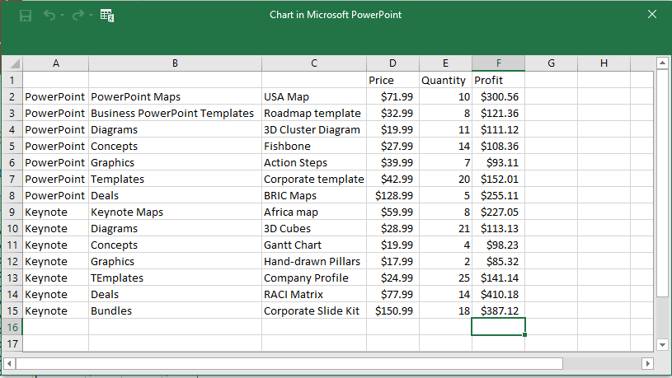
TREEMAP CHART
In information visualization terminology, Treemapping is a method applied to display hierarchical data by using 2D nested rectangles. They represent the nodes and leaves of the tree data, related to each other.
The Treemap chart displays categories by color and proximity and can easily show huge amount data which would be difficult with other chart types. However, on the offside, this chart is not great at showing hierarchical levels between the largest categories and each data point. Treemap, by their rectangular nature, are better suited for comparison among hierarchical levels.
Treemaps are more efficient space-wise. They don't involve the same empty space at the center of the visualization that the Sunburst charts do. Treemap has the added benefit of having parent labels-labels specific for calling out the largest parent groupings.
Here’s an example of how a Treemap looks:
SAMPLE DATA
TREEMAPPING CHART

Slide 5
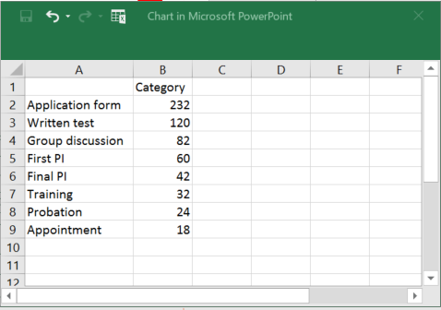
FUNNEL CHART
Used to represent stages, funnel chart is one of the new chart types in Microsoft PowerPoint 2016. It is very useful for the Sales industry to show the progress of revenue at different stages. Because of its simplicity and conception, a funnel chart is preferred by sales persons across industries. The funnel chart consists of values which decrease progressively as they move down the stages of a process. There by, bringing in the funnel shape. Steps to build a Funnel Chart:
1
Go to Insert Tab > Click Chart Option > Click Funnel Chart.
2
Clicking on “Funnel Chart” opens up an Excel Spreadsheet.
3
Simply add your data in the Excel spreadsheet. It will automatically transform into a funnel chart on the PowerPoint slide.
SAMPLE DATA
FUNNEL CHART

Slide 6
SUNBURST CHART
A Sunburst is a design commonly used in architectural ornaments and design patterns. It is also called a ring chart, or a multilevel pie chart. Sunburst chart is basically a stacked pie chart, created by stacking necessary number of pie charts on top of each other.
Like the Treemap, the Sunburst is another ideal chart type for displaying hierarchical data. Each level of the hierarchy is represented by one ring or circle with the innermost circle as the top of the hierarchy. A sunburst chart without hierarchical data, looks similar to a doughnut chart. The multiple levels of categories in this chart shows how the outer rings are related to the inner rings. The sunburst chart is most effective at showing how one ring is broken into its contributing pieces.
Sunburst is more immediate when compared to Treemap. Most people are trained to understand a pie chart and a sunburst is just an evolution of a basic pie chart.
Pie charts are often criticized by data visualization specialists. According to Stephen Few, a pie chart should be replaced most of the time by bar/column charts. Nevertheless, Stephen Few also mentions a strange fascination of human beings 'with all things circular'. There is an aesthetic beauty in circular forms. A circle is the most perfect shape. What circles lose in precision they gain in intuitiveness. Sunbursts are beautiful and produce beautiful visualizations. They instantly attract attention and engagement of the audience.. So even if you are a data visualization purist give the Sunburst a try.

Slide 7
SUNBURST CHART
SAMPLE DATA
SUNBURST CHART

Slide 8
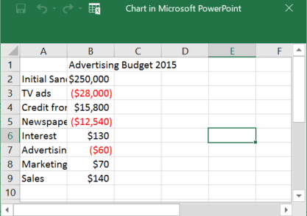
WATERFALL CHART
If you want to visualize your financial data but feel totally lost on how to do it, then Waterfall chart is the answer. It helps display both positive and negative values. Referred as bridge in finance, Waterfall chart offers a simple solution to visualizing financial statements. Analysts also use this chart to present a steady increment or decrement of numerical values in the data.
SAMPLE DATA
WATERFALL CHART

Slide 9
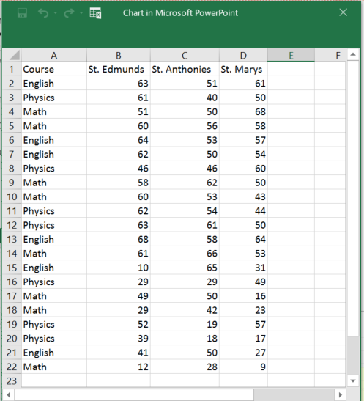
BOX AND WHISKER
A box plot is a convenient way to graphically depict groups of numerical data through their quartiles. In the diagram below, the lines extending vertically are called “whiskers”. These lines extending from the boxes (whiskers) indicate variables outside the upper and lower quartiles, and any point outside those lines or whiskers are called outlier.
The Box and Whiskers charts are mostly used in statistical analysis to compare results or test scores.
This type of chart shows the shape of the distribution, its central value, and its variability. In a box and whisker plot: the ends of the box are the upper and lower quartiles, so the box spans the interquartile range, the median is marked by a vertical line inside the box.
SAMPLE DATA
BOX AND WHISKER CHART

Slide 10
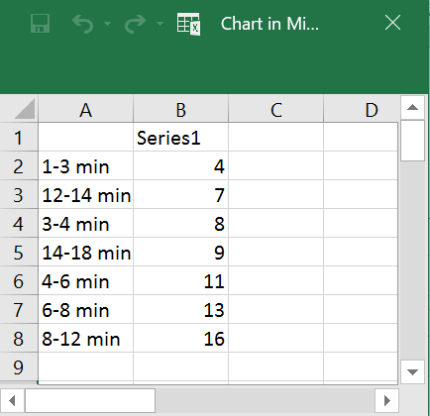
HISTOGRAM CHART
Also known as Pareto Chart, statisticians, analysts, and project managers widely use Histogram chart. It’s looks similar to bar chart but the Histogram measures the frequency of category.
SAMPLE DATA
HISTOGRAM CHART

Slide 11
ABOUT CHILLIBREEZE
Chillibreeze specializes in fast PowerPoint presentation formatting and related services for business and management consulting firms. Speed, reliability and relationship is the mantra Chillibreeze lives by. Consultants across the globe see Chillibreeze as more than just a service provider. They see Chillibreeze as a virtual extension of their own team providing an end to end solution for all their presentation design needs.
CURIOUS TO KNOW MORE?
Contact Us:
www.chillibreeze.com
sales@chillibreeze.com
Phone Numbers:
Global: +1 217 6364148
India: +91 364 2590304, 2590471

