Slide 1
Trends on the Edge: 2017 Culinary Trend Forecast
Culinary Trend Tracking Series Webinar
Kara Nielsen
Trendologist
January 2017

Slide 2
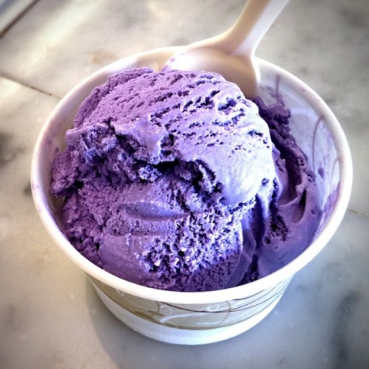
Topics
Introduction
Trend Categories
Meat & Poultry
Dairy
Baked Goods
Fruit & Vegetables
Nuts & Seeds
Flavorings & Seasonings
Q & A
Filipino Ube Ice Cream

Slide 3
Key Trend Drivers in 2017
Authentic & Artisan
Flavor Adventure
Redefining Premium
Comfort & Indulgence

Slide 4
Meat & poultry trends by trend maturity
1
2
3
4
Steak Tartare
Heritage Chicken Lovers
Modern American Steakhouse
Vegan “Meat”
Japanese Chicken Experts
Fancy Cracklings
Wild Boar
Wagyu Beef
Brisket Around the World

Slide 5
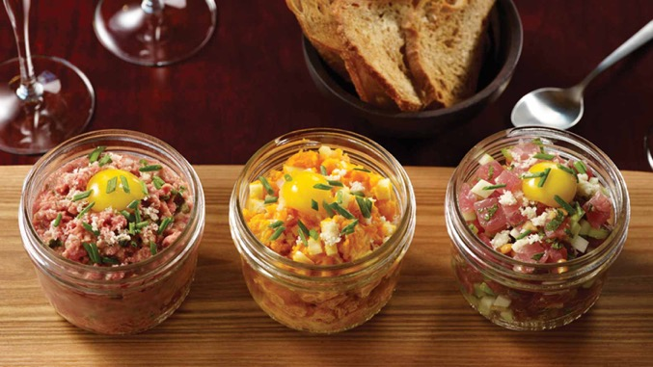
Steak tartare: good quality meat, creative expressions
1
Classic French bistro dish
Chopped raw beef steak seasoned with capers, shallots, mustard, parsley, egg yolk
Surge due to stream of good quality beef
Locally raised, grass-fed animals
Sold directly to restaurant and butchered in house
Sourced sustainably minded butcher shops or meat distributers
To eat raw beef consumers need to trust that it’s fresh and safe
Having a shorter supply chain is part of that process
Datassential MenuTrends
+36% one-year growth
+48% four-year growth
Trio of tartares in jars at The NoMad Bar, NYC

Slide 6
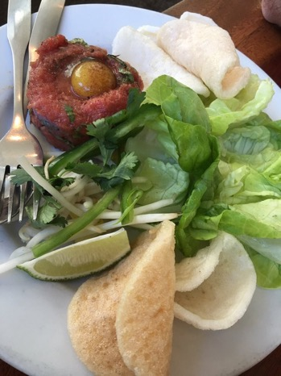
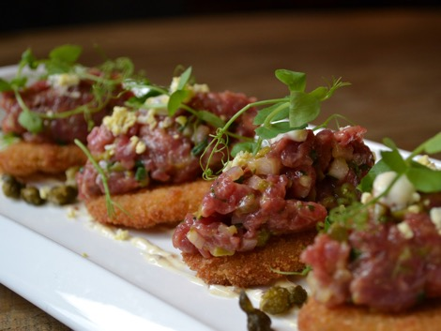
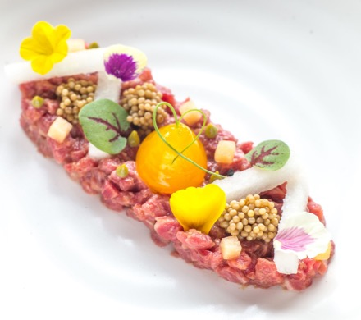
Steak tartare
1
Bastille Kitchen, on fried pickles
Oiji with Asian pear, pickled mustard seeds
Tasty N Alder Hmong Style

Slide 7
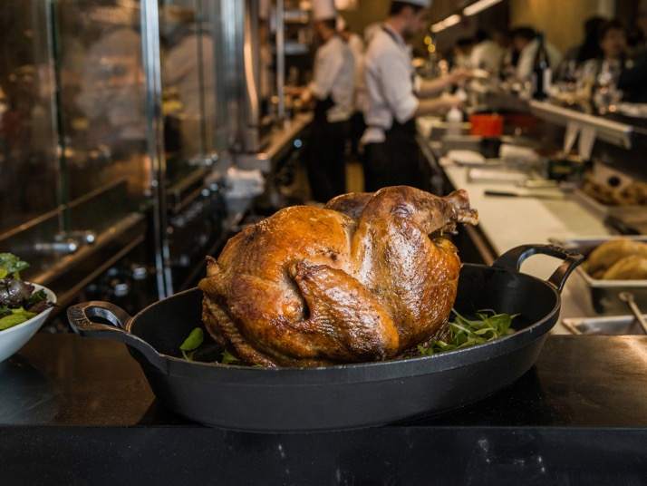
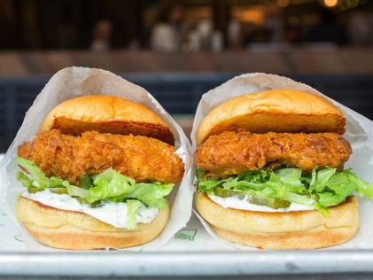
Heritage chicken lovers: Full-Flavored Tradition
1
Our love affair with comforting chicken continues
Premium poultry options are coming to market
Poultry breeders, ranchers and purveyors raising full-flavored birds from heritage breeds, French genetic stock
In 2017, as specialty supplies grow and more chefs and diners discover the delicious flavor of heritage chicken, expect to see even more of a chicken boom

Slide 8
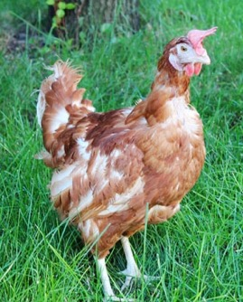
Heritage chicken Lovers
1
SASSO RED CHICKEN
Watkins Poultry Merchants, N.Y.
French red chicken breed from Sélection Avicole de la Sarthe et du Sud Ouest (SASSO)
Hatched in Quebec, raised in Pennsylvania
POULET BLEU
The North American Blue Footed Chicken produced by a Canadian breeder, raised on a Seattle farm
Inspired by French poulet de Bresse, an AOC bird renowned for its flavor and history
Serving Seattle chefs, butcher shops
JIDORI CHICKENS
Jidori Chicken in U.S. – Los Angeles company using name of traditional Japanese heritage chicken
Using cross between Rhode Island Red and Hinai-dori; raised in So. Cal
Jidori Eggs – often from Chino Valley Ranchers with deep yellow yolks

Slide 9
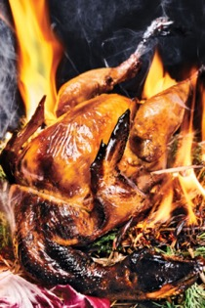
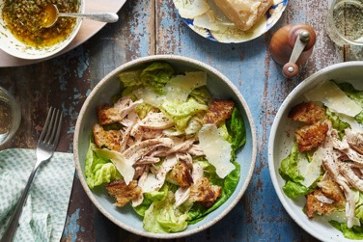
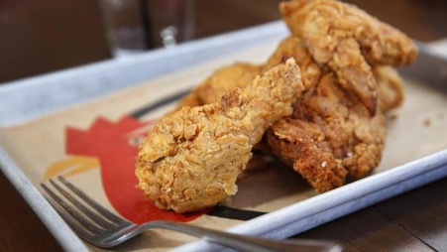
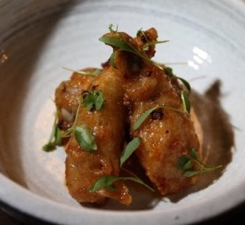
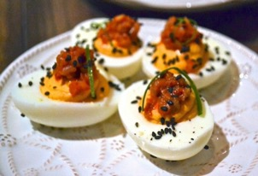
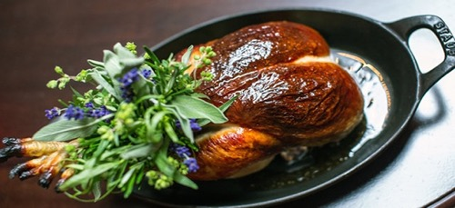
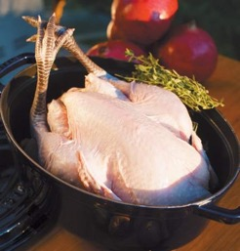
Heritage chicken lovers
1
Chefs around the country who focus on exquisite sources and delicious raw ingredients are tapping into heritage breed fowl and creating dishes that get diners’ attention, some by serving whole chickens in theatrical ways.
SASSO Chickens: Le Turtle chicken served on smoldering hay; Le Coq Rico leftovers; The NoMad roast bird
Jidori Chickens & Eggs: Crack Shack S. Diego fried chicken; Nomica, S.F. wings
Faith & Flower, L.A. kimchi deviled eggs
Poulet Bleu chicken ready for the oven, Seattle

Slide 10
Dairy trends by trend maturity
1
2
3
4
Frozen Asian Novelties
Thai Rolled Ice Cream
Taiwanese Shaved Snow
Meet Nordic Skyr
Playing with Cheese
Cottage Cheese, Disrupted
Butter Flavor Spectrum
Buttermilk Love

Slide 11
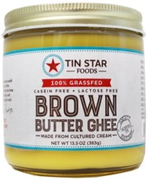
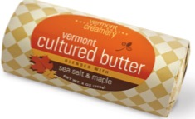
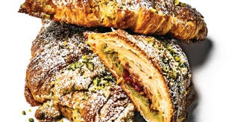
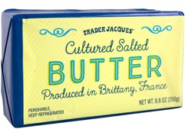
Butter Flavor Spectrum
3
CULTURED BUTTER
BROWNED BUTTER
FLAVORED BUTTER
Datassential MenuTrends
Brown butter on menus
+6% one-year growth
+60% four-year growth

Slide 12
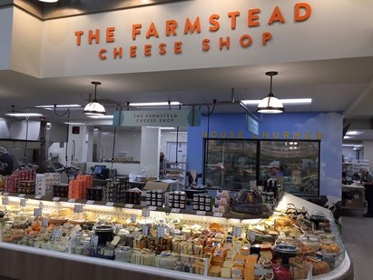
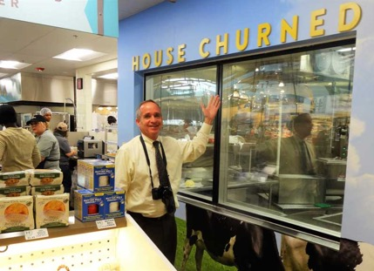
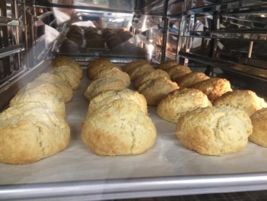
Butter Flavor Spectrum
3
FRESH BUTTER
Hand-churned butter
Harvest Market in Champaign, Illinois
Churned in house in the center of the store
Reinforces ties to farmers and dairies
Fresh, salted butter sold in waxed paper in one-pound packages and 12-oz. containers
Bakery uses unsalted product for buttercream icing on cakes
Leftover buttermilk paired with sweet butter in house-baked biscuits

Slide 13
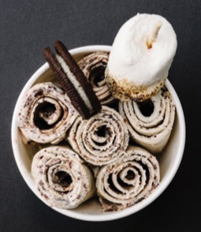
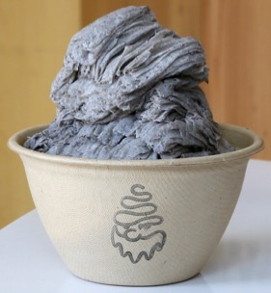
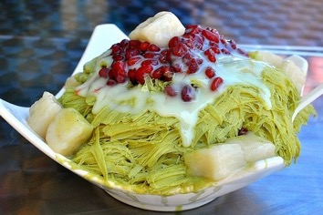
Frozen Asian novelties
1
THAI ROLLED ICE CREAM
Ice cream base spread on metal plate chilled to a frosty -10° F
Frozen layers scraped into cylinders with spatulas
Served with sauces and toppings
10 Below, NYC; 8 Fahrenheit, Atlanta
Chelo Creamery, L.A.: matcha green tea, dragon fruit, mocha flavors
Freezing Point Creamery, Oakland: durian, avocado
TAIWANESE SHAVED SNOW
Thickened ice cream base frozen in large cylinders then “shaved” to create soft, layered ribbons with a slightly chewy texture
Powder, S.F.: black sesame, green tea
SnowDays, NYC: New York cheesecake, coconut; top with grass jelly, red beans, cereal; drizzled with condensed milk, peanut butter sauce

Slide 14
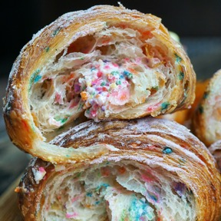
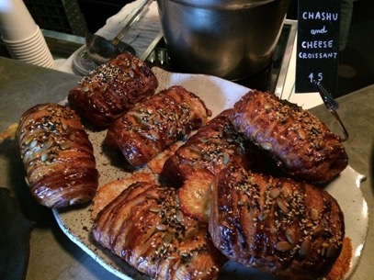
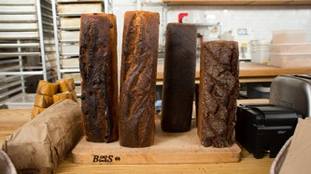
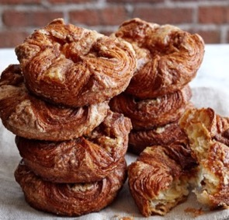
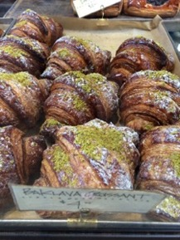
Trend CATEGORY: BAKED GOODS

Slide 15
Baked good trends by trend maturity
1
2
3
4
The New Neighborhood Bakery
Georgian Khachapuri
Japanese Milk Bread
Chinese Jian Bing
Creative Croissants
Bonjour Kouign Amann
Czech Kolaches
Bagel Renaissance
Hawaiian Baking
Jewish Sweet Baked Goods

Slide 16
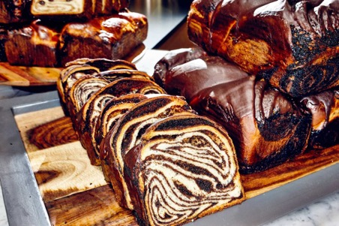
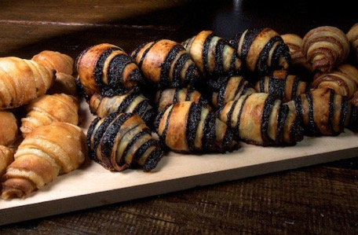
Jewish Sweet Baked Goods
3
BABKA LOVE
NYC: Breads Bakery; Sadelle’s; Russ & Daughters with babka French toast, ice cream sandwiches; vegan matcha babka at By Chloe SWEETS
Wise Sons, S.F.
Amelia’s, Sycamore Kitchen, L.A.
Bon Appétit, Food & Wine cover pics
Trader Joe’s Babka
RUGELACH
Made from cream-cheese-enriched dough, these crescents are filled with cinnamon and nuts, chocolate, or jam
Specialists: Petite Shell, NYC – laminates flavor into the dough; Nutella, blue cheese pear, dulce de leche
Breads Bakery, NYC; Saul’s Deli, Berkeley, Calif.
TABOON, San Francisco
Kosher bakery opened in late 2016 to great acclaim
Challah, pita bread, buns, foccacia, bagels
Babka, rugelach, sufganiyot
Recipes from Israeli baker’s great grandfather’s Jerusalem bakery

Slide 17
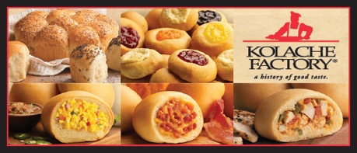
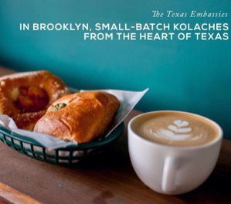
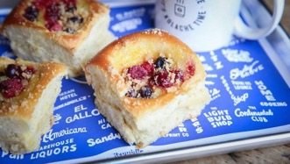
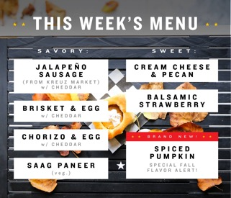
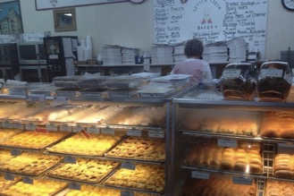
Czech kolaches
2
Kolache Factory: nearly 60 company and franchise stores across Texas and the Midwest; added to name confusion by calling a sausage-wrapped item kolache when it should be called “klobasnek.”
Republic Kolache above; menu below
Expat kolaches that take liberty with style and flavor.
Brooklyn Kolache Factory
Republic Kolache pop-up, D.C.
Happy Sparrow, Portland, Ore.
Happy Sparrow fillings include:
Bacon + egg
Turkey maple sausage
Tillamook cheddar + jalapeños
Poppyseed
Bananas + Nutella
Strawberry + cream cheese
Czech Stop in West, Texas famously supported first responders and the wounded after a fertilizer factory explosion nearby in April 2013. The 24-hour bakery, deli and gas station opened in 1983.

Slide 18
Fruits & vegetables by trend maturity
1
2
3
4
Spring Greens
Breakfast Salad
Cassava Root
Modern Mexican Zing
Chlorella & Spirulina
Kumquat
Refashioned Veggie Scraps
Veggie Spreads & Dips
Grapefruit & Pomelo

Slide 19
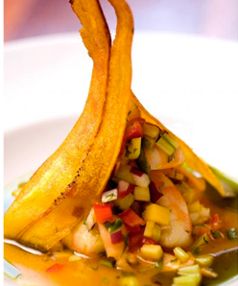
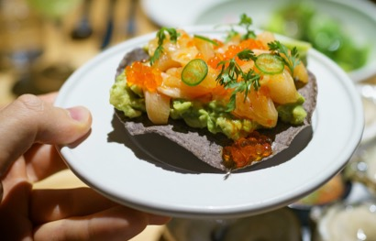
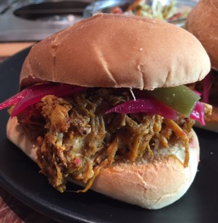
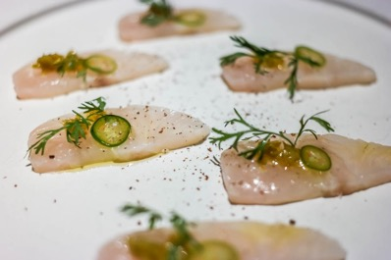
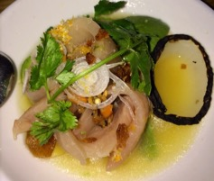
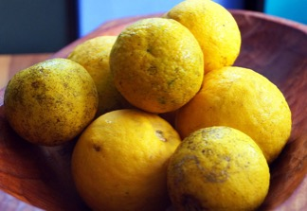
Modern Mexican Zing: citrus tang beyond limes
2
Japanese yuzu juice on Arctic char tostada
Persian black lime on hamachi with fermented serranos - Cosme, NYC
Ceviche: Passion fruit, lemon, aji amarillo – SushiSamba, Miami Beach
Calamansi in ceviche - La Condesa, Austin
Traditional sour (Seville) orange juice on cochinita pibil slider – Calavera, Oakland
Sour oranges for Cuban mojo

Slide 20
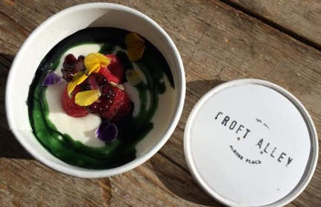
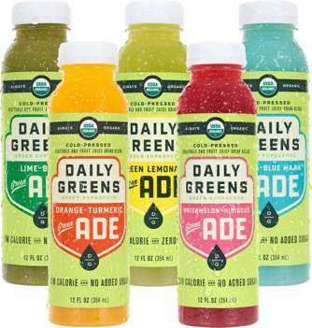
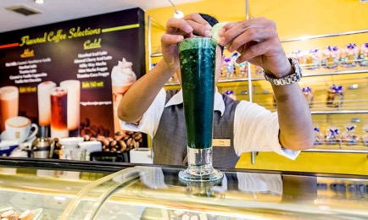
The Next Kale: Chlorella & spirulina
2
Chlorophyll swirl in yogurt – Croft Alley, L.A
Spirulina shake, Hotel Novotel Bangkok

Slide 21
Nuts & Seeds by trend maturity
1
2
3
4
Green Peanuts
Watermelon Seed Snacks
Super-Charged Nut Butters
Nut “Meats”
Sesame Halvah
Black Sesame Seeds
Loaded Nut Butters
Tahini
Nut Butter Boosts

Slide 22
Super-Charged Nut Butters
2
NATURALLY MORE with PROBIOTICS
Probiotics developed with Ganeden; signature strain said to be more effective than yogurt cultures; flax for omegas
Calling out peanut variety an appealing distinction: Organic Valencia Peanut Butter;
Also Chocolate Hazelnut, Roasted Almond; in jars or pouch
8g protein
WILD FRIENDS NUT BUTTER PROTEIN +
All-natural nut butter brand extends into protein with three flavors of peanut and almond butter
50% more protein from whey protein isolate
10-12g per serving
In single-serve packs or jars
NUTS ‘N MORE PEANUT BUTTER
“High Protein + Peanut Spread”
Added whey and organic flax for 14g protein and omegas; xylitol
Appeared on Shark Tank; sold online
Birthday Cake, Chocolate Maple Pretzel, Cookie Butter among other flavors

Slide 23
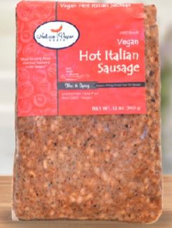
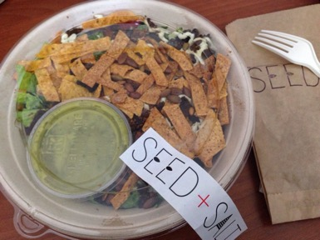
New Guises: Nut “Meats”
2
FOODSERVICE VEGAN/VEGETARIAN
Seed + Salt, S.F. vegan/paleo/GF prepared food café makes walnut chorizo for Taco Salad
Seattle Marriott Queso Fundido with Walnut Chorizo top selling veg dish
Recipes promoted by the California Walnut Board
NUT CASE VEGAN MEATS
Physician-entrepreneurs vegetarians developed Nut Case Vegan Meats in Grand Rapids, Michigan
Blend of brown rice, quinoa, walnuts, hazelnuts, seeds and spices
Chorizo, Hot Italian Sausage, Burgers, Breakfast Sausages
Sold fresh in local stores or online
NEAT MEAT REPLACEMENT MIX
Founder inspired to create meat substitutes for vegetarian kids
Converted fresh product to shelf-stable mix with added eggs and water to sell
Pecans, garbanzo beans, gluten-free oats and cornmeal, seasonings
Original, Italian, Mexican, Breakfast flavors; Neat also makes an egg substitute

Slide 24
Flavorings & Seasoning by trend maturity
1
2
3
4
Pandan
Cannabis
Japanese Koji
Filipino Flavor & Adobo
Hops Beyond Beer
Seaweed Basics
Seaweed Condiments
Filipino Ube
Japanese Miso

Slide 25
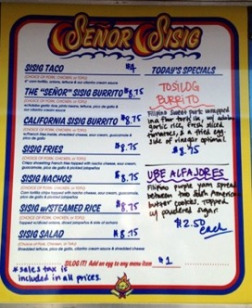
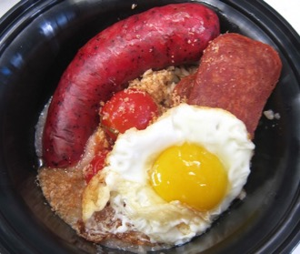
Filipino Flavor
Is 2017 the year Filipino cuisine becomes easier to find?
Complex comfort cuisine best suited to home cooks and family meals
Reflects centuries of Spanish rule, waves of Asian and Malaysian immigrants, and a touch of American military occupation (that would be the Spam)
Long history of fusion complicated by the geography of an archipelago; lots of regional variations
Mixes indigenous tropical ingredients like fruit and fish with Spanish pork and vinegar as well as Chinese soy sauce, garlic, ginger and noodles
Salty-sweet-sour flavor profiles (tamis, asim, alat) dominate along with funky, fermented ingredients
Pork in myriad ways – roasted whole, crispy fried, pulled apart head – is a defining factor
Vinegar a centerpiece for preservation and sour taste
Coconut, banana and banana leaves, calamansi limes and bright purple ube give Pinoy food distinction
WHERE TO FIND FILIPINO FARE
Austin: Kuneho from chef Paul Qui; Japanese small plates with Filipino influences
L.A.: LASA pop-up, RiceBar, Belly & Snout, Park’s Finest BQQ, Irenia, B Sweet; FrankieLucy Bakeshop
NYC: F.O.B., Jeepney, Pig & Khao, Manilla Social Club, Talde, Rice & Gold from Dale Talde to open in Bowery Hotel, 3/17
S.F.: Elena Una, Kainbigan, Señor Sisig food truck

Slide 26
Filipino Flavor
1
RECENT FILIPINO FOOD HAPPENINGS
Bad Saint in Washington, D.C. names #2 Best New Restaurant in Bon Appétit
Jollibee, Filipino fast-food/fried chicken, opens in NYC, Chicago suburb
Chef Dale Talde (Talde, Brooklyn) opens new outlets in Miami, publishes cookbook Asian-American; new hotel spot March ‘17
Chef/restaurateur Alvin Cailan (Eggslut, L.A.) leads Los Angeles Filipino food movement; runs culinary incubator in L.A.’s Chinatown, Unit 120
Isa Fabro launches successful Filipino pastry pop-up out of Unit 120 in L.A.; created hybrid “Isamadas” - a kouign amann-Filipino carioca cross
Filipino Food Movement hosts successful Savor Filipino 2016, Oakland
Lumpia Palooza in S.F. at food truck park

Slide 27
Filipino adobo & sour
1
Adobo is the most recognizable Filipino dish and is primarily pork or chicken (or both) cooked in vinegar, soy sauce and garlic and often scented with peppercorns and bay leaf. Spanish colonists named the native dish “adobo,” using the Spanish word for brothy stew but there aren’t the tomatoes or chiles found in Mexican, Caribbean or Spanish adobos here. The sour vinegar is the defining taste and one that is found in many dishes, used as a marinade or dipping sauce.
RIFFING ON ADOBO
Adobo Peanuts – Black vinegar, tamari, fried garlic – LASA, L.A.
Pork Belly Adobo – Soy sauce, vinegar, Sichuan peppercorns, crispy garlic, slow-poached egg, Pig & Khao, NYC
Chicken Adobo – Chicken legs in Red Boat fish sauce, garlic, vinegar, bay leaf with Red Boat-pickled jalapeños – Onefold, Denver
Tosilog Burrito – Filipino sweet pork, adobo garlic rice, tomatoes, fried egg with peppered vinegar – Señor Sisig food truck, S.F.
Rohan Duck Breast Adobo – Cauliflower, cipollini, kabocha, jus – Perla, Philly
FILIPINO SOUR
Vinegar (Suka)
Most-used pantry ingredients for preservation and sour punch, asim
Made from sugar cane, palm, coconut
Used in paksiw (fish poached in vinegar) adobo, kinilaw (like ceviche), dipping sauces, marinades
Calamansi Lime
Used in sisig (“to snack on something sour”), a stir-fry of chopped pig’s head meat and liver plus calamansi, chile; drink, desserts; Mansi juice
Tamarind
Used in sweet-sour soup sinigang
Green/unripe mangos, pineapples, guavas

Slide 28
Filipino pantry & Ube
1
2
SAUCES & CONDIMENTS
Soy sauce – multiple versions, sweet, thick
Vinegar – cane sugar, coconut, spicy
Fish sauce or patis
Banana ketchup, sweet chili sauce
Oyster sauce
Shrimp paste – bagoong
Tamarind soup mix
Coconut milk
Tomato sauce
Condensed, evaporated milk
Garlic, onion, ginger, annato, bay leaf, peppercorns
Lots of rice!
PURPLE UBE IN SWEETS
The purple sweet yam may be the hottest Filipino ingredient in food circles thanks to its use in desserts, ice cream and baked goods of all kinds
Asian ice cream and sweet shops as well as Filipino bakeries and restaurants play with ube’s purple power
Hood Famous, Seattle; Bsweet, L.A.; Lumpia Shack, N.Y.C.; Purple Patch, D.C.
Manila Social Club, Brooklyn – Golden Cristal, Ube Bae Donuts

Slide 29
Q & A
KARA NIELSEN
Trendologist
www.KaraNielsenFoodTrends.com
trendologistk@gmail.com
Reports available from Packaged Facts in February 2017:
2017 Forecast: Culinary Trend Tracking Series
Food Flavor Forecast 2017
Ready-to-Drink Beverage Trend Forecast 2017
DAVID SPRINKLE
Research Director
marketresearch.com
dsprinkle@marketresearch.com
Notes:
Natural channel
Health and nutrition as lifestyle
Part controlling health, past aspirational wellness
Identity
Trying out a trend
Price:
Costly
Difficult in foodservice
Wear out trying so hard

