Slide 1


Ergonomics
Notes:
Slide Show Notes
According to the Occupational Safety and Health Administration—OSHA—many office workers report work-related musculoskeletal disorders—or MSDs—every year. For some, the problem becomes so severe that they suffer a lot of pain and have to take time off from work for treatment and recovery. But the good news is that you don’t have to be one of those who develop MSDs on the job. By understanding basic ergonomic principles and applying them to your job, you can minimize MSD risk factors, avoid stresses and strains on your body, and keep healthy and safe as you work.

Slide 2

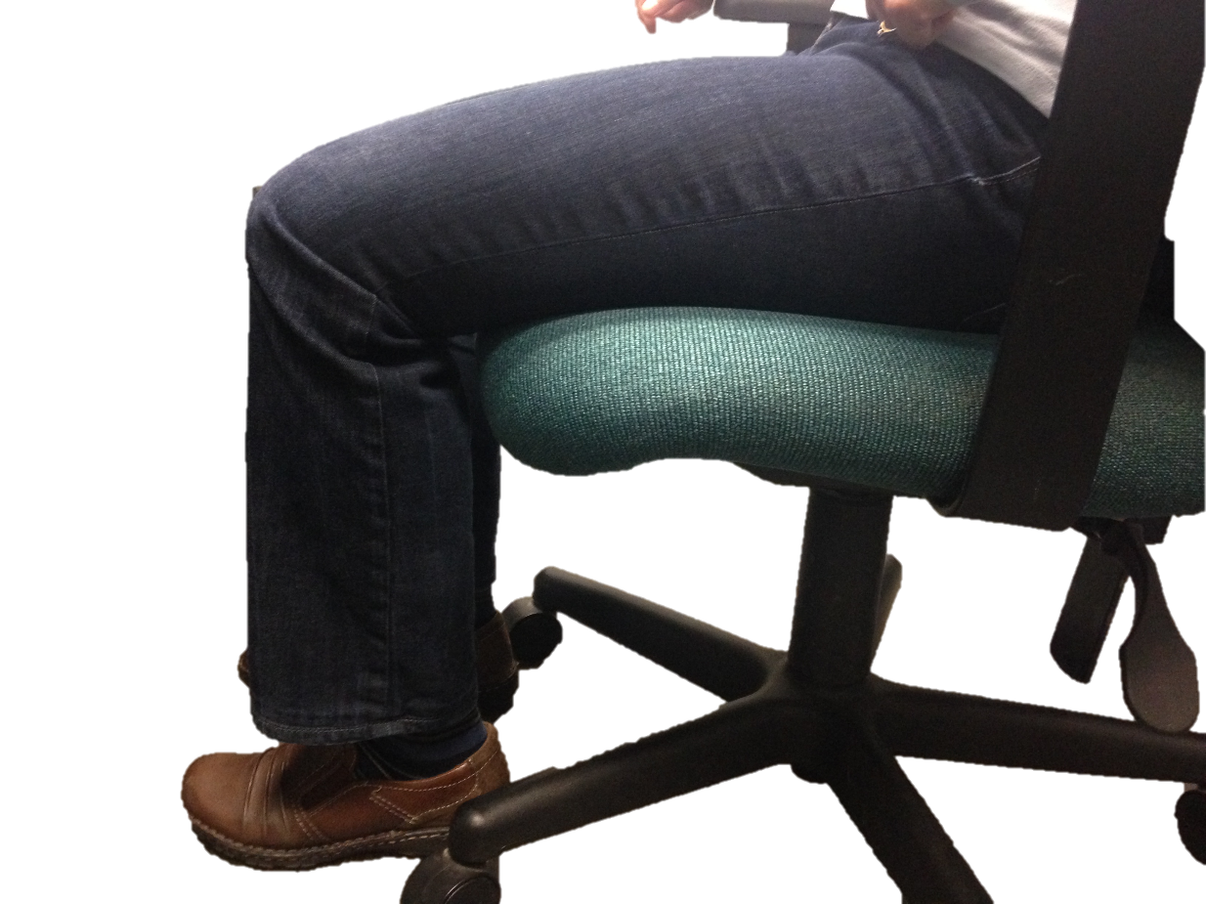
Your Chair

Slide 3
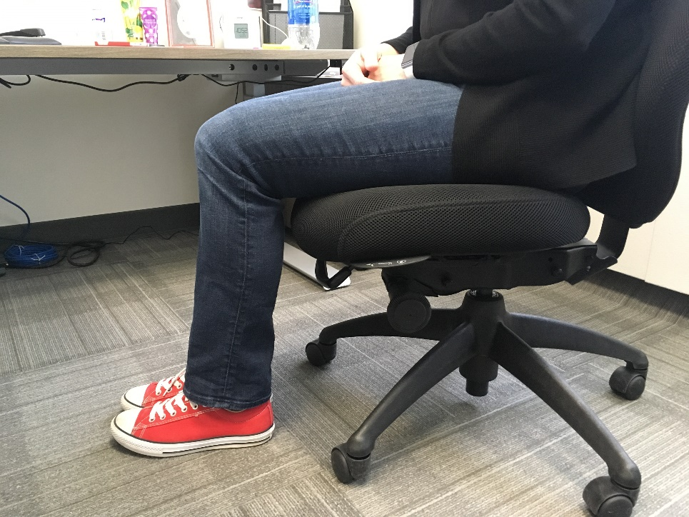
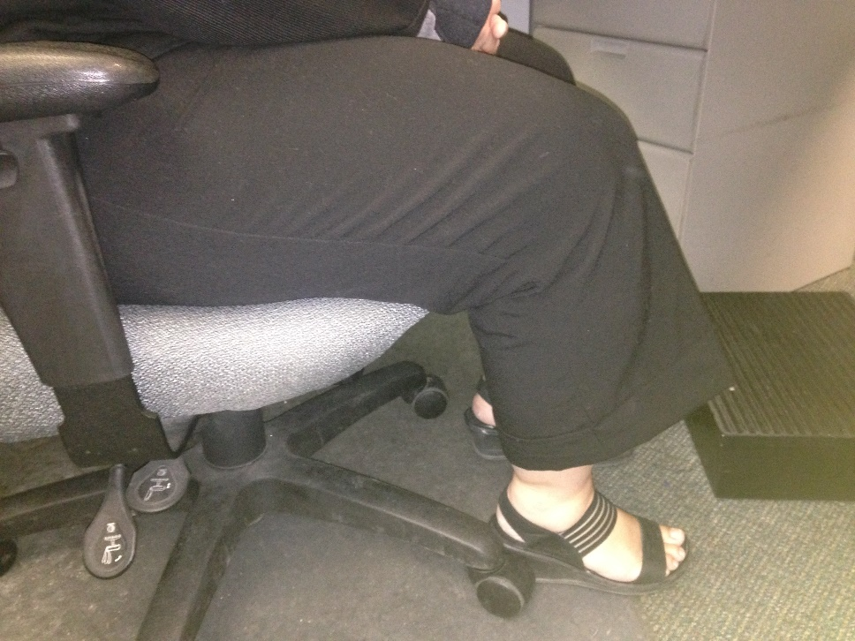
Your Chair – Seat Height

Slide 4
Your Chair – Armrests
Allows shoulders to relax
Supports arm weight
Relieves neck tension
Can be changed/removed

Slide 5
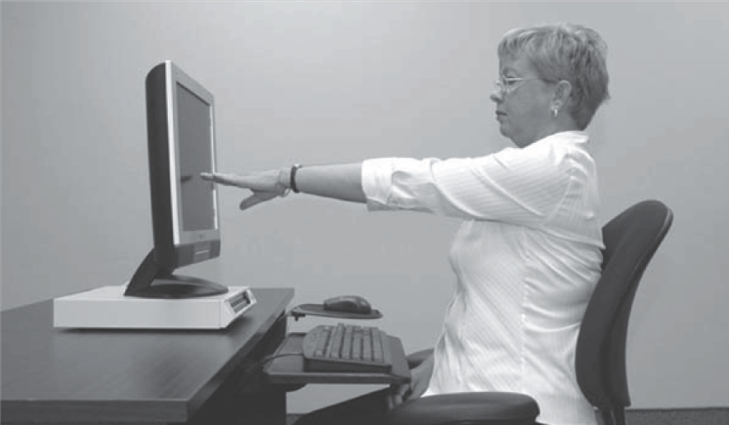
Screen Height - Ideal
The monitor should be:
Directly in front of user
Situated at seated eye height
Arm’s length away from user

Slide 6
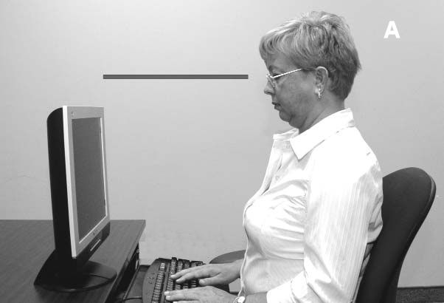
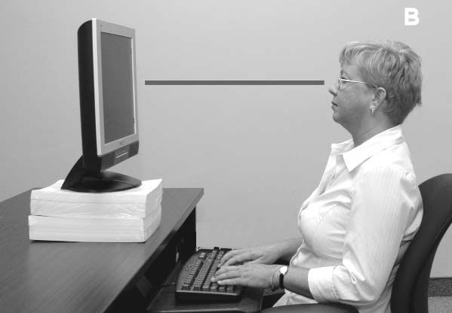
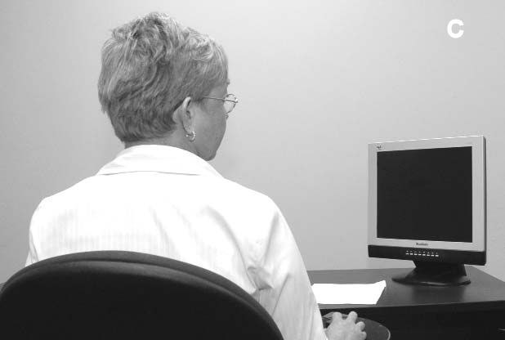
Screen Height - AVOID
When the monitor is too low, the neck is flexed
When the monitor to too high, the neck is extended
When the monitor is not directly in front of the user, the neck is twisted

Slide 7
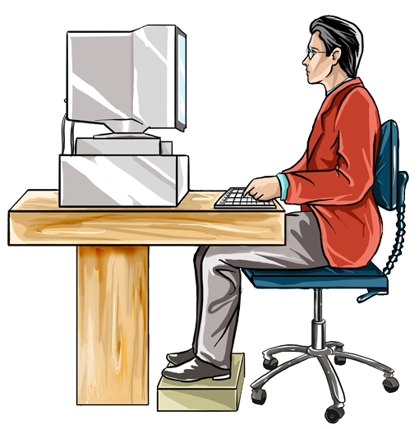
Computer Workstation:
Legs and Feet
Knees bent about
90 degrees
Thighs parallel
to floor
Chair at a
comfortable height
Feet flat on the floor or on a footrest
Notes:
Slide Show Notes
The position of your lower body while you work on the computer is also important in preventing MSDs.
Your knees should be comfortably bent about 90 degrees. The angle doesn’t have to be exact, as long as you’re comfortable.
Your thighs should be approximately parallel to the floor.
Adjust your chair at a comfortable height to allow your knees and legs to be comfortable.
Remove any obstructions under your workstation to your legs and feet so that you can maintain a comfortable working position.
Your feet should be resting flat on the floor or on a footrest. Although it’s good to change the position of your feet occasionally, you don’t want to be on your toes or heels for extended periods.
Think about your posture when working on the computer. Do you follow the ergonomic rules described in this and the previous two slides?
Ask a few volunteers to demonstrate their posture while working on the computer. Check to make sure their heads, shoulders, elbows, wrists, legs, and feet are all properly positioned. Correct any poor posture.

Slide 8
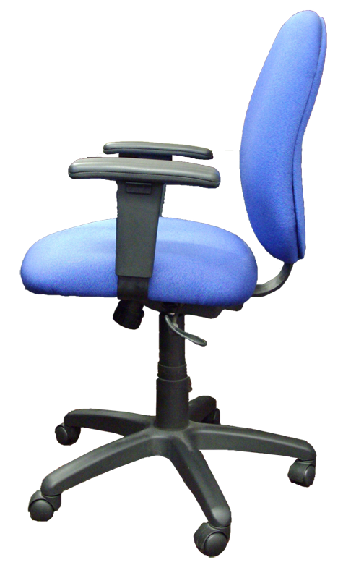
Chair Adjustments:
Seat Surface
Comfortable seat surface
Adjustable height
Adjustable tilt
Notes:
Slide Show Notes
A comfortable, ergonomically designed chair is critical when working at a computer workstation for extended periods every day.
The seat surface should be properly padded and comfortable, even after sitting for 30 to 60 minutes. The seat should also be at least an inch wider than your hips and thighs.
To determine the proper length of the seat, sit with your back against the back support. In this position, the front edge of the seat should be about an inch from the back of your knee. Also, the front edge should be contoured so that you’re not subjecting the back of your legs to contact stress with a hard corner of the front of the seat.
As we said in the previous slide, the chair height must be adjustable so that your feet can rest on the floor or on a footrest.
Some seat surfaces can also be tilted to help maintain a balanced posture. You may, for example, prefer a seat that is tilted slightly forward so that you can easily reach the keyboard and supplies on your workstation. Or you may want the seat surface tilted back to help you stay seated against the back support.

Slide 9

Using a Mouse
Control mouse movement from the elbow
Keep wrist straight
in neutral position
Switch mouse to
other side if you
feel stress
Notes:
Slide Show Notes
Most people consider the keyboard to be the main contributor to computer-related MSDs. However, the mouse, when used improperly, can also contribute to injuries.
Control the mouse movement from your elbow. Controlling the mouse with wrist movements will put strain on your nerves, blood vessels, and other soft tissue in your wrist.
Keep your wrist straight in the neutral position as you manipulate the mouse. Move or turn your elbow slightly to make mouse movements.
Also position your mouse properly. Here’s how: Sit back in your chair and relax your elbows. Lift your mouse hand up, pivoting your elbow, until your hand is just above elbow level. This is where your mouse should be located. You should not have to reach or extend your arm or body to use the mouse.
If you start to feel stress in your mouse arm or elbow over time, switch the mouse to the other side. It may take a little time to get used to manipulating the mouse with your other hand, but the change can relieve the stress in your normal mouse arm and elbow.
Do you use your mouse correctly to avoid developing an MSD?
Demonstrate the proper way to use a mouse.

Slide 10
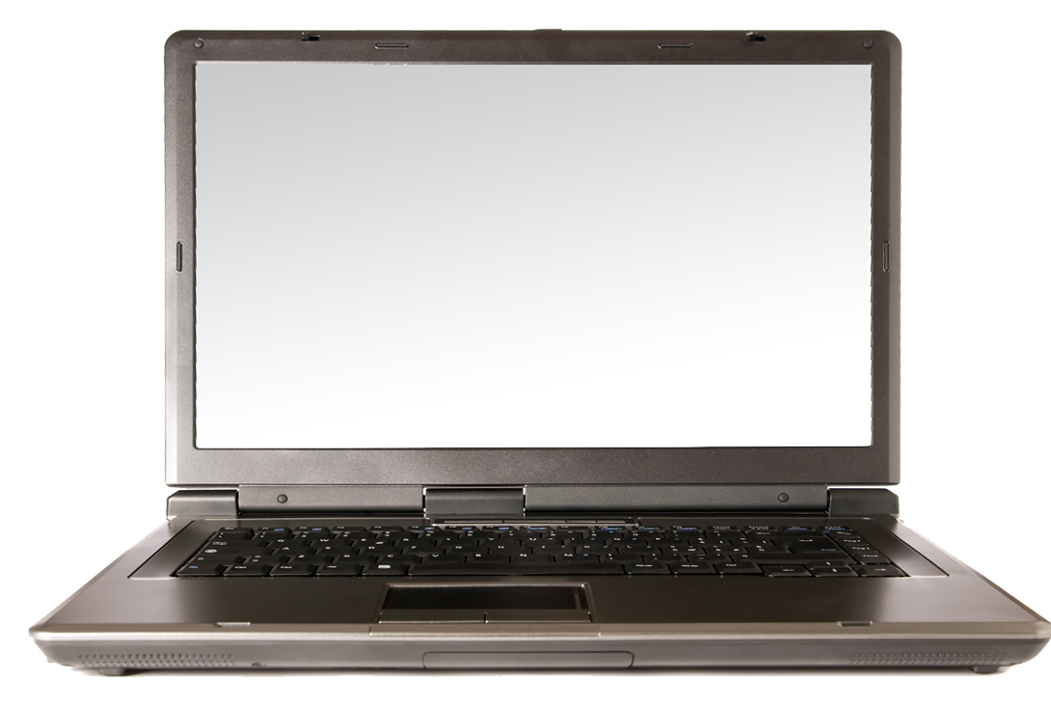
Using a Laptop
  Sit in a comfortable chair and adjust the laptop height
  Position screen like a desktop monitor
  Use separate keyboard and mouse
Notes:
Slide Show Notes
Working on a laptop can present ergonomic problems because the monitor and keyboard are not separated, which means you can usually achieve either good neck and head posture while working or good wrist and hand posture, but not both.
If you use a laptop occasionally or for short periods, it’s probably best to sacrifice neck posture than wrist posture.
Sit back in a comfortable chair and position the laptop so that you can maintain a neutral wrist position. Angle the screen to avoid neck strain as much as possible.
If you use a laptop exclusively, position the laptop screen as you would a workstation monitor—directly in front of you and at a comfortable height.
Use a separate keyboard and mouse to prevent strain while keyboarding and mousing for long periods of time.

Slide 11
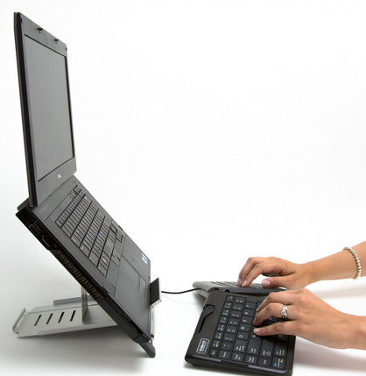
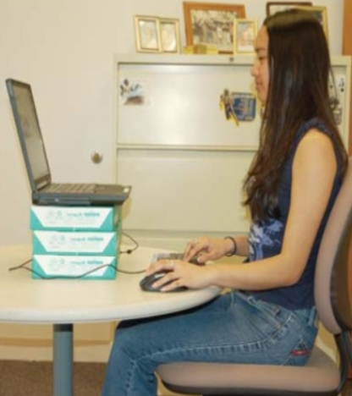
Laptop use

Slide 12

Break Time
Minibreak (30min):
  Relax your hands
Rest break:
  Do a different task
Eye break:
  Look away and blink
  20/20/20 Rule
Notes:
Slide Show Notes
Taking enough of the right kinds of breaks from keyboarding is another important way to prevent MSDs.
Minibreaks are not breaks from work. Rather they are very short breaks from using typing or mousing muscles. During a minibreak, allow your hands to relax in a flat and straight posture. Use the wristrest to relax your wrists for a few moments.
Rest breaks are longer periods in which you actually take a break from work. During a rest break, get up from your workstation and move around a little. Get a drink of water, or do a different task for a few minutes. You should take a short break from computer work at least every hour.
You also need to rest your eyes periodically. Take an eye break every 15 minutes or so and look away from the monitor for a minute at something across the room. This allows your eye muscles to relax. Also, blink rapidly for a few seconds to refresh your eyes. When typing, you might not blink as much as normal, and your eyes can become dry and sore.

Slide 13
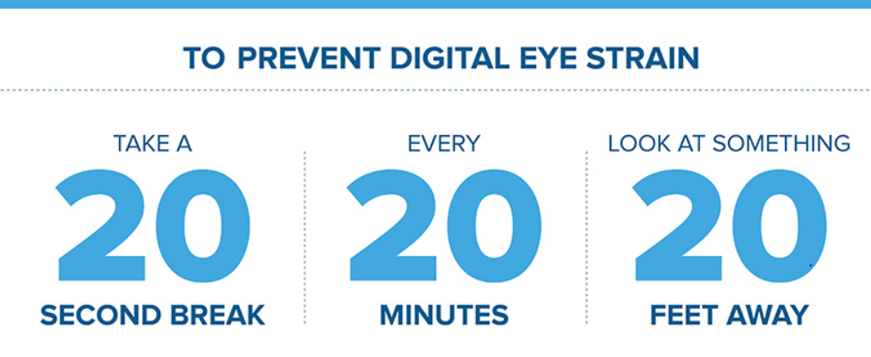

Slide 14

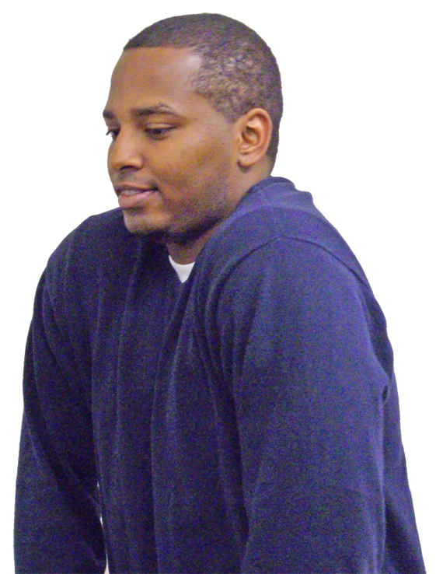

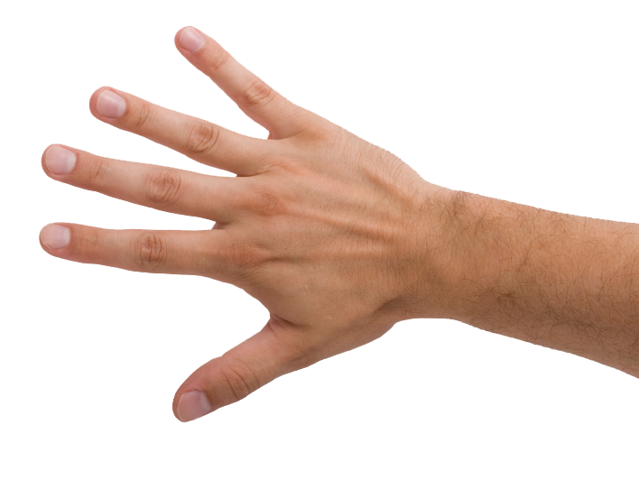
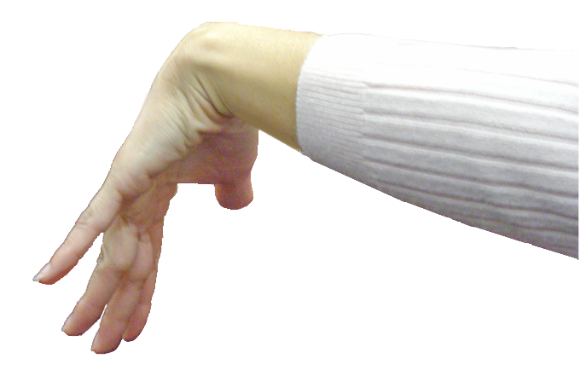
Exercises
Hands
Finger extensions
Wrists
Backwards stretch
Shoulders
Shrug and roll
Blade pinch
Overhead reach
Notes:
Slide Show Notes
Here’s another way to help prevent MSDs. Simple exercises can strengthen muscles and allow overworked areas to stretch. You can do them during work breaks and at the end of the day.
To exercise your hands, try finger extension. Make a fist, then extend and spread your fingers.
To stretch out wrists, hold your arms out in front of you and bend wrists up and down.
To relieve tight shoulder muscles, shrug your shoulders and then roll your shoulders forward and back.
Here’s another shoulder exercise called the blade pinch. With elbows out, move your arms back to bring your shoulder blades together.
And one more for the shoulders. Reach your arms over your head and stretch, bending from side to side.
Go ahead and take a couple of minutes to try each of these exercises.
Have trainees practice the hand, wrist, and shoulder stretches described in this slide.

Slide 15

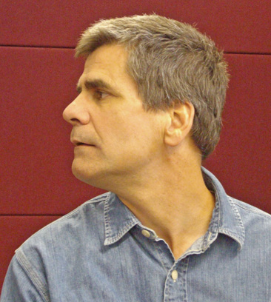
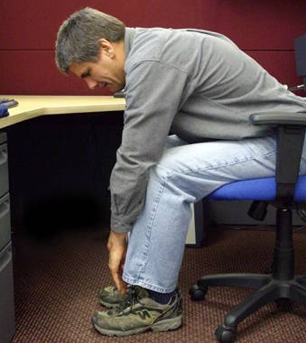
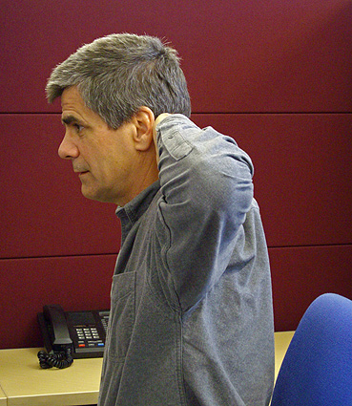
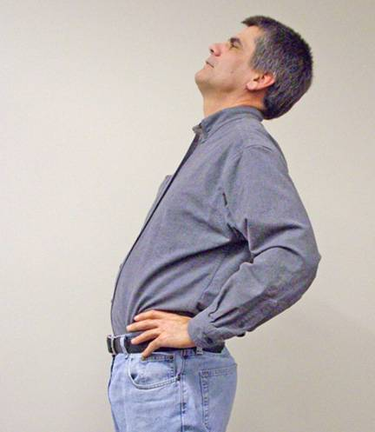
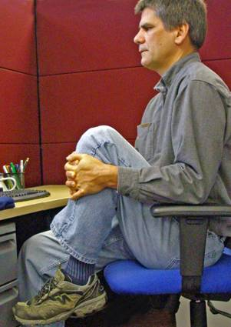
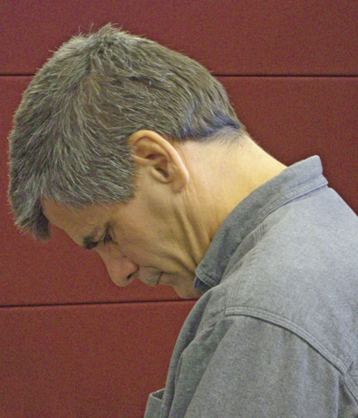
Exercises (cont.)
Neck
Nod head
Turn head
Tilt head
Back/arms
Hands behind head
Bend forward
Knee to chest
Back bend
Notes:
Slide Show Notes
Now let’s look at some exercises for the neck, back, and arms.
To stretch your neck:
Do the head nod. Just nod your head up and down a few times.
Then turn your head slowly from side to side.
And then tilt your head gently toward each shoulder.
For your back and arms:
Begin with your hands behind your head. Then bring your shoulder blades together.
Now another one for the back and arms. Sit in a chair and bend forward and try to touch the floor.
Next, also while sitting, grasp one knee with both hands and pull it up toward your chest. Switch knees and repeat.
Finally, stand up, place your hands on your hips, and bend backwards slowly and gently.
Go ahead and take a couple of minutes to try each of these exercises.
Have trainees practice the neck, back, and arm stretches described in this slide.

Slide 16
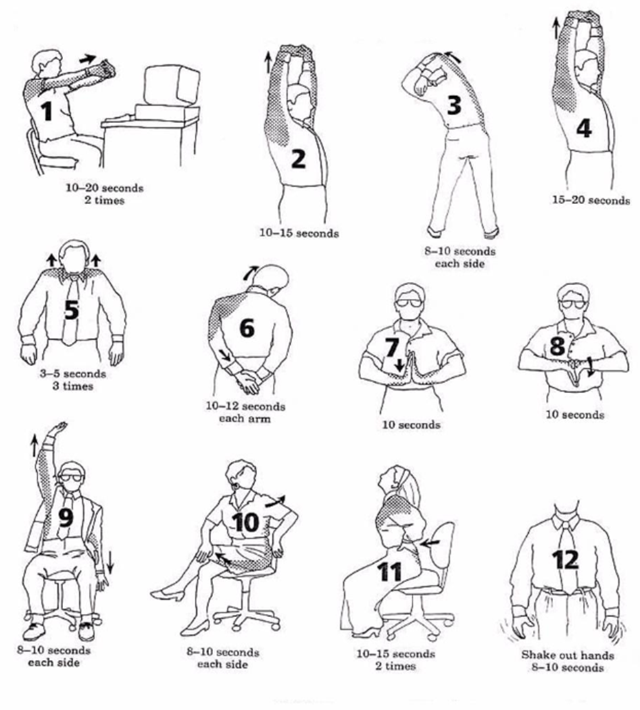
ERGO STRETCHING

Slide 17
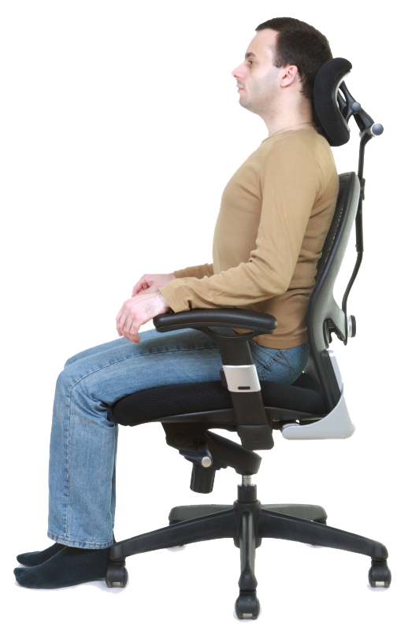
Focus on Your Posture
Elbows at sides,
forearms parallel to floor
Wrists in neutral position
Good back support
Feet flat on floor
Head and neck facing forward and straight
Relax shoulders
Notes:
Slide Show Notes
Now let’s review some of the MSD prevention tips we’ve been talking about in the previous slides. You’ve probably figured out by now that the real key to preventing work-related musculoskeletal disorders is to focus on your posture while you work.
Keep your elbows at your sides and your forearms parallel to the floor or tilted slightly downward to prevent nerve compression at the elbow.
Keep your wrists in a neutral position while keyboarding to prevent stress to the carpal tunnel.
Choose a comfortable chair with good back support, and position yourself close to the keyboard so that you don’t have to extend your arms.
Keep your feet flat on the floor or on a footrest.
Position your monitor and work documents so that you can keep your head and neck straight and facing forward, with minimal head turning while working.
And finally, relax your shoulders.
A good, comfortable work posture can be a big help in preventing MSDs.

Slide 18
If you have questions, please contact Carlos Morales
carlosm@wgbib.com

