Slide 1
Disclaimer
This communication is not intended to provide any legal advice or opinion on any individual situation and should not be relied on to determine insurance coverage or lack thereof as relates the Coronavirus. Insurance forms and endorsements vary based on insurance company, changes in edition dates, regulations, court decisions, and state jurisdiction. The information is based on review of insurance coverages, sources we deem to be reliable and communications we have received from insurance companies and other resources. We make no representation or warranty as to the accuracy of information as applied to individual cases.

Slide 2
About Wood Gutmann & Bogart
For more than three decades, Wood Gutmann & Bogart Insurance Brokers (WGB) has been a growing force in the California insurance marketplace. Our firm is headquartered in Orange County with affiliate offices throughout California.
We are an innovative insurance brokerage and consulting firm, providing Risk Management, Property & Casualty Insurance, Employee Benefits Consulting, Specialty Programs and Private Client solutions. The WGB team members are passionate advocates – sworn to deliver the peace of mind that our clients seek. We vigorously defend our clients from the risks that would put their lifestyles, livelihoods and legacies in jeopardy.
We are consistently recognized among the Top 100 Insurance Brokers and Best Independent Agency to Work For by Insurance Journal. Our award-winning culture, emphasis on teamwork, unwavering commitment to excellence, and our employees’ sense of ownership over what we deliver is the result of raising the bar on expectations. It is what makes us Passionate Advocates for Peace of Mind.
Notes:
Wood Gutman & Bogart has been in business for more than 30 years.
We headquartered in Tustin, CA with affiliate offices throughout the state.
And we are among the top 100 insurance brokers.

Slide 3
WORKING FROM HOME 101
Notes:
By definition, ERGONOMICS is the study of people's efficiency in their working environment. It’s he science of fitting a workplace to the user's needs.
COVID-19 has forced us to be agile and inventive without sacrificing the core necessities mandated by ergonomic disciplines.
Today’s presentation is a practical take on ergonomics and will provide recommendations that can be applied at home.

Slide 4
Agenda
01
Fine-tune your work-at-home plan
02
Healthy computing habits
03
Stretching and Exercise
04
Know Thyself
Working From Home 101| Wood Gutmann & Bogart Insurance Brokers | Insurance License 0679263
Notes:
We are keeping our agenda short today.
We will do our best to keep it under 30 min.

Slide 5
Fine Tune Your Work-at-Home Plan
Notes:
Let’s jump right into it.

Slide 6
Fine-tune your work-at-home plan
Working from home isn’t “one size fits all”
Segregators
Need to be closed off from personal life.
Integrators
Work better in, say, a kitchen, and with kids and pets around.
Early risers
Work best in the morning.
9 to 5ers
Get more done during normal daytime hours.
Determine what works best for your work at home plan, and discuss it with
your Supervisor.
Working From Home 101| Wood Gutmann & Bogart Insurance Brokers | Insurance License 0679263
Notes:
Working from home isn’t a “one size fits all” scenario. Some people, for example, are “segregators” who need to be closed off from personal life (such as in a home office).
While others are “integrators” who work better in, say, a kitchen, living room and with kids and pets around.
We also have the early riser category; they get most of their work done in the early hours of the day.
Next are our 9 to 5ers, they spread their work out and complete tasks in the morning and well into the afternoon.
Which category are you and your employees in? It could be one or several categories.
Regardless of which category or categories we are in, determine what works best for you and your team, and discuss it.

Slide 7
Fine-tune your work-at-home plan
For most, morning is prime-time
Research indicates short-term memory tasks are performed
better earlier in the day.
Experts tell us that cognitive ability achieves peak
performance in the morning.
How is this information applicable?
Studies show that prolonged stress can lead to a decrease
performance.
When assessing ergonomic risk, consider not only the physical,
but also the psychological impact.
Working From Home 101| Wood Gutmann & Bogart Insurance Brokers | Insurance License 0679263
Notes:
A few things fall under the prime-time category:
Energy Level
Short Term Memory (research shows that short term memory tasks are performed best early in the day)
Cognitive ability (Experts tell us that it achieves peak performance in the morning
How is this information applicable?
Studies show that prolonged stress can lead to a decrease employee performance.
When I do an ergo evaluation in addition assessing physical ergonomic risk, I also consider psychological risk.

Slide 8
Healthy Computing
Notes:
To understand the best way to set up a work at home space, it is helpful to understand the concept of neutral body positioning.
This is a comfortable working posture in which the joints are naturally aligned.

Slide 9
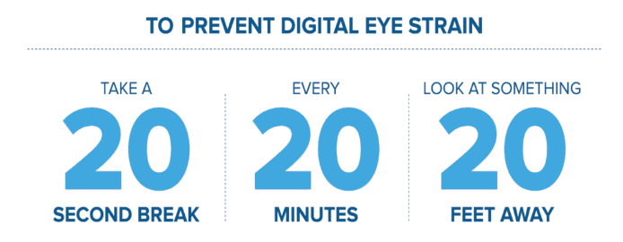
Healthy Computing Habits
Use softer touch when keying and relax
the grip on the mouse.
Avoid working too long in one position.
Change your body posture frequently.
Take frequently breaks and stretch
periodically.
Give your eyes a visual break.
Working From Home 101| Wood Gutmann & Bogart Insurance Brokers | Insurance License 0679263
Notes:
Let’s begin by employing the soft touch keying method. This is where the user makes ever attempt to strike the keyboard keys lightly and relax the grip on their mouse.
How do we avoid working in one position too long, we set a timer or set up a calendar invite to remind us to change positions and stretch.
We can change our body posture by standing if we are sitting and sitting if we are standing. Simple right?
Its also crucial to take scheduled breaks and again take time to stretch.
Also give your eyes a break. The 20 20 20 rule for example can prevent eye strain. The rule says that for every 20 minutes spent looking at a screen, a person should look at something 20 feet away for 20 seconds.

Slide 10
Makeshift Home Office Set-up
Notes:
Let's have some fun here and look at unacceptable makeshift home office set ups.

Slide 11
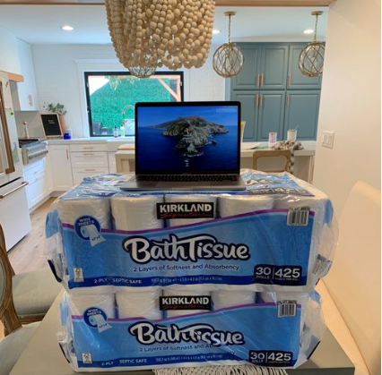
Makeshift Home Office Set-up
Notes:
We understand it’s an added expense, but the alternative is a stand-up desk unit.

Slide 12
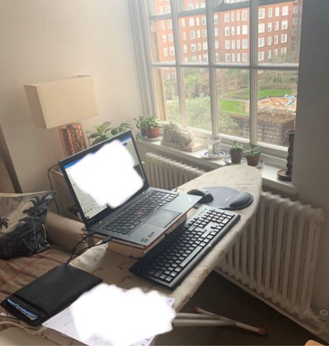
Makeshift Home Office Set-up
Notes:
In theory this is a good idea, but an ironing board is not engineered to hold the weight of a computer for a prolonged period.

Slide 13
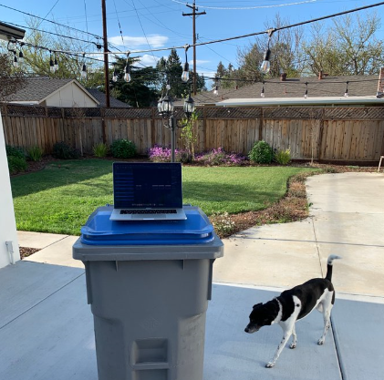
Makeshift Home Office Set-up
Notes:
Weather permitting, working outdoor is a great idea. However, the desk area in this photo is not conducive to achieve neutral body posture and our natural alignment.

Slide 14
Neutral Body Posture and Natural Alignment
Notes:
Let’s talk about Neutral Body Posture and Natural Alignment.

Slide 15
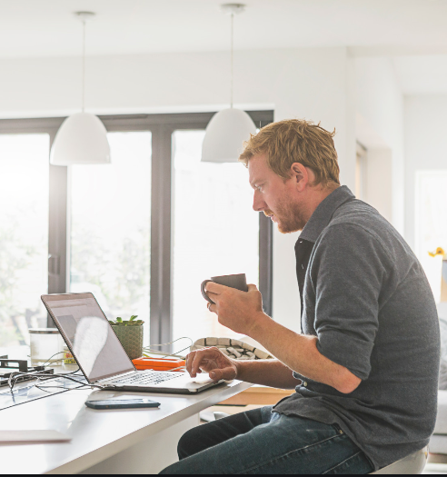
Neutral Body Posture and Natural Alignment
Notes:
Neutral Body Posture and Natural Alignment cannot be achieved if we are leaning forward and looking down at our computer screen.

Slide 16
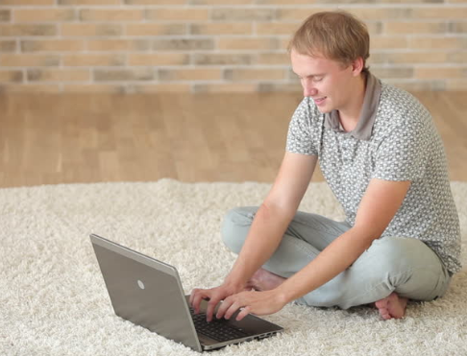
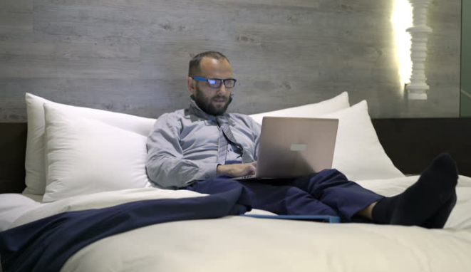
Neutral Body Posture and Natural Alignment
Notes:
Neutral Body Posture and Natural Alignment cannot be achieved if we are resting our head in one arm and computing with the other. The gentleman in this picture is also looking down at the screen.
AVOID working on your bed or sitting on the floor.

Slide 17
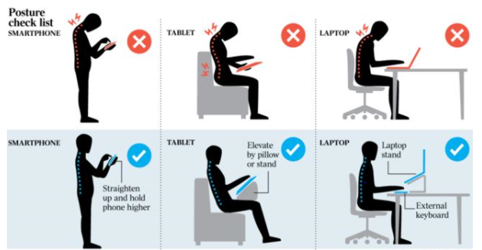
Neutral Body Posture and Natural Alignment
Working From Home 101| Wood Gutmann & Bogart Insurance Brokers | Insurance License 0679263
Notes:
Let’s look at good body posture when standing and sitting. The employees in the top row are looking down at a phone, tablet, and laptop screen. Working in that position for too long will lead to discomfort and pain.
When working from a smart phone, make sure the screen is at eye level.
A tablet may can be supported by a pillow or stand.
A riser or stand can be used to elevate a laptop screen and an external keyboard and mouse must be used.

Slide 18
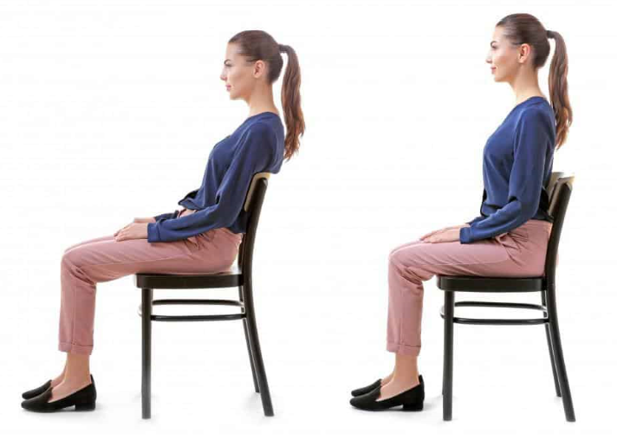
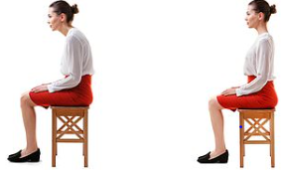
Notes:
When sitting in a wood chair of stool, sit on a pillow and avoid slouching or leaning forward.
Remind your employees to sit straight, this achieved by scooting back in the chair until the person’s back is against the chair and their hips are in the bend of the chair.

Slide 19
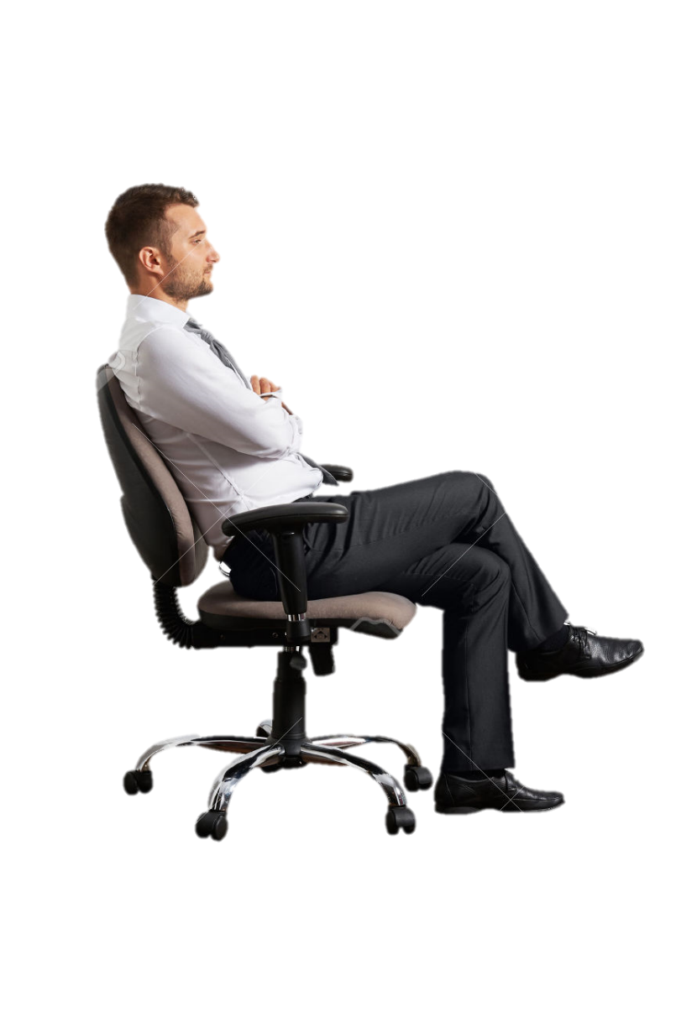
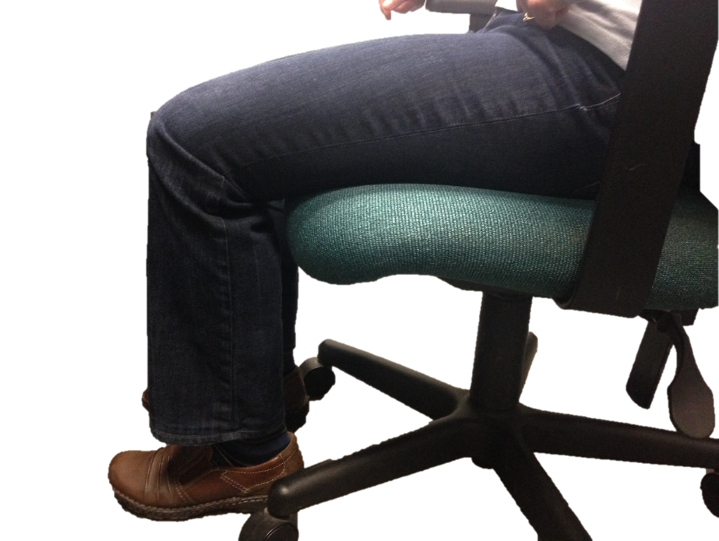
Healthy Computing
Your Chair
Working From Home 101| Wood Gutmann & Bogart Insurance Brokers | Insurance License 0679263
Notes:
The ideal chair for prolonged sitting is an office chair. No need to go out and buy a bunch of office chairs, instead let teach employees to avoid working in one position for too long,
change body posture frequently and take stretch breaks.
For those who have an office chair at home.

Slide 20
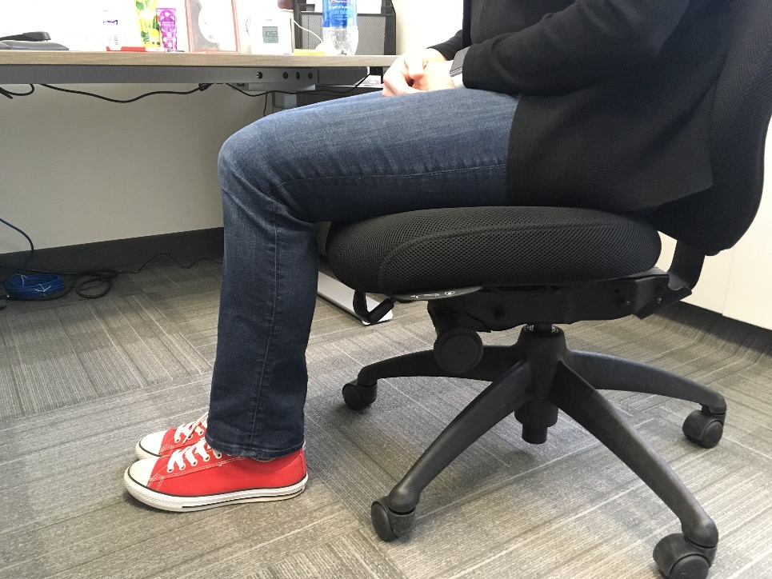
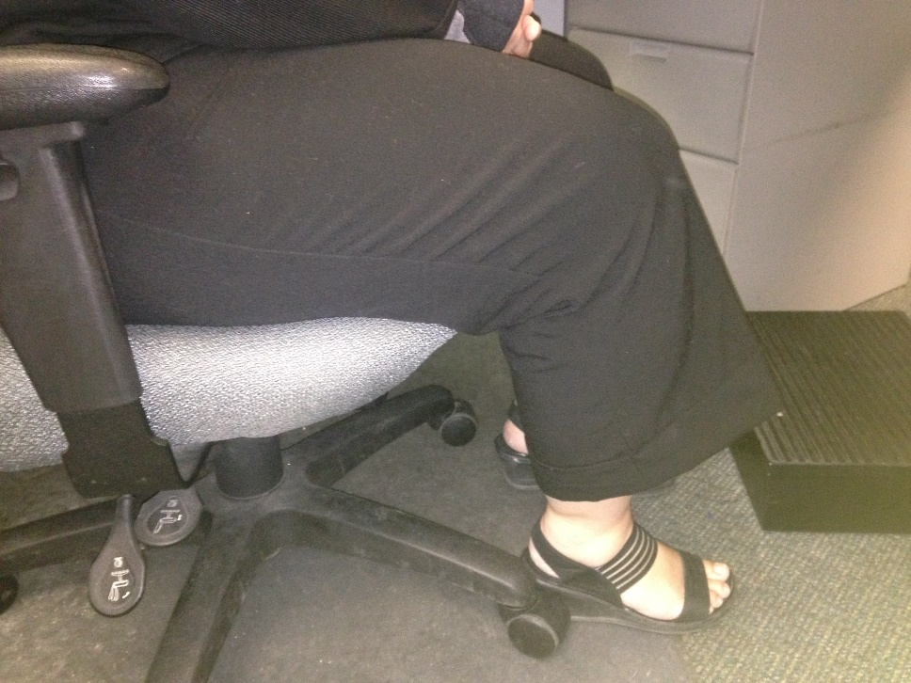
Healthy Computing
Your Chair – Seat Height
Working From Home 101| Wood Gutmann & Bogart Insurance Brokers | Insurance License 0679263
Notes:
Chair height is crucial. The photo on the left is the angle we want to sit in (90 degrees). Feet flat on the floor. If our feet are not flat on the floor, it will cause issues eventually.

Slide 21
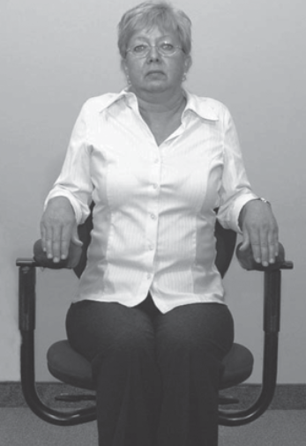
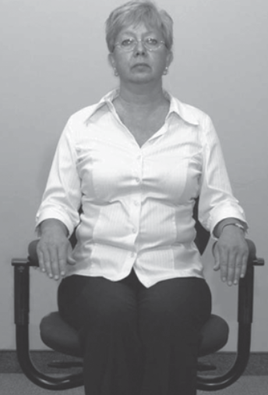
Healthy Computing
Chair Armrests
Working From Home 101| Wood Gutmann & Bogart Insurance Brokers | Insurance License 0679263
Notes:
Office chairs are ideal, because they are adjustable.
The armrests must be adjusted must be adjusted accordingly. When I do an assessment, I like to place them at desk height, this way they become an extension of the desk when arms are pulled back.

Slide 22
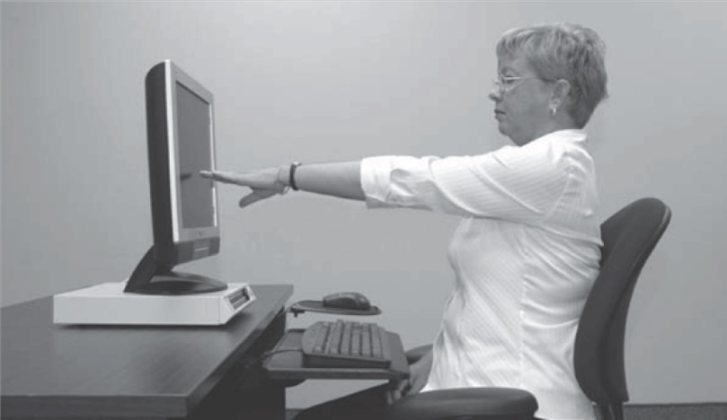
Healthy Computing
Screen Height - Ideal
The monitor should be:
Directly in front of user
Situated at seated eye height
Arm’s length away from user
Working From Home 101| Wood Gutmann & Bogart Insurance Brokers | Insurance License 0679263
Notes:
The computer monitor must be set a the correct height. Directly in front of the user, at eye lever and arms length.
Those of you sitting in front of your computer, STOP and take a few seconds to stretch your arms out and make sure your monitor is the correct distance and height.

Slide 23
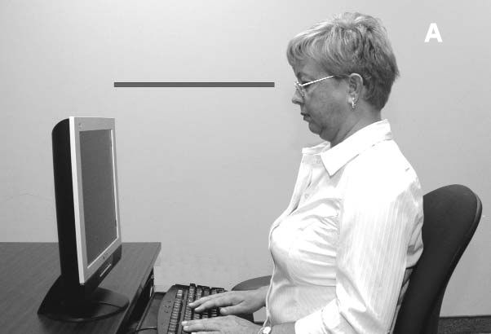
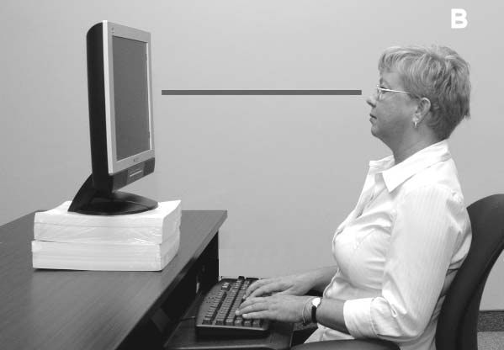
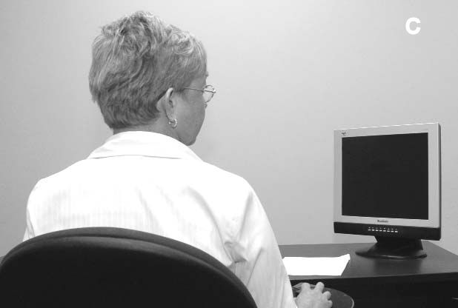
Healthy Computing
Screen Height - AVOID
When the monitor is too low, the neck is flexed
When the monitor to too high, the neck is extended
When the monitor is not directly in front of the user, the neck is twisted
Working From Home 101| Wood Gutmann & Bogart Insurance Brokers | Insurance License 0679263
Notes:
When set up your computer monitor.
Avoid looking down at the screen
Avoid looking up at the screen
Avoid having to look sideways at the screen

Slide 24
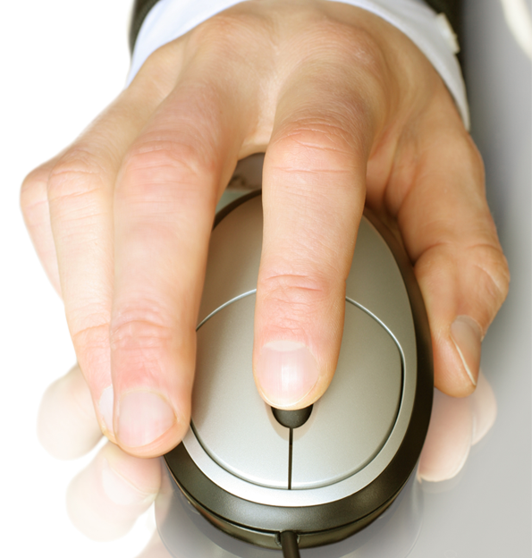
Using a Mouse
Control mouse movement from your elbow
Keep wrist straight in neutral position
Switch mouse to other side or use alternate hand
Working From Home 101| Wood Gutmann & Bogart Insurance Brokers | Insurance License 0679263
Notes:
Try this exercise. CONTROL YOUR MOUSE BY ONLY MOVIONG YOUR ELBOW, KEEP YOUR WRIST AND FOREARM STRAIGHT.
Another great tip when using a mouse is to switch it periodically to the alternate hand.

Slide 25
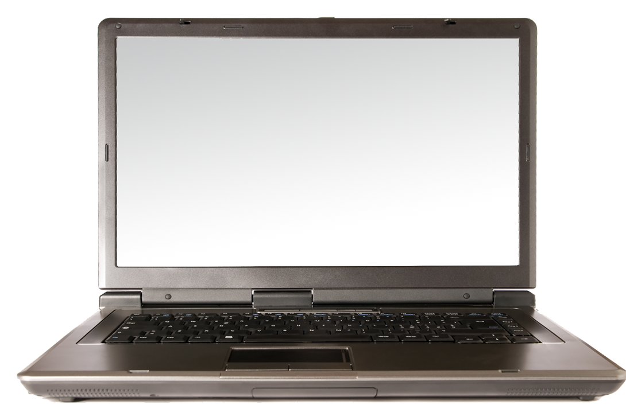
Using a Laptop
Sit in a comfortable chair and adjust the laptop height
Position screen like a desktop monitor
Use separate keyboard and mouse
Notes:
Using a laptop at a desk or table required a riser, the user may also elevate by alternate means. Similar to a computer monitor it must be at eye level.

Slide 26
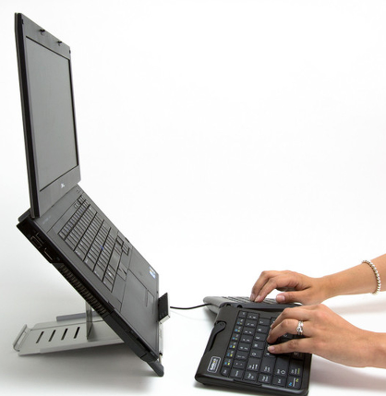
Laptop Use
Notes:
USE OF. RISER WITH LAPTOP

Slide 27
Test Your Knowledge
WHAT’S WRONG WITH
THIS PICTURE
Working From Home 101| Wood Gutmann & Bogart Insurance Brokers | Insurance License 0679263
Notes:
LET”S TEST YOUR KNOWLEDGE.

Slide 28
Computer Position
No eternal keyboard and
mouse.
3. Monitor height.
Notes:
1. Computer Position
2. No eternal keyboard and
mouse.
3. Monitor height.

Slide 29
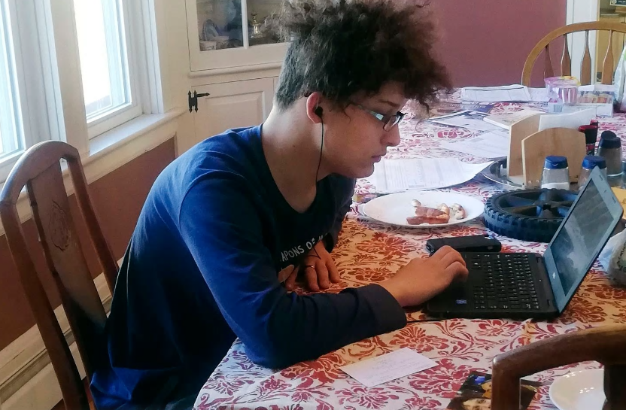
Bad Posture.
Lack of external keyboard
and mouse.
3. Monitor height.
Notes:
Let's make sure our children are also practicing good ergonomics.
1. Bad Posture.
2. Lack of external keyboard
and mouse.
3. Monitor height.

Slide 30
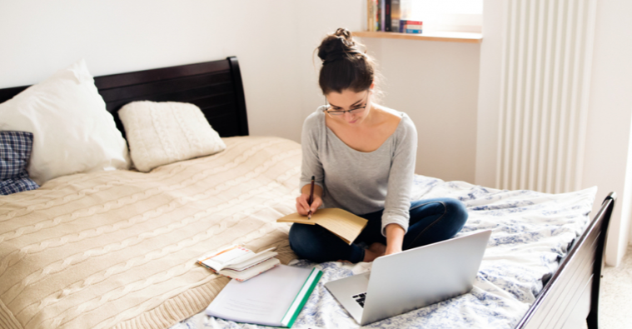
Natural body alignment is impossible to achieve when working from a
bed.
Notes:
DON’T WORK WHERE YOU SLEEP.
Natural body alignment is impossible to achieve when working from a
bed.

Slide 31
Stretching and Exercise
Stretching
It’s the simplest, easiest thing we do that helps us stay sane while
working from home.
Every hour or so, step back from my desk/work area and spend five
minutes doing stretches.
Hold a stretch for a minimum of 15 seconds to a maximum of 30
seconds.
Exercise
Produces Endorphins
Improves Memory
Creates a sense well being
Working From Home 101| Wood Gutmann & Bogart Insurance Brokers | Insurance License 0679263
Notes:
We can set up calendar reminders to remind us to stretch. Did you know that stretching help our sanity while
working from home.
Athletes do it before a game or race. Every hour or so, step back from work area and spend five
minutes stretching.
Hold a stretch for a minimum of 15 seconds to a maximum of 30 seconds.
Let’s not forget that Exercise, Produces Endorphins, Improves Memory and Creates a sense well being.

Slide 32
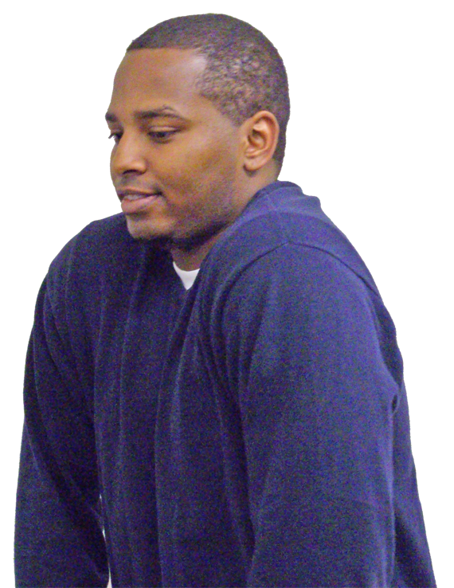
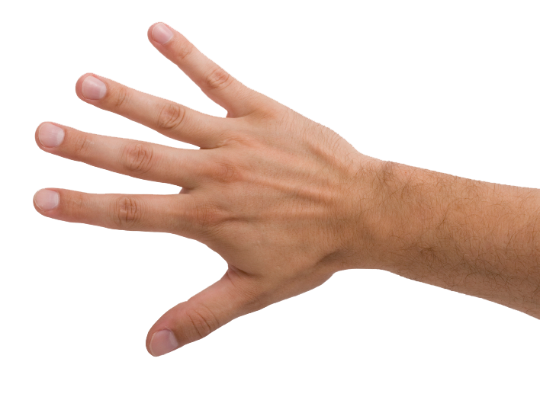
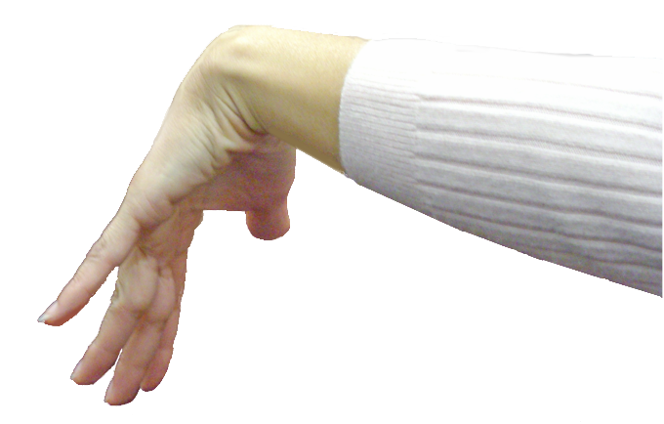
Exercises
Hands
Finger extensions
Wrists
Backwards stretch
Shoulders
Shrug and roll
Blade pinch
Overhead reach
Notes:
Let’s look at some common exercises and stretching.

Slide 33
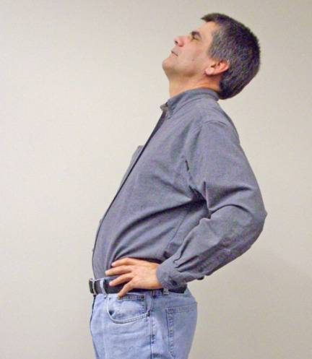
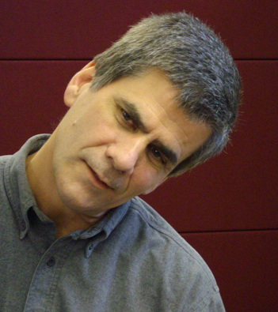
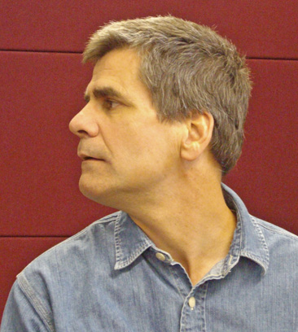
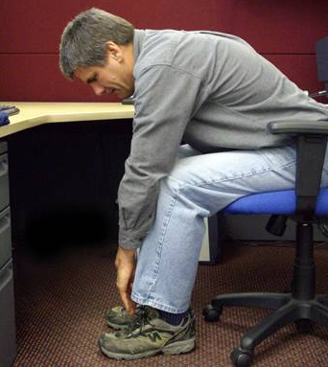
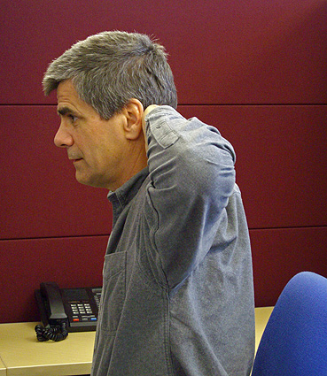
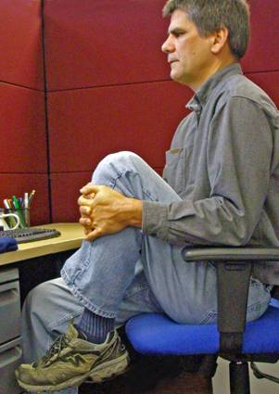
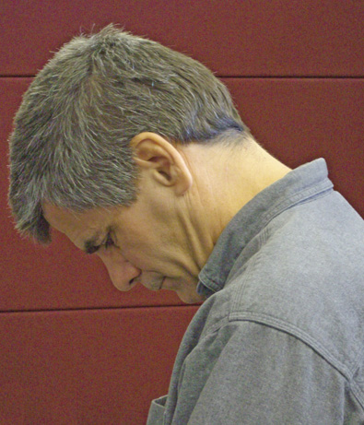
Exercises (cont.)
Neck
Nod head
Turn head
Tilt head
Back/arms
Hands behind head
Bend forward
Knee to chest
Back bend
Working From Home 101| Wood Gutmann & Bogart Insurance Brokers | Insurance License 0679263
Notes:
Slide Show Notes
Now let’s look at some exercises for the neck, back, and arms.
To stretch your neck:
Do the head nod. Just nod your head up and down a few times.
Then turn your head slowly from side to side.
And then tilt your head gently toward each shoulder.
For your back and arms:
Begin with your hands behind your head. Then bring your shoulder blades together.
Now another one for the back and arms. Sit in a chair and bend forward and try to touch the floor.
Next, also while sitting, grasp one knee with both hands and pull it up toward your chest. Switch knees and repeat.
Finally, stand up, place your hands on your hips, and bend backwards slowly and gently.
Go ahead and take a couple of minutes to try each of these exercises.
Have trainees practice the neck, back, and arm stretches described in this slide.

Slide 34
ERGO STRETCHING
Notes:
You can provide this as a handout to your employees and assignment stretches. Monday they do 1-4, Tuesday they do 5-7, Wednesday they do 8-10, Thursday they do 11, 12 and back to 1 and 2, Friday they choose which stretching exercises to do.

Slide 35
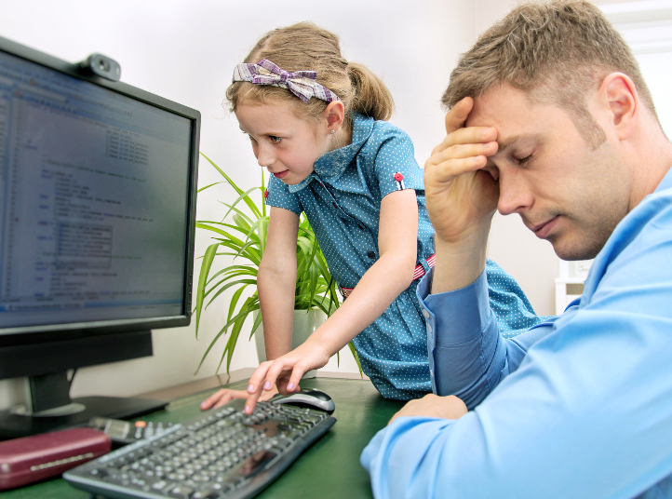
Know Thyself
Avoid Distractions
Friend and Family
Frequent trips to the kitchen for a snack
A loud television
Barking dog
Social Media and Web Browsing
Housework
Working From Home 101| Wood Gutmann & Bogart Insurance Brokers | Insurance License 0679263
Notes:
It may seem unkind to say, but I bet you can guess what (or who) the first distraction to avoid ? Family and Friends. It doesn't seem nice to call friends and family distractions, but if they don't understand that we are "working from home", then they are a distraction. And distractions affect our productivity by cutting into our work hours and add stress to our day. We need to set boundaries and for those of us with children set a schedule.
If you absolutely have to go to the kitchen for a snack, make it a healthy one.
Turn the television off if its becoming distraction.
Make sure pets are comfortable, especially during a heatwave.
Turn off notifications on your phone to avoid being distracted by Social Media post and text.
And avoid doing housework during work hours.

Slide 36
Know Thyself
Plan your day in detail
Do what you can, discuss with your supervisor when you can’t.
Set a timer to take minibreaks
Don't let distractions postpone your duties
Find your work rituals
Working From Home 101| Wood Gutmann & Bogart Insurance Brokers | Insurance License 0679263
Notes:
Plan your day in detail
-For example, dad maybe an earlier riser and starts his day at 6am. He takes a break at 9am and set the kids up with their homework assignments. Mom begins her day at 9am and at noon takes a lunch break with the family. After lunch the kids take a nap or have exercise time and mom and dad have time to respond to email and return calls. Sound too perfect, maybe but it’s a start. Come up with your own plan and fine tune it until it becomes routine or we go back to life before COVID-19.
Over communication is necessary when we are working remotely. Employees tell your Supervisor when you cannot meet a deadline, and Supervisors keep communication lines open.
Set a timer to take minibreaks-
- Phone alarm, Calendar reminder
Don't let distractions postpone your duties
DON”T DO THE DISHED WHEN YOU ARE IN THE KITCHEN GETTING YOU MORNING COFFEE.
5. Find your work rituals
Have a designated work mug for your coffee,
Get ready for work every morning like you are physically going into work. Dress up, do your hair — whatever you'd normally do.
If you miss commuting to work and being stuck in traffic, walk down the block and back.
These things will signal your brain that it’s time to get to work. And put us in a professional
mindset.

Slide 37
Thank you!
Contact Carlos Morales
Carlosm@wgbib.com
Notes:
We hope these recommendation were helpful, and truly appreciate your participation.

