Slide 1
COVID-19 & Your Workplace What You Need to Know Today Remote Work Technology Tips & Tricks
March 27, 2020
Tom Ault, Director, Technical Training & Senior Consultant

Slide 2
Agenda
Connecting from Home
Bandwidth
Wired vs. Wireless
Headsets
Collaboration Tools
Video/Audio/Chat

Slide 3
Poll: How are you connecting to the Internet?
Wireless
Hard wire
Tin can and string

Slide 4
Poll: How would you rate your connection?
No issues!
Intermittent issues!
Did the webinar start?

Slide 6
Simple Connection Diagram

Slide 7
Getting Started
Test your connection speed:
https://www.speedtest.net

Slide 8
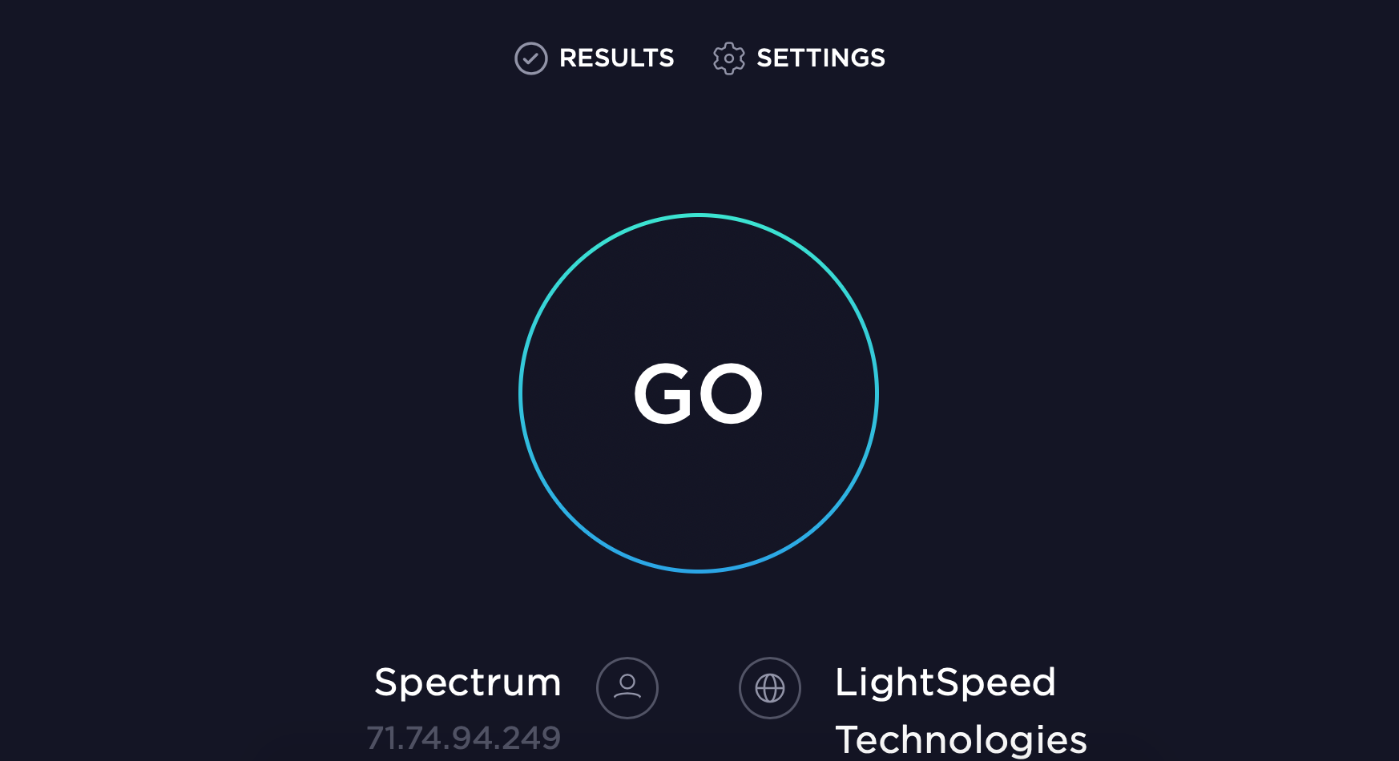

Slide 9
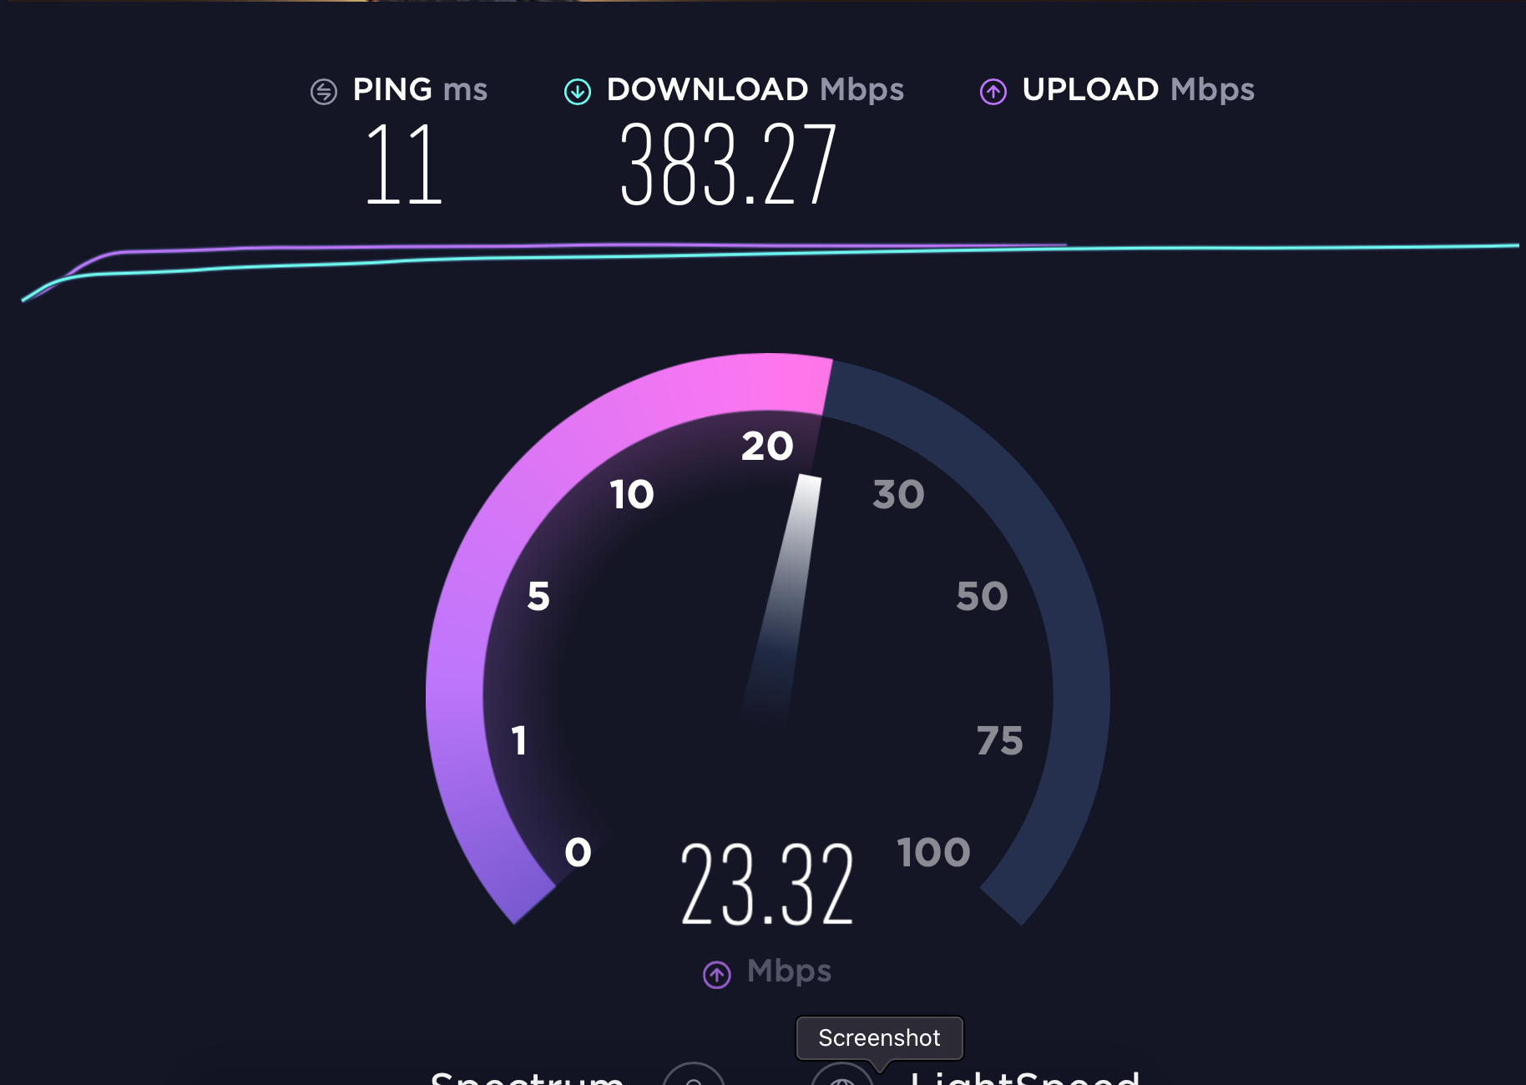

Slide 10
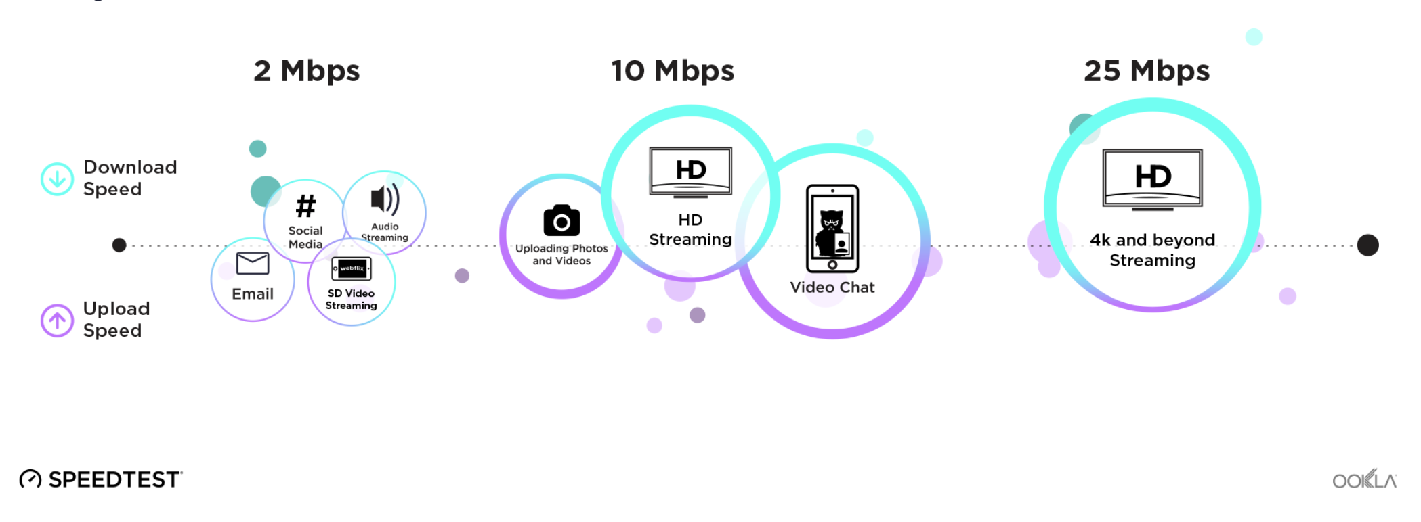

Slide 11
Tips to Improve Your Connection
Position your router in a central location or close as possible to your work location
Position yourself as close as you can to the router
Upgrade your modem and router if older than 4-5 years
The new “mesh” routers are standard routers with additional nodes that take the main signal and extend it throughout the area. These seem to work pretty well
You could also just buy an extender that does the same thing without buying a whole new system
Hard wire your computer into the router – this will always produce a better signal

Slide 12
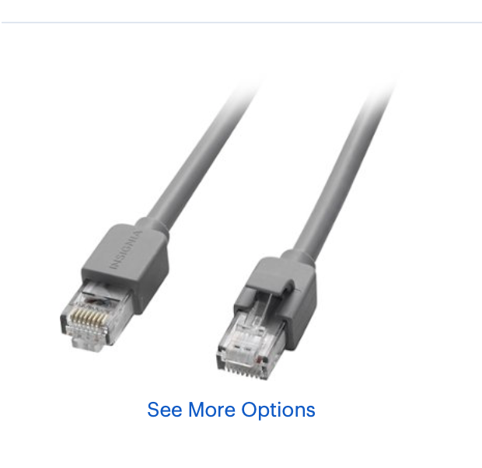
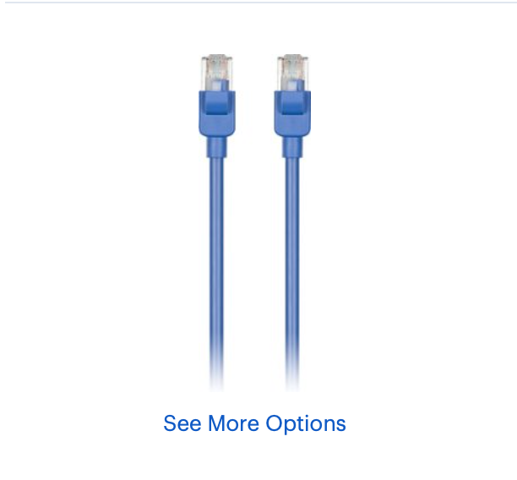
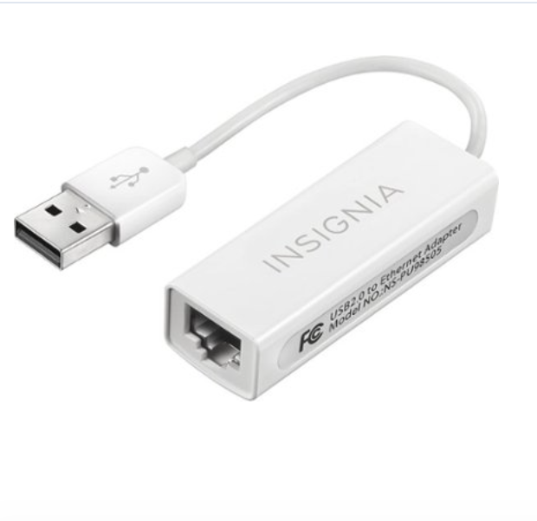
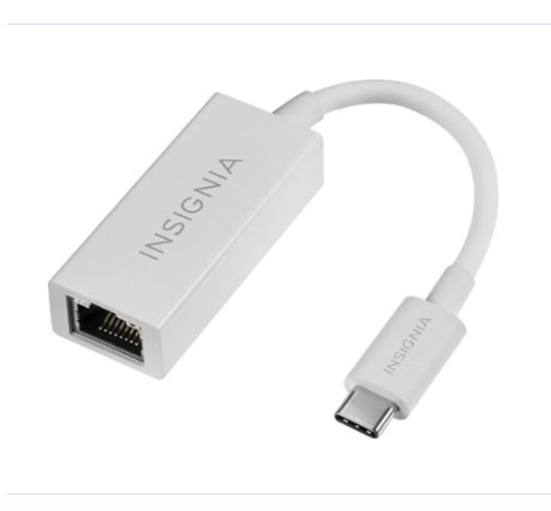
Ethernet Connections

Slide 13
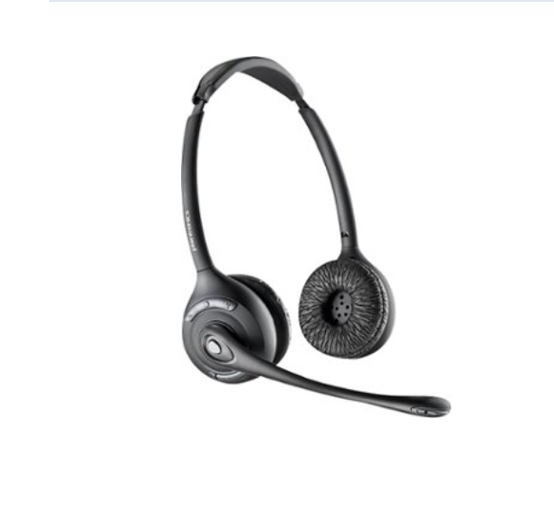
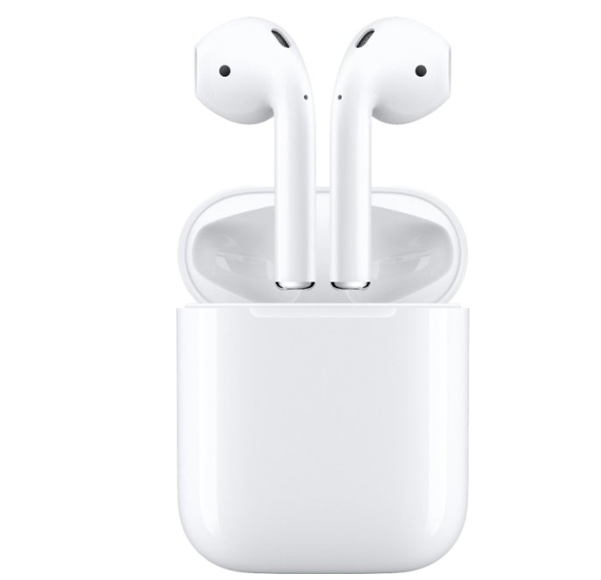
Headsets
Get comfortable using mute!!

Slide 14
Collaboration Tools

Slide 15
Simplify and Standardize
Team Chat
Video Calls
Document Sharing

Slide 16
Collaboration Tools
MS Teams
Google Hangouts
Slack
Zoom
Webex/Adobe/GoToMeeting
Notes:
4% multitask on video calls vs. 57% on audio calls

Slide 17
Questions?? Feel free to email: tault@yourERC.com

Slide 18
Thank you for attending!! Stay Safe!

