Slide 1
EnterpriseTube
Premium
Animated Slides
Please hit‘F5’ or Click Start Slide Show
VIDIZMO Products
Features vary for each product
NADEEM KHAN, VP Sales
email/Skype for Business: Nadeem.khan@Vidizmo.com
Whatsapp & Cell Phone: +1 703 731 2925

Slide 2







About VIDIZMO, LLC.
VIDIZMO recognized in Gartner Magic Quadrant for Enterprise Video Content Management
300+ Years collective experience delivering Video using Microsoft Technologies
Featured Customers
Featured Customers
Partnership
Partnership

Slide 3
EnterpriseTube Key Features
Branded Video Portals Host, manage, stream live and on-demand videos and other digital assets Provide public or private access to employees, customers , prospects etc. Embed on website, integrate with Enterprise IT such as SAML-P,SharePoint Track who is watching what when and how much Enterprise security & integration Host it within your Own Cloud such as Microsoft Azure, On-Premises or use VIDIZMO’s Azure Cloud

Slide 4







EnterpriseTube
Roles
Click here for Live Demo
Administrators
Multiple MediaTube + MediaLMS Channels
Managers
Marketing
Portal
Training
Portal
Employee
Voice
Crew Portal
Investor
Relations
Moderators
Contributors
Viewers & Learners
Employees
Authenticated
Enterprise Single Sign-On
Customers
Authenticated – VIDIZMO Login, Facebook, Microsoft ID, Google ID
Public Users
Anonymous
EnterpriseTube Multi-Tenant Portals Provide Complete User and Content Segregation

Slide 5
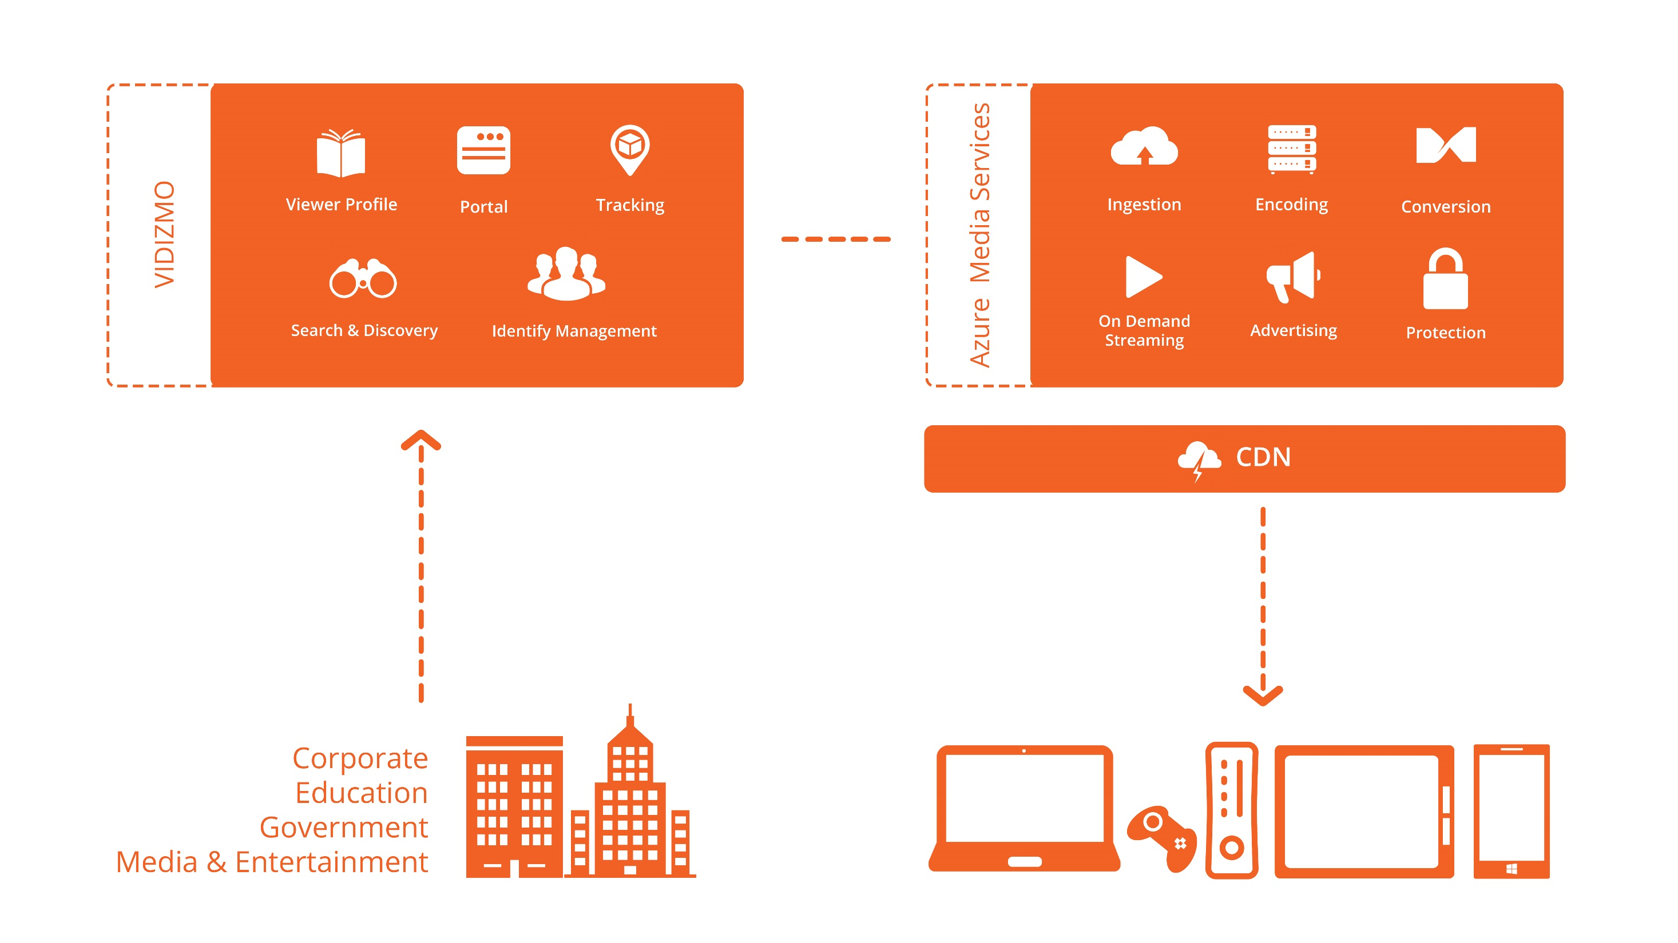
VIDIZMO On-Demand Streaming

Slide 6
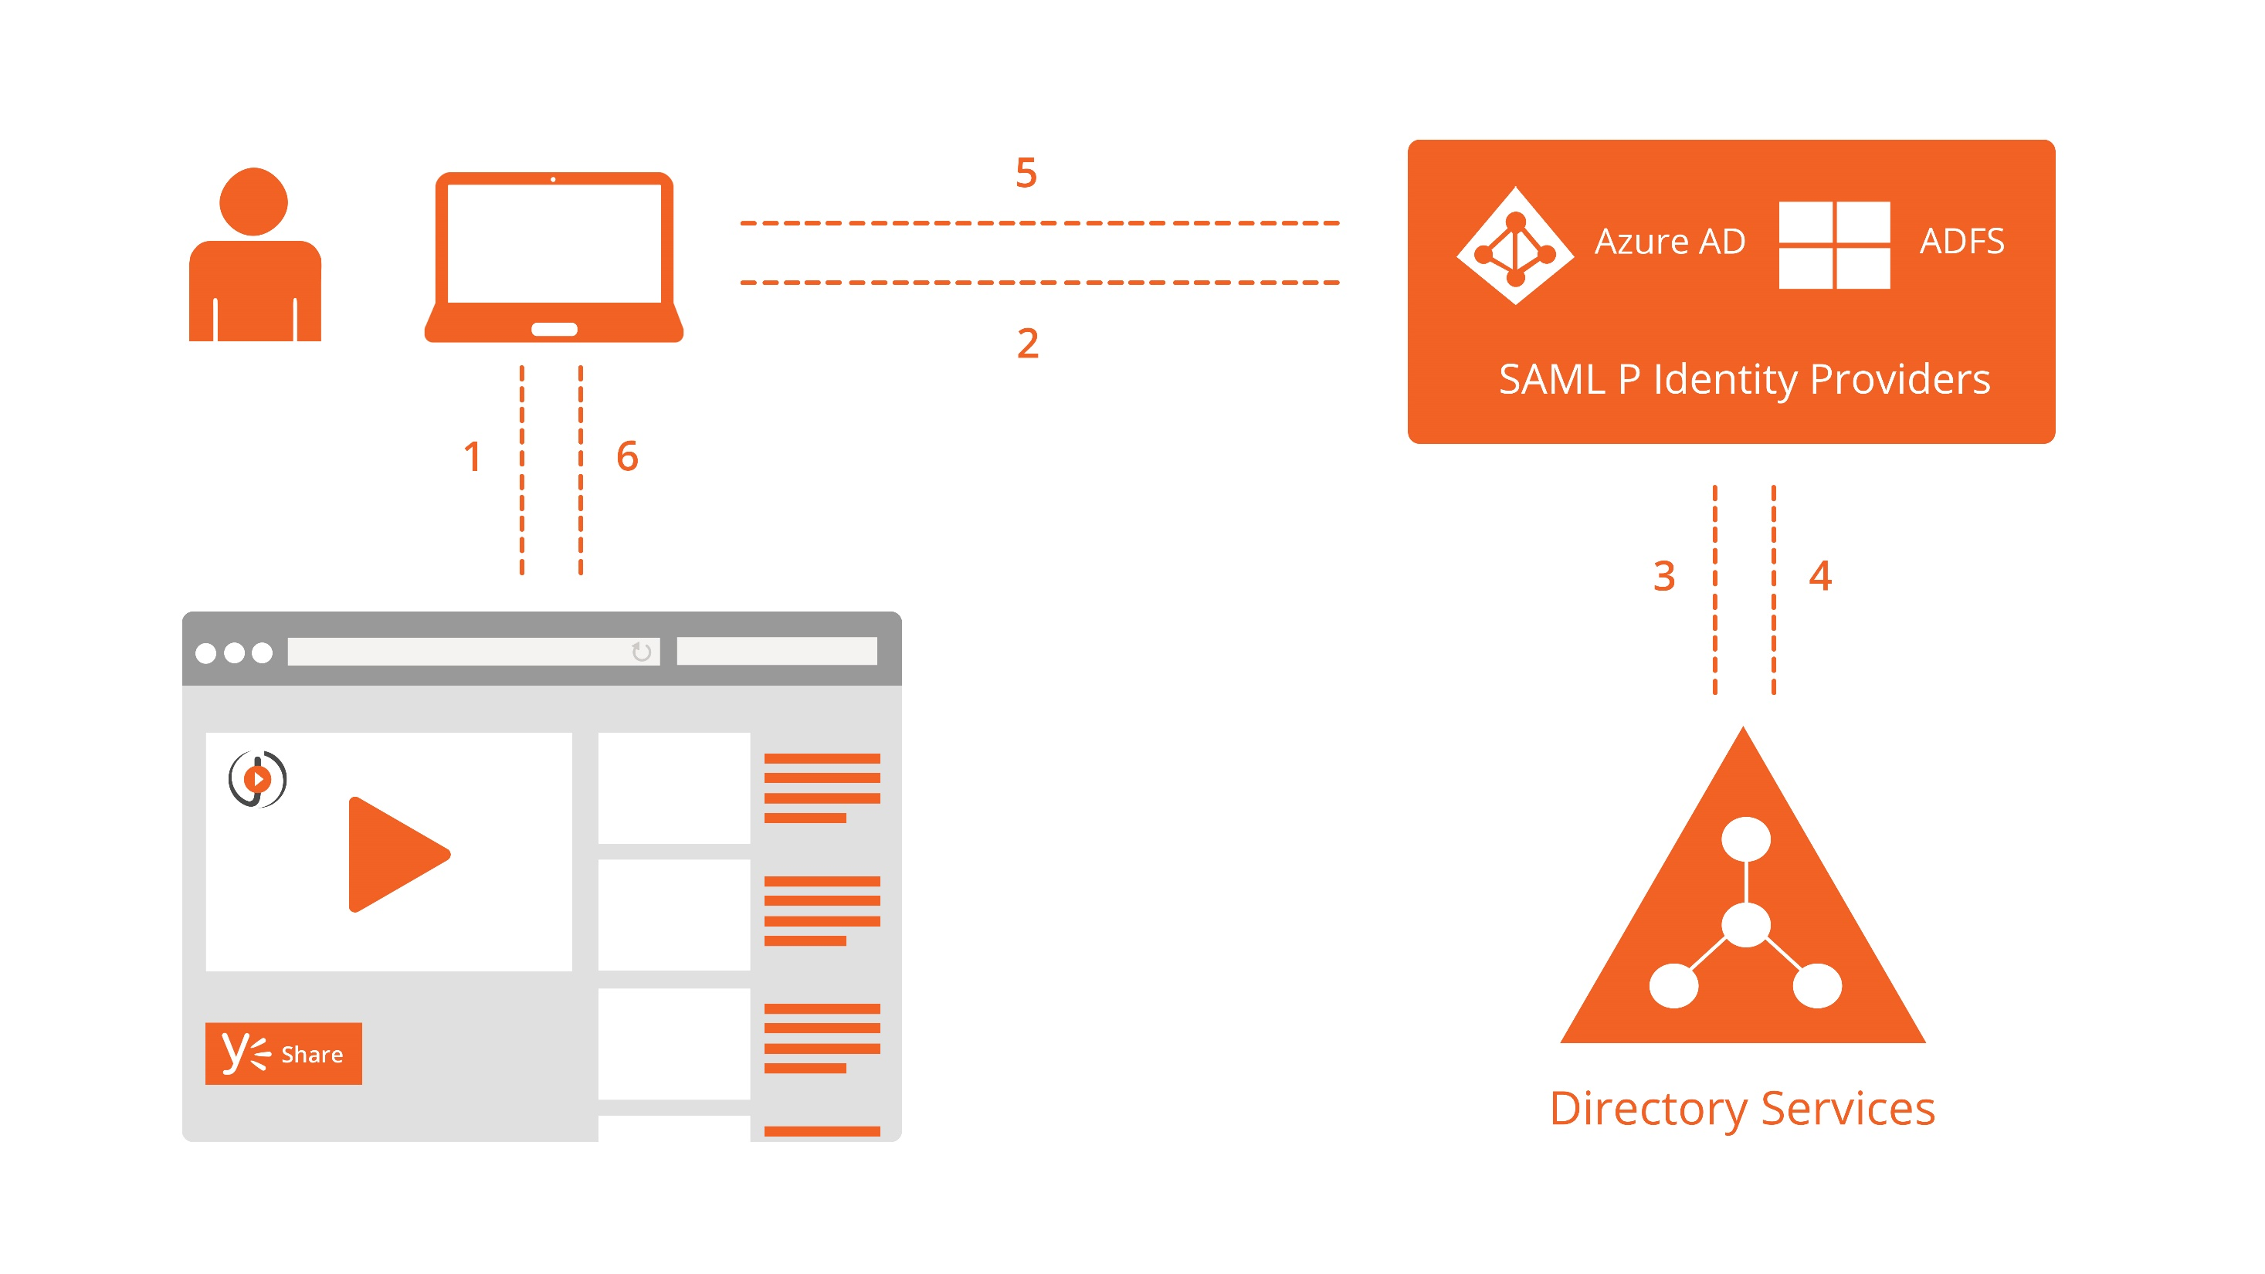
VIDIZMO Identity

Slide 7
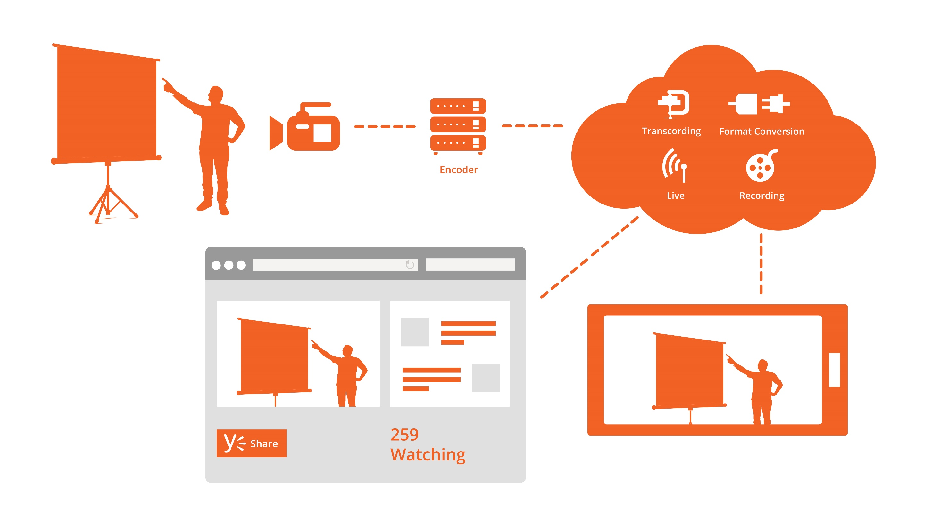
VIDIZMO Live Streaming

Slide 8
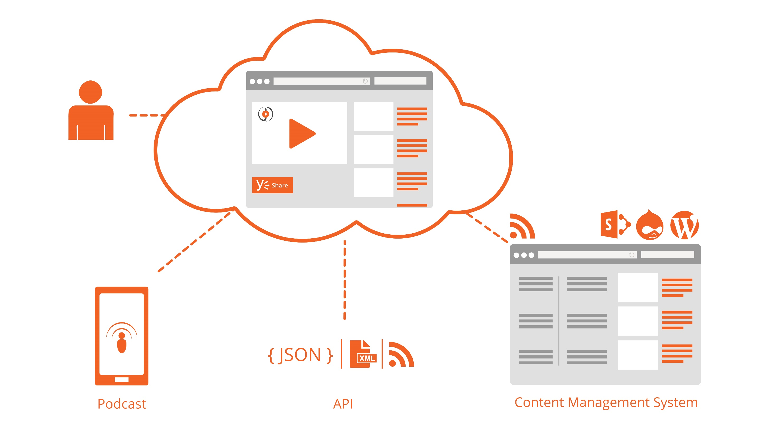
VIDIZMO Integration

Slide 9
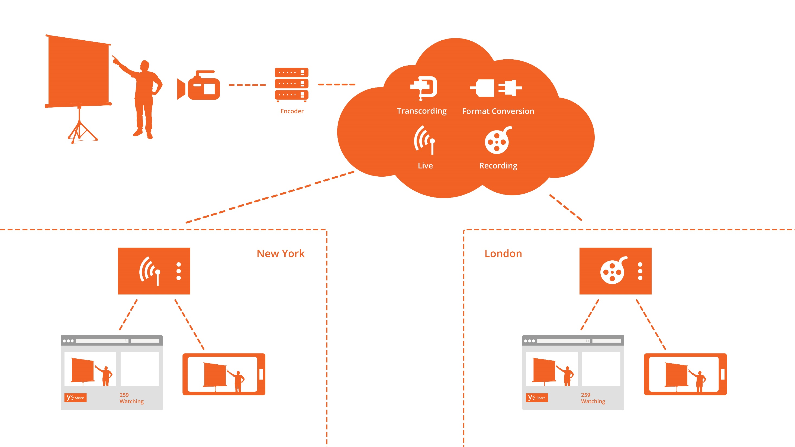
VIDIZMO Edge Content Caching

Slide 10


Availability
On-Premises
Private Cloud
100% Cloud
Hybrid

Slide 11
VIDIZMO Digital Media & Video Solutions
Branded out-of-the-box Portal with all products
Content caching around the world or within enterprise to accelerate media delivery
IT Friendly: Enterprise Security
Content playback on all devices, playable on varying bandwidths
100% in the cloud, Hybrid and 100% On-Premise models
Leverages investments in existing IT infrastructure

Slide 12































VIDIZMO Products work with your favorite Business Applications

Slide 13





















DAM
Raw Files
Portal - Channels
Single Sign On
CMS
CRM
LMS
3rd Party
Social Media
API
Website
Enterprise /
3rd Party
System
Internal Staff
Customers
Students &
Trainees
Authorized
Users
Public Users
Ingest Video & Content from any source – Play in favorite Application

Slide 14
Streaming Technology Support
Live & On-Demand
Adaptive
  Adobe’s HTTP Dynamic Streaming (HDS)
  Apples HTTP Live Streaming (HLS)
  Microsoft’s Smooth Streaming (used by Netflix)
Standard
  HTTP Progressive Download – Multiple Bitrates
  RTMP Flash
Multicast
  Multicast Support

Slide 15
Product Overview
Click here to view Product Features Comparison

Slide 16
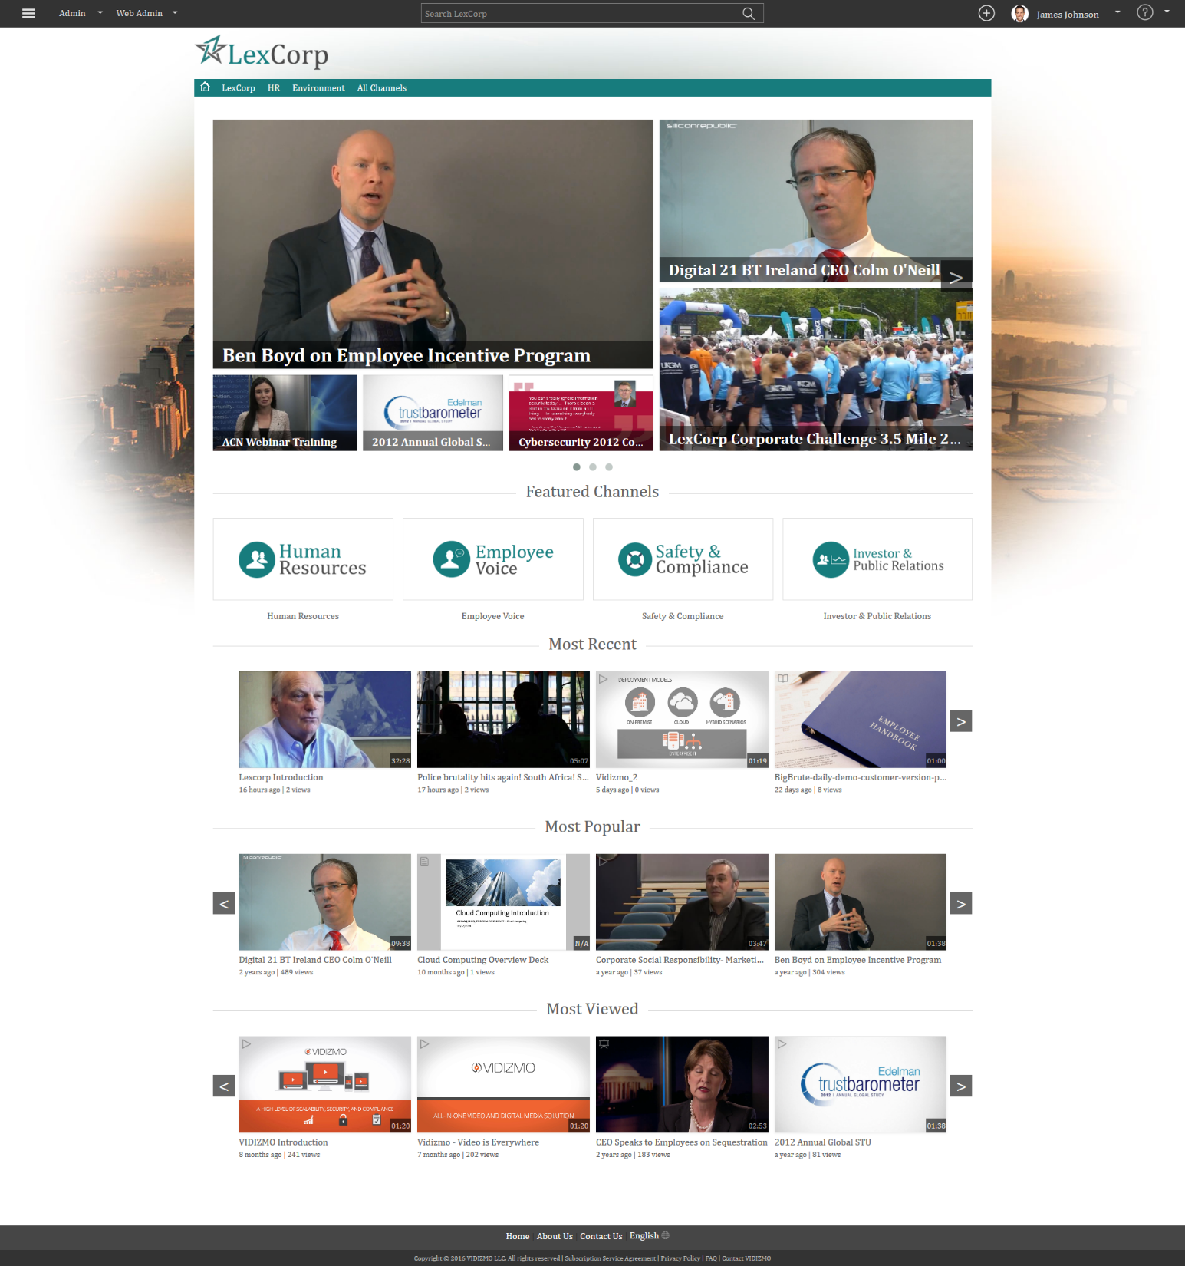
Enterprise Tube Premium
Home Page

Slide 17
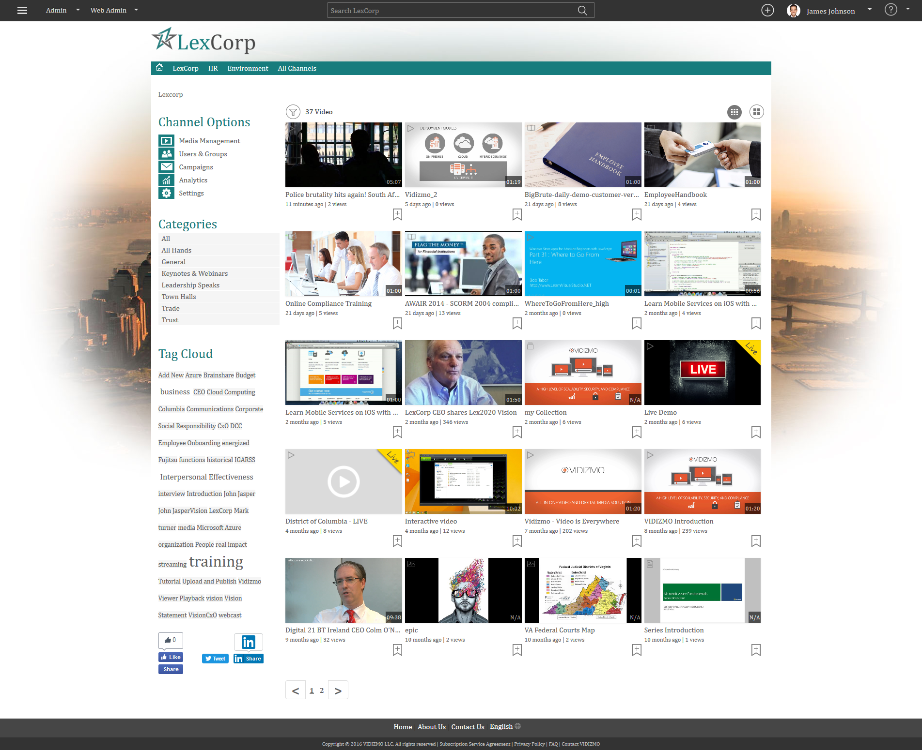
Channel Home Page Overview

Slide 18
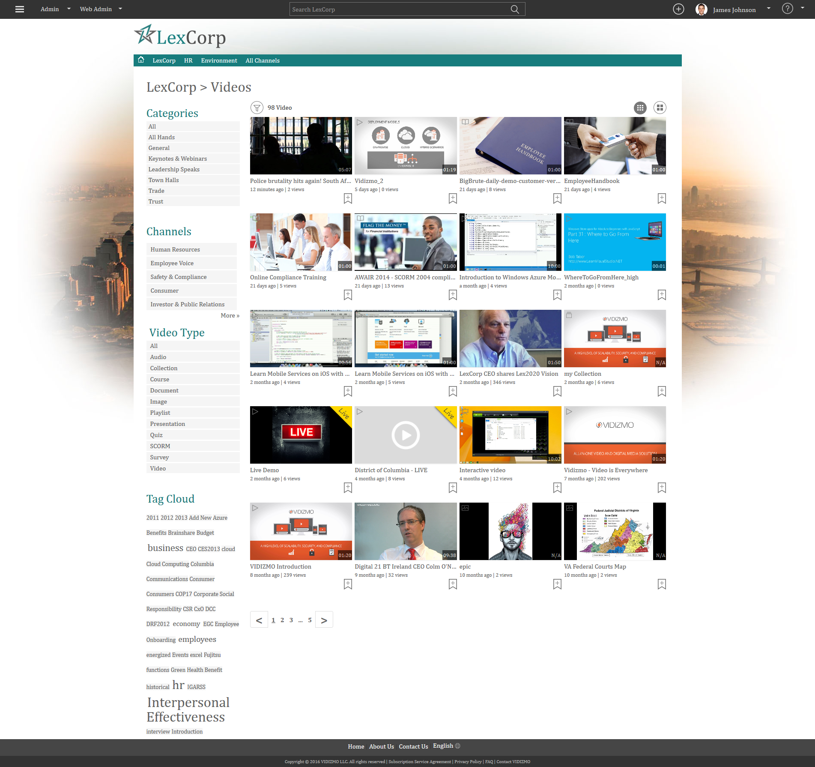
Search Library Overview
Search directly through the published Media
Content may include Video, Audio, Documents, PowerPoint Presentations etc.

Slide 19
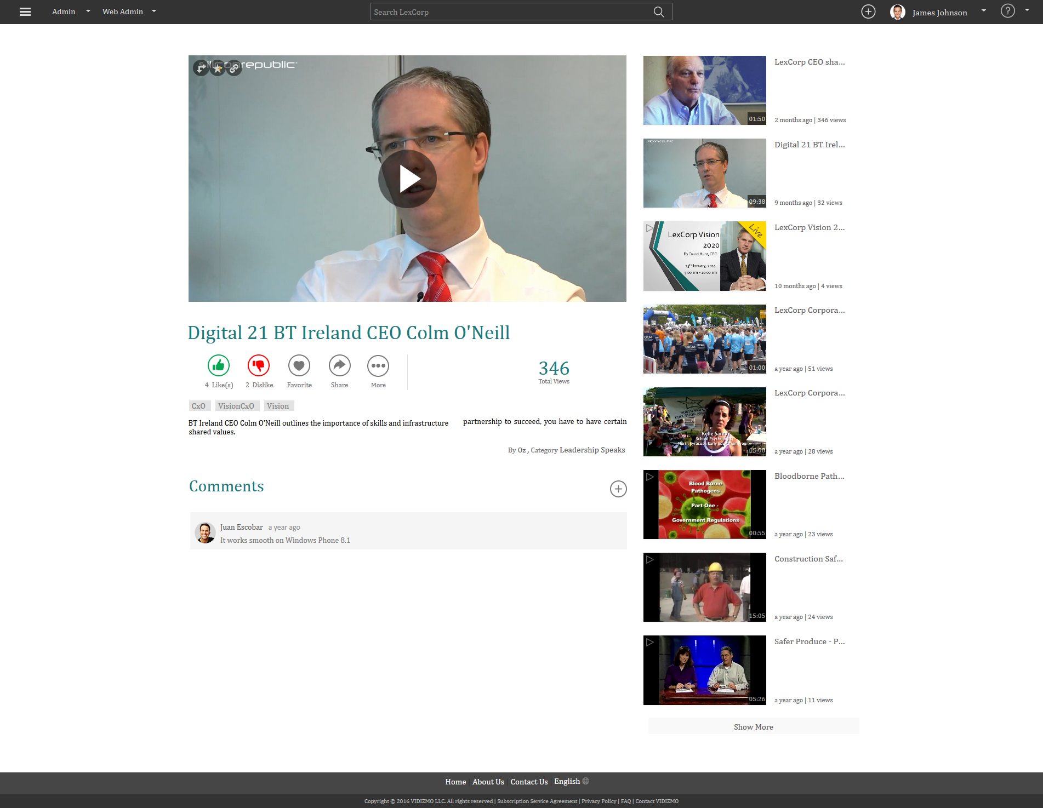
Video Playback

Slide 20
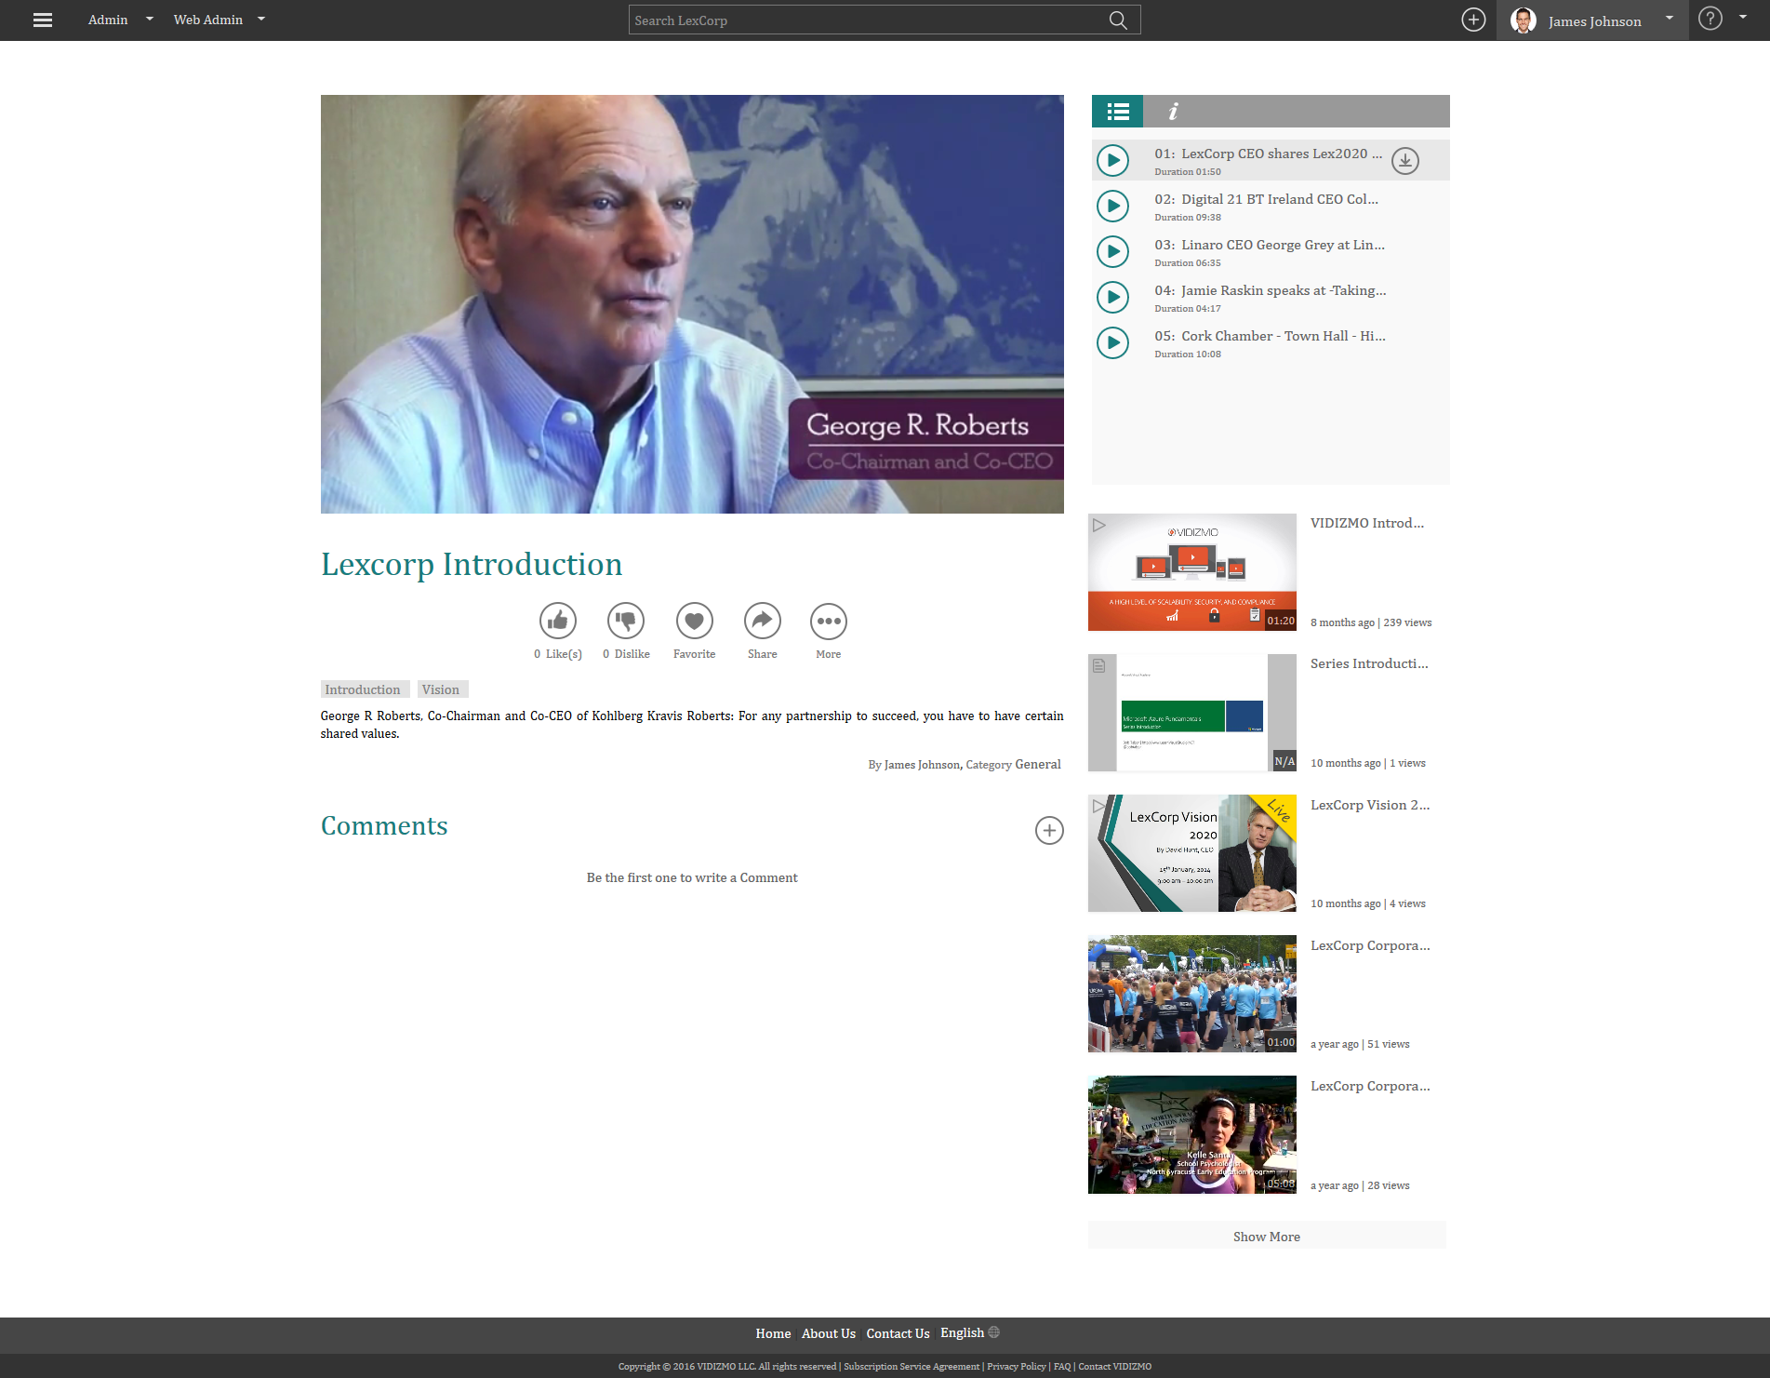
Playlist & Course Playback

Slide 21
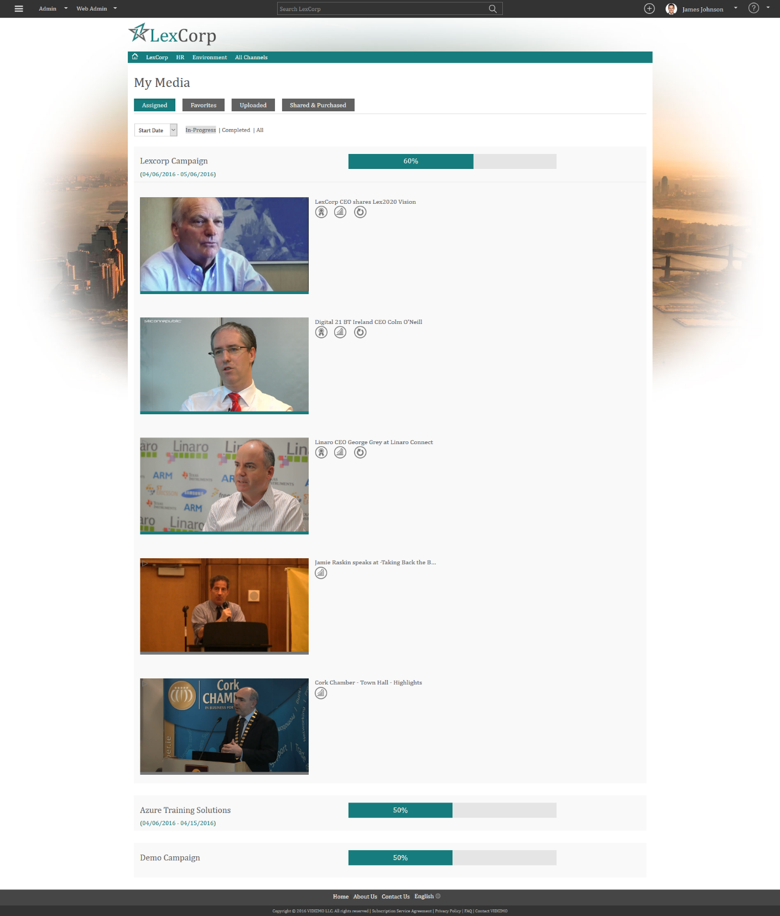
My Media Page

Slide 22
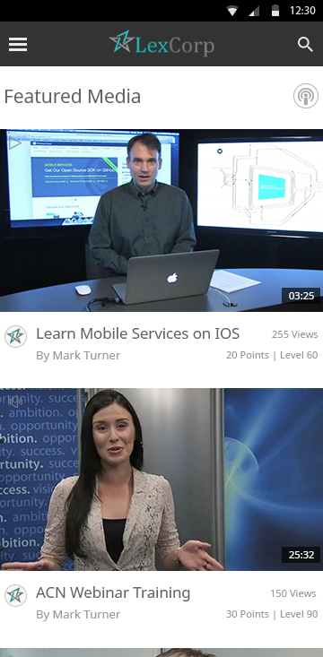
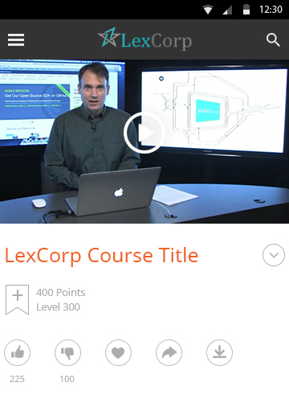
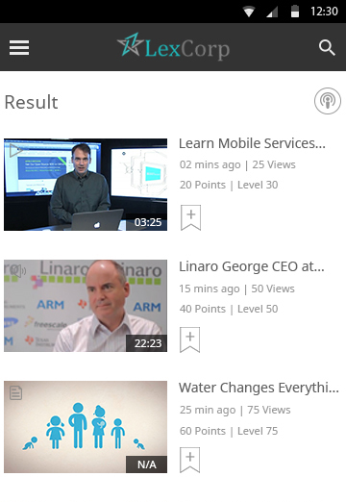
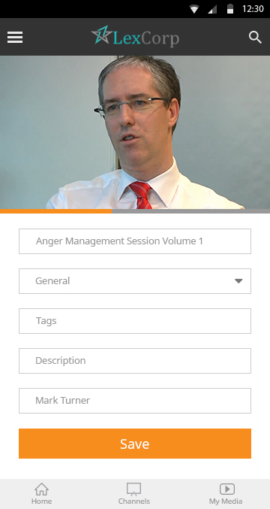
Mobile Access
Home Page, Playback, Search Library & Upload from Mobile Devices
Home Page
Playback
Search Library
Upload

Slide 23
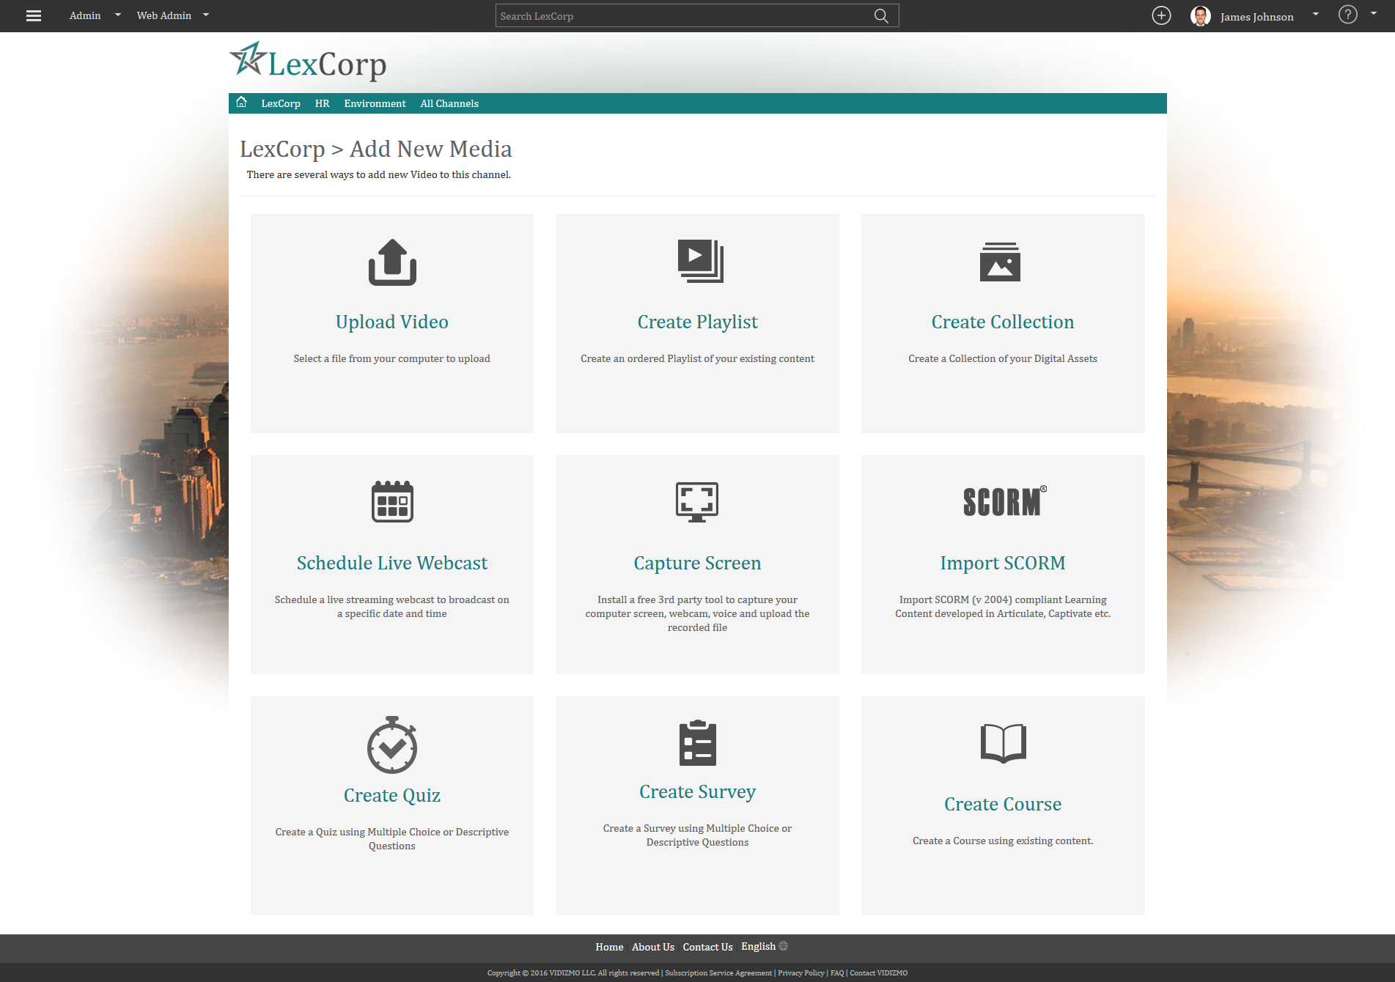
Admin panel
Add New Media
Upload Video, Document Create Playlist, Collection, Quiz, Survey & Course etc

Slide 24

Upload Video

Slide 25
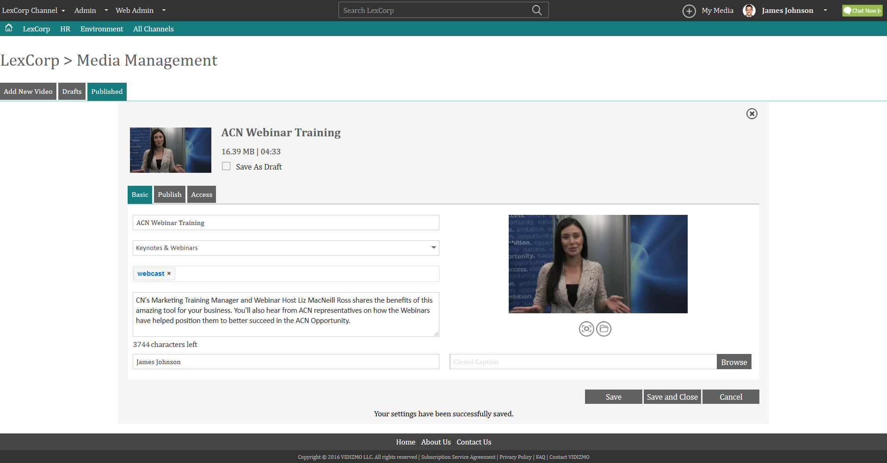
Upload Video
Basic Settings

Slide 26
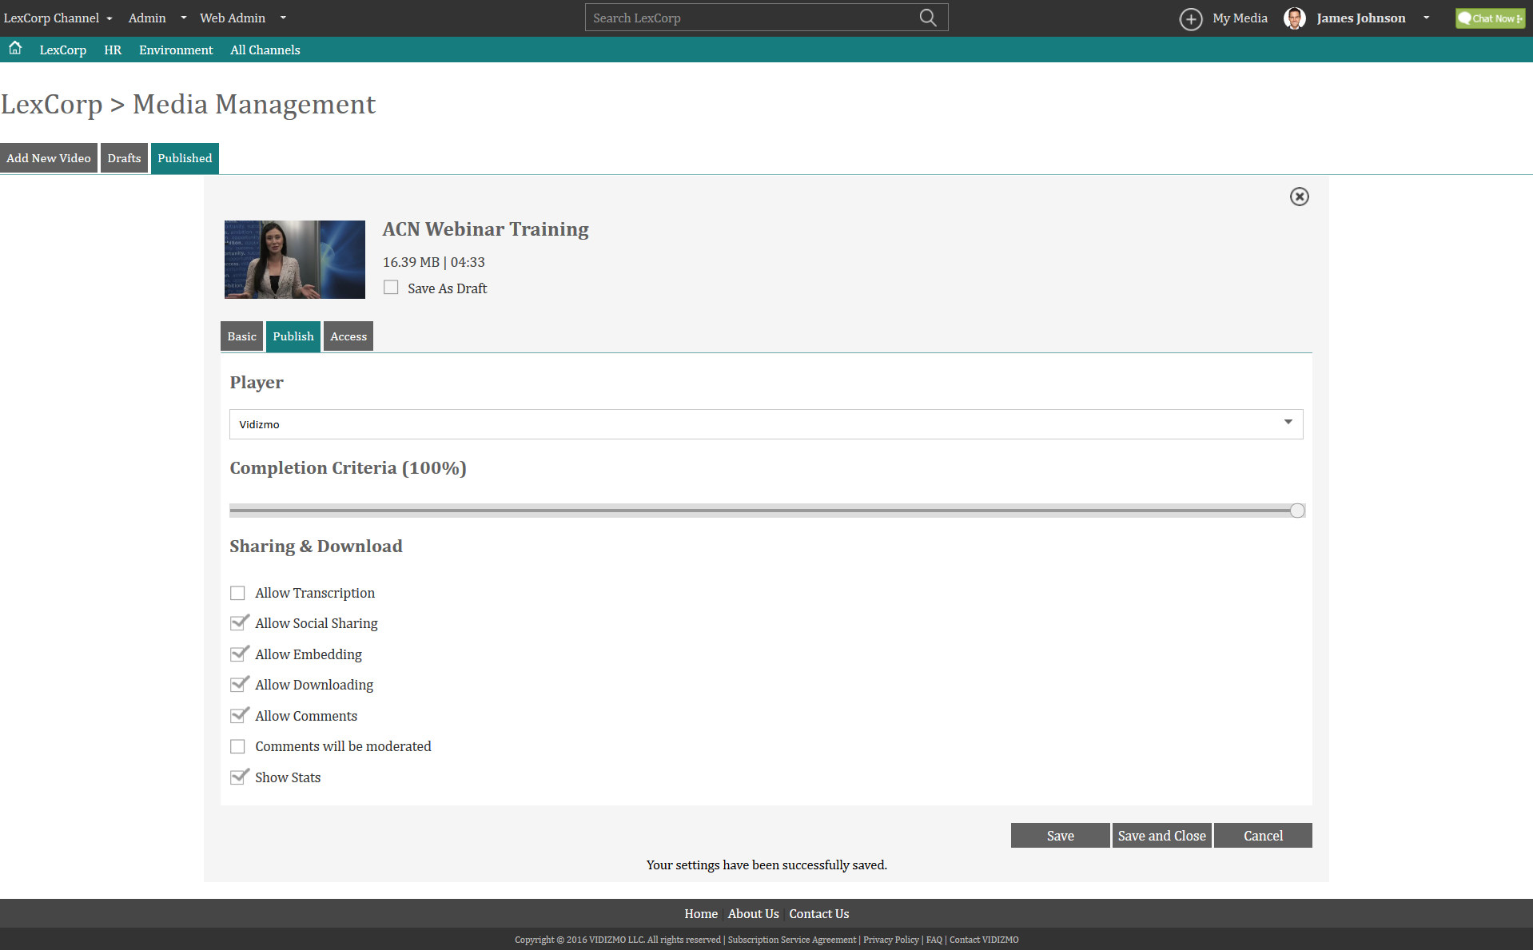
Upload Video
Publish Settings

Slide 27
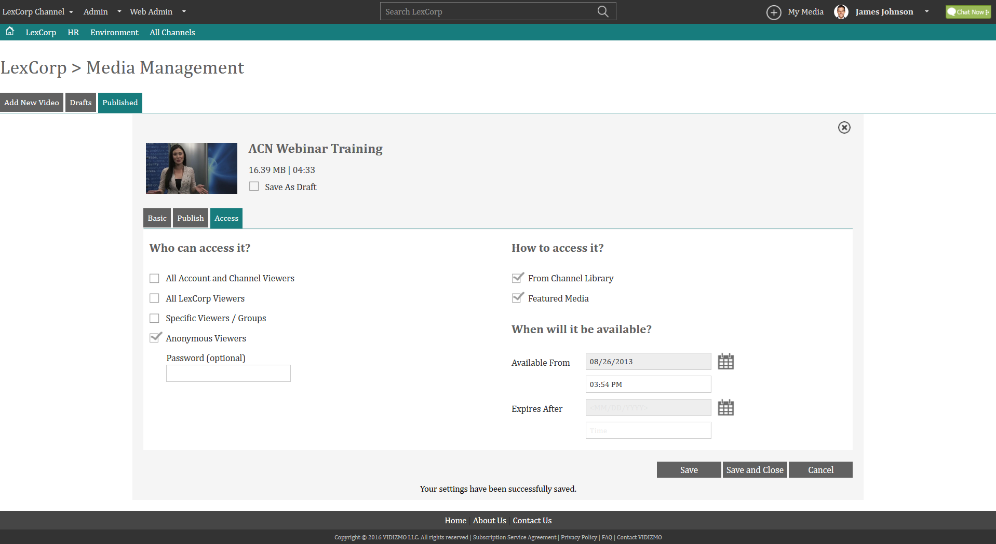
Upload Video
Access Settings

Slide 28
Create Collection
Combine your digital assets (Audio, video, documents) to create a collection

Slide 29
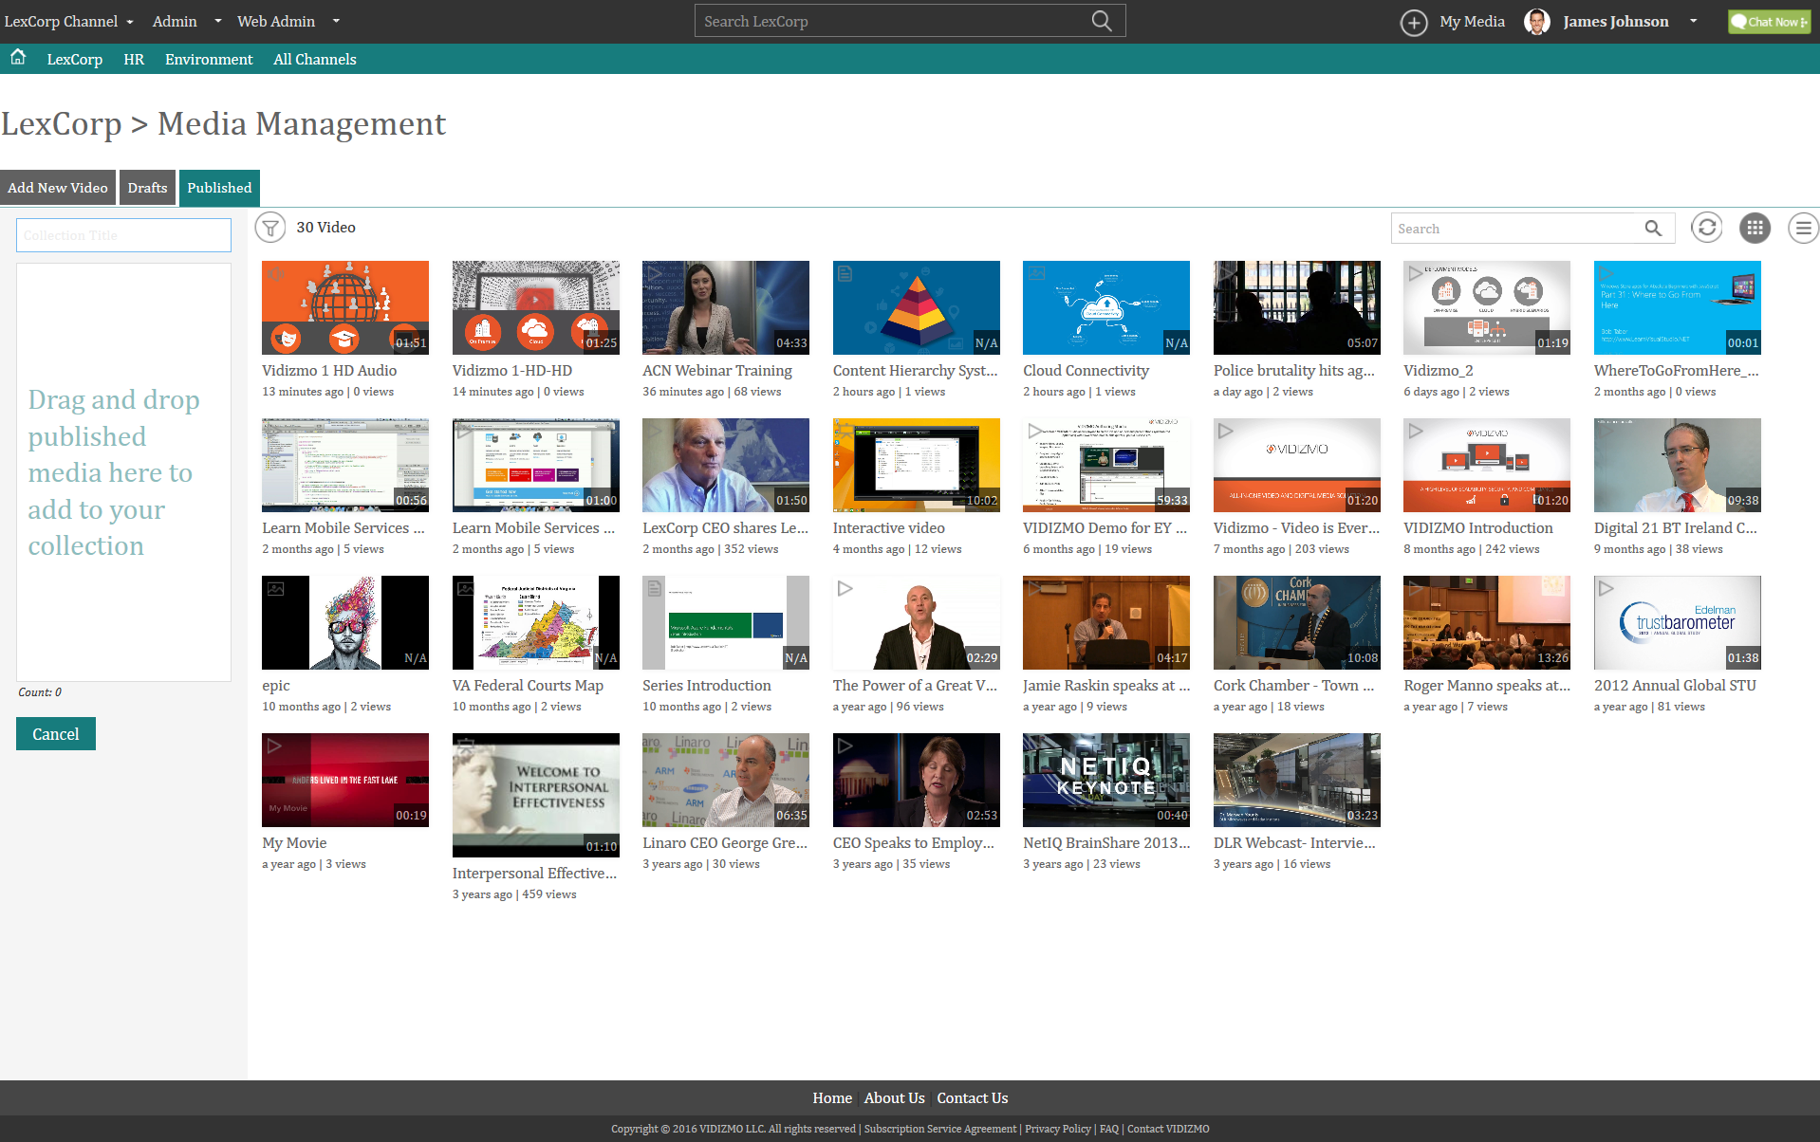
Add Content
Drag and Drop the content to create collection

Slide 30
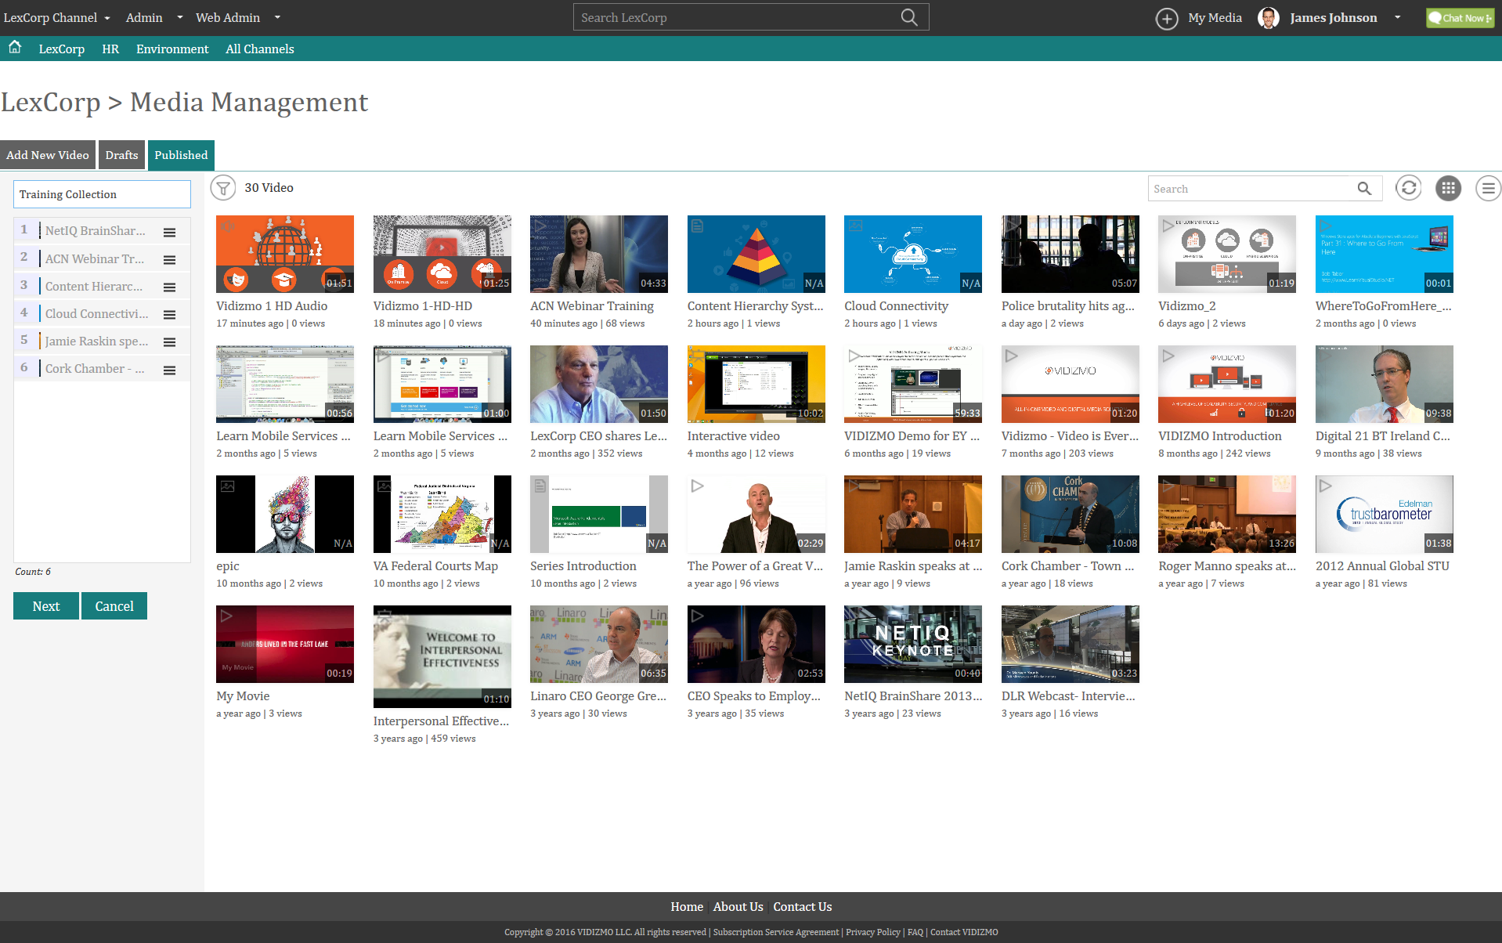
Content Added

Slide 31
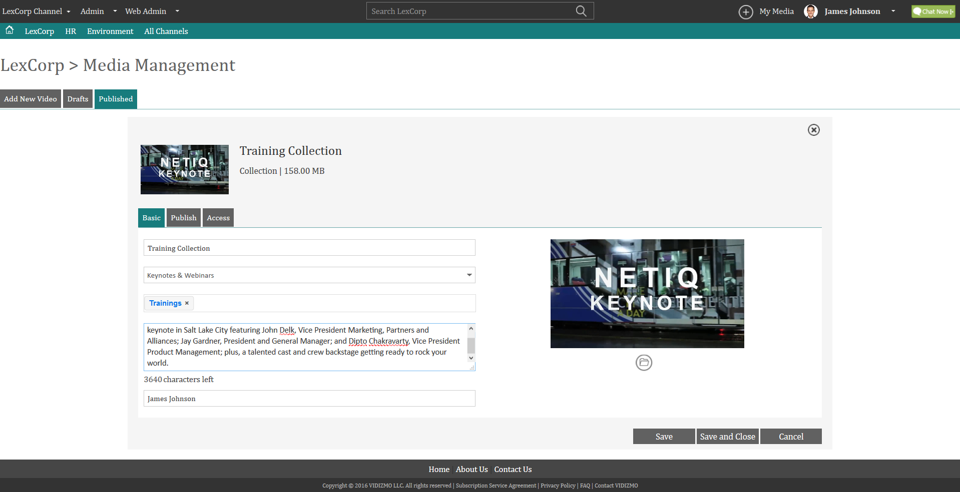
Collection Creation Basic Settings

Slide 32
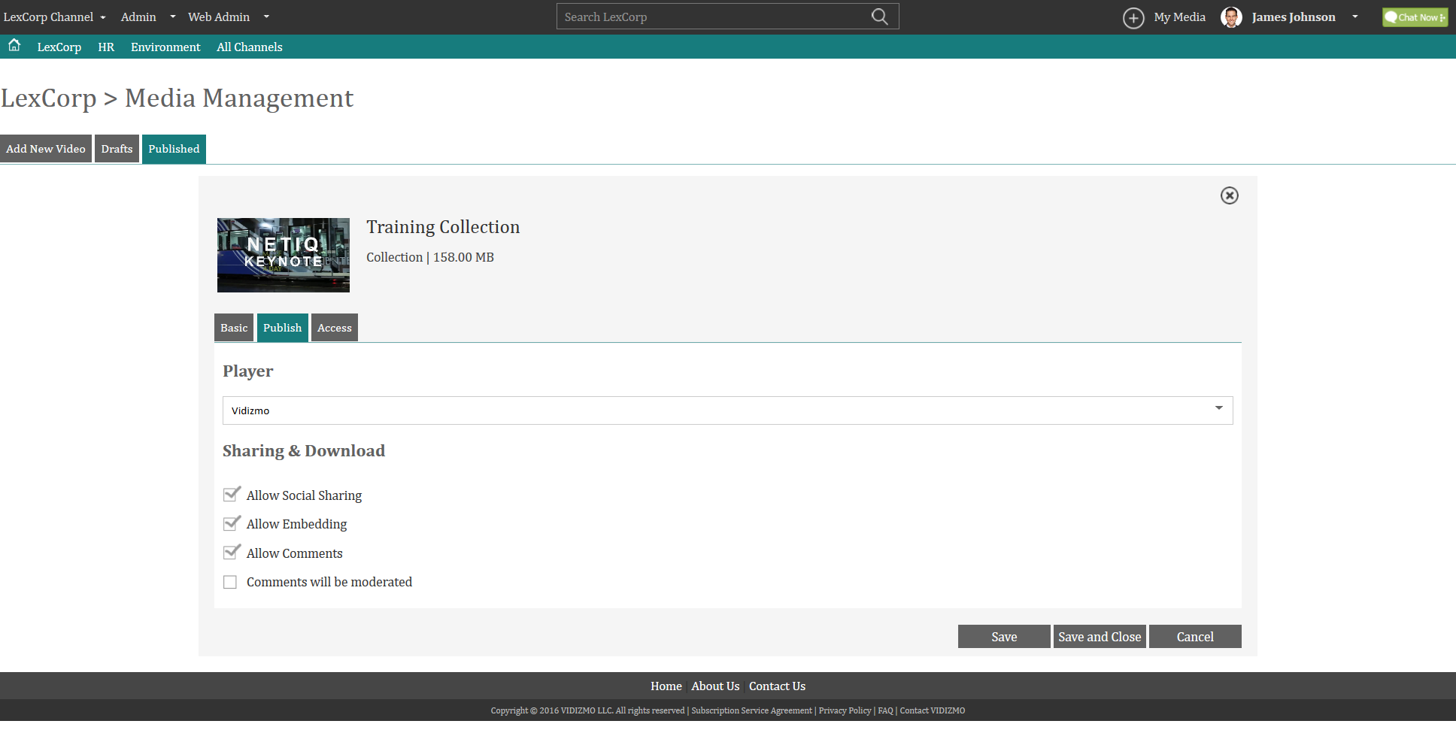
Collection Creation Publish Settings

Slide 33
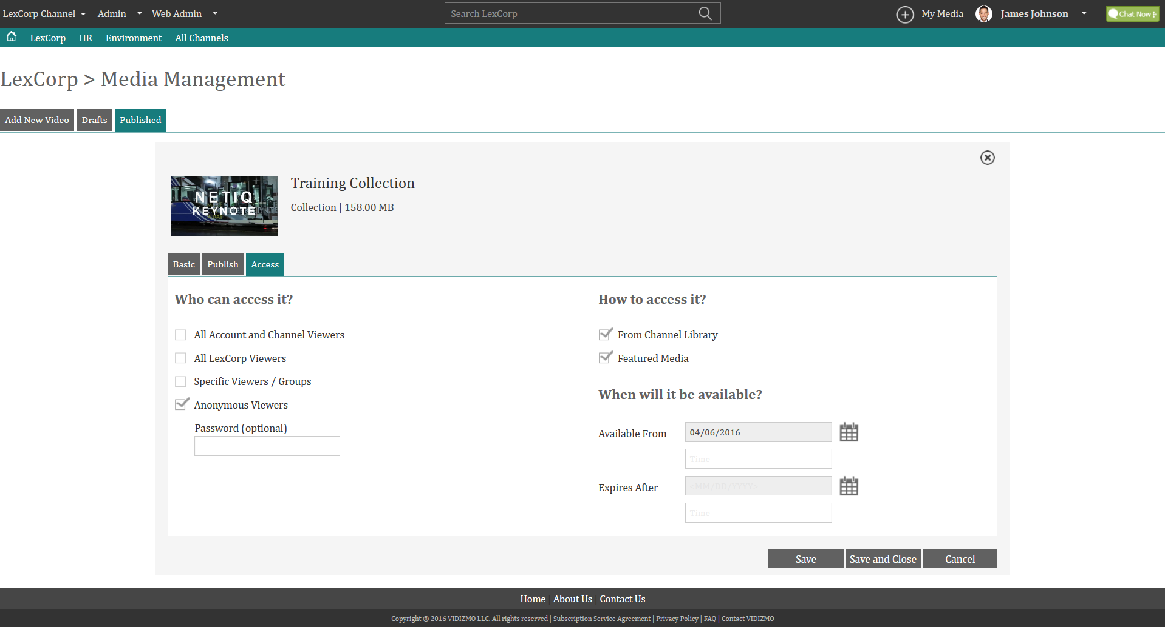
Collection Creation Access Settings

Slide 34
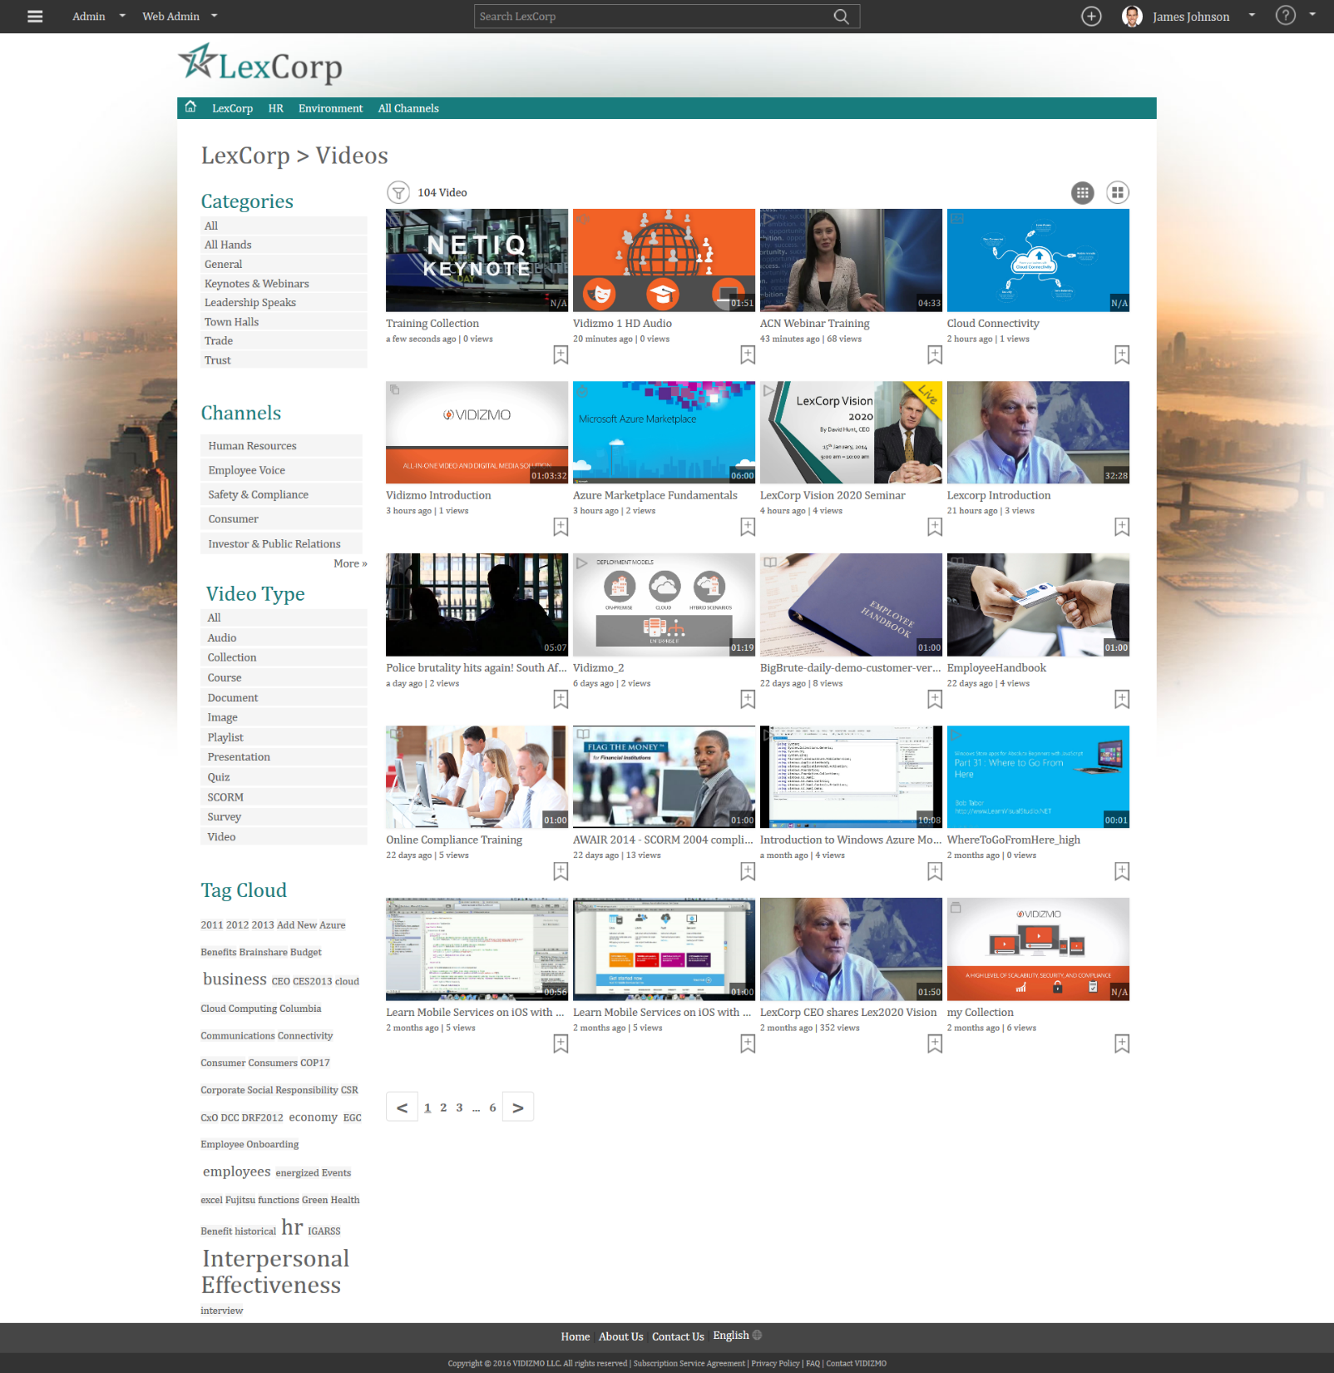
Collection Published

Slide 35
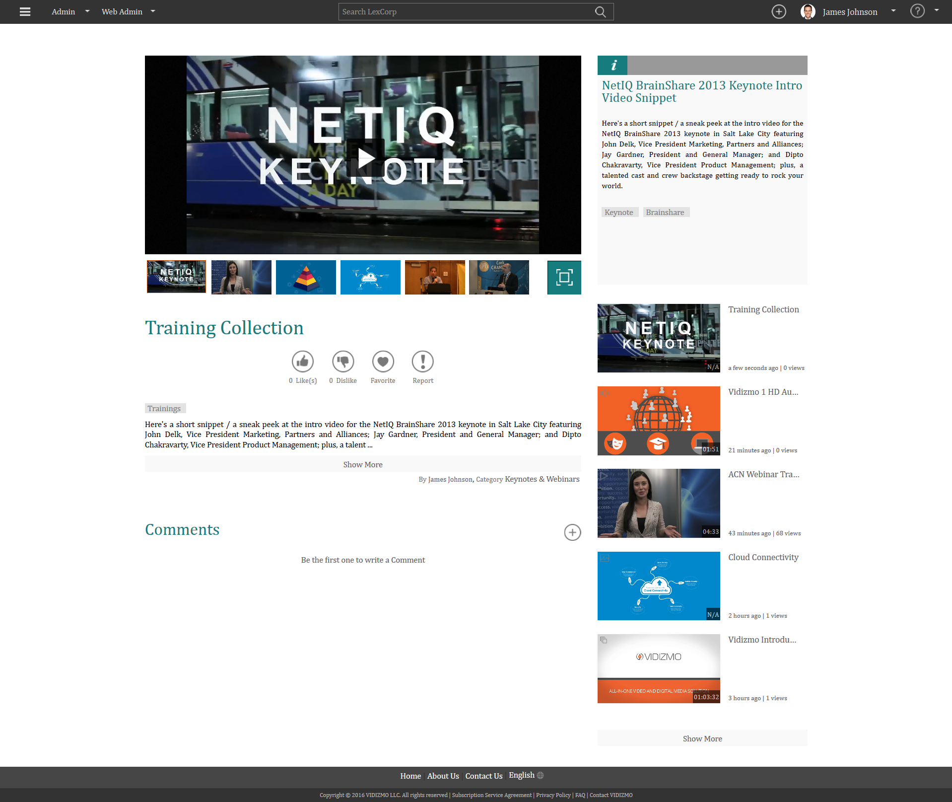
Collection Playback

Slide 36
Creating and Schedule a Live Webcast
Create and schedule a Live Webcast / Live Streaming session using VIDIZMO

Slide 37
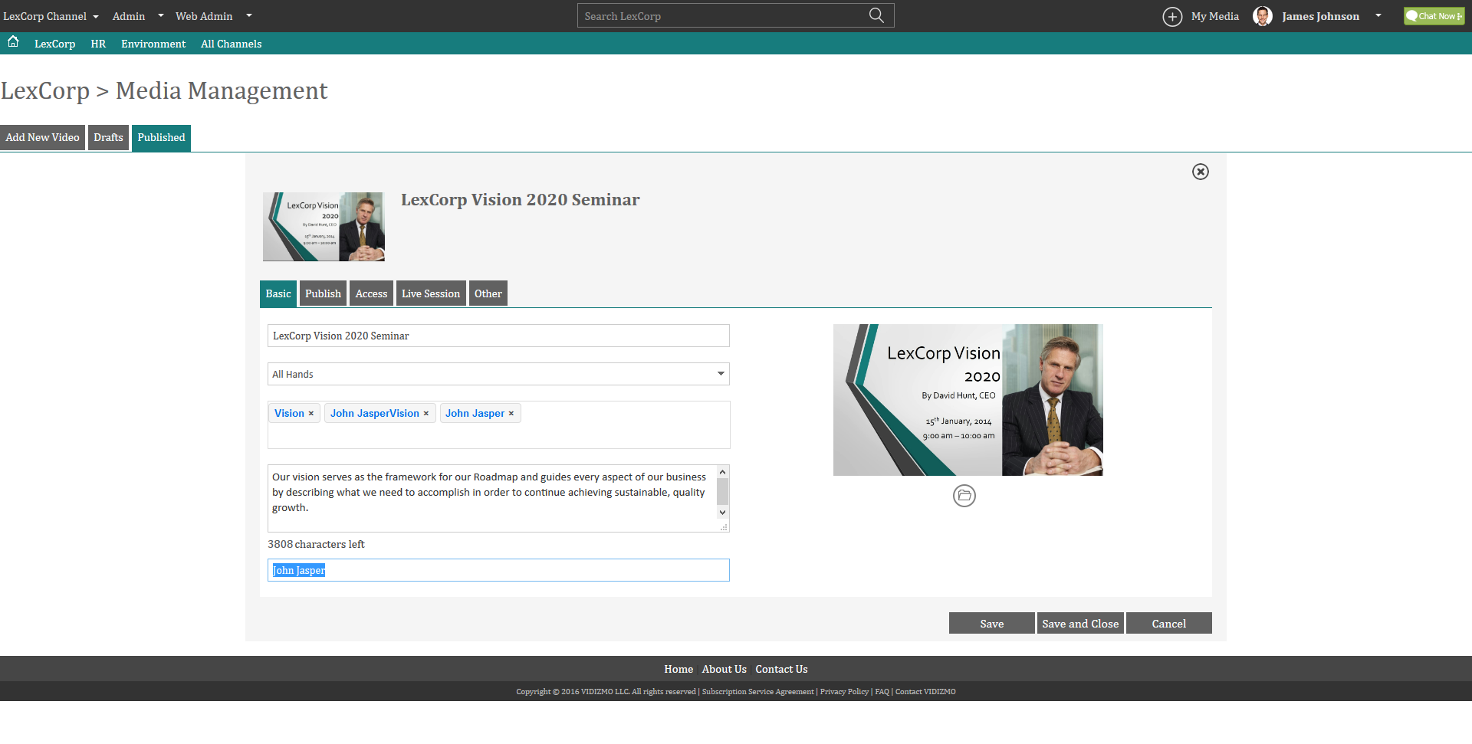
Live Webcast Settings
1. Basic Tab

Slide 38
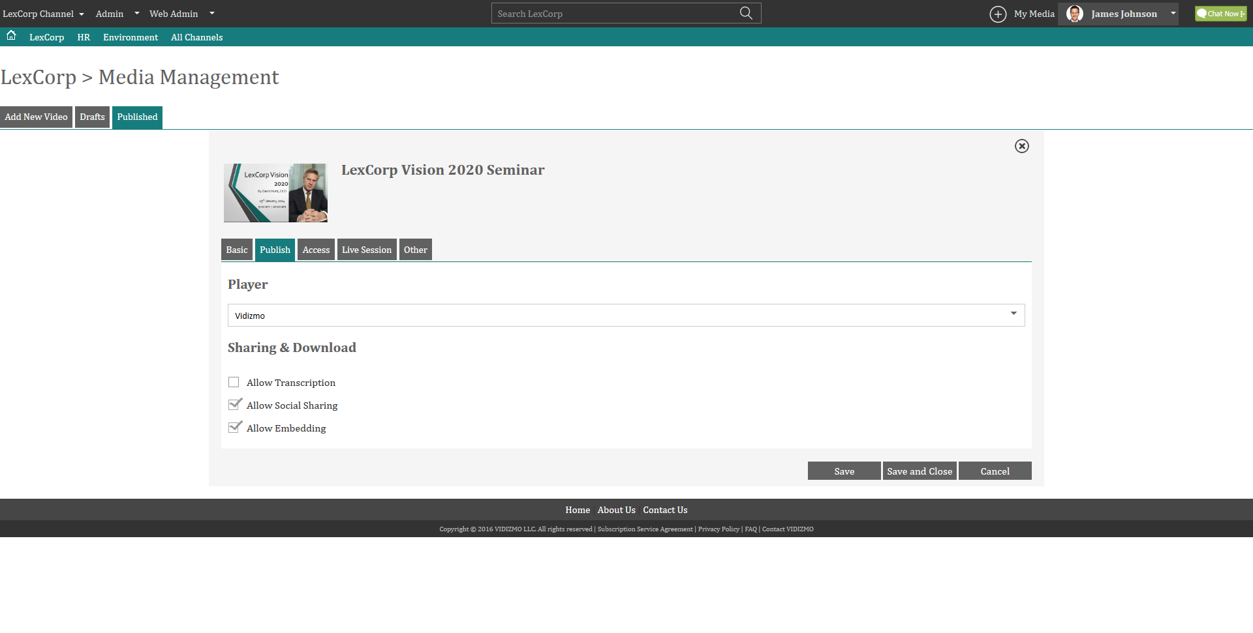
Live Webcast Settings
2. Publish Tab

Slide 39
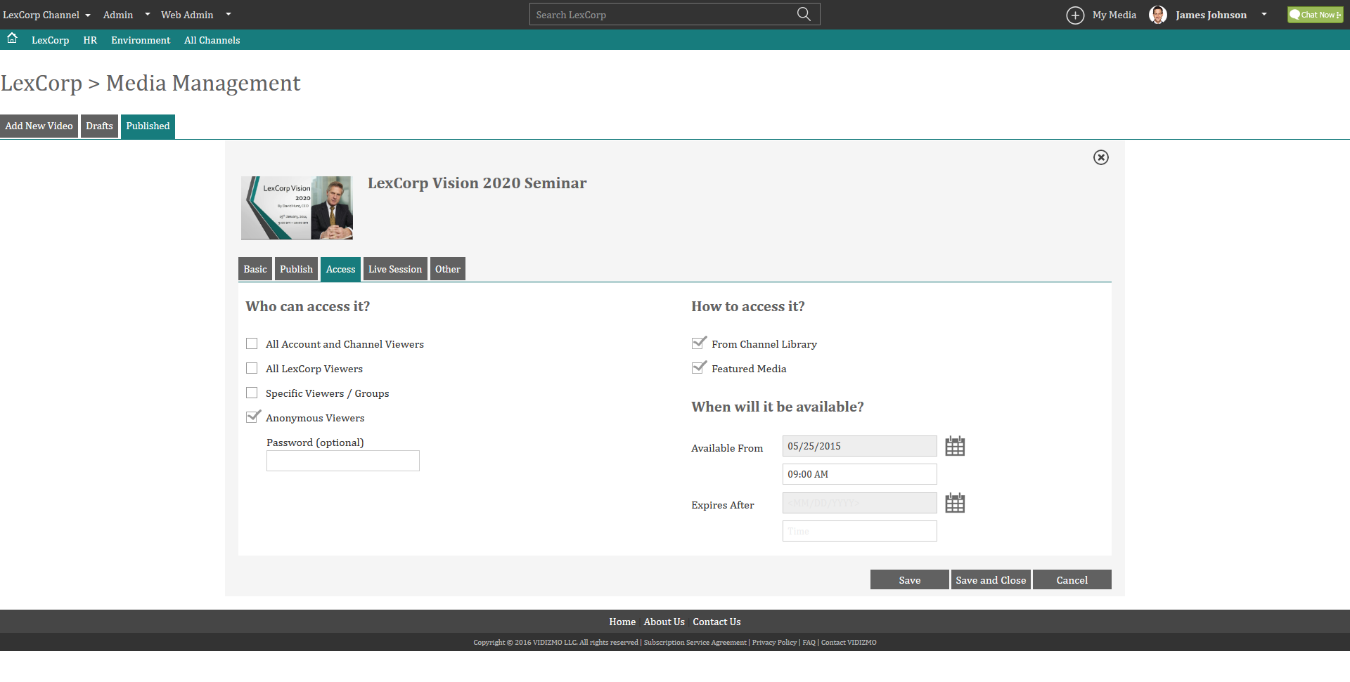
Live Webcast Settings
3. Access Tab

Slide 40
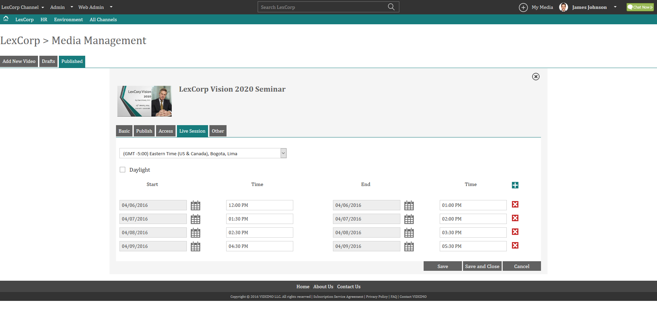
Live Webcast Settings
4. Live Session

Slide 41
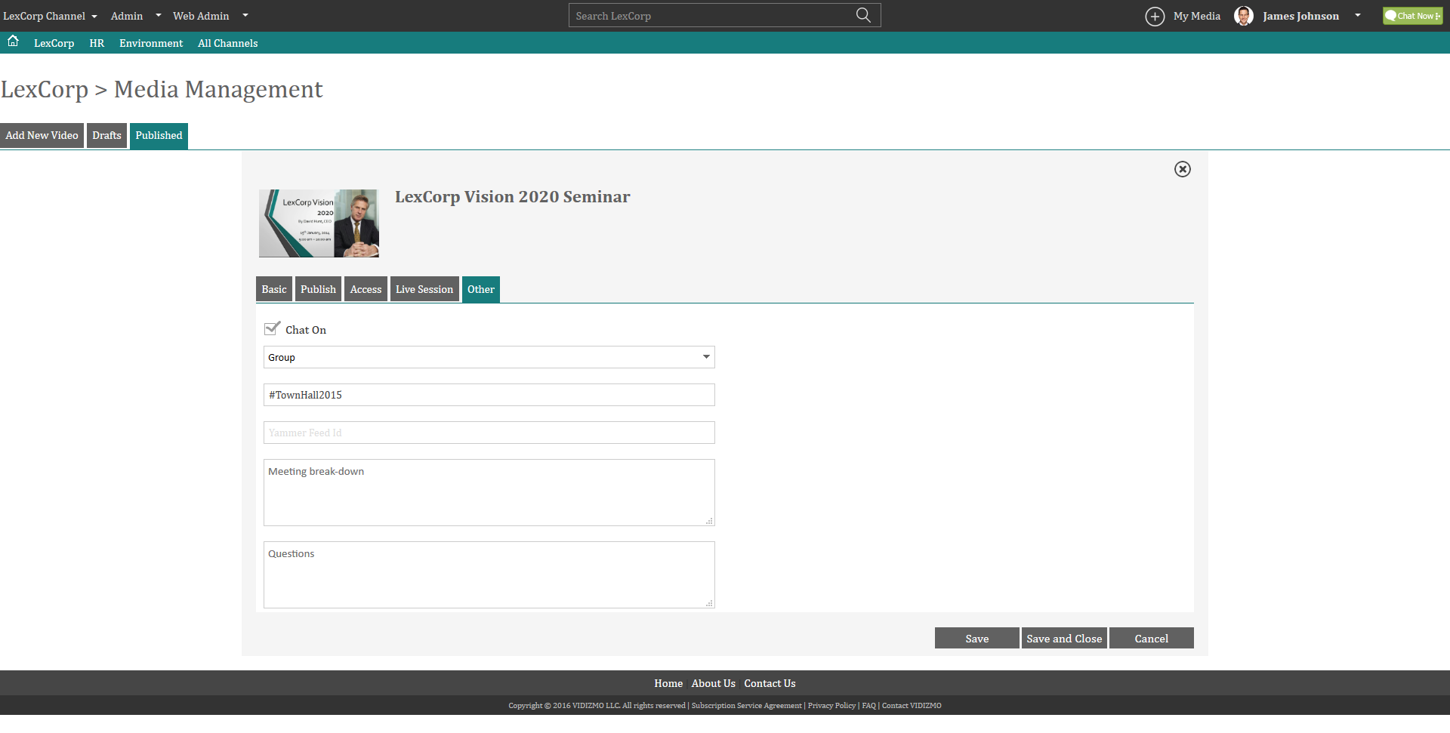
Live Webcast Settings
5. Other

Slide 42
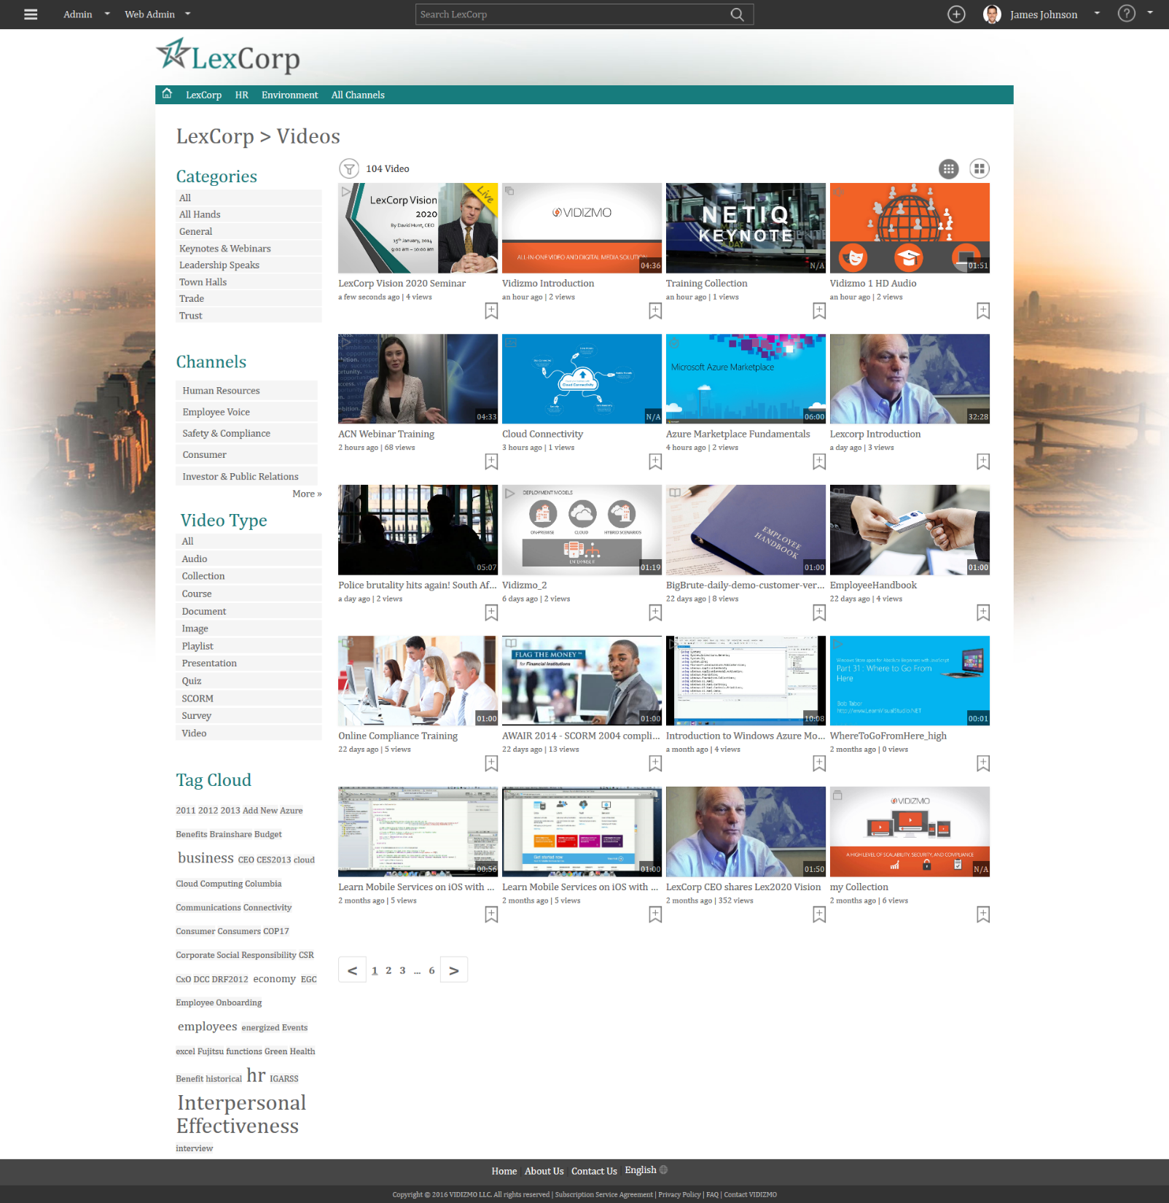
Live Webcast Session Created

Slide 43
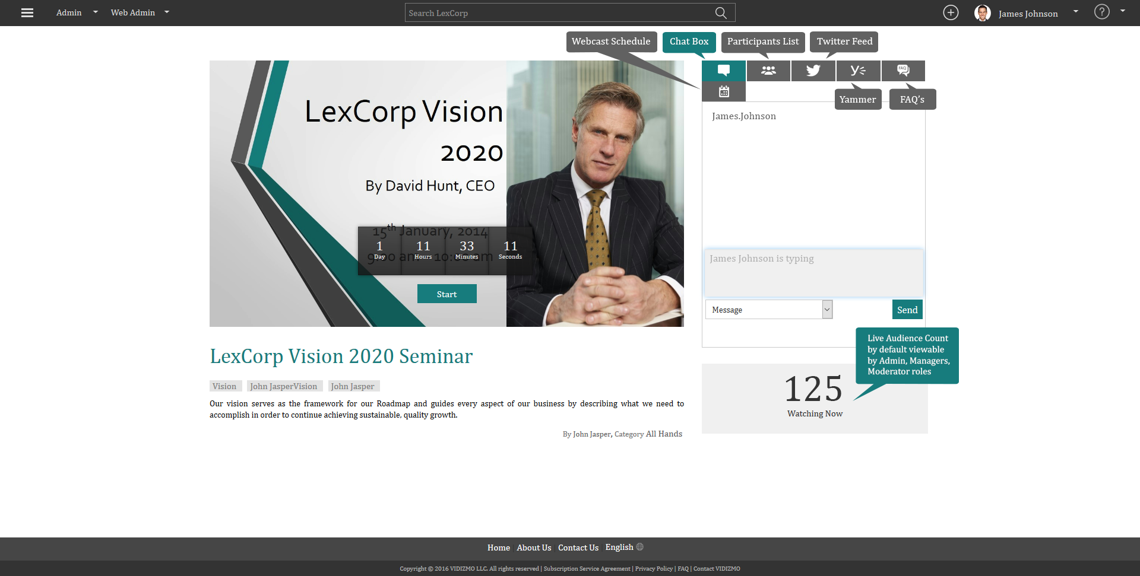
Live Streaming Session with Chat
Conduct unlimited Live Streaming Sessions using VIDIZMO
Include Chat, Twitter Feed, Yammer Feed to increase interactivity

Slide 44
Create SCORM

Slide 45
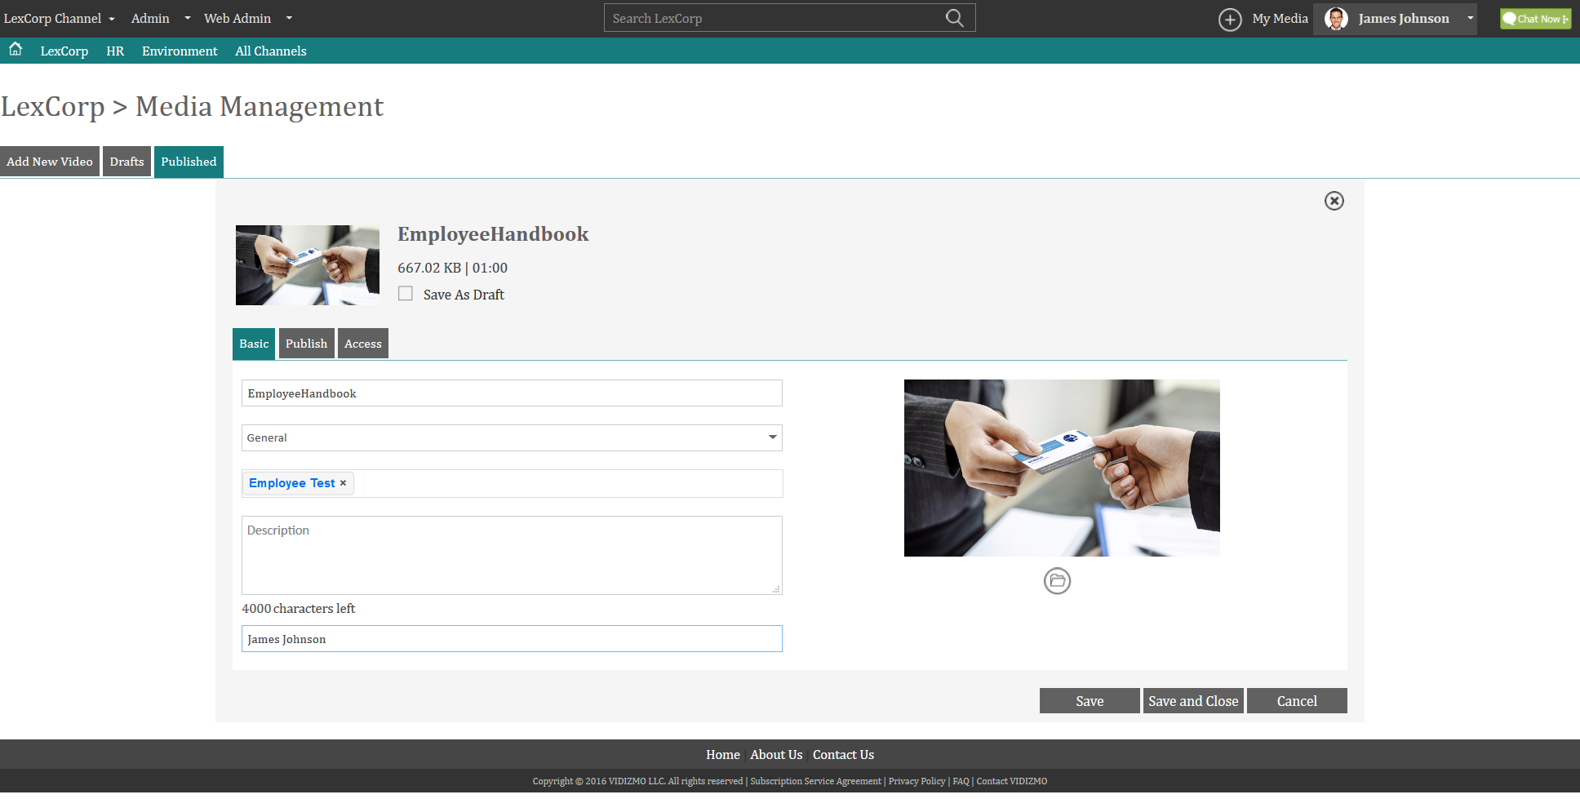
Creating SCORM
1. Basic Settings

Slide 46
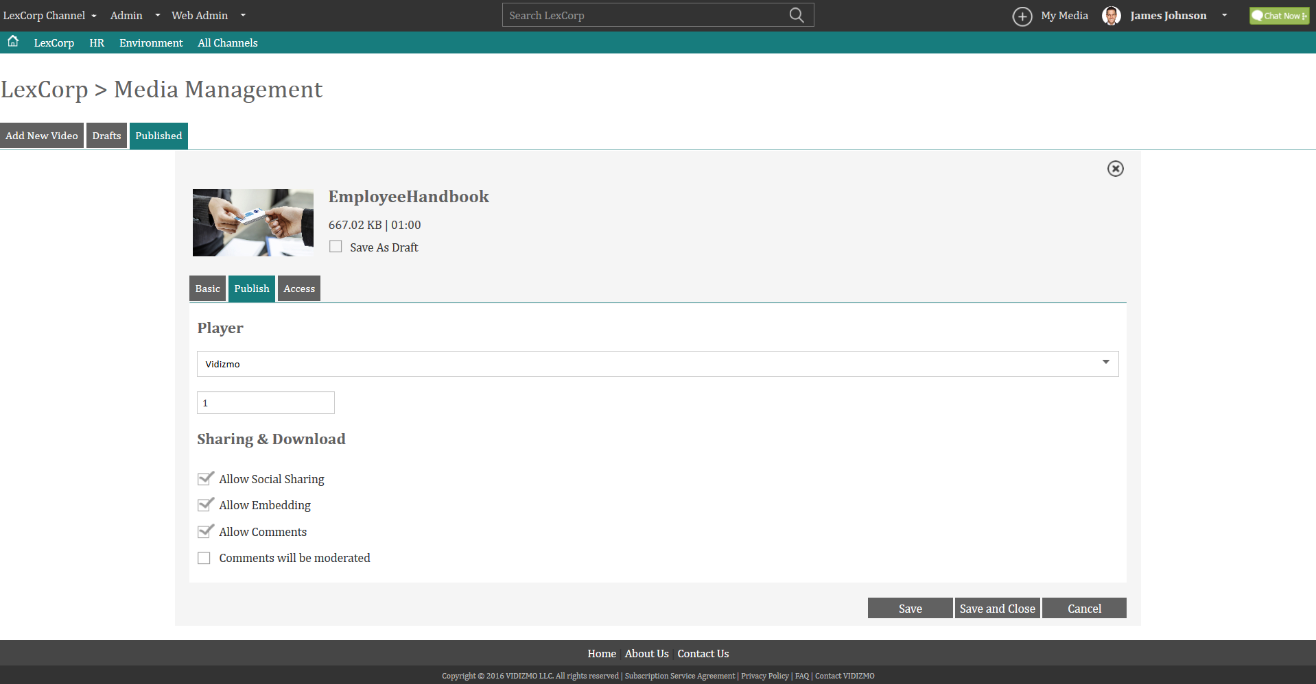
Creating SCORM
2. Publish Settings

Slide 47
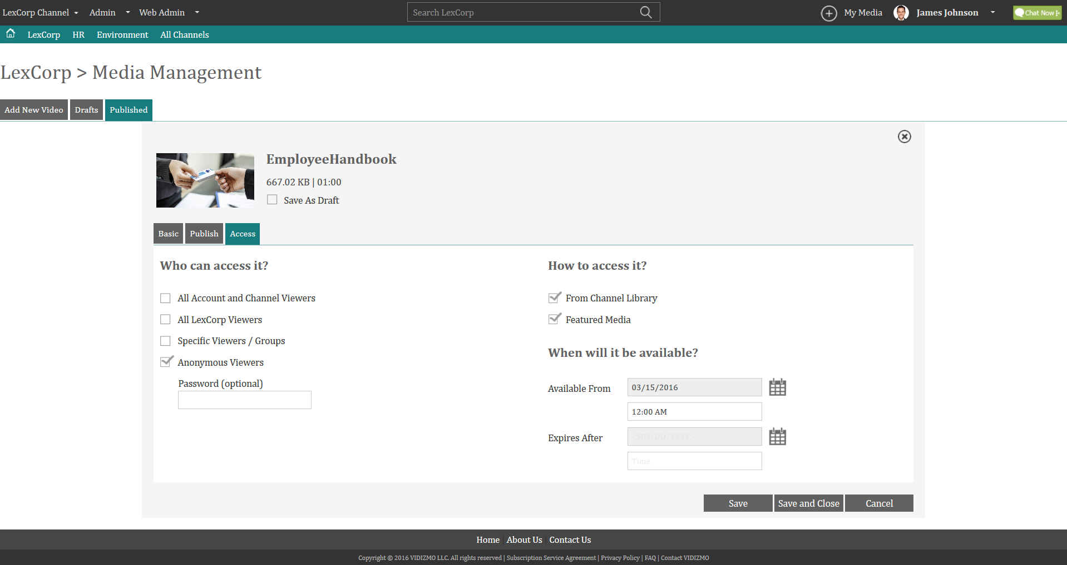
Creating SCORM
3. Access Settings

Slide 48
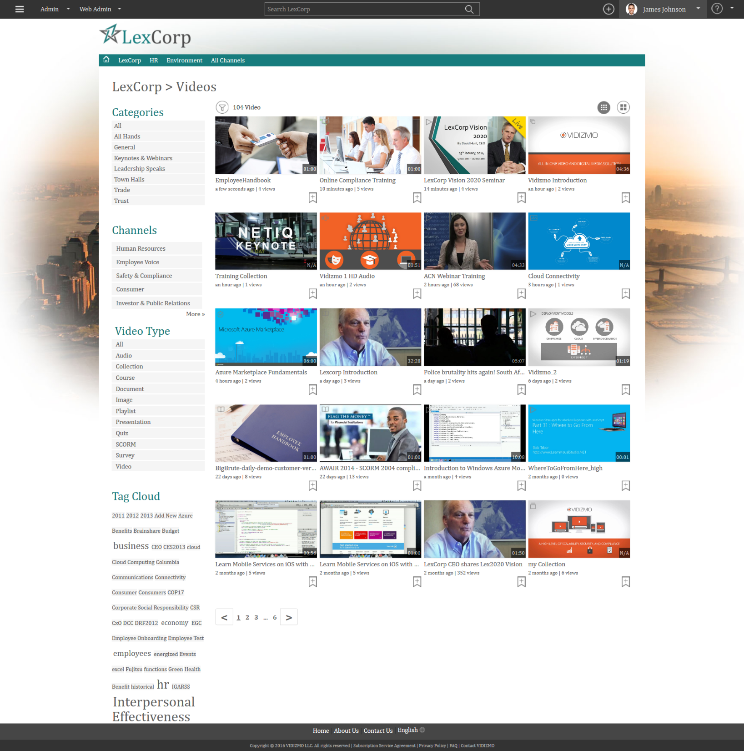
SCORM Created

Slide 49
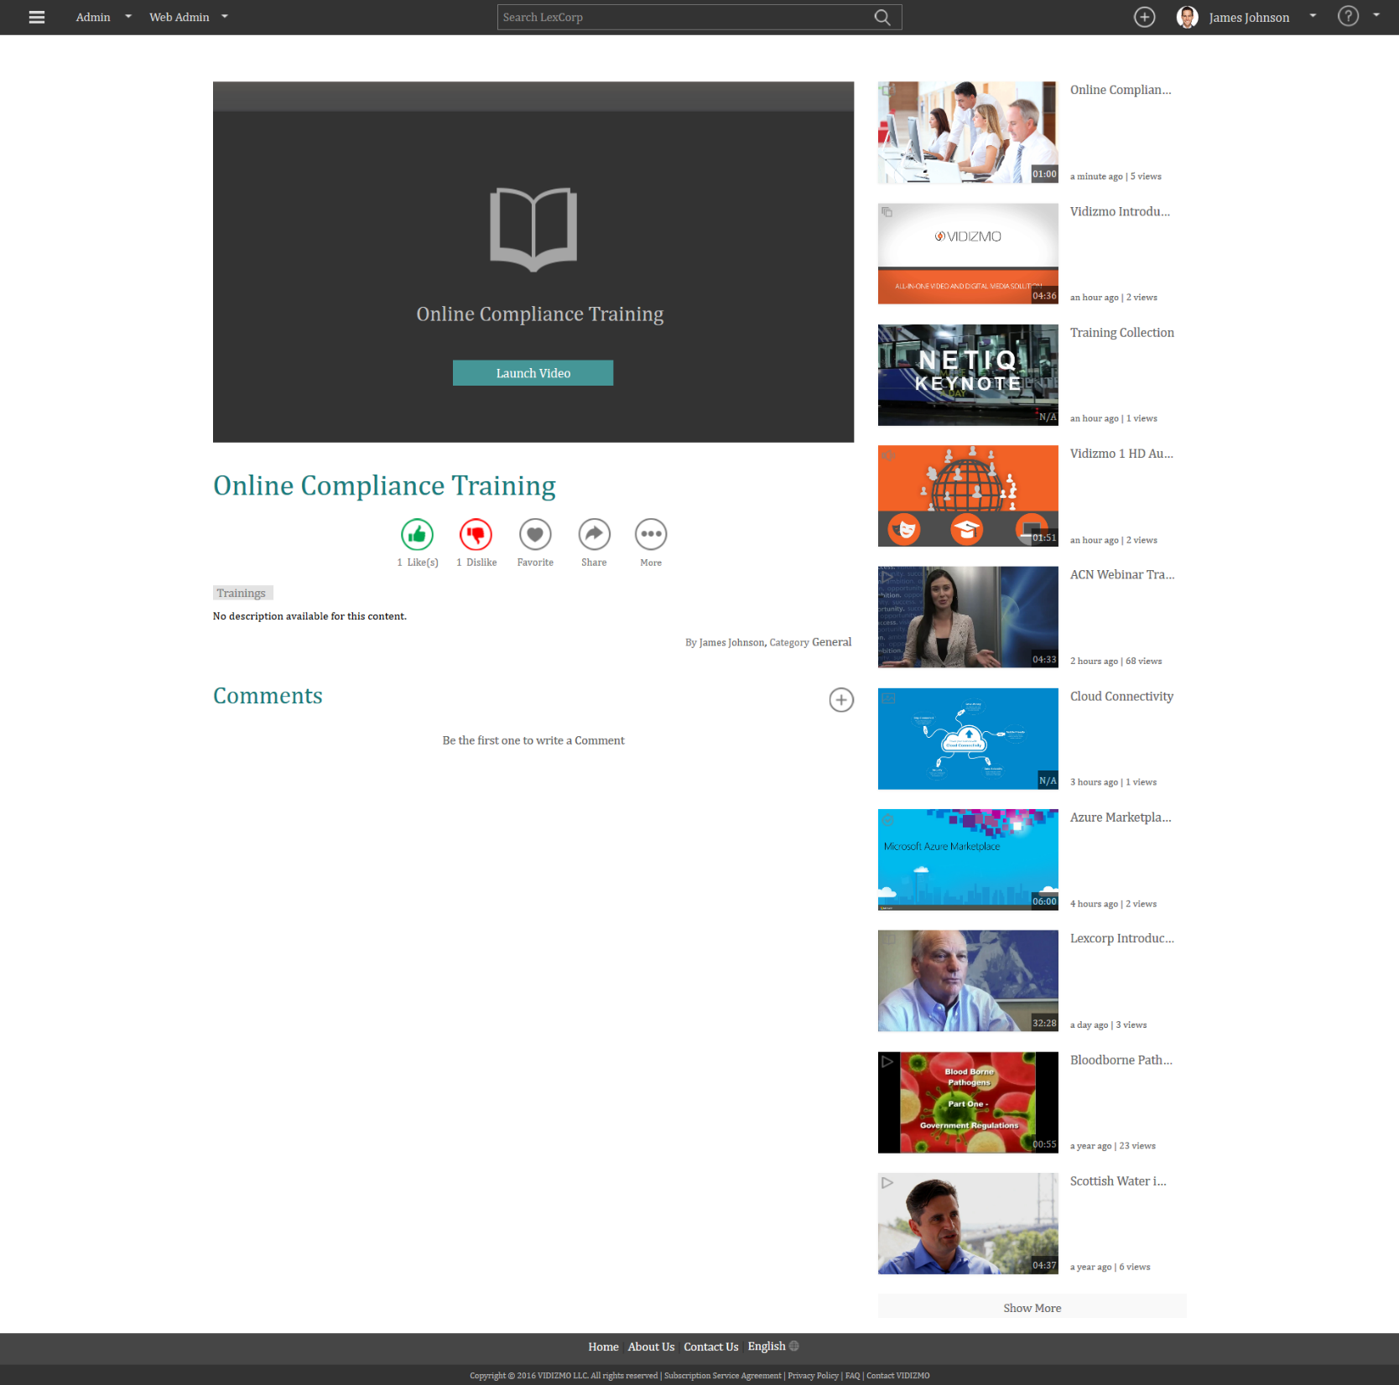
SCORM
Launch Module

Slide 50
SCORM Playback
Launch Module

Slide 51
Create SCORM

Slide 52
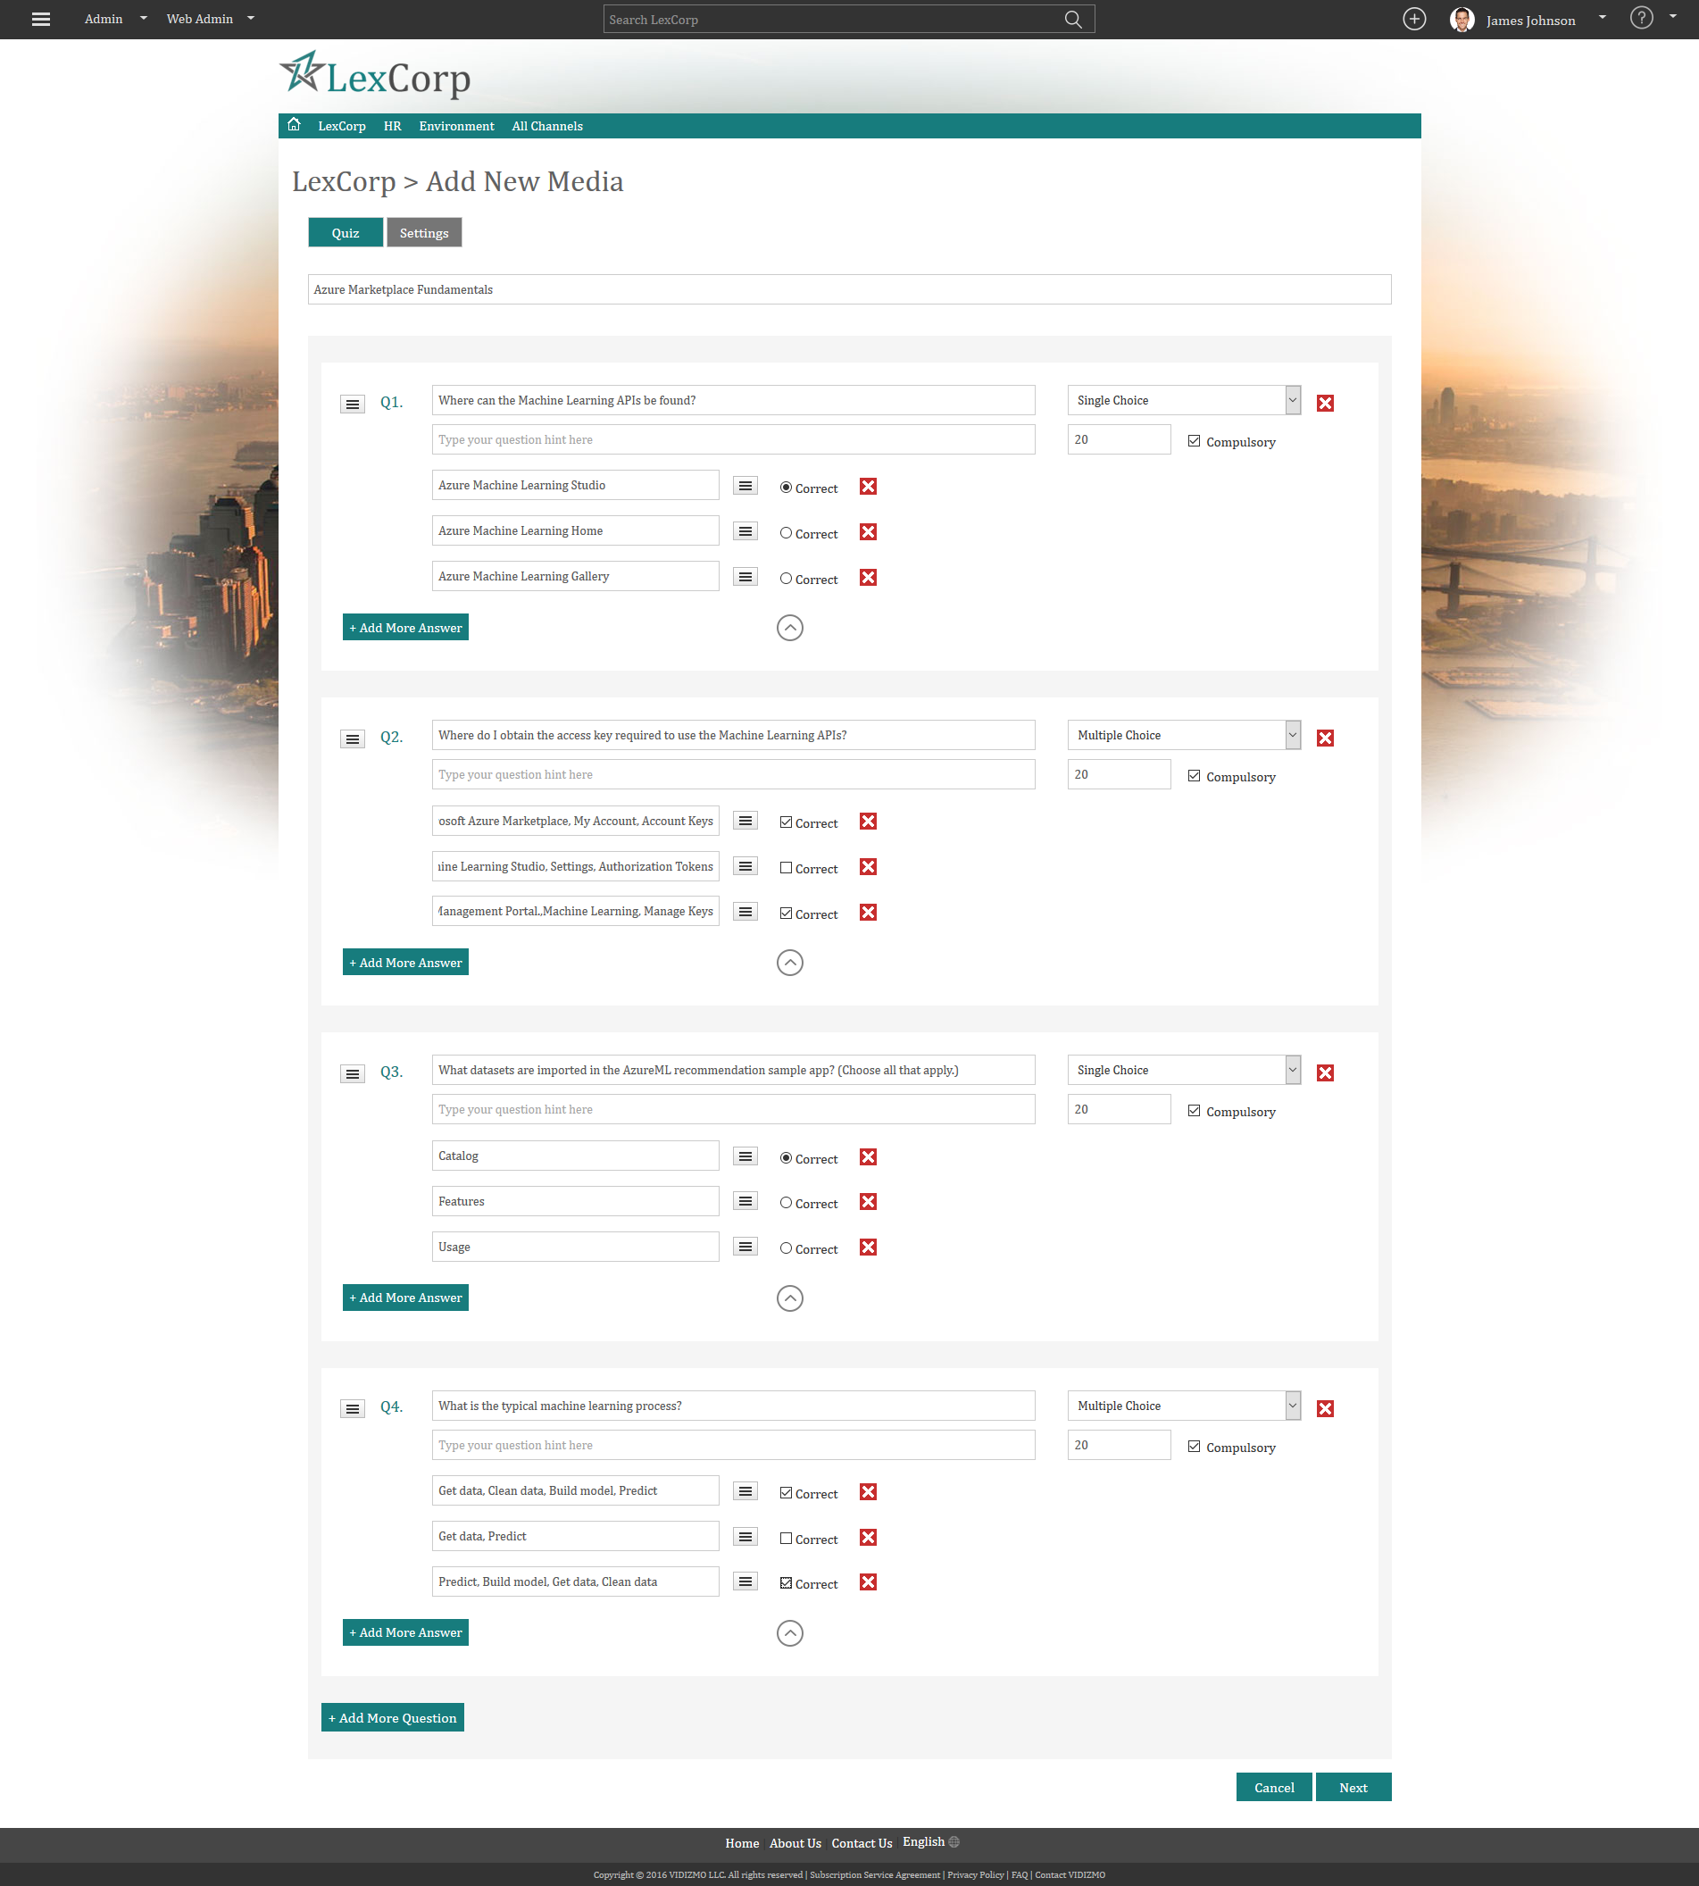
Creating a Quiz
Add Single & Multiple Type
Questions

Slide 53
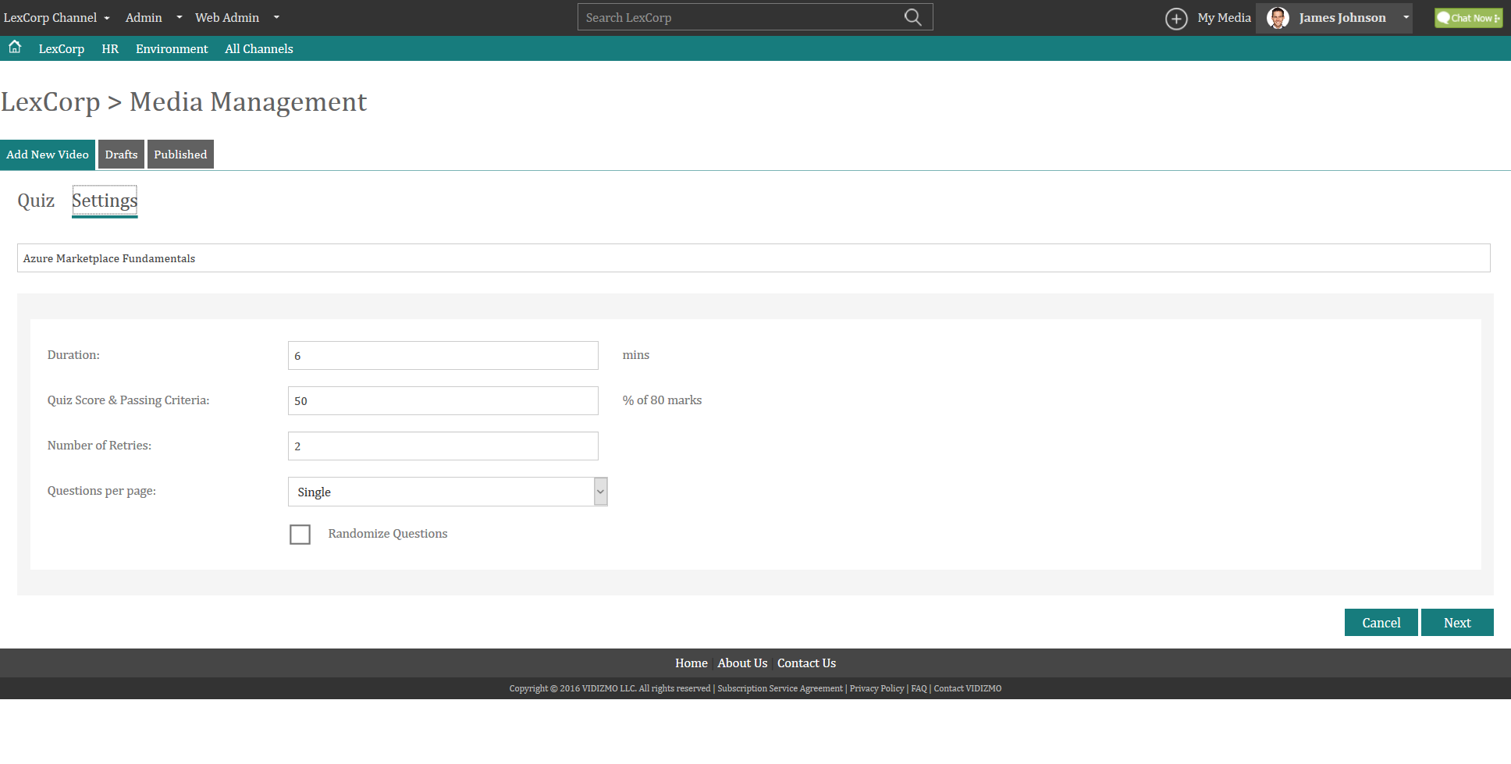
Quiz Settings

Slide 54
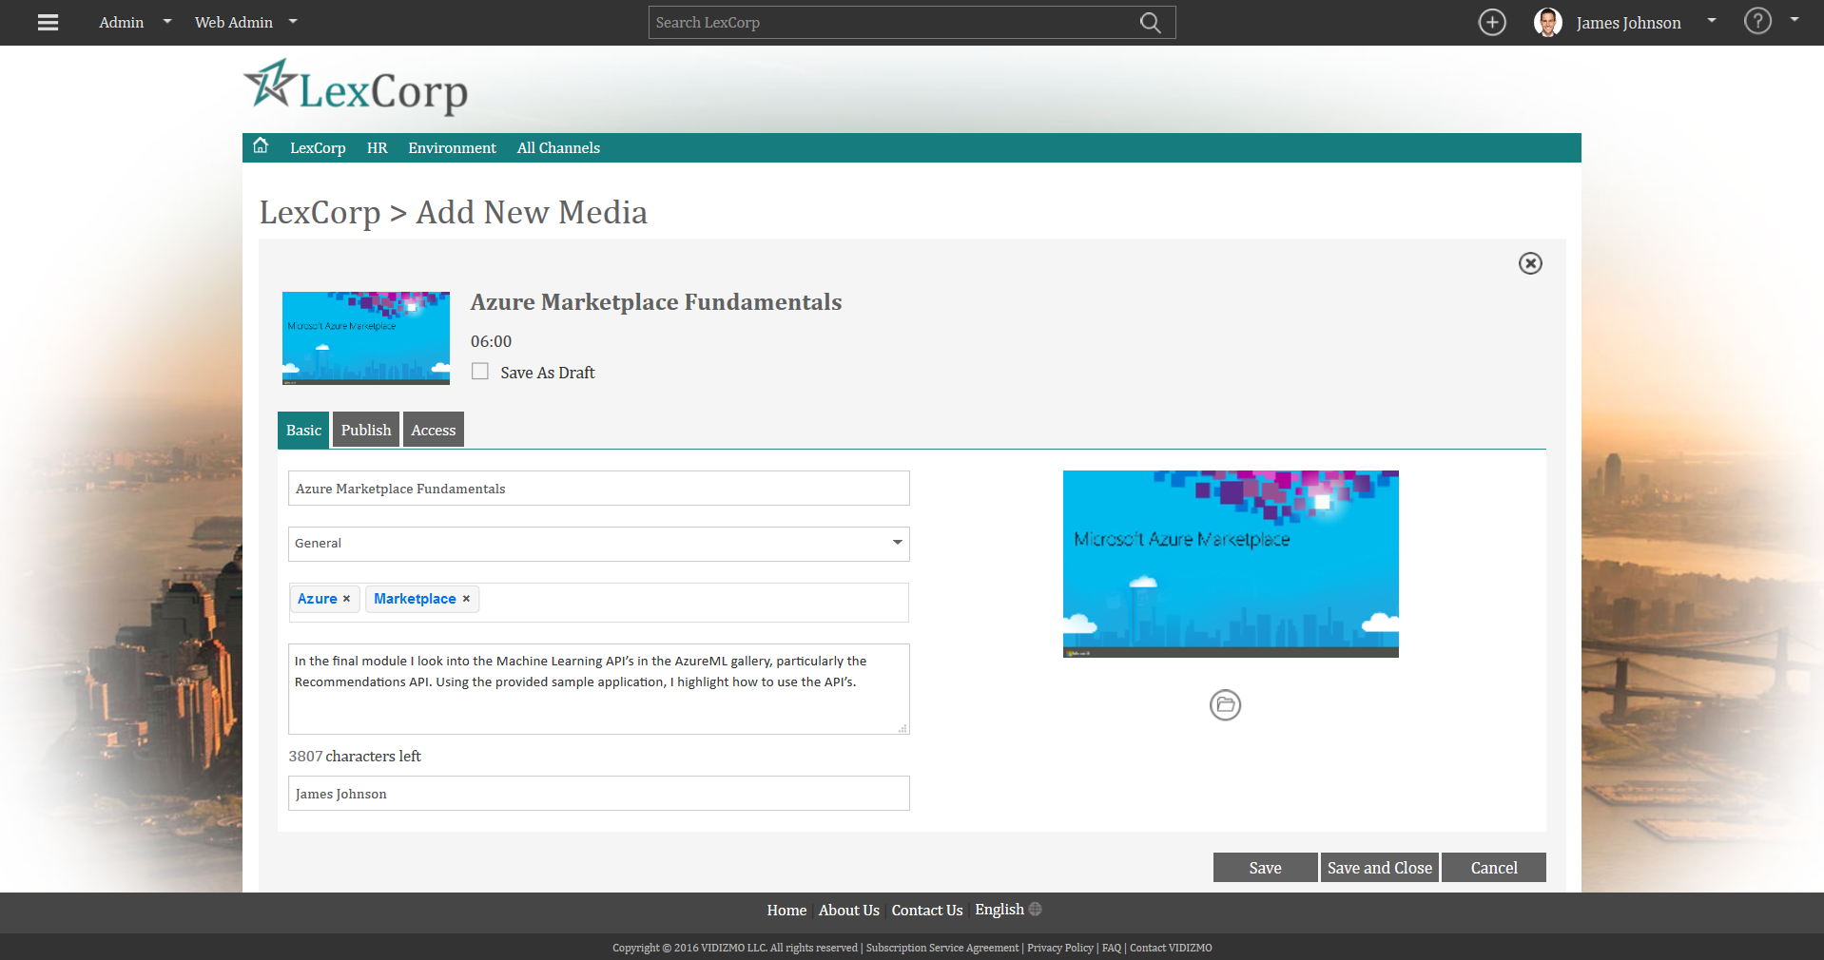
Creating a Quiz
Basic Settings
Give your Quiz a Title, Assign it to a Category, Add Tags, Description and Image

Slide 55
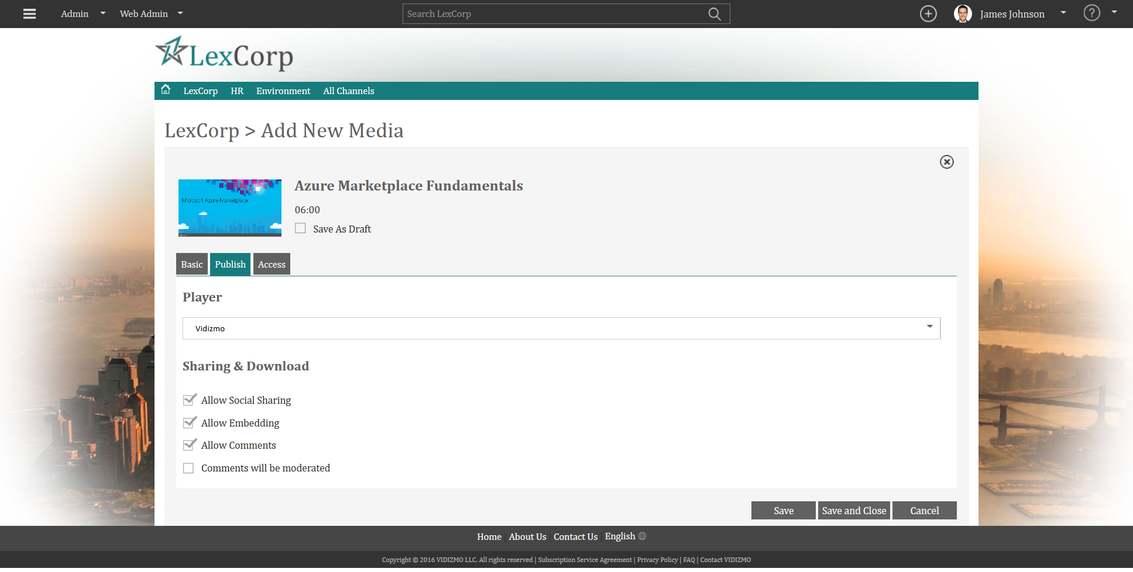
Creating a Quiz
Publish Settings
Give your Quiz a Title, Assign it to a Category, Add Tags, Description and Image

Slide 56
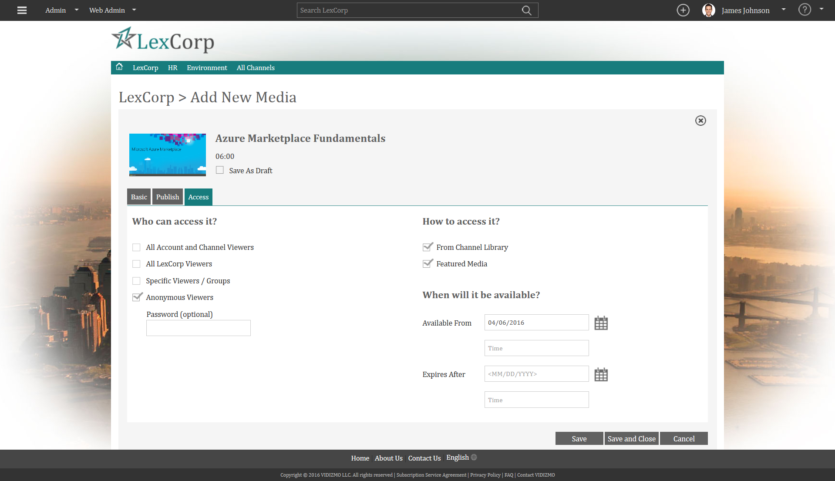
Creating a Quiz
Access Settings
Give your Quiz a Title, Assign it to a Category, Add Tags, Description and Image

Slide 57
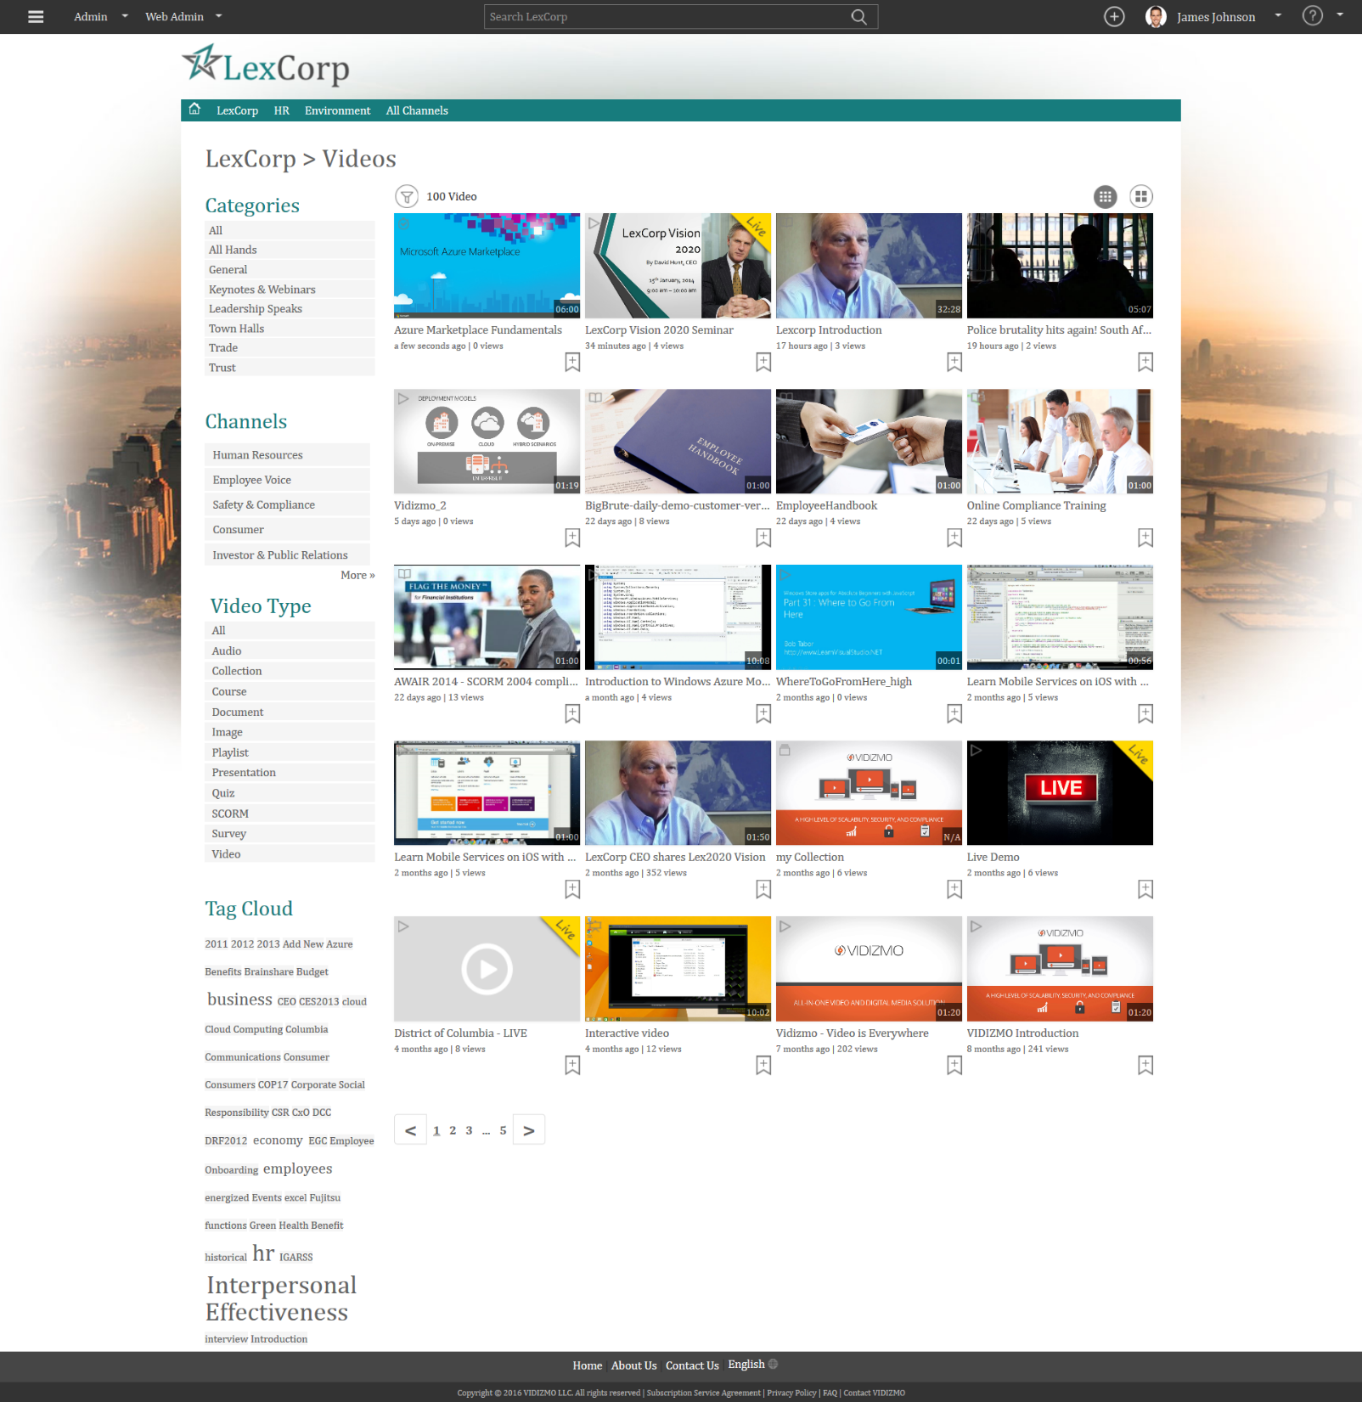
Quiz Created

Slide 58
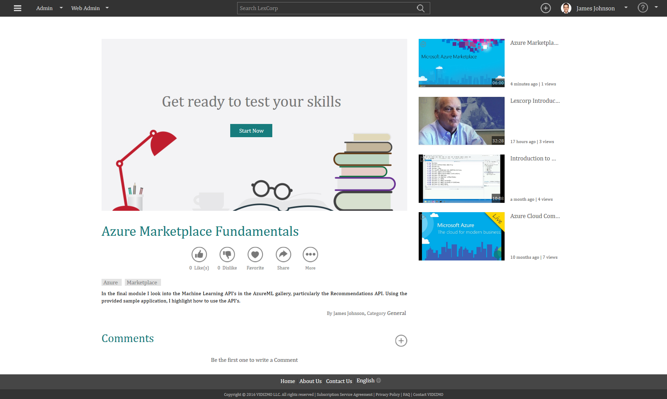
Quiz Playback
Start Now

Slide 59
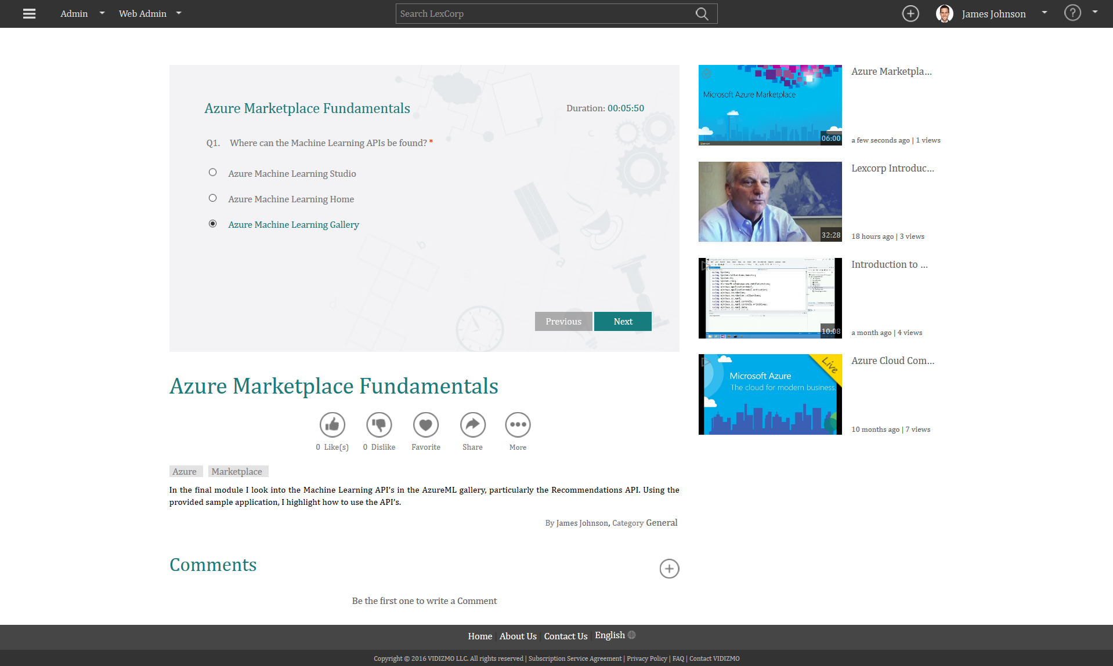
Quiz Playback
Single Choice Question

Slide 60
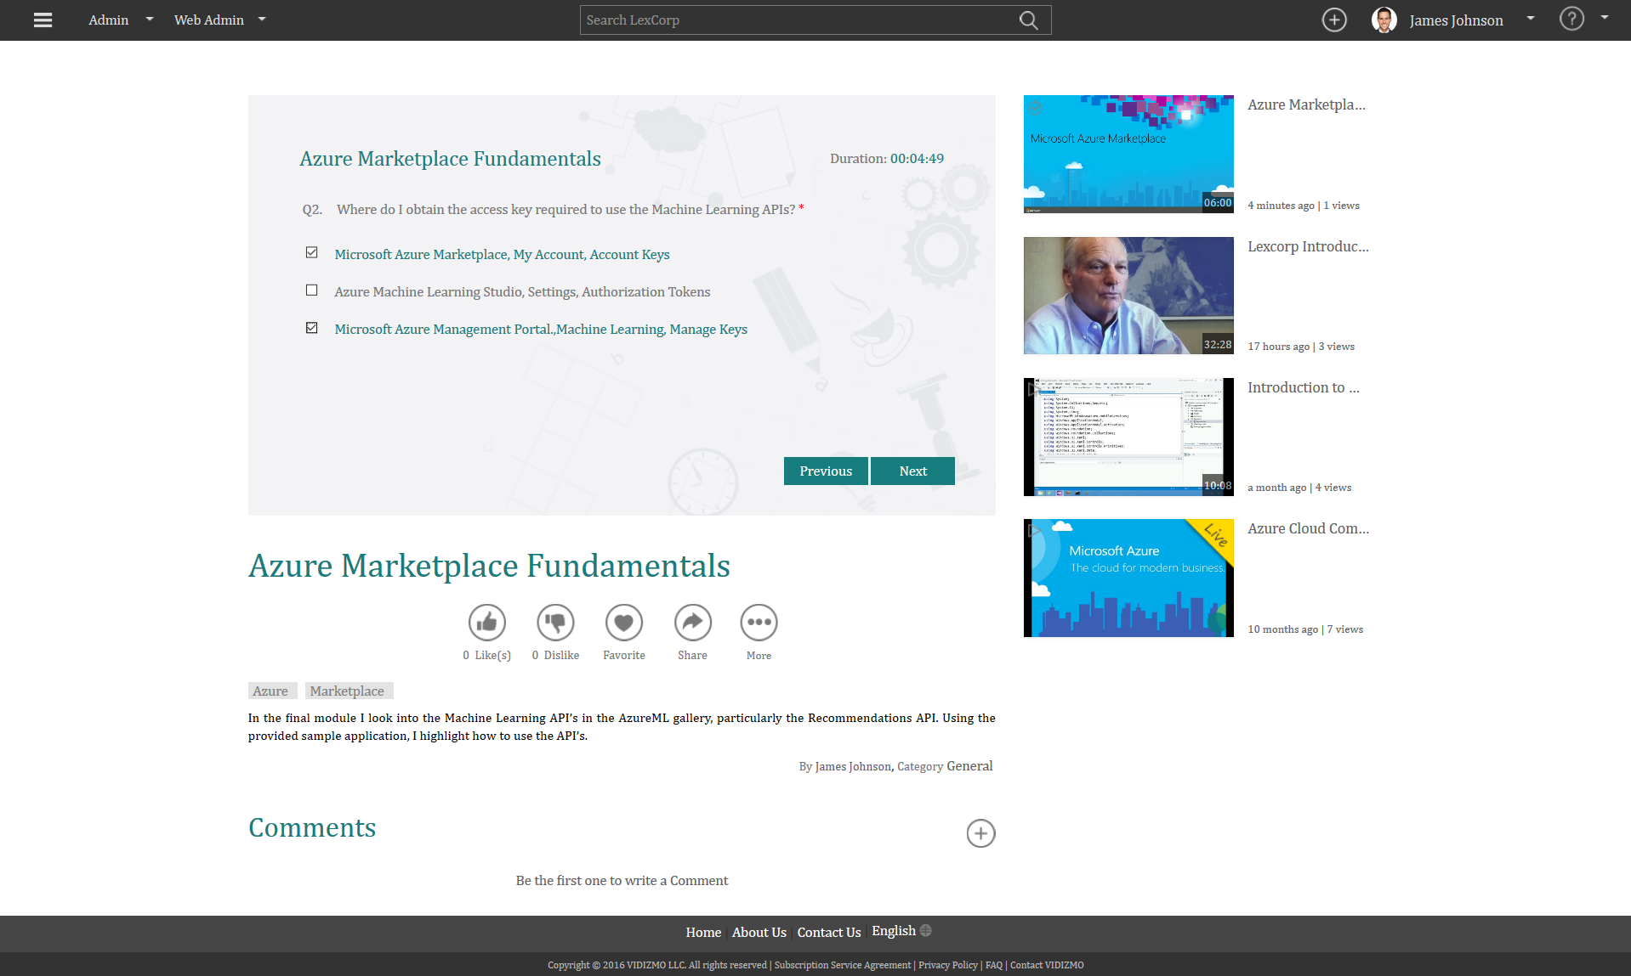
Quiz Playback
Multiple Choice Question

Slide 61
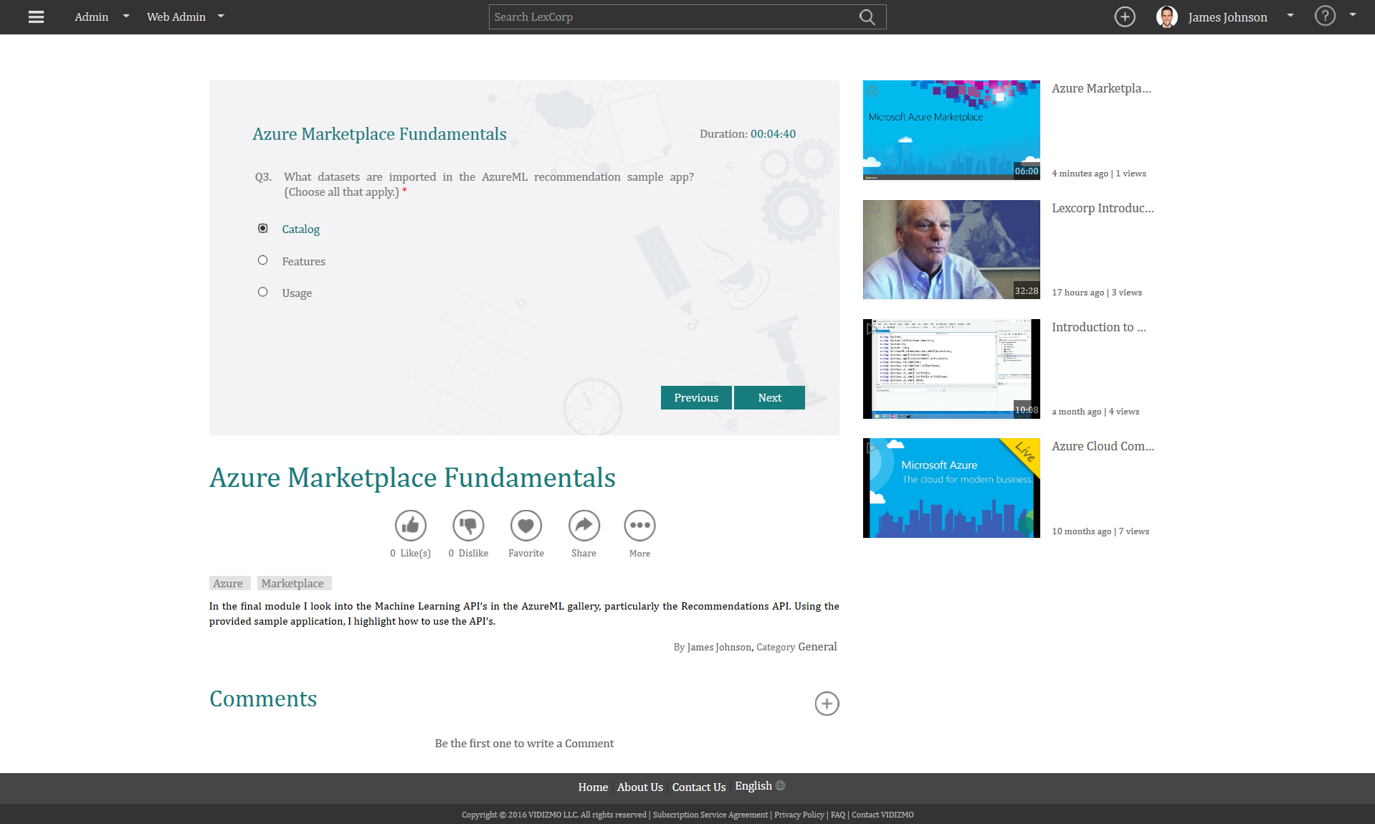
Quiz Playback
Continue

Slide 62

Quiz Playback
Continue

Slide 63
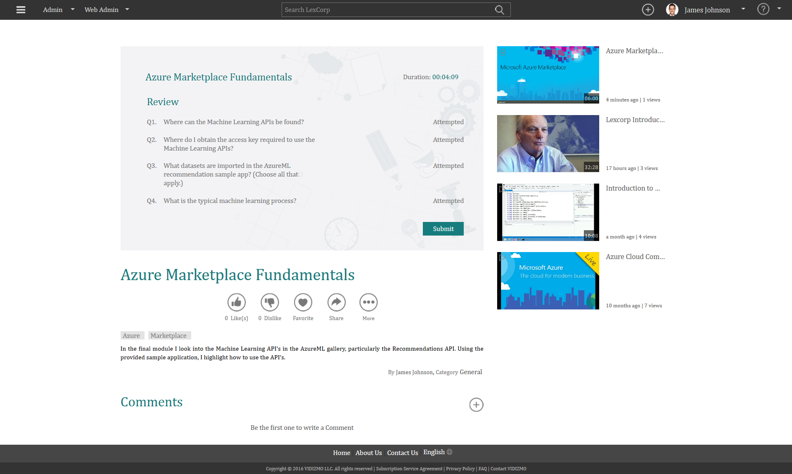
Quiz Playback
Review Questions Attempted

Slide 64
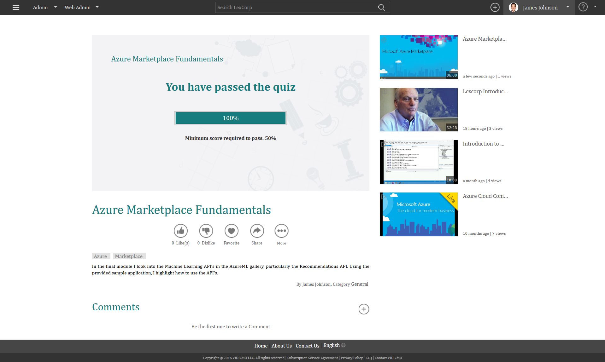
Quiz Completed

Slide 65
Creating a Survey

Slide 66

Creating a Survey Add Single & Multiple Type
Questions

Slide 67

Creating a Survey
Settings Tab

Slide 68

Creating a Survey
1. Basic Tab

Slide 69

Creating a Survey
2. Publish Tab

Slide 70

Creating a Survey
3. Access Tab

Slide 71

Creating a Survey
4. Custom Tab

Slide 72

Survey Created

Slide 73

Survey Playback
1. Single Choice Question

Slide 74

Survey Playback
2. Multiple Choice Question

Slide 75

Survey Playback
3. Descriptive Choice Question

Slide 76

Survey Completed

Slide 77
Create an Interactive Course

Slide 78

Create a Course
1/2
Your course can include videos, sounds, images, documents, quizzes, polls, surveys

Slide 79

Create a Course
2/2
Your course can include videos, sounds, images, documents, quizzes, polls, surveys

Slide 80

1. Create a Course
Basic Settings
Give your Course a title, assign it to a category, provide description and select thumbnails.

Slide 81

2. Create a Course
Publish Settings
Give your Course a title, assign it to a category, provide description and select thumbnails.

Slide 82

3. Create a Course
Access Settings
Give your Course a title, assign it to a category, provide description and select thumbnails.

Slide 83

Course Created
Access your Course in published content.

Slide 84
Course Playback

Slide 85

My Media
1. Assigned Tab

Slide 86

My Media
2. Favorites Tab

Slide 87

My Media
3. Uploaded Tab

Slide 88

My Media
3. Shared & Purchased Tab

Slide 89



MediaLMS: Test Viewer & Issue Certificates
Viewing Completion Certificates
Use simple Video or SCORM Compliant Content to produce communication, training, education
Use built-in VIDIZMO MediaLMS to assign trainings and issue Certificates
or
Notify Orgnization LMS of successful viewing thru SCROM

Slide 90

Manage Campaigns

Slide 91

Create New Campaign
Step 1 of 4

Slide 92

Create New Campaign
Step 2 of 4
Add Videos

Slide 93

Create New Campaign
Step 2 of 4
Videos Added

Slide 94

Create New Campaign
Step 4 of 4
Create Campaign Launch

Slide 95

Campaign Created
Azure Training Solutions

Slide 96

My Media
New Campaign Added

Slide 97

Analytics
Dashboard

Slide 98

Users & Groups
Analytics
2. Overall Users Activities

Slide 99

Video Analytics
1. Overall Viewed Video

Slide 100

Video Analytics
2. Detailed Viewing History

Slide 101

Campaign Analytics
Campaign Performance

Slide 102

Settings
2. General

Slide 103

Settings
7. Login
VIDIZMO integrates with your Enterprise Single Sign On

Slide 104

Settings
9. Tags

Slide 105

Control Panel
Overview
Admin -> Control Panel

Slide 106
Architecture

Slide 107
VIDIZMO Products Use of Technology
Technologies | Importance
Microsoft Azure (CLOUD) Storage, CDN, Media Services, ACS | Required
Microsoft Azure VM (Compute) – Runs .NET App | Required
Windows Server / SQL Server (2012 R2) | Required
Office 365 Integrate Enterprise Tube with Office365 with Single Sign-On etc. | Optional
SharePoint 2010/2013/2015 Enterprise Tube in SharePoint with Single Sign-On, Enterprise Search and Workflows around Video | Optional
Skype 2013/2015 Automatically upload Lync recordings in Your Enterprise Tube Channel | Optional
Android & iOS App | Optional
Single Sign-On using Azure AD, Azure ACS, ADFS or SAML-P | Required
Free trial accounts available
Managed Pilots available
Available as Cloud, Hybrid & On-Premises
Immediate Rollout for Cloud Account, Hybrid may take few days to weeks to rollout

Slide 109











VIDIZMO Products
Built on Microsoft Azure Cloud
  Azure Media Services
Client Libraries
VIDIZMO’s EnterpriseTube
(Web Application: Windows Server 2012 R2/ MS SQL 2012 R2/ .NET)
Media Services Architecture
REST APIs
Windows 8
Azure Media Services & Azure Components
Enterprise CDN
Silverlight
Secure
Media Ingest
Encoder/Premium
On-Demand
Origin
Live Streaming
Live Origin
Ad Insertion
Windows Phone
Media Job
Scheduling
Indexer
AES & DRM
Dynamic Packaging
Analytics
Identity Management
HTML5
Azure CDN
Flash
Microsoft Azure Core Platform
Adaptive Streaming
Porting Kits
(STB, iOS / Android)
Origin
Caching

Slide 111


Slide 112

VIDIZMO for SharePoint

Slide 113
Products, Services & Solutions
Products
VIDIZMO MediaTube
VIDIZMO MediaLMS
VIDIZMO EnterpriseTube
VIDIZMO Virtual Academy
VIDIZMO MediaCommerce
VIDIZMO for SharePoint
VIDIZMO For Dynamics CRM
VIDIZMO ID Connector
VIDIZMO API
VIDIZMO Widgets
Services
Customization & Integration
Strategy & Planning
Network Infrastructure Analysis
Content Architecture
Training
Cost Analysis
Solutions
Corporate Communication, Webinars & Webcast, Enterprise YouTube, Training & Development, Online University, Health Academy

Slide 114
100% Cloud
10-100,000+ Users, Canned Packages
Hybrid
250 – 100,000+ users
Windows Azure Cloud, Azure Media Services
100% On-Premises
1000-100,000+ Users
VIDIZMO on Windows Azure Cloud, Integrates with On-Premise Enterprise Applications
Windows Server, Tailored Solution
Managed Implementation, Professional Services
Managed Implementation, Professional Services
Instant Setup
Customers can use their existing Azure and other software licenses under Enterprise Licensing Agreements

Slide 115
Thank You
MORE QUESTIONS?
Nadeem.khan@Vidizmo.com
Cell: +1 703 731 2925

