Slide 1
Virtual Academy Walkthrough
NADEEM KHAN, VP Sales
email/Skype for Business: Nadeem.khan@Vidizmo.com
Whatsapp & Cell Phone: +1 703 731 2925

Slide 2
About VIDIZMO, LLC.
VIDIZMO recognized in Gartner Magic Quadrant for Enterprise Video Content Management
300+ Years collective experience delivering Video using Microsoft Technologies
Featured Customers
Featured Customers
Partnership
Partnership

Slide 3
Virtual Academy
VIDIZMO Virtual Academy provides organizations self-paced, gamified learning environment for employees, prospect, customers and partners to improve their knowledge and skills using interactive multi-media courses, compete with their peers and receive recognition for their accomplishments.
Learners |  | Trainers
Create & manage their own Learning Plans for self-paced courses Score Points, Earn Badges on completing modules Climb up the Leaderboards Receive Completion Certificates |  | Create courses with video, images, documents and quizzes Create classes for Learners to enroll or manually assign courses to Learners Analyze course activity, class performance, learner scores etc.

Slide 4
Virtual Academy
VIDIZMO Virtual Academy provides organizations self-paced, gamified learning environment for employees, prospect, customers and partners to improve their knowledge and skills using interactive multi-media courses, compete with their peers and receive recognition for their accomplishments.
Learners |  | Trainers
Create & manage their own Learning Plans for self-paced courses Score Points, Earn Badges on completing modules Climb up the Leaderboards Receive Completion Certificates |  | Create courses with video, images, documents and quizzes Create classes for Learners to enroll or manually assign courses to Learners Analyze course activity, class performance, learner scores etc.

Slide 5
Virtual Academy
Roles
Administrators
Class Managers
Marketing
Class
IT Skills
Class
Business Skills Class
Customer
Education
Partner
Education
Moderators
Contributors
Learners
Employees Authenticated
Enterprise Single Sign-On
Customers
Authenticated – VIDIZMO Login, Facebook, Microsoft ID, Google ID
Partners
Anonymous

Slide 6
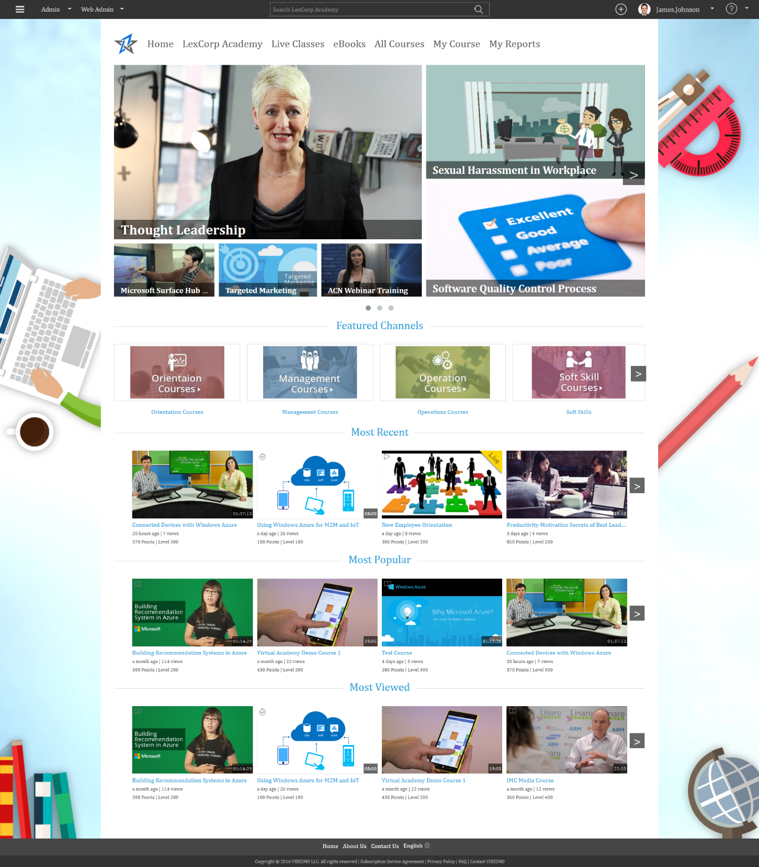
Virtual Academy Homepage
Featured Classes & Courses
Featured Channels & Sub-Portals
Most Recent, Most Popular search bars
Notes:
User visits the Portal

Slide 7
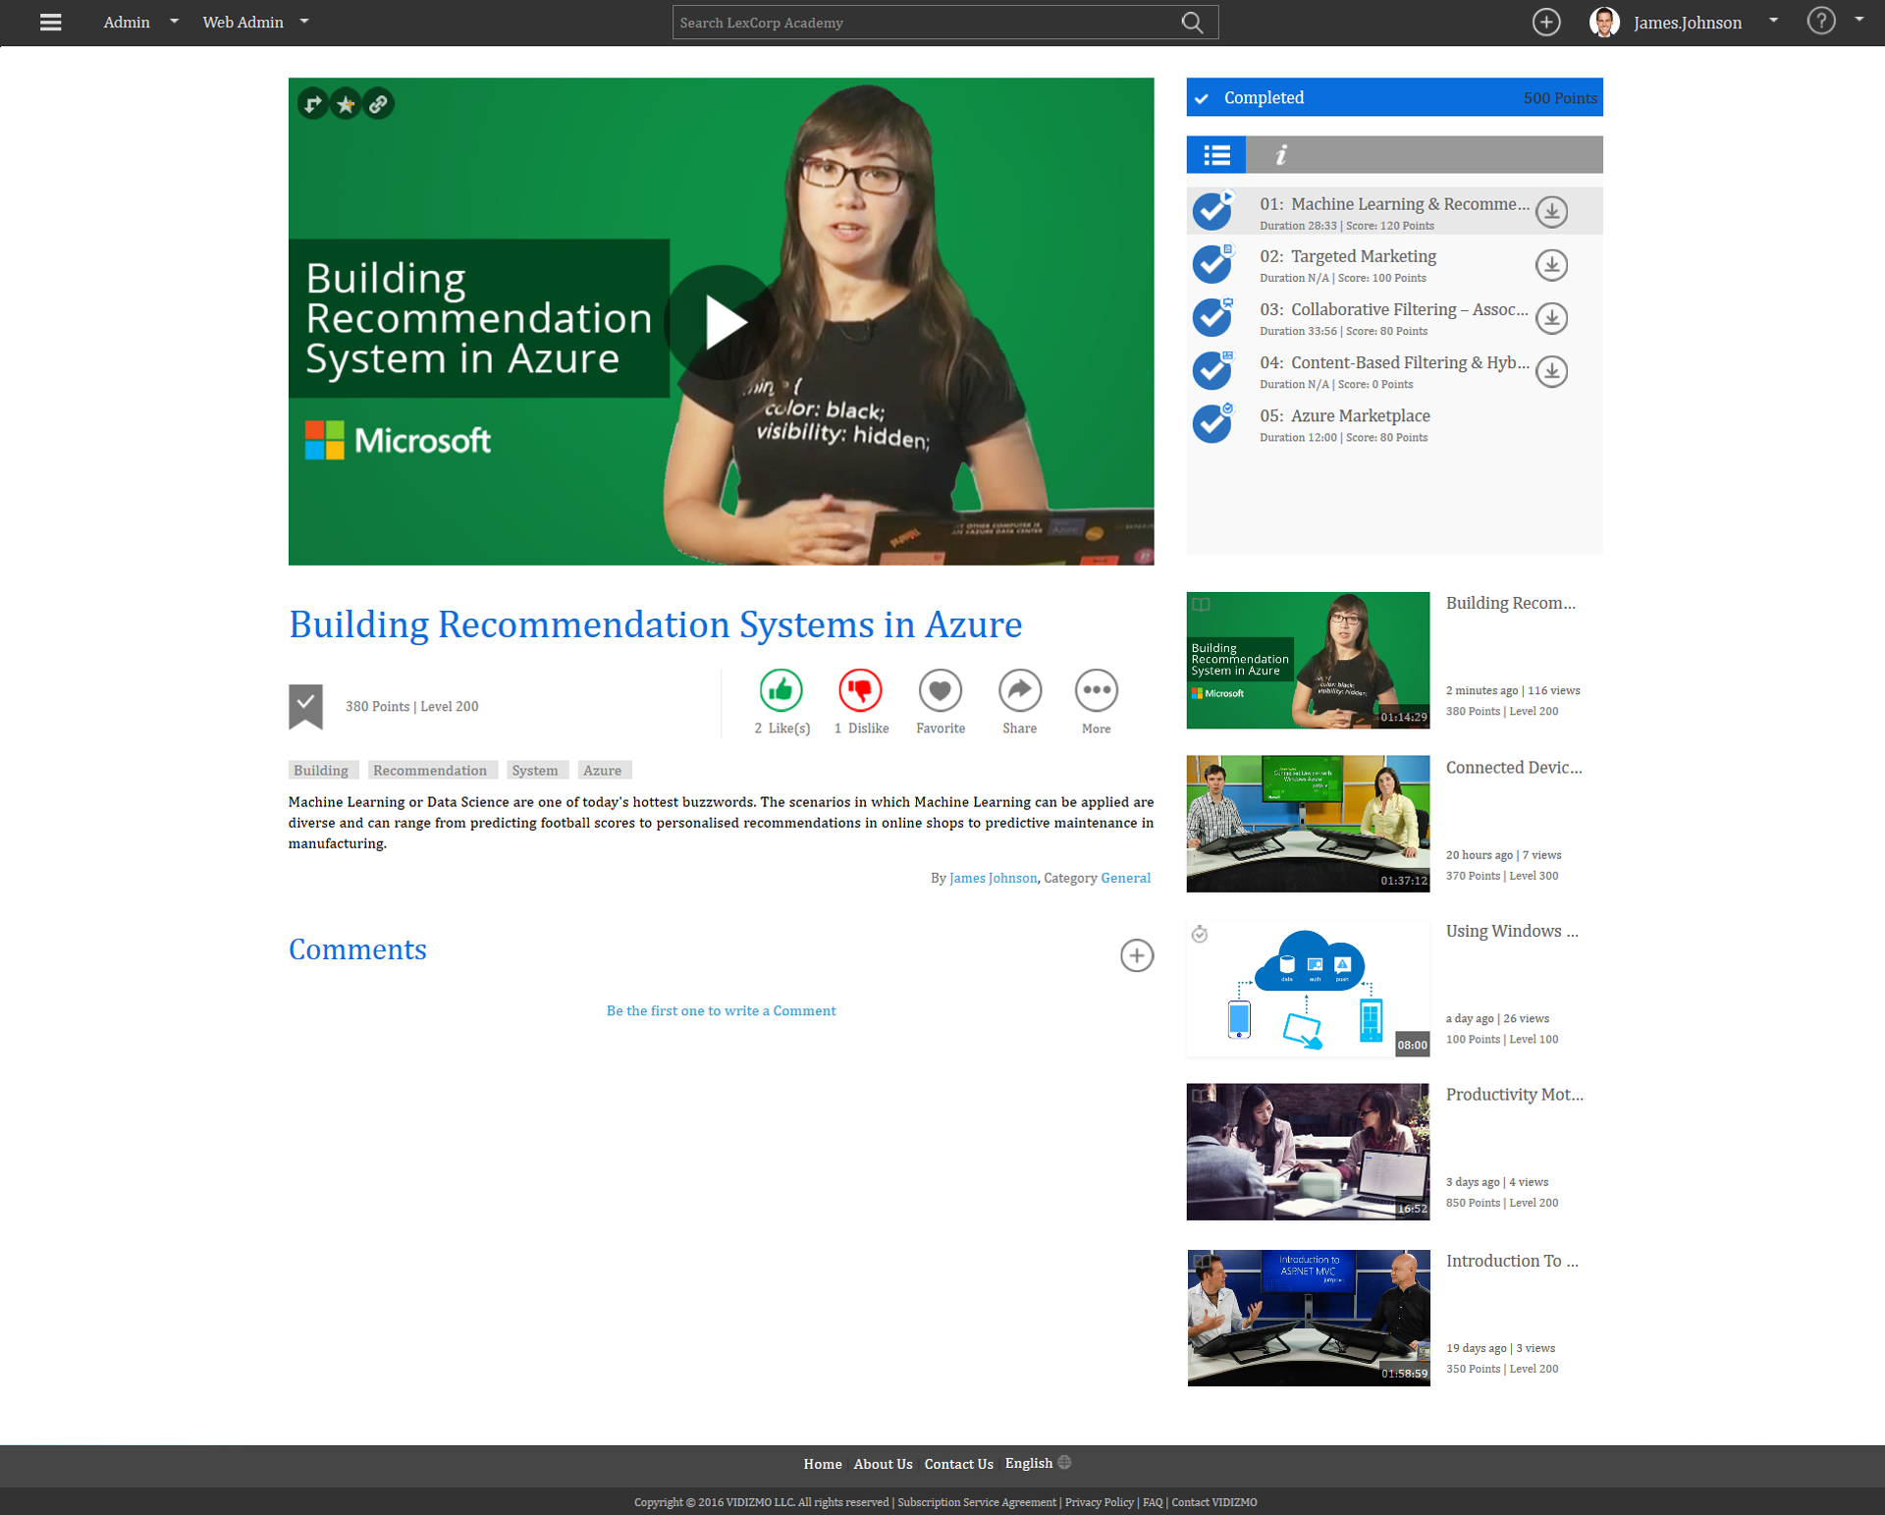
Interactive Course
Building Recommendation Systems in Azure
Notes:
User visits the Portal

Slide 8
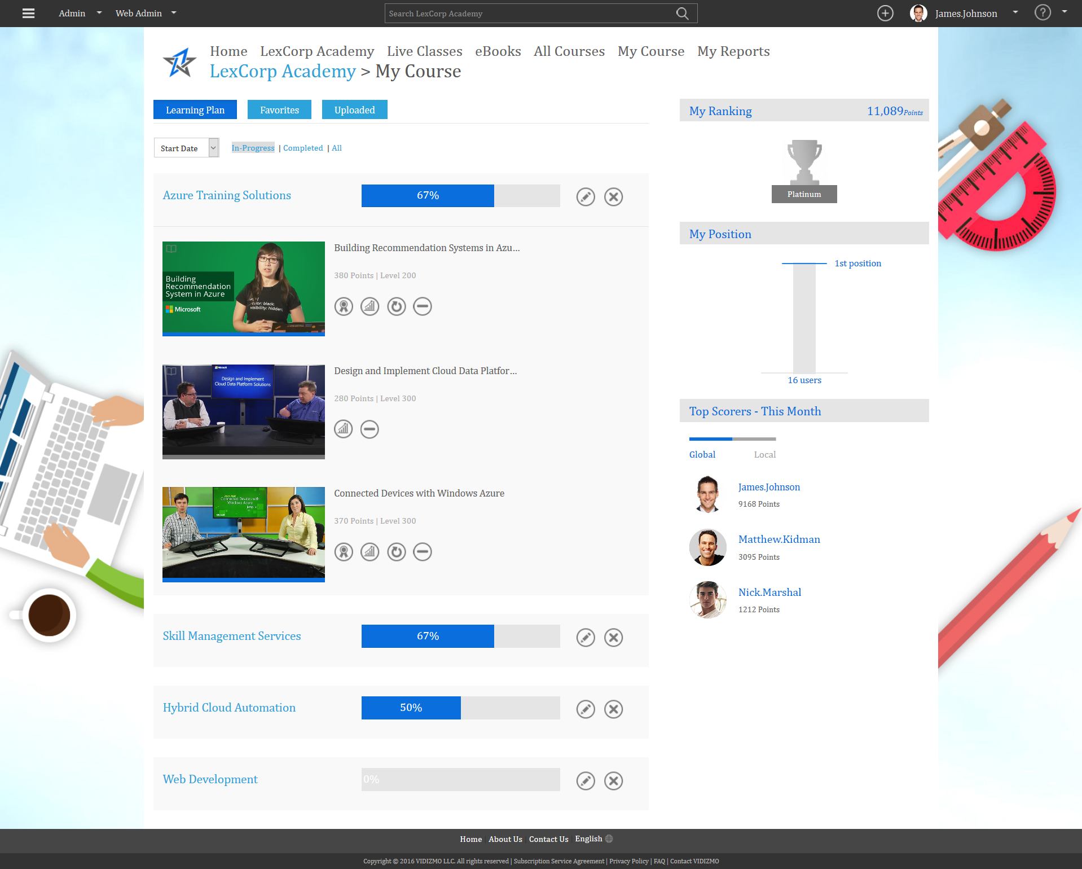
Personalized Learning Plans
This is the Learners personalized area. It shows the Assigned Courses, Learning Plans and it’s progress along with the Leaderboard and Top Scorer’s of the week

Slide 9
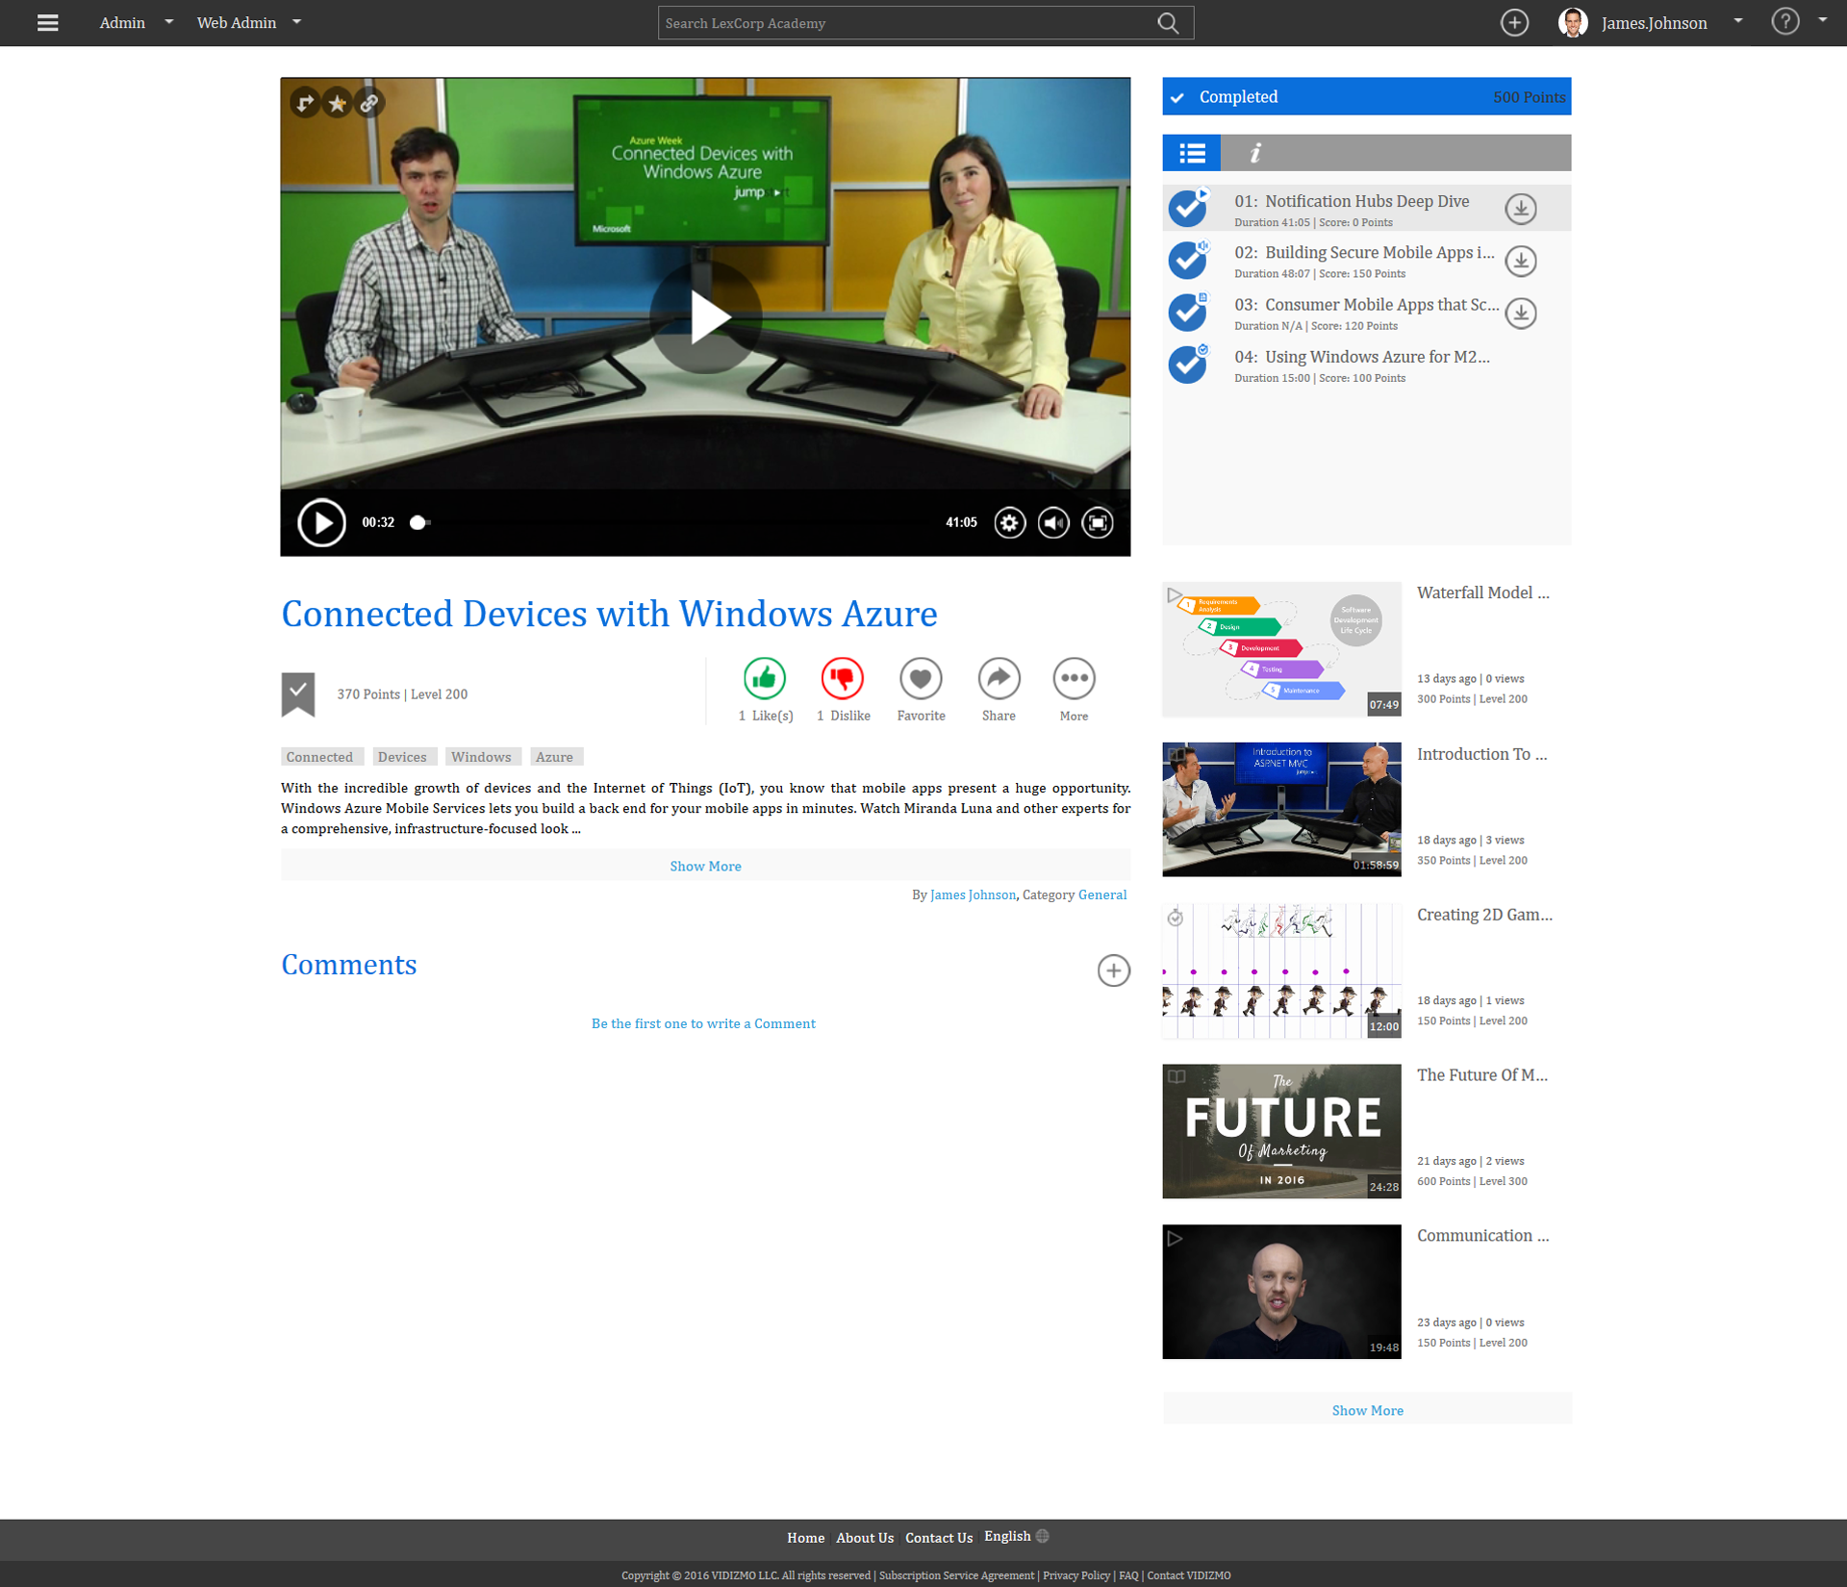
Interactive Presentations with real-time feedback
Learning Content includes streaming video, presentations, sounds, images quizzes , polls.

Slide 10
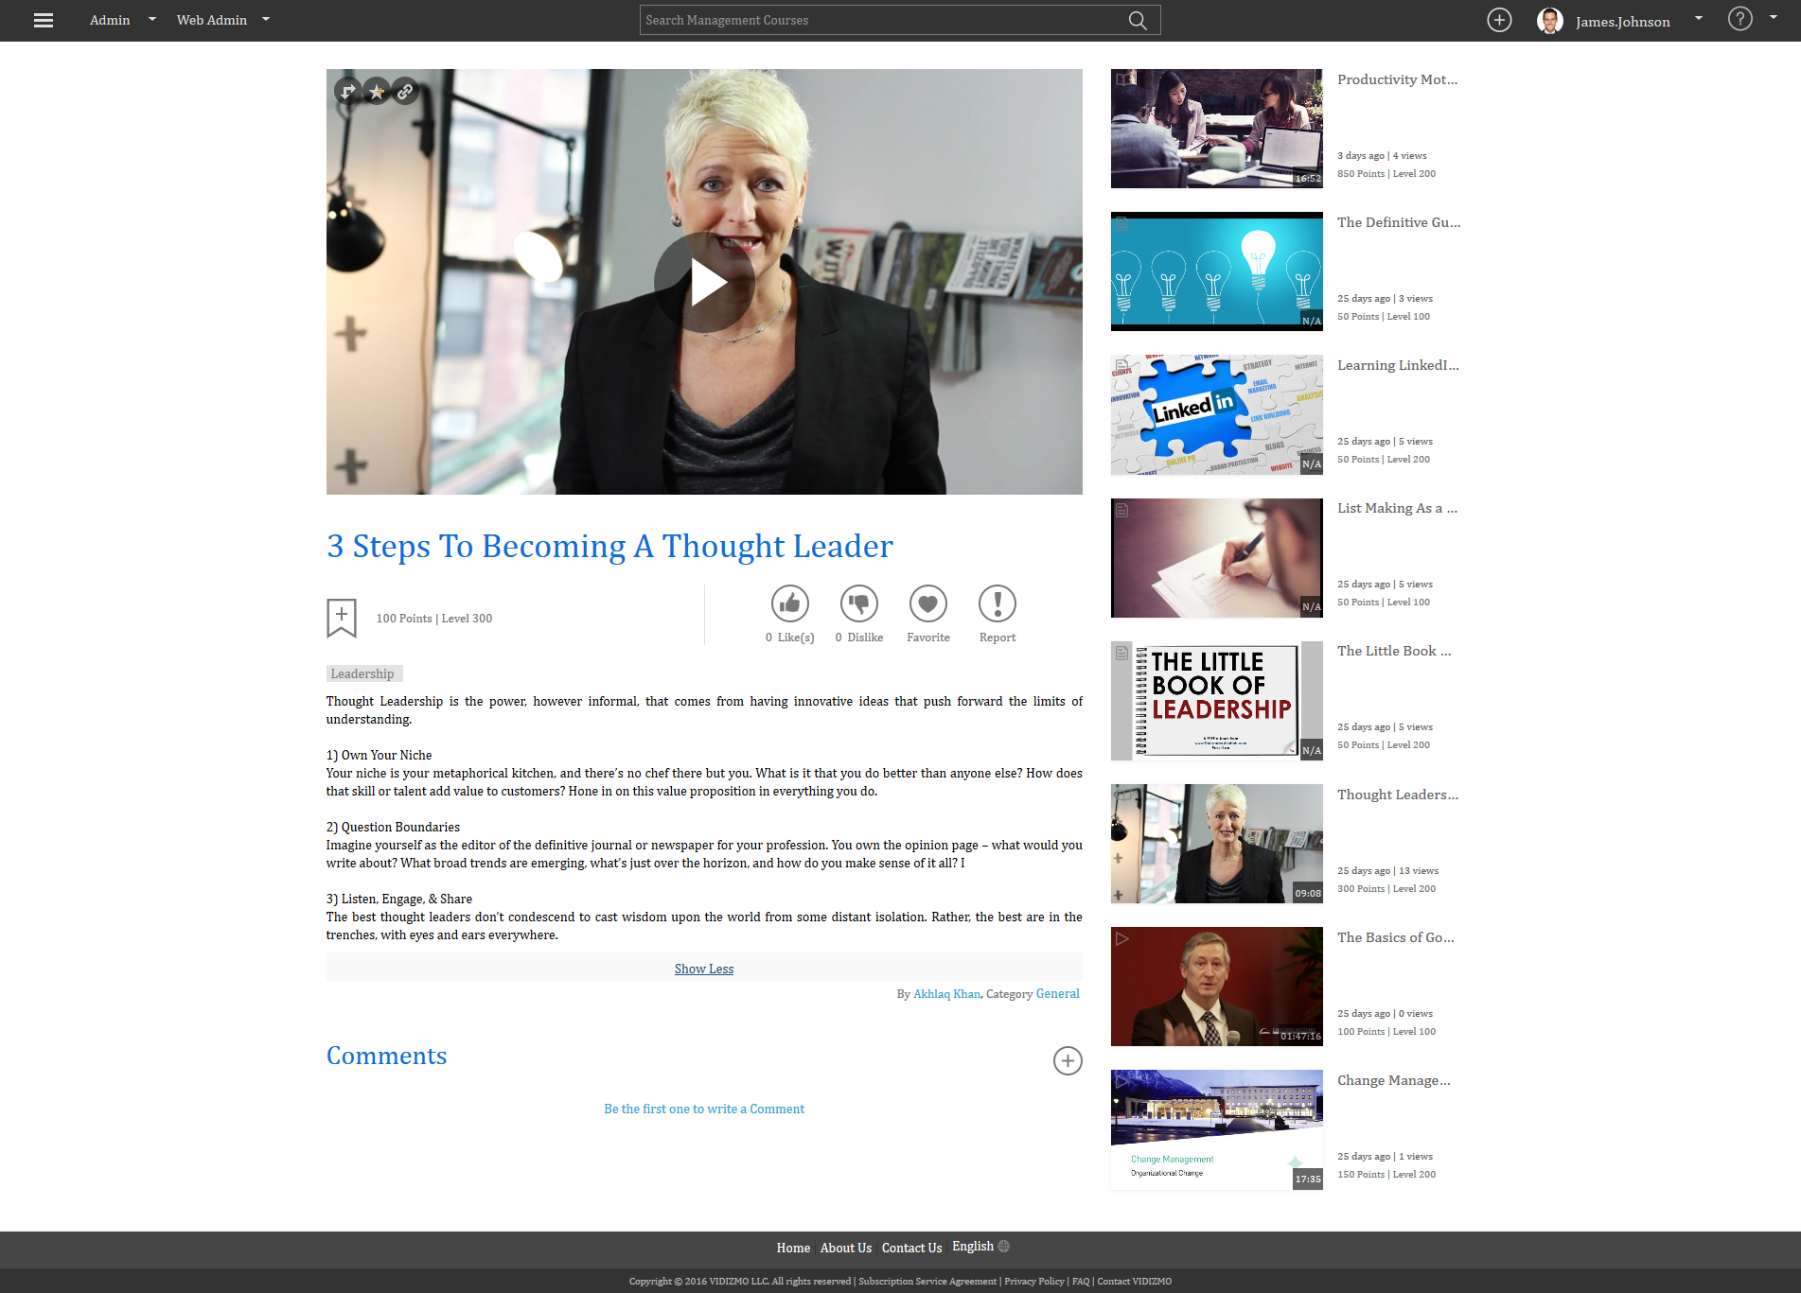
Video Playback
Learning Content in term of video

Slide 11
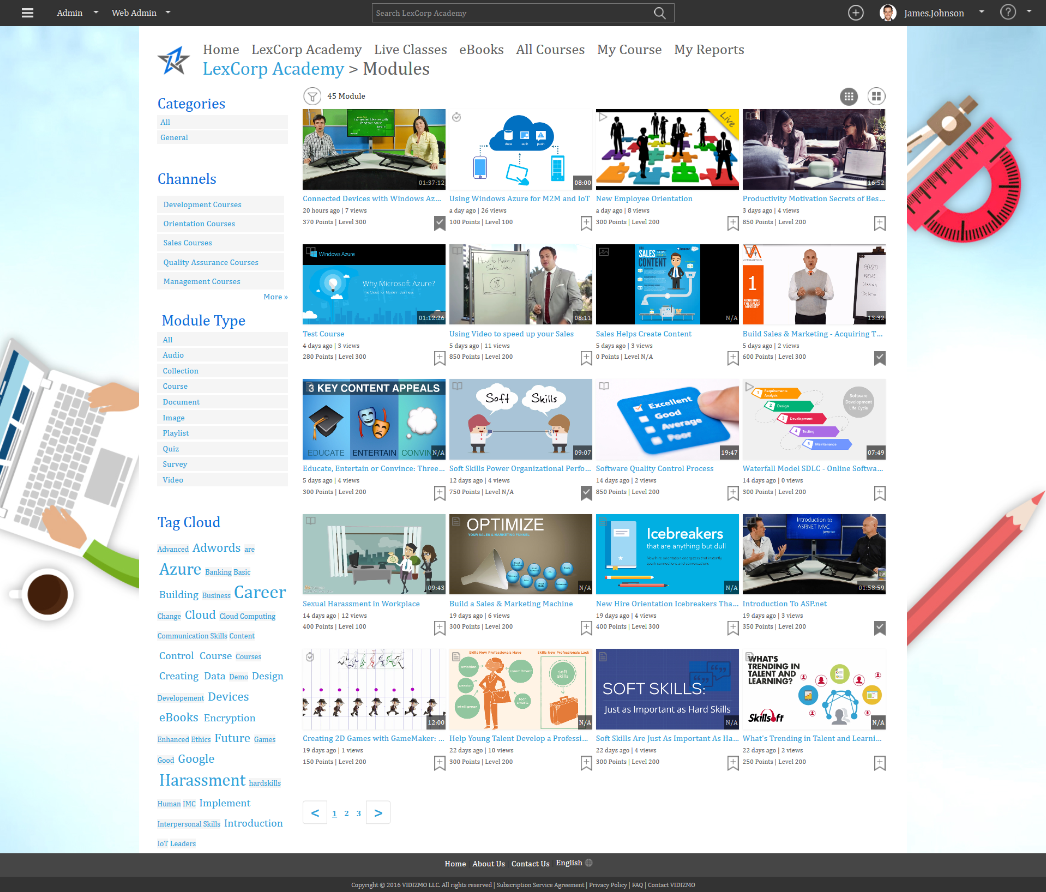
Search Library Overview
Search directly through the published Media. Content may include Video, Audio, Documents, PowerPoint Presentations etc.

Slide 12
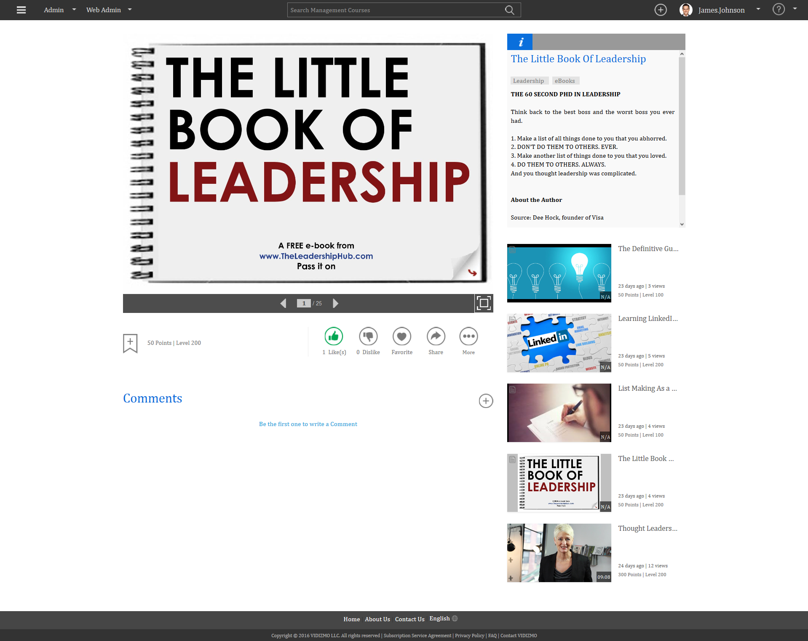
Multi-Media Slides, EBooks Brochures, Documents.
Learning content may include presentations , images , quizzes etc.

Slide 13
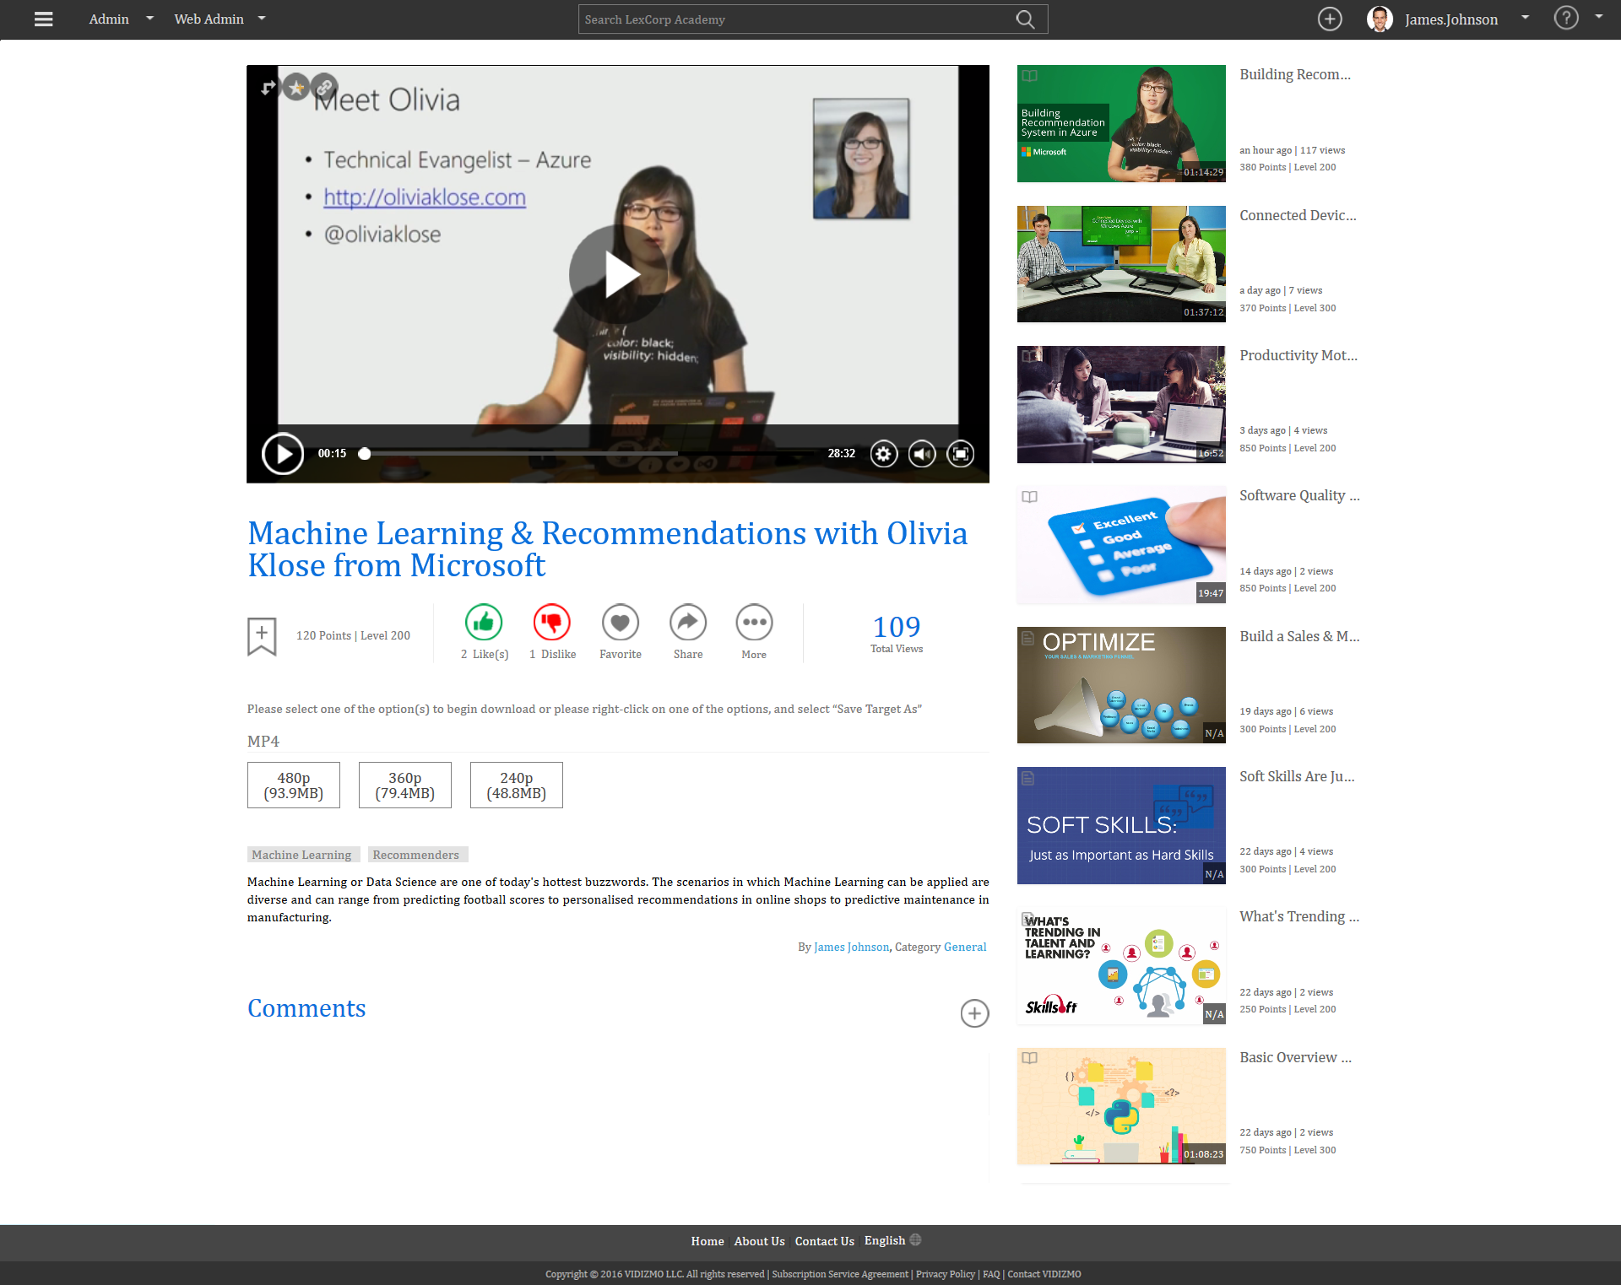
Video & Content Download
Learning Content can be downloaded in various resolutions as required.

Slide 14
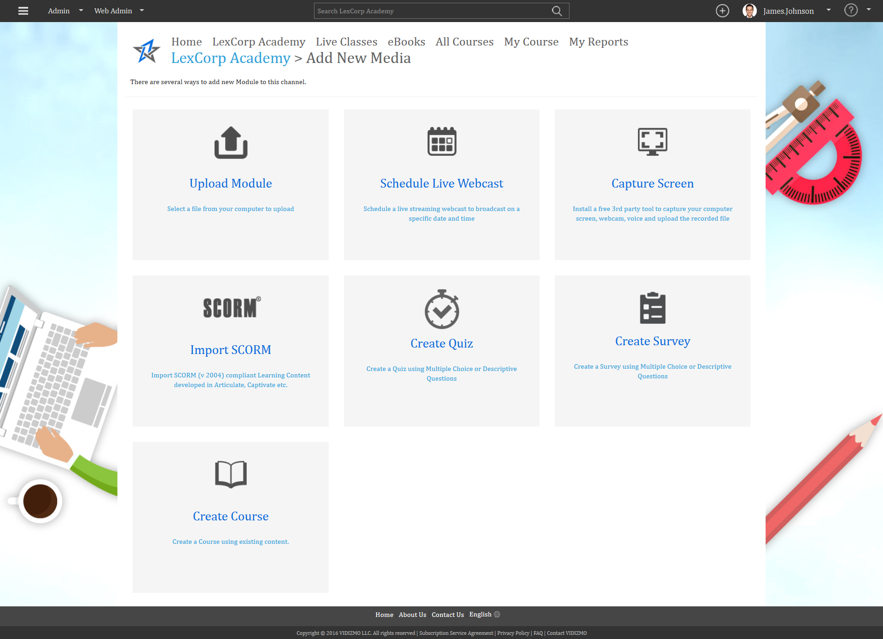
Media Management Dashboard
Clean mobile friendly responsive layout to perform all built-in features

Slide 15
Upload Module
Add a upload Content

Slide 16
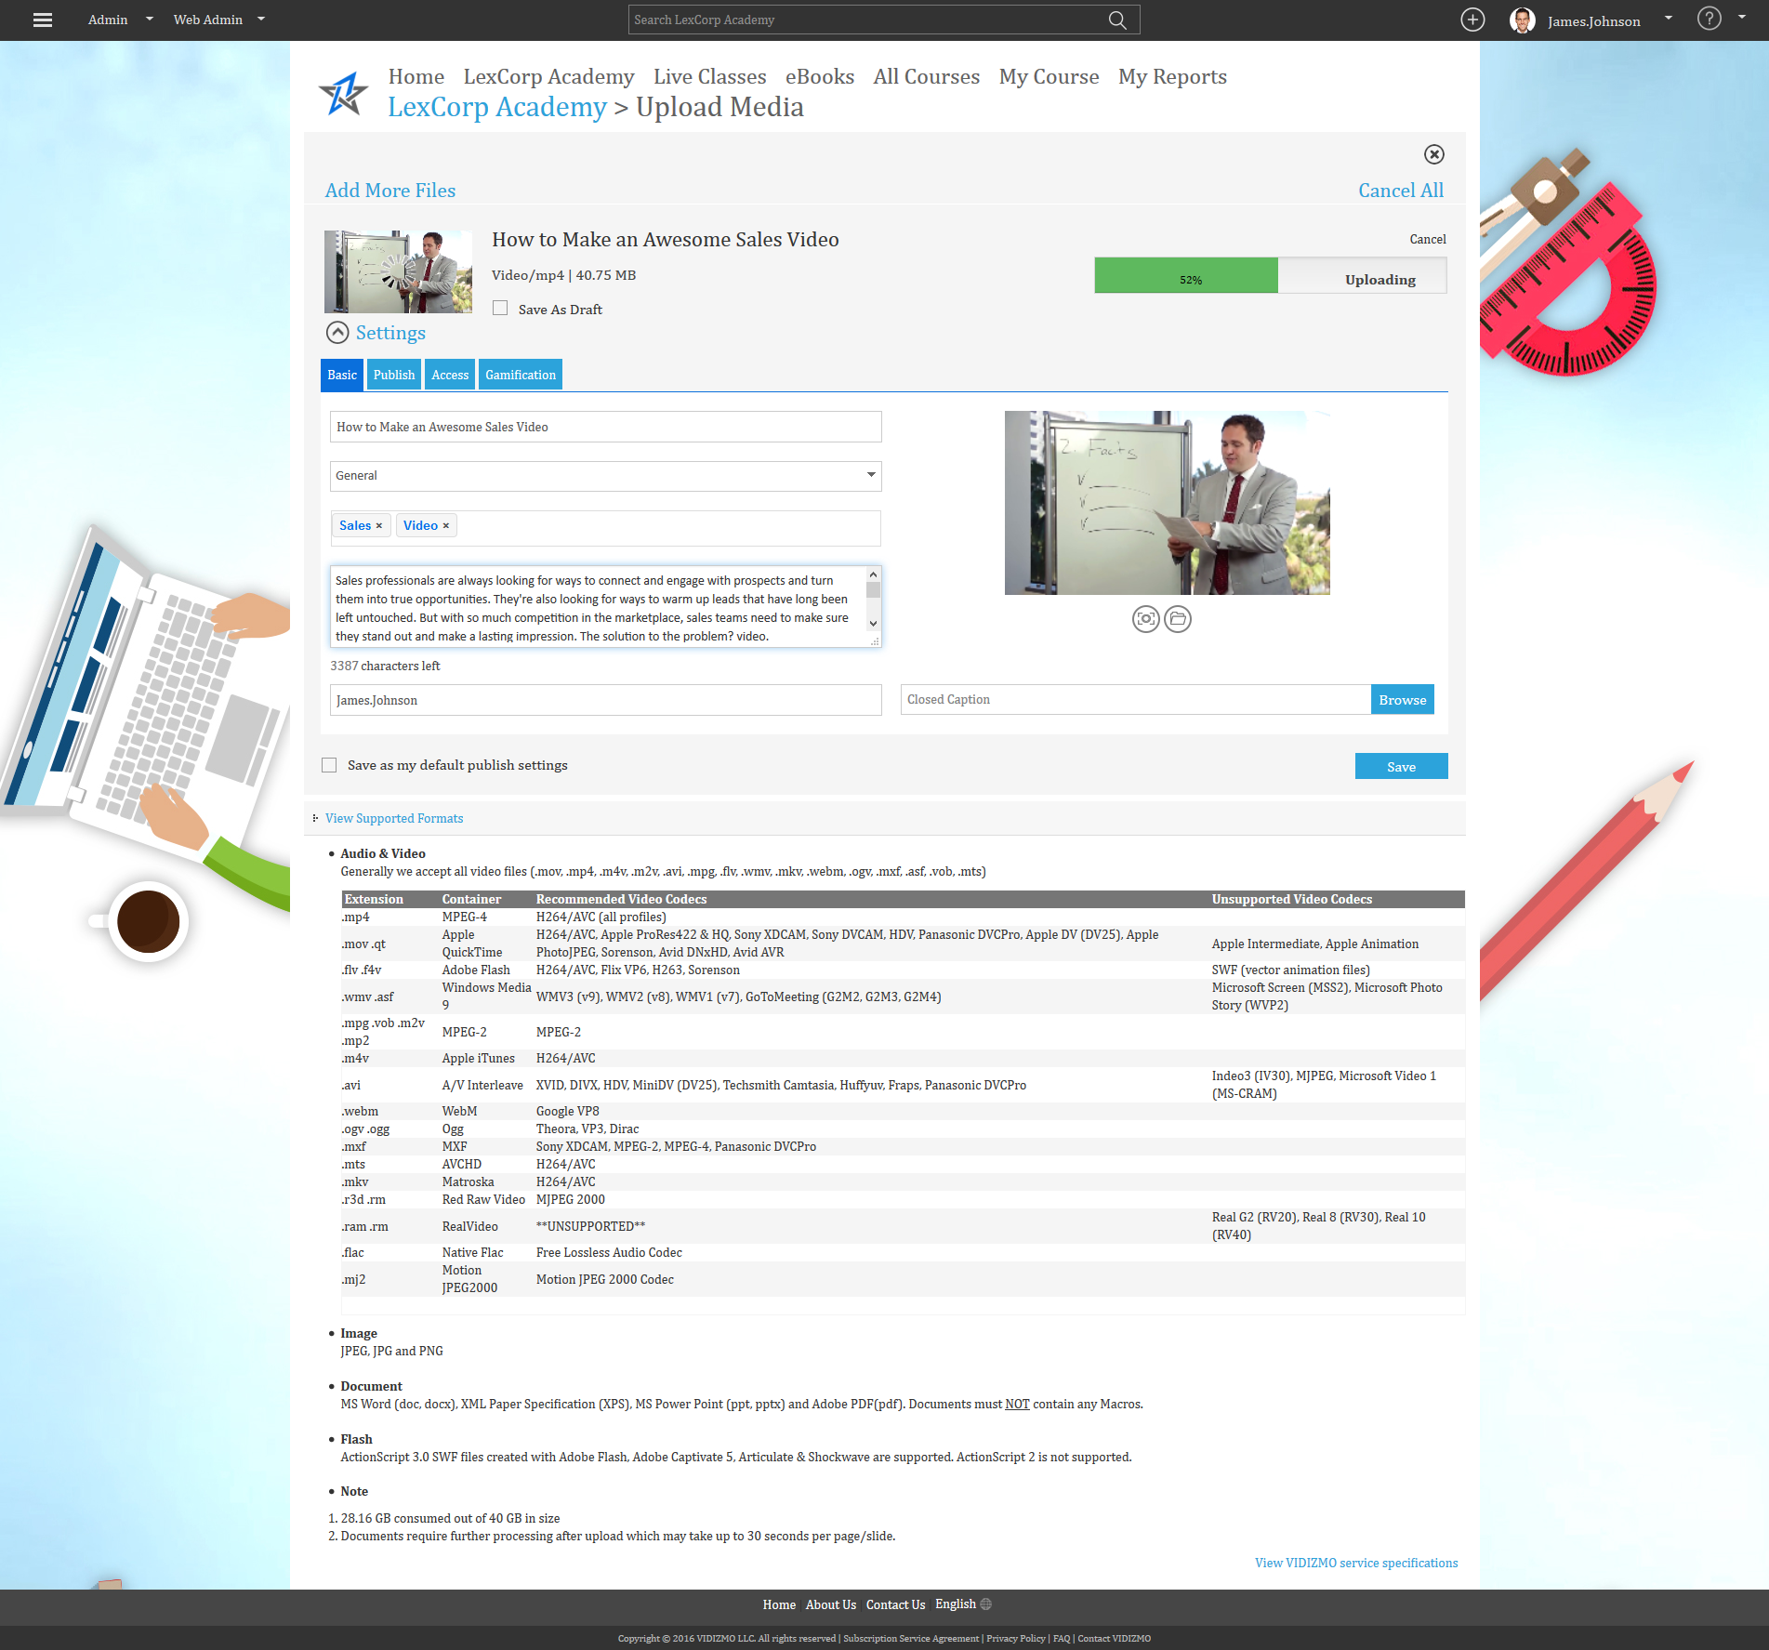
Upload Module
Uploading Start
1. Basic Settings with Title, Category, Tags Description & Author Name with supported Formats Audio & Video

Slide 17
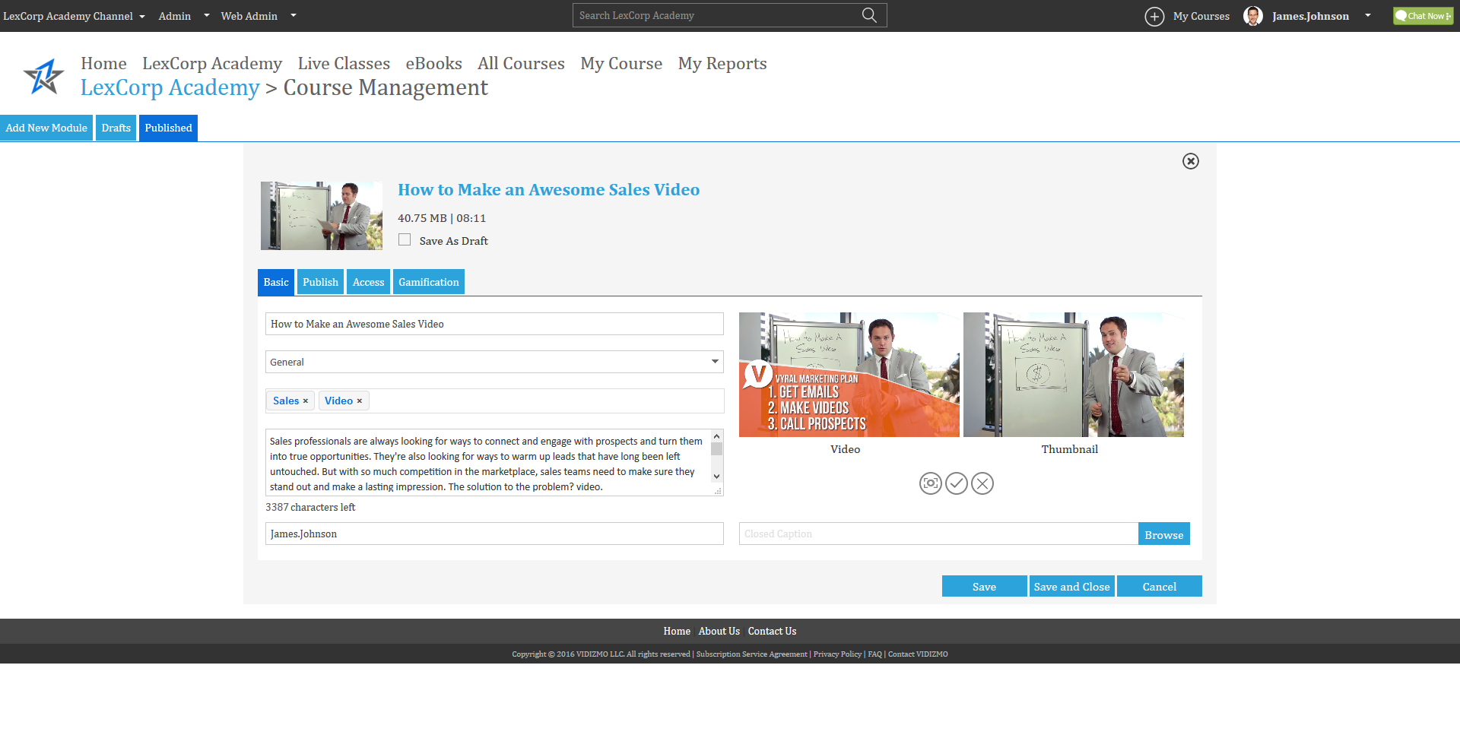
Upload Module
Capture Thumbnail from Video

Slide 18
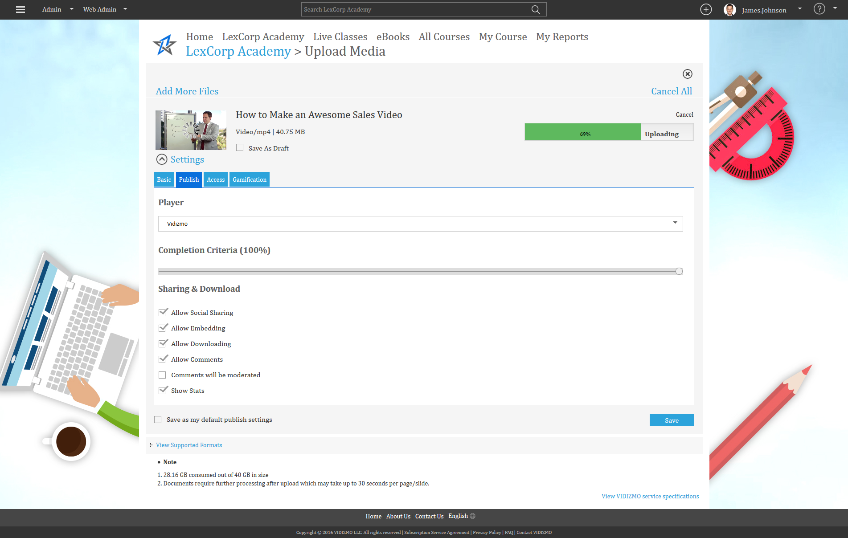
Upload Module
2. Publish Settings with Sharing & Downloads

Slide 19
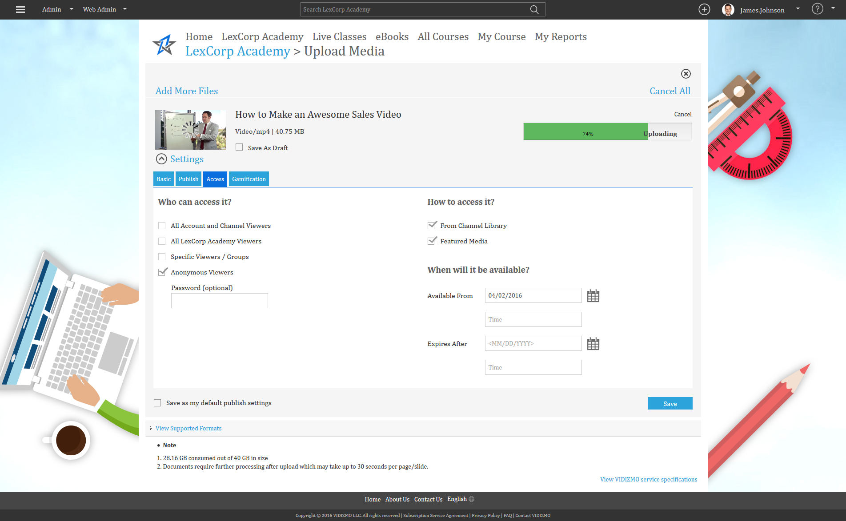
Upload Module
3. Access Settings with Anonymous Viewers

Slide 20
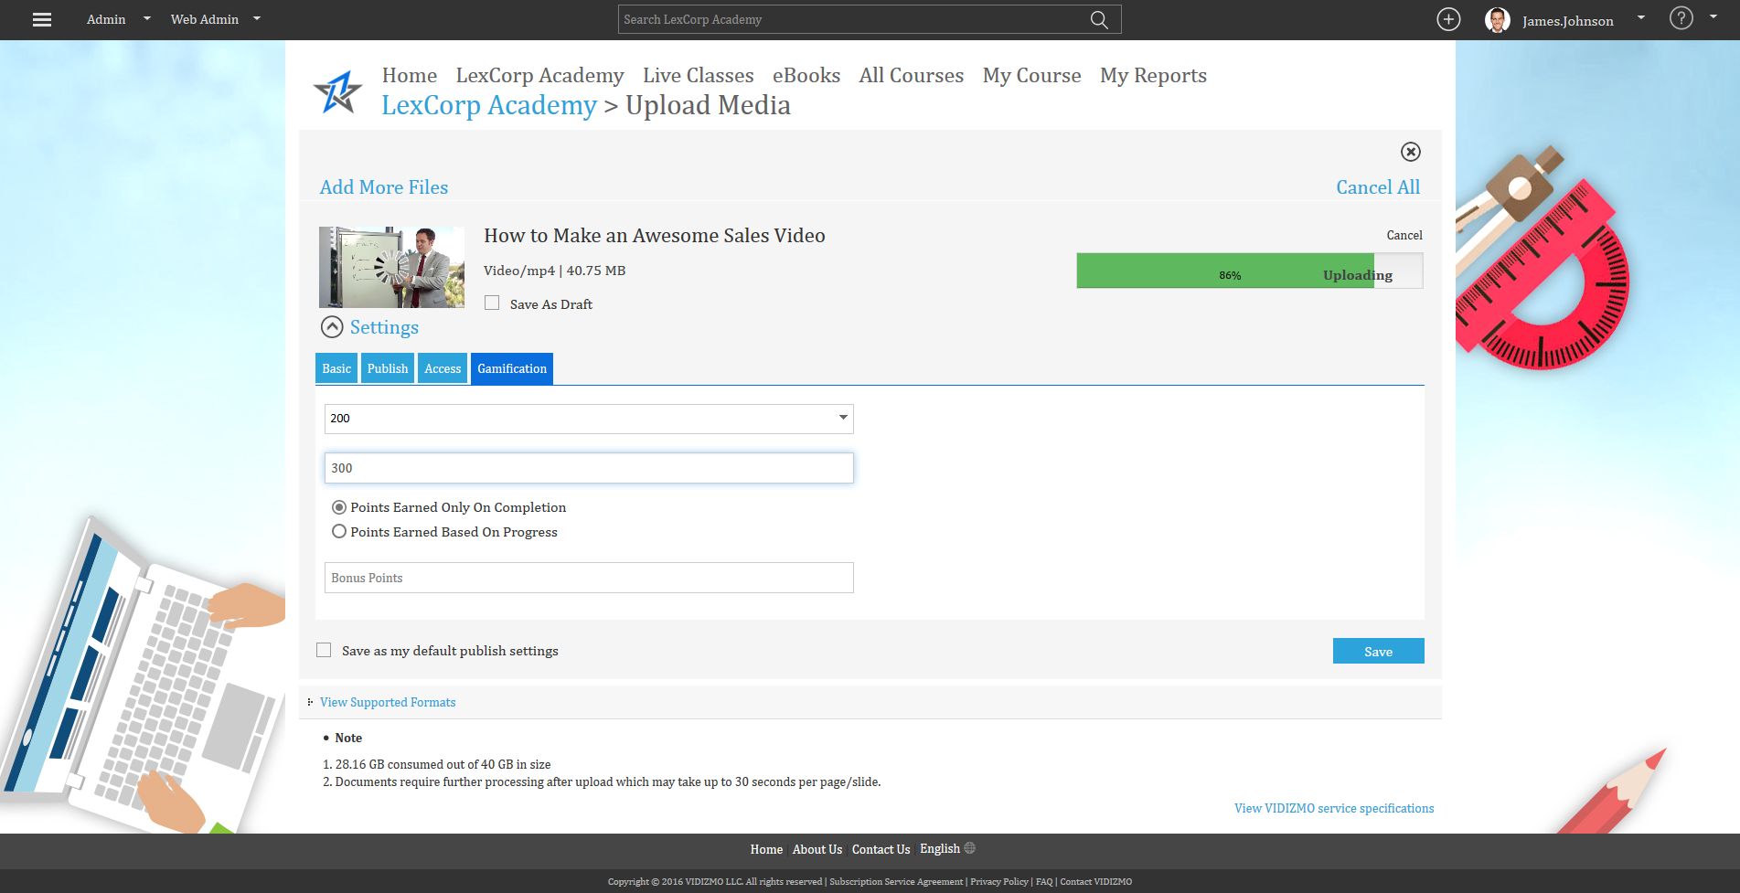
Upload Module
4. Gamification Setting of Points & Levels

Slide 21
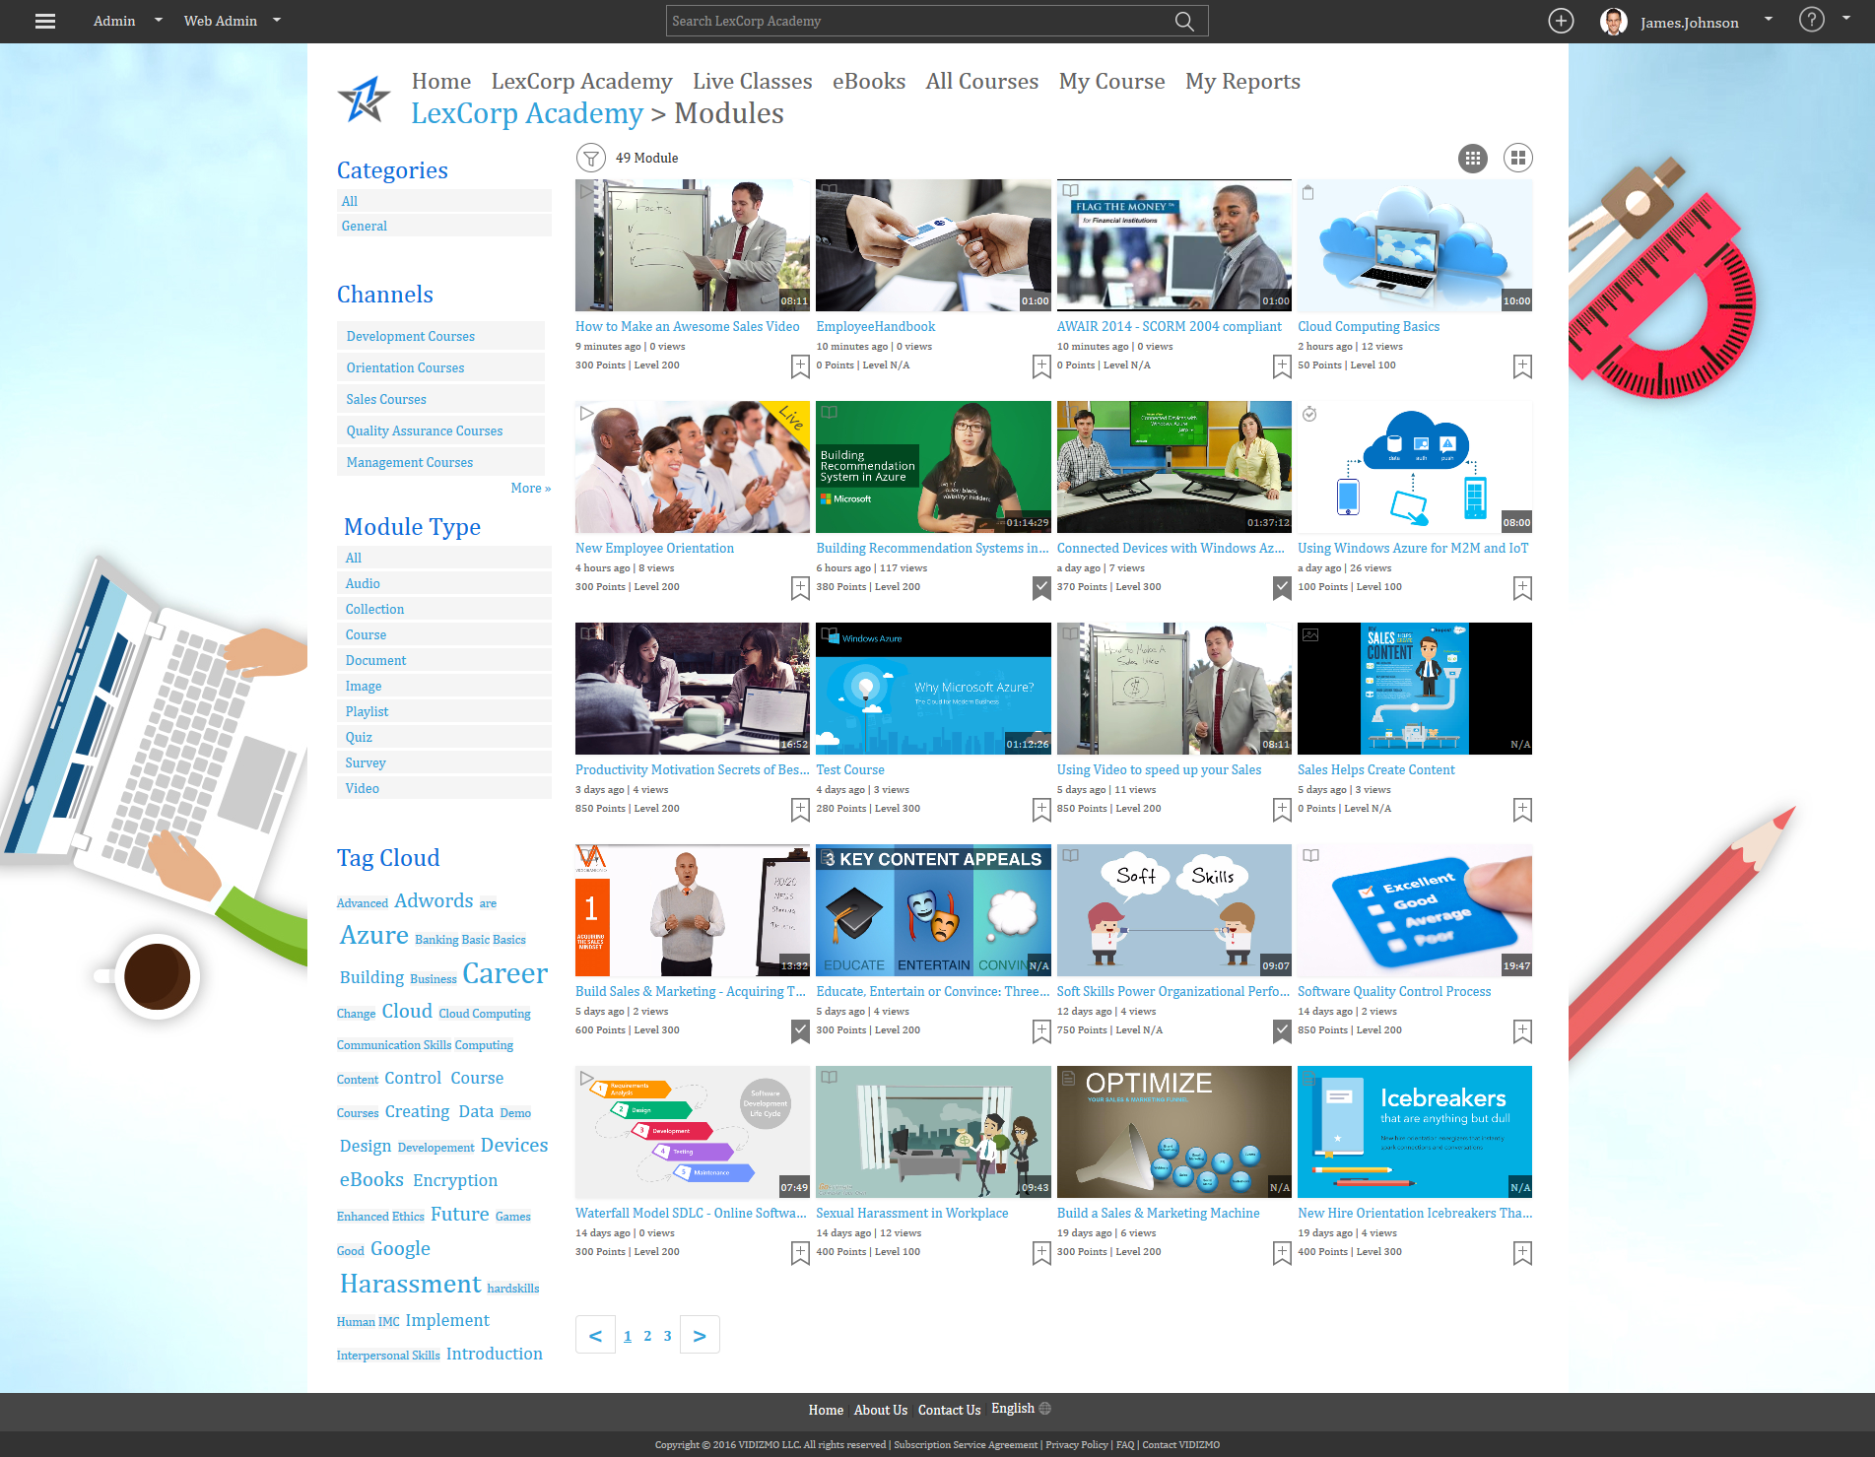
Module Uploaded

Slide 22
Module Presentation

Slide 23
Creating a Schedule Live Webcast
Create a Live by combining multiple digital assets and assign in to learners/viewers.

Slide 24
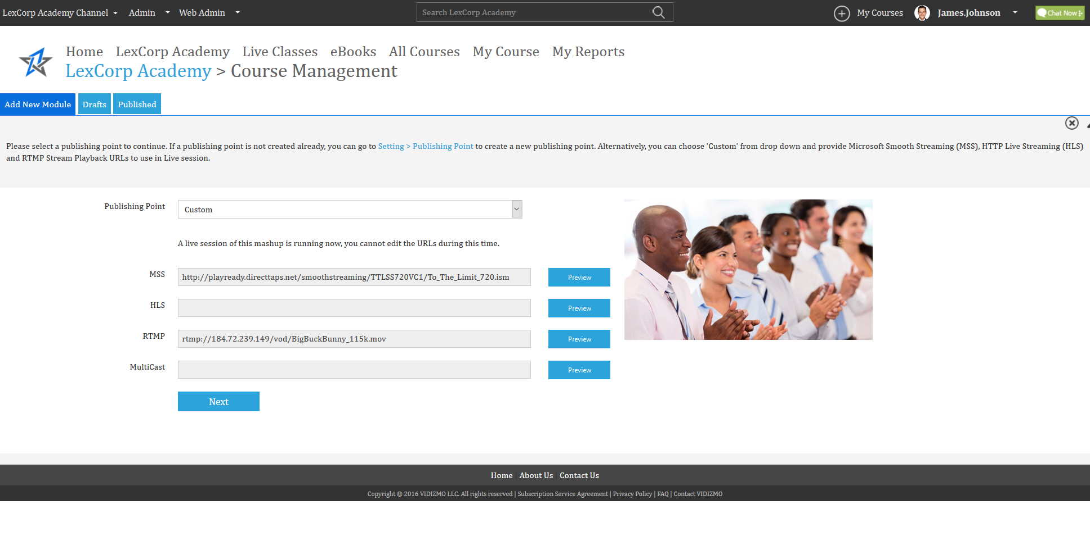
Create a New Publishing Point
Please select a publishing point to continue. If a publishing point is not created already, you can go Settings -> Publishing Point to create a new publishing point

Slide 25
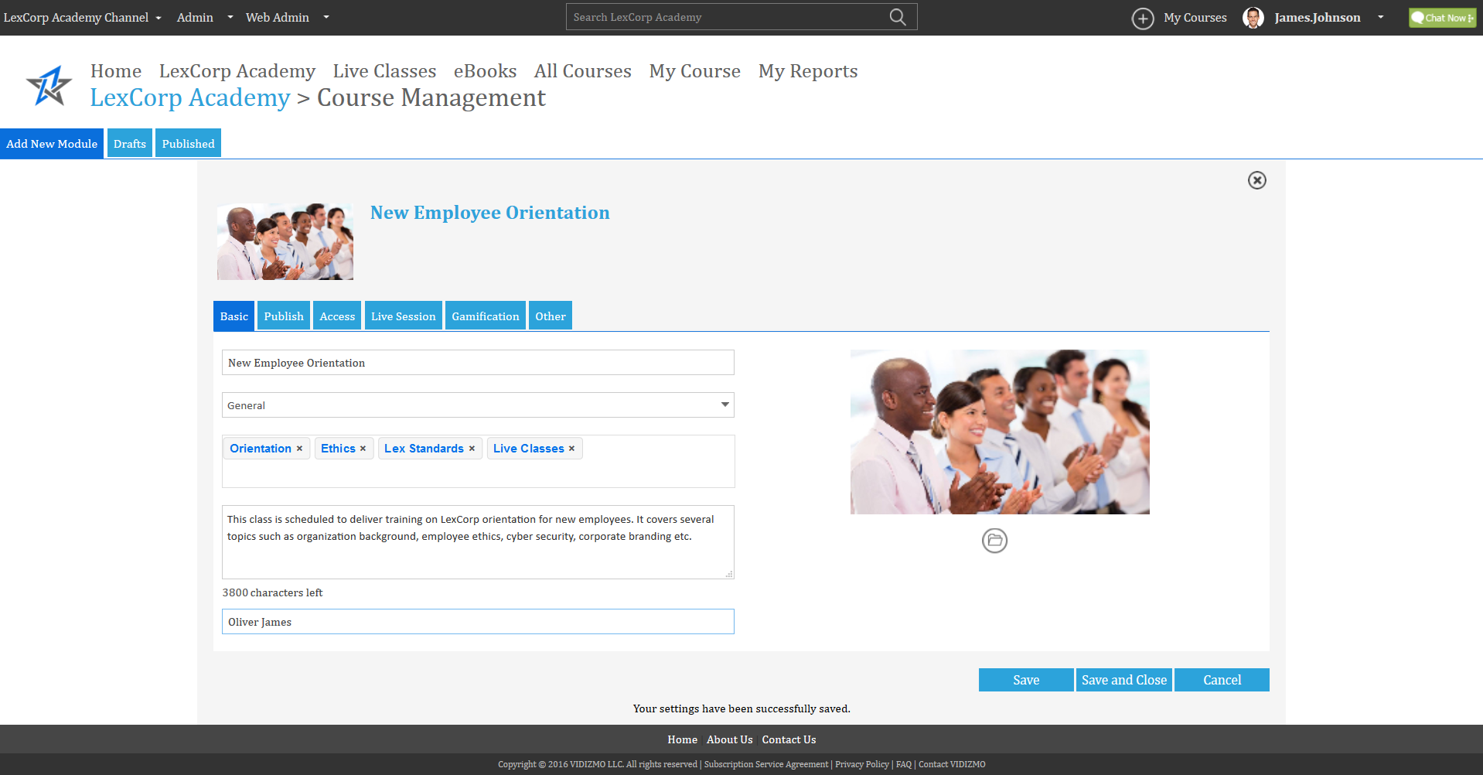
Live Webcast Settings
1. Basic Tab

Slide 26
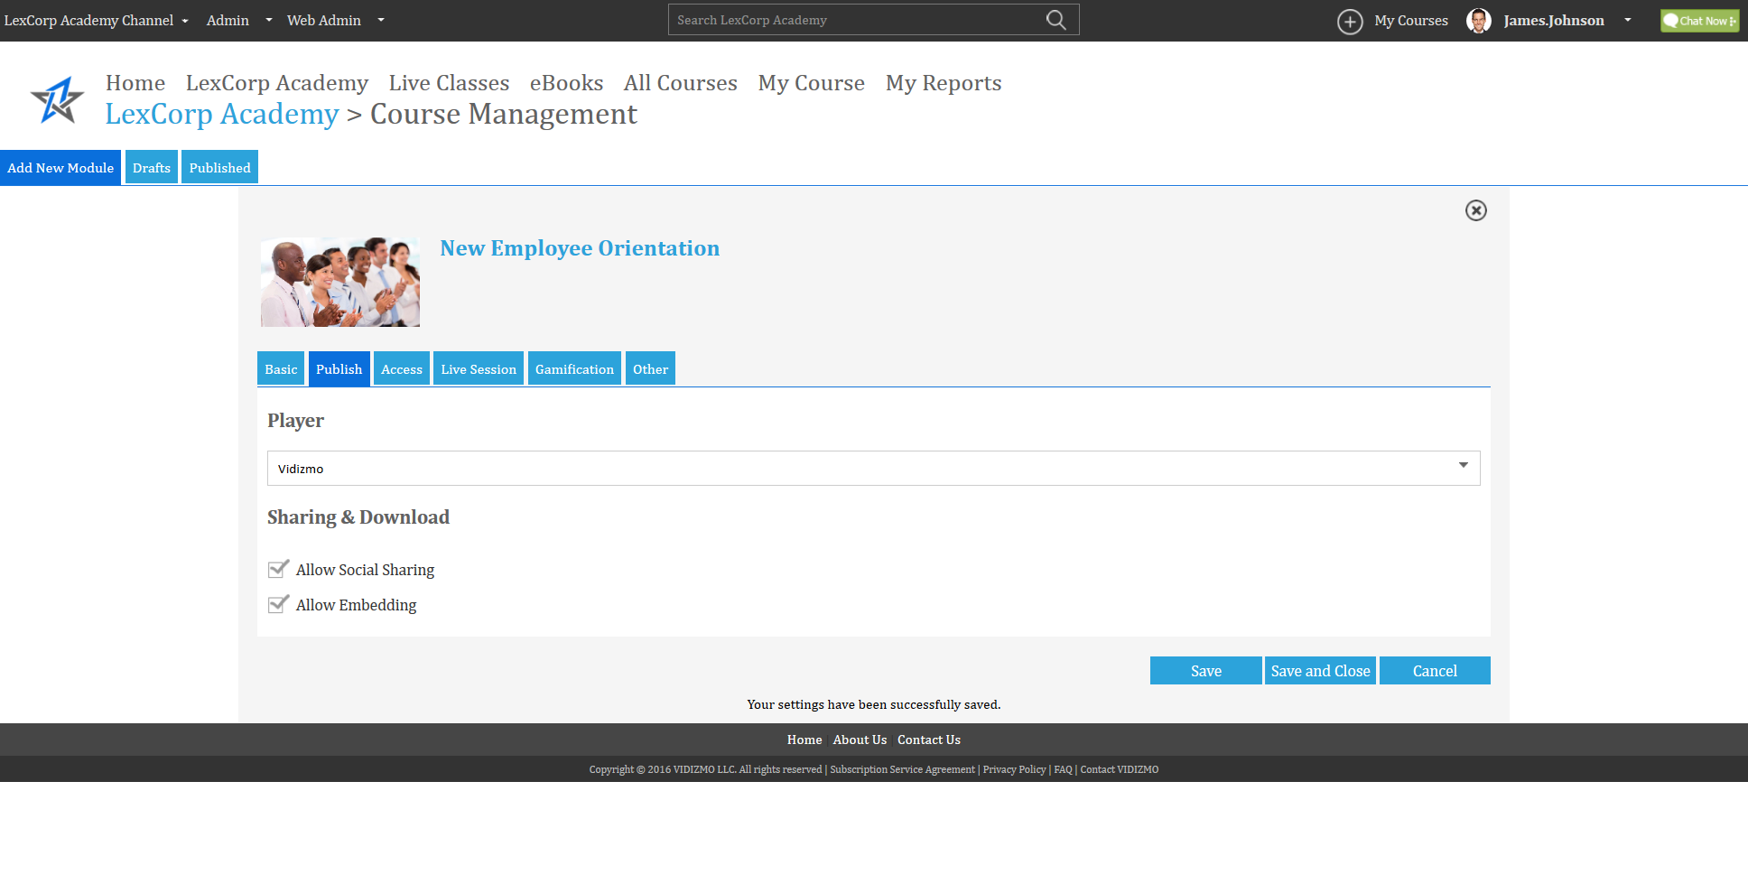
Live Webcast Settings
2. Publish Tab

Slide 27
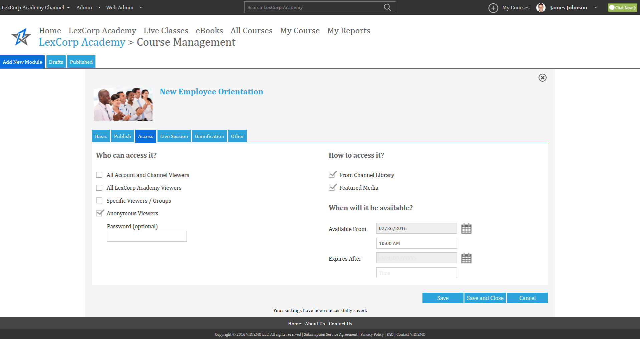
Live Webcast Settings
3. Access Tab

Slide 28
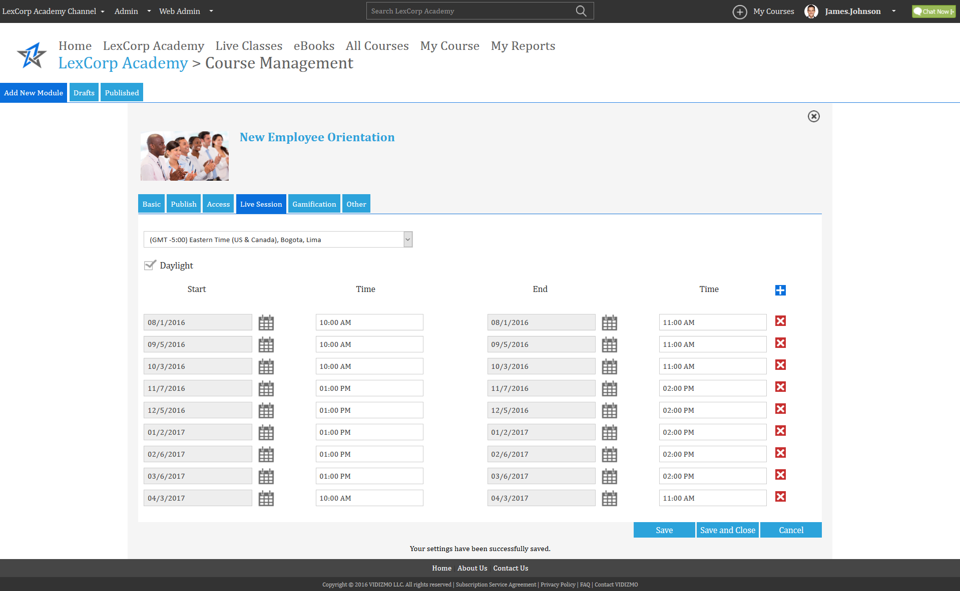
Live Webcast Settings
4. Live Session

Slide 29
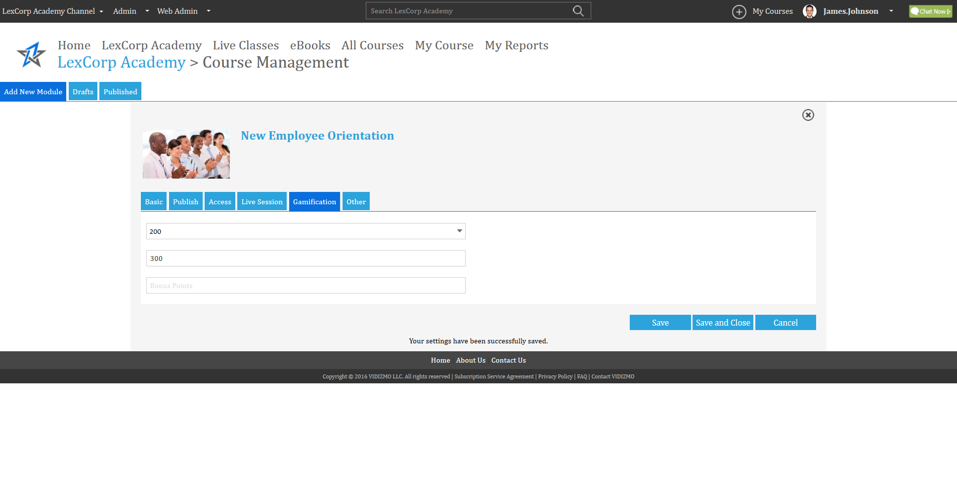
Live Webcast Settings
5. Gamification Tab

Slide 30
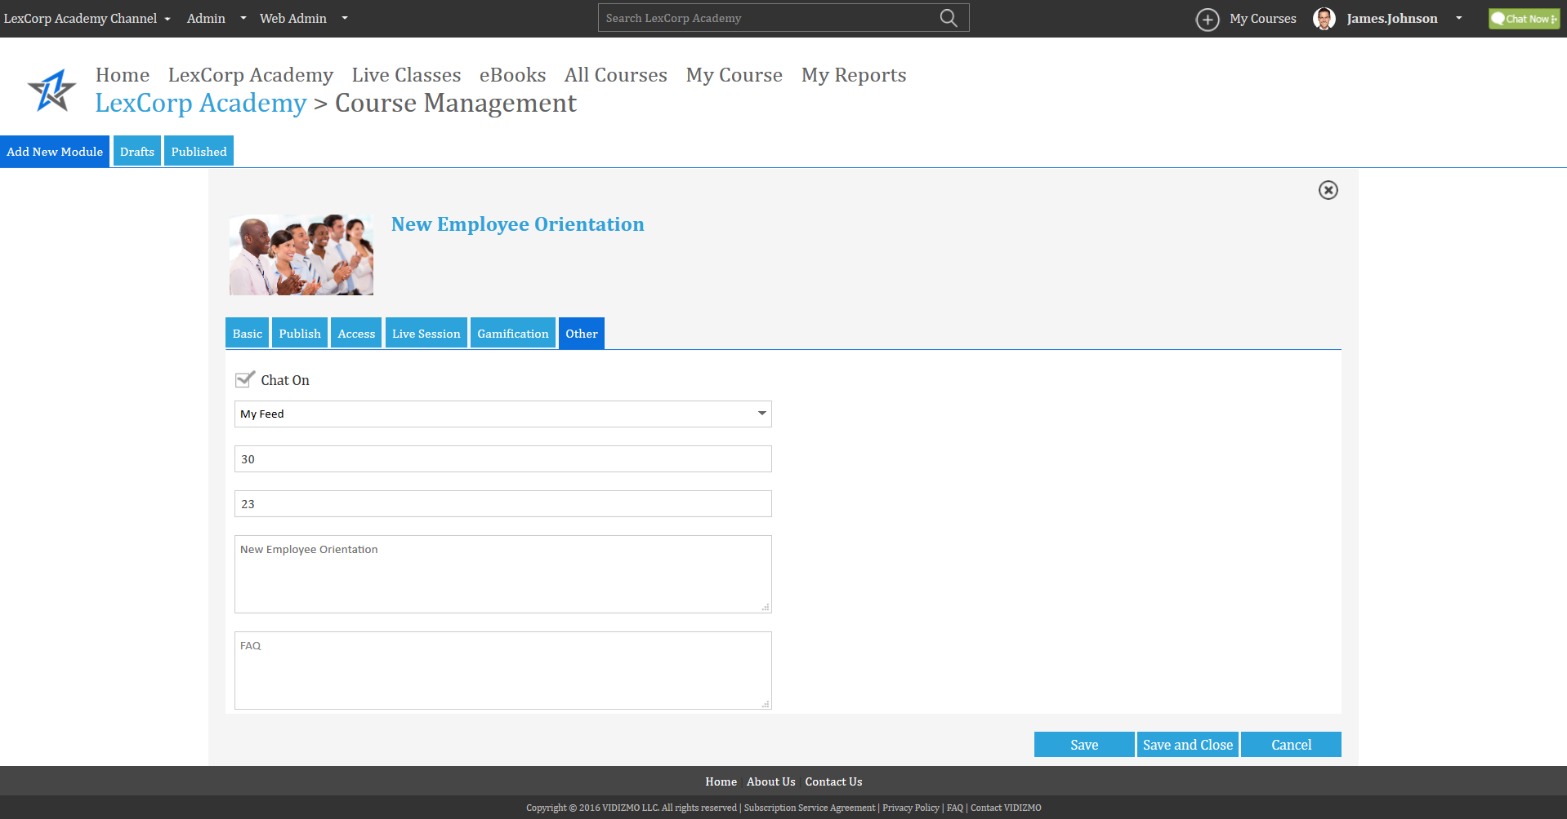
Live Webcast Settings
6. Others Tab

Slide 31
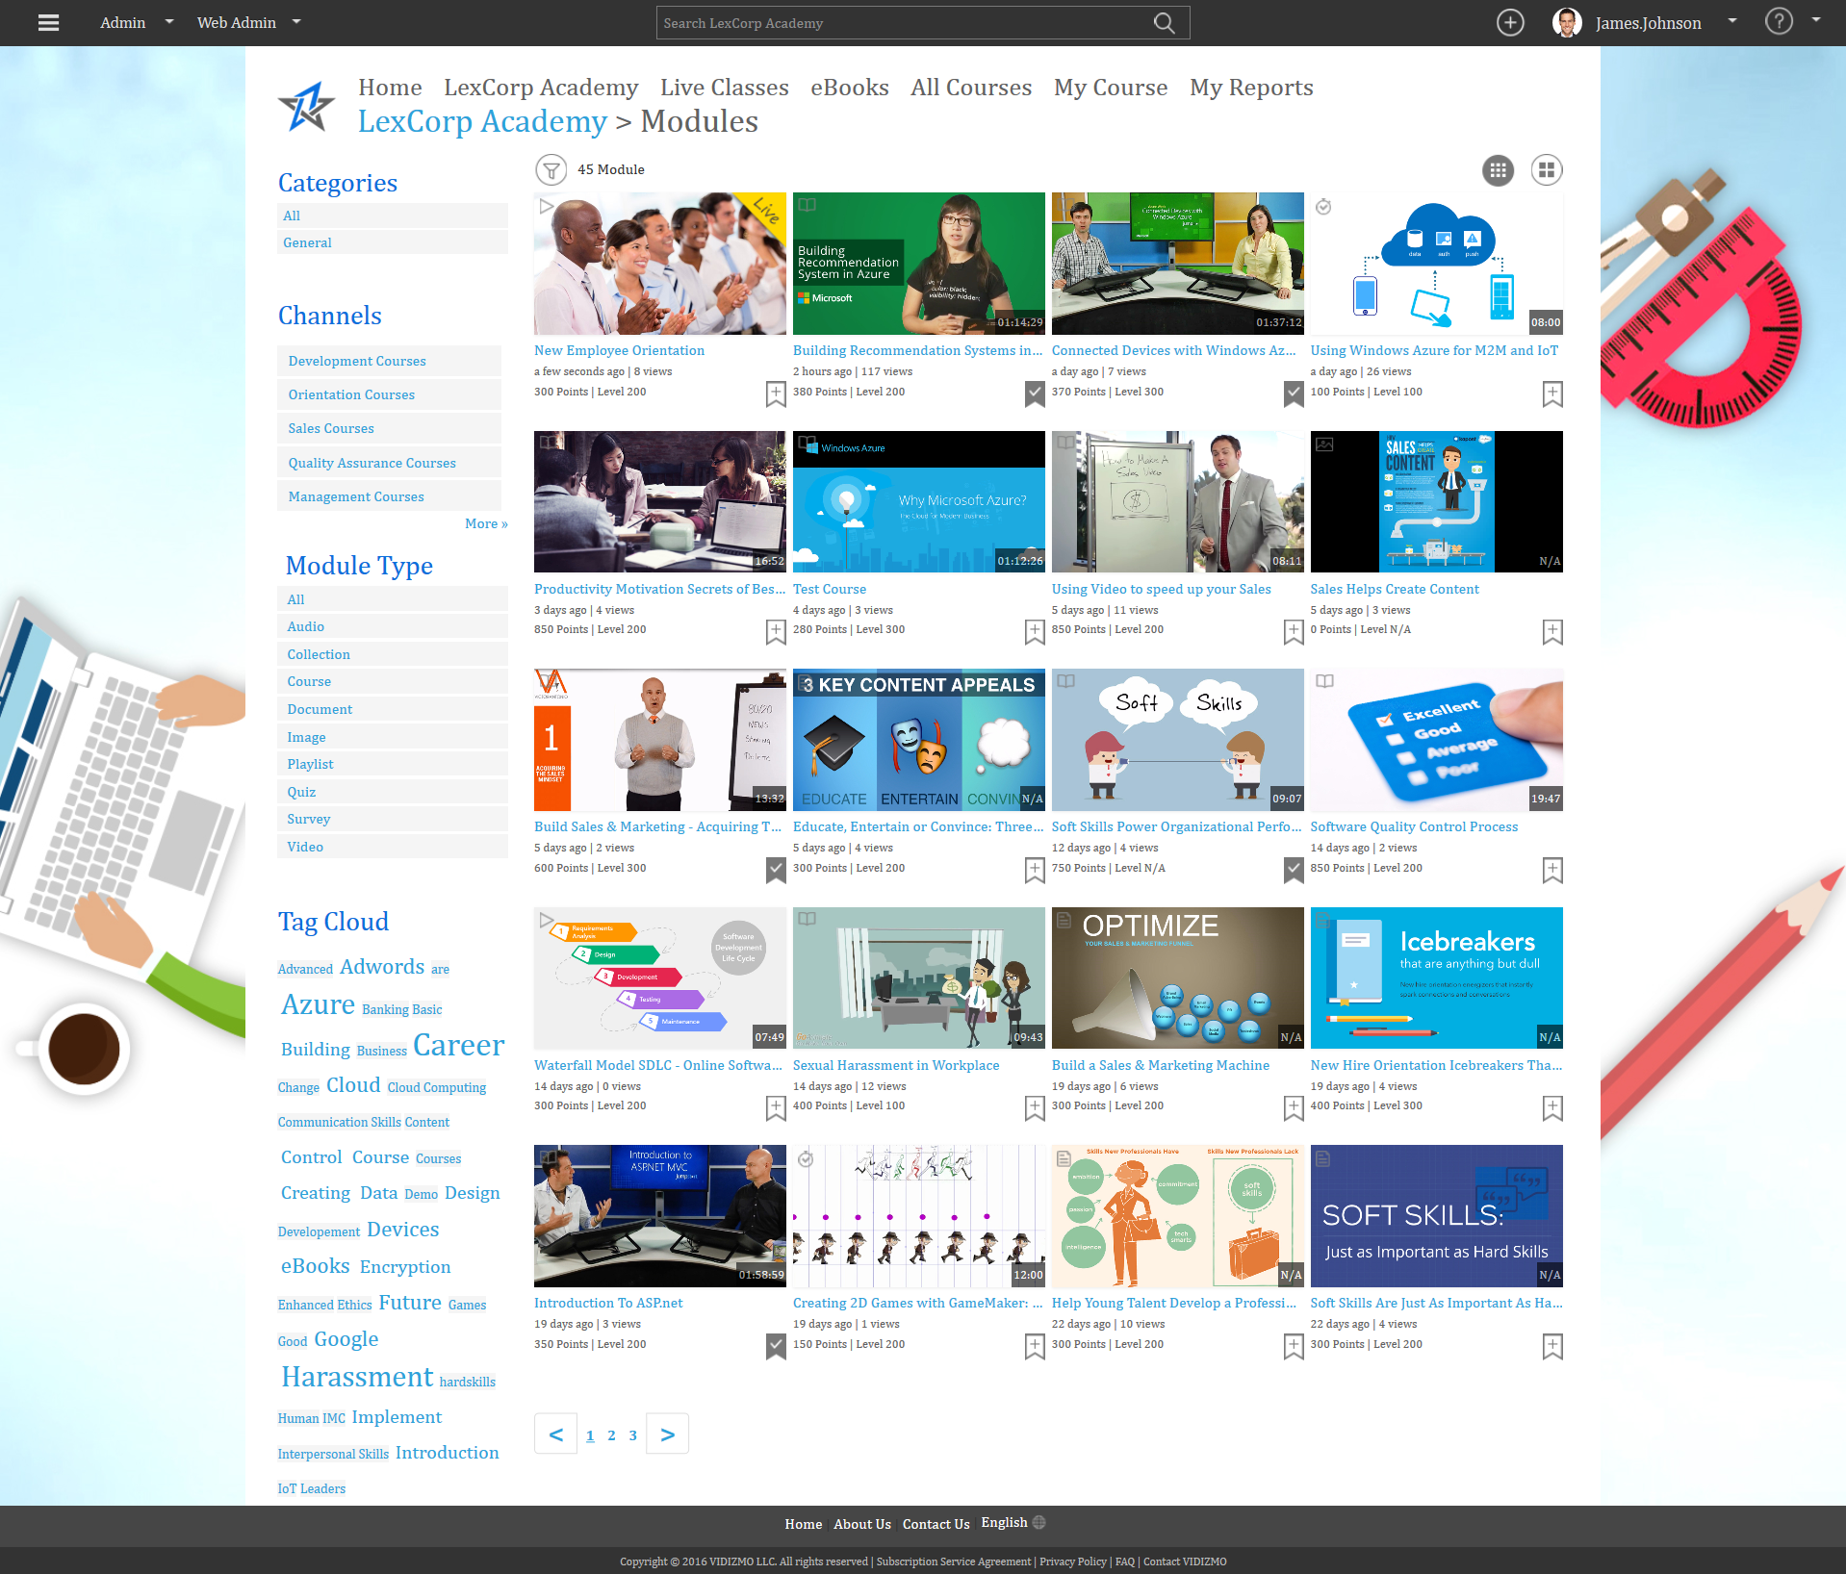
Live Webcast Session Created

Slide 32
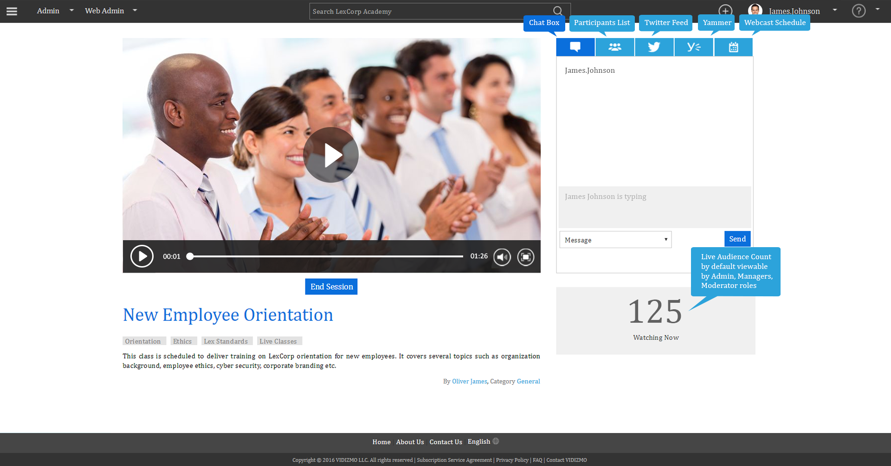
Live Streaming Session with Chat
Conduct unlimited Live Streaming Sessions. Include Chat, Twitter Feed, Yammer Feed for the viewers.

Slide 33
Creating a Course
Create a course by combining multiple digital assets and assign in to learners/viewers.

Slide 34
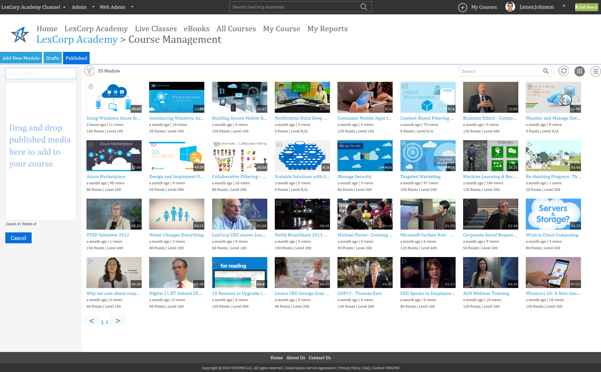
Create a Course 1/2
Your course can include videos, sounds, images, documents, quizzes, polls, surveys
Notes:
Showing Learning Plan

Slide 35
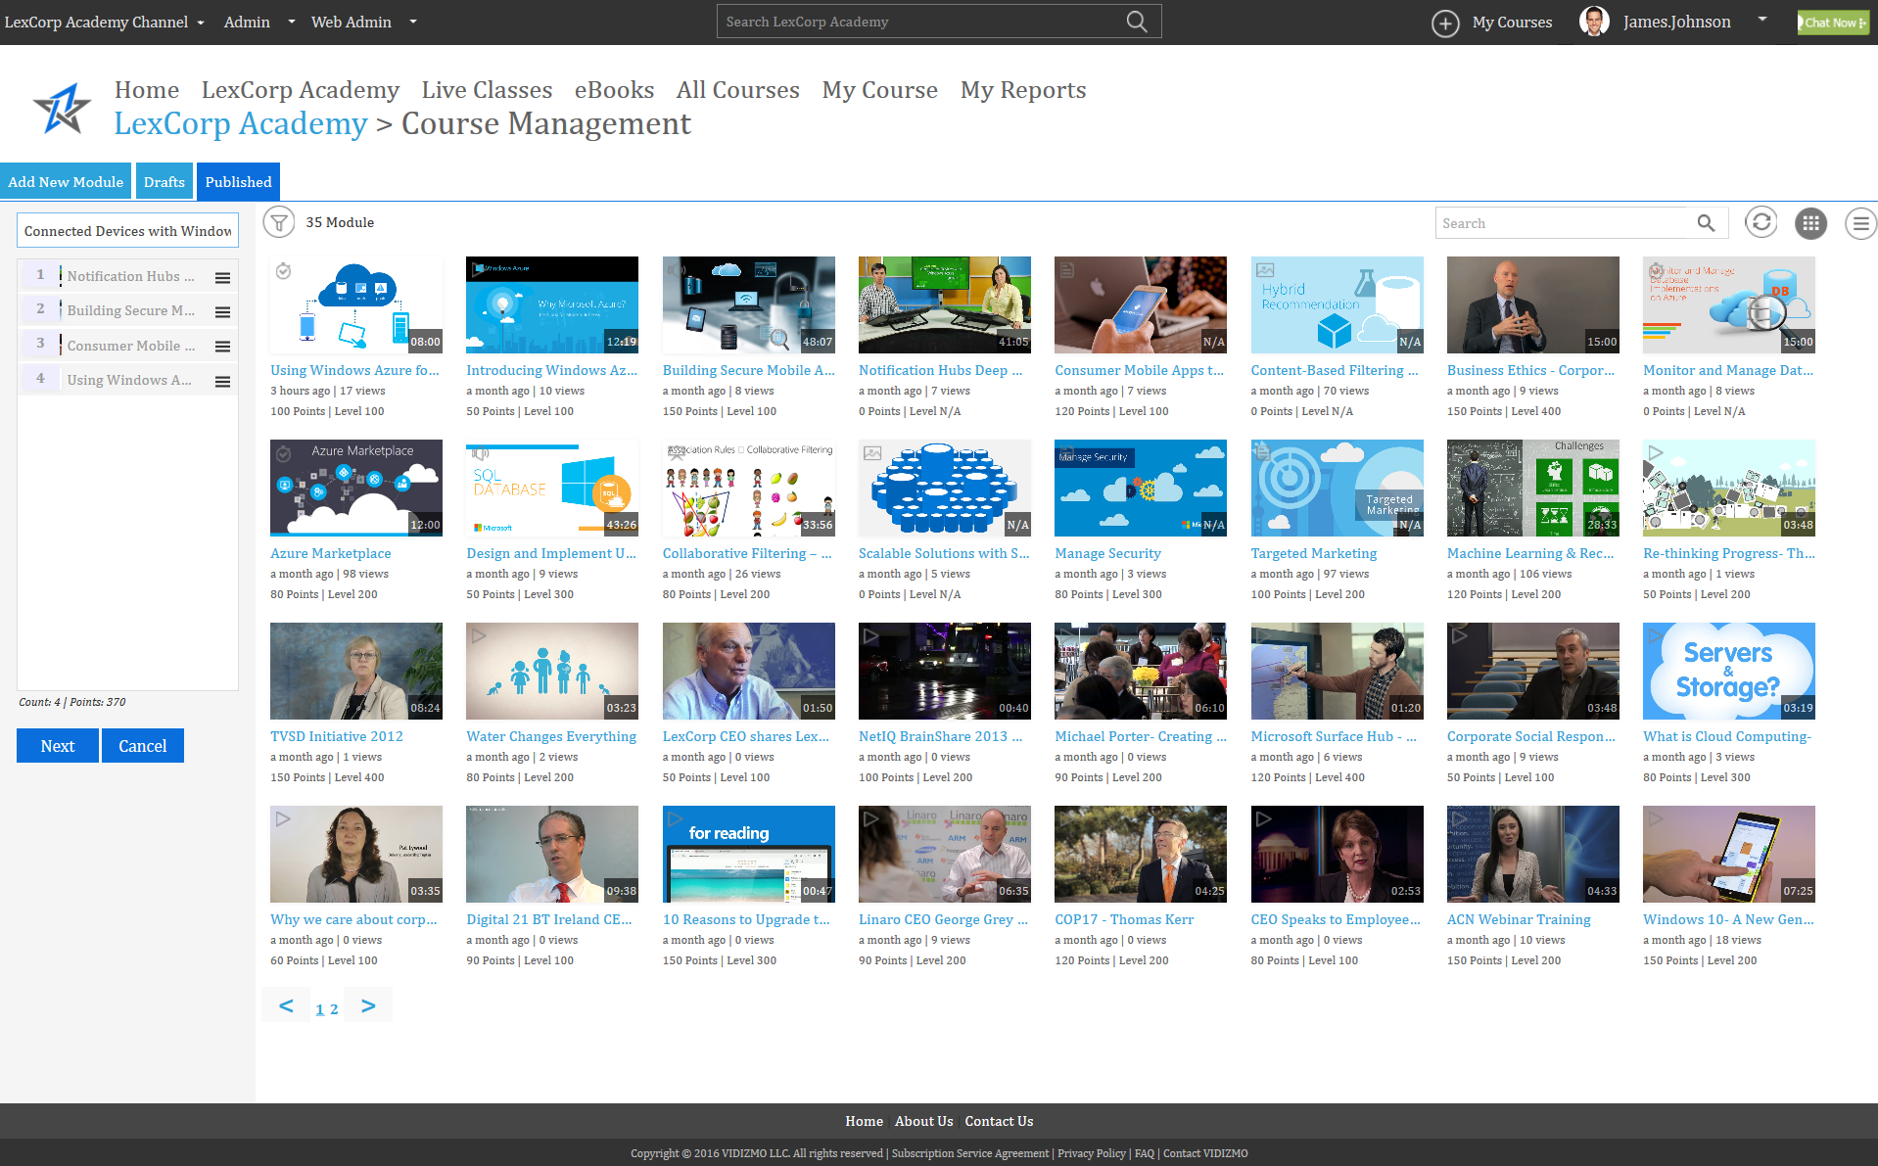
Create a Course 2/2
Your course can include videos, sounds, images, documents, quizzes, polls, surveys
Notes:
Showing Learning Plan

Slide 36
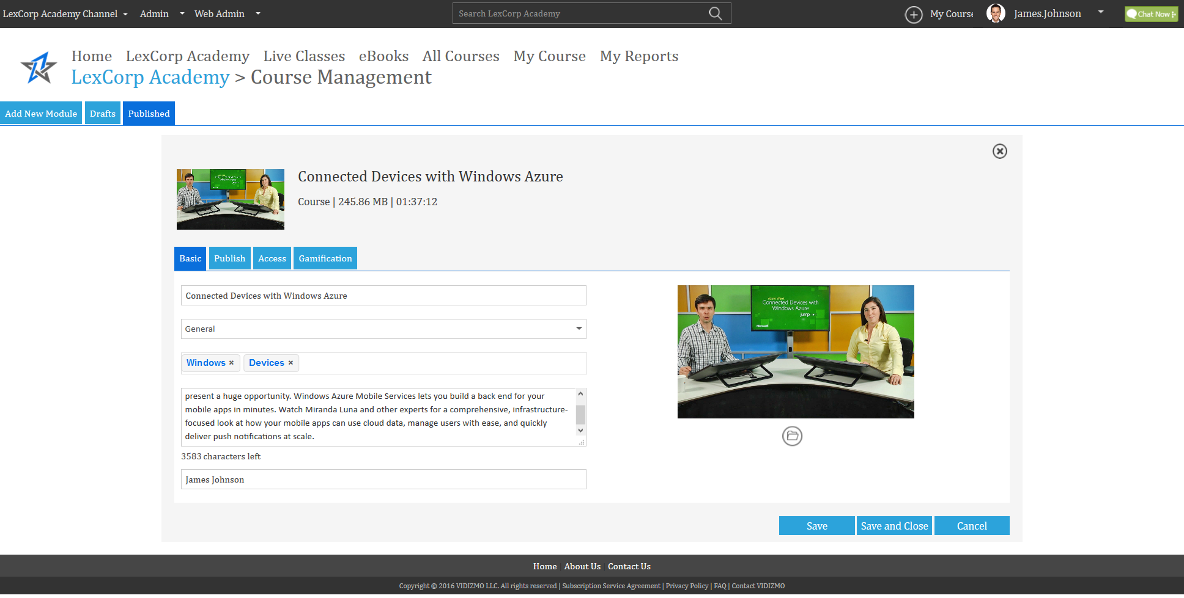
1. Create a Course Basic Settings
Give your Course a title, assign it to a category, provide description and select thumbnails.
Notes:
Showing Learning Plan

Slide 37
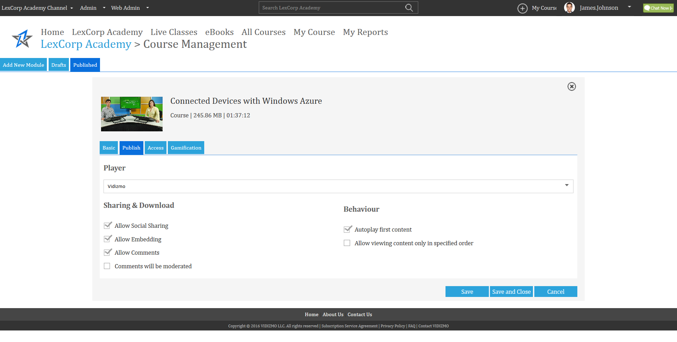
2. Create a Course Publish Settings
Manage sharing and downloading, Allow or restrict commenting
Notes:
Showing Learning Plan

Slide 38
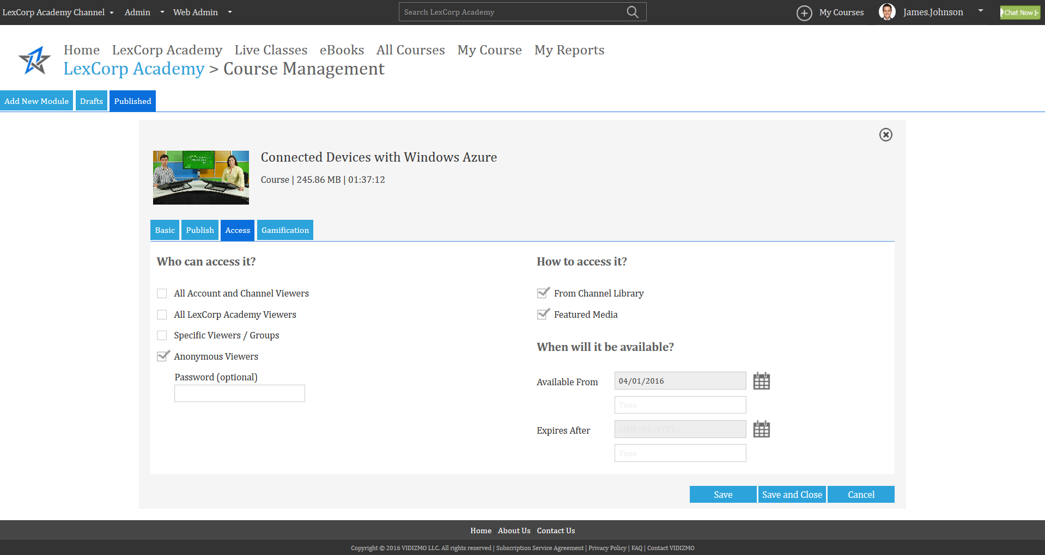
3. Create a Course Access Settings
Manage Accessibility of your Course and Rights Access.
Notes:
Showing Learning Plan

Slide 39
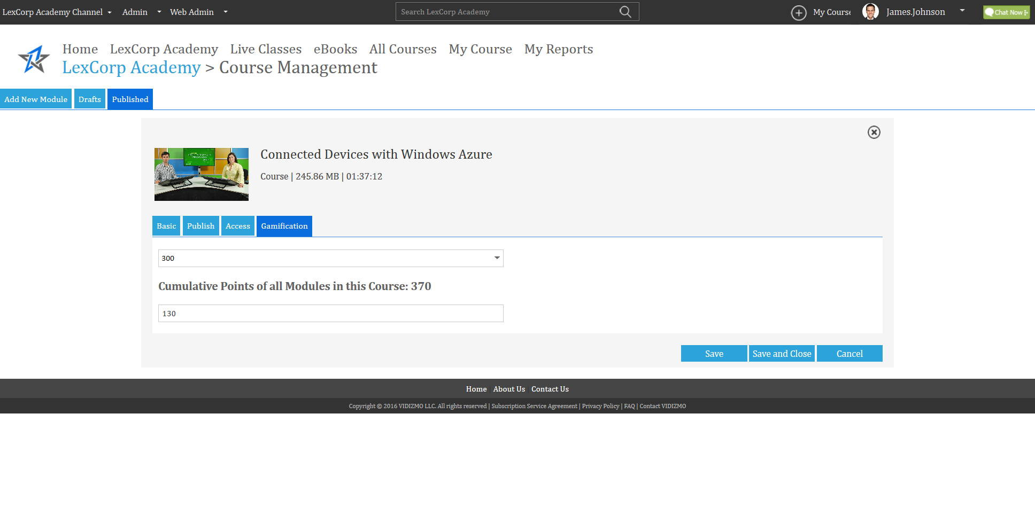
4. Create a Course Gamification Settings
Increase Course interactivity by allocating points, levels and gamification.
Notes:
Showing Learning Plan

Slide 40
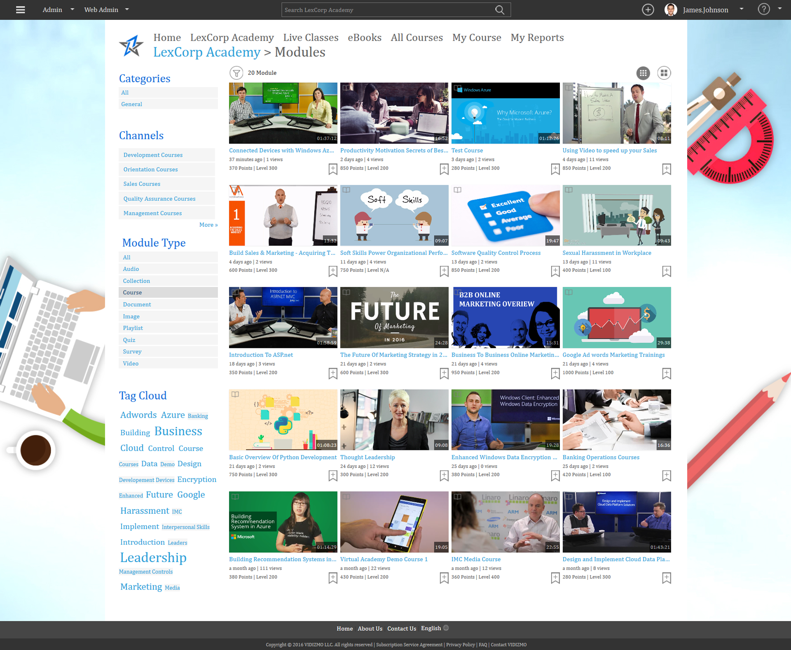
Course Created
Access your Course in published content.
Notes:
Showing Learning Plan

Slide 41
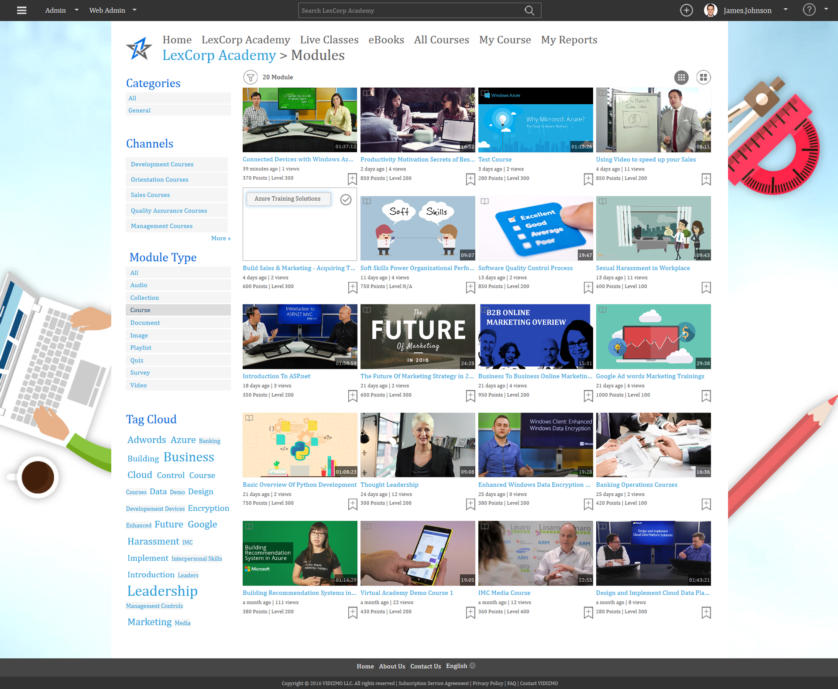
Course - Add To Learning Plan
Learners can Add the Course to their Learning Plan for self-paced study.
Notes:
Showing Learning Plan

Slide 42
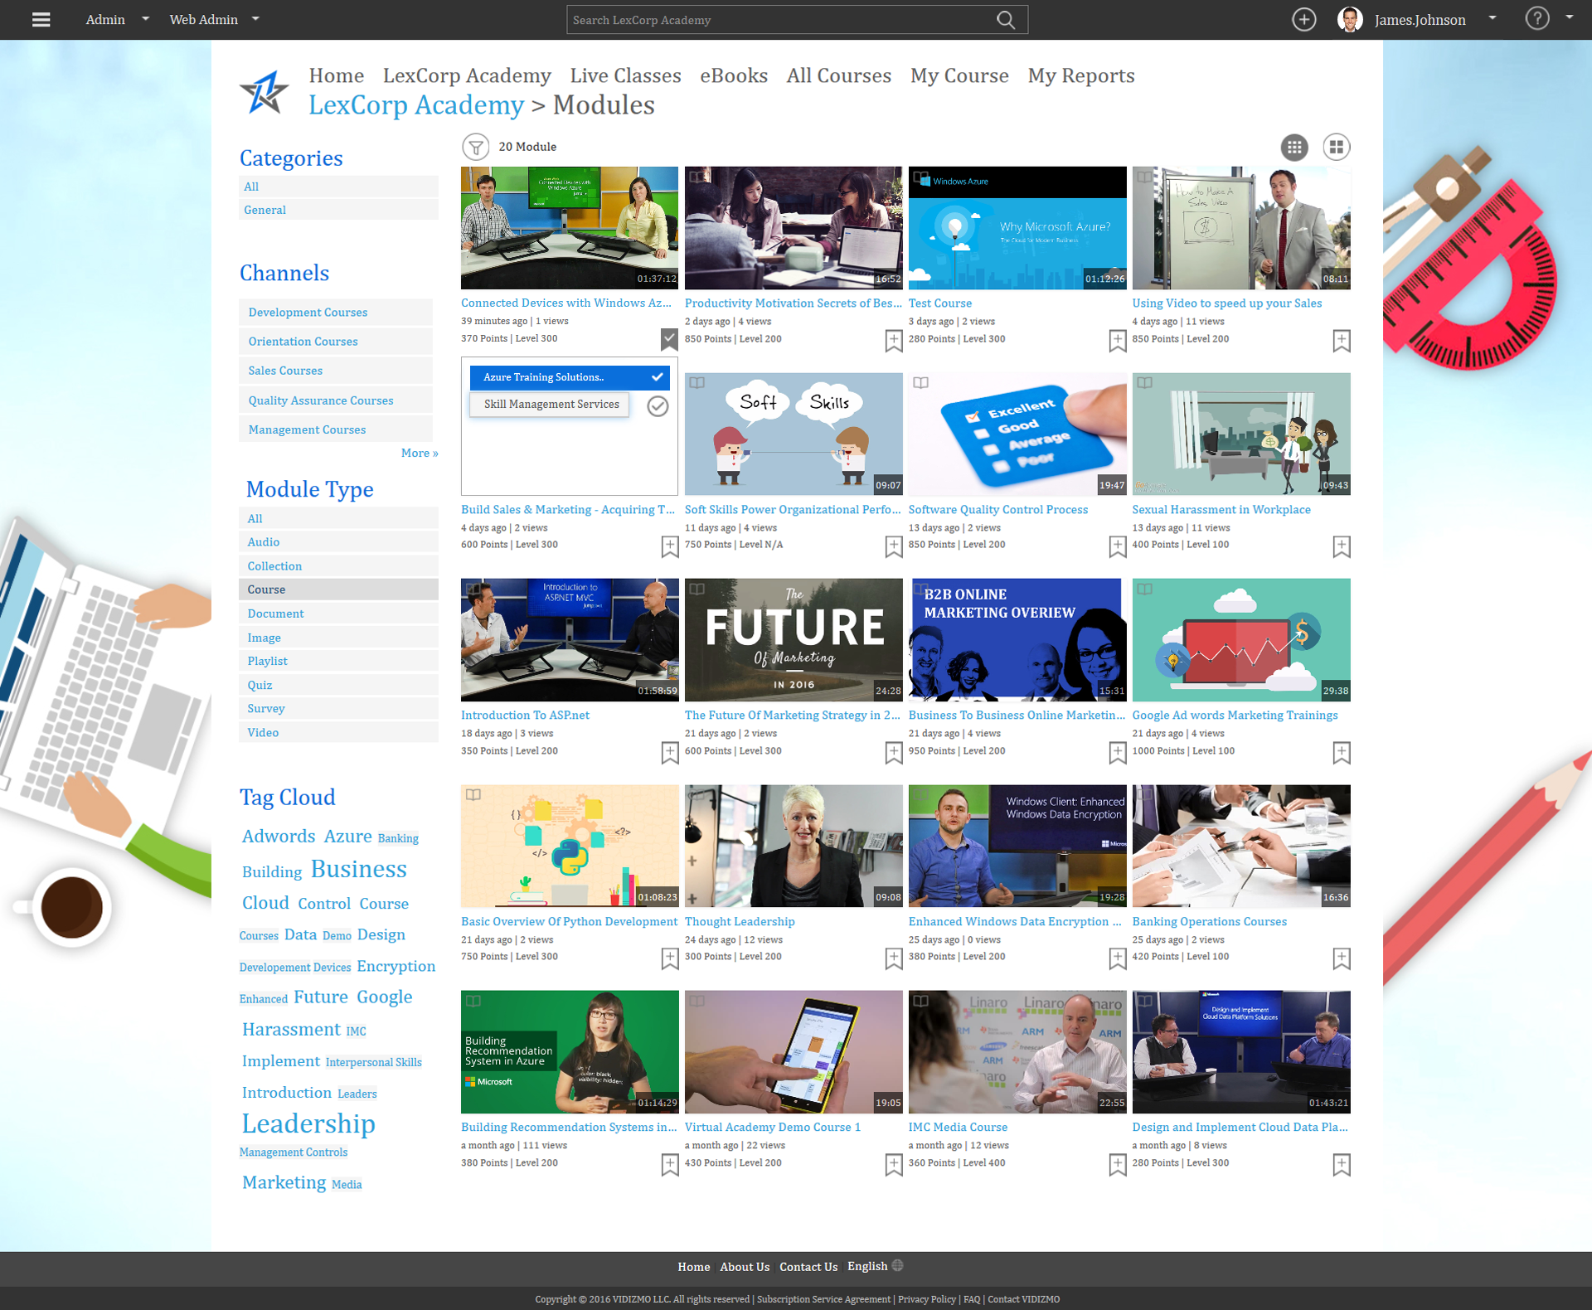
2. Course Add To Learning Plan
Learners can Add the Course to their Learning Plan for self-paced study.
Notes:
Showing Learning Plan

Slide 43
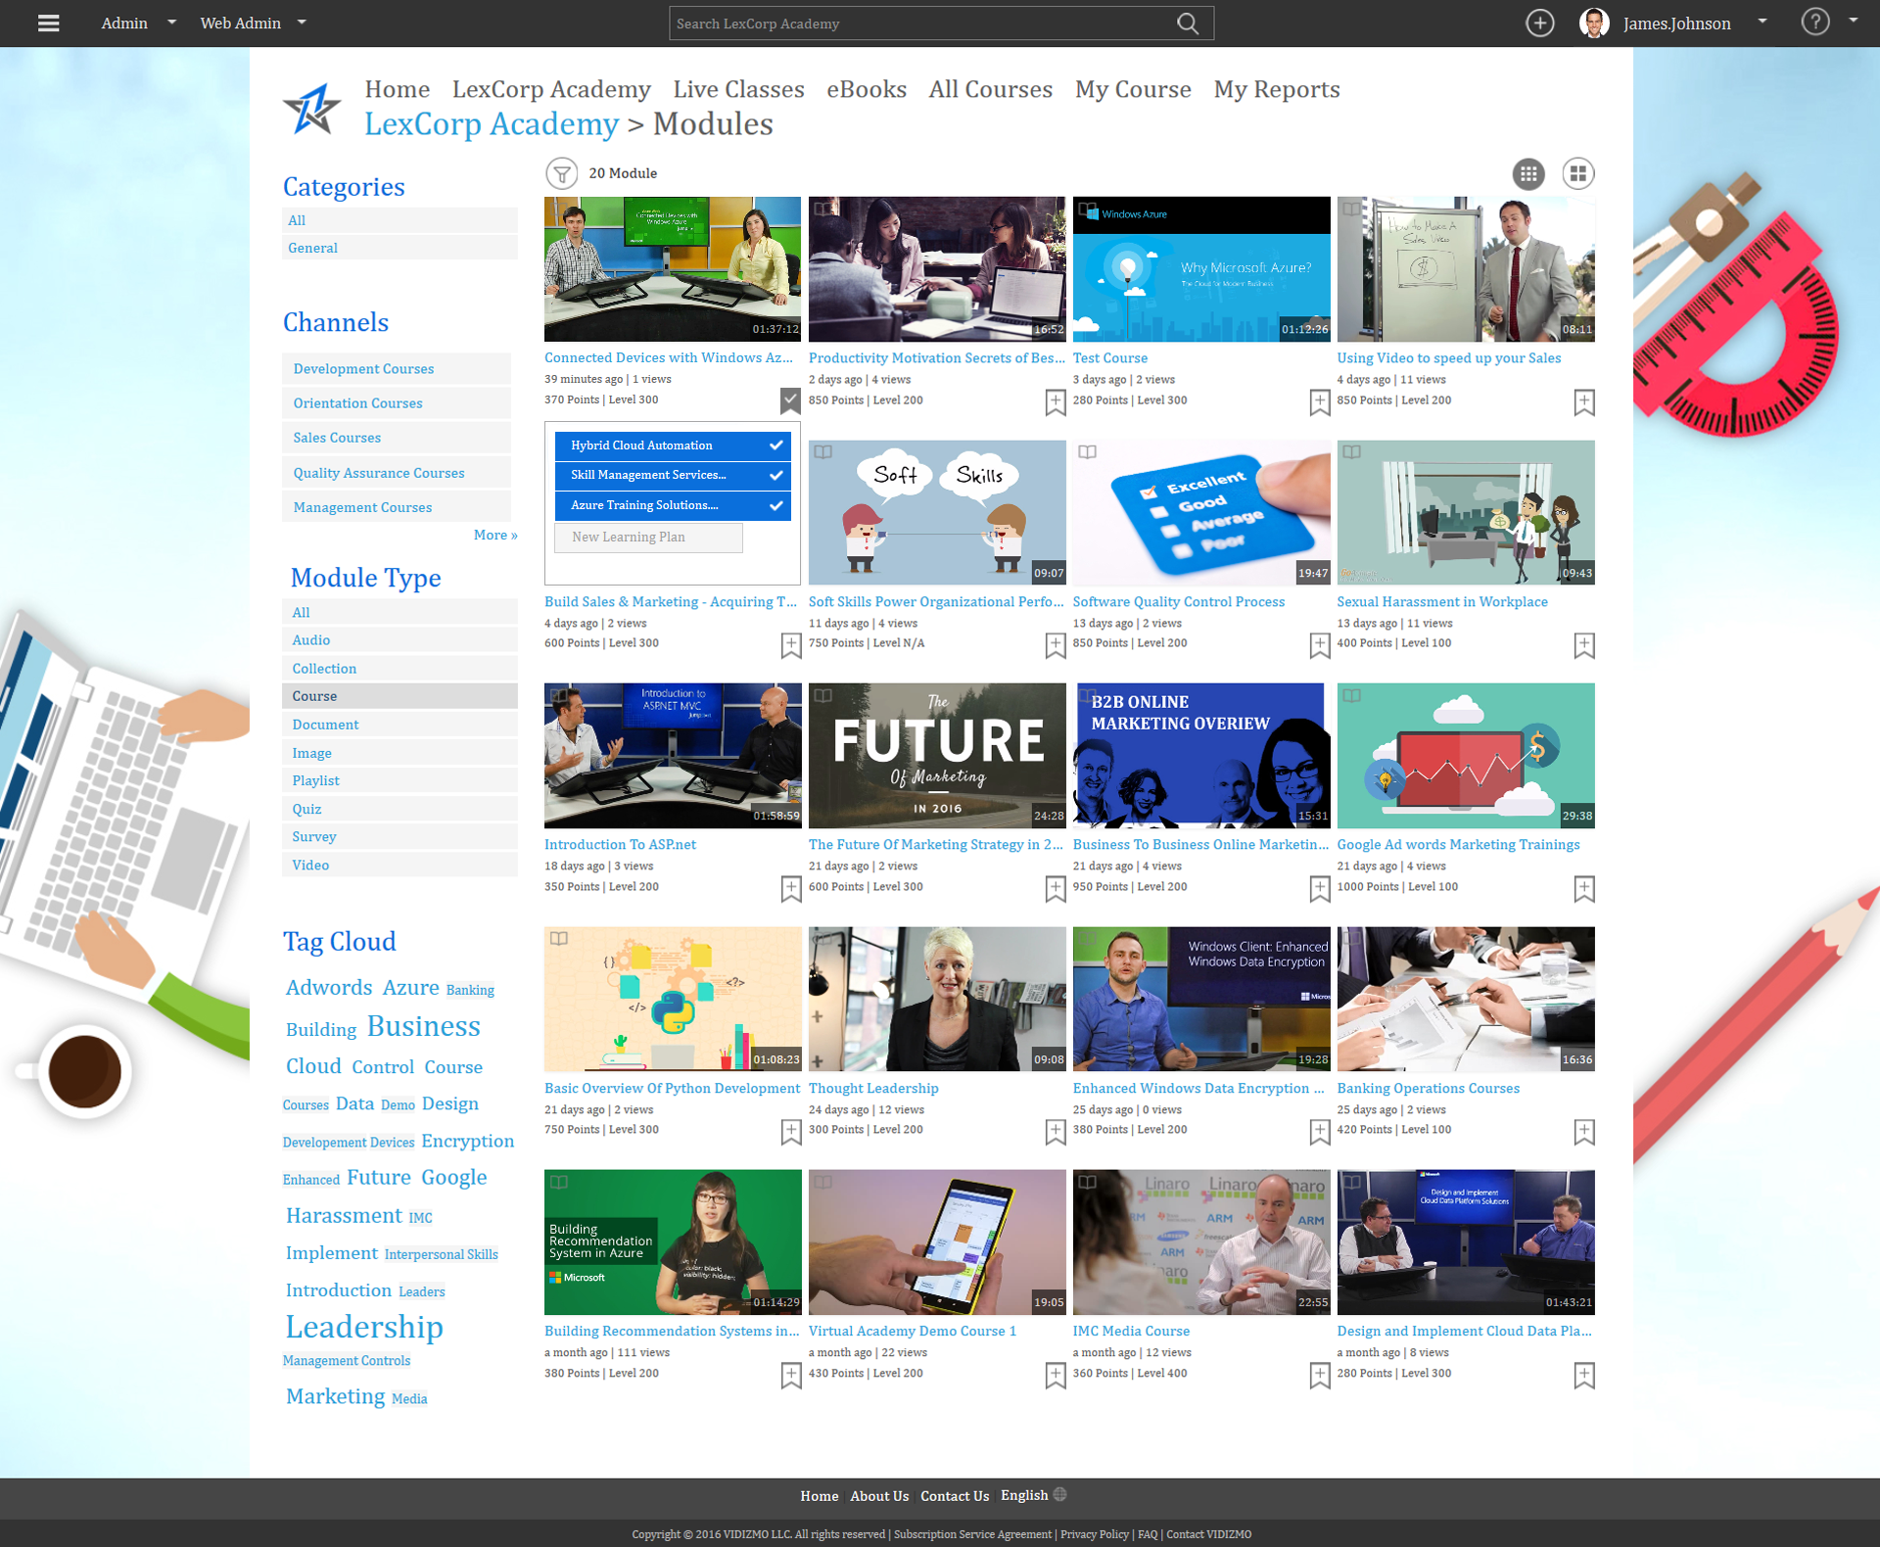
3. Course Add To Learning Plan
Notes:
Showing Learning Plan

Slide 44
Learning Plan Added
Notes:
Showing Learning Plan

Slide 45
Learning Plans
Learners can track progress and manage courses in their personalized Learner’s Area.
Notes:
Showing Learning Plan

Slide 46
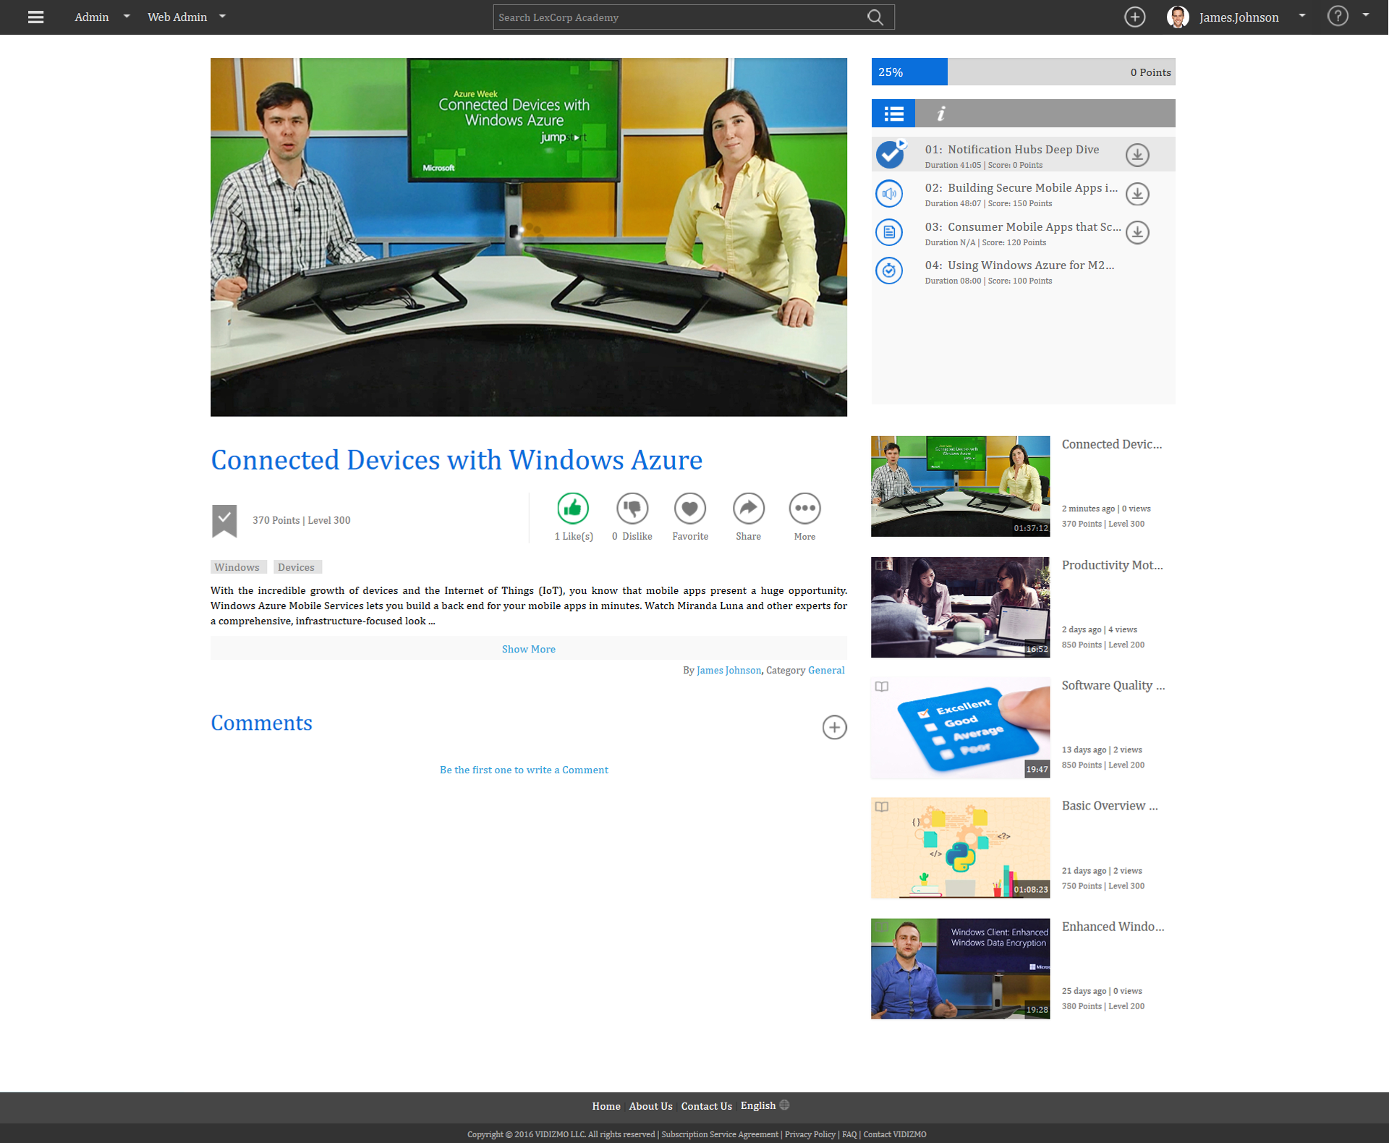
Course Playback Overview Module 1
Notes:
Showing Learning Plan

Slide 47
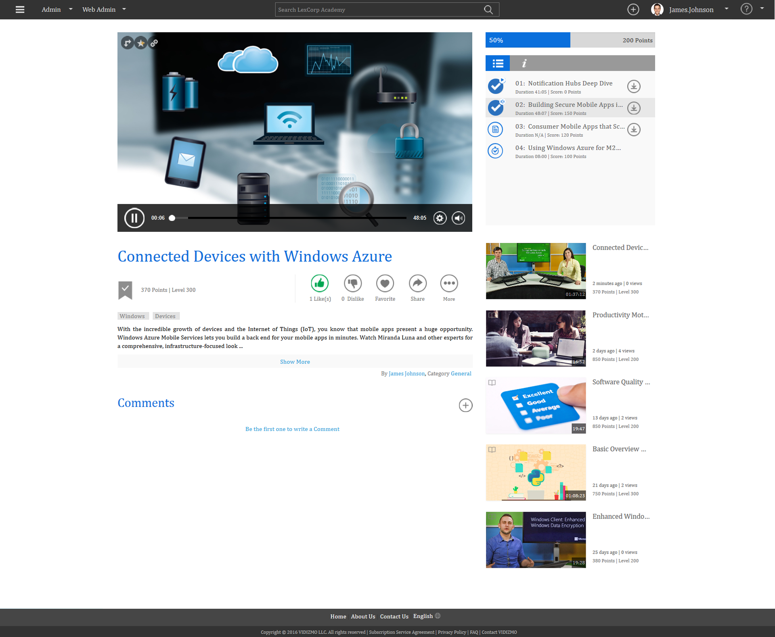
Course Playback Overview Module 2
Notes:
Showing Learning Plan

Slide 48
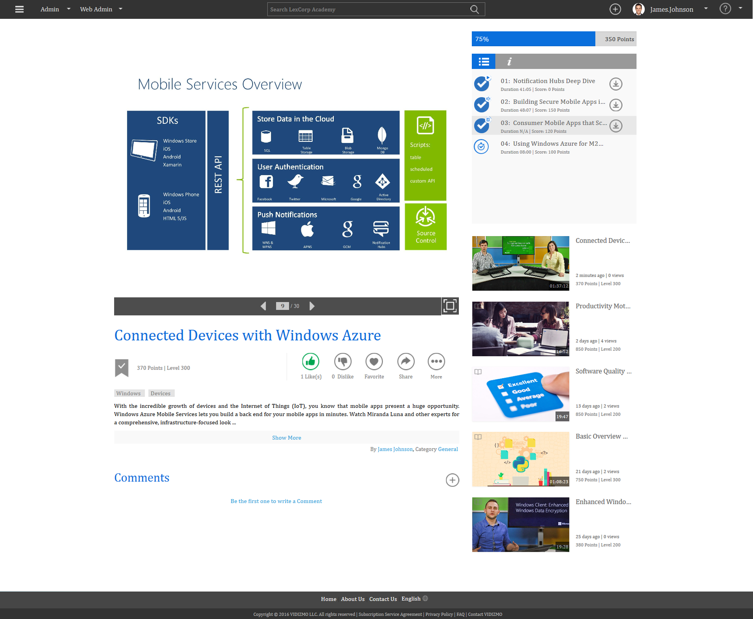
Course Playback Overview Module 3
Notes:
Showing Learning Plan

Slide 49
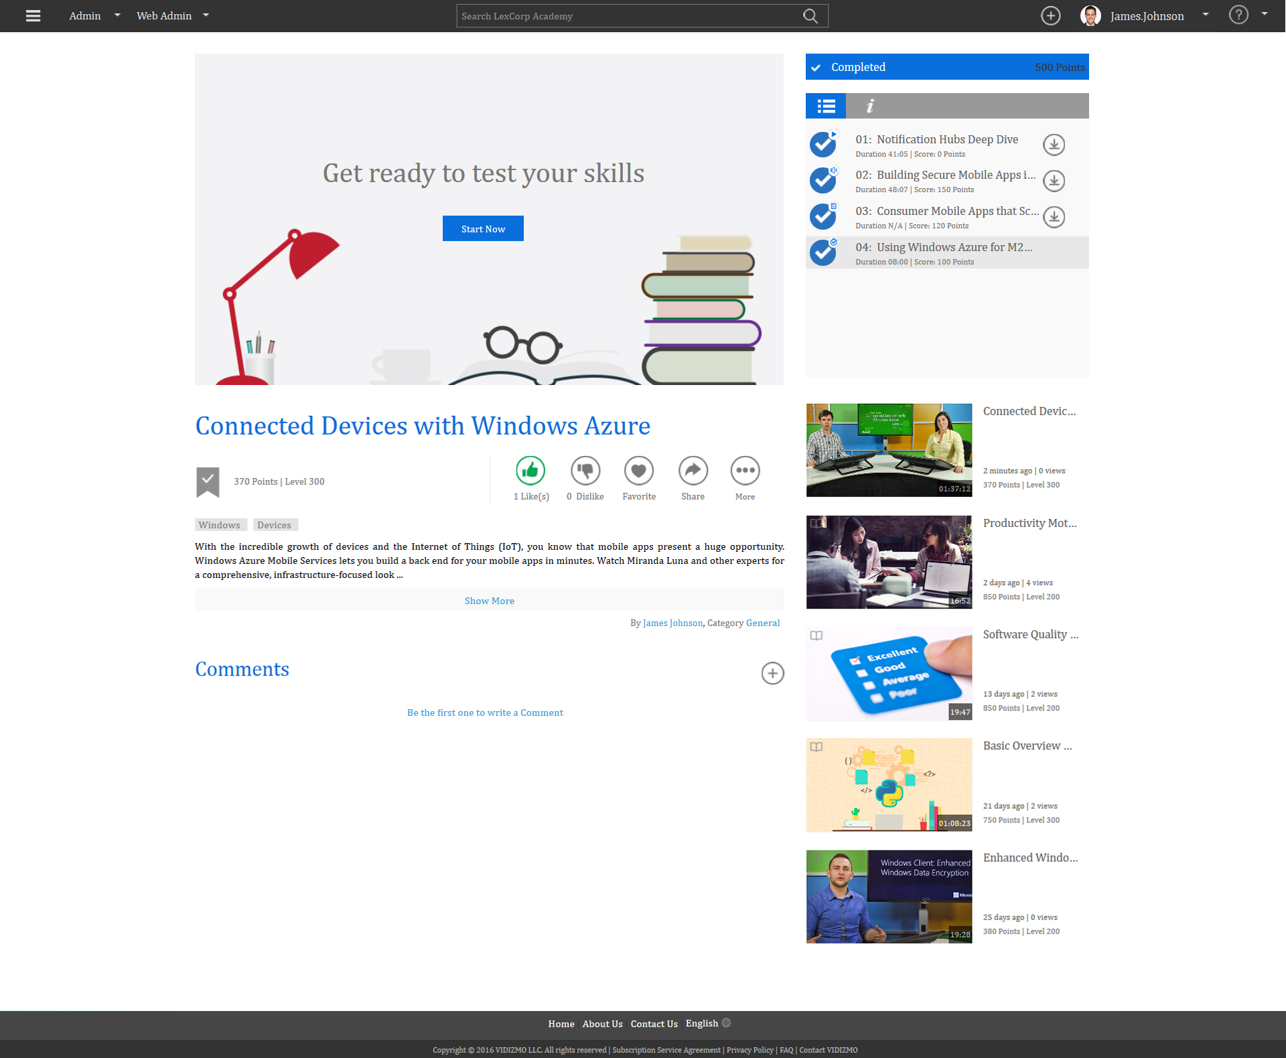
Course Playback Overview Module 4
Notes:
Showing Learning Plan

Slide 50
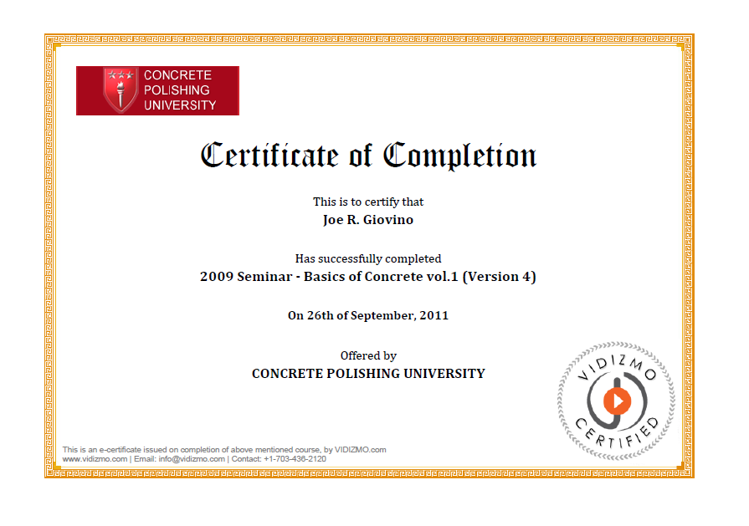
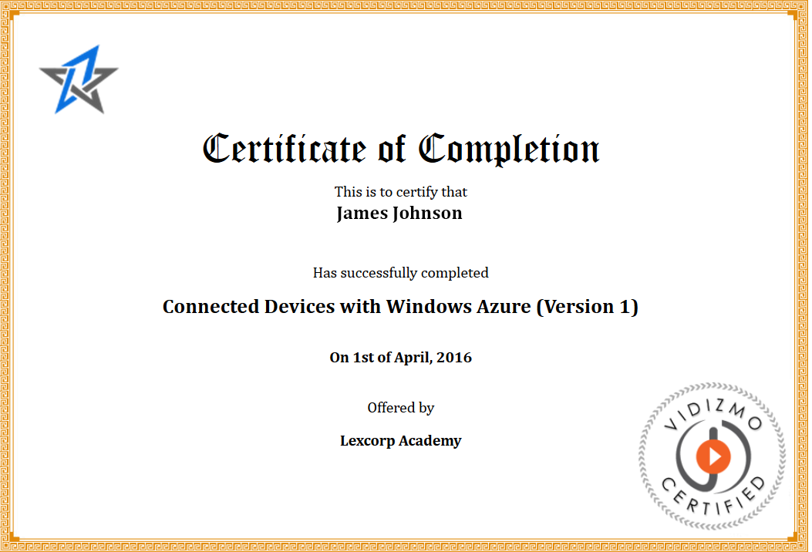
Virtual Academy: Test Viewer & Issue Certificates
Viewing Completion Certificates
Use simple Video or SCORM Compliant Content to produce communication, training, education
Use built-in VIDIZMO Virtual Academy to assign trainings and issue Certificates or Notify Orgnization LMS of successful viewing thru SCROM

Slide 51
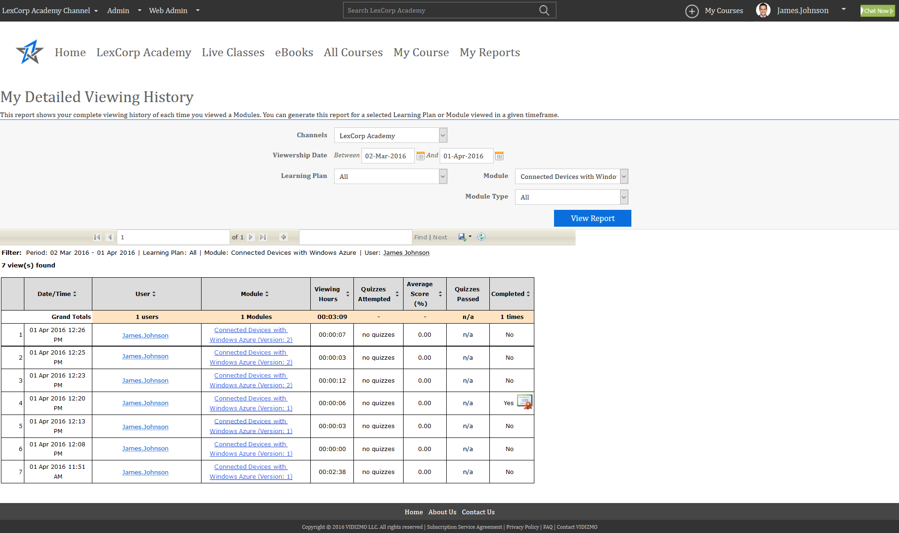
Built-in Analytics
My Detailed Viewing History

Slide 52
Creating a Quiz
Test your learner’s skills

Slide 53
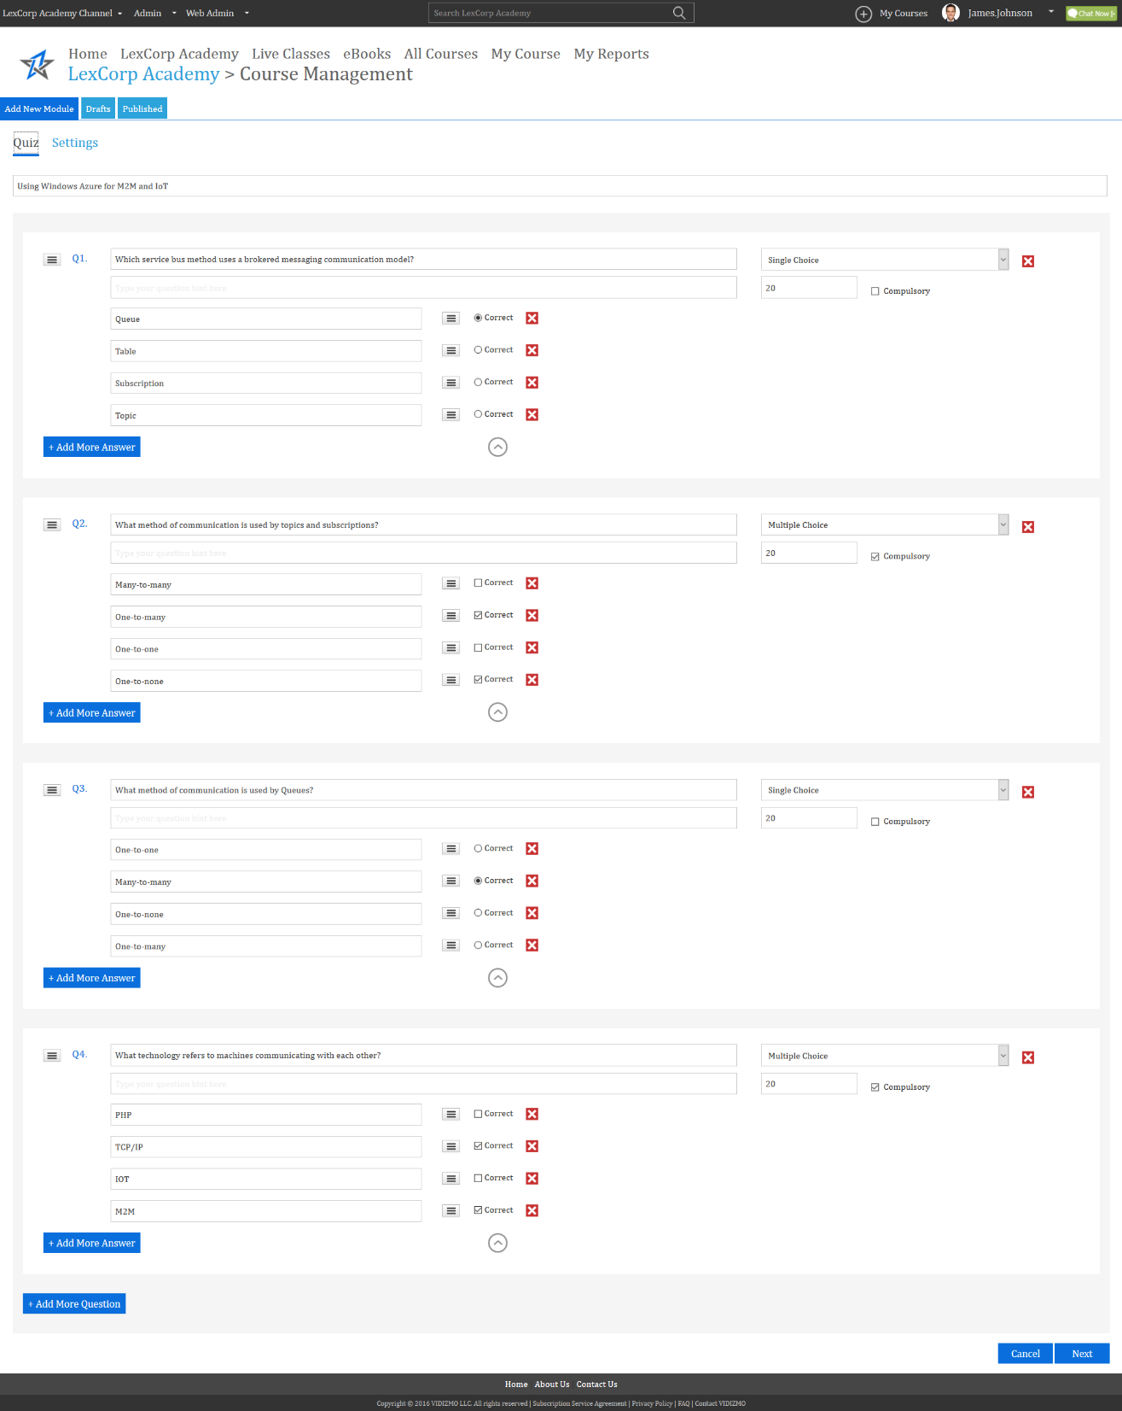
Creating a Quiz Add Single & Multiple Type Questions

Slide 54
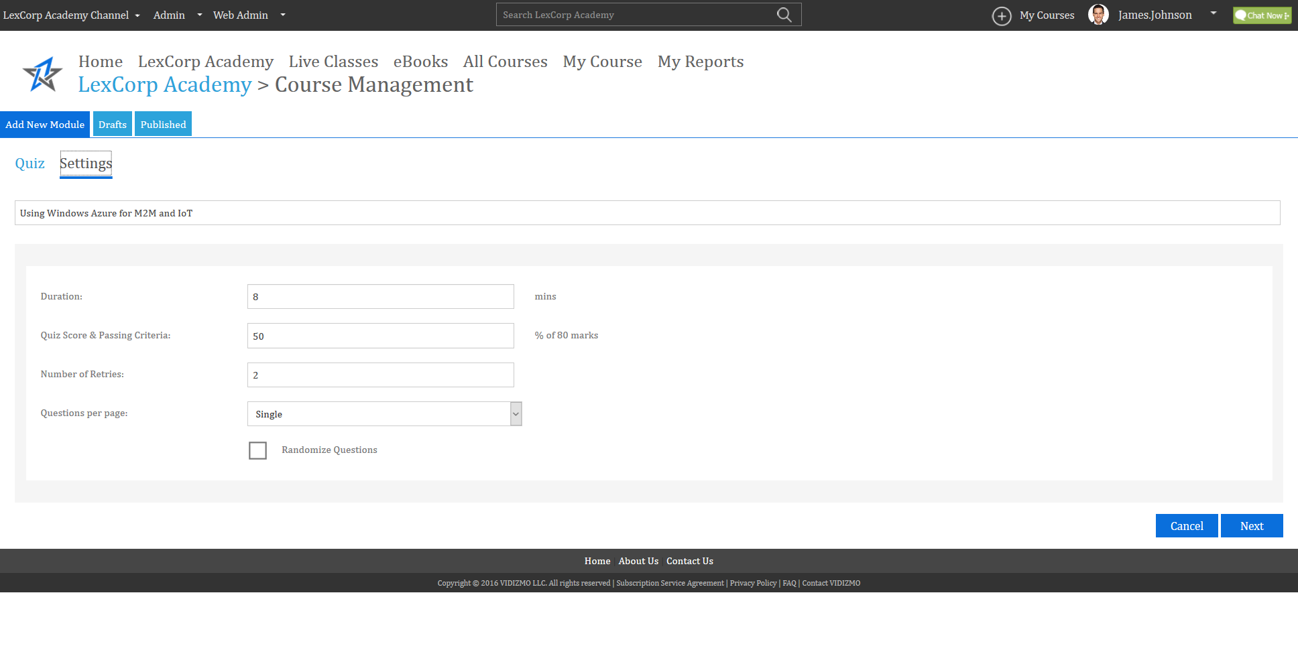
Quiz Settings

Slide 55
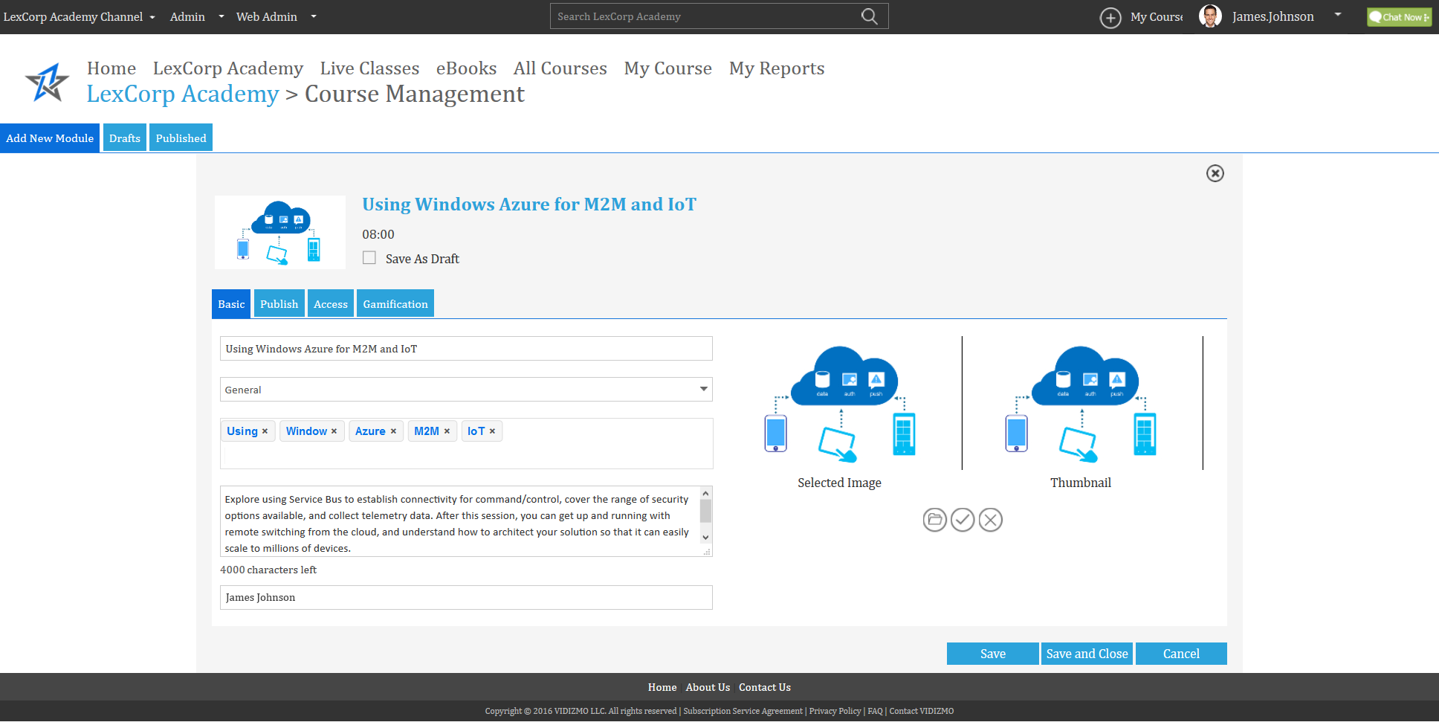
Creating a Quiz Basic Settings
Give your Quiz a Title, Assign it to a Category, Add Tags, Description and Image

Slide 56
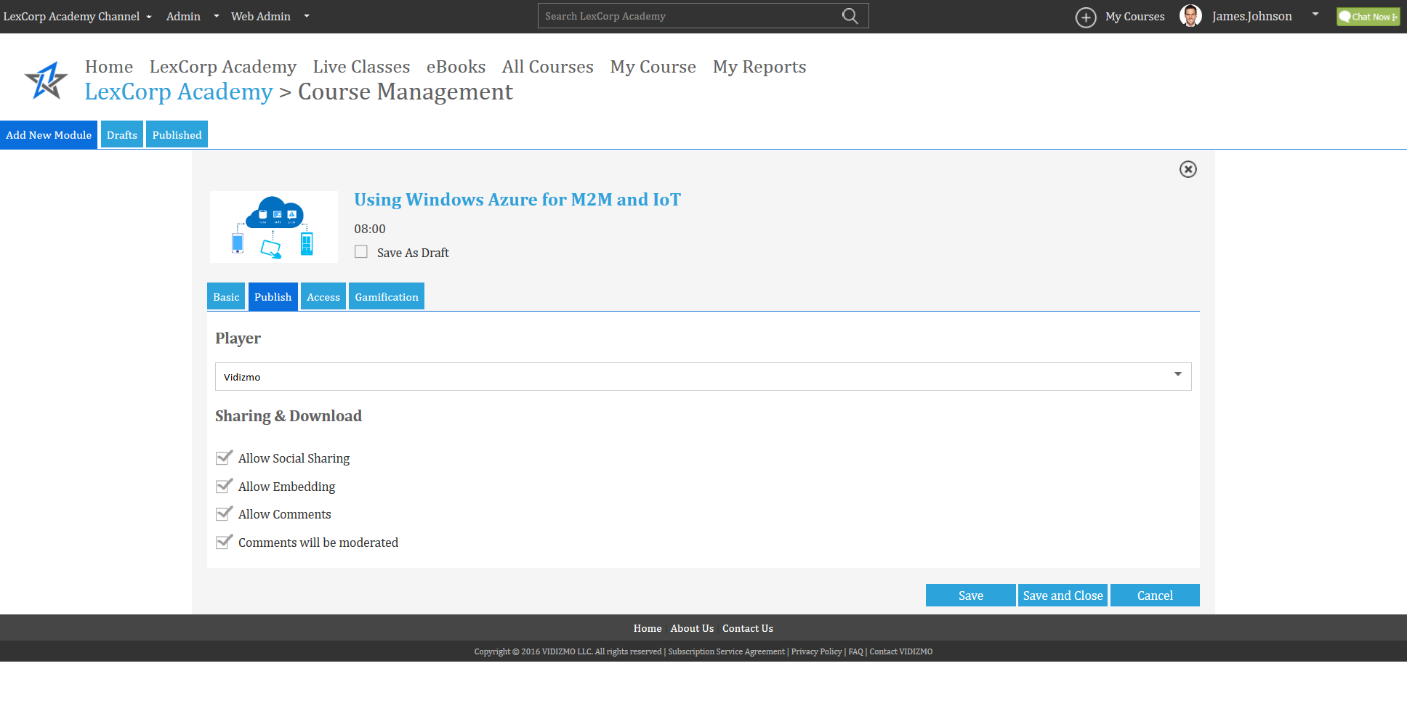
Creating a Quiz Publish Settings
Enable or disable Social Media Sharing, Downloading, Commenting.

Slide 57
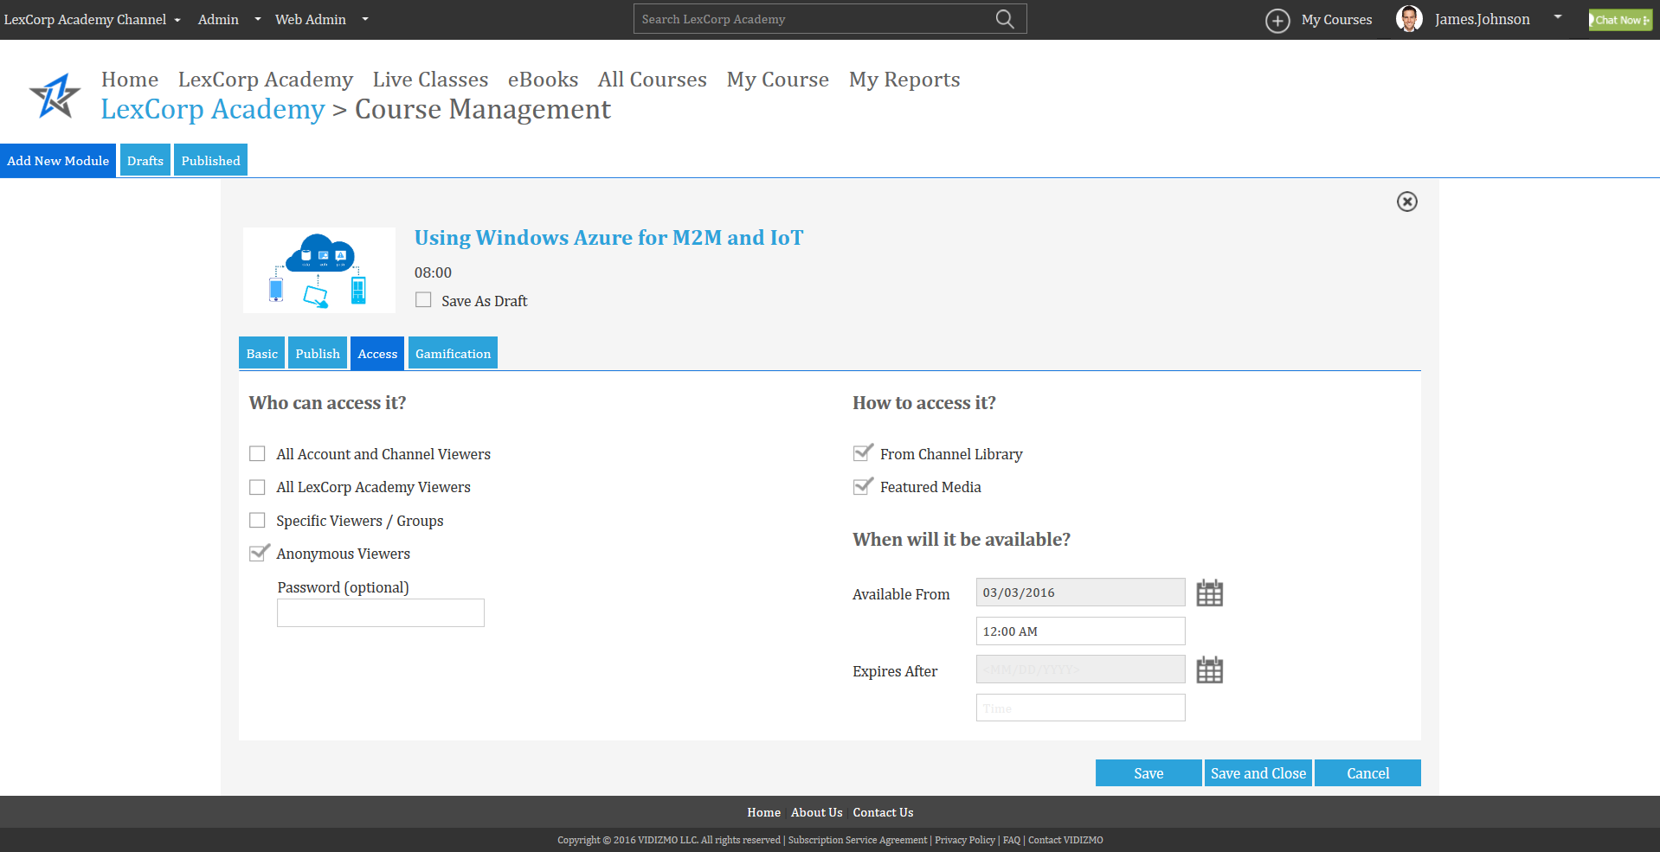
Creating a Quiz Access Settings
Detailed Rights Access Management, Select Expiry and Accessibility options.

Slide 58
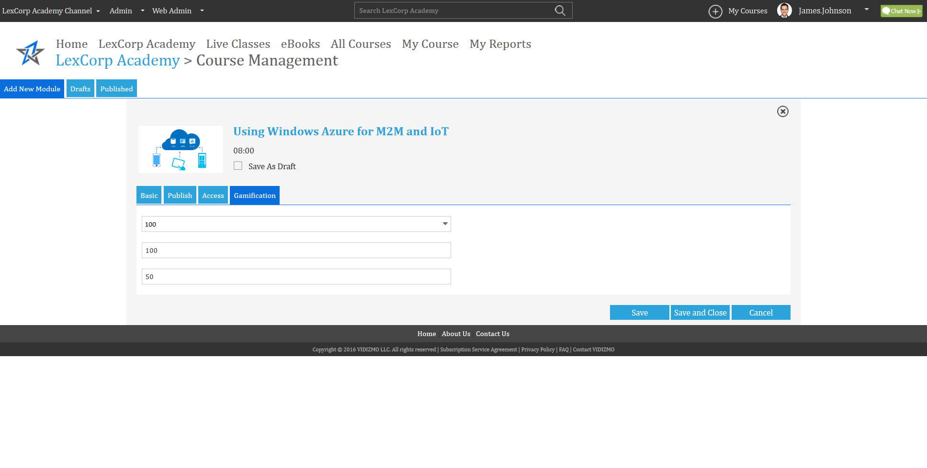
Creating a Quiz Gamification Settings
Increase interactivity by adding points, levels and score.

Slide 59
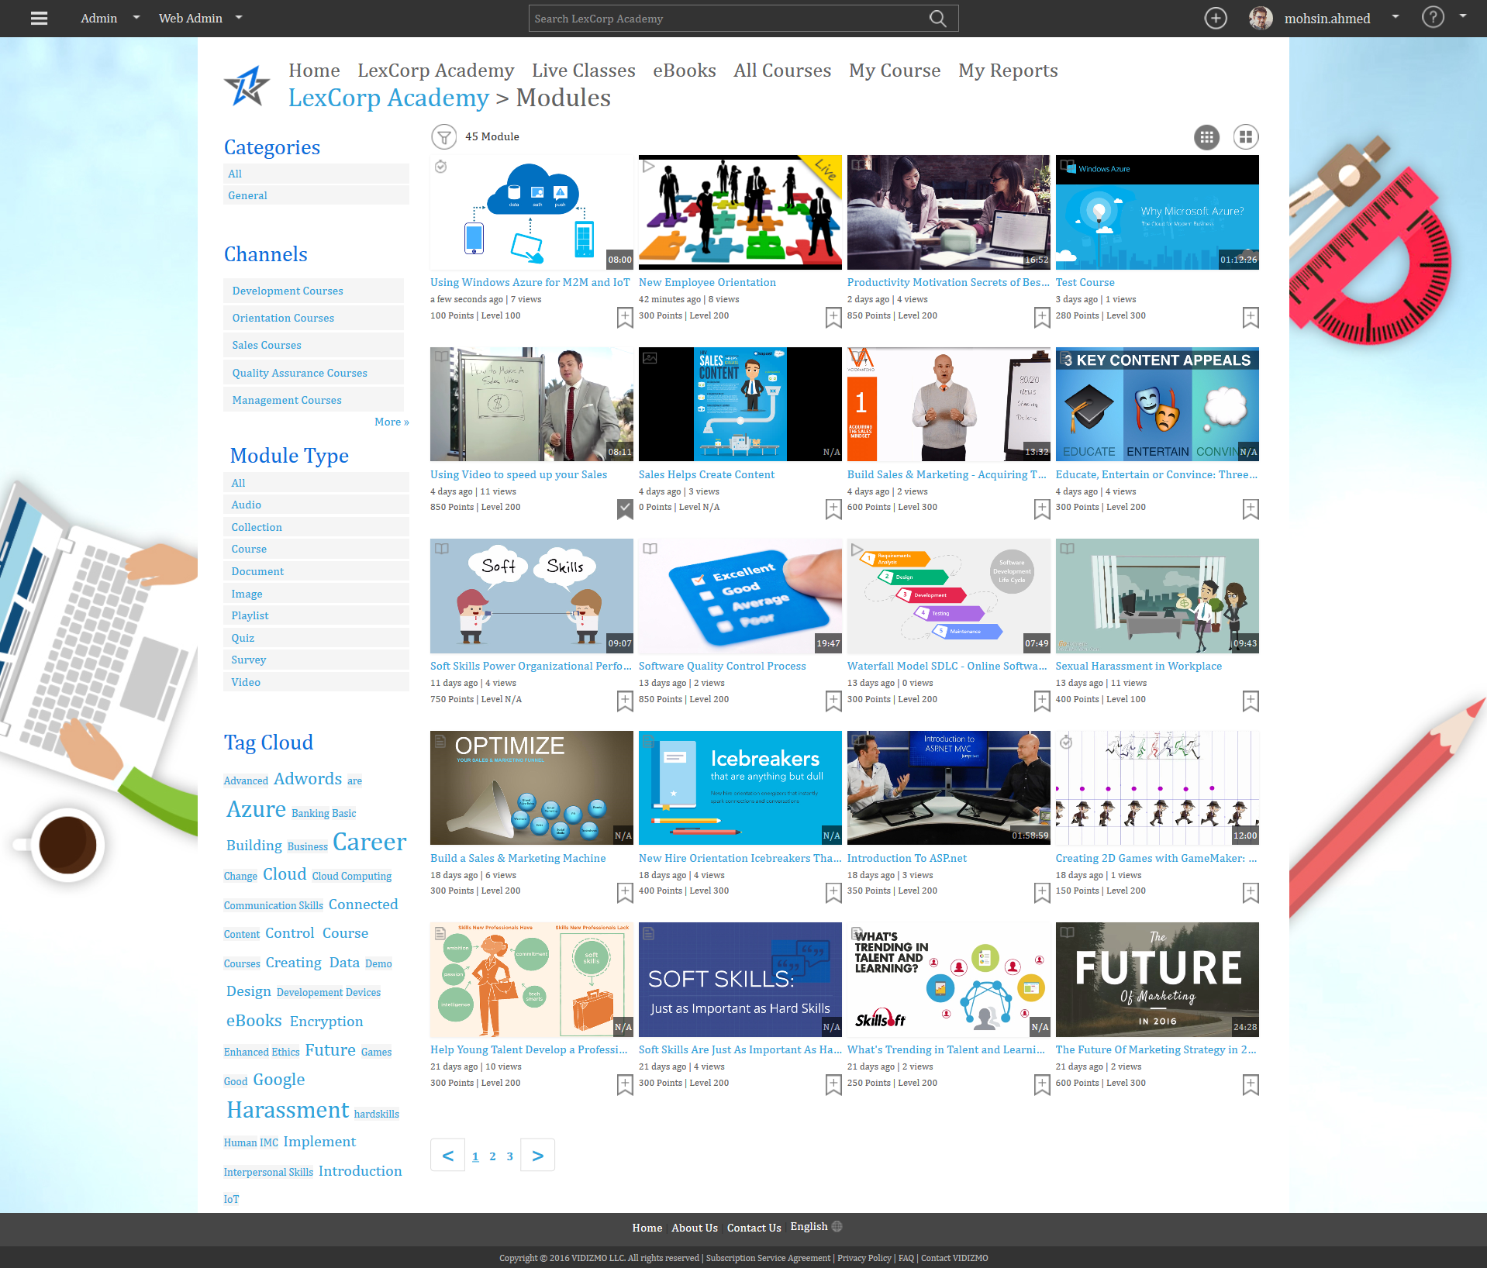
Quiz Created

Slide 60
Quiz within Presentation Start Now
Quiz playback

Slide 61
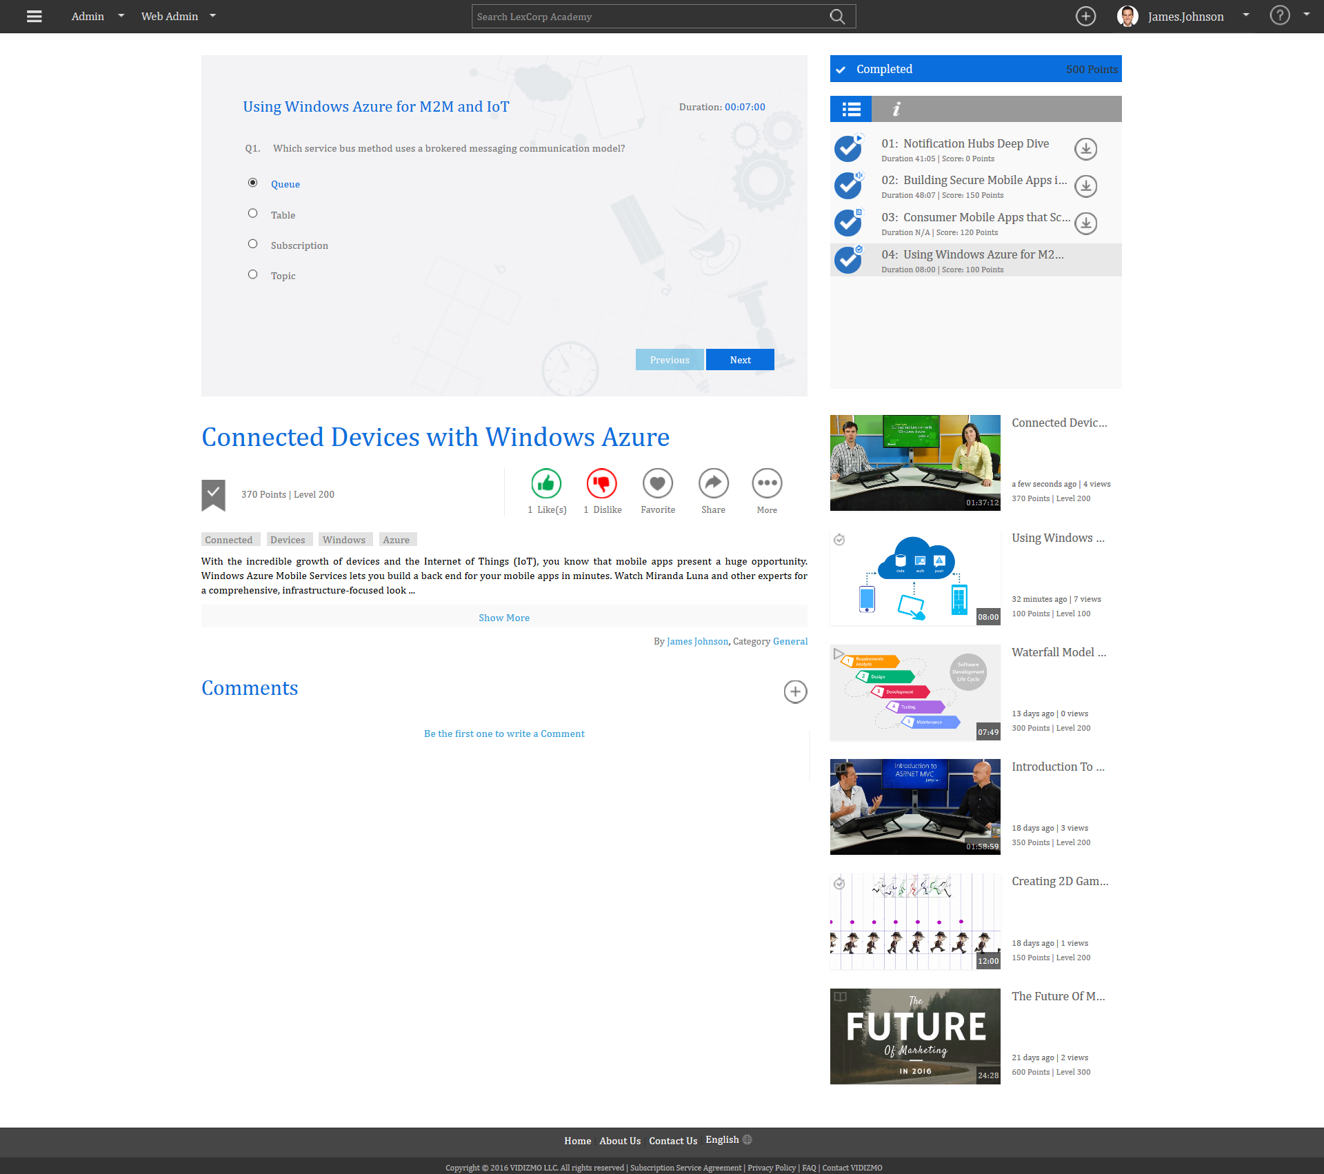
Quiz within Presentation Single Choice Question

Slide 62
Quiz within Presentation Multiple Choice Question

Slide 63
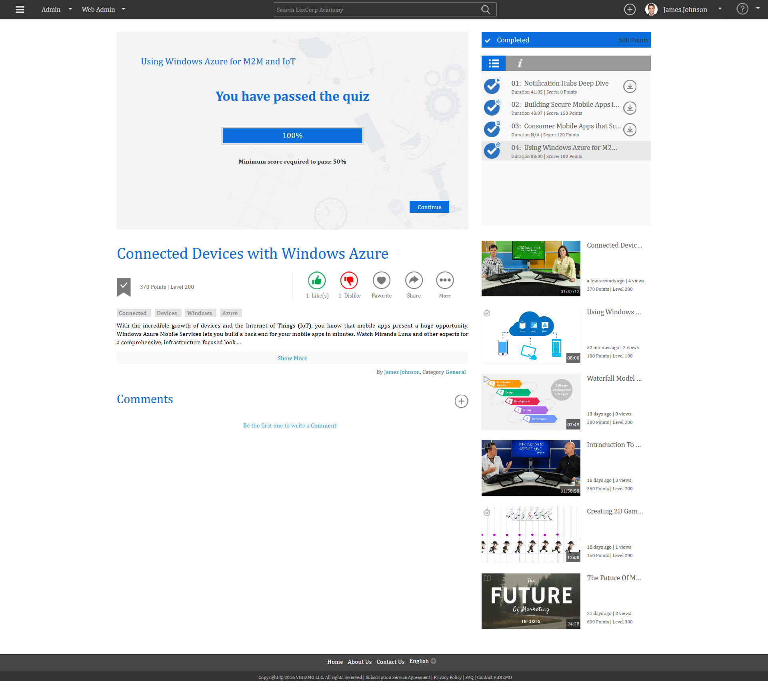
Quiz within Presentation Passed Successfully

Slide 64
Creating a Survey
Test your learner’s skills

Slide 65
Creating a Survey Add Single & Multiple Type Questions

Slide 66
Survey Settings

Slide 67
Creating a Survey Basic Settings
Give your Survey a Title, Assign it to a Category, Add Tags, Description and Image

Slide 68
Creating a Survey Publish Settings
Enable or disable Social Media Sharing, Downloading, Commenting.

Slide 69
Creating a Survey Access Settings
Detailed Rights Access Management, Select Expiry and Accessibility options.

Slide 70
Creating a Survey Gamification Settings
Increase interactivity by adding points, levels and score.

Slide 71
Survey Created

Slide 72
Survey Single Choice Question
Survey playback

Slide 73
Survey Multiple Choice Question

Slide 74
Survey Single Choice Question Continue

Slide 75
Survey Completed

Slide 76
Scorm Playback

Slide 77
Scorm Playback
Launch Module

Slide 78
Lex Corp Academy Analytics Dashboard

Slide 79
Recent Activities & Trends

Slide 80
Overall Users Activities

Slide 81
Overall Viewed Modules

Slide 82
Learning Plan Performance

Slide 83
My Reports

Slide 84
My Course Quiz Score

Slide 85
My Quiz Attempts

Slide 86
Users & Groups Overview
Admin -> Users & Groups

Slide 87
Manage Users & Groups
Added Users

Slide 88
Manage Users & Groups
All Roles
Viewer, Contributor,
Moderator, Manager &
Administrator

Slide 89
Manage Users & Groups
Bulk Edit, Delete, Disable
& Reset Password Of User

Slide 90
Manage Users & Groups
Added Users

Slide 91
Manage Users & Groups
Add New User

Slide 92
Manage Users & Groups
Add New as Viewer, Contributor,
Moderator, Manager &
Administrator
In Roles

Slide 93
Manage Users & Groups
Create New User Group

Slide 94
Manage Users & Groups
Create New User Group

Slide 95
Manage Users & Groups
Developers Group Created of 6 Users

Slide 96
Manage Users & Groups
Group Created

Slide 97
Settings Overview
Admin -> Settings

Slide 98
Settings
1. Home Page

Slide 99
Settings
2. General

Slide 100
Settings
3. Branding

Slide 101
Settings
4. Organization

Slide 102
Settings
5. Categories

Slide 103
Settings
6. Publishing Points

Slide 104
Settings
7. Login
Single Sign on Enabled

Slide 105
Settings
8. Tags

Slide 106
Settings
9. Gamification

Slide 107
Control Panel Overview
Admin -> Control Panel

Slide 108
Control Panel
1. Transcoding

Slide 109
Control Panel
2. Roles

Slide 110
Control Panel
3. Event Logs

Slide 111
Control Panel
4. Email Templates

Slide 112
Control Panel
5. Work Flow Queue

Slide 113
Control Panel
6. Player Priority

Slide 114
Control Panel
7. Content Hosting & Encoding

Slide 115
Control Panel
8. ECDN

Slide 116
Billing Report

Slide 117
Video with Transcript feature
Our New Feature

Slide 118
1. Create Learning Plans
Upcoming Feature

Slide 119
Create Learning Plans Users & Groups

Slide 120
Create Learning Plan Settings

Slide 121
Learning Plan Customize Certificates

Slide 122
Manage Learning Plans

Slide 123
Learning Plans Analytics

Slide 124
Course Analytics Reports
Note: This feature will be available in upcoming release.

Slide 125
Course Analytics Reports
View Details

Slide 126
Course Dashboard
1. Overview

Slide 127
Course Dashboard
2. View Details

Slide 128
Course Dashboard
3. User Details

Slide 129
Course Dashboard
4. Learning Plan Details

Slide 130
Thank You
MORE QUESTIONS?
Nadeem.khan@Vidizmo.com
Cell: +1 703 731 2925

