Slide 1
Connect
INSERT YOUR LOGO
Mobile App

Slide 2
Meet the Connect App
Your mobile-based telephony management app
Self-service for key telephony features.

Slide 3
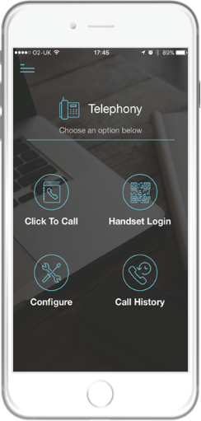
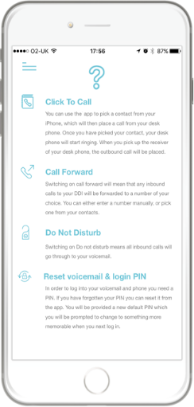
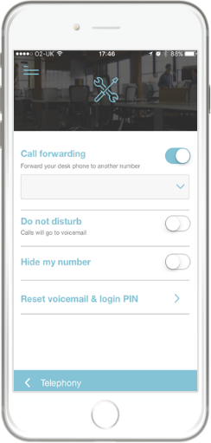
Connect Mobile App

Slide 4
Key Features
Configure and click to call
You and your customers can configure your handset features such as call forwarding, set up your voicemail and login PIN. You can initiate calls from your desk phone using your mobile phone.
QR code login and call history
You and your customers can login to your handset automatically, by scanning the QR code with the camera on your mobile phone. It’s simple and easy and means less login details to remember.
Anywhere call history
You can see past calls made and received from your desk phone. Quickly and easily reply to calls from your mobile so you never miss an opportunity when you’re away from your desk.
Browser-based Connect
The browser-based version of Connect gives you easy access to IT and comms service orchestration and delivery as well as feature management. You can assign services to customers and allow them to self-service on new products or upgrades.

