Slide 1
Marketing ‘Ride-Along’ Best Practices

Slide 2
Agenda
1
Prepare, Observe, Debrief
2
Marketing Ride-Along Evaluation Form
3
Marketing Ride-Along Execution
4
Understanding Individual Needs

Slide 3
Field Day Action Items
Ride-Along Action Items
Prepare
Review Appts and Plan for Day
Meeting Agenda for each planned meeting activity
Review Planned Task List for the day
Objectives Review how action plans align with marketing team objectives
Observe
NEW Marketing Staff:
Observe basic skills and marketing process understanding
Coaching: Tell them, show them, watch them, redirect
TENURED Marketing Staff:
Listen/Observe. Don’t interrupt. Let the marketing manager operate through their day. Be a Spectator and Coach
Debrief
Discuss day using Marketing Ride-Along Evaluation Form
Always discuss Positive First (THERE IS ALWAYS A POSITIVE)
Limit Action Items to only three
Transparent, Open feedback and Coaching. This is critical to improve marketing skills
Note: Pay attention to use of time spent on marketing team objectives vs. other time spills
Notes:
3

Slide 4
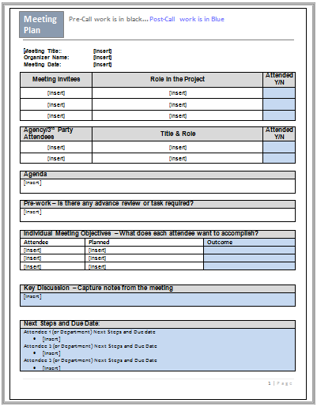
Marketing Agenda (Call Plan)
Attendees:
Who is invited to the meeting. What are is their role in the project and meeting?
Agenda:
What is the agenda for the meeting?
Objectives:
What does each attendee want to get out of the meeting?
Meeting Notes: Capture the key discussion points and next steps/dates

Slide 5
Marketing Ride-Along Execution
Expectations
Preparation
Good mix of activities that reflect the normal course of a day
Planned task list that includes all active projects and priorities
Prepare for meetings with a completed Meeting Plan for every meeting being run as the facilitator
Request role and pre-work requirements for meetings attended as a participant
Schedule ‘Ride-Along’ day at least a week in advance
Confirm a 1-hour timeslot at the end of the day for a debrief
Marketing leader reviews the planned agenda for the day in advance
Marketing leader and marketing contributor sit down for 30-minutes in advance to discuss the plan for the day

Slide 6
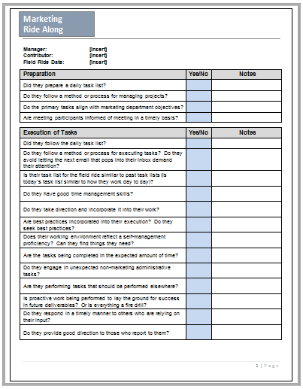
Marketing RideAlong Evaluation Form (page 1)
Preparation:
Who well does the contributor prepare their day? Is preparation evident in all aspects of how their day unfolds?
Execution of Tasks:
How effective is the contributor at accomplishing tasks, building deliverables and managing projects that are key to their role?

Slide 7
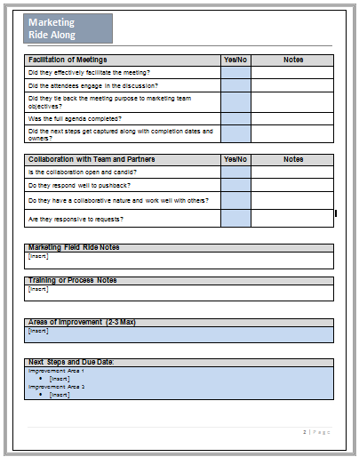
Marketing RideAlong Evaluation Form (page 2)
Facilitate Meetings:
How effective is the contributor at running meetings?
Collaboration:
How well does the contributor collaborate with partners and other members of the team?
Areas of Improvement:
Capture 2-3 areas to focus development
Next Steps and Due Dates:
Agree and capture the key next steps/dates

Slide 8
Marketing Leader Observation
Start
Meet in a private setting to review the days task list and priorities
Compare priorities with the overall marketing department’s objectives
Conduct a mini-debrief after each major interaction (Meeting, major task)
Inspect
Validate that the contributor is leveraging department resources.
Is the contributor following appropriate marketing processes?
Is the contributor using their time wisely, following their plan?
Does the contributor perform significant work outside department priorities?
Marketing Leader Role in Meetings & Team Interactions
Make it known department wide when ‘riding’ with a contributor
Defer to the contributor when discussion is directed to you
Marketing leader should feel like a spectator
Bottom Line: Don’t run meetings or interactions for contributors.

Slide 9
Marketing Ride-Along Debrief
Major Interaction Mini-Debriefs
Post Ride-Along Debrief
Take notes and debrief after each major interaction (meeting, major task, etc.)
Start by asking contributor how he/she felt the interaction/task was performed.
Ask the contributor to self-evaluate their performance in the interaction/task
Provide 2-3 observations and discuss potential changes for future interactions/tasks
Conduct a 1-on-1 Meeting at the end of the Ride-Along Day
Discuss in an area where the conversation is private
Review progress based on previous action items
Agree on action items for next ride-along
Discuss recommended areas of improvement and positive feedback
Note: Coach with questions, not statements!

Slide 10
Understanding Individual Needs
High Skills/Low Motivation (Reluctant Contributor) This person needs someone to motivate them, show them how to be excited. (Needs a Cheerleader) | High Skills/High Motivation (Peak Performer) This person needs someone to give feedback and help them perfect the skills. (Needs a Coach)
Low Skills/Low Motivation (Disillusioned Learner) This person needs to be completely directed. This person may be in the wrong job. (Needs a Director) | Low Skills/High Motivation (Enthusiastic Beginner) This person has the motivation, but needs to be taught how to perform the skills. (Needs a Teacher)
Notes:
10

Slide 11
Individual Needs Ride-Along Execution
Tenured Contributor
New Contributor
Observe interactions/tasks and provide feedback
Focus on strategic execution of Marketing Processes
Explain how changes in approach will lead to results
Focus on Motivation
Help them plan their day and point out how the tasks align with objectives
Observe areas of training and mentoring requirements
Observe task implementation
Be prescriptive
Provide 2 or 3 key developmental objectives

