Slide 1
How to Get More Out of Your 8(a) Designation
www.ostglobalsolutions.com
www.fedmine.us
PRESENTERS: Olessia Smotrova, Lindsay Carry

Slide 2
About Us
Fedmine
Fedmine is a web-based business intelligence platform that helps you to make intelligent decisions through better understanding of market data
Aggregates 16 federal procurement data sources and makes available via an intuitive user interface
Allows you to view the level of detail you need to make smart business decisions
OST Global Solutions, Inc.
Help businesses grow through:
GovCon Incubator
Business Development Center of Excellence
Bid & Proposal Academy
Won $22 Billion+ since 2005
Supported 18 out of the top 20 federal contractors, and hundreds of small businesses

Slide 3
Challenge
It took a lot of work to get into the 8(a) program
Now you are here, but not seeing much benefit and the clock is ticking
How do you get the most from the program while you have the 8(a) status?
Civilian Agencies
Department of Defense
Civilian Agencies
Department of Defense
Federal Government
Federal Government
Legislative
Legislative
Defense
Defense
Quasi Government
Quasi Government
Independent Agencies
Independent Agencies
Notes:
OS

Slide 4
Focus Areas
Determining the lowest hanging fruit
Selecting targets for 8(a) set asides
Securing sole source contracts
Developing a cohesive 8(a) pipeline strategy
Federal Agency Contracts to 8(a) program participant
 | FY18 | FY17 | FY16
Civil Agencies | $58,411,173 | $493,957,681 | $480,544,392
Defense Agencies | $6,541,656 | $243,793,004 | $255,064,841
Independent Agencies | $14,942,122 | $85,407,767 | $88,305,076
Legislative Agencies | $0 | $122,836 | $63,237
GRAND TOTAL | $79,894,951 | $823,281,288 | $823,977,546
Notes:
OS

Slide 5
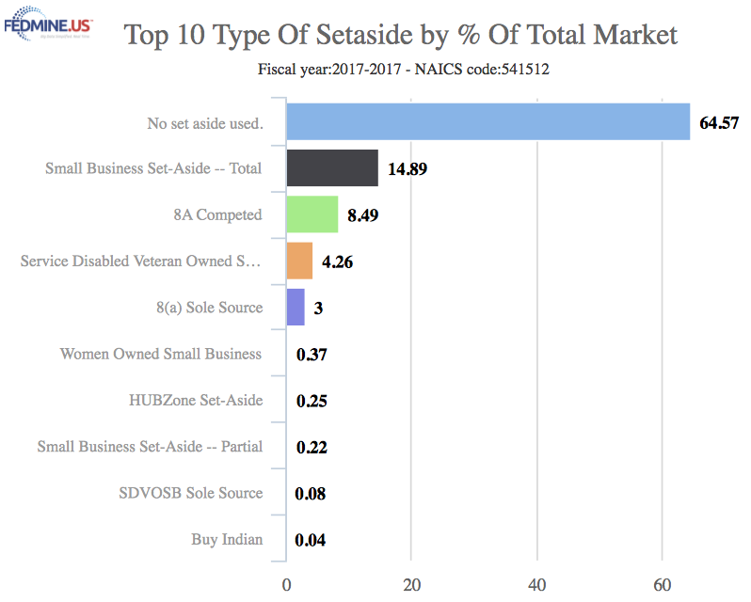
Select Opportunity Search Criteria
Must not be on an IDIQ vehicle the company doesn’t have
Pick a focus NAICS (primary NAICS is good)
Select focus agencies
Examine expiring opportunities where the government may need this service again
It may be that the agency’s purpose was to fill a one-time need
The nature of the product or service and the Agency’s dependence upon continued services may hint at follow on opportunities
An agency may not have sufficient workforce to conduct support operations and it deems it is not in the Government’s interests to hire employees
Unlikely to have a direct follow-on contract to develop same software application as in an expiring contract
Notes:
OS

Slide 6
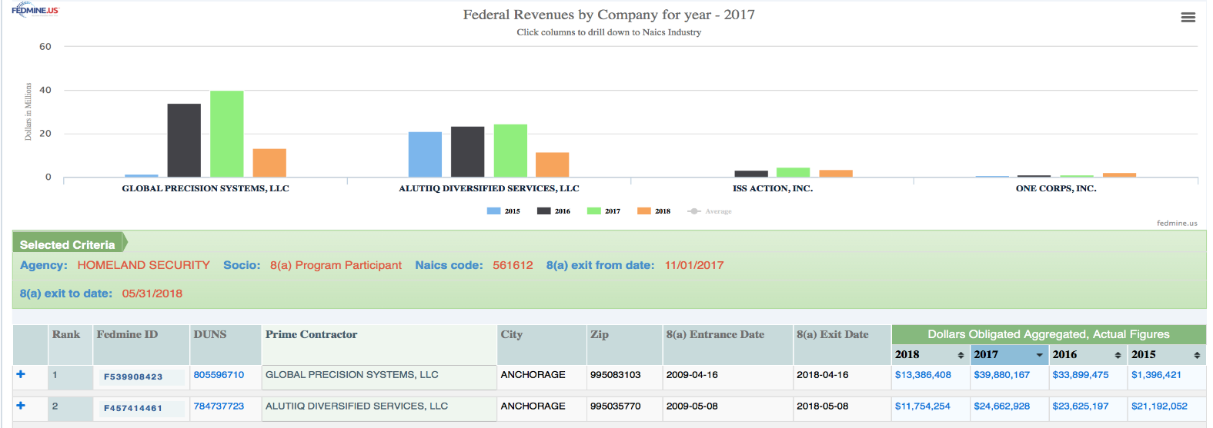
Opportunity Criteria (Cont.)
Opportunities generally don’t leave the 8(a) program once entered
8a company won’t be able to prime it again because it is graduating or has graduated already but didn’t have to recertify
Incumbent will need to sub to another 8(a) company to keep portion of the work
Search for 8(a) opportunities in the focus agency/NAICS code that has just expired or will soon expire (next 2 yrs)
Notes:
LC: This slide is where I feel I should be talking and showing our 8a expiring contracts search either by NAICS and/or by GWAC, go over the search results, transaction detail + old RFP, then go into company profile

Slide 7
Opportunity Criteria (Cont.)
Exclude super-8(a)s (Indian tribes, ANCs, Native Hawaiian Organizations or CDCs) from the search as they are able to spawn more 8(a)s and tend to keep the work in the “family”
How much risk does the incumbent want to bear if the two dates (recompete and 8(a) expiration) are close by?
Look first for set aside/competed contracts first, and not sole source opportunities
8(a) sole source is achieved through contacts
Requires finding specific contracting officers and creating a contact plan
Sole Source opportunities don’t have any statement of work or other documents posted to further qualify opportunity
Some may be hard to reach as contracts are being “flipped over” to a newer 8(a) by the companies with expiring 8(a)
Notes:
LC: This slide is where I feel I should be talking and showing our 8a expiring contracts search either by NAICS and/or by GWAC, go over the search results, transaction detail + old RFP, then go into company profile

Slide 8
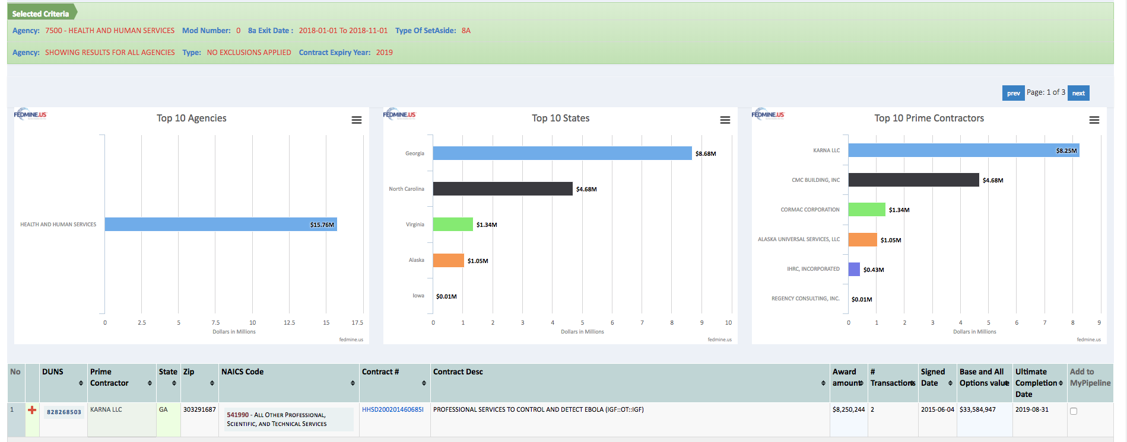
Opportunity Criteria (Cont.)
You could also search by companies with expiring 8(a) at the agency
If starting with the company, don’t discard sole source opportunities
You can approach the company and agree with them to flip the work over to you
It may work if you have a great sales person on staff and an attractive quid-pro-quo
Notes:
LC:

Slide 9
Determine the Timeline
Must guess at the timeframe for re-compete: the more complex the work, the longer the Procurement Administrative Lead Time (PALT) to develop a follow-on acquisition plan, solicit offers and award the contract
Government needs sufficient lead-time to solicit and award a follow-on contract to either the incumbent or successor so that there is no interruption in services
For complex services, the lead time may be 6-12 months or more
For commercial services or products that are not as complex, 6 months or less
Can guess at Agency’s lead time for a specific follow-on requirement by reviewing previous solicitations to assess the lead time needed by comparing the published solicitation issue dates and award dates for comparable opportunities.
This information will be also helpful to selecting an appropriate date range for the search for expiring contracts
Notes:
OS: Likely be talking during this slide but I could show an opportunity search to showcase how long it takes from solicitation to award? Could also show Industry Day or Contracting Officer search during this time, but up to you.

Slide 10
Confirm the Opportunity is Real
Must call COs and OSDBU to confirm if this is a real opportunity
If the CO is not assigned to this opportunity, need to find out who is; more calling around is needed
Often phone calls aren’t answered; so we need to ask CO or OSDBU for the next public event at that agency for access to their staff to verify the pipeline
Open house
Match making
Industry Day, etc.

Slide 11
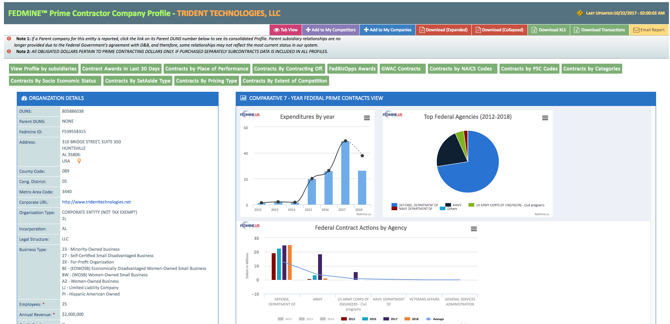
Prioritizing Your Work
Whom do we already know?
What strategy (sole-source, competitive) do we prefer?
Do you know enough about this work to decide to take all of it, instead of sharing with an incumbent?
Could you check if the incumbents are favored at the agency?
It may be harder to chase sole-source opportunities without much associated information
Who will contact the 8(a) incumbents?
Need: Opportunities description together with target company profiles and contact information

Slide 12
Strategic Considerations
Target companies with many 8(a) opportunities that may be shopping for a partner, at least 2 years before their 8(a) expiration
Cold calling is tough; rejection rate is high
Think of it as dating first, before getting married
Find other opportunities to work on together and build a relationship – look at companies just starting their transition period
It is a long-term proposition, not a quick fix

Slide 13
Contact Information
Olessia Smotrova – President/CEO
otaylor@ostglobalsolutions.com
Cell 240-246-5305
David Huff – Vice President
dhuff@ostglobalsolutions.com
Cell 513-316-0993
Office 301-384-3350
service@ostglobalsolutions.com
Lindsay Carry – VP, Customer Success
lcarry@fedmine.us
Cell 703-582-0640
Archisha Mehan – VP, Business Development
archisha@fedmine.us
Cell 240-476-4850
Office 301-279-7575
info@fedmine.us
www.ostglobalsolutions.com
www.fedmine.us

