Slide 1
Making the case for Change Management
Introducing the Changefirst methodology,
People-Centred Implementation (PCI®)

Slide 3
Organisations need to deliver business critical changes
Consider the time spent building strategies and technical solutions
Versus the time spent planning “how” change will take place

Slide 4
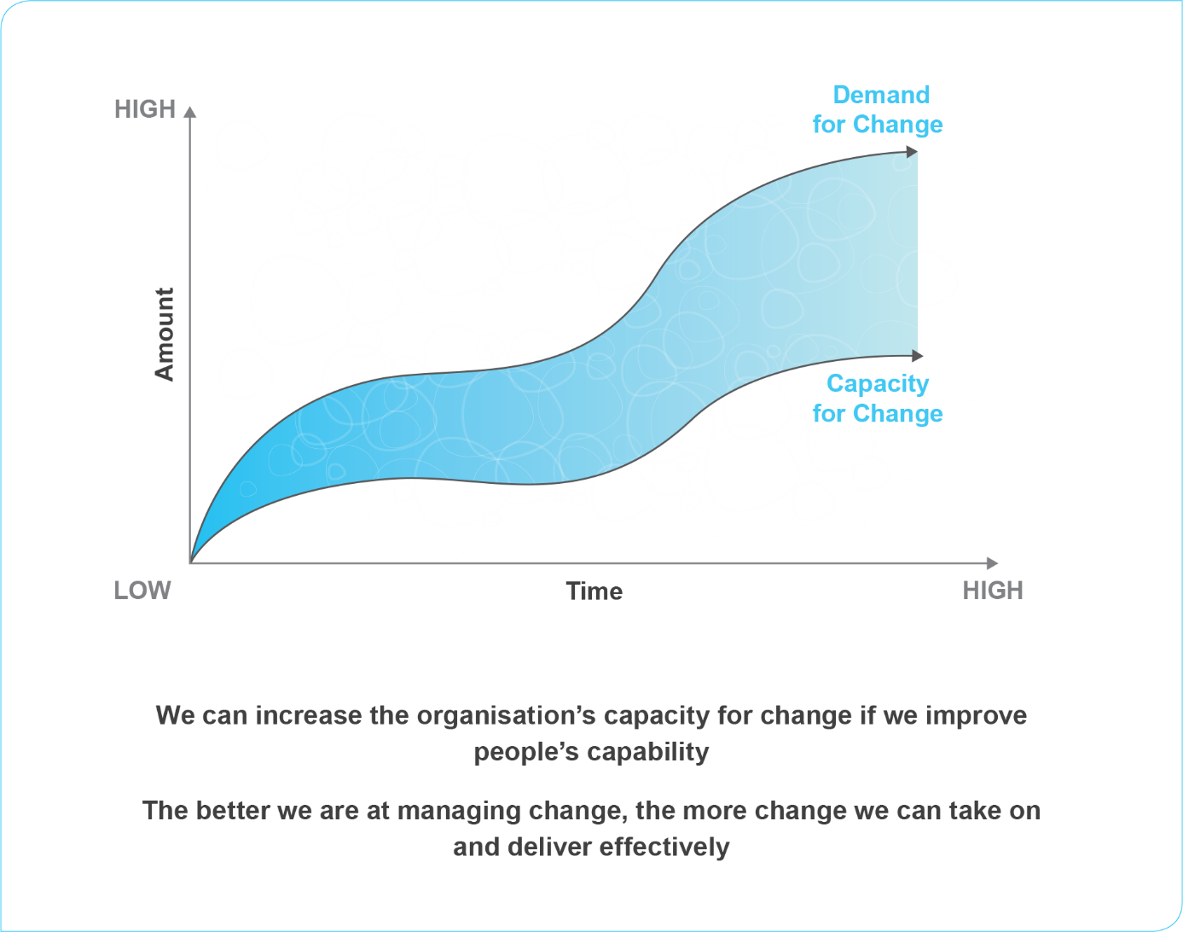
Demand for change often exceeds people’s capacity
Major organisational change often required major personal change to:
Behaviours
Aspirations
Values

Slide 5
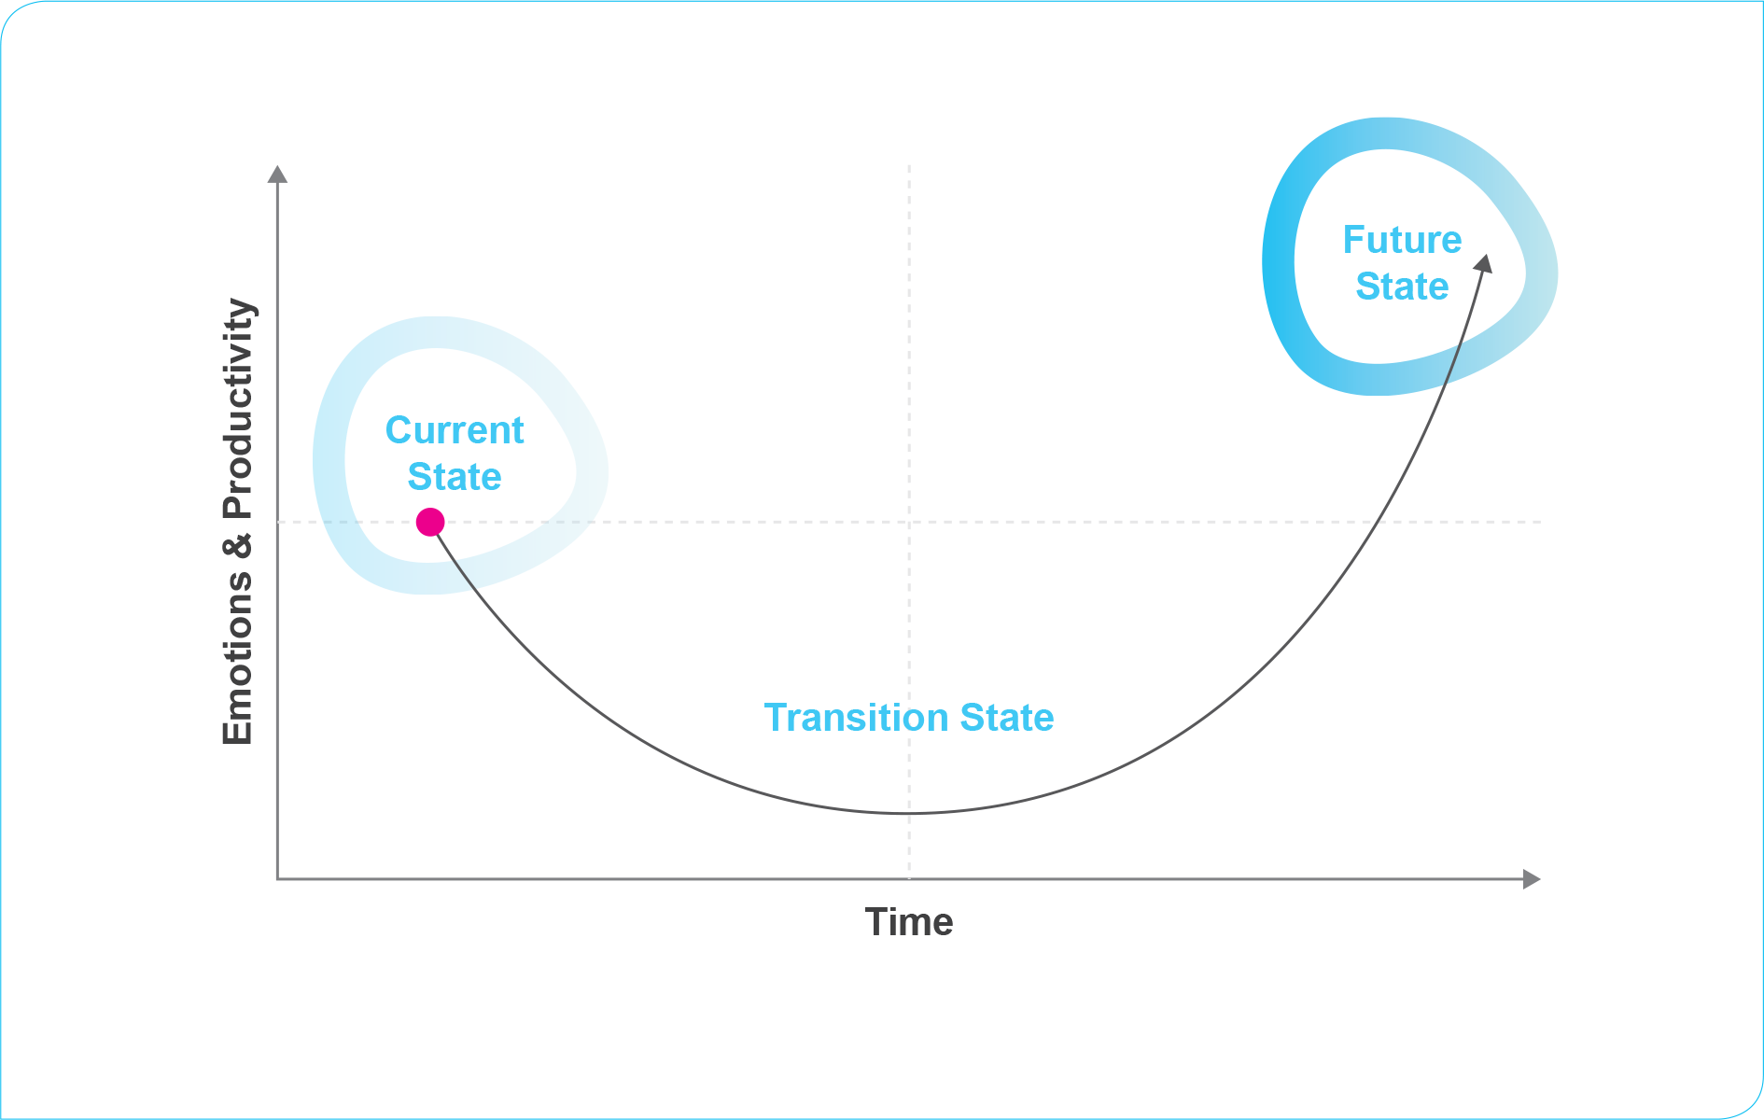
Major change is disruptive for people
Stop doing things in the old ways
Engage with a new system
Successfully transition from old to new

Slide 6
People suffer from a loss of control
Conscious and unconscious feelings of a loss of control
Different people may feel this is loss very differently

Slide 7
Loss of control causes resistance that threatens implementation
A behavioural reaction to feelings of a loss of control
Any opposition to a move away from the status quo
greater the disruption, higher the resistance
Not a bad thing, perfectly normal human response
Change Agents anticipate, surface and manage resistance

Slide 8
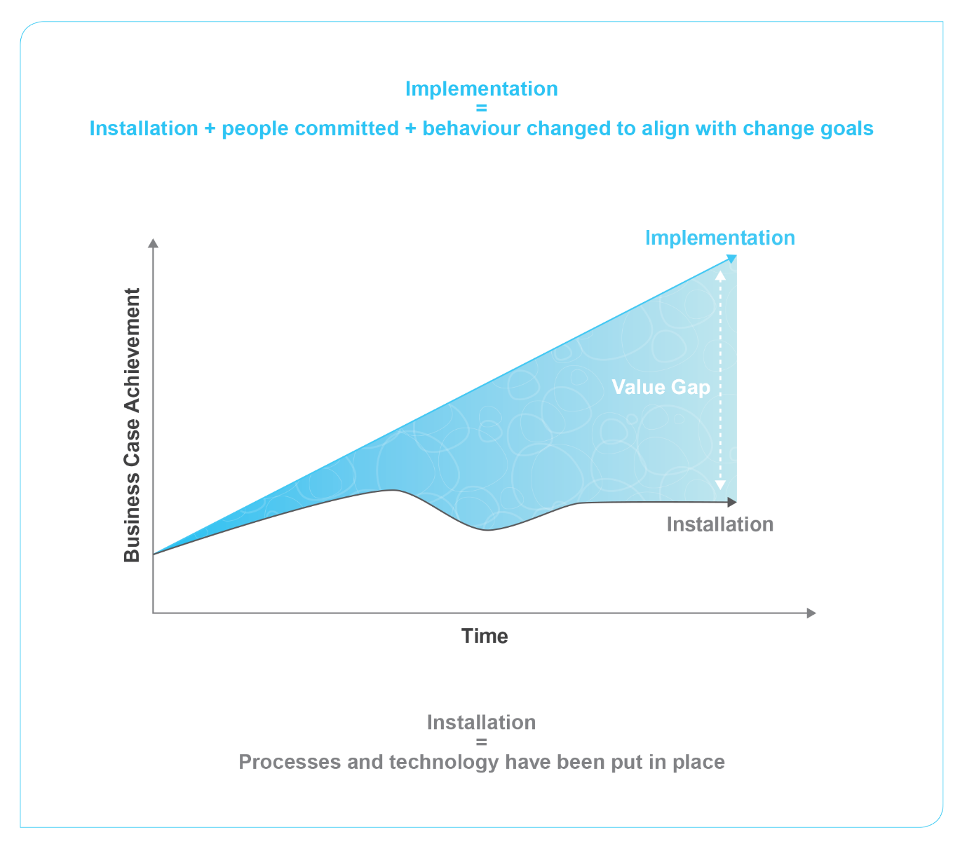
Organisations are in danger of installing rather than implementing change
Value Gap = intended results vs. actual delivery
Value Gap can be very costly for organisations

Slide 9
Typical costs of installed change
Failing to deliver – the business case and dealing with a more resistant audience
High people costs – lack of engagement
Loss of leadership credibility – reducing the likelihood of future change success
Poor competitor in the marketplace – rarely delivering on strategic ambitions

Slide 10
PCI® drives successful implementation through commitment
Successful implementation requires commitment building and behaviour change
Commitment building happens in stages

Slide 11
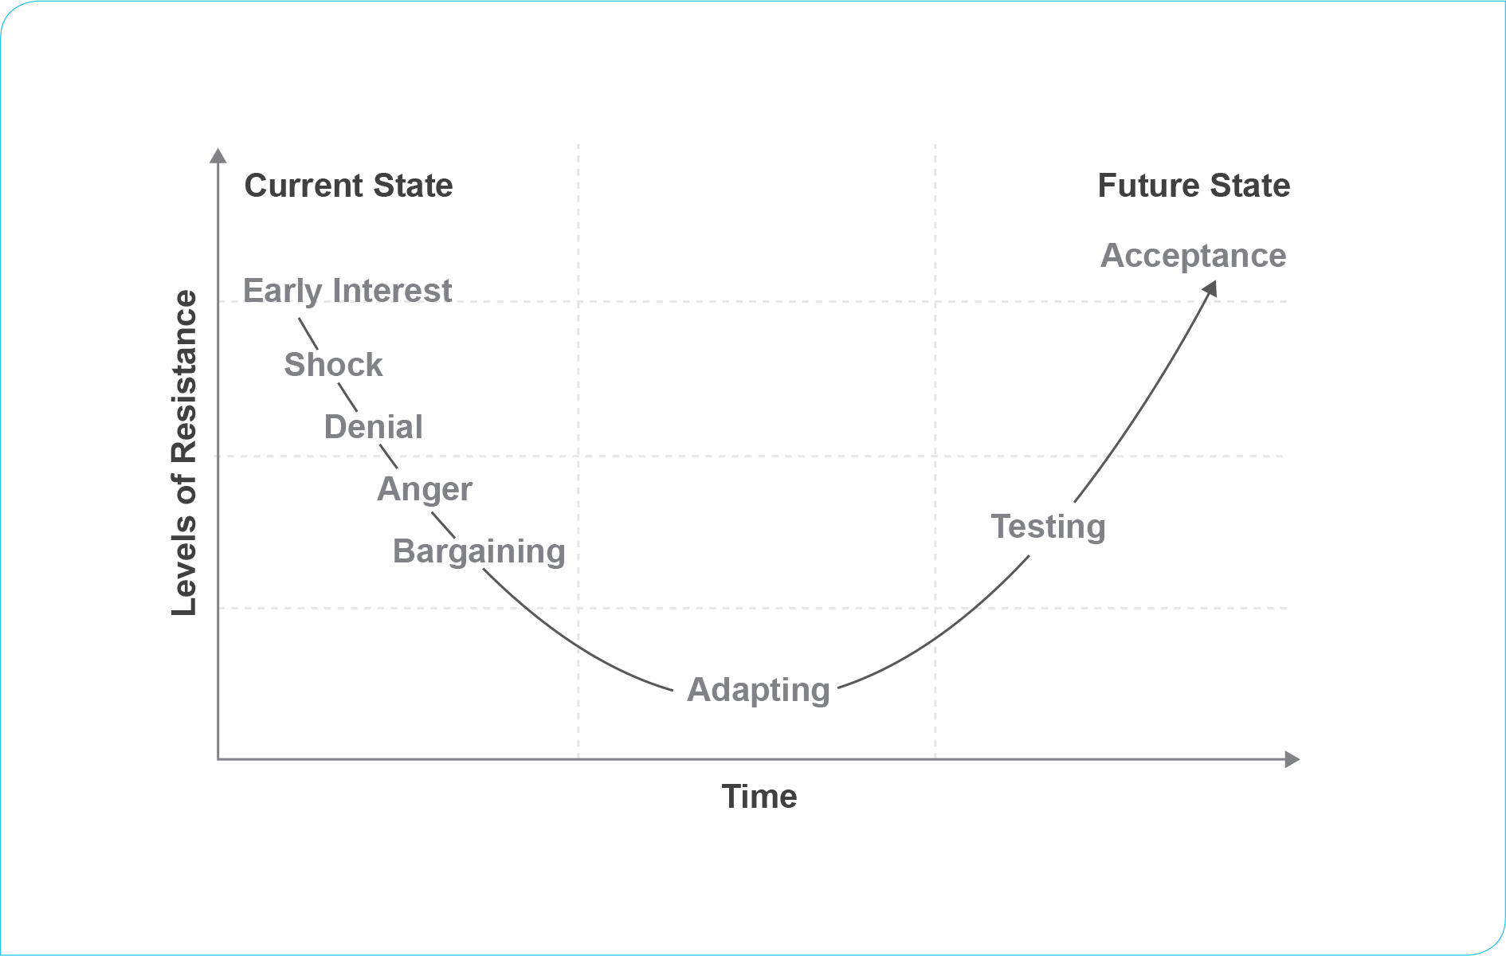
PCI® also helps manage the personal reactions to change that can threaten commitment
Resistance threatens commitment
People can be moving forward towards commitment one minute and resisting change the next!

Slide 12
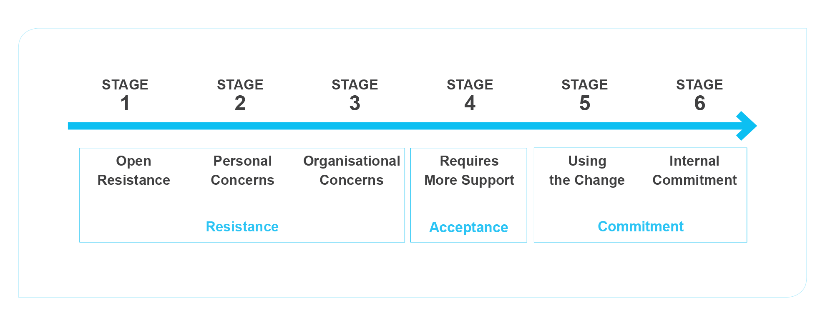
PCI® provides tools to measure the progress and success of commitment building activity

Slide 13
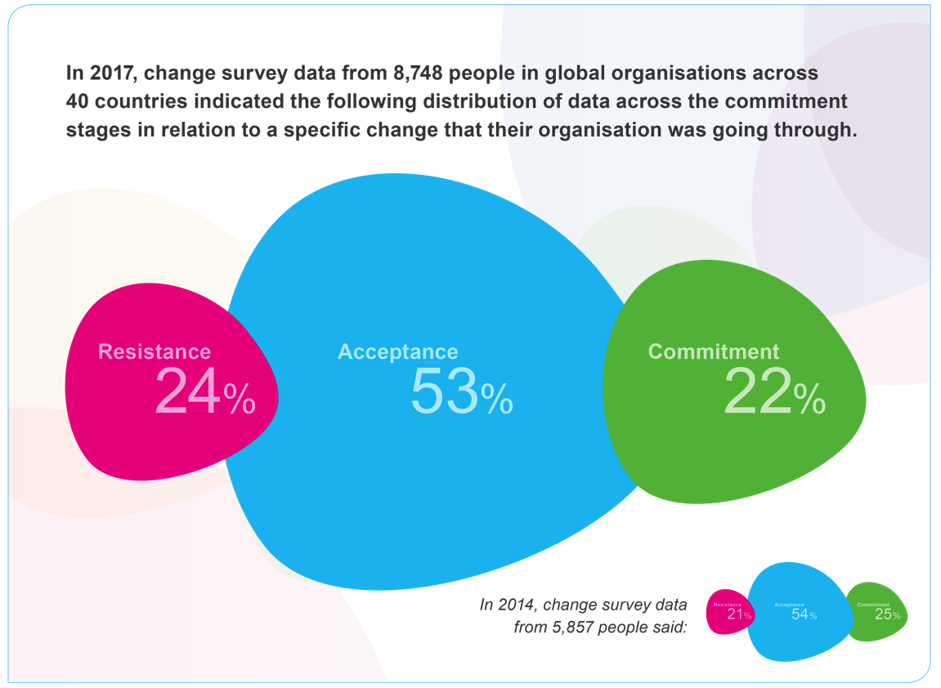
Changefirst Database – Initiative Legacy Assessment
PCI allows you to benchmark your own change performance against the largest global change implementation data
>40,000 respondents and >600,000 individual data points in total

Slide 14
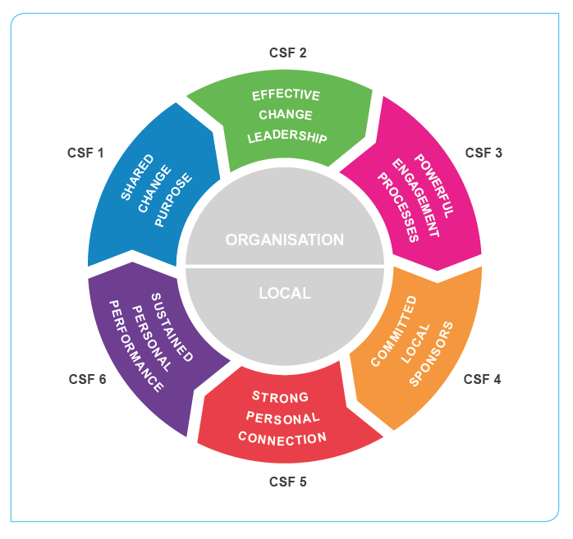
PCI® comprises of 6 Critical Success Factors for major change
SHARED CHANGE PURPOSE
People are dissatisfied with the current state and buy-in to the vision
EFFECTIVE CHANGE LEADERSHIP
Change leaders are ensuring the change is implemented
ORGANISATIONAL
POWERFUL ENGAGEMENT PROCESSES
Processes are being used to ensure people are engaged
COMMITTED LOCAL SPONSORS
Managers are willing and able to help people adapt
STRONG PERSONAL CONNECTION
People are committed and new behaviours are being used
LOCAL
SUSTAINED PERSONAL PERFORMANCE
Resistance to change is being managed and people are being helped to adapt

Slide 15
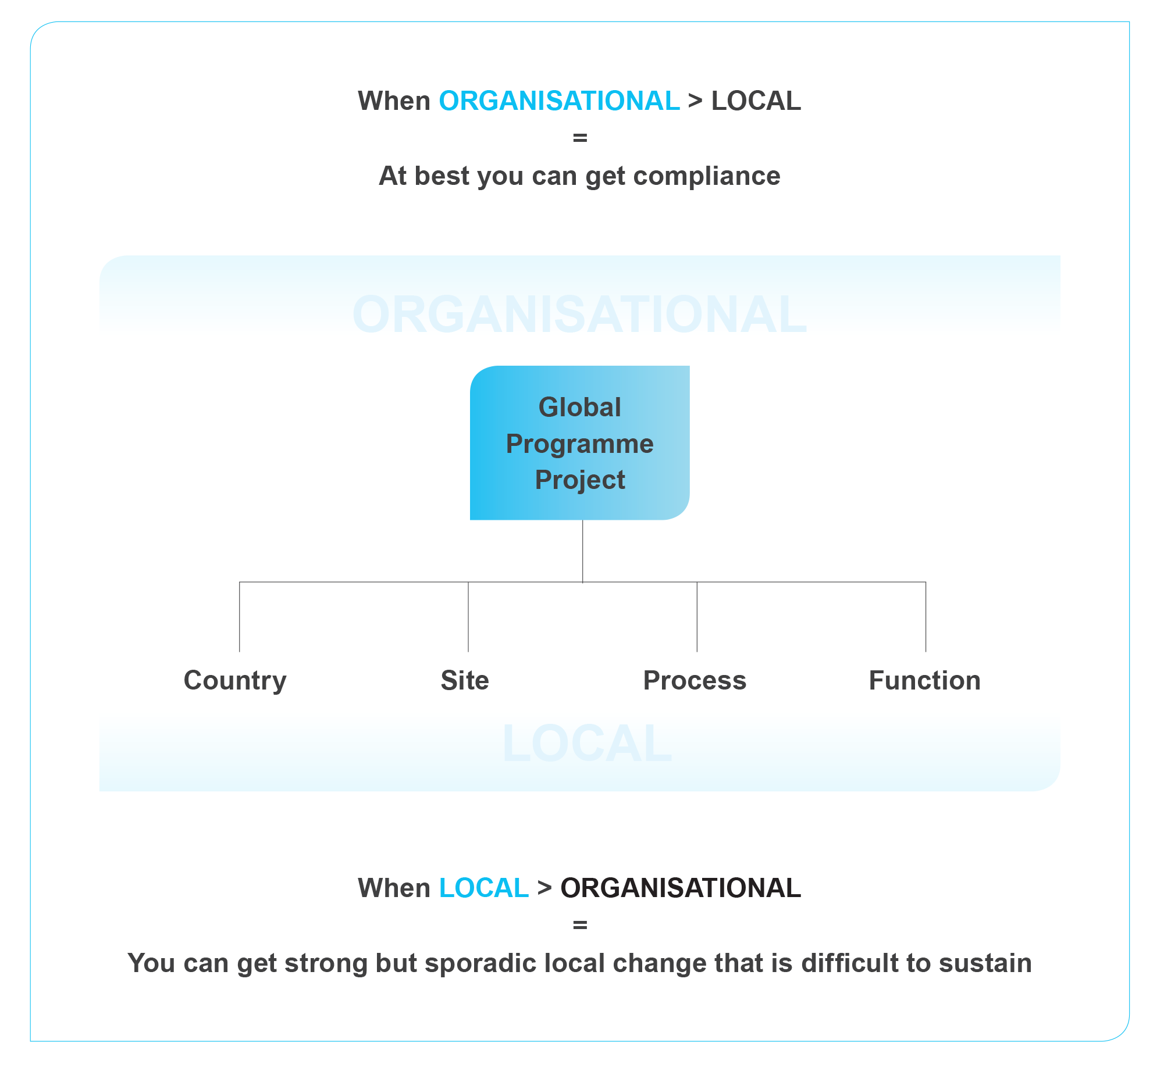
PCI® recognises the need to balance organisational requirements and local needs during change

Slide 16
PCI® has a strong research basis
The Psychology of successfully delivering Organisational Change
The Research Basis for the PCI Methodology
The Power of Data – our annual longitudinal research and “big data” report

Slide 17
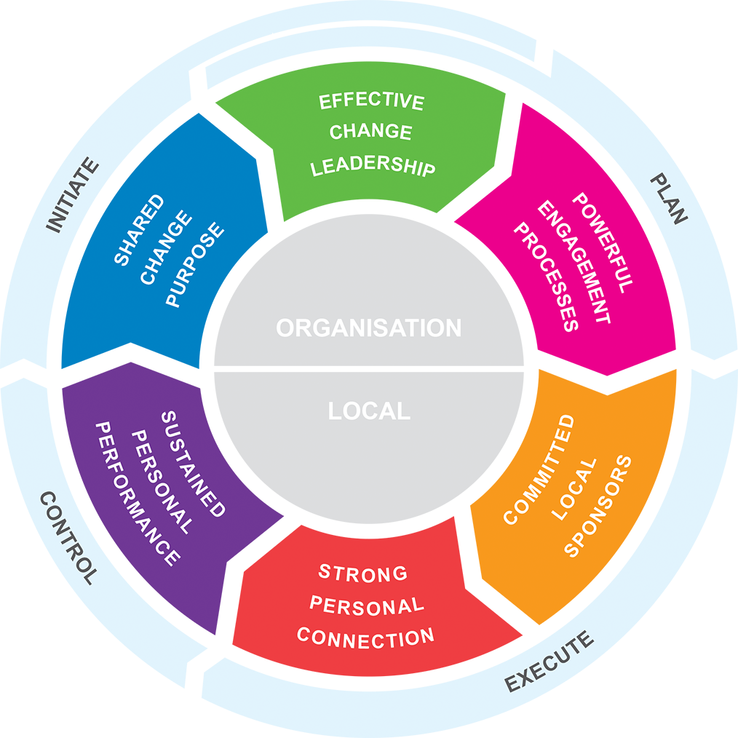
PCI® integrates with project strategies to help build more complete and aligned change plans

Slide 18
Summary
Demand for change > people’s capacity to assimilate change
Organisational change required major personal change and major personal change can be disruptive
Loss of control during change can cause resistance and resistance threatens successful implementation.
Organisations install more than they implement and installed change can be very costly.
PCI helps drive success through commitment building
Tools to measure progress and success of commitment building
6 Critical Success Factors for assessment and tracking
PCI has a strong research foundation and integrates easily with other frameworks.

