Slide 1
Roadmap Pro
Introduction to PCI Process

Slide 2
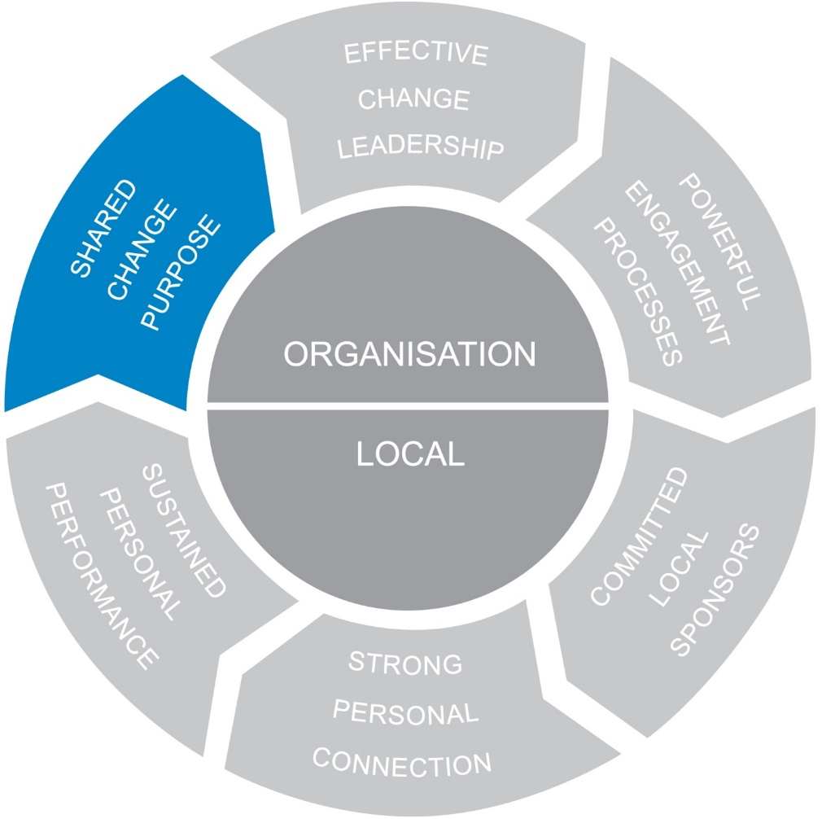
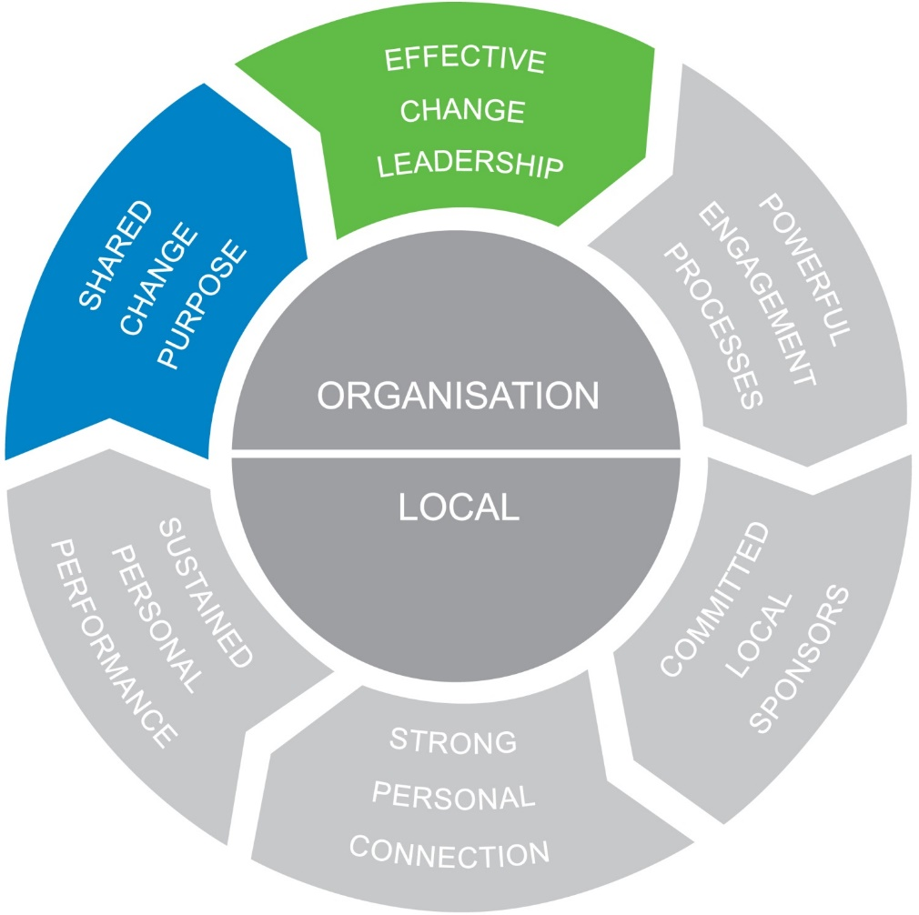
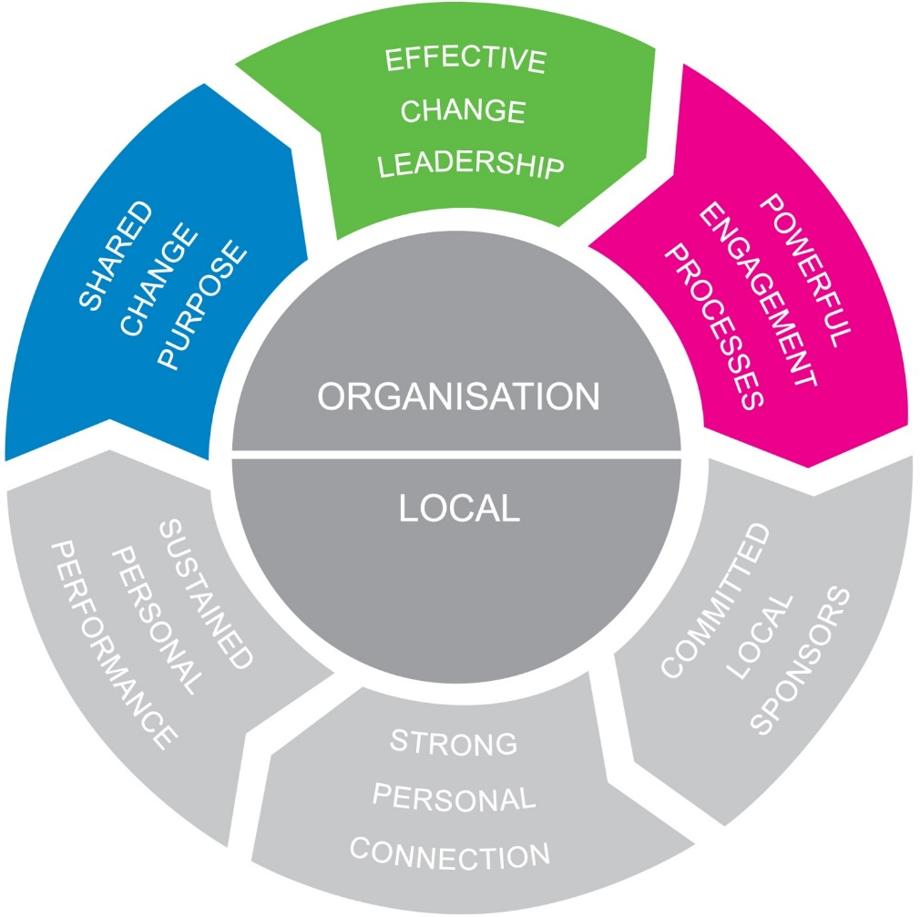
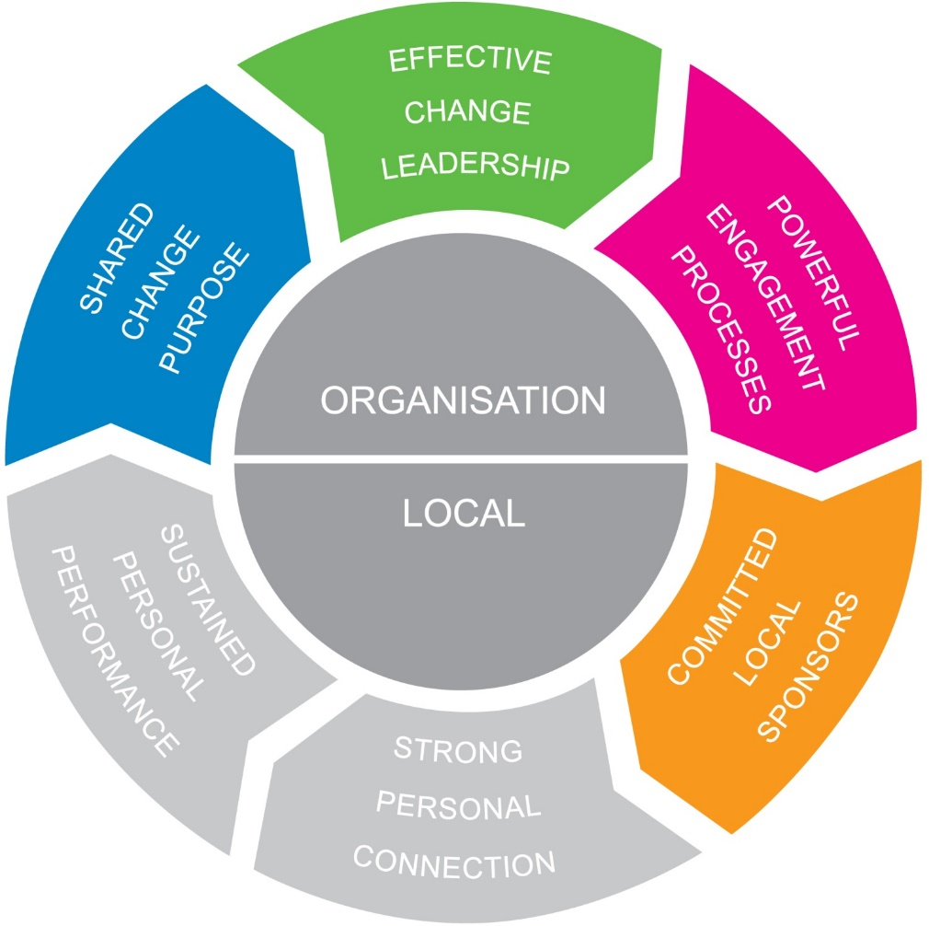
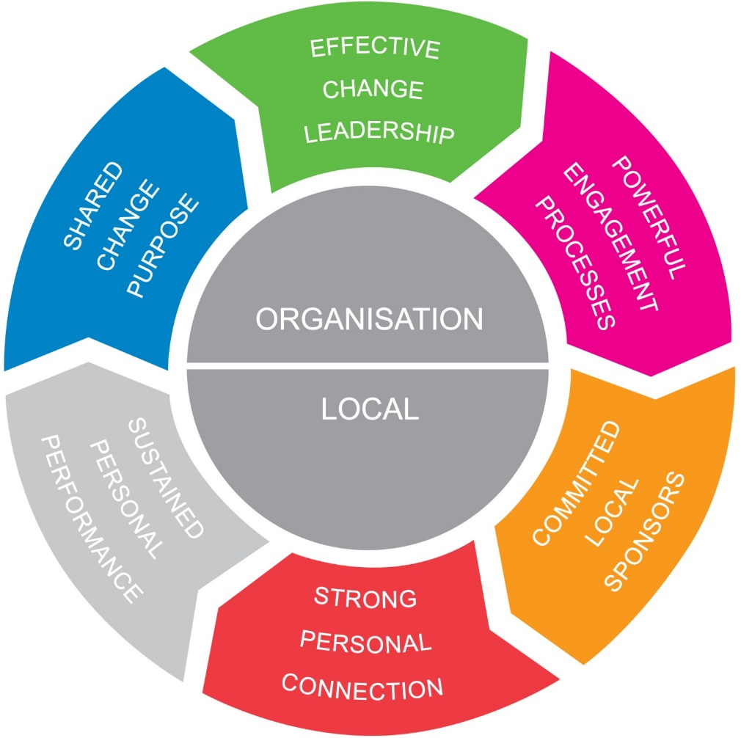
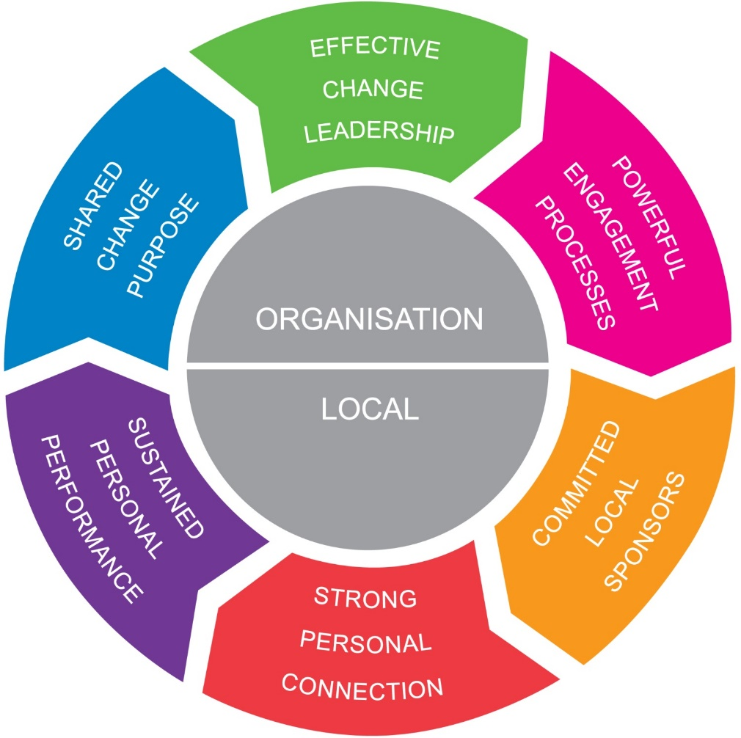
People-Centred Implementation
People-Centred Implementation

Slide 3
Shared Change Purpose
Key people are significantly dissatisfied with the way things are now and buy-in to the vision for change
Risk areas
Vision
Imperative
Solution Visibility

Slide 4
Effective Change Leadership
Organisational leaders will do everything it takes to ensure the change is implemented and change teams are skilled at implementing change plans
Risk areas
Sponsor Behaviour
Confidence In Agents
Informal Influence

Slide 5
Powerful Engagement Processes
Organisational processes are in place that ensure people are appropriately engaged
Risk areas
Involvement
Training
Rewards
Communications

Slide 6
Committed Local Sponsors
Middle and front-line managers are committed to the change and are willing to work with their people to obtain buy-in and help them work to adapt to the change
Risk areas
Local role modelling
Local managers support

Slide 7
Strong Personal Connection
Sponsors and agents understand how to connect people to the change and key people are buying in to the need and vision for change
Risk areas
Personal Imperative
Solution Viability
Being Successful

Slide 8
Sustain Personal Performance
Sponsors and agents understand why key people will resist the change and plans are in place to help them adapt and increase performance
Risk areas
Future Security
Financial Impact
Work Relationships
Level Of Responsibility
Learning Curve

Slide 9
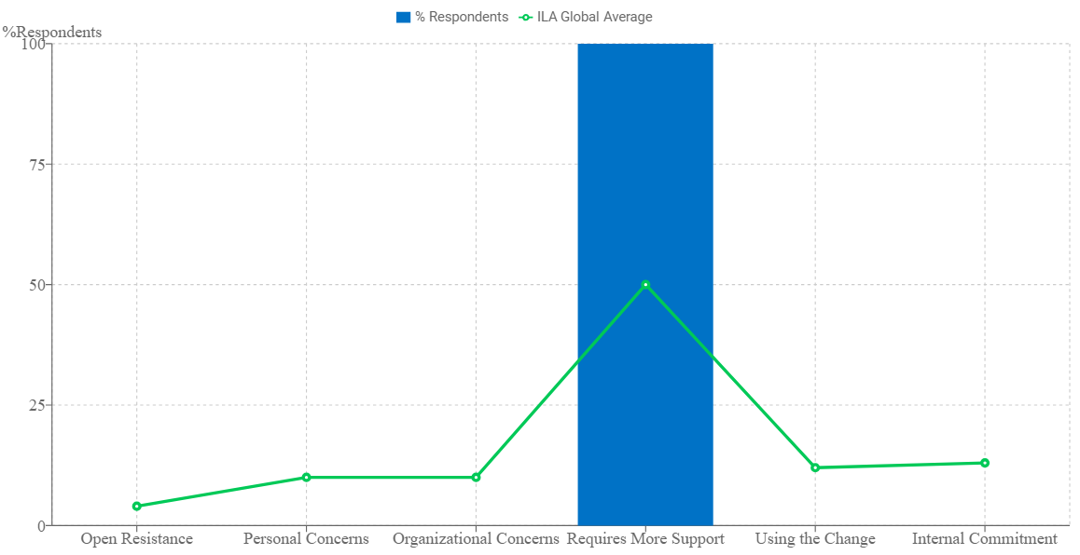
Lead Indicator
Acceptance
Resistance
Commitment

Slide 10
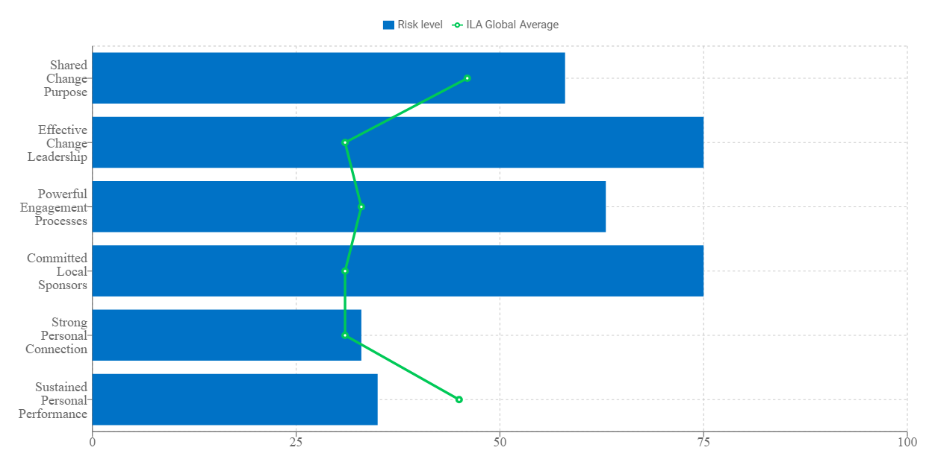
Critical Success Factors

Slide 11
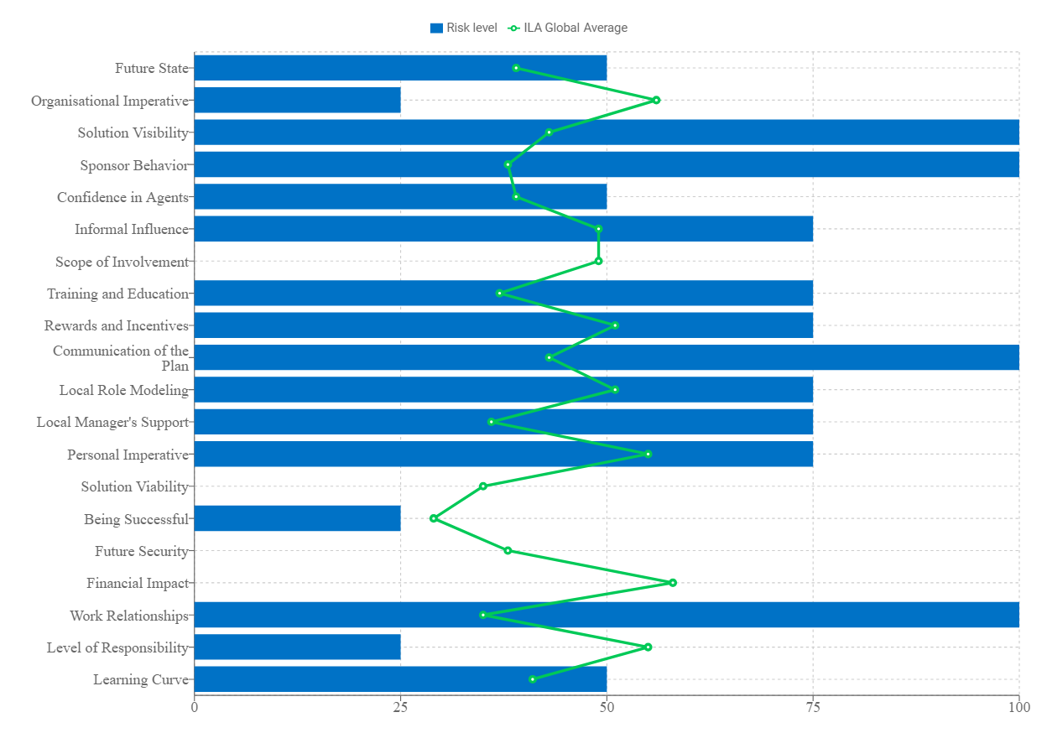
Risk Dimensions

Slide 12
Promoted to the Dashboard
12

Slide 13
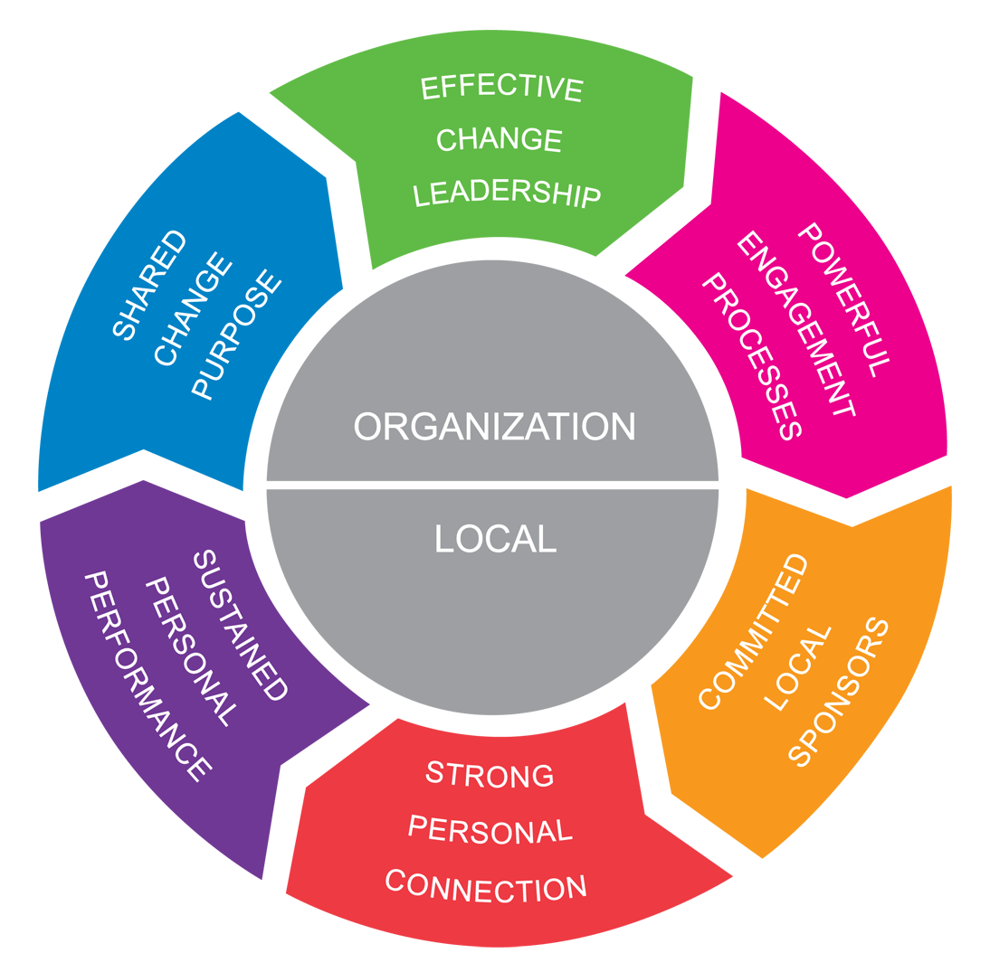
Plan
Deploy

