Slide 1
How Olin is Implementing a Digital Supply Chain on Journey to S/4HANA
Rene Julien, Material Master Data Manager, Olin Corporation
Jeffrey Topel, Account Executive, Utopia Global
Gorpam Kahn, Sr. Delivery Director, Utopia Global

Slide 2
Building Together
Acquisitions of global businesses and facilities with multiple business systems each with different data structures and naming conventions required a new, standardized, common platform with common business processes, structure, and naming convention for the Master Data
Notes:
The Olin Corporation is an American manufacturer of ammunition, chlorine, and sodium hydroxide. Based in Clayton, Missouri, it traces its roots to two companies, both founded in 1892: Franklin W. Olin's "Equitable Powder Company" and the "Mathieson Alkali Works". The company became the Olin Corporation in 1969, and began to sell off many of its acquired businesses. In October 2015, Olin acquired Dow Chemical’s US Gulf Coast Chlor Alkali, Global Chlorinated Organics, and Global Epoxy businesses. Across the globe, the businesses and facilities have multiple business systems each with different data structures and naming conventions. A key success factor in achieving the expected benefits is standardizing on a common platform with common business processes, structure and naming convention for their Master Data.

Slide 3
The Business Challenge
UNIFICATION
Standardization of data retention and naming conventions for Material Masters
FOUNDATION
Unification of the historical business systems and data structures
Establish the foundation for a single, global structure

Slide 4
No One Understands Data Like We Do!
Focus on data supporting Digital Transformation & the Intelligent Enterprise
Data Strategy: Roadmap for People, Process and Technology
Data Quality: Data Profiling, Data Cleansing, Enrichment
Data Migration: SAP S/4HANA Migrations, Data Services
Data Governance: MDG core domains and Utopia developed solutions
History/Innovation/Growth
Founded in 2003 and headquartered near Chicago
Over 500 employees worldwide
Largest R&D team focused on Master Data Governance in the World
#1 referred partner by SAP for EIM Solutions
Proprietary accelerators and templates support entire EIM portfolio from SAP
Exclusive partner for SAP MDG Solution Extensions
SAP MDG for Enterprise Asset Management (MDG-EAM)
SAP Asset Information Workbench (AIW)
SAP MDG for Retail and Fashion Management (MDG-RFM)
Notes:
Utopia brings a unique value proposition to SAP customers to drive an overall data and data governance strategy to accelerate and lower the cost of their digital transformation - while enabling the intelligent enterprise. We see data

Slide 5
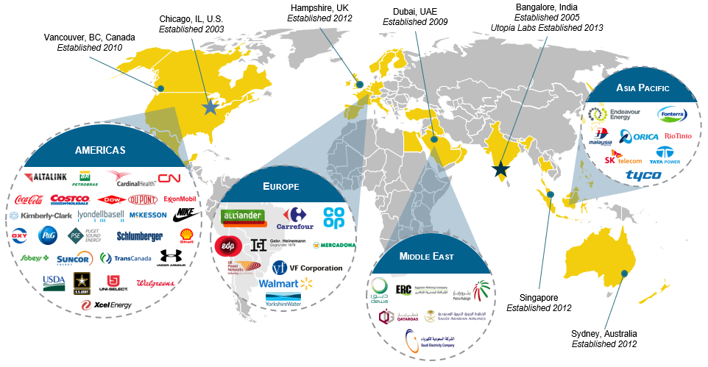
Global Customers
Notes:
We have happy clients located all over the world, and a global team, comprised of over 200 experienced data practitioners who are experts in legacy and source system environments and the SAP landscape.

Slide 6
Utopia and Olin Collaboration
The key reason why Utopia was chosen was for their experience & expertise in EAM data, and offering end to end business solution along with data migration and MDG implementation
There are some companies which do data cleansing, some who do data migration and then some who do MDG implementation – but there is only one Utopia who does all the three
Utopia services were only used for the MRO data cleansing and EAM data standards for Olin. Utopia is continuing to extending their hand in service by offering services with the migration & MDG implementation

Slide 7
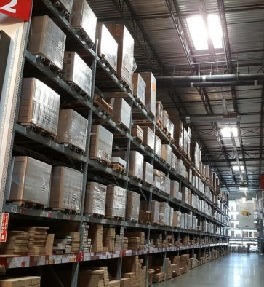
Expected Business Value
Keep Material master data consistent, up-to-date, and accurate across the organization
Reduce inventory carrying costs / obsolete materials through more-efficient spares and parts management
Improve material availability
Improve safety through more-accurate equipment data

Slide 8
The Solution
Project for Material Master Data Cleansing and Enrichment
Hub deployment model to centrally manage and distribute master data
Improved business rules and workflow capabilities that are natively integrated with SAP Master Data Governance
Leveraged best practices library establishing a standardized, predefined central data model with rules definition across material management
Unavailable characteristic value and Manufacture information were covered and updated in crib crawl support activity
Accurate, enhanced material data including replacement parts, spare parts inventory and synchronization with financial master data

Slide 9
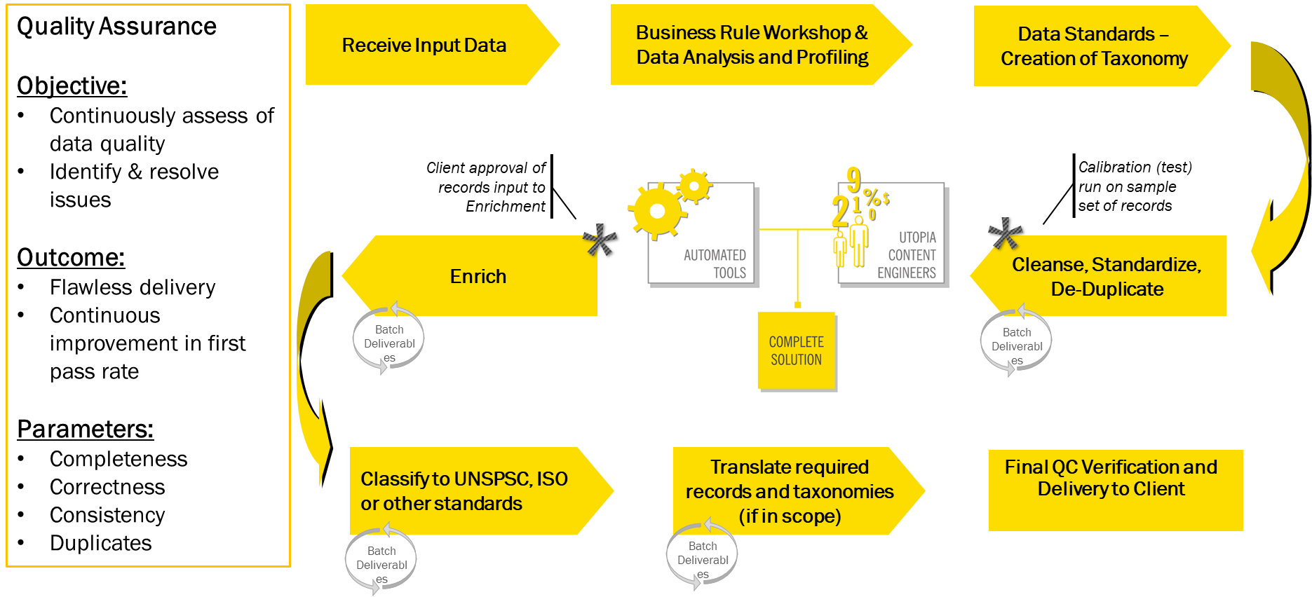
Project Execution

Slide 10
Project Specifics
Scope Definition Workshop
Data extraction
Execution phase
Delta Sweep
Final De-Duplication
Delivery of load files

Slide 11
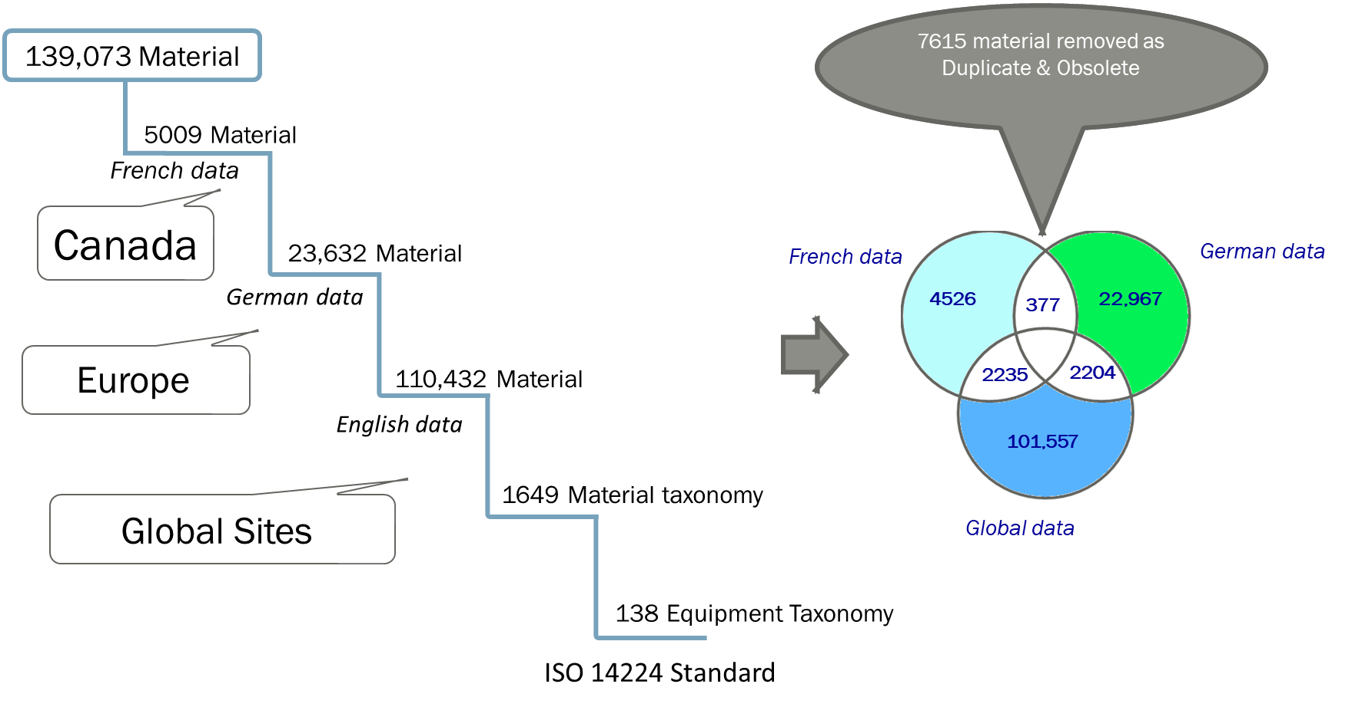
Project Specifics

Slide 12
Benefits / Value Realized and Expected
Reduction of 58% of initial material masters reviewed
Expectation of increased purchasing power
Only two of seven phases have been implemented
Expectation of the ability to unify warehousing globally

Slide 13
Lessons Learned
Risks | Mitigation Strategy | Lessons
Quality / Quantity of Data to be Cleansed | Q/A data prior to submission | Accountability needs to be integrated into the QA process
Personnel Changes | Overview Process and orientation with Utopia Team | Clear guidance with respect to roles & responsibilities
Crib Crawl Support | Face to face support for training and crib crawl from Olin Project Team | Face to face support is required for overcoming the barriers

Slide 14
Utopia Products and Innovations
SAP MDG Solutions Extensions
SAP MDG for Enterprise Asset Management
SAP Asset Information Workbench
SAP MDG for Retail & Fashion Management
Structured and Unstructured Content
EAM - ISO 14224 equipment standards – over 350 equipment classes
MRO - UNSPSC based material Taxonomy – over 4,000 noun modifier pairs

Slide 15
Intellectual Property: Key Solution Areas
Key Innovations
Data Governance Accelerator
4C’s Machine Learning
uXLoader – Excel based Mass Upload
Data Quality Remediation
Data Migration Package
Material Master Short and Long Text

Slide 16
Questions?
Rene Julien
Material Master Data Manager
Olin Corporation
Jeffrey Topel
Account Executive
Utopia Global
314.616.6684
jtopel@utopiainc.com
www.utopiainc.com

Slide 17
Follow Us
Thank you for your time
Follow us on at @ASUG365

