Slide 2
Enterprise Adoption of Drone Technology is in its Nascence.
—PwC Global IQ Survey (2017)

Slide 3
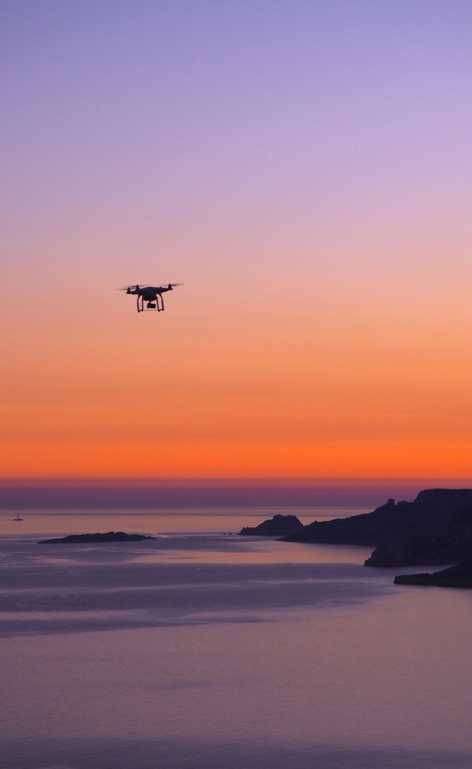
In summary
We help industry leaders use aerial intelligence to transform their business.
THE_PROSPECT’S_CHALLENGE
THE_SOLUTION
THE_CALL_TO_ACTION
THE_EXPECTED_RESULTS

Slide 4
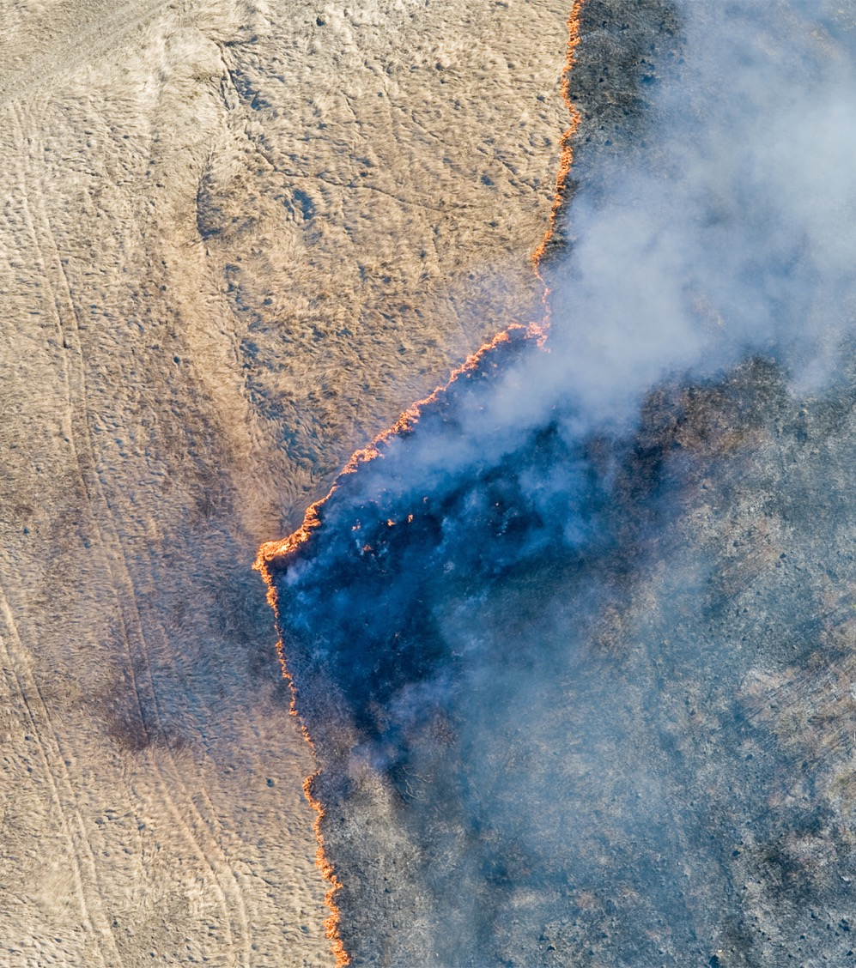
Facing Today’s Challenges
Add Text Here
Add Text Here
Add Text Here
Notes:
http://www.bioone.org/doi/abs/10.1614/WT-D-16-00046.1?journalCode=wete

Slide 5
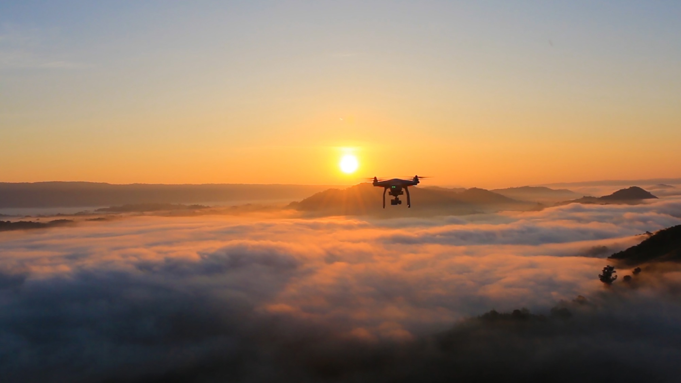
Our Promise: Add Text
Ex. Transform the Way Business Is Done

Slide 6
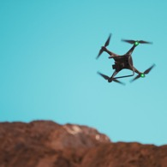
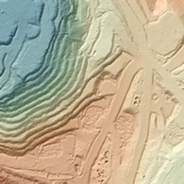

More accurate measurements; higher-fidelity maps and models
Anomaly detection
Get more value out of existing work
Assure quality
Field technicians fly drones with advanced sensors over areas of interest
Algorithms process sensor data into 2D, 3D, and point cloud models, maps, and reports
Faster deployment and data collection
Rapid insights
Collect more data in less time and at lower costs
Respond to opportunities
Site managers use aerial intelligence to direct activity on-site
Remove staff from hazardous environments
Greater data security and privacy
Regulatory compliance
Prevent injuries and deaths
Reduce losses and downtime
Avoid legal issues

Slide 7
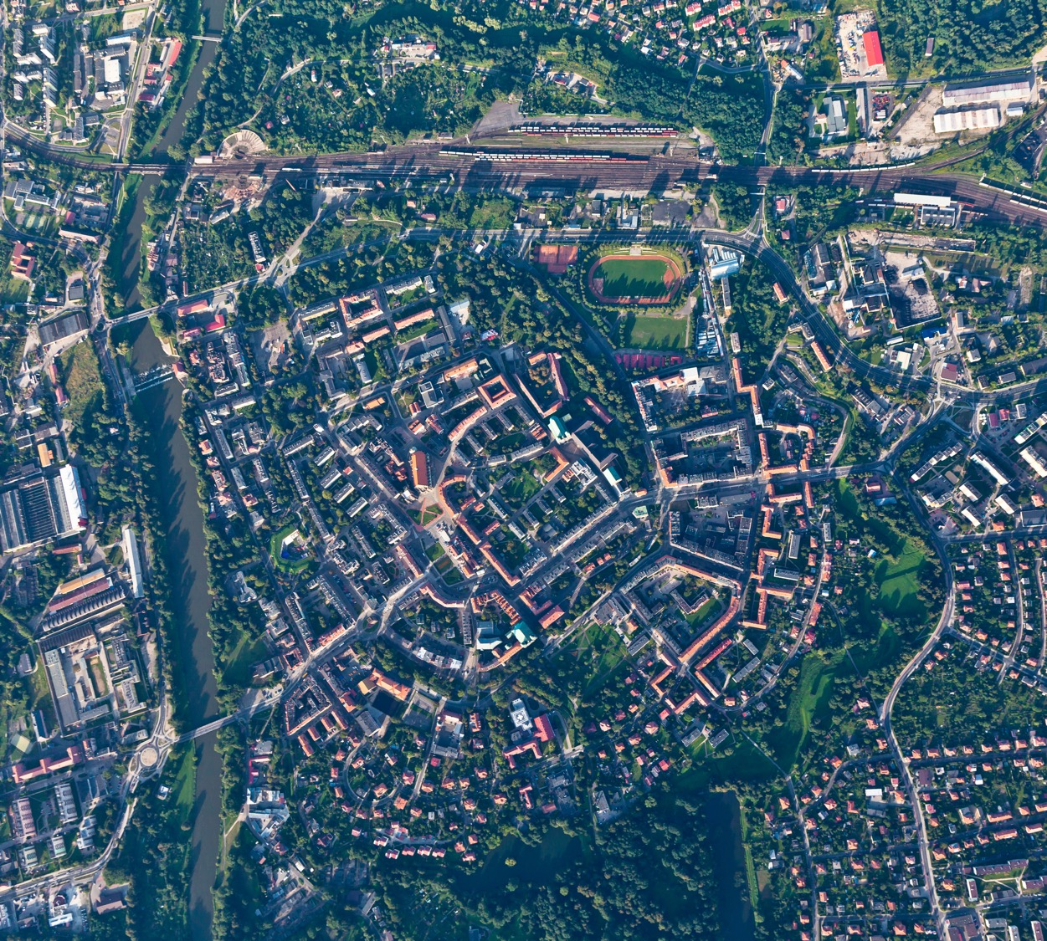


2D Mapping
Produce high-resolution aerial imagery of property before and after a damaging event
BENEFITS & OUTCOMES
Increase assessment accuracy
Reduce assessment time
Accelerate claims management
Reduce bias and fraud
Orthomosaic
Visual

Slide 8
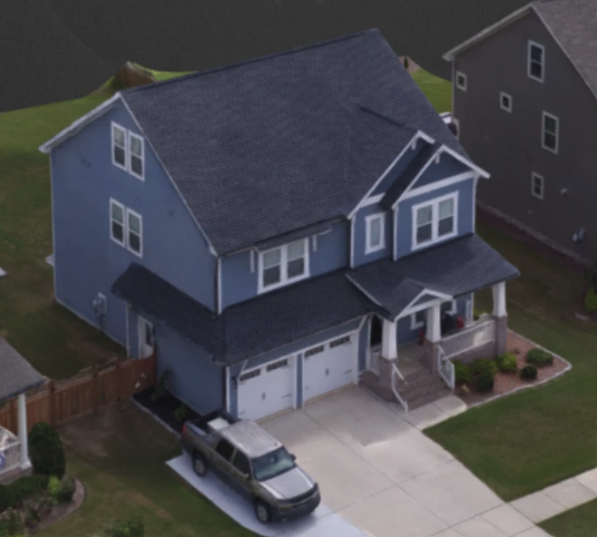
3D Mapping
Produce high-resolution aerial imagery of property before and after a damaging event
BENEFITS & OUTCOMES
Increase assessment accuracy
Reduce assessment time
Accelerate claims management
Reduce bias and fraud
Orthomosaic, 3D Structure
Visual, LiDAR

Slide 9
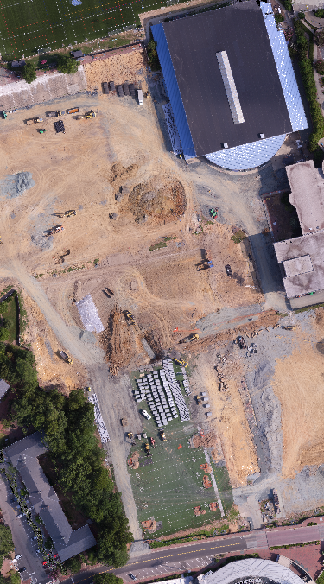
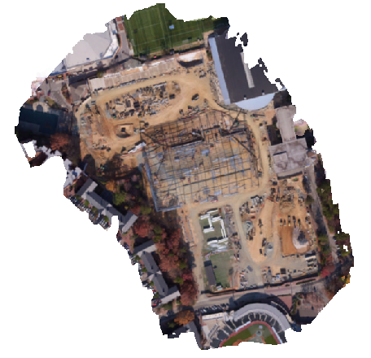
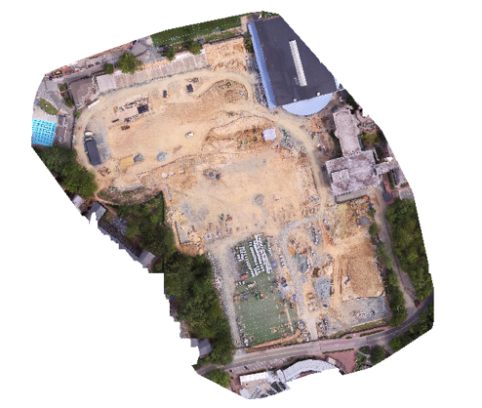
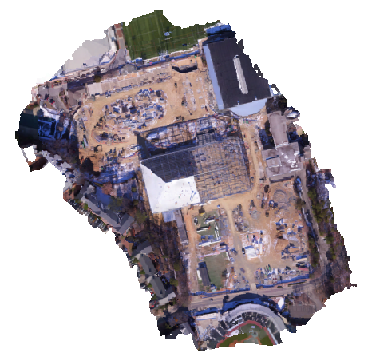
Jobsite Reports and Progress Monitoring
Track and report on daily progress and productivity
BENEFITS & OUTCOMES
Improve the accuracy of scope, schedule, and cost estimates
Identify safety issues
Accelerate reporting and client communications
Prevent and reduce claims
Progress Monitoring Report
Visual

Slide 10
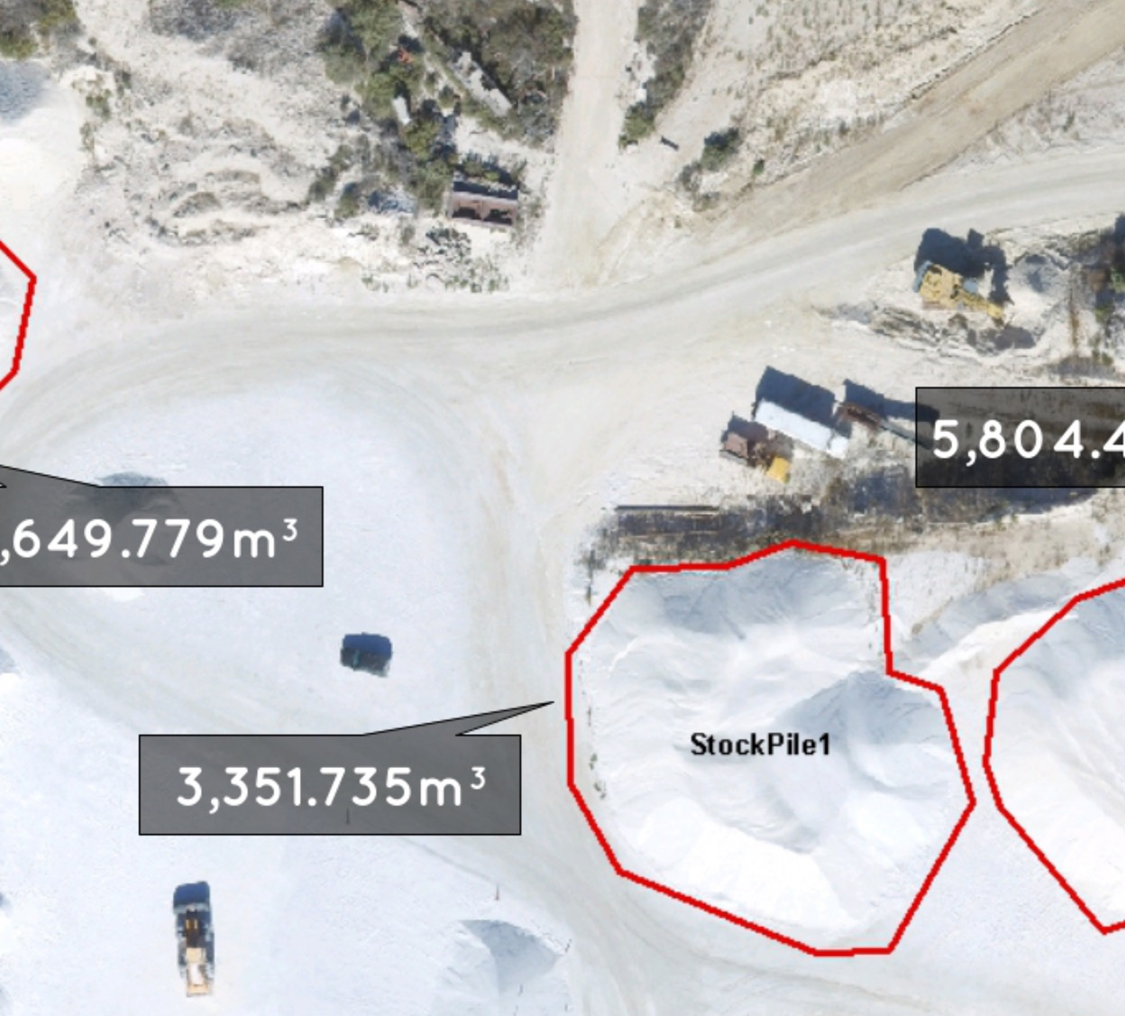
Volume Measurement
Calculate cut-fill and liquids volumes
BENEFITS & OUTCOMES
Increase the accuracy and authority of measurable work reports
Accelerate surveys and project engineering and management
Volume Measurement
Visual, Thermal, LiDAR

Slide 11
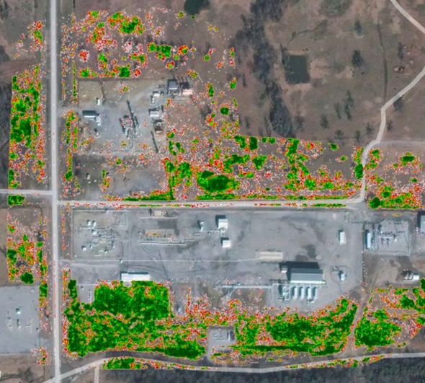
Environmental Monitoring and Mitigation
Plan remediation and track progress using topographic surveys and plant health indices
BENEFITS & OUTCOMES
Accelerate surveys
Protect uptime
Reduce the risk of high-consequence events
Orthomosaic, Plant Health Indices
Visual

Slide 12
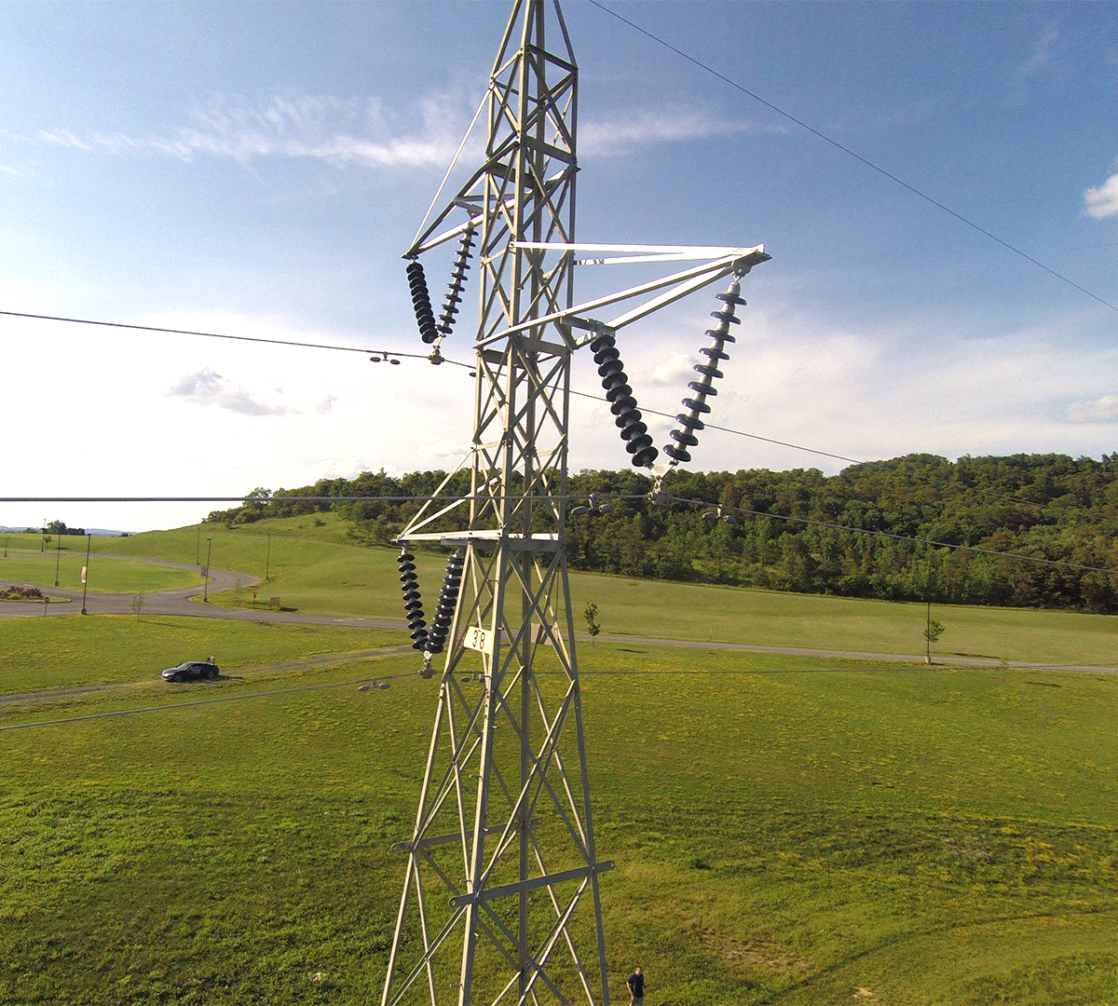

Video Streaming
Conduct remote inspections
BENEFITS & OUTCOMES
Accelerate inspections
Reduce risk to field staff
Video

Slide 13
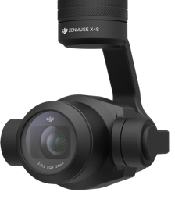

Our Offering
1. Select your drone
2. Select sensors
3. Collect & view imagery
4. Get insights
ROTARY WING DRONE
FIXED WING DRONE

Slide 14
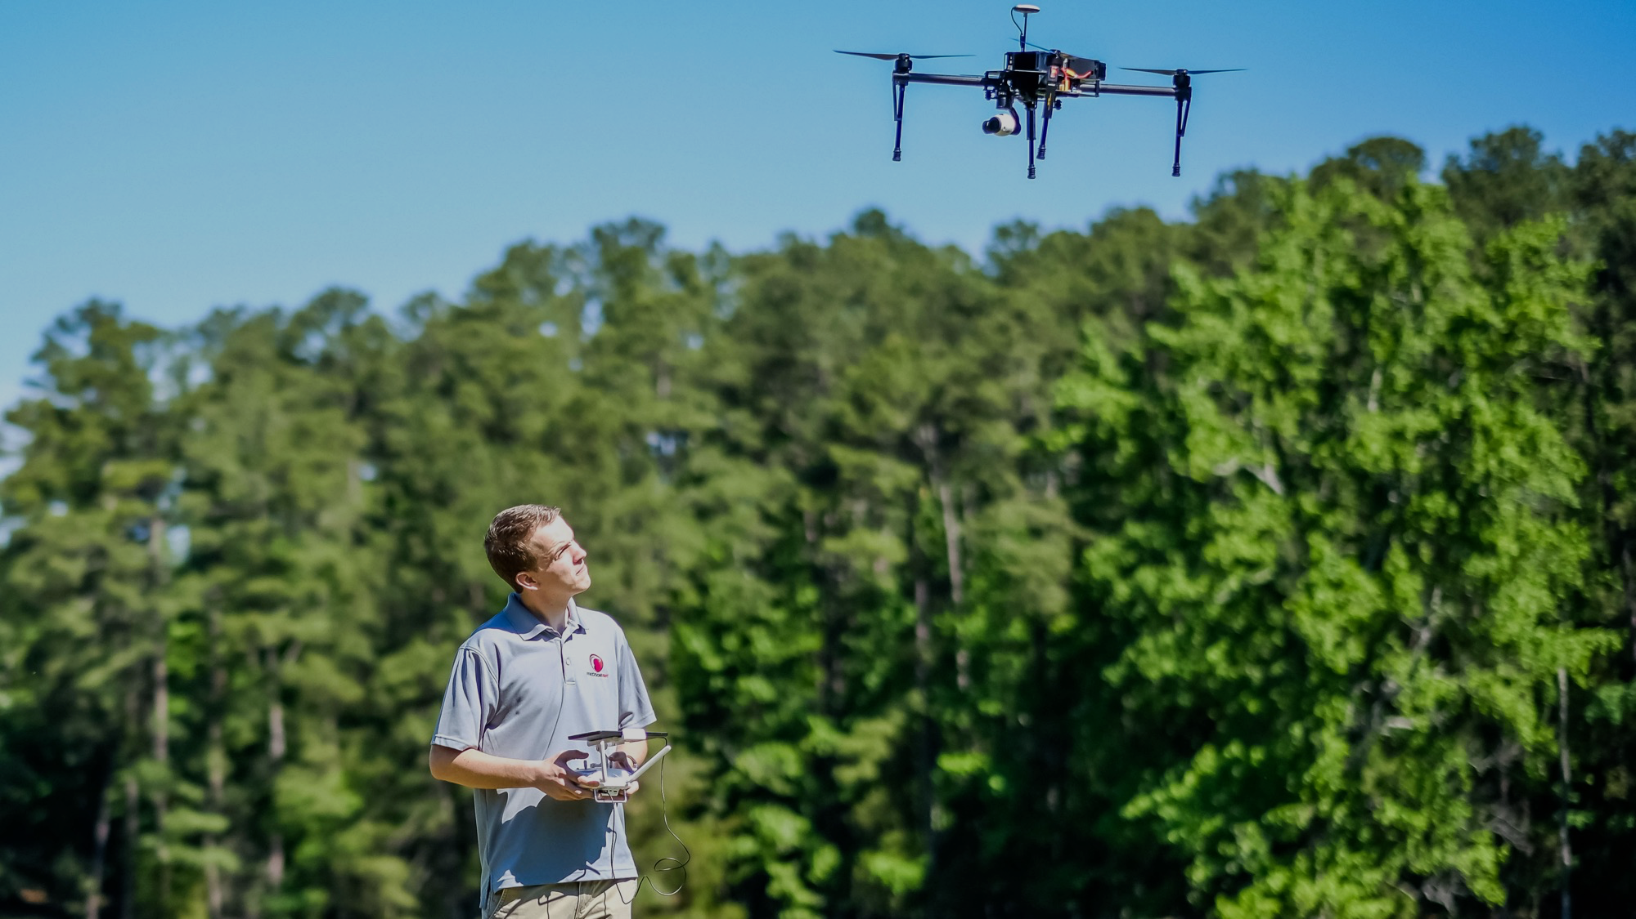
HARDWARE drones

Slide 15


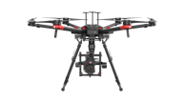
DJI Multirotor Drones
 | DJI M200 | DJI M210 | DJI M210-RTK | DJI M600
Maximum Payload | 2.34 kg | 2.3 kg | 2.3 kg | 15.5 kb (total)
Flight/Hovering Time | 13-38 mins | 13-38 mins | 13-32 mins | 16-39 mins
Max. Flight Speed | 51.4 mph |  |  | 40 mph
Max. Wind Resistance | 26.8 mph |  |  | 88 mph
Operating Temperature | -4° to 113° F (-20° to 45° C) |  |  | 14°—104° F (-10°—40° C)
Max Transmission Distance | 4.3 miles |  |  | 3.1 miles
Operating Frequency | 2.400-2.483 GHz; 5.725-5.825 GHz

Slide 16
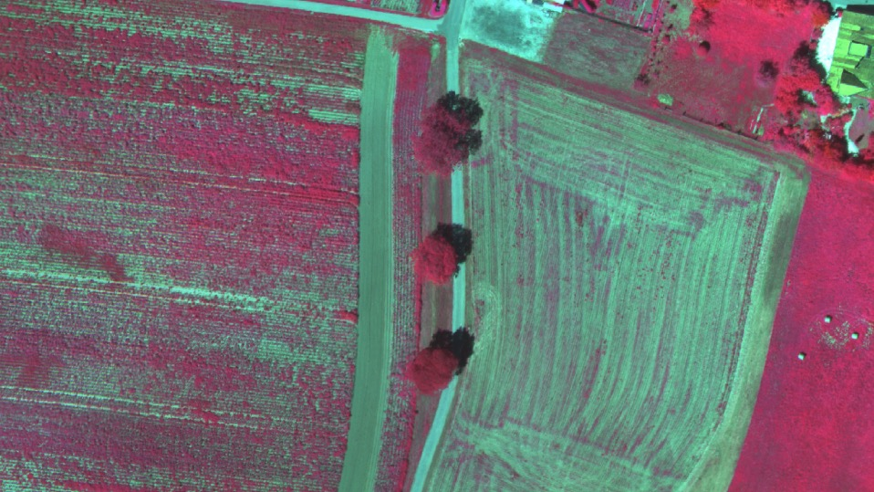
HARDWARE sensors

Slide 17
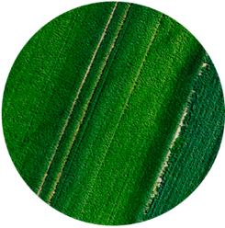
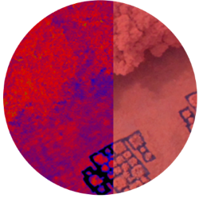
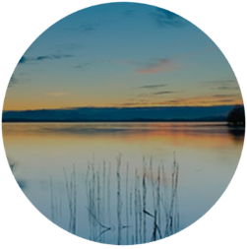
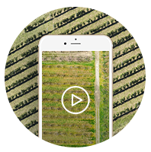
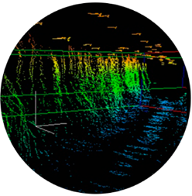
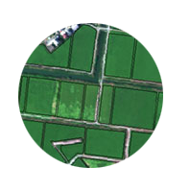
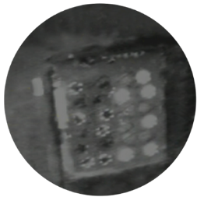
SENSORS
HARDWARE
VISUAL CAMERA
3-CHANNEL
MULTI-SPECTRAL
Data is collected using a diverse set of advanced sensors.
Benefits
Collect data for a variety of applications
Ensure maximum precision and fidelity
5-CHANNEL
ADVANCED
MULTI-SPECTRAL
VIDEO
LIDAR
HYPER-
SPECTRAL
THERMAL IR

Slide 18


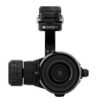

DJI Zenmuse Sensors
 | X4S | X5S | X5 | Z30
Effective Pixels (MP) | 20 | 20.8 | 16 | 2.13
Ground Resolution at 50m | 1.5 | 1.1 | 1.3 | .7-8 cm
Sensor Type | CMOS
Focal Length (mm) | 8.8 | 9-45 | 15 | 10-1200
Pixel Pitch (microns) | 2.714 | 3.277 | 3.754 | -

Slide 19

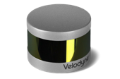
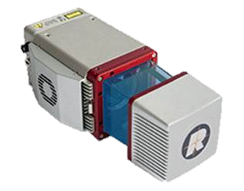
LiDAR Sensors
 | Velodyne VLP-16 | REIGL miniVUX-1
Detection Range | 100 m | 150-250 m
Accuracy | ±3 cm | 15 mm / 10 mm
Measurement Rate (points/second) | 300k-600k | 100k

Slide 20

software
Flight, Mapping, and Algorithms

Slide 21
SOFTWARE
A free mobile application that enables drone operators to capture advanced remote sensing data and imagery, semi-autonomously.
Features and Benefits
Accommodate a variety of sensors and environmental conditions
Fly the most efficient path
Conduct recurring surveys using a single flight plan
Operate without an Internet connection
Pass imagery to PrecisionViewer and PrecisionMapper, seamlessly
Bring-your-own-device (optional)

Slide 22
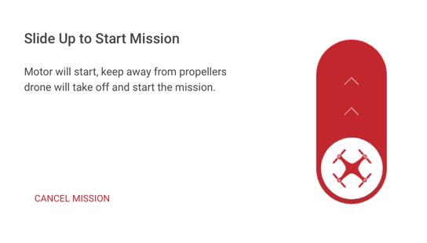
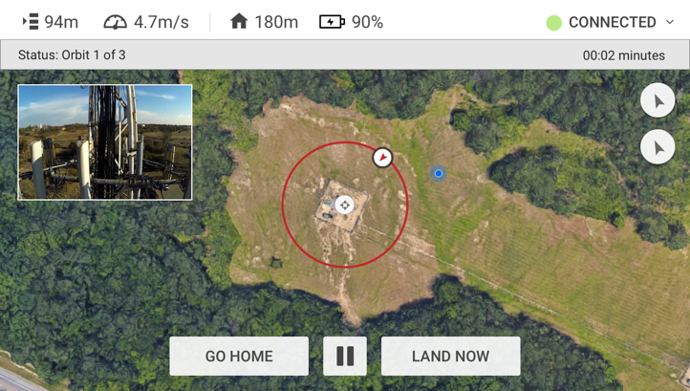
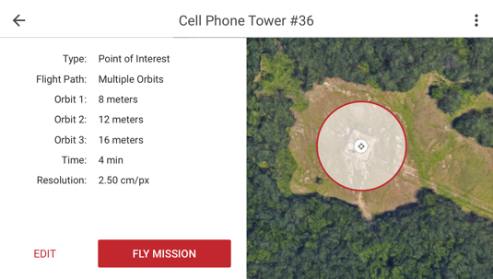
SOFTWARE
Professional
An application that enables drone operators to capture of aerial imagery, semi-autonomously.
Features and Benefits
All of the features and benefits of PrecisionFlight
Advanced flight plan creation
Terrain following
In addition to DJI drones, it’s compatible with Pixhawk, xFold, and others
Includes Command Center

Slide 23
SOFTWARE
An application that enables drone operators to QA aerial imagery and make flight path adjustments, in the field.
Features and Benefits
View site surveys minutes after landing
Evaluate image quality
Add ground control points to ensure data accuracy
Increase data upload speeds by compressing the data
Operate without an Internet connection

Slide 24
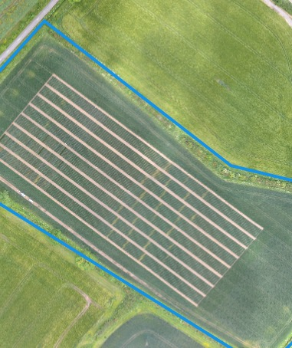
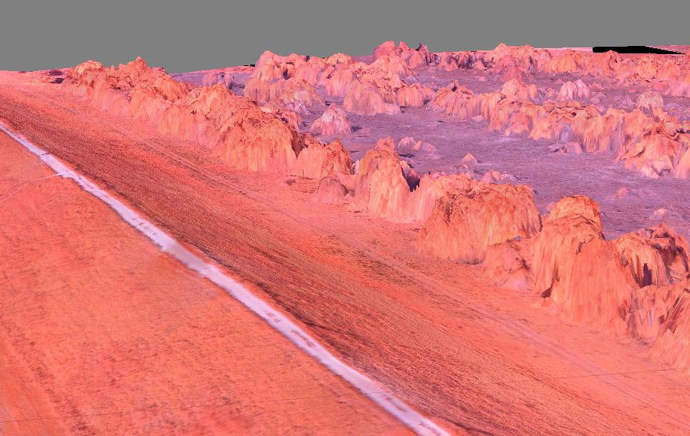
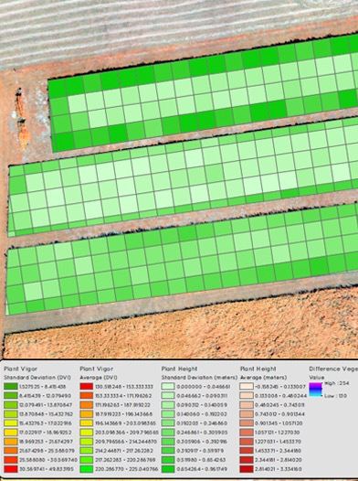
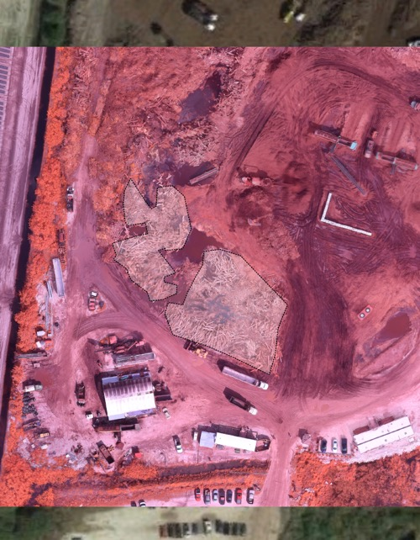
Analytics
Turn aerial imagery into actionable insight—automatically.
MAPS
models
ANALYSIS
REPORTS
See and say: maps, models, analysis, and reports.

Slide 25

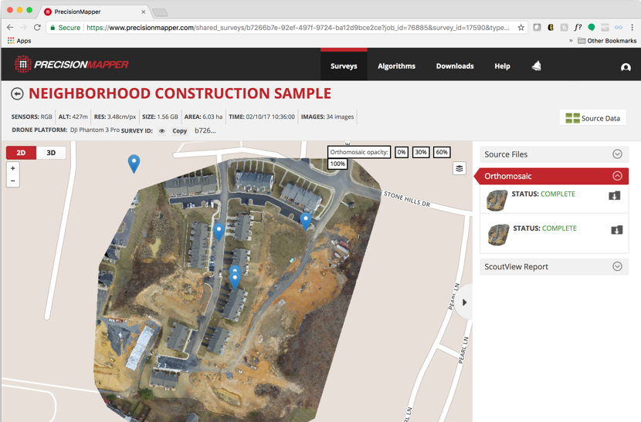
SOFTWARE
Professional
A local and cloud application that automatically processes aerial imagery into maps, models, analysis, and reports.
Features and Benefits
On-demand aerial intelligence with unlimited uploads and processing
Get more from each survey with the complete library of algortihms
Store, view, and share data from advanced sensors, i.e. LiDAR

Slide 26
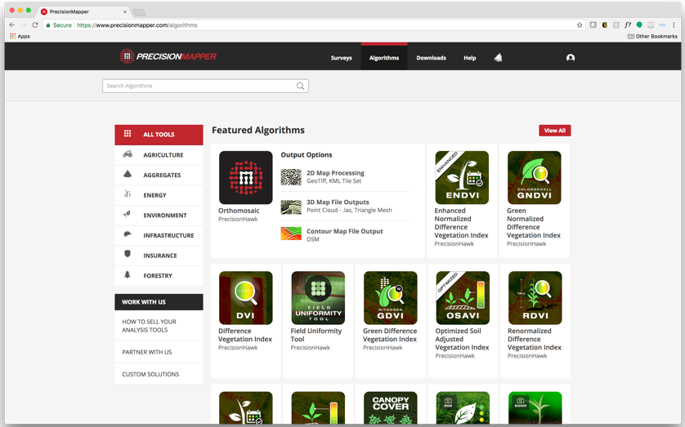
Marketplace
SOFTWARE
Access an ever-expanding library of first- and third-party algorithms.
Algorithms
Orthomosaic, mapping, 3D modeling, and point clouds
Vegetation identification and health
Damage assessment
Volume and surface measurements
Progress monitoring
And more…

Slide 27
The Smarter Package
Get a drone and sensor, and unlimited access to
If your drone or sensor is damaged due to an incident during normal operation, we’ll repair or replace it
After two years, upgrade to the latest drone and sensor
PROFESSIONAL

Slide 28
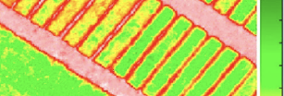
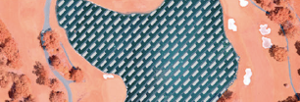
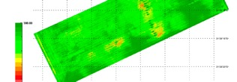
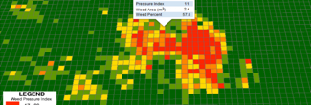

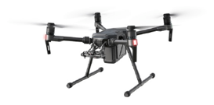
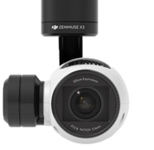
Smarter Agriculture Package
Plan Health Indicies
Waterpooling
Nitrogen Measurement
Weed Pressure Mapping
INSERT DRONE NAME, PHOTO PRICE
1 Visual Sensor
& Optional Sophisticated Sensor
EX. M200
$1250/month
$1500/month
3-Band Sequoia LiDAR Thermal Hyperspectral
Unlimited flights and storage
Advanced algorithms
Advanced sensors

Slide 29
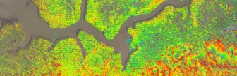






Smarter Construction Package
Digital Surface Model
Roof Inspection
Facility Management
Jobsite Reports
INSERT DRONE NAME, PHOTO PRICE
1 Visual Sensor
& Optional Sophisticated Sensor
M200
Add Text
$1250/month
$1500/month
3-Band Sequoia LiDAR Thermal Hyperspectral
Unlimited flights and storage
Advanced algorithms
Advanced sensors

Slide 30
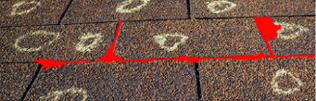

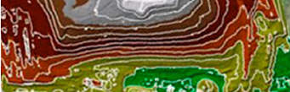
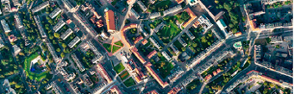
Smarter Surveying Package
Roof Inspection
Pipeline Monitoring
Topographic Mapping
Urban Planning
INSERT DRONE NAME, PHOTO PRICE
1 Visual Sensor
& Optional Sophisticated Sensor
M200
Add Text
$1250/month
$1500/month
3-Band Sequoia LiDAR Thermal Hyperspectral
Unlimited flights and storage
Advanced algorithms
Advanced sensors

Slide 31
PrecisionMapper free vs. Professional
Features |  | PrecisionMapper | PrecisionMapper Professional
Basic Features | Price | Free | Only comes in SmarterPackages which include a drone & visual sensor
 | Orthomosaic - Cloud | ✔ | ✔
 | Orthomosaic - Offline | ✘ | ✔
 | Offline Data Validation at the site | ✔ | ✔
 | Ortho Maps per Month Limit | 5” | Unlimited
 | Max Photo Upload per Map | Unlimited | Unlimited
 | Resolution Limits | Unlimited | Unlimited
Sensors | Visual | ✔ | ✔ (Enhanced)
 | Video | ✔ | ✔ (Enhanced)
 | 3-Channel | ✘ | ✔
 | 5-Channel | ✘ | ✔
 | HyperSpec | ✘ | ✔
 | LiDAR | ✘ | ✔
 | Thermal | ✘ | ✔
Algorithms* | Basic | ✔ | ✔
 | Advanced | ✘ | ✔
Additional Tools | Ground Control Points | ✔ | ✔
 | File Export | ✔ | ✔
 | Annotate & Collaborate | ✔ | ✔
 | Phone & Email Support | ** | ✔
 | User Management | ✘ | ✔
*Algorithms for Agriculture, Insurance, Construction, Energy, Government
**For $95/month get unlimited Ortho maps and technical support

Slide 32
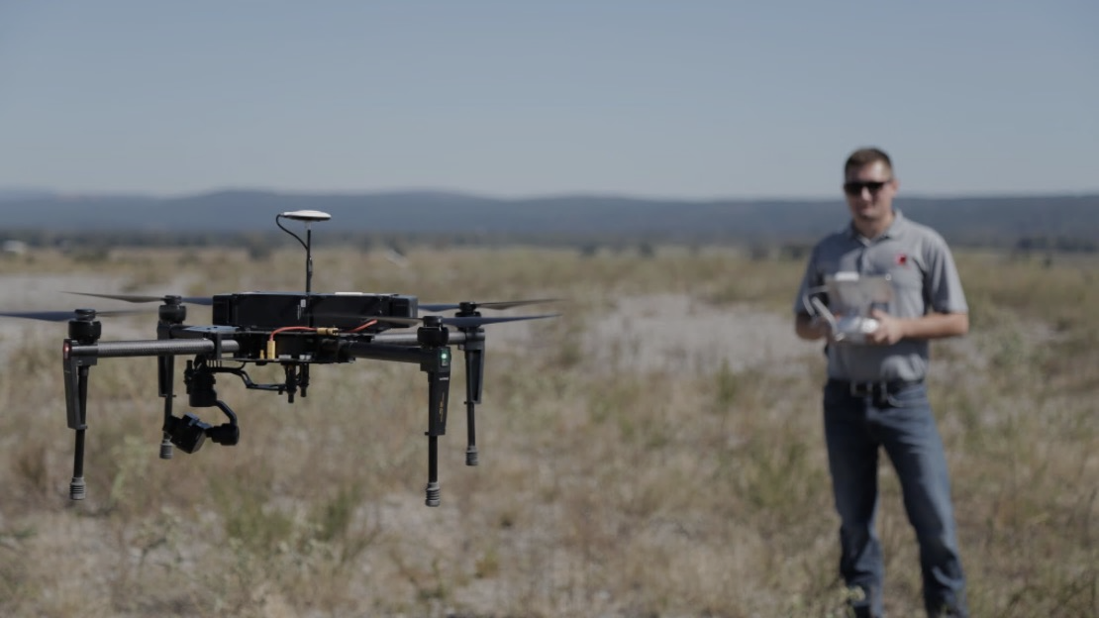
Thank you.
_YOUR_NAME_
_YOUR_CONTACT_

Slide 33
Appendix

Slide 34
ICONS

