Slide 1
Successful Student Intervention
Making student success our core business.

Slide 2
The Critical List
How to fill out …

Slide 3
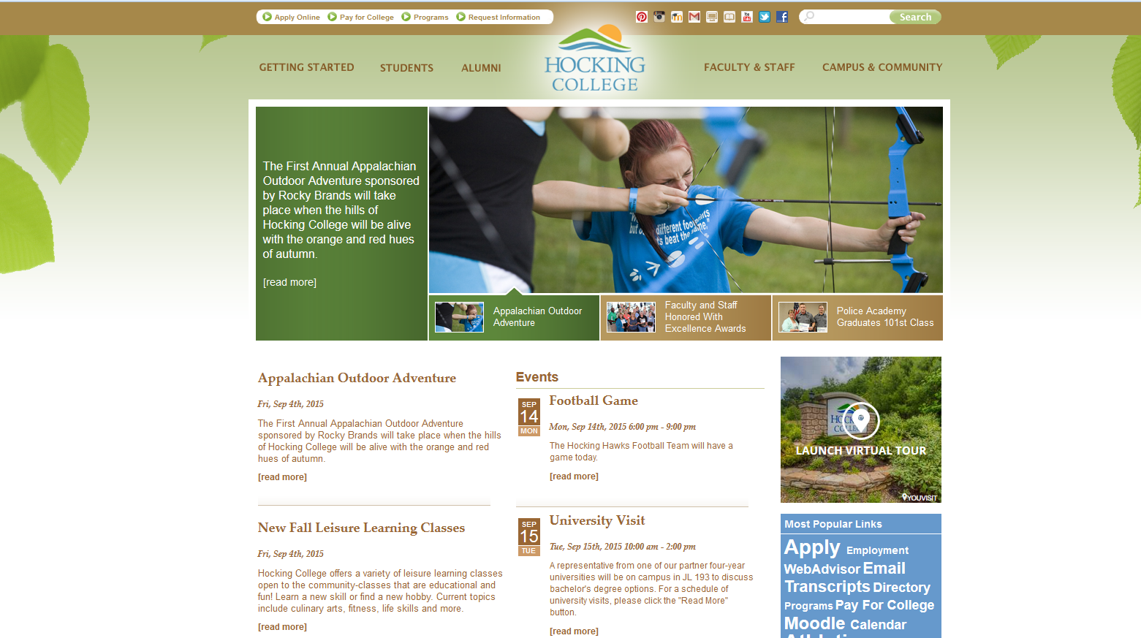

Slide 4
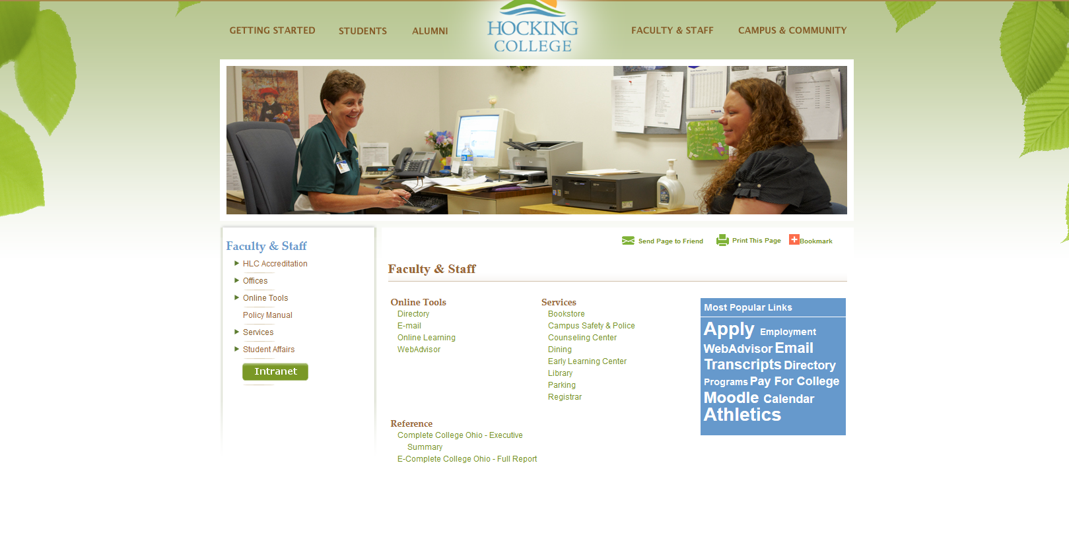

Slide 5
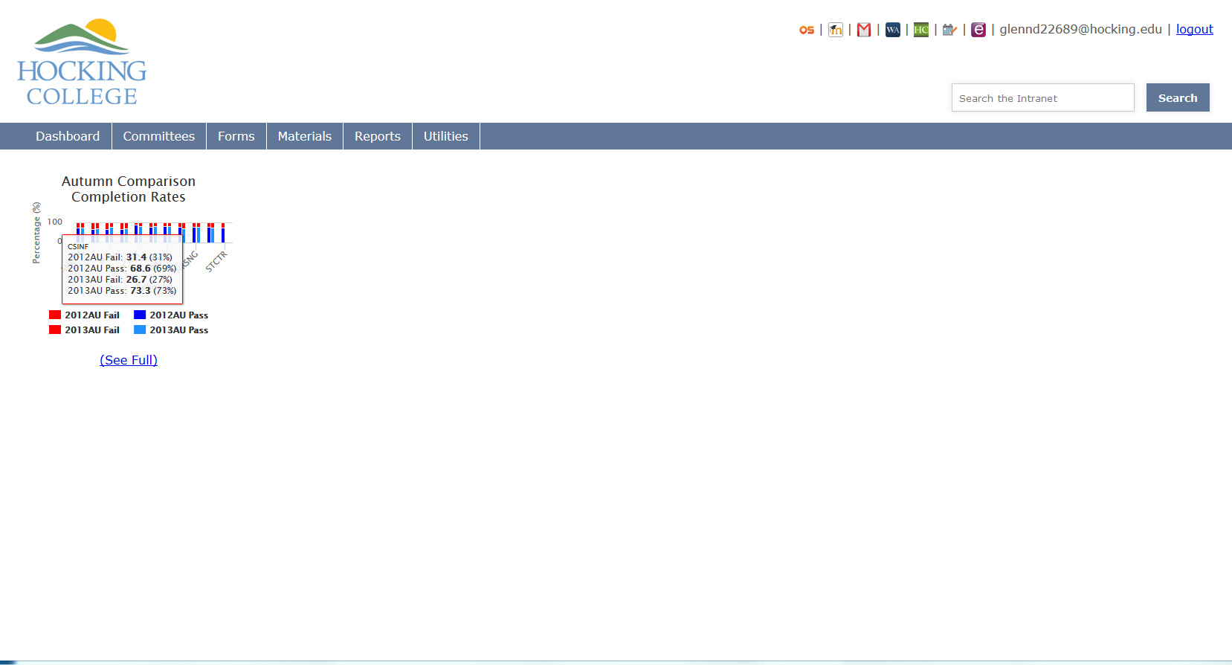

Slide 6
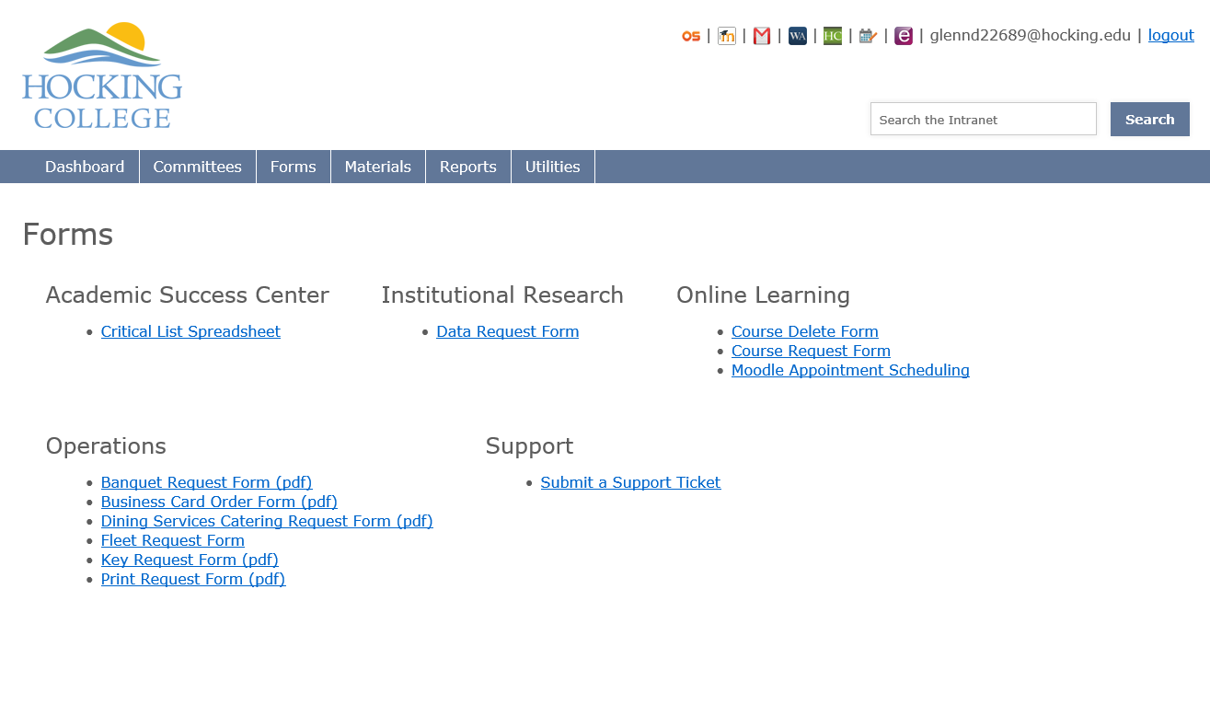

Slide 7
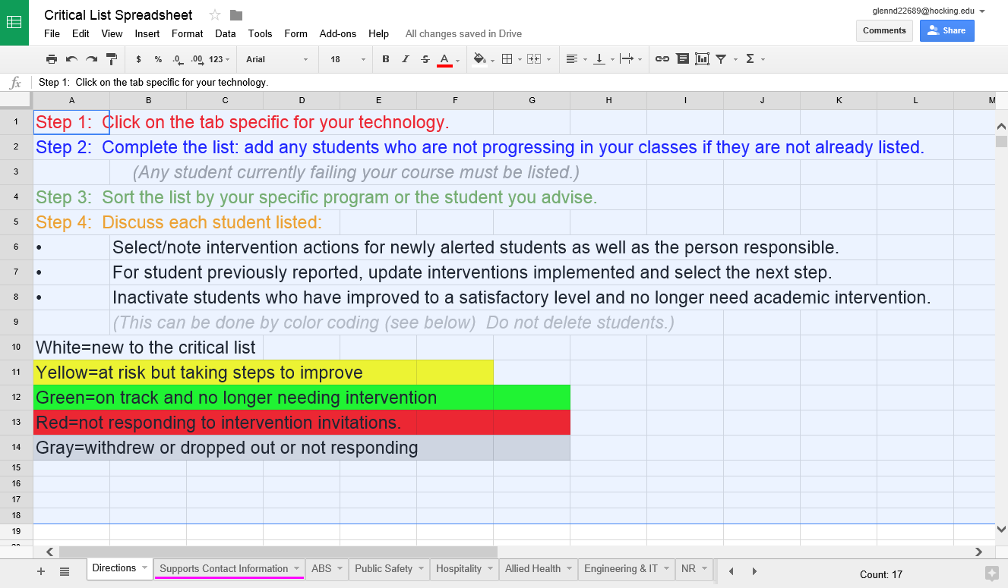

Slide 8
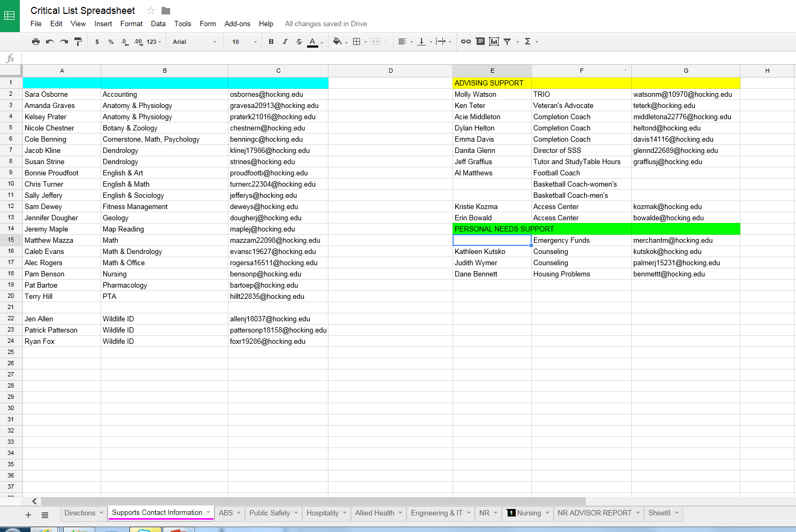

Slide 9
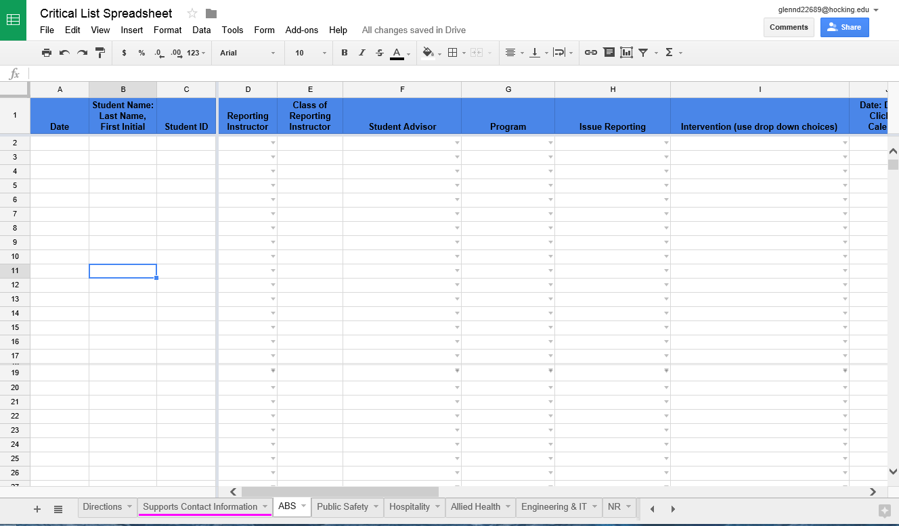
By using a sorting tool the list can be arranged to show a number of things…

Slide 10
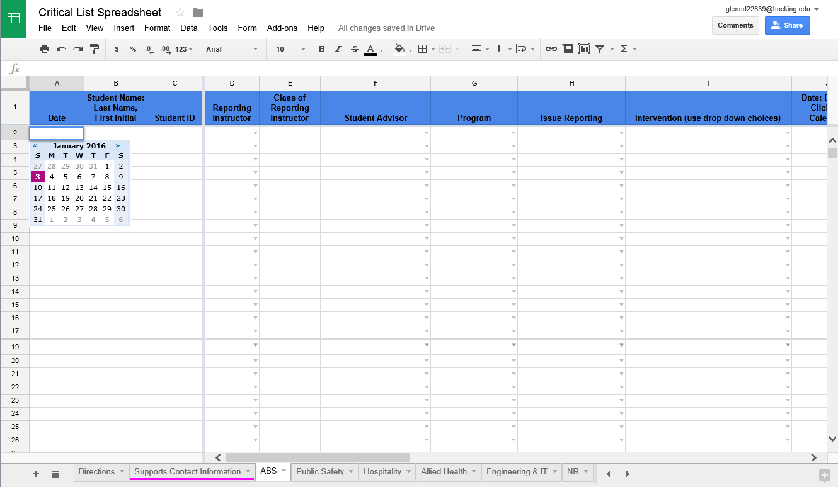
Convenient drop-down boxes have been embedded to allow for more efficient reporting.

Slide 11
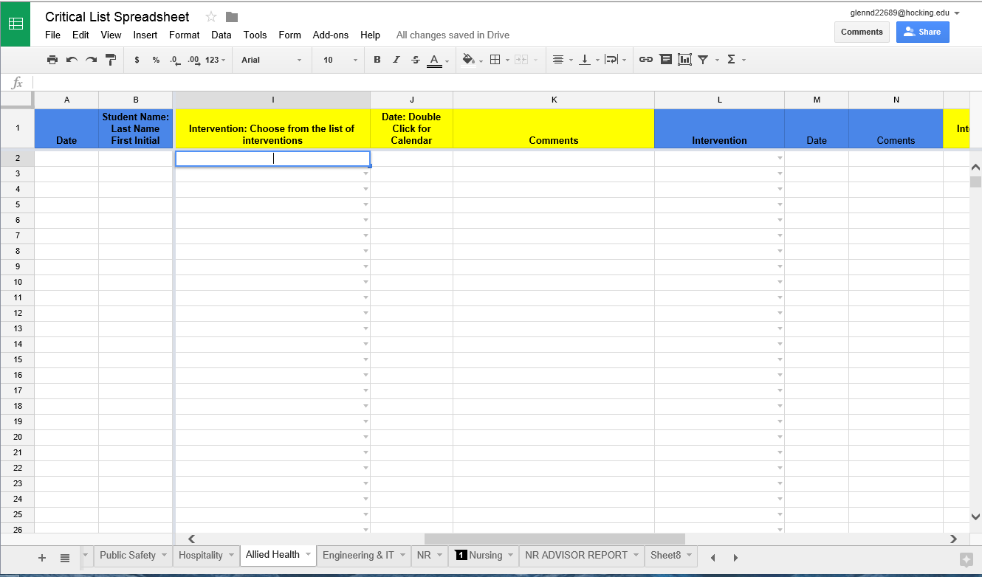
Grouped columns are used to report on each intervention tried. The number of interventions are not limited. There are 17 listed.

Slide 12
Intervention drop down list (1-17)
1. Meet with instructor
2. Meet with advisor
3. Meet with Department Chair
4. Meet with Dean
5. Group Intervention
6. Make appointment with tutor
7. Require Study Table Hours
8. Crisis Tutoring
9. Refer to ANKI training session

Slide 13
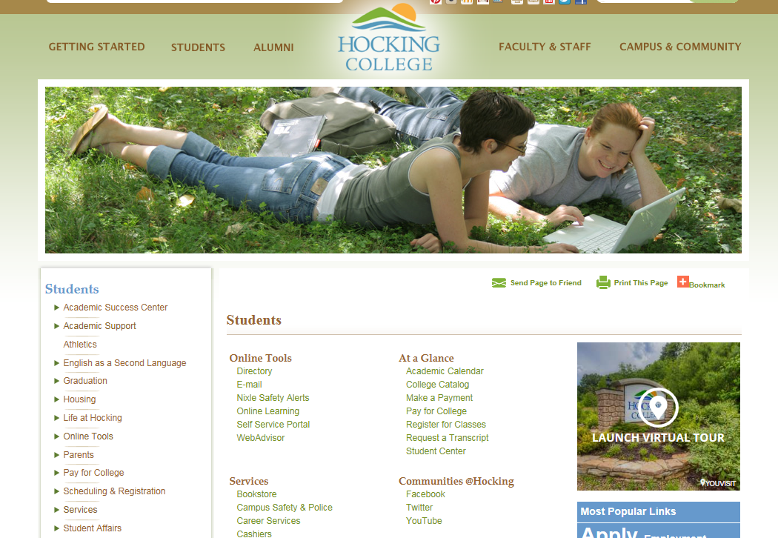

Slide 15
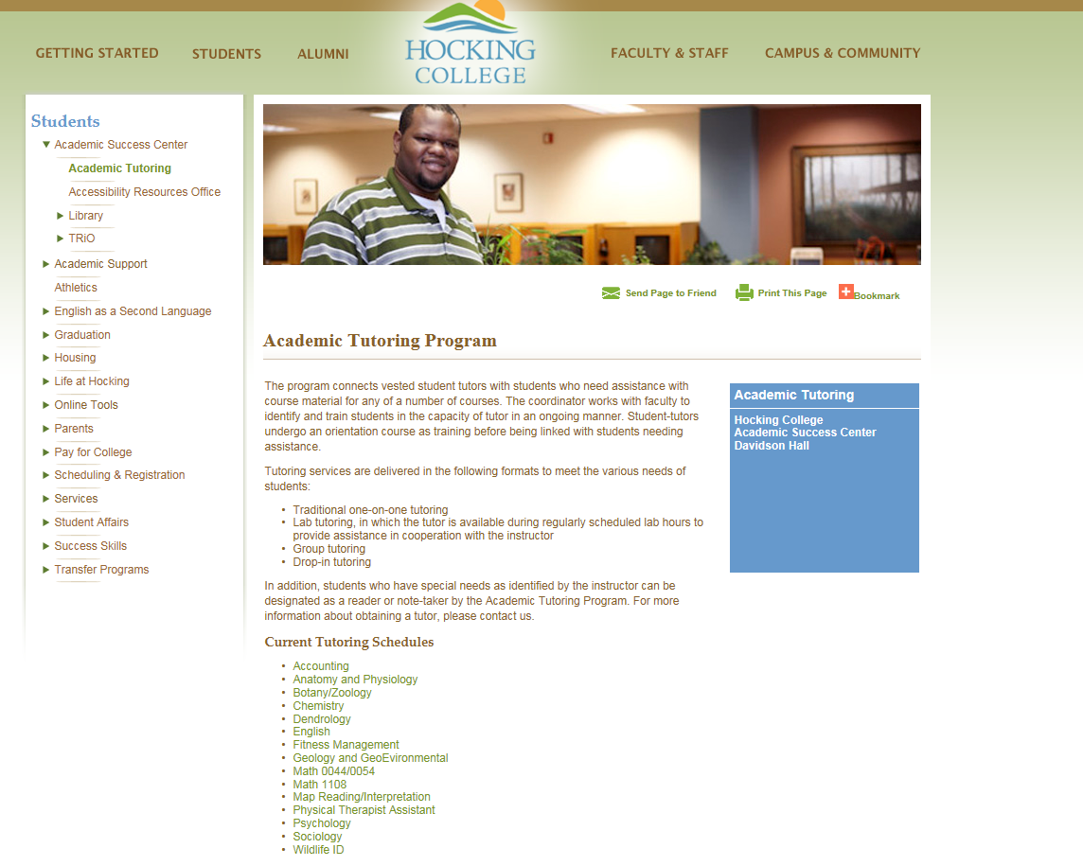

Slide 16
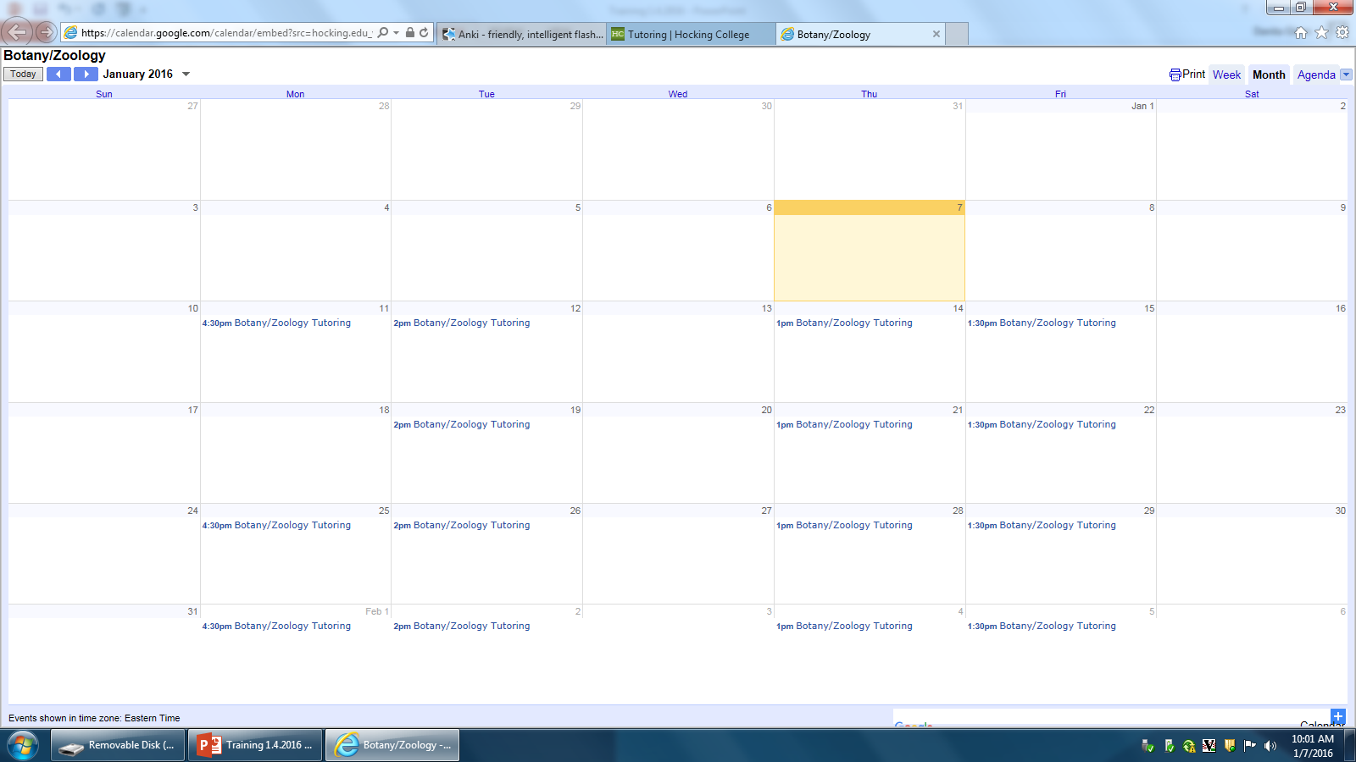

Slide 17
Intervention drop down list (1-17)
10. Refer to Director of Success Center
11. Refer to TRIO
12. Refer to the Access Center
13. Pair with a student mentor
14. Refer to Veteran's Advocate
15. Instructional Intervention: re-teach
16. Instructional Support: Request ANKI
17. Instructional Support: Create ANKI

Slide 18
Successful Student Intervention
Making student success our core business.

