Slide 1
Customer and Installer Quotes
2014/15_UK

Slide 2
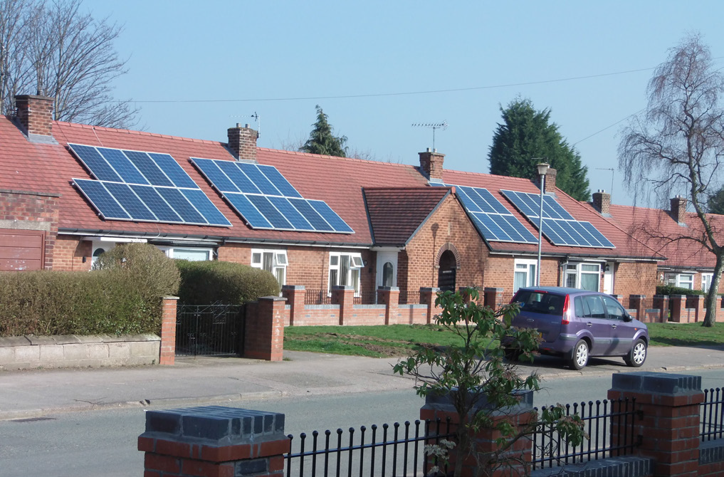
One Solution Fits Many Roofs in UK Social Housing
“The Enphase Microinverter makes the design and installation really simple, saving time and money.”
    — Joe Cooney, Estimator
    Rothwell Plumbing
    Installed 500 home social housing scheme for Weaver Vale Housing Association.

Slide 3
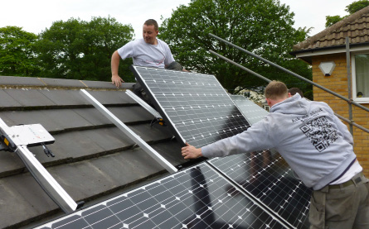
Moving Out of the Shade and into Solar
“Working with Enphase Energy means we are free to design systems that meet client expectations despite shading and without the constraints of string design.”
    Thomas Newby, Managing Director
    The Phoenix Works
    One of the first UK installation partners for Enphase Energy.

Slide 4
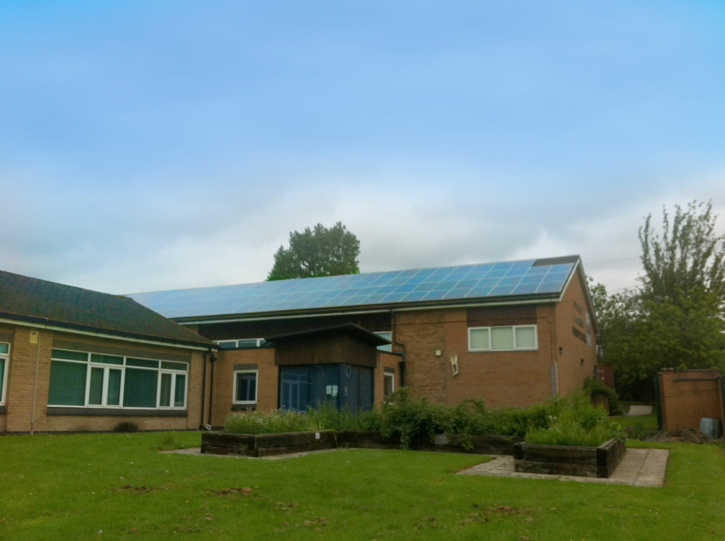
Excellence in the Classroom, Excellence on the Roof
“We were drawn to the 20-year warranty provided by Enphase. This means for the school peace of mind for 20 years. No comparison with the standard 5 years offered by most string inverter companies.”
    Andy O’Shea, Site Manager
    Ash Green Community Primary School

Slide 5
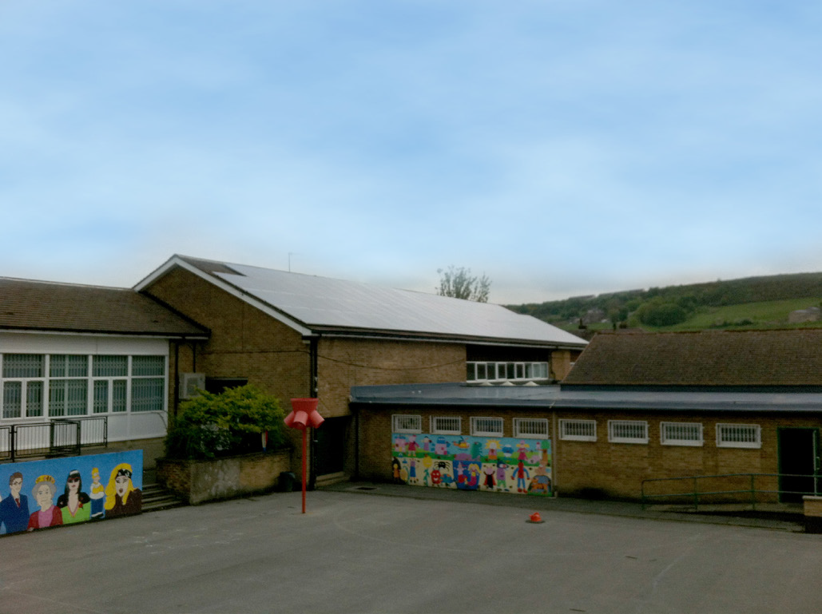
Excellence in the Classroom, Excellence on the Roof
“Concerns of safety, from a design and installation perspective, as well as long-term power production, usually poses serious issues when it comes to bringing solar power onto school’s campuses due to the strict health and safety policies.
With the Enphase System safety is increased, while fire risks reduced, thanks to an all AC-system with no high-voltage DC wiring and components.”
— Brett Reynolds, Sales Manager
Solarlex
The two systems installed by Solarlex means over 80% of the schools energy needs are met.

Slide 6
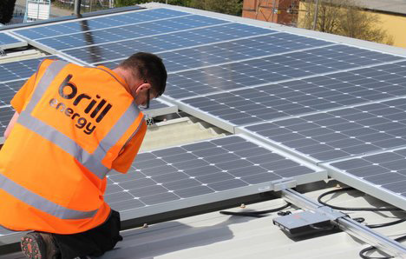
Generating Power Through Cloudy Skies
“The Enphase Microinverter System was the obvious choice for us to generate power and save money. Brill Energy provided sound transparent advice offering a number of options which allowed us time to make the right choice for us. The Enphase System’s performance, output, monitoring, and warranty package made it stand out. The information was clear, concise, and compelling.”
— Andrew Ralston, Sales Director
STM Power Transmission Ltd
Brill Energy recognised that microinverters are the way forward for UK photovoltaic systems, particularly in the North of England where there is less radiation from the sun.

Slide 7

Aged Mineworkers Charity Saves Money with Solar
“For any company to warranty a product for 20 years, the build quality, safety and reliability must be second to none.”
— Kris Laver, Solar PV Operations Manager
Saving Energy
The Enphase System allowed Saving Energy to install some sites as one array on terraced rooftops and share the system sizes equally.

Slide 8
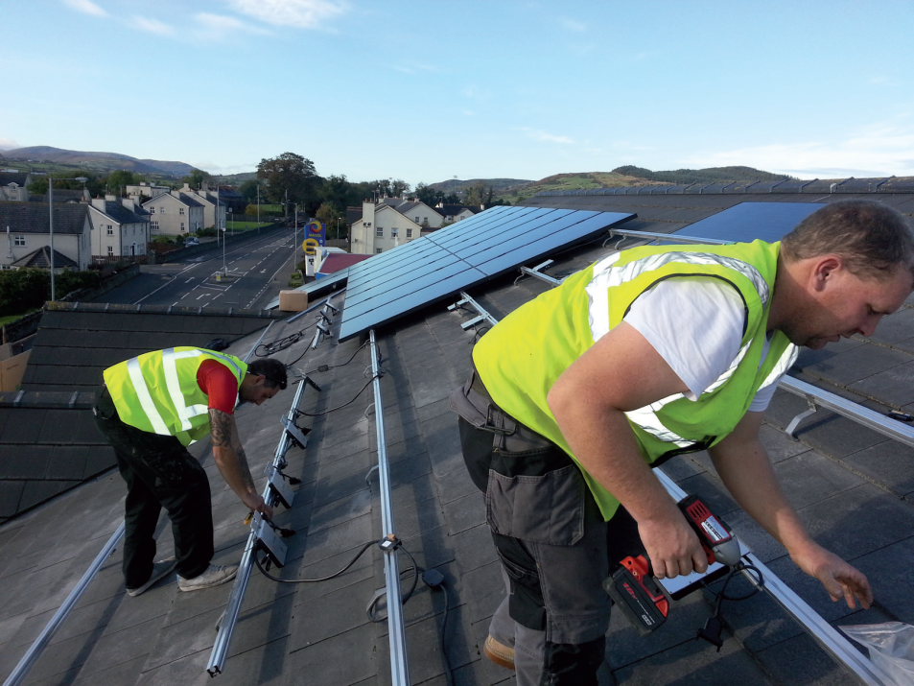
Enphase’s Plug-and-Play technology Offers First-Class Service
“Solar seemed like a no brainer. It offered a good return for not a major financial investment.”
— Michael Johnston, Owner
Fresh Food Centre
Solar NI found the ease of the installation using Enphase second to none. The Enphase solution requires no DC design and consists of plug-and-play technology. This allows Solar NI to offer their customers a first-class install and unparalleled yield.

Slide 9
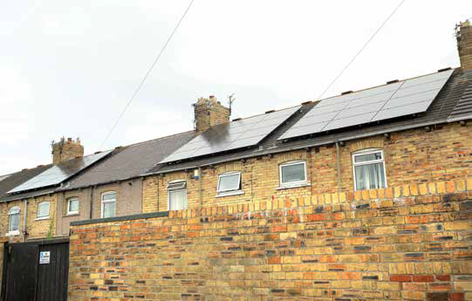
Solar PV Chosen as Driving Force of Regeneration
“The safety of the DC ending above roof, not in roof provides complete peace of mind for the client.”
— Kris Laver, Solar PV Operations Manager
Saving Energy Ltd

Slide 10
Thank You

