Slide 1
Fraud
Watch Your Identity
Notes:
Welcome to this session on Fraud: Watch Your Identity. Thank you for attending.
This session should take us around 20 mins.

Slide 2
Learning objectives
What is fraud?
What is identity theft?
What happens and what can you do?
Our company’s anti-fraud policy
Notes:
In this session we’ll look at:
What is fraud?
What is identity theft?
What happens and what can you do?
Our company’s anti-fraud policy

Slide 3
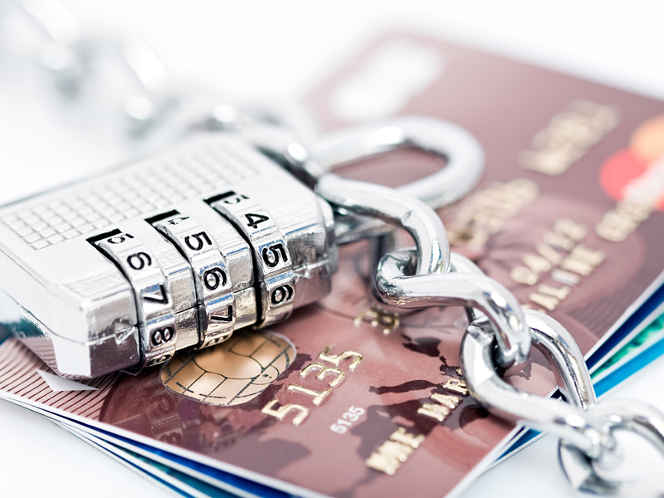
What is fraud?
"Dishonest representation, failure to disclose information or abuse of position that is intended for making a gain for oneself or another, or causing a loss to another or exposing another to a risk of loss"
Notes:
[Ask delegates]
What is fraud?
[Lead a discussion and flipchart suggestions, before clicking to reveal the answer]
Fraud is:
"Dishonest representation, failure to disclose information or abuse of position that is intended for making a gain for oneself or another, or causing a loss to another or exposing another to a risk of loss“

Slide 4
What is identity theft?
When fraudsters have enough personal information about someone (e.g. name, date of birth, address) to impersonate them
Rose by 57% in 2016
(Source: BBC website)
148,000 victims in the UK in 2015
Accounts for 41%
of all fraud
Notes:
[Ask delegates]
What is identity theft?
[Canvass opinion and lead a brief discussion first.]
Identity theft is when fraudsters have enough personal information about someone (e.g. name, date of birth, address) to impersonate them.
Identity theft rose by 57% last year with 148,000 victims in the UK in 2015. And it accounts for 41% of all fraud.

Slide 5
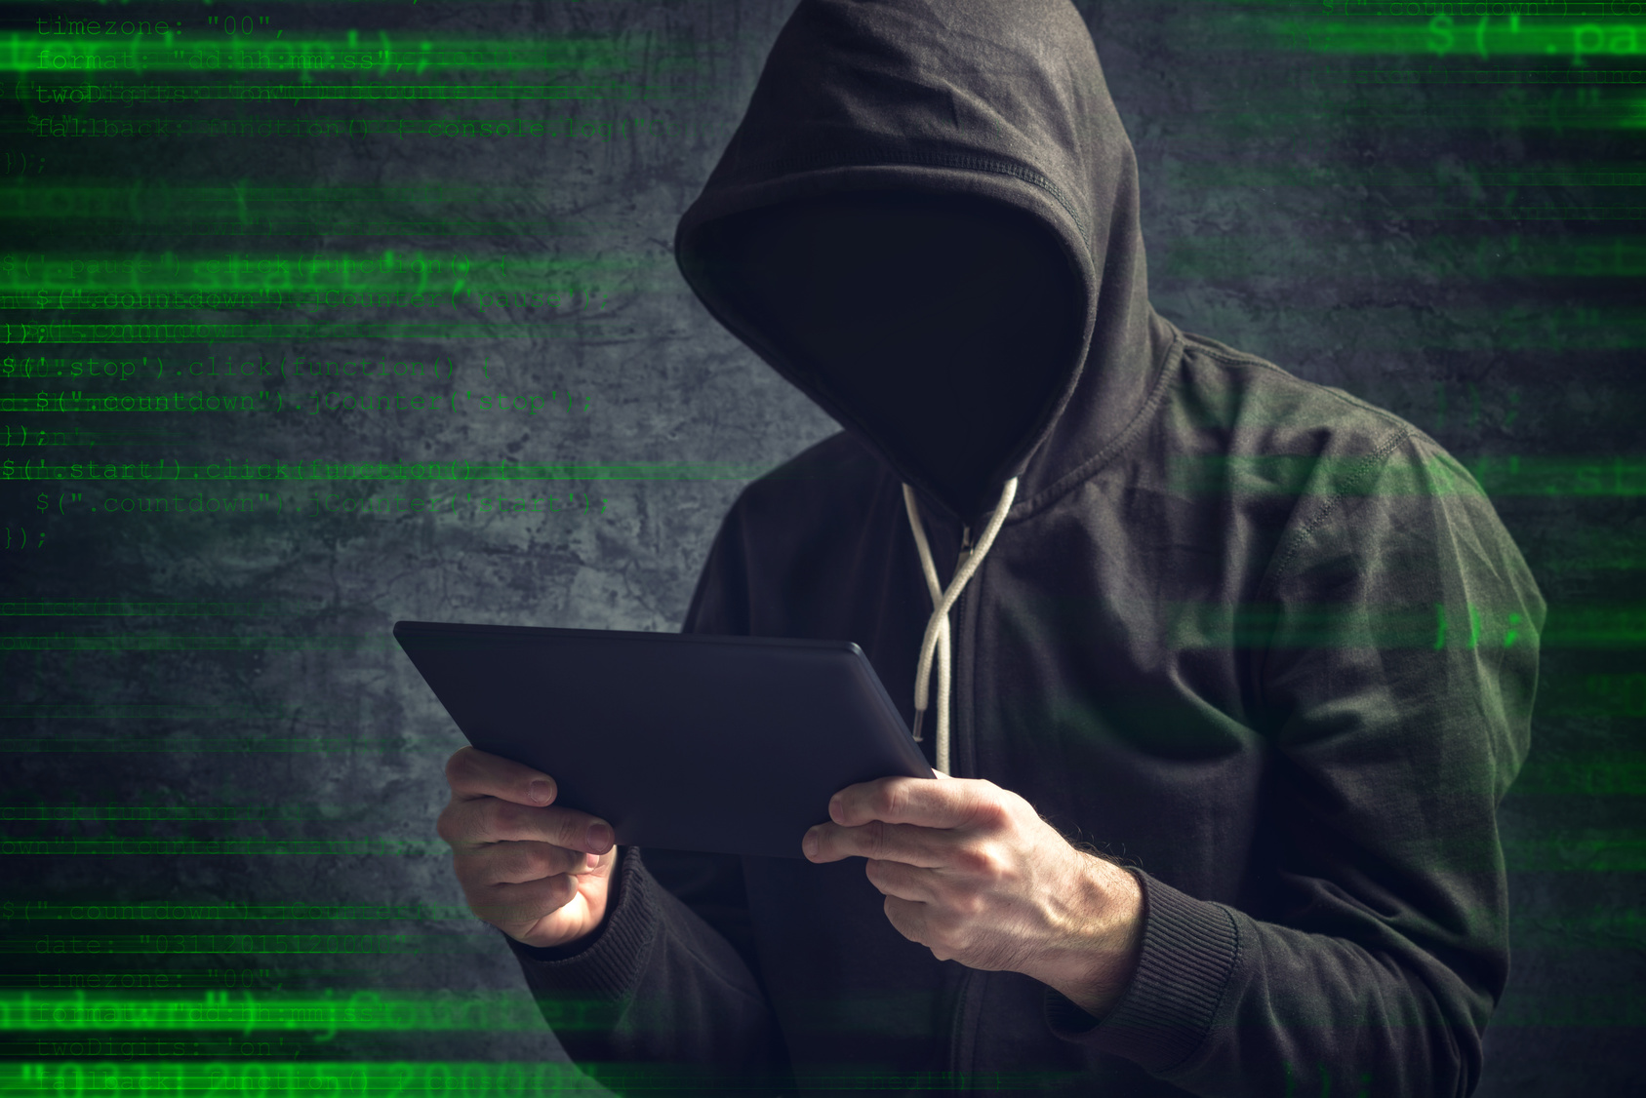
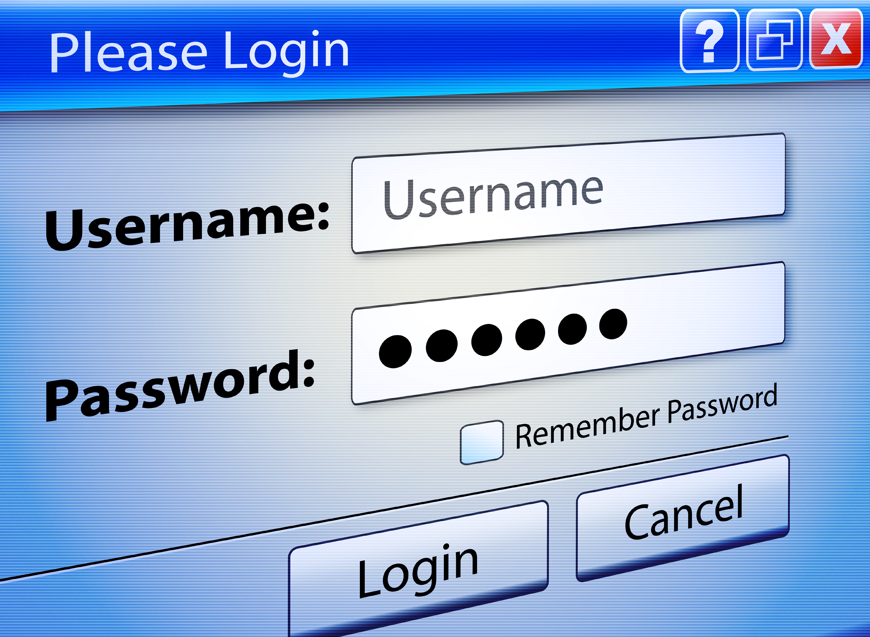
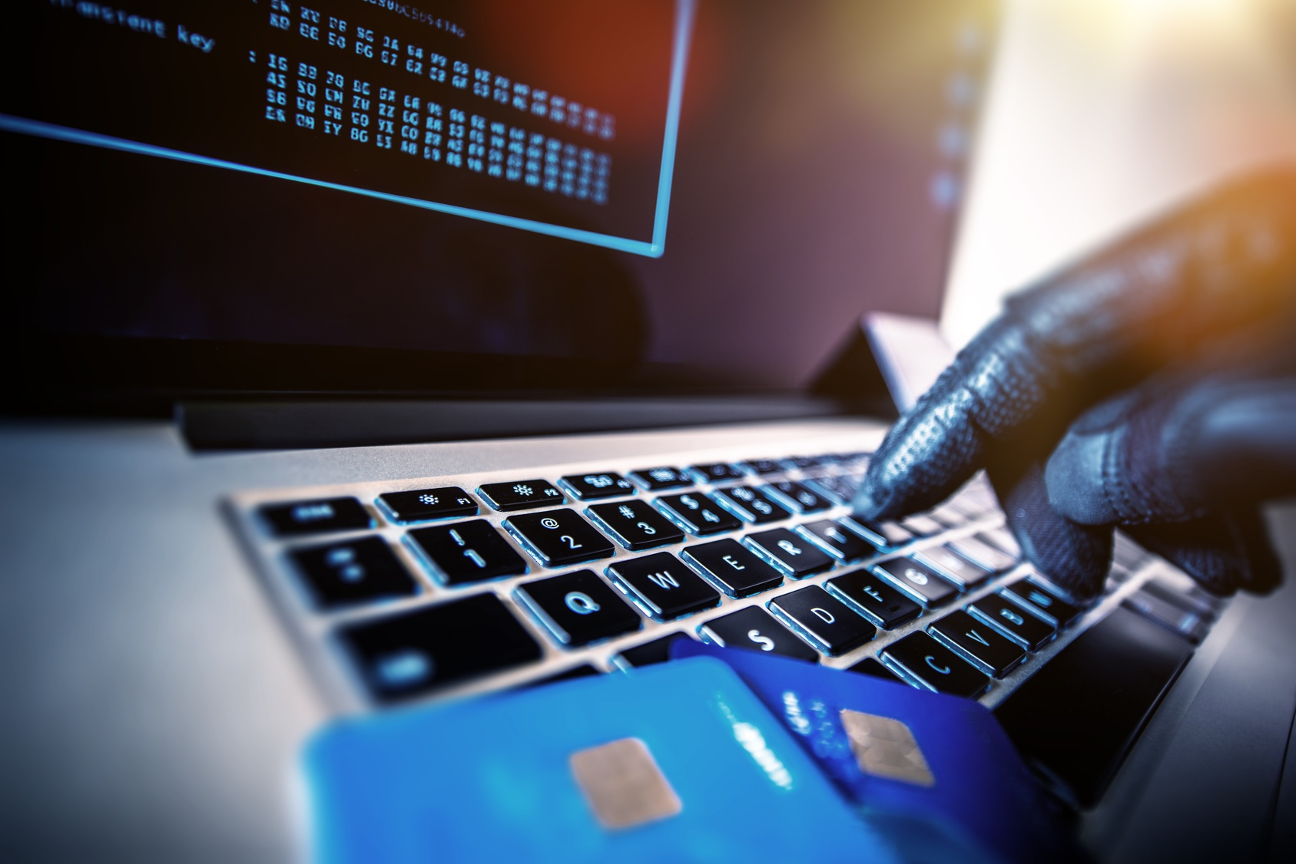
3 types of identity crime
Identity theft
Identity fraud
Account takeover
Notes:
There are three types of identify crime:
Identity theft - where, having got your personal details, someone impersonates you opening up new accounts, or applying for passports or licences in your name
Identity fraud - where forged documents are used to create a new identity, to apply for financial products or services (credit cards, loans, bank accounts) without you knowing, and buy products or services (such as cars, holidays, jewellery, electrical goods, mobile phones, etc)
Account takeover fraud - where someone has enough personal data to bypass security and take over your accounts

Slide 6
You make the call: Is it True or False?
“They applied for a credit card in my name and bought holidays and luxury goods. When I complained to the card company, they said I was to blame and it wasn’t their problem”
Individuals are always to blame for identity theft. What do you think?
Switch image pls
True
False
✓
Notes:
Take a look at this example and decide whether the statement is true or not.
[Allow for thinking time before clicking next]
This is False. We must all work together to prevent identity fraud, ensuring we make the right checks and follow our systems and controls.

Slide 7
You make the call: Is it True or False?
“It’s a victimless crime – I mean, no-one actually gets hurt, do they?”
What do you think?
Switch image to male/minority pls
True
False
✓
Notes:
Take a look at this example and decide whether the statement is true or not.
[Allow for thinking time before clicking next]
This is False. Identity theft can be traumatic for victims and take them considerable time to clear their name (and reinstate their reputation) with credit agencies. Identity fraud also increases the cost of services for everyone.
Our Company bears a responsibility for protecting all personal data that we hold and preventing criminals with stolen data from gaining unauthorised access or applying for products or services fraudulently.

Slide 8
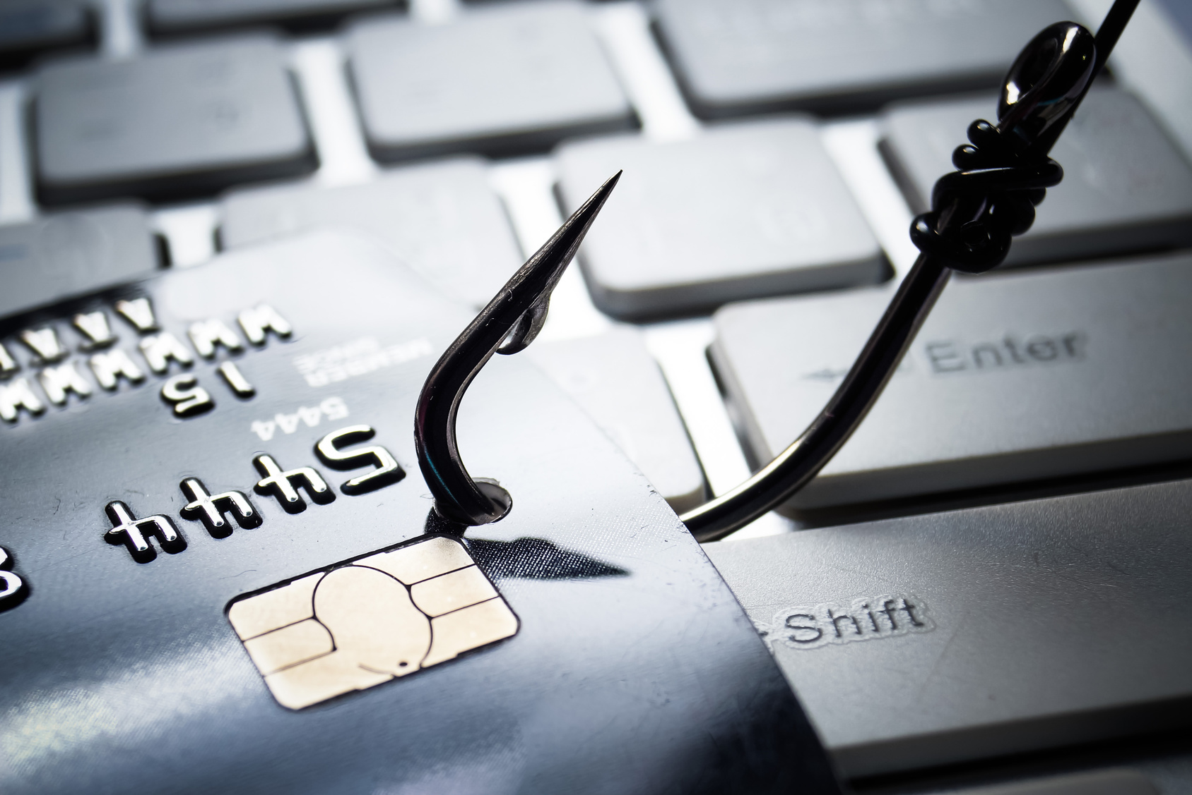
How does it happen?
Fraudsters use different methods to steal someone’s identity:
Phishing, smishing or vishing
Malware
Dumpster diving
Notes:
Fraudsters use different methods to steal someone’s identity. The main ones are shown here.
[Talk through each one, emphasising any that we’re particularly susceptible to.]
Phishing is where fraudsters send out emails that appear to come from legitimate sources, like banks, charities or government departments. By sending out millions of such emails, there is a good chance that someone will think the email is genuine and clicking through to fake websites to reveal their personal information.
Smishing is where text messages are sent and vishing is where phone calls are made, instead of emails.
Malware is malicious software that infects computers and sends personal information from the victim's computer to the fraudster. Malware can hijack your web browser, capture your web activity and whatever you type, and even enable fraudsters to control your computer.
Dumpster diving is where fraudsters raid public or domestic rubbish bins for discarded personal information, credit card approval applications, etc which can then be used to open accounts and receive credit in the victim's or company's name. It's not glamorous but it's certainly effective.

Slide 9
When it goes wrong
Scammer posed as celebrity to defraud Santander of £120,000
PlayStation users fear identity theft after hack
Man jailed for 9 months for stealing identity
T-Mobile loses data of 15m customers in Experian hack
Notes:
Here are some examples of cases that have made the headlines recently.
[As an add-on, discuss other recent cases, if required.]

Slide 10
Our Anti-Fraud Policy
Encouraging everyone to get involved
Appointing people with specific responsibility for investigating fraud
Co-operating fully with regulators and law enforcement to prevent and tackle fraud
Requiring everyone to read and implement our Anti-Fraud Policy
Notes:
Our Anti-Fraud policy sets out our rules, processes and procedures designed to combat identity theft and protect us from fraud.
We are committed to tackling identity theft and fraud by:
Encouraging everyone to get involved
Appointing people with specific responsibility for investigating fraud
Co-operating fully with regulators and law enforcement to prevent and tackle fraud
Requiring everyone to read and implement our Anti-Fraud Policy

Slide 11
DO
Read our Company's Anti-Fraud Policy – make sure you understand the rules and you know what to do
Conduct appropriate risk-based due diligence – conduct all ID and V checks in line with our procedures
Know how to spot 'red flags' - ie unusual or suspicious activity or behaviour
Take precautions to safeguard personal information – e.g. information sharing, secure storage and disposal
Report any knowledge or suspicion of identity theft or fraud immediately
Notes:
Here's what you should do:
Read our Company's Anti-Fraud Policy – make sure you understand the rules and you know what to do
Conduct appropriate risk-based due diligence – conduct all identity and verification checks in line with our procedures
Know how to spot 'red flags' - ie unusual or suspicious activity or behaviour
Take precautions to safeguard others’ personal information – e.g. information sharing, secure storage and disposal, etc (shredding personal documents)
Report any knowledge or suspicion of identity theft or fraud immediately

Slide 12
DON’T
Respond to pressure imposed by callers
Assume that another colleague, department or company has made the necessary due diligence checks
Share your password with anyone else or use the same one for your home and work PC
Wait for someone else to report concerns
Never try to bypass any of our controls – our rules are there for a reason!
Notes:
Don't:
Respond to pressure imposed by callers - fraudsters may push you to breach data rules, claiming they'll miss out on a deal or threaten that they'll complain
Assume that another colleague, department or company has made the necessary due diligence (ID and V) checks
Share your password with anyone else or use the same one for your home and work PC
Wait for someone else to report concerns
Never try to bypass any of our controls – our rules are there for a reason!

Slide 13
Scenario 1: Identification and verification checks
What do you think? Is it acceptable?
Yes, Lucy has enough to open the account
Not sure – it depends if the customer has other accounts with us
No, birth certificates cannot be used
No, mobile phone statements cannot be used
My customer wants to open a new account. She has a birth certificate and a statement by her mobile phone provider.
✓
Notes:
This is Lucy. A customer wants to open a new account. Lucy explains what identity documents she has brought in.
What do you think? Is it acceptable?
[Allow for thinking time before clicking next again]
To summarise:
Make sure you know what forms of identification are permitted and what are not. Generally, statements from mobile phone providers are not acceptable.
Documents must be original – if copies are used, they must be certified by authorised people (e.g. accountant, solicitor, etc).
Statements must be no more than 3 months old. <to be customised by clients>

Slide 14
Wake up to identity fraud
Watch CIFAS’s YouTube video - #datatogo
https://www.youtube.com/watch?v=sq-0tjv4_BA&feature=youtu.be
Notes:
Watch this video to learn more about identity theft.
[Video plays for 1:30 min]

Slide 15
DO
Store your personal information safely and shred them on disposal
Protect your personal information when you move house
Get a copy of your credit report
Check before you buy online
Report unusual or suspicious transactions on your accounts
If you’re a victim of identity theft, report it to the police and Action Fraud
Contact CIFAS to apply for protective registration
Notes:
We need to be vigilant to identity theft in our work but also in our personal lives too.
To protect yourself from identity theft, there are a number of things you should do:
Store your personal information safely, including those you carry, and shred them on disposal
Protect your personal information when you move house
Get a copy of your credit report
Check before you buy online
Report unusual or suspicious transactions on your accounts
If you’re a victim of identity theft, report it to the police and Action Fraud
Contact CIFAS to apply for protective registration
Keep informed of the latest scams too, so you know what to expect and how to protect yourself.

Slide 16
DON’T
Overshare information on social media – fraudsters trawl sites for personal information
Reveal personal information to fraudsters on the phone – banks will never ask for your PIN or password
Post photos which reveal sensitive information – eg credit or debit card data, passport number, etc
Never try to bypass any of our controls – our rules are there for a reason!
Notes:
Don't:
Overshare information on social media – fraudsters trawl sites for personal information
Reveal personal information to fraudsters on the phone – banks will never ask for your PIN or password
Post photos which reveal sensitive information – eg credit or debit card data, passport number, etc
Never try to bypass any of our controls – our rules are there for a reason!

Slide 17
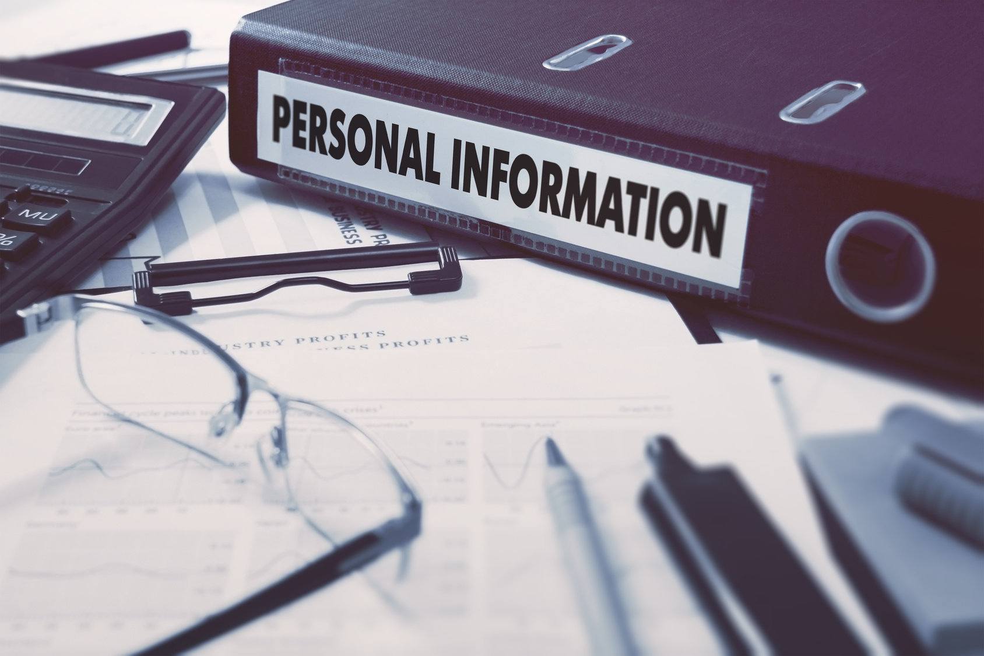
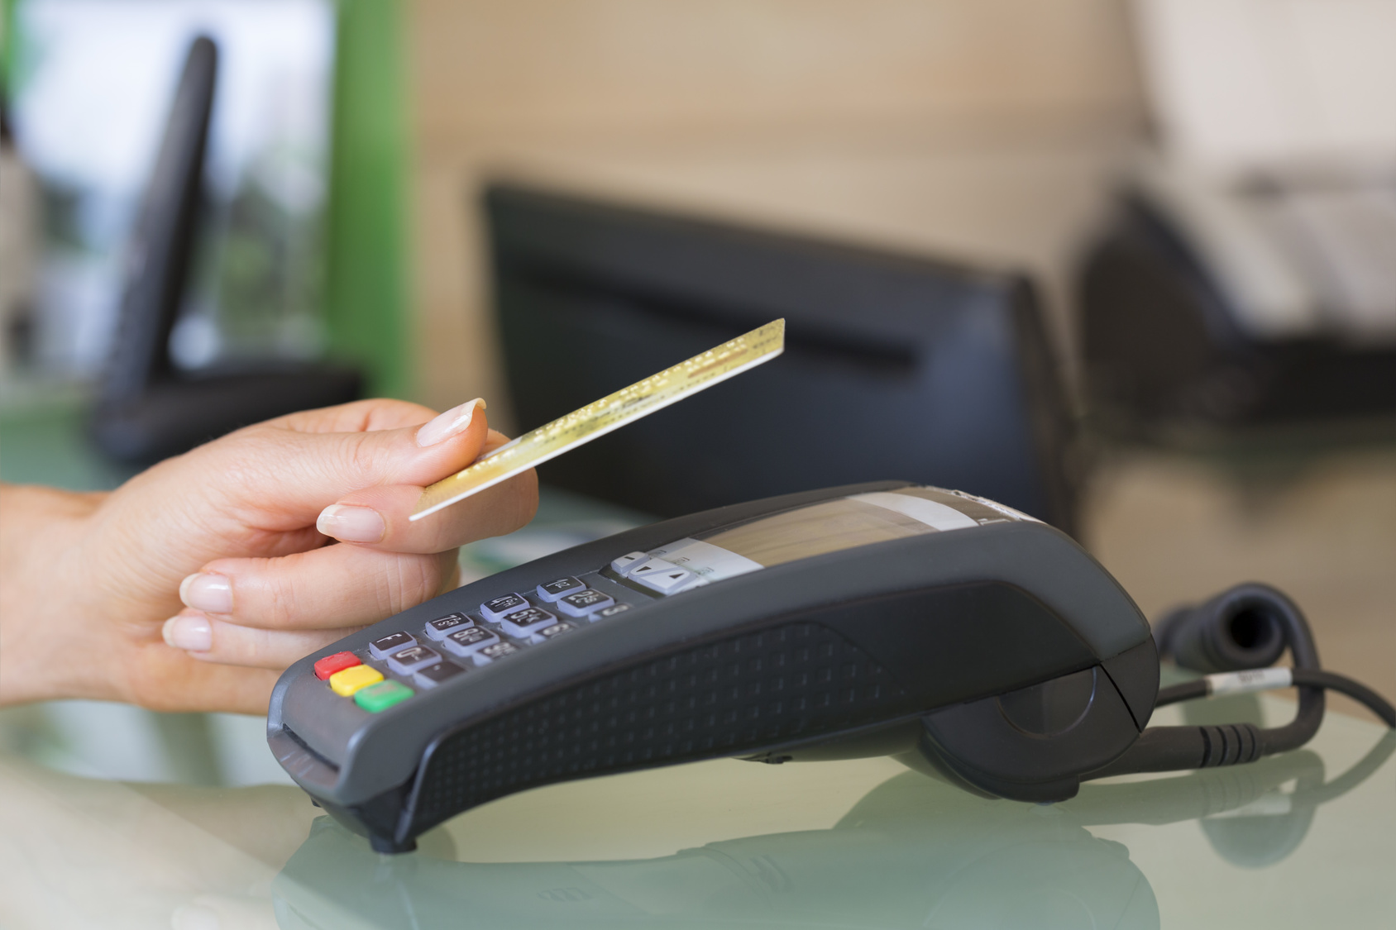
You make the call: Is it suspicious or not?
Callers requesting personal information they should already have
Mark from our IT Helpdesk calling to schedule routine maintenance
Customers making significant transactions after changing personal details
✓
✓
Suspicious
Not suspicious
Suspicious
Not suspicious
Suspicious
Not suspicious
✓
Notes:
Take a look at this example and decide whether it is suspicious or not.
[Allow for thinking time before clicking next]
By being vigilant, you can protect yourself and our customers from identity theft.

Slide 18
Any Questions?
Notes:
Do you have any questions?

Slide 19
Next steps
Call _____ on _____ if you need information or guidance
Call _____ on _____ if you need to raise concerns
Access self-study courses on our e-learning portal for further training [or optionally – Complete your mandatory training on our corporate e-learning portal]
Notes:
You can get more help and information on this issue from these contacts.
Or, for a more in-depth look at this topic, access our self-study course.

