Slide 1
Accidents Can Happen
[Name] • [Date]
Notes:
Welcome to this session on Accidents can happen. Thank you for attending.
This session should take us around 20 mins.

Slide 2
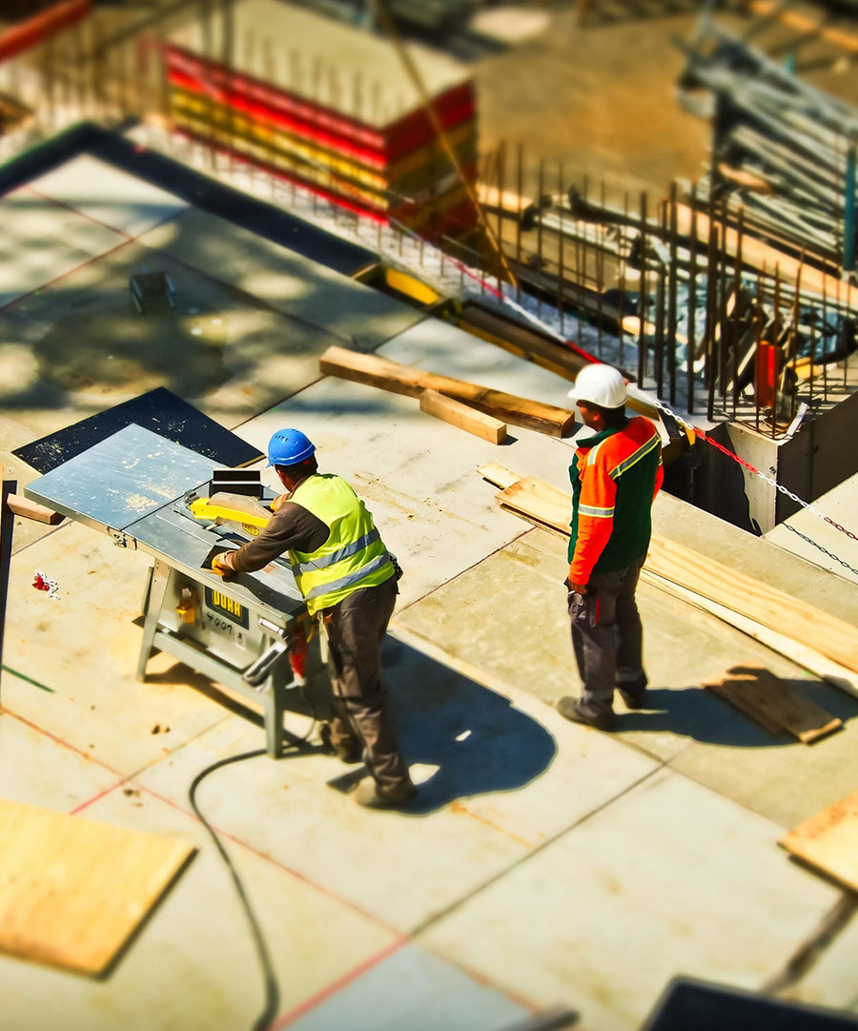
Learning Objectives
Why workplace safety?
Health and safety law
Your responsibilities
Our company’s health and safety policy
Notes:
In this session we’ll look at:
Why workplace safety?
Health and safety law
Your responsibilities
Our company’s health and safety policy

Slide 3
Safety first
142 workers killed at work
1.7 million workers suffering from work-related ill-health
822,000 workers suffering from work-related stress, depression or anxiety
441,000 workers sustaining non-fatal injuries (Labour Force Survey)
27.3 million working days lost due to work-related ill-health and workplace injuries
19.4 million working days lost because of stress, depression, anxiety or musculoskeletal disorders
Workplace injuries and ill health cost: £14.3 billion
Notes:
[Ask delegates]
Why health and safety?
Most of us have never suffered a serious injury at work, and so we may sometimes take health and safety at work for granted. But take a look at the statistics for 2014/15 compiled by the Health and Safety Executive (HSE):
142 workers killed at work
76,054 other injuries to employees
152,000 over-7-day-absence injuries
198,000 over 3-day-absence injuries
27.3 million working days lost due to work-related ill-health and workplace injuries
19.4 million working days lost because of stress, depression, anxiety or musculoskeletal disorders
Workplace injuries and ill health cost: £14.3 billion
[Source: http://www.hse.gov.uk/statistics/causinj/index.htm and http://www.hse.gov.uk/statistics/dayslost.htm]
[Research more current statistics or those specific to your sector before delivering this session.]

Slide 4
You make the call: Who is responsible?
Is she right?
Yes, 100% - no-one else is responsible for this
No – Everyone has a role to play
No – It’s the HSE’s responsibility
✓
“It’s down to my company and no-one else to make sure that my working environment is safe”
Notes:
Look at this example and decide whether she is right or not.
[Allow delegates time to read and make a decision before clicking Next.]
In fact, we are all responsible for making the workplace safe. Both employers and employees have specific duties under the Health and Safety at Work Act.

Slide 5
Safety and the law
Our Company has a legal duty to ensure the health, safety and well-being of employees, contractors, visitors and members of the public under the:
Health and Safety at Work Etc. Act 1974
Management of Health and Safety at Work Regulations 1999
Corporate Manslaughter and Corporate Homicide Act 2007
Health and Safety (Offences) Act 2008
Notes:
Our Company has a legal duty to ensure the health, safety and well-being of employees, contractors, visitors and members of the public under the:
Health and Safety at Work Etc. Act 1974
Management of Health and Safety at Work Regulations 1999
Corporate Manslaughter and Corporate Homicide Act 2007
Health and Safety (Offences) Act 2008
Failure to comply with safety laws can have serious consequences - for you personally as well as our Company. Sanctions include fines, imprisonment and even loss of licence.

Slide 6
Employers are responsible for providing:
A safe workplace where risks to health and safety are properly controlled
Safe appliances
Safe storage and handling of potentially hazardous materials
Personal protective and safety equipment, if required
Sufficient information, training and supervision
Rest breaks and welfare amenities
Notes:
Employers are responsible for providing:
A safe workplace where risks to health and safety are properly controlled
Safe appliances
Safe storage and handling of potentially hazardous materials
Personal protective and safety equipment if required
Sufficient information, training and supervision
Rest breaks and welfare amenities

Slide 7
You are responsible for:
Complying with our health and safety policy
Following operating instructions and safety guidelines
Taking reasonable care not to put yourself or other people at risk by what you do or don't do
Not interfering with or misusing anything that's been provided for your health, safety or welfare
Declaring any condition or medication that may impair your ability to work
Promptly reporting any emergencies, incidents, injuries, or illnesses
Notes:
You are responsible for:
Complying with our health and safety policy
Following operating instructions and safety guidelines
Taking reasonable care not to put yourself or other people at risk by what you do or don't do
Not interfering with or misusing anything that's been provided for your health, safety or welfare
Declaring any condition or medication that may impair your ability to work
Promptly reporting any emergencies, incidents, injuries, or illnesses

Slide 8
When it goes wrong
Firm fined £450k after construction workers fall from height
Alton Towers/Theme park fined £5m for rollercoaster crash
£3m fine for offshore gas incident
Contractor killed by reversing lorry
Jaguar Land Rover/Car firm fined £900k after worker injury
Notes:
Safety affects all industries – big and small.
If we get it wrong, the consequences can be disastrous, resulting in fatalities and life-changing injuries for those affected, as well as significant fines and reputational damage for the company.
[As an add-on, discuss the Alton Towers case – highlighting the personal cost to those involved, and also the loss of business and damage to its reputation.]
Here are some examples of cases that have made the headlines recently.
[As an add-on, discuss other recent cases, if required.]

Slide 9
Busting myths
“Health and safety’s only important in high-risk sectors, not if you work in an office”
No. While some sectors are high risk, safety matters to everyone. Even in offices, there are risks of trips and falls, cables, etc
“Accidents happen – you can’t prevent them”
No. By being aware of the risks and taking action, we can reduce the likelihood of accidents, injuries and incidents
“With bans on conkers, health and safety’s gone mad”
No. Trivialising safety like this causes confusion. As the HSE puts it: “Health and Safety is about saving lives, not stopping them.”
Notes:
There are several myths about health and safety. Let’s explore some of them together.
[For more on health and safety myths, go to: http://www.hse.gov.uk/myth/dec10.htm]

Slide 10
Hazards
Which of the following best describes a hazard?
A hazard refers to an accident where someone is injured
A hazard refers to the probability that an accident will occur
A hazard is anything that has the potential to cause harm to you or others
✓
Notes:
Health and safety risks at work arise from hazards. Without hazards, there would be no risk. In any office, there are numerous potential hazards - including liquid spills, faulty wiring, trailing cables, unstable objects, faulty appliances, poor posture, and working patterns.
Which of the following best describes a hazard?
[Allow time for reading and reflection before clicking next.]
A hazard is anything with the potential to cause harm to you or others.

Slide 11
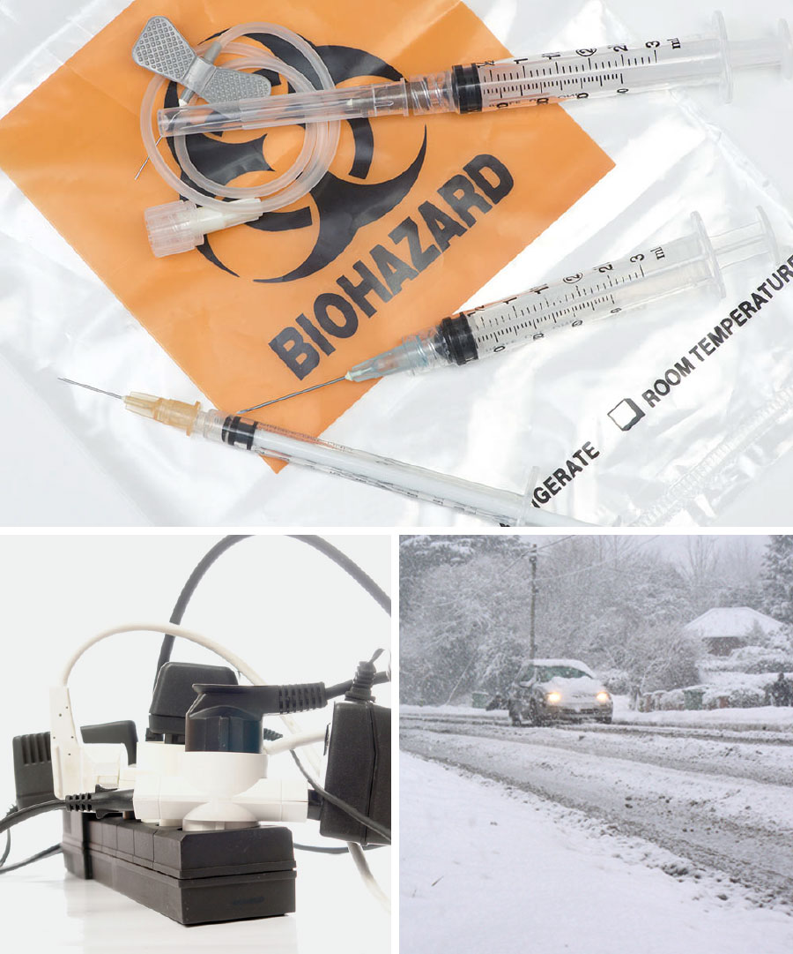
Types of hazards
Physical
Mechanical
Environmental
Chemical
Biological
Notes:
What about where you work?
There may be a variety of hazards, depending on the job you do.
Some, such as carbon monoxide or radiation, by themselves will always cause harm, while others (such as knives or staplers) will only cause harm if they are used incorrectly.
Hazards can be grouped into categories:
Physical – eg wet floors, loose carpets or cables, obstructions, a steep gradient, a confined space or work at height, heavy objects to be moved, etc
Mechanical – eg moving or rotating machinery, tools (such as paper cutters, hole punches, knives, saws and drills), office equipment, vibrating equipment (such as buffing and sanding machines), cutting and packing machinery, etc
Environmental – eg electricity, extreme temperatures, excessive noise, dust pollution, water pollution, poor light levels, pollen or other agents (for asthma sufferers)
Chemical – eg noxious gases or fumes, bleach and other cleaning agents, poisons, acids and alkaline solvents, etc
Biological – eg strains of influenza, viruses (such as Norovirus and MRSA), blood-borne pathogens (such as HIV and Hepatitis B), sickness and ill-health (such as vomiting and diarrhoea)

Slide 12
What is risk?
“…the likelihood of a hazard causing harm or adverse effects as a result of exposure. It focuses on the probability and the severity of the harm…”
Notes:
What is a risk?
[Allow time for discussion before clicking Next.]
Risk is:
“…the likelihood of a hazard causing harm or adverse effects as a result of exposure. It focuses on the probability and the severity of the harm…”

Slide 13
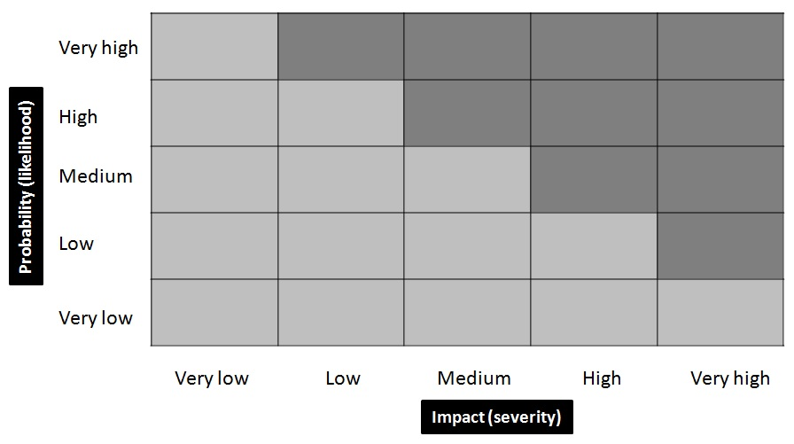
Assessing risk
Notes:
So, how do we assess risk?
The level of risk arising from a given hazard can be categorised on a scale - from Very Low (where the risk is minimal) to Very High (where many people may be affected and the risk is greatest).
The risk from a hazard is highest if the likelihood of harm is Very High and the severity or impact is also Very High. [point to top right of the diagram]
The risk is lowest if the likelihood of harm from the hazard is Very Low and the severity or impact is also Very Low. [point to bottom left of the diagram]
By plotting risks on a risk matrix, you can see right away which risks are most significant and take action to control them.

Slide 14
Risk control measures
Eliminate the hazard
Substitute or reduce the hazard
Isolate or enclose the hazard
Install engineering controls
Introduce safe systems of work
Use personal protective equipment
Notes:
How do we manage safety risks?
What measures do we take to reduce the level of risk?
There are 6 things we can do:
Eliminate the hazard – eg stop doing the work altogether (although it’s not always practical to do this)
Substitute or reduce the hazard - using something less harmful instead
Isolate or enclose the hazard - eg ventilation unit, a separate working area, a lock-up or cage
Install engineering controls - for example, barriers and guards, reduction devices, etc
Introduce safe systems of work - such as a written procedure for how a task must be carried out safely, permit-to-work procedures, etc
Use personal protective equipment - for instance, gloves, boots, goggles, and ear defenders or plugs

Slide 15
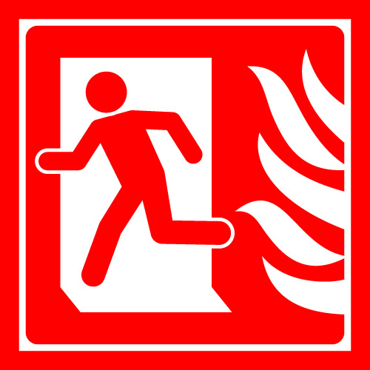
Safety signs
Fire safety signs
Emergency escape
Mandatory
Prohibition
Warning
Notes:
Safety signs help to warn people of hazards at work. They're just one of the many ways in which our company provides information about the hazards in your area. But, they're only effective if you know what each sign means.
There are five types of safety signs that you should be aware of:
Firefighting or fire safety - red rectangle or square with white symbol featuring a fire and/or text
Emergency escape - green square or rectangle with a white symbol or text
Mandatory - blue circle, square or rectangle with white symbol and/or text
Prohibition - black symbol on a white background with a red circular band and crossbar placed on top
Warning - yellow triangle with a black band around and black symbol or text inside

Slide 16
You make the call: Recognising the signs
What does this sign mean?
Flammable material
Explosive material
Keep fire door clear
No ignition sources beyond this point
✓
Notes:
Look at this example and see if you know it means.
[Allow for thinking time before clicking next]
This is a warning sign and indicates a flammable material or high temperature.
[Customise this before you deliver the session with the signs that are commonly used in your workplace. In particular, include any that are often ignored.]

Slide 17
You make the call: Recognising the signs
What does this sign mean?
No running in the corridor
No dancing
No unescorted visitors past this point
No pedestrians beyond this point
✓
Notes:
What about this one?
[Allow for thinking time before clicking next]
This is a prohibition sign and means there is no access for pedestrians in this area.
You might see it in a loading bay or an area where fork-lift trucks are used.
[Customise this before you deliver the session with the signs that are commonly used in your workplace. In particular, include any that are often ignored.]

Slide 18
You make the call: Recognising the signs
What does this sign mean?
No running down this corridor
Route to lift
Safe emergency exit route
Keep this door clear at all times
✓
Notes:
And finally what about this one?
[Allow for thinking time before clicking next]
This is an emergency escape sign. It shows the safe emergency exit route. You’ll need to follow these signs to evacuate the building if there’s a fire.
[Customise this before you deliver the session with the signs that are commonly used in your workplace. In particular, include any that are often ignored.]

Slide 19
Fire and fire safety
Relax… it’s probably just a drill. What’s the hurry? There’s plenty of time.
Isn’t that the fire alarm? C’mon... Why are you still working? Don’t we have to get out?
Notes:
[Hold a discussion with delegates, canvassing opinion before continuing. Does this happen where they work?]
In summary:
In a real fire, every second counts. So, don’t be complacent when the fire alarm sounds.

Slide 20
Fire and fire safety: Our obligations
Fire safety measures
Fire-fighting equipment – eg extinguishers, blankets, sprinklers, etc
Evacuation procedures
Regular fire drills
Fire safety training
Notes:
To reduce the risk of fire, our company has in place:
Fire safety measures , including clearly signposted fire exits, fire extinguishers, alarms, sprinklers, etc
Evacuation procedures, with trained and nominated fire wardens
Regular fire drills to ensure that the alarms and procedures are working
Fire safety training for all employees at induction and at regular intervals thereafter
You can help here too by:
Completing the fire safety training assigned to you
Being clear about our fire safety measures and procedures
Participating fully in all drills and exercises
Immediately reporting anything which increases the risk of fire or anything wrong with safety measures or procedures (eg missing fire extinguishers, poor housekeeping, blocked exits, faulty alarms) to your health and safety officer

Slide 21
The fire triangle
Heat
Oxygen
Fire triangle
Fuel
Notes:
All fires need three things to start and keep burning: heat, oxygen and fuel.
Heat – combustion occurs when flammable objects are ignited. Sources of ignition matches, lighter, smoking materials, lightning, cooker, faulty wiring, etc.
Fuel – something to burn – typically combustible materials (such as wood, plastics, rubber, fabric, paper, petrol, cooking oil, natural or butane gas, etc). It may be a solid, liquid or gas.
Oxygen – readily available in the air around us.
If any one of these elements is not present, a fire cannot start. If any is removed, the fire will be extinguished (put out).

Slide 22
You make the call: Good or poor practice?
In summer, Alan keeps the fire door propped open to keep the office cool
Good
Poor ✓
Gloria keeps the corridors clear - free from debris and obstructions
Good ✓
Poor
When the building is evacuated, Amy waits in a local coffee shop
Good
Poor ✓
Notes:
Look at this example and decide whether it represents good practice or not.
[Show each one in turn and allow delegates time to read and make a decision before clicking Next.]
Follow our rules to stay safe.

Slide 23
Our Health and Safety Policy
Providing information and training – raising awareness
Explaining our systems and controls
Carrying out regular risk assessments
Providing personal protective equipment
Appointing people with specific responsibility for safety – our Health and Safety officer
Requiring everyone to read and implement our Safety Policy
Notes:
Our Health and Safety Policy sets out our rules, processes and procedures and is designed to promote safety for everyone.
We demonstrate our commitment to safety by:
Providing information and training – raising awareness
Explaining our systems and controls
Carrying out regular risk assessments
Providing personal protective equipment
Appointing people with specific responsibility for safety – our Health and Safety officer
Requiring everyone to read and implement our Safety Policy
[As an add-on, provide everyone with a copy of your Health and Safety Policy and explain the key points. You might also introduce your Health and Safety Officer in the session giving them a 5-min slot to explain their work and offer advice.]

Slide 24
Do
Read our Company's Health and Safety Policy – make sure you understand our rules and know what to do
Co-operate fully with us and help us put safety first
Wear any protective equipment or clothing that you have been given
Take note of the safety signs where you work
Tie your hair back and remove jewellery before operating equipment
Report any issues or safety concerns immediately to your manager
Notes:
We can’t do this alone. Here's what you should do:
Read our Company's Health and Safety Policy – make sure you understand our rules and know what to do, especially in an emergency
Co-operate fully with us and help us put safety first
Wear any protective equipment or clothing that you have been given or that is assigned to you
Take note of the safety signs where you work – find out what they mean and comply
Tie your hair back and remove jewellery before operating equipment
Report any issues or safety concerns immediately to your manager
Talk to your manager if you have concerns about safety or if you need anything else to stay safe at work.

Slide 25
Don’t
Interfere with anything that has been provided in the interests of safety
Adjust or remove any safety equipment or devices without permission
Manually carry heavy items over long distances
Use display screen equipment for prolonged periods
Do anything to compromise your own or others’ safety
Notes:
Don't:
Interfere with anything that has been provided in the interests of safety
Adjust or remove any safety equipment or devices (such as closing fire doors, removing equipment guards or limiters, etc) without permission
Manually carry heavy items over long distances – using a trolley instead
Use display screen equipment for prolonged periods
Do anything to compromise your own or others’ safety

Slide 26
Any Questions?
Notes:
Do you have any questions?

Slide 27
Next steps
Call _______ on _______ if you need information or guidance
Call _______ on _______ if you need to raise concerns
Access self-study courses on our e-learning portal for further training [or optionally – Complete your mandatory training on our corporate e-learning portal]
Notes:
You can get more help and information on this issue from these contacts.
Or, for a more in-depth look at this topic, access our self-study course.

