Slide 1


Increasing Information Literacy in Online and On-Campus Classes
© 2018 Credo Reference Limited. All Rights Reserved

Slide 2

What is Information Literacy? Why is it Important?
Information Literacy (IL) refers to the ability to recognize a need for information and to find, analyze, and synthesize related material from books, articles, websites and more.
A 2017 survey* of 42,000 students in more than 1,700 courses at 12 major research universities showed that:
Retention rates were higher for students whose courses included IL instruction.
Students whose courses included IL instruction reported higher average first-year GPAs than those whose courses did not.
Students who took IL instruction successfully completed 1.8 more credit hours per year than students who did not.
*http://www.arl.org/storage/documents/publications/The_Impact_of_Information_Literacy_Instruction_on_Student_Success_October_2017.pdf
© 2018 Credo Reference Limited. All Rights Reserved

Slide 3
How Can Information Literacy be Taught in my Online Class?
Online students need the same IL skills as on-campus students do, and all students need reinforcement of IL concepts over time. Professors of both sets of students lack the time to present these concepts in depth, however.
With these issues and the needs of our entire population in mind, [library name] has subscribed to Credo Instruct, a set of online resources that aims to:
Help students learn how to find relevant and reliable library and other research materials
Formulate appropriate, workable research questions
Synthesize what they learn into a final product such as a research paper, including citations that are apt for their field
© 2018 Credo Reference Limited. All Rights Reserved

Slide 4
Credo Instruct Enhances What
You’re Already Doing
If your class focuses on IL already, Instruct’s multimedia can complement that work
If not, Instruct gives you an option to start incorporating IL instruction in a “low lift” way
Instruct is not meant to, and cannot, replace your librarian
What is included:
  Videos
  Tutorials
  Quizzes
  Assessments
© 2018 Credo Reference Limited. All Rights Reserved

Slide 5
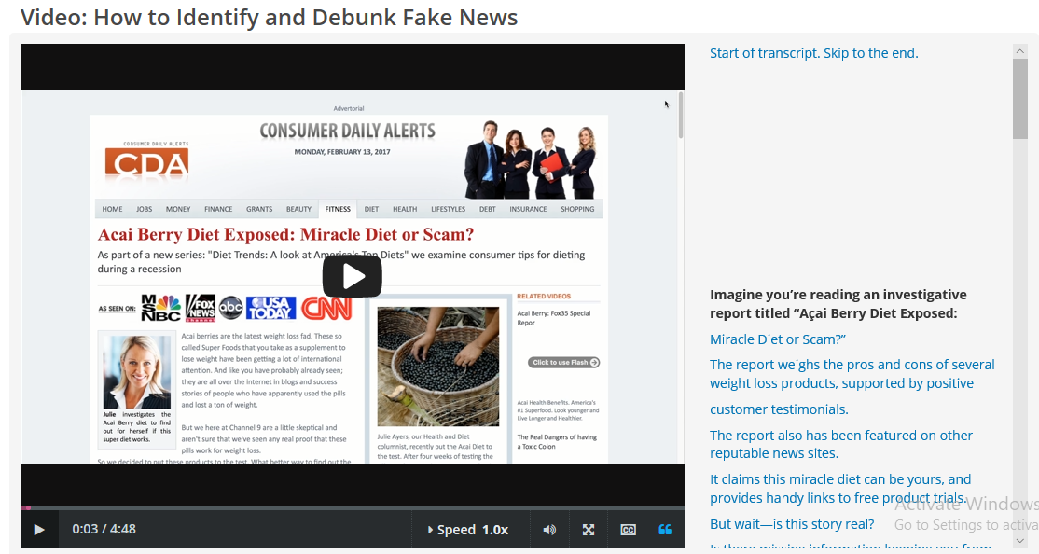
For Example…
The Instruct section “Evaluating Information” includes the video “How to Identify and Debunk Fake News” [add a link to your copy of this video]
© 2018 Credo Reference Limited. All Rights Reserved

Slide 6
How Can Instruct be Used?
Professors can use the videos and tutorials in class as part of a lecture or hands-on instruction
The material can be used to “flip” instruction—in this scenario, students get the lecture portion of the class as homework and benefit from more active learning during class time
The material can be integrated in [LMS name] and the students’ grades on the Instruct pre- and post-test and quizzes will sync to your LMS gradebook
Students can use Instruct independently outside of class
The material can be embedded or linked to from any website
See Credo’s Teaching Guides, which recommend multimedia to match common course needs
© 2018 Credo Reference Limited. All Rights Reserved

Slide 7
This Frees Time To …
Reinforce the Basics Students need constant reinforcement (as you know!), especially over semesters.
Engage in Active Learning Go deeper into information literacy content, tackling the more complex and nuanced aspects of information literacy. Lead class discussions or conduct activities such as case studies, peer review, etc. around specific aspects of information literacy. Active learning engages students with material in a way that lecture cannot.
Build Relationships By focusing on hands-on learning during your face-time with students, you will be more able to build relationships by supporting students through meaningful instruction and activities that are relevant to their class.
© 2018 Credo Reference Limited. All Rights Reserved

Slide 8
Faculty Assistance Materials
Example Assignment: Annotated Bibliography | A sample annotated bibliography assignment that uses the material in Credo Instruct. It lists Instruct videos and tutorials that can be used at each stage of the assignment.
Example Curriculum Mapping of Instruct Multimedia | A curriculum map that shows how the items in Credo Instruct correlate with common gen-ed learning outcomes.
Credo Instruct also has a faculty module built into it where you will find:
[Add links to your Credo content to each listing below:]
How to Use Instruct | Tutorial: Designing Effective Research Assignments
Teaching With Instruct Guides | Promoting Instruct
Video: Why IL Matters to Faculty | Standards Mapping
© 2018 Credo Reference Limited. All Rights Reserved

Slide 9
Adding Credo Links to Online Classes
Librarian and faculty options for using Credo Instruct in common learning management systems are found at https://modules.zendesk.com/hc/en-us/categories/115001115026-Implementation; please see the sections on Blackboard, Canvas, D2L, and Moodle for instructions and screenshots related to those systems and add them as appropriate to this presentation.
For assistance with another LMS, please contact support@credoreference.com
© 2018 Credo Reference Limited. All Rights Reserved

Slide 10
Questions?
Please contact [library contact name, email, etc.]
© 2018 Credo Reference Limited. All Rights Reserved

