Slide 1
Increasing Information Literacy in Online and On-Campus Classes
© 2018 Credo Reference Limited. All Rights Reserved

Slide 2
What is Information Literacy? Why is it Important?
Information Literacy (IL) refers to the ability to recognize a need for information and to find, analyze, and synthesize related material from books, articles, websites and more.
A 2017 survey* of 42,000 students in more than 1,700 courses at 12 major research universities showed that:
Retention rates were higher for students whose courses included IL instruction.
Students whose courses included IL instruction reported higher average first-year GPAs than those whose courses did not.
Students who took IL instruction successfully completed 1.8 more credit hours per year than students who did not.
*http://www.arl.org/storage/documents/publications/The_Impact_of_Information_Literacy_Instruction_on_Student_Success_October_2017.pdf
© 2018 Credo Reference Limited. All Rights Reserved

Slide 3
How Can Information Literacy be Taught in my Online Class?
Online students need the same IL skills as on-campus students do, and all students need reinforcement of IL concepts over time. Professors of both sets of students lack the time to present these concepts in depth, however.
With these issues and the needs of our entire population in mind, [library name] has subscribed to Credo View, a set of online videos that aims to:
Help students learn how to find relevant and reliable library and other research materials
Formulate appropriate, workable research questions
Synthesize what they learn into a final product such as a research paper, including citations that are apt for their field
© 2018 Credo Reference Limited. All Rights Reserved

Slide 4
Credo View Enhances What You’re Already Doing
If your class focuses on IL already, the videos in View can complement that work
If not, View gives you an option to start incorporating IL instruction in a “low lift” way
View is not meant to, and cannot, replace your librarian
Created by librarians and curriculum experts, the View videos are polished looks at various information literacy themes
The videos are short enough to show in class and not lose students’ attention
All of the videos are ADA compliant. They feature closed captioning and dynamic transcripts. The videos can be played at different speeds to match students needs and preferences.
© 2018 Credo Reference Limited. All Rights Reserved

Slide 5
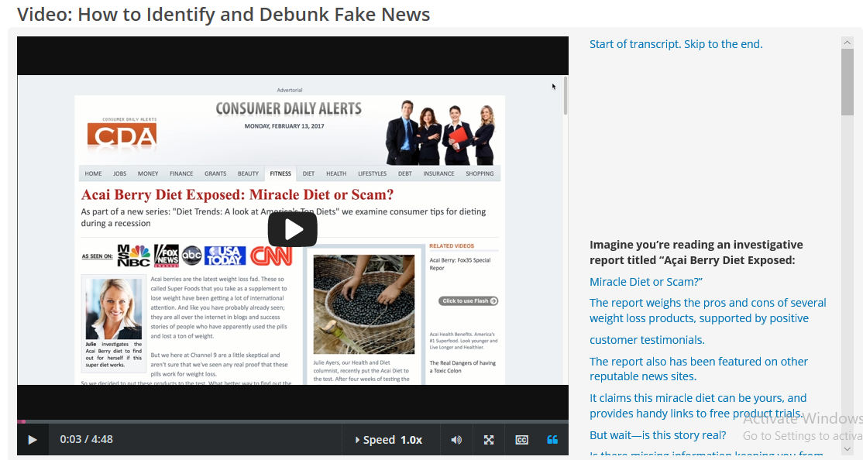
For Example…
Because of the recent prominence of disinformation, Credo View offers a video called “How to Identify and Debunk Fake News” [add a link to your copy of this video]
© 2018 Credo Reference Limited. All Rights Reserved

Slide 6
How Can View be Used?
Professors can use the videos in class as part of a lecture or hands-on instruction
The material can be used to “flip” instruction—in this scenario, students get the lecture portion of the class as homework and benefit from more active learning during class time
The material can be offered through the library’s website, LibGuides, and in your school’s LMS [LMS name]
Interested students can use View even when it is not assigned as part of a class
See Credo’s Teaching Guides, which recommend multimedia to match common course needs
© 2018 Credo Reference Limited. All Rights Reserved

Slide 7
This Frees Time To …
Reinforce the Basics Students need constant reinforcement (as you know!), especially over semesters.
Engage in Active Learning Go deeper into information literacy content, tackling the more complex and nuanced aspects of information literacy. Lead class discussions or conduct activities such as case studies, peer review, etc. around specific aspects of information literacy. Active learning engages students with material in a way that lecture cannot.
Build Relationships By focusing on hands-on learning during your face-time with students, you will be more able to build relationships by supporting students through meaningful instruction and activities that are relevant to their class.
© 2018 Credo Reference Limited. All Rights Reserved

Slide 8
Faculty Assistance Materials
Teaching guides for faculty who use View https:// modules.zendesk.com/hc/en-us/articles/360004829691-Teaching-Guides-Credo-View
See how the View materials match up with various accreditation standards https://cdn.credoreference.com/client-7446/edx/learning-tools-help-site/standards-mapping/View_Standards_Mapping_Winter_2019.xlsx
Getting Started with View https://cdn2.hubspot.net/hubfs/2569500/Getting%20Started%20with%20View.pdf
© 2018 Credo Reference Limited. All Rights Reserved

Slide 9
Questions? Please contact [library contact name, email, etc.]
© 2018 Credo Reference Limited. All Rights Reserved

