Slide 1
Notes:
NAIFA is the National Association of Insurance and Financial Advisors. We are what the bar association is to attorneys. My name is _________. Like others in the audience today, I am a volunteer with NAIFA.
NOTE: Be sure you bring a “sell sheet” with you as a leave behind piece. Sheets can be found at https://leaders.naifa.org/marketing

Slide 2
NAIFA’s
Membership
Promise
Notes:
NAIFA makes a Membership Promise to
Advocate for you and your clients
Educate you so you can better serve your clients
Differentiate you from other advisors and agents
Along with NAIFA’s promise, I’m making my personal promise to you that NAIFA will always advocate for you, educate you and differentiate you.

Slide 3
Advocate.
The protective advisor.
Notes:
Advocate…NAIFA members are the protecTIVE advisor…NOT the protectED advisor…the protectIVE advisor.

Slide 4
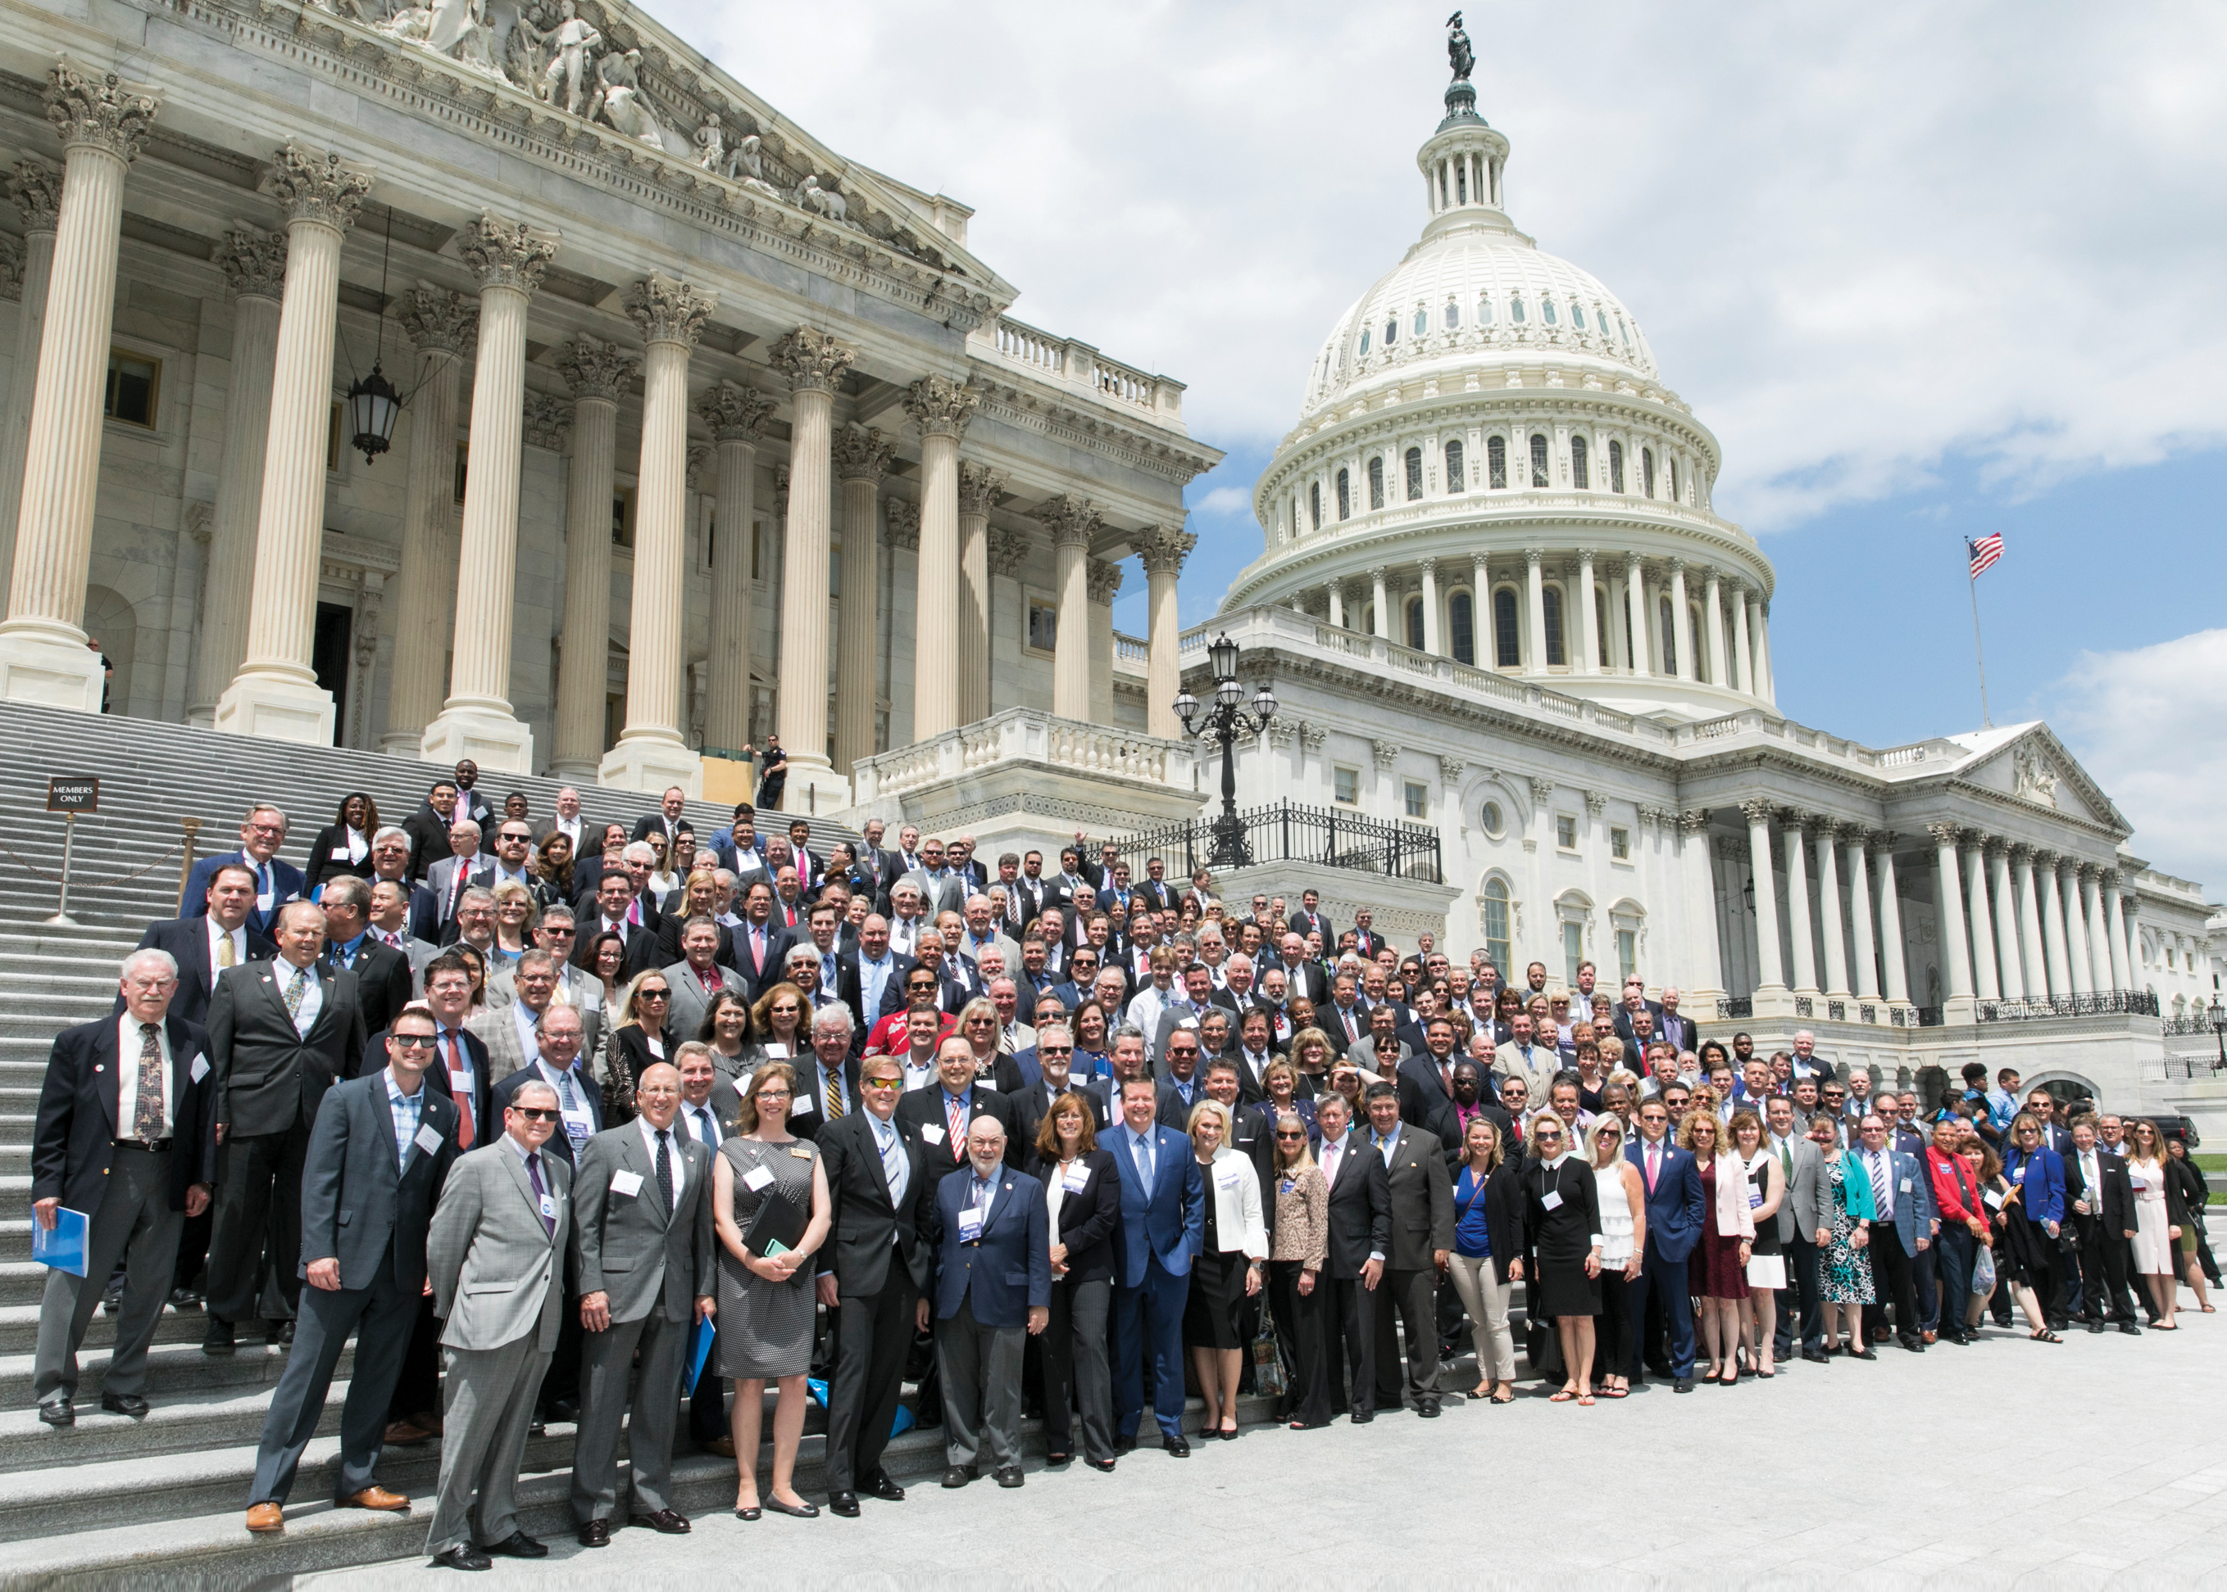
A NAIFA Member In Every Congressional District
Federal Level
The Power of You.
The Power of Us.
Notes:
NAIFA protects our clients in Washington DC…all 50 state capitals…and NAIFA has a member in every Congressional District.
No other association in the insurance and financial services industry and operating in our space make this claim.
NAIFA combines and leverages the power of our individual members into the power of us to protect our clients no matter where they may reside.
In 2018, NAIFA sued the federal government over the Dept. of Labor Fiduciary Rule and we won.
In May of 2019, 600 NAIFA members went to Washington to lobby for passage of the Secure Act, and the very next week the bill passed the House. In December, NAIFA members, again, visited Washington. A few weeks later the Secure Act was attached to the spending bill and signed into law.
[Add an example from your state of a legislative or regulatory victory here]

Slide 5
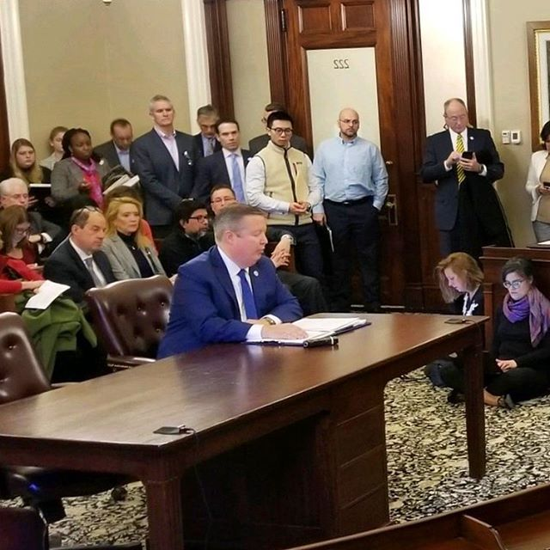
State Advocacy
Interstate Level
In Every State Capital
Political & Day on Hill Events
Division of Securities
NAIFA-MA & Kevin Mayeux, CEO

Slide 6
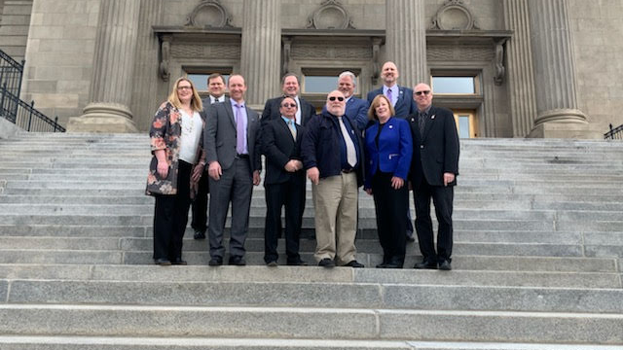
State Level
In Every State Capital
Political & Day on Hill Events

Slide 7
Educate.
The thinking advisor.
Notes:
NAIFA members are the Thinking Advisor.
NAIFA Educates you in a way no other association does. We educate those who are new to the business and those who consider themselves elite advisors or Top of the Table MRDT advisors.
Our education is broken down into:
Education that develops your individual interpersonal & relationship sales skills
Education that develops your practice management skills so that you can be the best business owner possible
Education that provides insight into niche markets to help you grow your business through partnerships or specialization

Slide 8
Watch Virtually or at a Watch Party
One National Meeting per Month with Top Speakers
Pledge of Allegiance to Unite Us All for Serving MainStreetUSA
Notes:
NAIFA has a program called NAIFA Live where you can hear from top speakers around the country as part of your chapter’s monthly meeting. We conduct both NAIFA business and education in a new format that breaks down geographic barriers and allows all local and state chapters to participate as one.
You can dial in to the live event from your desktop or mobile phone or you can participate in a Watch Party in your area where you can watch the presentation and participate in group discussions about the topic.
If you can’t participate in real-time, the programs are all recorded so you can access them on-demand at your convenience.

Slide 9
Notes:
There’s also the Big Ideas Webinar series that you can tune into live or on-demand for no extra fees to hear top notch speakers.

Slide 10
Analysis 06
Synth chartreuse XOXO, tacos brooklyn VHS plaid.
Notes:
And there’s more… The Talent Development Center focuses on providing personal development programs to serve every stage of a financial service professional’s career.
LACP. Life and Annuities Certified Professional. Although FINRA recognizes hundreds of designations only eleven are certified by an outside agency. Many companies have recognized the importance of this designation and allow their producers to use it.
Professional Pathway. Truly unique to NAIFA, this tool lets members map out an education program whether they are brand new to the business, mid-career or a senior advisor. No other association in our space is set up to serve members at every stage of their career
---------------
[Other programs you can highlight if time allows]
LUTCF. Life Underwriter Training Council Fellow is a designation members can earn after completing in-depth courses on life underwriting.
Our Learning Center is where you can drop in virtually to access programs and materials specific to your practice area.
NAIFA’s Performance plus Purpose Conference features top speakers to inspire and educate members with sales tips and market insights to take their practice to the next level.

Slide 11
Notes:
NAIFA’s Limited and Extended Care Planning Center is changing the way financial advisors think about Long Term Care.
NAIFA came up with this concept a few years ago and reached out to companies in the long term care space with the idea. Many of them wanted to find a way to educate consumers about the long term crisis from a neutral standpoint. NAIFA raised nearly a half million dollars from 15 founding sponsors to do just this
We are trying to raise awareness for financial advisors that long term care needs to be a part of everyone’s financial plan. The site allows financial advisors to learn more about funding options for long term care and build your network with expert partners who will expand your book of business while providing top quality client care.

Slide 12
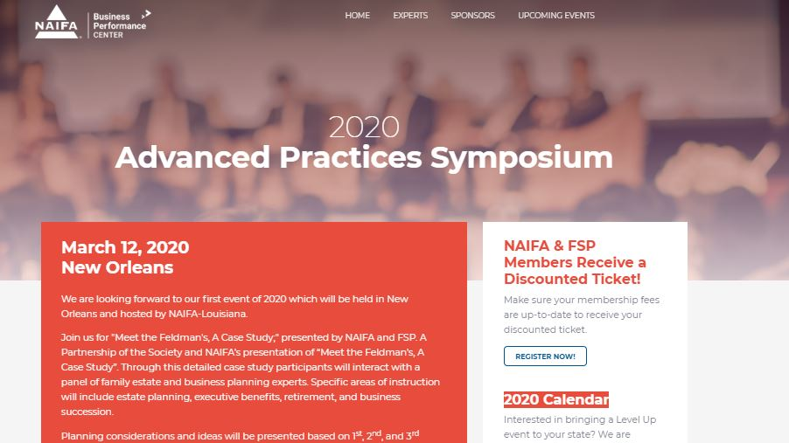
Notes:
Via our Business Performance Center, NAIFA offers an Advanced Practice Symposium. This Symposium is designed for members working in the Advanced Markets or those wanting to expand their practice into these markets. This program is not lecture. It’s an educational event built around a case study with lawyers, tax consultants, and products specialists all making a contribution. Again, allowing you to quickly identify experts with whom you can partner to expand your book of business.

Slide 13
Notes:
Finally there is the annual Performance + Purpose conference which is the educational event of the year

Slide 14
Differentiate.
The trusted advisor.
Notes:
Differentiate.
How are NAIFA members different?
There are various studies that have been done…not by NAIFA, but by others…that show that NAIFA members earn $10,000 to $43,000 more than non members. Why is this?
NAIFA members are the trusted advisor.

Slide 15
The NAIFA
Code of Ethics
Notes:
NAIFA members take a pledge always to put their clients’ best interests ahead of their own.
Our members take this pledge very seriously.
Few associations operate with a code of ethics, almost none include a best interest statement.
Who here would not take that pledge?
Who here would not stand up and say I always put my clients’ best interests ahead of my own?

Slide 16
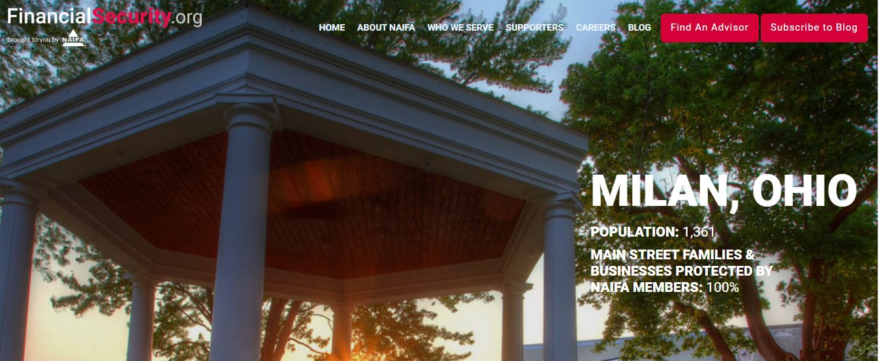
Notes:
FinancialSecurity.org is NAIFA’s site to promote consumer awareness and how NAIFA members serve Main Street USA. This site is gaining momentum where it matters the most – with consumers.
Consumers can go find an advisor or agent who is a NAIFA member that subscribes to our code of ethics.
Members can write consumer-focused articles for the site and be profiled on the site.
Soon members will be able to have their photo and additional information about their practice included with their directory listing on the site.

Slide 17
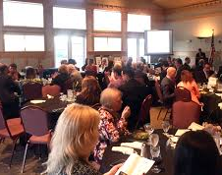
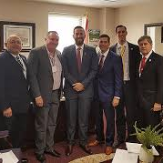
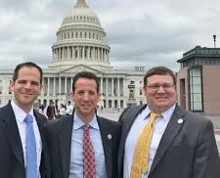
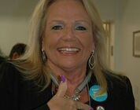
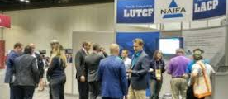
Connected Community for Life
Notes:
NAIFA members are connected to a community of like-minded individuals. NAIFA members openly share their ideas and best practices with one another. NAIFA members service their community via NAIFA sponsored events.
[Add a personal story about your connection to the community. Share a story about how a member gave you an idea that helped you close a case or an experience you’ve had through a community service project working alongside your fellow members]

Slide 18
POWER OF THE PIN Delivering on NAIFA’s Membership Promise
Notes:
[Always have your NAIFA pin on! Point to it!]
See this pin?
It is a symbol that
I advocate for my clients.
I am committed to educating myself to better serve my clients
I always put my clients’ interest before my own
On a personal note, I wear this on every client meeting because my clients often ask me about it….when they do, I say:
“I am a member of the National Association of Insurance & Financial Advisors, my professional association. As a member, I take a pledge to always act in my clients’ best interest. It’s like the AMA for doctors…you wouldn’t go to a doctor that wasn’t a member of the AMA, would you?” I also say, “Over the next few weeks, you will decide whether you want to work with me or not as your financial advisor…if you decide not to work with me, I encourage you to go to advisorsyoucantrust.org and find another NAIFA member who has made the same pledge as I have to always put your interests above their own”.

Slide 19
Notes:
I would like to ask you all a question. What value would you place on what I have just described? Many tell me $100 a month. We at NAIFA have a career friendly fee structure designed to be affordable regardless of your time in the industry.

Slide 20
www.naifa.org/join
Notes:
Now take out your phone and go to www.naifa.org/join. Join today and on Monday, your name will be posted to social media and our website. Your benefits will begin immediately. Should you join today, I would be happy to present you with your NAIFA pin.

