Slide 1
Data Model – Advanced
Your Guides: James Gille and Dave Matzdorf

Slide 2
Introductions
Take 5 Minutes
Turn to a Person Near You
Introduce Yourself
Business Cards

Slide 3
Part I: Introduction

Slide 4
Part II: Blobs and Timeslicing

Slide 5
Agenda
Time slices
Out-of-the-box objects
OOTB Functions
OOTB Stored Procedures
Inline Functions
Methods to find database objects

Slide 6
Storing time-scaled values
Time-scaled values stored in a database BLOB
Database Data type (Binary Large Object)
Cannot be read using sql
Able to store multiple data elements
BLOB data is source data

Slide 7
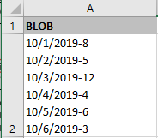
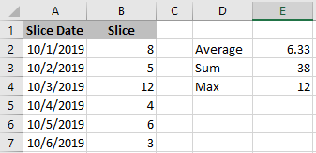
Why are BLOBs used
Pros
Hold HUGE amounts of data
Compressed to save space
Increased performance
Used by MSP and OWB
Cons
Cannot be read using SQL
Blob Data
Normalized Data

Slide 8
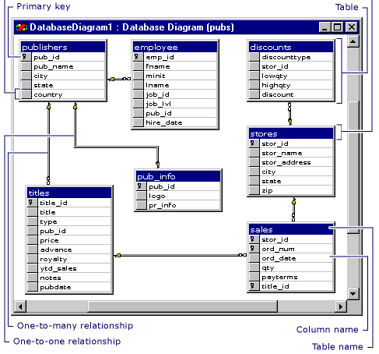
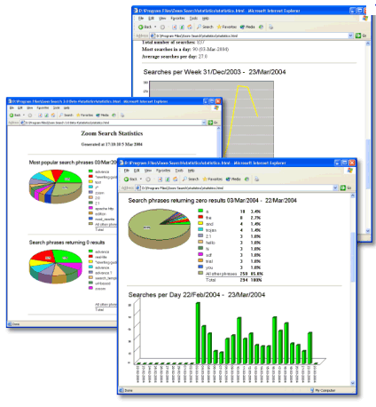
What Is A Timeslice
Timeslices provide a window into BLOB data
Timeslice job extracts a portion of the BLOB data to normalized tables
Defined by timeslice settings
Creates normalized tables
Time Slice Tables
Daily
Weekly
Bi-Weekly
Monthly
Quarterly
Yearly
…more
Timeslice job
BLOB data
Reports, Dashboards…

Slide 9
What is actually stored in the BLOBs
Each blob contains one or more “Curves”
PREXTENSION fields store multiple curves. Ex: Assignments store ETC, Actuals, Baseline curves
Different types of curves
Allocation curves store percentage based base. Ex: Allocations
Hour curves store units Ex: Hours or dollars
Fiscal curves store units related to an entity and a fiscal period
Calendar curves store non-working days, daily shift definitions
Curve components
Default value
Segment List

Slide 10
Part II: OOTB Database Objects

Slide 11
Functions
Get user timezone offset: LOG_TIMEZONE_DIFF_FCT(user id)
Get full OBS Path: OBS_UNIT_FULL_PATH(obs unit id)
Get full task Path: PRJ_GET_TASK_FULL_NAME_FCT(task id, project id)
Sum assignment hours: PRJ_SUM_ASSIGNMENT_FCT(team id, actuals or etcs)
Get cost plan group by attributes: RPT_FINANCIAL_GROUPING_FCT(plan id, language_code)

Slide 12
Functions (Continued)
FX Rate Conversion: FIN_CONVERT_CURRENCY_FCT(amount, rate type, transaction date, from currency code, to currency code)
Get task days late: COP_DAYS_LATE_FCT(task finish date, baseline finish date, task status)
Date functions
Truncate a date
Add dates

Slide 13
Stored Procedures
Compile DB objects: CMN_DB_COMPILE_SP
Gather table stats: CMN_GATHER_TABLE_STATS_SP
Clean Datamart: NBI_CLEAN_DATAMART_SP
Refresh the Datamart flat OBS table: NBI_POPULATE_OBS_DIM_SP
Get the next auto-number: CMN_AUTONUM_GET_NEXT_SP
Get the next table id: CMN_ID_SP
Get a rate: PPA_GETRATE_WITHROLE

Slide 14
Inline Functions
Only available in Oracle 12
Allows a function to be called inline
Behaves just like the WITH clause
Allows SaaS customers to utilize the power of PL/SQL
Can call OOTB stored procedures directly in our SQL
Getting auto-numbers
Getting next table ids
Getting rates

Slide 15
How To Find Database Objects
Clarity Studio
SQL Trace
Data Dictionary Tables
USER_OBJECTS / SYS.OBJECTS
USER_TABLES / INFORMATION_SCHEMA.TABLES
USER_TAB_COLUMN / INFORMATION_SCHEMA.COLUMNS
Jaspersoft reports
Rego’s Data Dictionary Extractor

Slide 16
Questions?

Slide 17
Thank You For Attending regoUniversity
Instructions for PMI credits
Access your account at pmi.org
Click on Certifications
Click on Maintain My Certification
Click on Visit CCR’s button under the Report PDU’s
Click on Report PDU’s
Click on Course or Training
Class Name = regoUniversity
Course Number = Session Number
Date Started = Today’s Date
Date Completed = Today’s Date
Hours Completed = 1 PDU per hour of class time
Training classes = Technical
Click on I agree and Submit
Let us know how we can improve! Don’t forget to fill out the class survey.
Phone
888.813.0444
Email
info@regouniversity.com
Website
www.regouniversity.com

