Slide 1
Title
[Insert School Name Here]
DIBELS Next Data Review
Beginning of Year 2019 - 2020
ELAT
CO Early Literacy Assessment Tool

Slide 2
Title
Agenda
Introduction
Composite Score Analysis
Measure-Level Analysis
Progress Monitoring
BOY Action Planning
ELAT
CO Early Literacy Assessment Tool

Slide 3
Objectives
During this session, we will:
Analyze DIBELS Next data trends for BOY 2019 - 2020
Action Plan for the remainder of the year

Slide 4
Title
Agenda
Introduction
Composite Score Analysis
Measure-Level Analysis
Progress Monitoring
BOY Action Planning
ELAT
CO Early Literacy Assessment Tool

Slide 5
Composite Score Data Analysis
Insert screenshot of Comparing Populations Report (mCLASS) by grade OR copy/paste link to the report.
Notes:
Review the data with your staff. [Insert the % at or above benchmark at BOY and EOY for each grade to read during the presentation.]
Ask the staff for trends they notice in the data, potential root causes, and next steps.

Slide 6
Composite Score Current Levels of Performance
Percent of students at or above benchmark at BOY | Kinder _________% | 1st _________% | 2nd _________% | 3rd _________%

Slide 7
Composite Score Underlying Cause Analysis
Instruction (All Tiers): Is core instruction being implemented with fidelity? Is intervention in place?
Scheduling and Time: Are all students that need intervention receiving it? Are students in the correct intervention? How much time is being spent in core/intervention? Does it match the recommendations of the Literacy Framework?
Staffing: Does the allocation of supplemental staff support the instructional needs of all students (both in core and intervention)? Are the most highly qualified teachers leading intervention groups?
Assessment Practices: Are assessment staff adequately trained on DIBELS Next to ensure accurate data collection?
Effective Data Review Practices: Have instructional staff reviewed current data and know where instruction needs to be for each student?
Professional Development: Has there been sufficient training on all resources (universal instruction/intervention)? Does instructional staff have a deep knowledge of early literacy skills and how to teach struggling students on the skills?
Notes:
Review possible underlying causes
Determine underlying causes that apply to your school, and delete all others from the slide

Slide 8
Title
Agenda
Introduction
Composite Score Analysis
Measure-Level Analysis
Progress Monitoring
BOY Action Planning
ELAT
CO Early Literacy Assessment Tool

Slide 9
Measure-Level Analysis – Grade K
Insert screenshot of Comparing Measures report by grade (mCLASS), or copy/paste link to report. This report may take more than one slide. If necessary, add slides.
You can also insert screenshots of “performance by submeasure” from your Participant Notebook.
Notes:
Review the data with your staff.
Ask the staff for trends they notice in the data, potential root causes, and next steps.

Slide 10
Measure-Level Analysis – Grade 1
Insert screenshot of Comparing Measures report by grade (mCLASS) or copy/paste link to report. This report may take more than one slide. If necessary, add slides.
You can also insert screenshots of “performance by submeasure” from your Participant Notebook.
Notes:
Review the data with your staff.
Ask the staff for trends they notice in the data, potential root causes, and next steps.

Slide 11
Measure-Level Analysis – Grade 2
Insert screenshot of Comparing Measures report by grade (mCLASS) or copy/paste link to report. This report may take more than one slide. If necessary, add slides.
You can also insert screenshots of “performance by submeasure” from your Participant Notebook.
Notes:
Review the data with your staff.
Ask the staff for trends they notice in the data, potential root causes, and next steps.

Slide 12
Measure-Level Analysis – Grade 3
Insert screenshot of Comparing Measures report by grade (mCLASS) or copy/paste link to report. This report may take more than one slide. If necessary, add slides.
You can also insert screenshots of “performance by submeasure” from your Participant Notebook.
Notes:
Review the data with your staff.
Ask the staff for trends they notice in the data, potential root causes, and next steps.

Slide 13
Measure-Level Reflection
Initial question | Probing questions
What celebrations are there? | What can you do with this information? Who do you need to share it with?
At each grade level, were there specific literacy skills that students struggled with? Which grades and which skills? Were there trends across the school? | Why might this be? Look at next slide for ideas to determine underlying causes.
Notes:
Choose how much information you want to share with your staff from the table above. Definitely share the first column (celebrations and grade-level and school-wide trends.)

Slide 14
Measure-Level Underlying Cause Analysis
Instruction (All Tiers): Is evidence-based core instruction being implemented with fidelity? Are literacy interventions in place?Are literacy interventions aligned with student needs?
Scheduling and Time: Are all students that need intervention receiving it? Are students in the correct intervention? How much time is being spent in core/intervention? Does it match the recommendations of the district?
Staffing: Does the allocation of supplemental staff support the instructional needs of all students (both in core and intervention)? Are the most highly qualified teachers leading intervention groups?
Assessment Practices: Are assessment staff adequately trained on DIBELS Next to ensure accurate data collection?
Effective Data Review Practices: What structures are in place to support teachers in data review (time, data protocol, etc.)? Have instructional staff reviewed current data and know where instruction needs to be for each student?
Professional Development: Has there been sufficient training on all resources (universal instruction/intervention)? Does instructional staff have a deep knowledge of early literacy skills and how to teach struggling students on the skills?
Notes:
Review possible underlying causes
Determine underlying causes that apply to your school, and delete all others from the slide

Slide 15
Title
Agenda
Introduction
Composite Score Analysis
Measure-Level Analysis
Progress Monitoring
BOY Action Planning
ELAT
CO Early Literacy Assessment Tool

Slide 16
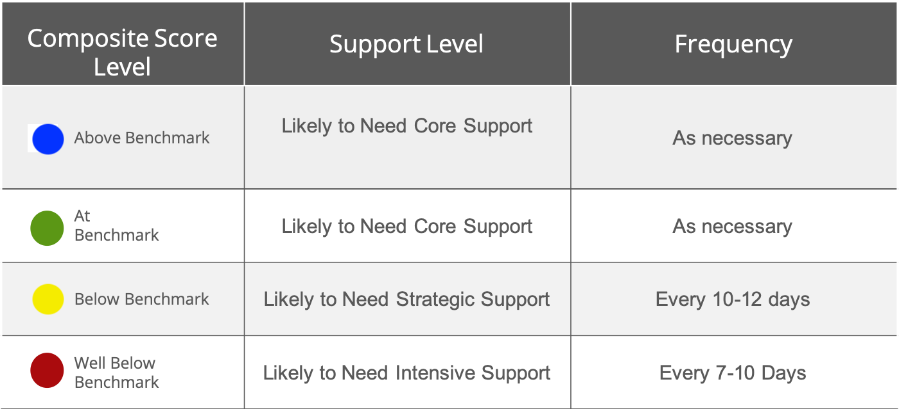
Progress Monitoring
Notes:
Review your progress monitoring expectations as a part of ELAT

Slide 17
Progress Monitoring
Share progress monitoring best practices
Notes:
Review your progress monitoring expectations and suggested best practices

Slide 18
Composite Score Rehearsal Feedback
Glows:
Grows:
Notes:
This slide should be hidden before you share with staff. This is to help you prepare to present.

Slide 19
Measure by Grade Level Rehearsal Feedback
Glows:
Grows:
Notes:
This slide should be hidden before you share with staff. This is to help you prepare to present.

Slide 20
Title
Agenda
Introduction
Composite Score Analysis
Measure-Level Analysis
Progress Monitoring
BOY Action Planning
ELAT
CO Early Literacy Assessment Tool

Slide 21
BOY Action Plan
Insert your plans or next steps here
[flexible format!]
Notes:
Review the plan on the slide with staff.
Record any other notes here.

Slide 22
Sharing Next Steps
Grade-Level Action Plans
Notes:
Based on the schoolwide action plan and the data reviewed, have grade levels split into groups to create an action plan for 19-20 school year
Have grade-level teams share out their priorities and why.

Slide 23
Support Staff and Resources
Karen Cushman Associate Director, Education Partnerships kcushman@amplify.com (765) 366-5013 | Tammy Yetter Senior Consultant, P-3 Office Colorado Department of Education Yetter_T@cde.state.co.us (970) 768-5158 | Dori Klar Professional Development Manager Senior Partnerships Manager dklar@amplify.com (202) 390-2483
Amplify Customer Care help@amplify.com (800) 823-1969 M–F 5 a.m. to 5 p.m. MT |  | Amplify Education Support edsupport@amplify.com (800) 823-1969 M–F 6 a.m. to 4 p.m. MT
mCLASS Home Use these websites for all levels of reporting including district, school, class, and student information based on your provider. | ELAT Microsite Statewide Benchmark windows, enrollment documents, professional development resources, and information about the solutions provided by Amplify. | Colorado Department of Education READ Act, P-3 Office READ Act website contains useful tools, guidance documents, and important information. Find your CDE Regional Consultants here.

